Slide 1
Atomistic Modeling of Nanostructures
-Effects of disorder on valley splitting-
Zhengping Jiang
Committee: Prof. Gerhard Klimeck (Chair)
Prof. Supriyo Datta, Prof. Alejandro Strachan

Slide 2
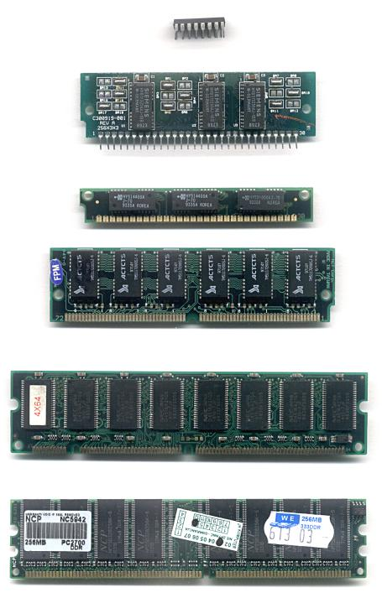
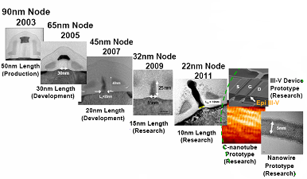
Nanoelectronic Device Scaling
PC 2G
2008
Laptop 2*2G
2009
PC 4*2G
2010
Future?
2^n*2G
Technology makes life simple, not heavy.
One bit, typically:
DRAM: MOS transistor + capacitor
Future:
More info in one memory unit or decrease size.
Acknowledgement: Robert Chau, Intel
MOS: ~60nm with pitch
2

Slide 3
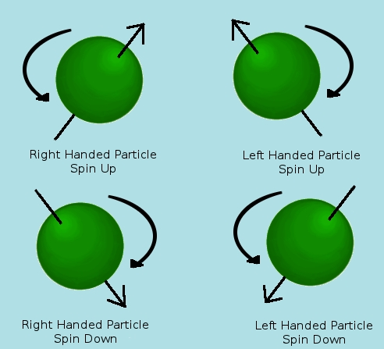
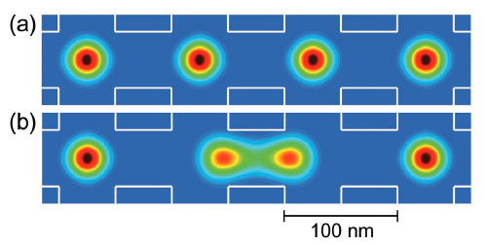
Why quantum computation is pursued?
Concept of Quantum computation:
Electrical engineer
bit
1
0
Can we realize it?
qubit
a|1>+b|0>
Spin !
Computer
science
Is it small?
Physicist
Logician
…
comparable or even
smaller than DRAM
More information in one qubit!
What are we waiting for?
3

Slide 4
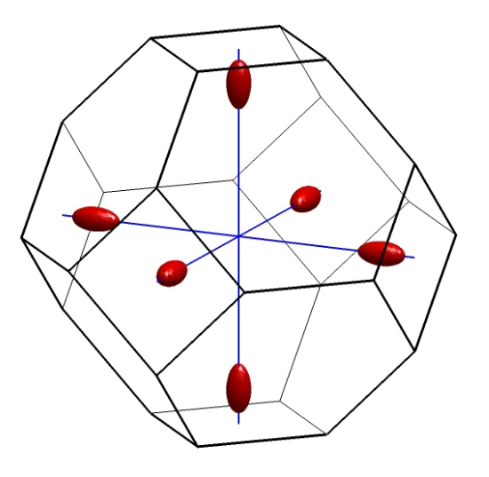
Challenge to realize qubit
Quantum computing dilemma:
Manipulate qubit by external force.
Isolation from external force to maintain quantum information between gate operations.
Which material could be used?
  silicon
Closest to mainstream semiconductor technology.
Long spin coherence time. Existence of spin‐free nuclear isotopes.
Valley degeneracy could be problem in qubit operation.
Valley degeneracy is potential source for decoherence.*
To use silicon, degeneracy must be lifted.
*B. Koiller et al. PRL 88 (2002)
4
Notes:
Si: weak spin-orbit coupling, week electron-phonon coupling
Degeneracy: 1) Intuitive answer: one state vs six state 2) exchange coupling

Slide 5
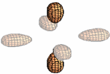
valley splitting – lift valley degeneracy
Biaxial strain splits six-fold* valley-degeneracy into
Lower two-fold degeneracy
Higher four-fold degeneracy
How to lift valley degeneracy?
Lowest two-fold degenerate valleys split
in the presence of sharp confinement
potentials in QWs.
4 fold
Energy spacing between two resulting energy level.
6 fold
2 fold
QW
k_{z}
k_{z}
k_{y}
k_{y}
k_{x}
k_{x}
Valley-splitting
Valley-splitting is a critical design parameter for QC devices.
-> remove degeneracy.
*Spin degeneracy is not included here.
5
Notes:
Simple model color

Slide 6
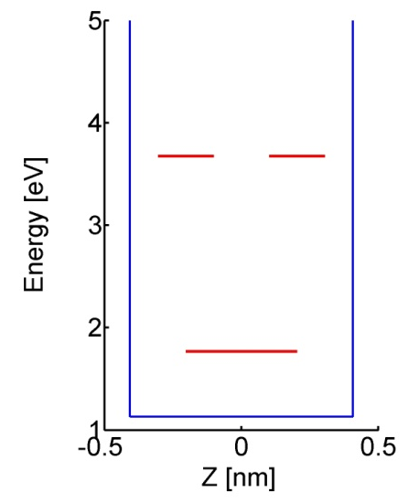
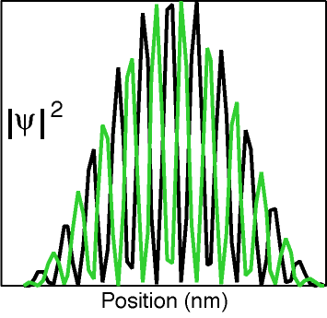
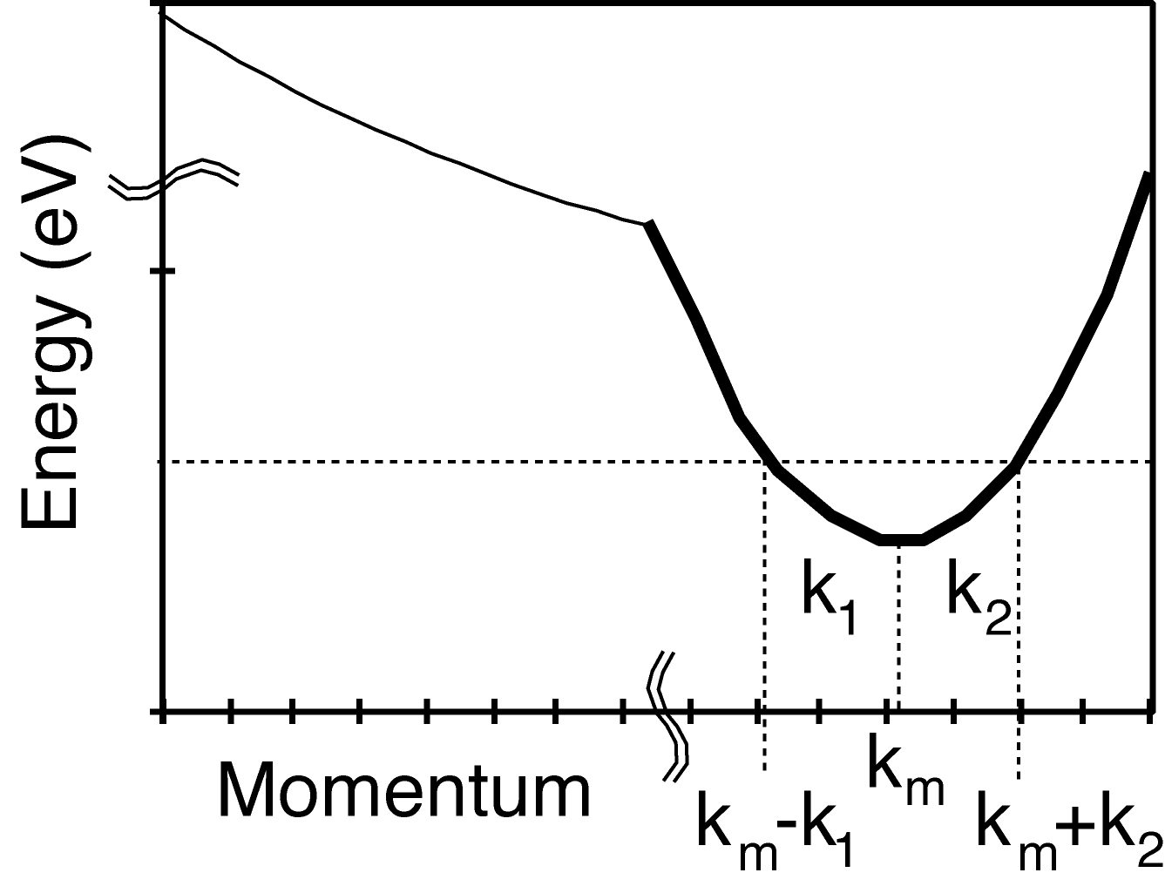
Simple quantum well states
Most basic
quantum mechanical problem:
Particle in a box
2nd
2nd
1st
1st
L
quantize k
E
Schrödinger Equation
2 propagating states
Parabolic
Dispersion
1 bound
state
k
Thanks to Neerav for figures.
6
Notes:
5 Atomic layer (approx 8A) thick silicon (001) thin film.

Slide 7
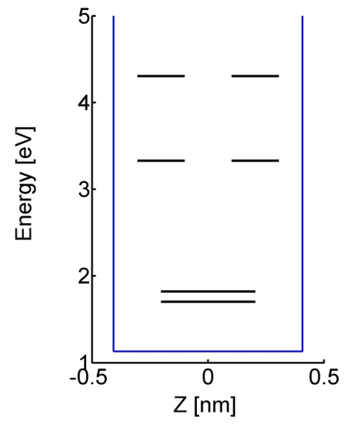
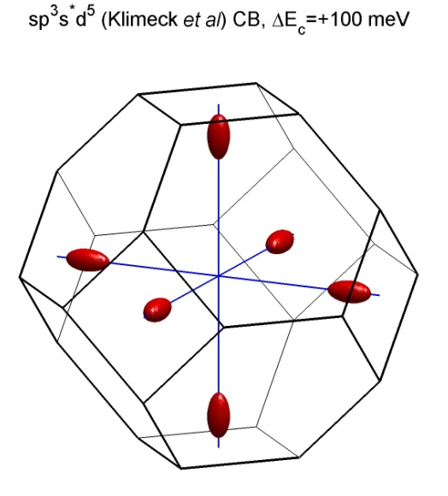
Valley splitting: Quantum Wells
Special Considerations in Si
2nd
1st
E
k_{1,2}=π/L
k_{1,2}=π/L
2 valleys
4 propagating states
2 bound states
k_{1,2} envelope
k_{m} fast oscillations
k
T. Boykin et al. PRB 70 (2004)
7
Notes:
5 Atomic layer (approx 8A) thick silicon (001) thin film.

Slide 8
Can we build QC now?
Quantum computation requirements:
2 level system: spin degree of freedom.
Non-degenerate state well separated from excited states.
Valley
splitting
Valley + spin
splitting
Valley
splitting
E₃
Valley + spin
splitting
2 fold
E₂
E₁
QC states
QC states
E₀
Insufficient valley splitting:
Interaction with environment destroy origin phase of states.
Error when reading out states.
Sufficient valley splitting is required to preserve quantum information.
8
Notes:
Why (clear statement) Low T 1.5 meV

Slide 9
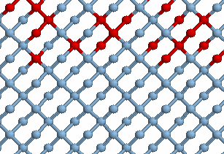
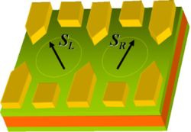
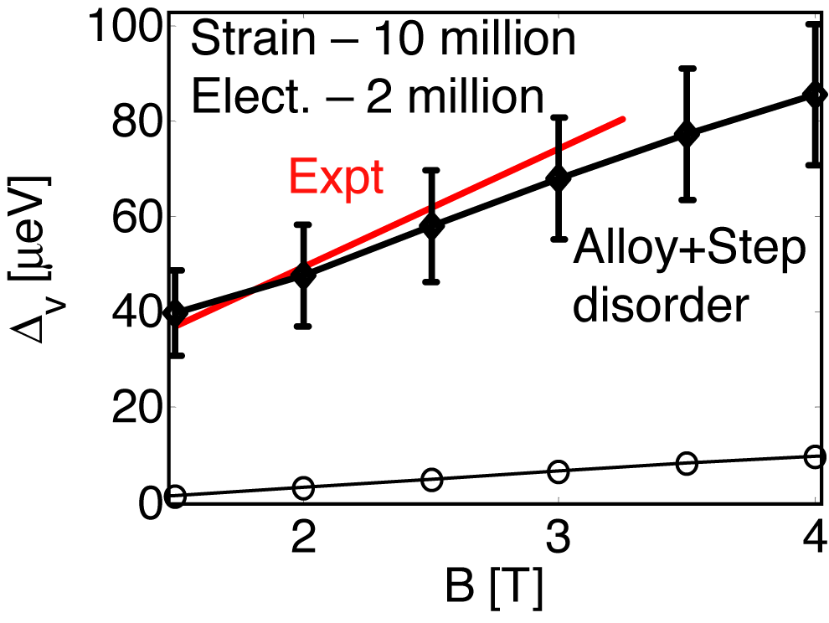
Realization of a Si based QC architecture
Alloy disorder
Quantum Computing devices
SiGe
Si
Friesen et al., PRB, 2003
Goswami et al., Nature Physics, 2007
Why choose SiGe:
SiGe substrate provide tensile strain to Si, which lifts degeneracy (6 to 2).
Relaxed SiGe confines electron in Si. (2 to 1)
Confinement potential and strain could be tuned by Ge composition, which could be used to control valley splitting.
Disorder in alloy must be considered!
Kharche et al., APL., 2007
9

Slide 10
Realization of a Si based QC architecture
Alloy disorder
Quantum Computing devices
SiGe
Si
Friesen et al., PRB, 2003
Quantities show potential effects:
  Electric field: top and back gate
  Strain: SiGe lattice mismatch
  Well width
  Barrier disorder
Understand effects of these quantities and find a effective simulation model.
Kharche et al., APL., 2007
10

Slide 11
Simulation results
Valley splitting in (100) SiGe/Si/SiGe
Approaches
Electric field and well width dependence
  QW with no disorder barrier
  QW with SiGe barrier
Dependence of VS on barrier disorder
Approaches
Disorder effects
  Ordered barrier and random alloy barrer
  Ordered barrier and partially ordered barrier
11

Slide 12
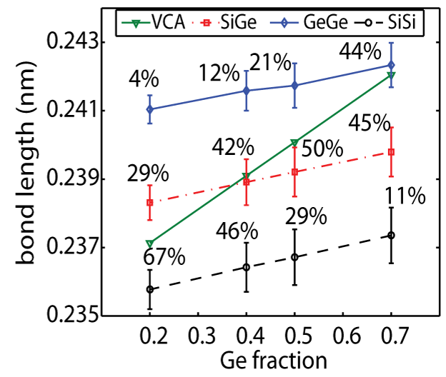
Valley splitting in (100) SiGe/Si/SiGe QW
Objective:
Modeling real strain in Si QW.
Modeling valley splitting in quantum well structure with SiGe barrier.
Method:
Strain: VFF Keating model
  Bandstructure: Nearest neighbor sp3d5s* tight - binding model
  Results:
  Experimental observed tri-mode bond length distribution.
Lattice mismatch
Increase SiGe volume in strain calculation to mimic relaxed SiGe substrate and strained Si
Bond length changes with Ge composition but tends to preserve their bulk value.
12

Slide 13
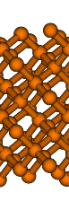
Valley splitting in (100) SiGe/Si/SiGe QW
Smooth VS variation with electric field
Objective:
Valley splitting dependence on well width with smooth barrier.(no SiGe)
Valley splitting dependence on electric field.
Method:
Strain: VFF Keating model
  Bandstructure: Nearest neighbor sp3d5s* tight - binding model
  Smooth barrier simulated by carbon TB parameters.
  Results:
  Strong oscillation with well width in flat QW.
  Suppression of oscillation in electric field.
no disorder
  Boykin et al., APL. 2004
E
Effective W not change
WF confinement
13

Slide 14
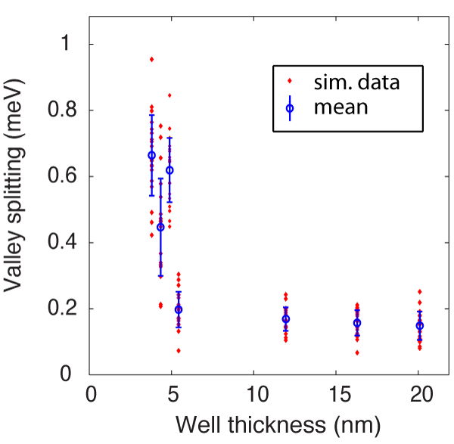
Valley splitting in (100) SiGe/Si/SiGe QW
Objective:
VS dependence on well width with disorder barrier.
Match VS with experimental width and electric field.
  2MV/m electric field
  Si well thickness: 3.8~20nm
Method:
Strain: VFF Keating model
  Bandstructure: Nearest neighbor sp3d5s* tight - binding model
  Results:
  Qualitative agreement with experiments.(trend & error)
  Disorder mixes valley splitting values for thin QWs.
Exp. Data
Exp: At 2MV/m, well width did not change for W>9nm*
*K. Sasaki, APL (2009)
14
Notes:
Self-consistent potential.

Slide 15
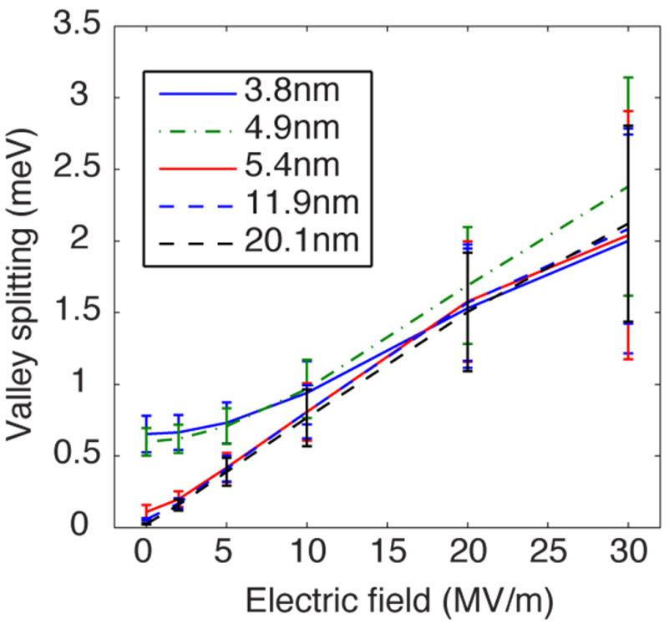
Valley splitting in (100) SiGe/Si/SiGe QW
Objective:
VS dependence on electric field.
Predict VS in high electric field.
Method:
Strain: VFF Keating model
  Bandstructure: Nearest neighbor sp3d5s* tight - binding model
  Results:
  Uncertainty due to disorder is huge in high field.
  In contrast to smooth barrier simulation:
    Electric field != smooth VS variation
High electric field:
WF is pushed to interface.
Strong alloy scattering.
Uncertainty due to disorder
15

Slide 16
Simulation results
Valley splitting in (100) SiGe/Si/SiGe
Approaches
Electric field and well width dependence
  QW with no disorder barrier
  QW with SiGe barrier
Dependence of VS on barrier disorder
Approaches
Disorder effects
  Ordered barrier and random alloy barrer
  Ordered barrier and partially ordered barrier
16

Slide 17
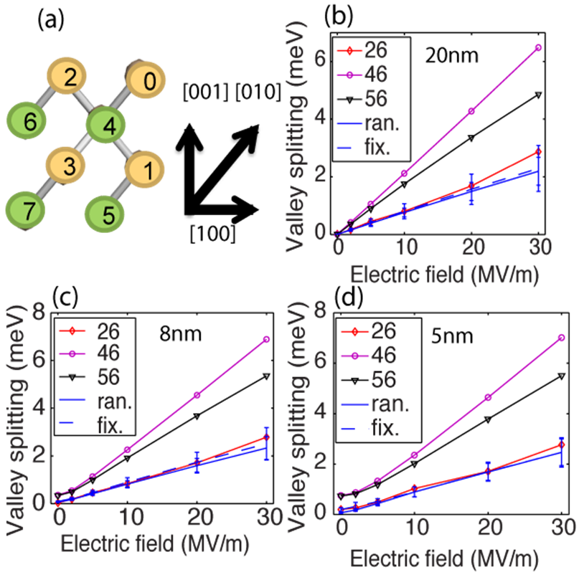
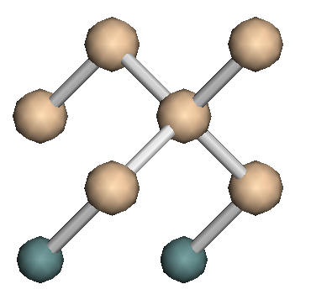
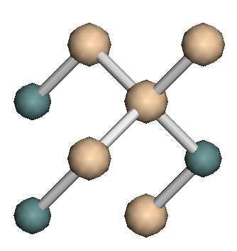
dependence of VS on barrier disorder
Objective:
Understand how disorder affects VS.
Effects of different bonds in VS.
Method:
Strain: VFF Keating model
  Bandstructure: Nearest neighbor sp3d5s* tight - binding model
Geometry construction powered by atomistic modeling
Example:
  25% atom replaced by Ge
  Ge disconnected cell
  Ge adjacent cell
(a)
(b)
Replace #4 and #6.
Only Si-Ge bond exist.
Replace #2 and #6.
Si-Ge and Ge-Ge
bond in crystal.
17

Slide 18
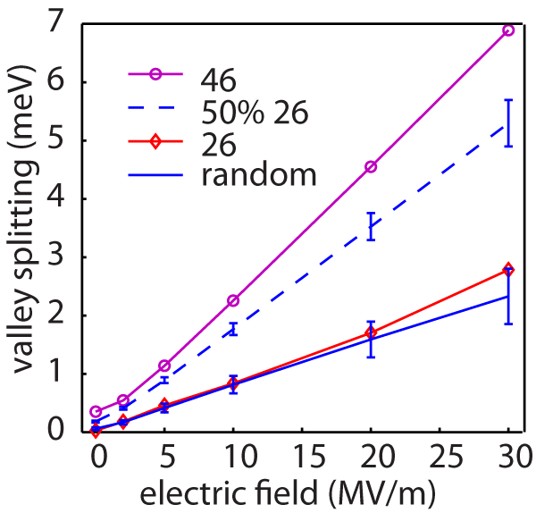
dependence of VS on barrier disorder
Objective:
Understand how disorder affects VS.
Effects of different bonds in VS.
Method:
Strain: VFF Keating model
  Bandstructure: Nearest neighbor sp3d5s* tight - binding model
Geometry construction powered by atomistic modeling
Results:
Different bond types have different effects on VS.
Different bonds show different scattering potential for electrons.*
Notes:
Build barrier with one cell type
-> ordered barrier
Random place Ge in barrier
-> disorder barrier
(# in fig.: Ge atom position)
Saumitra etc. APL (2011)
18

Slide 19
conclusions
Atomistic simulation considers geometry construction intuitively.
Atomistic simulation reproduce bond length disorder in real structures.
Valley splitting is sensitive to surface condition.
Dependence on electric field and well width
  VS oscillates with well width in low electric field.
  High electric field suppress oscillation with well width, but disorder will bring in big uncertainty.
Dependence on disorder
  Ge-Ge bond plays important role in determining VS.
  Disorder provides rough scattering potential and hence reduce valley orbit coupling.
20

Slide 20
Summary of contributions
Valley degeneracy in Si (110) QWs
match experimental observation by introducing miscut in QW.
Valley splitting in Si (100) QWs
Valley splitting dependence on electric field and well width.
Strain effects on valley splitting.
Alloy disorder in SiGe
Match experimental band structure by band unfolding.
Effects of disorder on valley splitting.
Software development:
RTDNEGF in nanoHUB: Resonance finding algorithm & RGF
NEMO3D: band-unfolding algorithm, VCA, Parallel computation benchmark
NEMO5: Resonance finding algorithm, semi-classical solver, effective mass Hamiltonian constructor etc.
21

Slide 21
acknowledgement
Committee members:
Professor Klimeck, Professor Strachan and Professor Datta
Funding and support from my advisors.
Professor Timothy Boykin
Klimeck Group Members & Alumni
Labmates
22

Slide 22

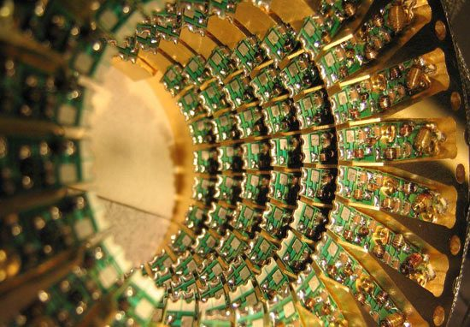
Questions

Slide 24
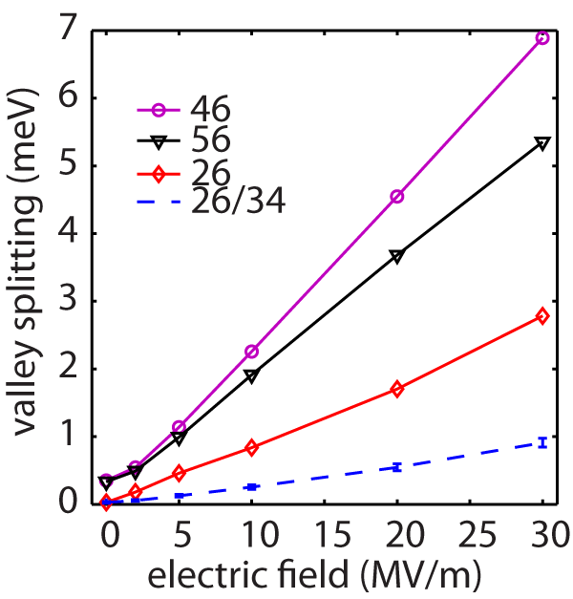
dependence of VS on barrier disorder
Objective:
Understand how disorder affects VS.
Effects of different bonds in VS.
Method:
Strain: VFF Keating model
  Bandstructure: Nearest neighbor sp3d5s* tight - binding model
Geometry construction powered by atomistic modeling
Results:
Different bond types have different effects on VS.
Disorder provides rough scattering potential, which will suppress valley orbit coupling.*
Cell {46}: flat scattering potential
Cell {56}: Periodic scattering potential
Cell {26}: Scattering potential with Ge-Ge bond
Cell {26/34}: 50%{26} + 50%{34}
# in fig.: Ge atom position
*D. Culcer etc. PRB 82 (2010)
17

Slide 25
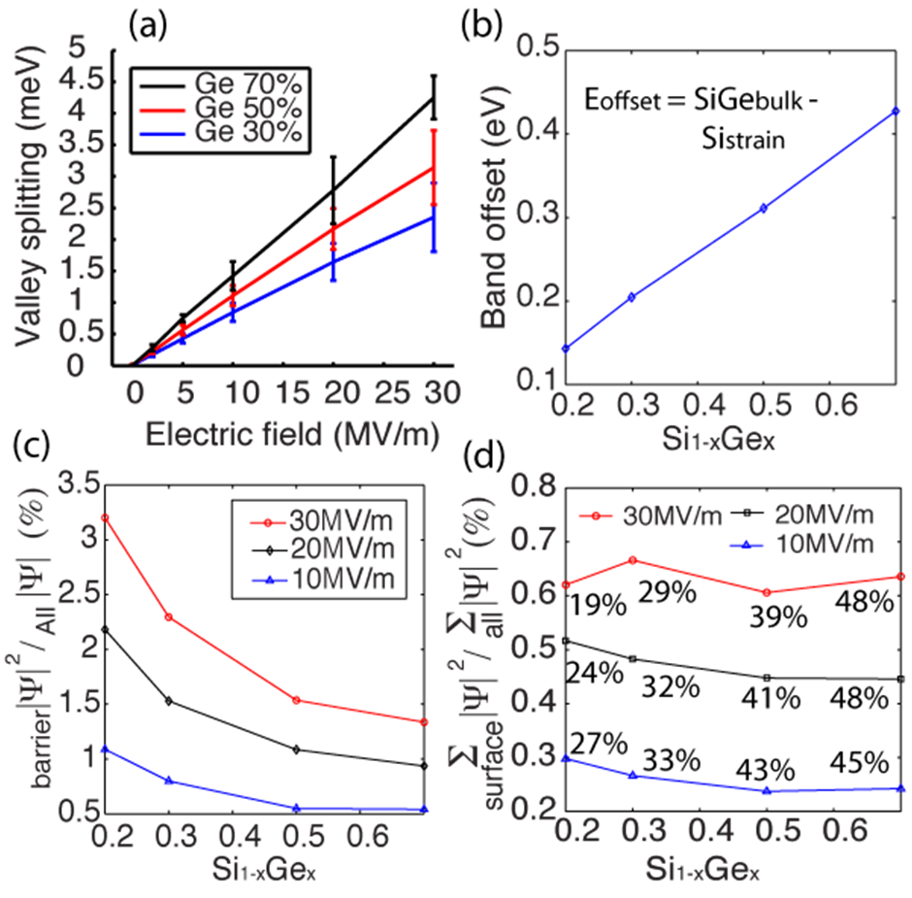
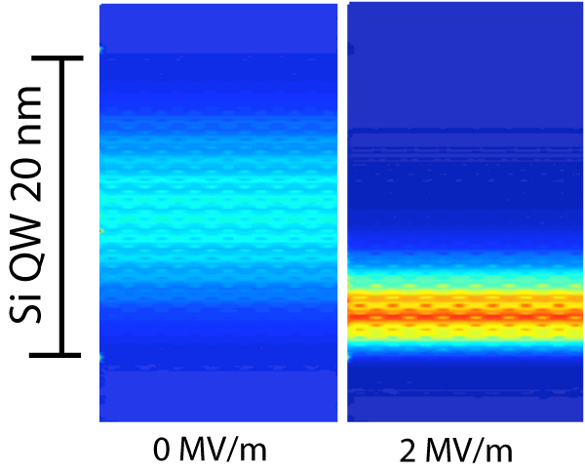
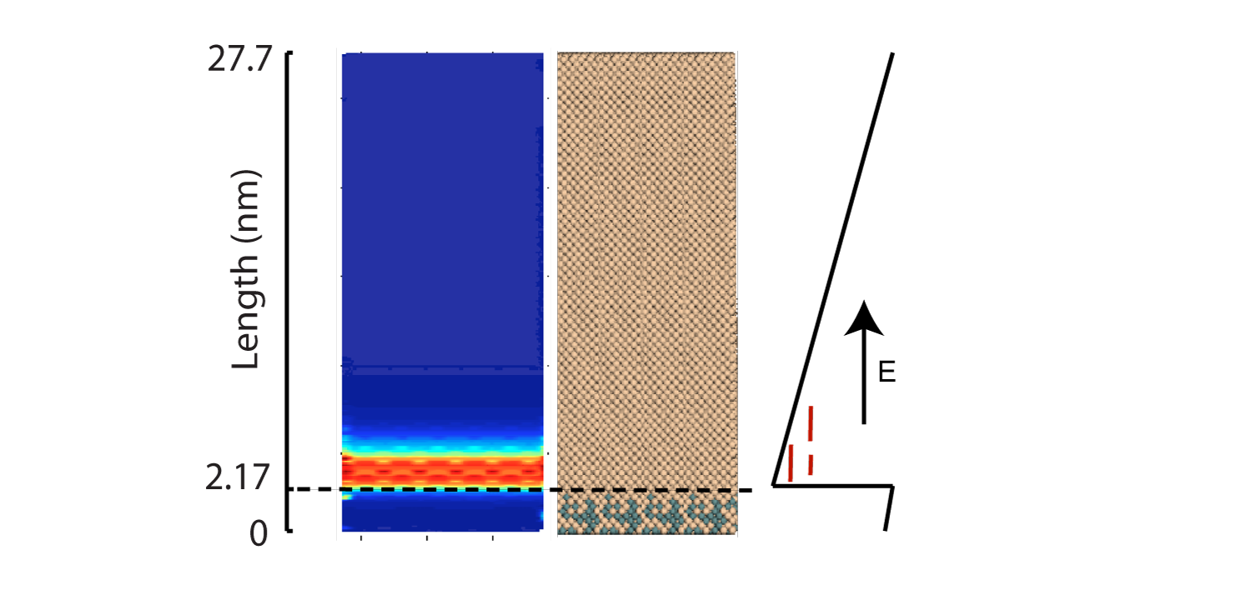
Wavefunction penetration
Effects of electric field
  Wavefunction piles up near barrier
How much WF is inside barrier?
Up to 3% WF will penetrate into Barrier.
High Ge gives less WF penetration due to strong potential barrier.

Slide 26
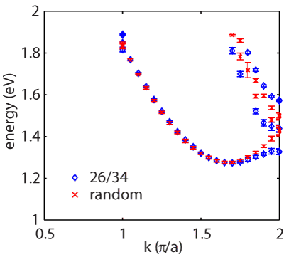
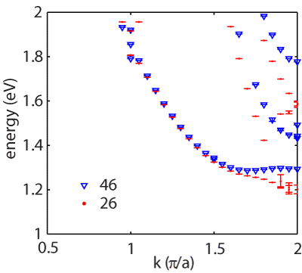
Dispersion
Barrier potential comes from band offset
Random alloy materials do not have translational symmetry
Electronic dispersion from band unfolding
Random samples
Ordered samples
~70meV
Cell {26} is more transparent.
Dispersion is not directly related to VS.
WF in Si is composed of Pz orbit. Difference in E-K might be related to orbit info.

