Slide 1
Tight-Binding Modeling of Intermediate Valence
Compound SmSe for Piezoelectronic Devices
Zhengping Jiang*, Yaohua Tan, Micheal Povolotskyi,
Tillmann Kubis, Gerhard Klimeck (Purdue University)
Marcelo Kuroda, Dennis Newns, Glenn Martyna (IBM)
Timothy Boykin (The University of Alabama in Huntsville)
*jiang32@purdue.edu

Slide 2
Outline
Motivation
  Beyond Moore’s Law
  Next Generation Switch
Piezoelectronic Transistor
  Device Design
  Working Principle
Metal Insulator Transition in SmSe
Tight Binding Parameterization
Summary

Slide 3
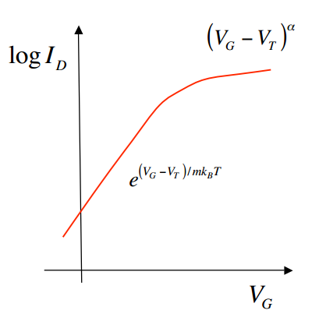
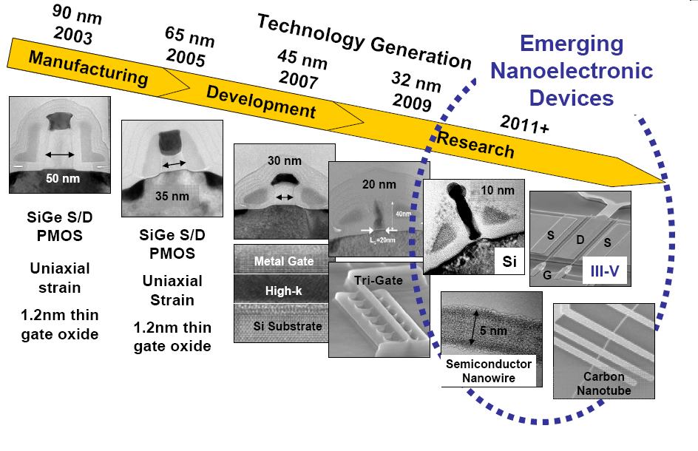
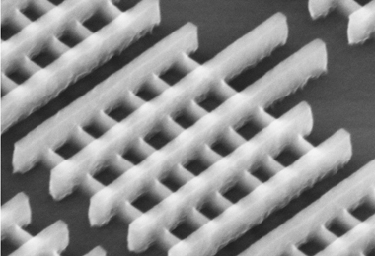
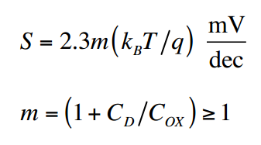
Beyond Moore’s Law
Latest Generation FinFET
Technology drives device to scaling limit.
60mV/dec barrier still exist
Heat dissipation prevents any performance improvement through increasing clock frequency!
Thinking Beyond Moore’s Law → Beyond Si FET

Slide 4
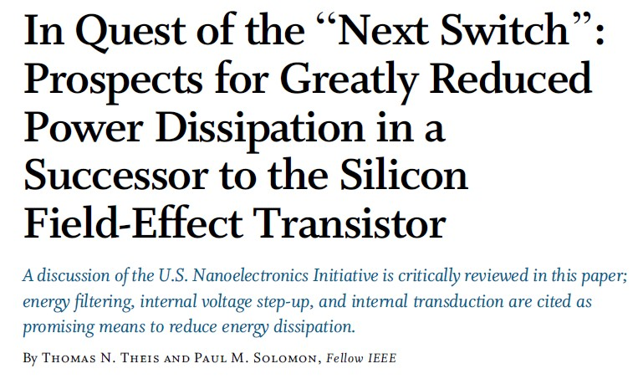
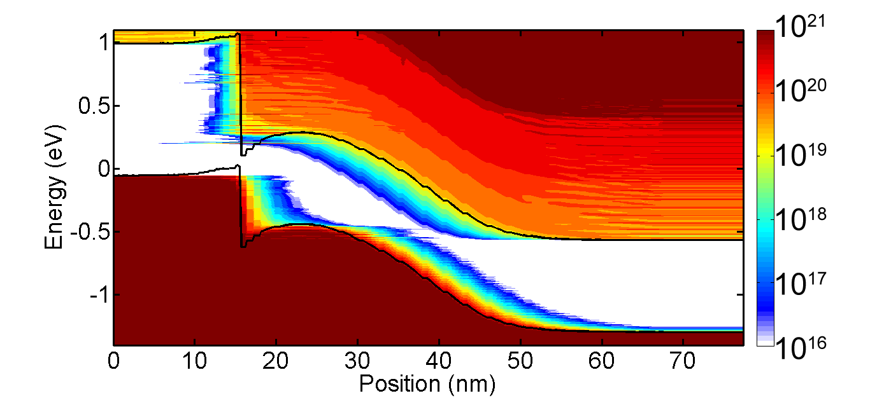
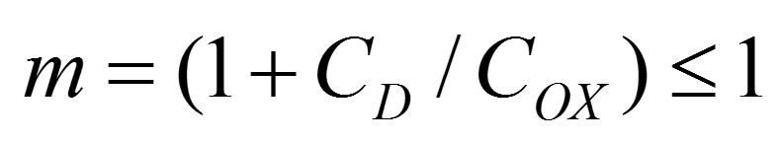
Next Switch
Energy Filtering
TFET
Quantum tunneling instead of thermal emission
Internal Voltage Step-up
Internal Transduction
Ferroelectronic FET & quantum capacitive device
Spin fet & nano-electromechanical switch
Lower voltage to flip spin then modulate barrier height
Low Subthreshold Swing → Circumvent the Boltzmann distribution or break the direct voltage-barrier relation

Slide 5
Piezoelectronic Transistor (PET)
Energy Filtering
Internal Transduction
Internal Voltage Step-up
3 Contacts
2 Channels
PiezoResistive Material
(e.g. SmSe)
Current OUTPUT
Pressure induced metal insulator transition
Voltage INPUT
Relaxor PiezoElectric Material
(e.g. PMN-PT)
Deformation due to E field
Properties of PE and PR enable internal voltage step-up and internal transduction of acoustic and electrical signals.

Slide 6
Working principle
Internal Voltage Step-up
Internal Transduction
Voltage applied on Gate – Common terminals:
Deformation inside PE channel
Electrical → Acoustic
Pressure
on PR
PR: insulator to metal transition
Deformation
Gate Voltage
Vg
Vg
Current in PE channel
Acoustic → Electrical
How does PET achieve SS<60mV/dec?

Slide 7

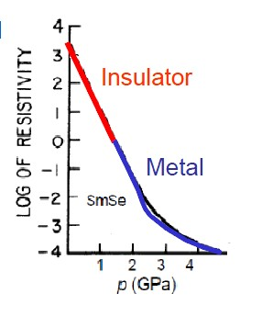
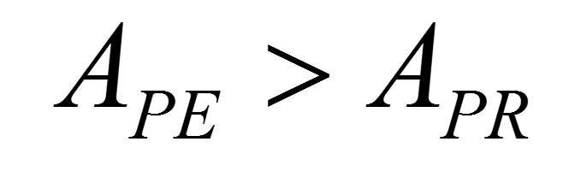
Mechanical and Electrical Features
Internal Transduction
Large Area / Volume Ratio Between PE/PR
Internal Voltage Step-up
Hammer-Nail Effect
Small Deformation in PE → Large Strain in PR
High response PE and big conductance change in PR
SmSe
High response Relaxor Piezoelectric Material
Sound velocity in nanostructure → high speed
Small Volume Change → Big Resistivity Change in PR
Phys. Rev. Lett. 25, 1430 (1970)
PET is capable of high performance and large scale integration!
D. M. Newns, B. G. Elmegreen, X. H. Liu and G. J. Martyna, Advanced Materials (2012).

Slide 8
Metal-Insulator Transition in SmSe
Conventional Ec
f-electron band, New Ev
Conventional Ev
5d
5d
Eg = 0.45eV
Pressure
4f
4f
Insulating material
Conducting material
4p
4p
Scaling limit of PET determined by onset of tunneling.
Quantum transport for MIT in tight-binding.

Slide 9



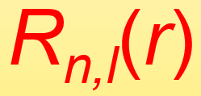
Methods
1. ab-initio calculation
Ab-initio band structure E_{i}(k)
Wave functions
GGA + U
2. Determine TB model and fitting variables
→ Analytical formula for TB basis functions
is Tesseral function, is to be parameterized
3. Iteratively optimization
DFT Hamiltonian to TB Hamiltonian: basis transformation
H_{ab-initio} → H_{TB}
Approximate H_{TB} by two center integrals
Compare Ek with DFT and redo Step 3.
Parameter refinement by simplex method
→ Target: Ek along high symmetry directions

Slide 10
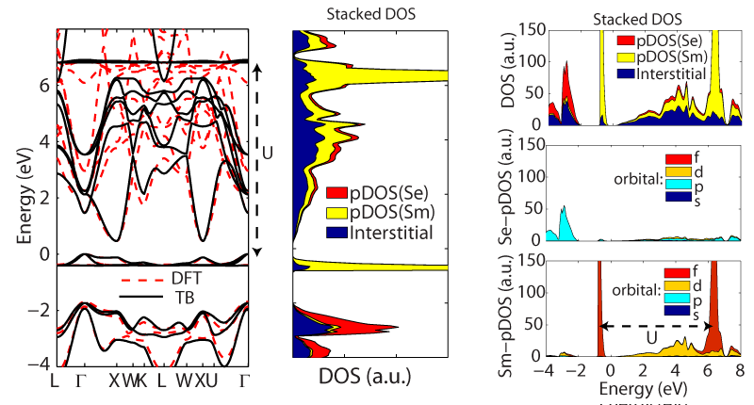
Determine tight binding model
DFT density of states:
f-electron splitting due to strong correlation
SmSe: DFT bandstructure
DFT decomposition: DOS into angular momentum
Se p-orbital: lower valence band
Sm d-orbital: conduction band
Sm f-orbital: top valence band
Splitting of f-orbital: covered through SO coupling
Require TB model: sp3d5f7s* + SO

Slide 11
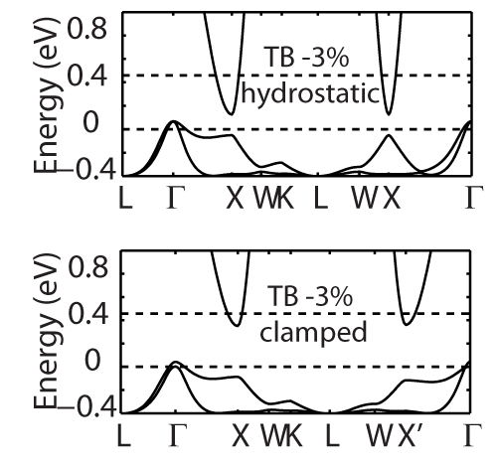
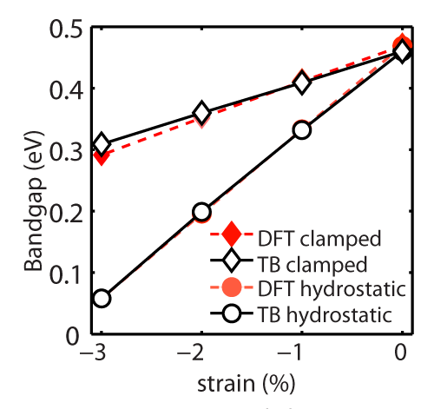
Strain effects on bandstructure of SmSe
Bandstructure without strain
Energy range most relevant to transport
Energy range most relevant to transport
Parameter fitted to band structure of hydrostatic strain and applied to clamped (uniaxial) strain with no modification.
Bandgap is closing with strain in linear trend
TB matches DFT trend!

Slide 12
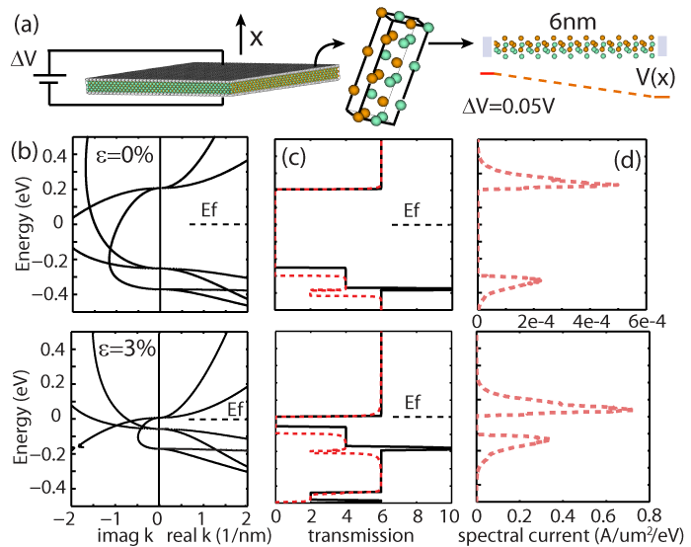
Transport simulation
PR layer is measured in thin film.
Lateral length > Thickness
Simulation is approximated by 1-D model.
Periodic BC
Extract 1-D simulation model with and without electric field.

Slide 13
Results
Modeled imaginary band (b) and transmission (c) of SmSe thin film.

Slide 14
Summary
Piezoelectronic Transistor shows promising properties to overcome 60mV/dec limit.
  Internal transduction
  Internal “voltage” step-up
Metal-Insulator Transition in piezoresistive material is critical
Tight binding model could reproduce MIT from bandstructure effects
  Second nearest neighbor TB model: sp3d5f7s*+SO
  Strain model
Need modeling of Metal-SmSe interface and e-e scattering for f-electrons (work in progress)

Slide 15
THANKS

Slide 16
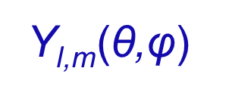

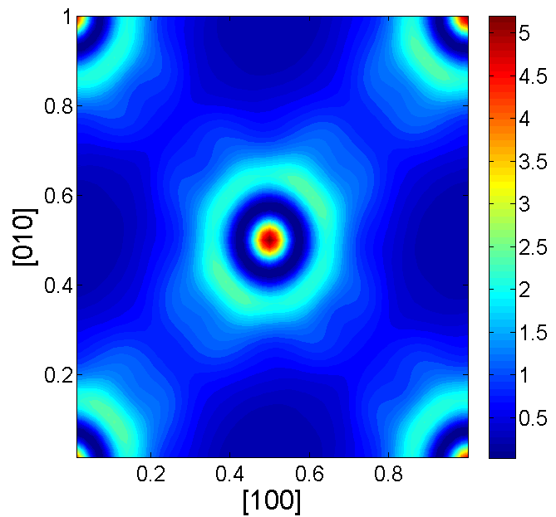
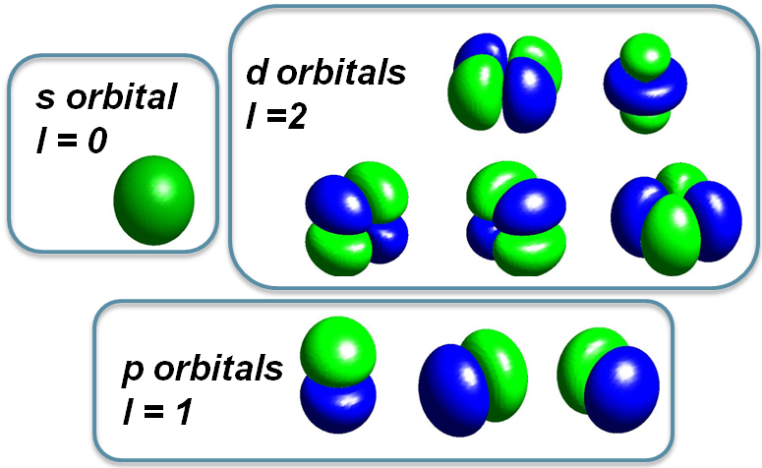

Method
Step: ab-initio calculation → E_{i}(k), φ_{i,k}(r), H_{ab-initio}
Y_{l,m}(θ,φ)
Ab-initio band structure E_{i}(k)
2. Step:
Define analytical formula for TB basis functions
Ψ_{n,l,m} (r,θ,ϕ) = R_{n,l}(r)Y_{l,m}(θ,ϕ)
Y_{l,m}(θ,ϕ) is Tesseral function, R_{n,l}(r) is to be parametrized
Wave functions φ_{i,k}(r)

Slide 17


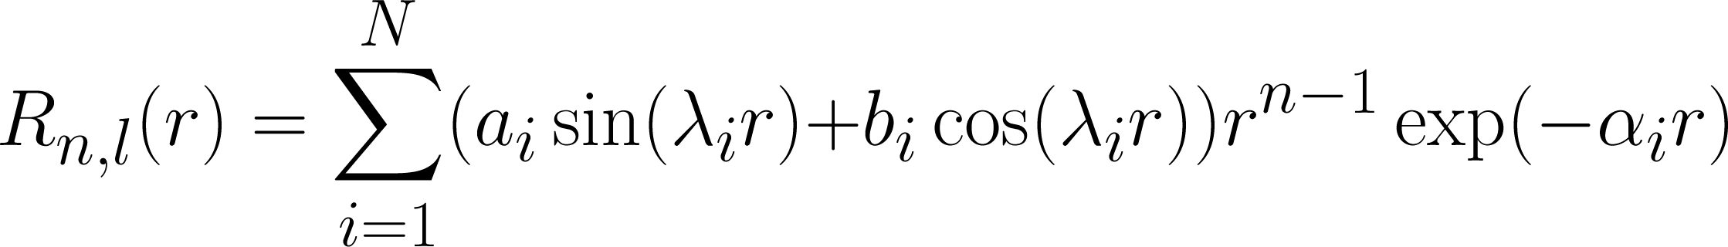
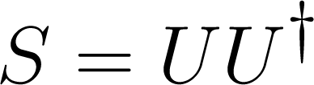

Method (continue)
Step: Parameterize
get transform matrix U: ab-initio basis → TB basis
4. Step:
basis transformation (low rank approximation):
H_{ab-initio} → H_{TB}
Approximate H_{TB} by two center integrals;
Iteratively optimize the TB results
Step:
Compare the TB results (band structure, wave functions) to ab-initio results; Measure the overlaps of basis functions;
Step：
Parameter refinement by simplex method
→ Target: Ek along high symmetry directions
J. Slater & G.Koster PR. 94,1498(1964)
A. Podolskiy & P. Vogl PRB 69, 233101 (2004)

