Slide 1
Quantum Transport in Ultra-scaled
Phosphorus-doped Silicon (Si:P) Nanowires
Hoon Ryu, Sunhee Lee and Gerhard Klimeck
(Purdue University, USA)
B. Weber, S. Mahapatra and M. Y. Simmons
(University of New South Wales, Australia)
L. C. L. Hollenberg
(University of Melbourne, Australia)

Slide 2
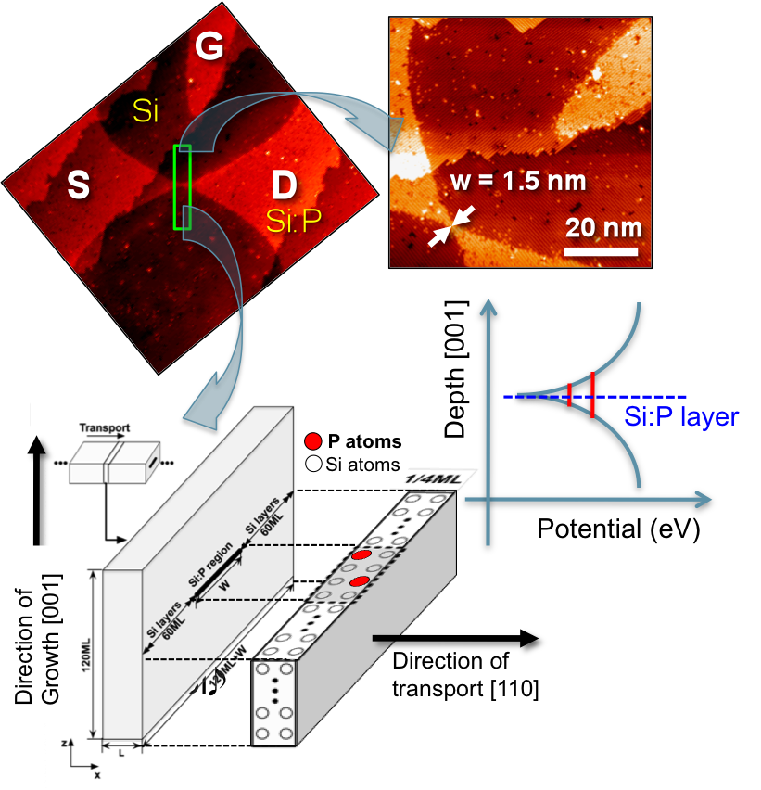
Target of modeling
STM planar patterned Si:P wire
Features
(1) Ultra-scaled narrow/thin channel.
(W < 2(nm), L < 10(nm))
(2) Extremely high channel doping.
(~ 1.7x10¹⁴ (cm⁻²), 1/4ML doping)
(3) Low-temperature transport in the
quantum and quasi-ballistic regime.
λ_{F} at T=4(K) ~ 5(nm) [1]
i-Si (~ 25 nm)
n-Si (~ 10¹⁵)
2D phosphorus
1/4ML δ-doped layer
L and W of wire channel ~ λ_{F}
[1] K. Goh et al, PRB 2007.

Slide 3
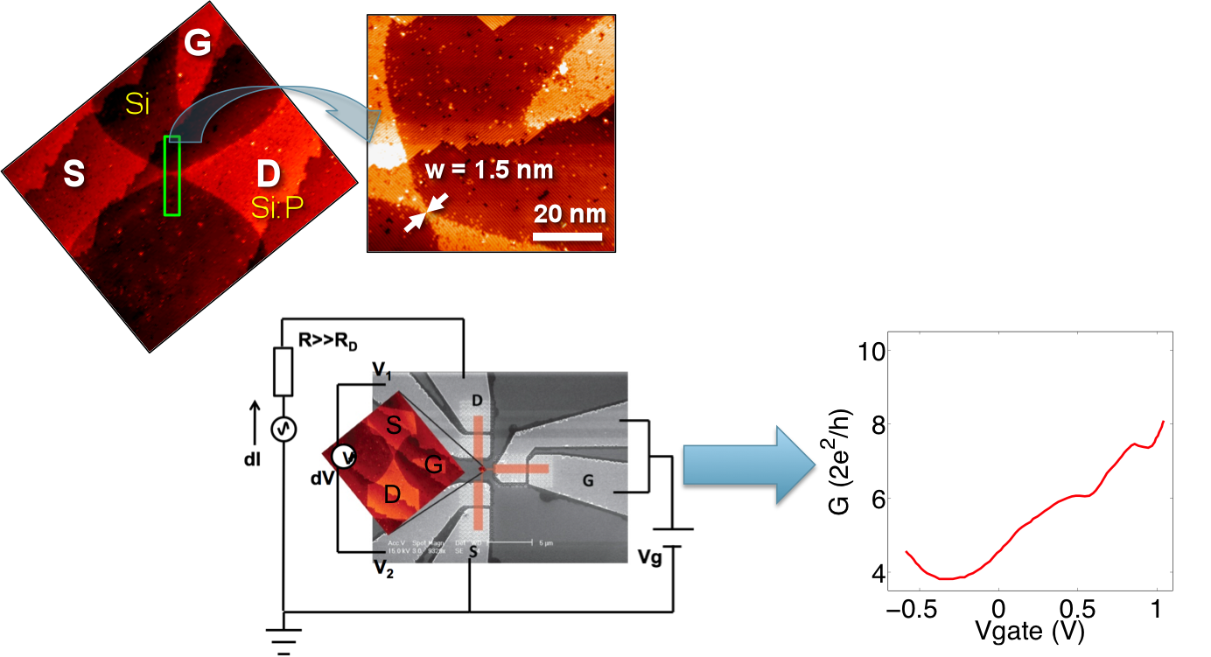
Problems to be tackled
STM planar patterned Si:P wire
Questions to answer
(1) Extremely dense doping.
→ Is it a metal?
(2) Gate modulation by in-plane contact
→ Why is there a local minimum in G?
(3) Is the transport channel-confined?

Slide 4
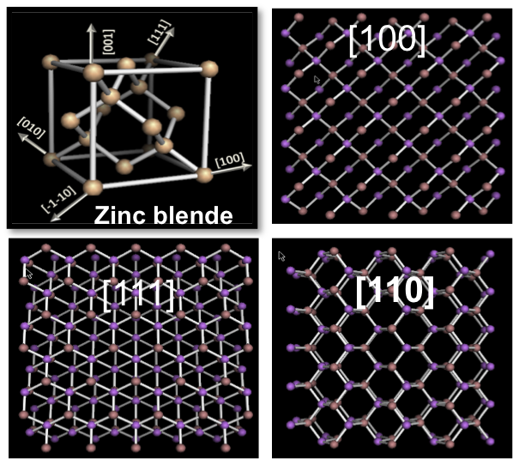
Methodology (1) : Tight-binding band model
[1] Choose the crystal type
[2] Represent the device atomistically
[3] Obtain atomistic Hamiltonian for
electronic structure calculation
Representation of electronic domain using TB approach
(1) 10-band nearest neighbor spds* Tight-binding band model based on the localized atomic orbital treatment.
Appropriate for treating atomistic effects – Surface roughness, Alloy randomness, Lattice distortion due to strain…
(3) Structural, material and potential variation treated easily.

Slide 5
Methodology (2) : Simulation domain
Can’t take the whole domain
Assumption of homogeneous wire:
Super-cell approach with periodic BC
(2) 120ML (~16.3(nm)) thick Si layer to prevent impurity states from being affected by the confinement wall.
G
S
D

Slide 6
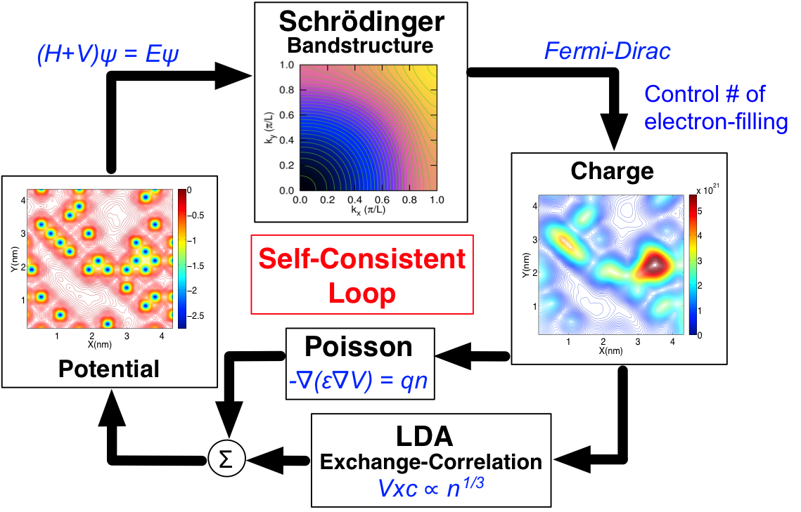
Methodology (3) : Charge-potential self-consistency
Densely doped device with many electrons
(1) Schrödinger-Poisson equation for the charge-potential self-consistency
(2) Electron exchange and correlation energy – Local Density Approximation

Slide 7
Bandstructure at charge neutrality
Semi-metallic property at charge neutrality
(1) Conduction band minimum of bulk Si → 0 (eV)
(2) Band-anticrossing: play an important role in gate-modulation (next slide)
Projection of 6 ellipsoid in Si bulk
1-D Bandstructure and Density of state
3D:
[001]
[010]
E_{F}
E_{F}
[100]
1Δ, 2Δ
2Γ
1Γ
2D-1D:
G(Ballistic) ~ 6(2e²/h)
[110] dispersion

Slide 8
Bandstructure at charge neutrality
Semi-metallic property at charge neutrality
(1) Conduction band minimum of bulk Si → 0 (eV)
(2) Band-anticrossing: play an important role in gate-modulation (next slide)
Projection of 6 ellipsoid in Si bulk
1-D Bandstructure and Density of state
3D:
[001]
[010]
E_{F}
E_{F}
[100]
1Δ, 2Δ
2Γ
1Γ
2D-1D:
G(Ballistic) ~ 6(2e²/h)
[110] dispersion

Slide 9
Gate dependence of channel conductance
Understand the minimum in conductance shown with increasing Vg
(1) Higher Vg will fill more electrons in channel
(2) Change electron-filling in the super-cell and computes the bandstructure
(3) # of subbands (or modes) crossed by EF – conductance in the ballistic regime
# of modes crossed → Local minimum due to band-anticrossing
Nelectron | 2.0 (Neutral) | 2.2 | 2.5 | 2.7
G(Ballistic) | ~6(2e²/h) | ~4(2e²/h) | ~6(2e²/h) | ~10(2e²/h)

Slide 10
Comparison of channel conductance
Experiment vs. Calculation in the ballistic regime
spds* TB (T=1.3(K))
Measured at T=1.3(K)
Corrected w. contact Rs

Slide 11
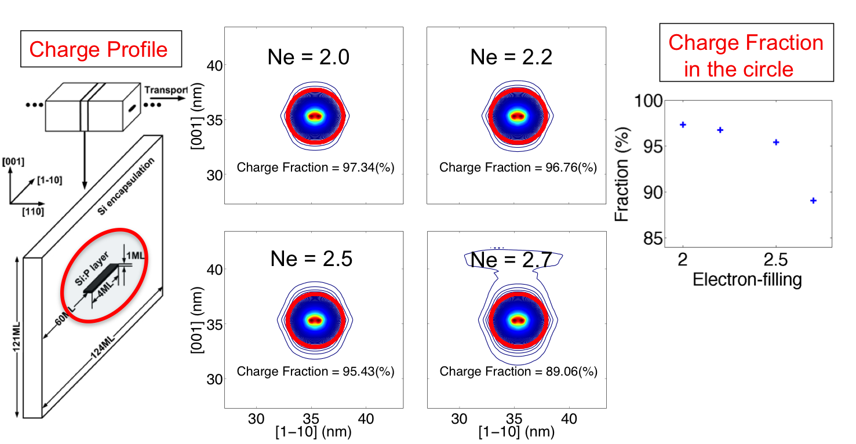
Transport through confined channel
Charge fraction at δ-doping narrow channel
(1) Cut off charge: 1(%) of peak value at charge-neutrality.
(2) Effective cross-sectional area ~ 4(nm²)

Slide 12
Conclusions
Conduction properties of narrowest Si:P nanowires
- Atomistic tight-binding calculation coupled with charge-potential self-consistency.
Confirmed semi-metallic property of Si:P nanowires
- From the bandstructure and fermi-level position.
Understood the unusual gate modulation observed in Si:P nanowires
- Local minimum in gate-conductance due to the sub band anticrossing.
Confirmed channel-confined transport
- From the electron distribution on the transport-perpendicular plane.
Matching experimental data with gate bias is still under progress
- Gate modulation has been considered with different electron-filling in the channel.

