Slide 1
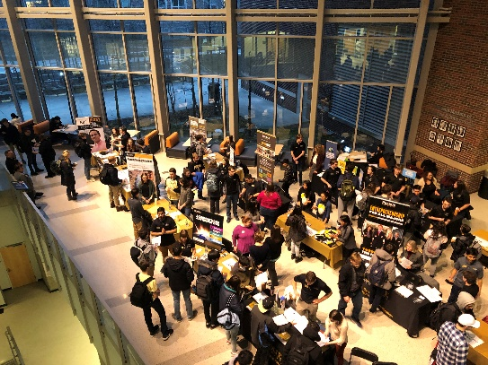
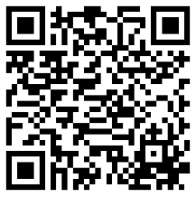
Engineering Major Fair
Thursday, Feb 12th– 5:45-6:45pm | LMBS 3239, 3261, and 3285
Do you want to learn more about the Engineering majors at Purdue?
Are you still deciding what you want to major in engineering?
Do you want to talk with someone from the engineering major you are considering?
Come meet one-on-one with representatives from each major.
Learn about courses, career options, and other opportunities.
RSVP:
https://purdue.ca1.qualtrics.com/jfe/form/SV_4T8sHPIcK32YcaW

