Slide 1
Rear Axle Module
EV Kart Manual
EPICS

Slide 2
Table of Contents
Topic | Page
Overview | 3
Tools | 4
Parts | 5
Understanding Tools Nomenclature | 8
Step 1: Bearings | 9
Step 2: Cassettes | 11
Step 3: Axle | 20
Step 4: Wheel Hub | 27
Appendix and References | 32

Slide 3
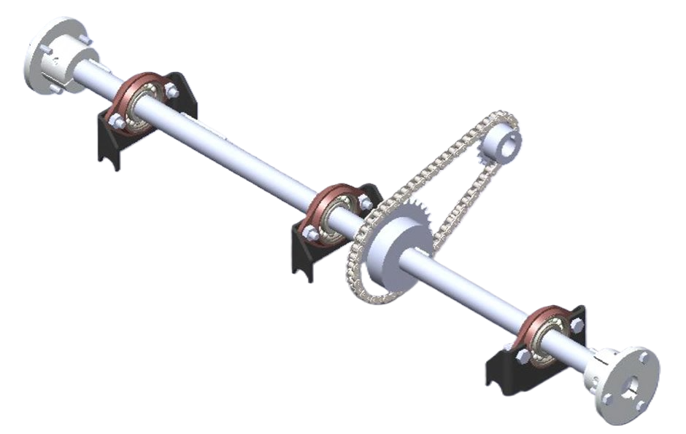
Overview
This module will be divided into four steps:
Bearings
Cassettes
Axle
Wheel Hub
1
2
3
4

Slide 4
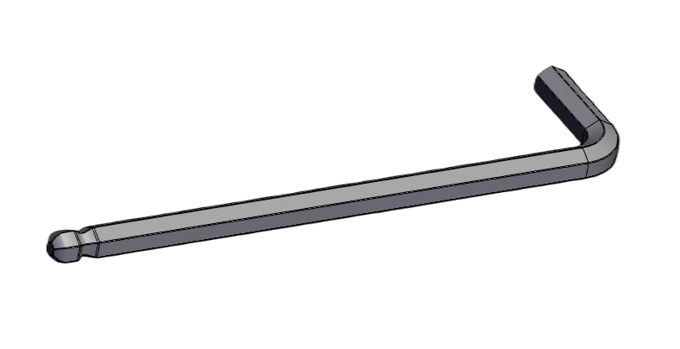
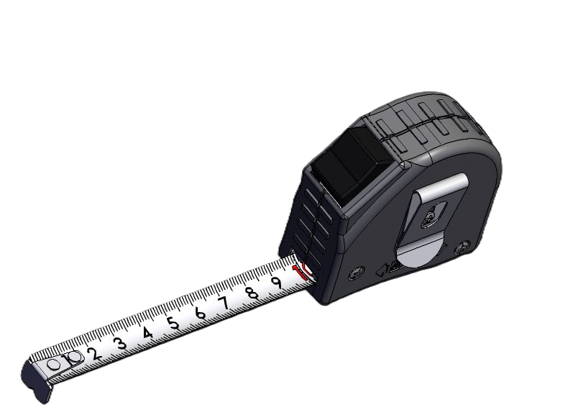
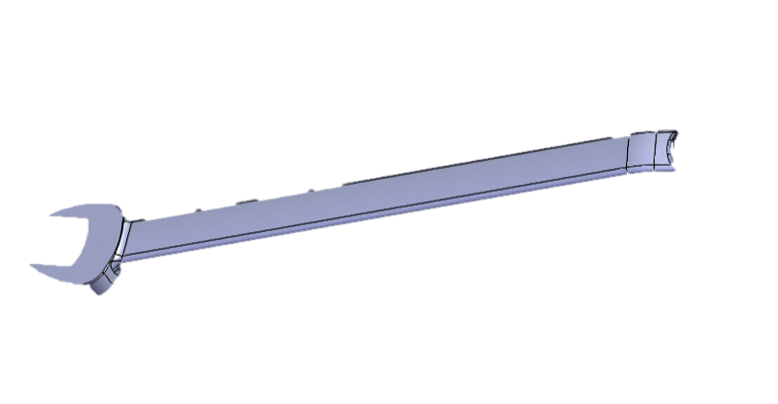
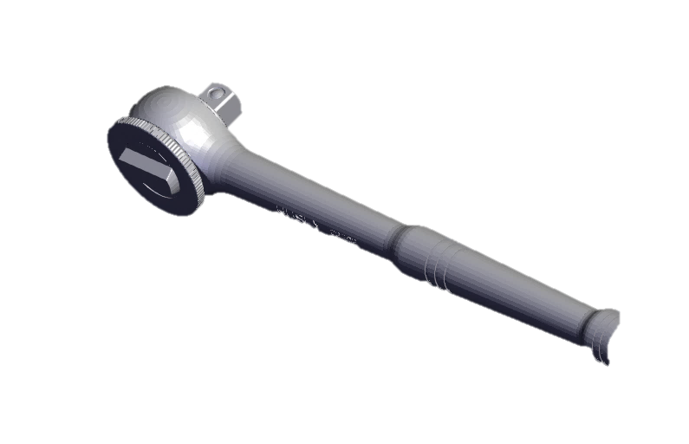
Tools
Required Tools for Module
5mm and 6mm Allen Wrench
Tape measurer
13/17mm wrench
10,13,17mm socket wrench set
(Optional) Rubber Mallet for adjusting axle height
1.
3.
2.
4.

Slide 5
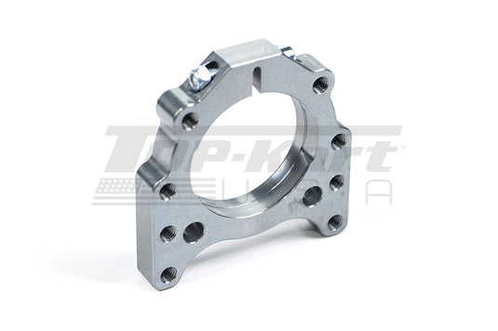
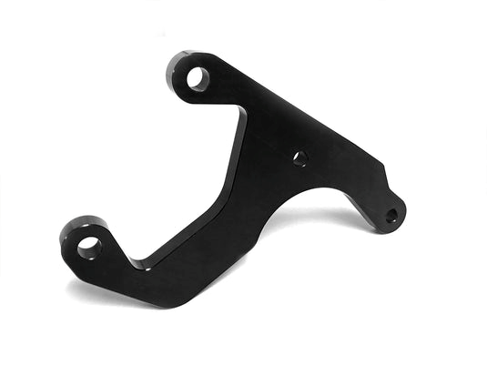
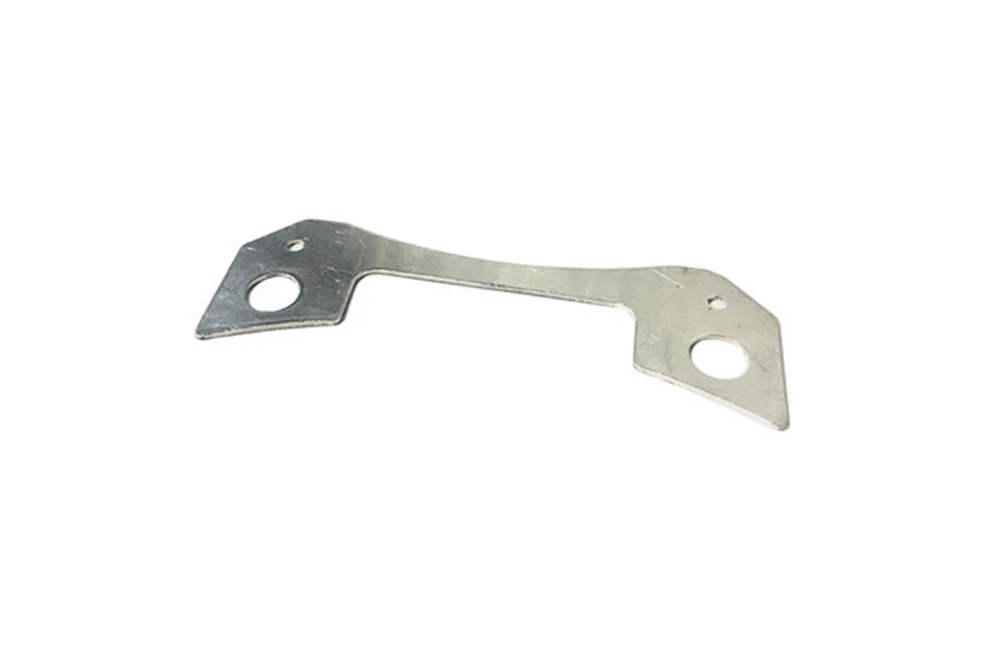
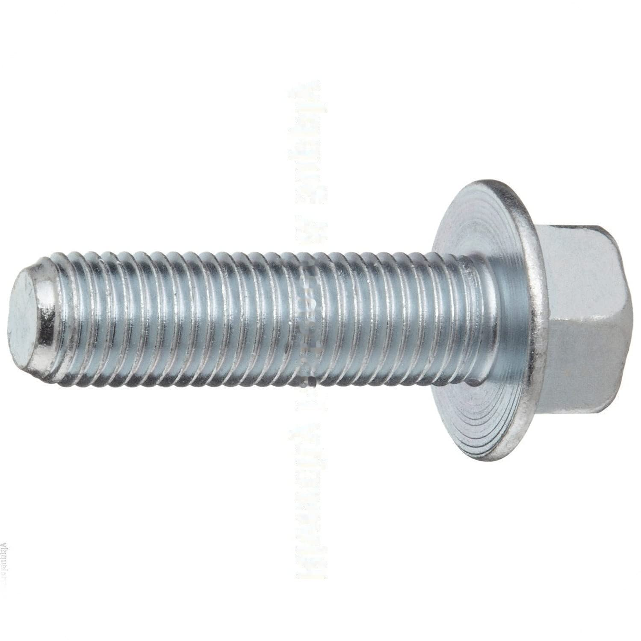
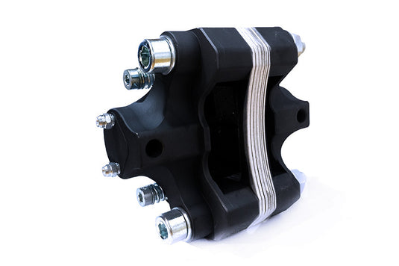
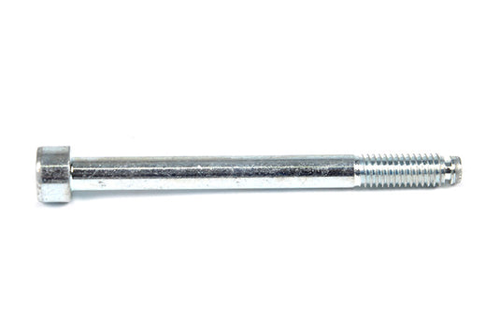
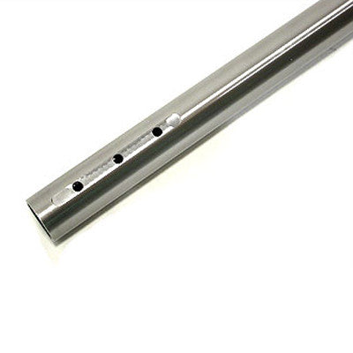
Parts
Required Parts for Module
50mm Aluminum Bearing Cassette
Economy Caliper Bracket
Brake Caliper Spacer
M8x1.5x25mm Cassette Bolts
D.30 Brake Caliper
Economy Caliper Bolt M10 x 110
50mm PKT Axle

Slide 6
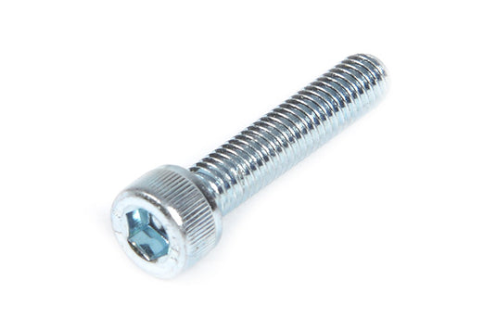
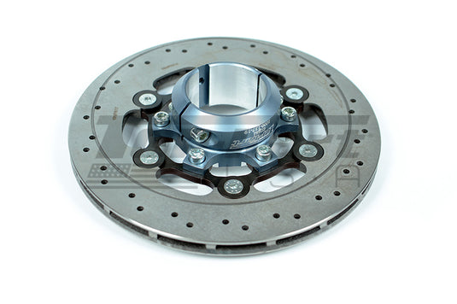
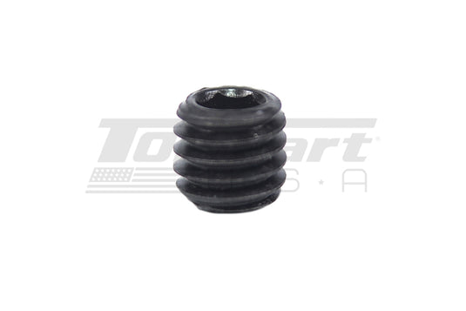
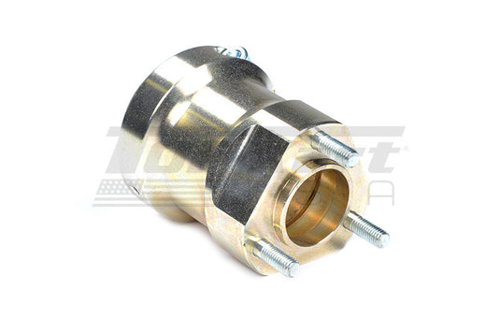
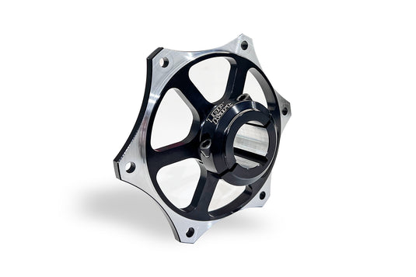
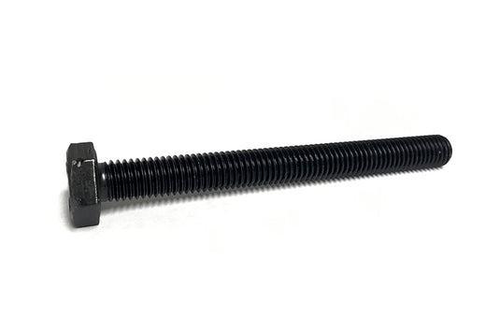
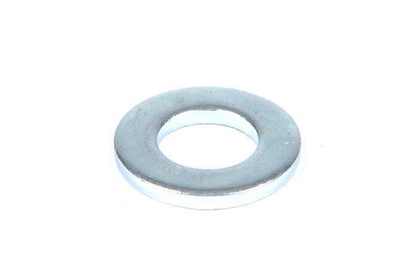
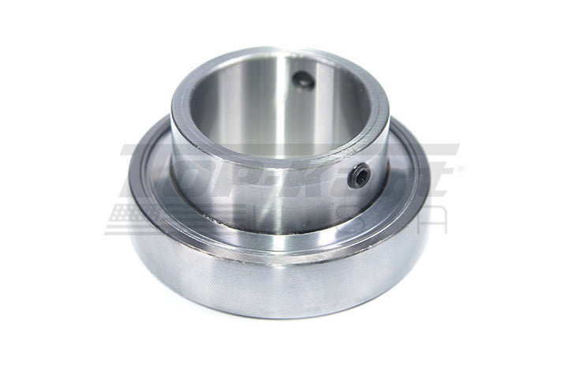
Parts
Required Parts for Module
Brake/Sprocket Hub Pinch Bolt M6 x 30
50mm Complete Brake Disc
M6 x 10 Set Screws
50mm Rear Wheel Hub Aluminum
30mm Sprocket Carrier
Engine Stop Bolt
M8 Flat Washer
50mm (ID) Axle Bearing

Slide 7
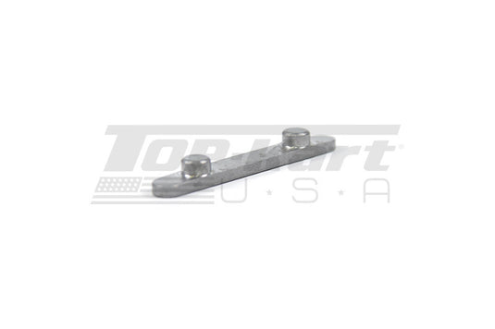
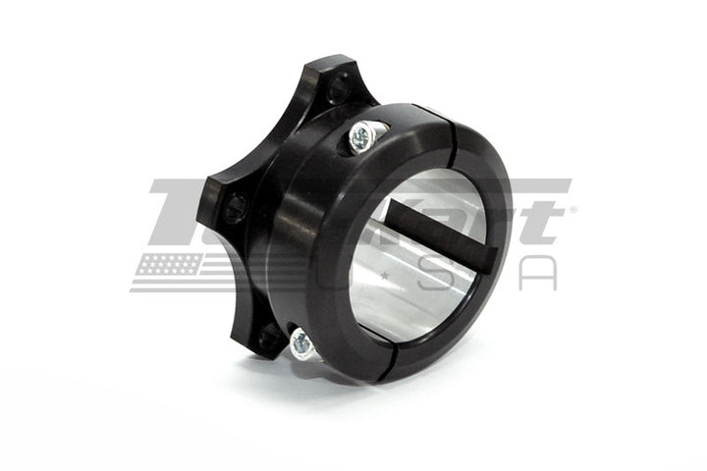
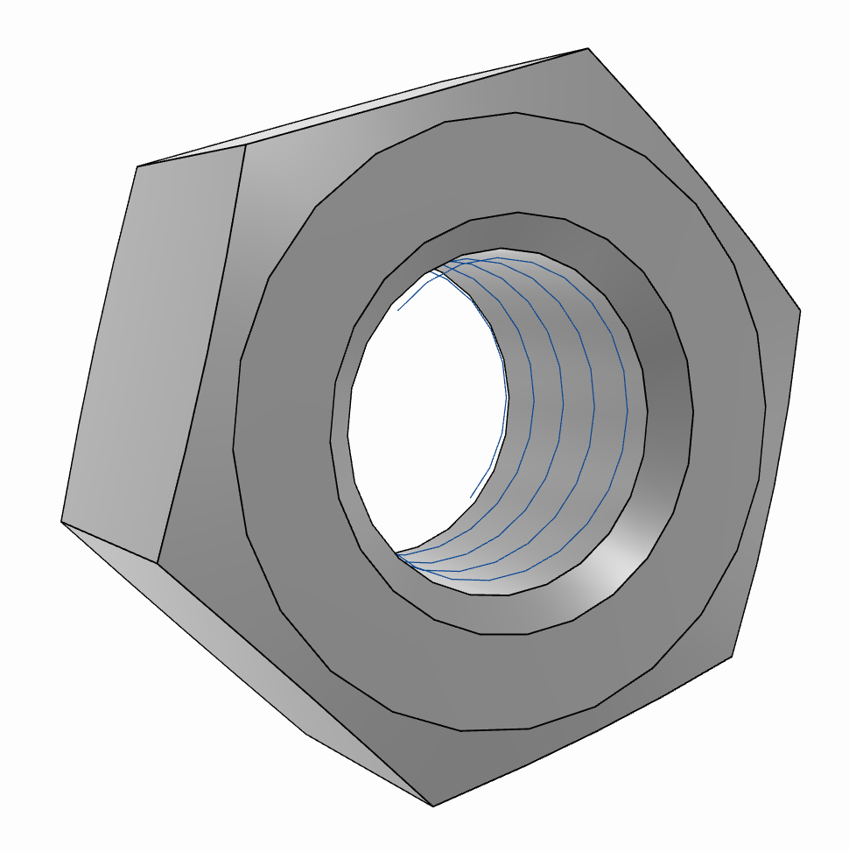
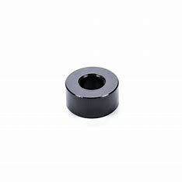
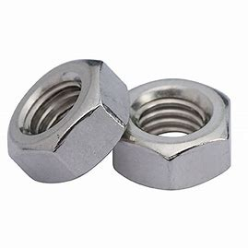
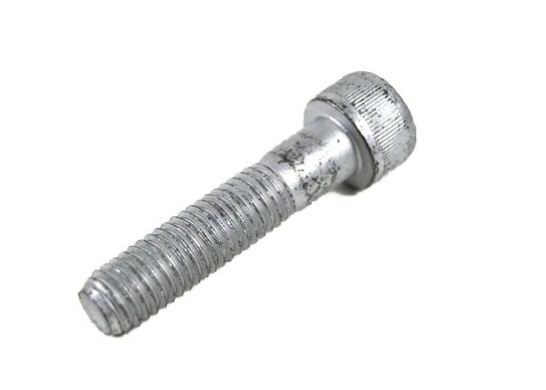
Parts
Required Parts for Module
2 Peg Key
Brembo Brake Hub
M10 Nylon Nut
Economy Bracket Caliper Spacer
M8 Nylon Nut
M10x45 Cap Bolt

Slide 8
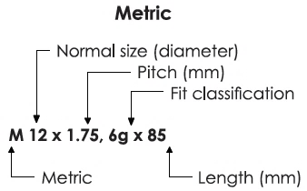
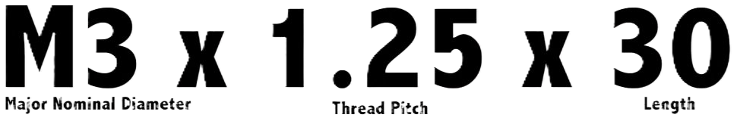
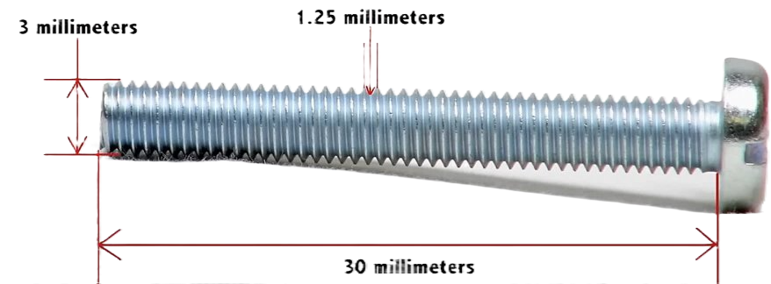
Understanding Tool Nomenclature
Metric Terminology:
Example:
*all measurements in this guide will exclude pitch and fit classification

Slide 9
Step 1: Bearings (0:36-1:24)
Rear Axle Assembly
Note: if bearings come pre-installed, skip this step.

Slide 10
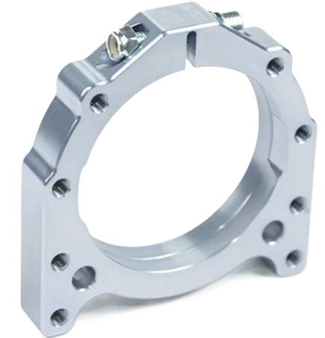
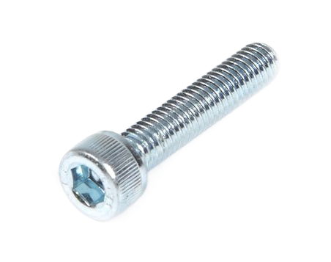
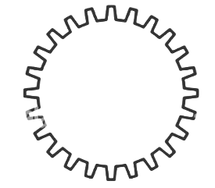
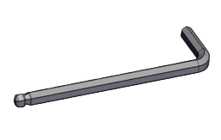
Pinch Bolt
1.1
50mm Aluminum Bearing Cassette
Brake / Sprocket Hub Pinch Bolt M6 x 30
5mm Hex Key
Check that the M6x30 pinch bolt is loosened.
Use a 5mm Hex key if needed.

Slide 11
Step 2: Cassettes (1:25-3:16)
Rear Axle Assembly

Slide 12
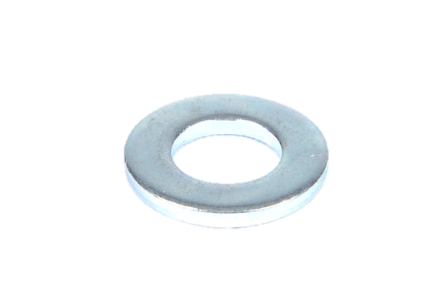
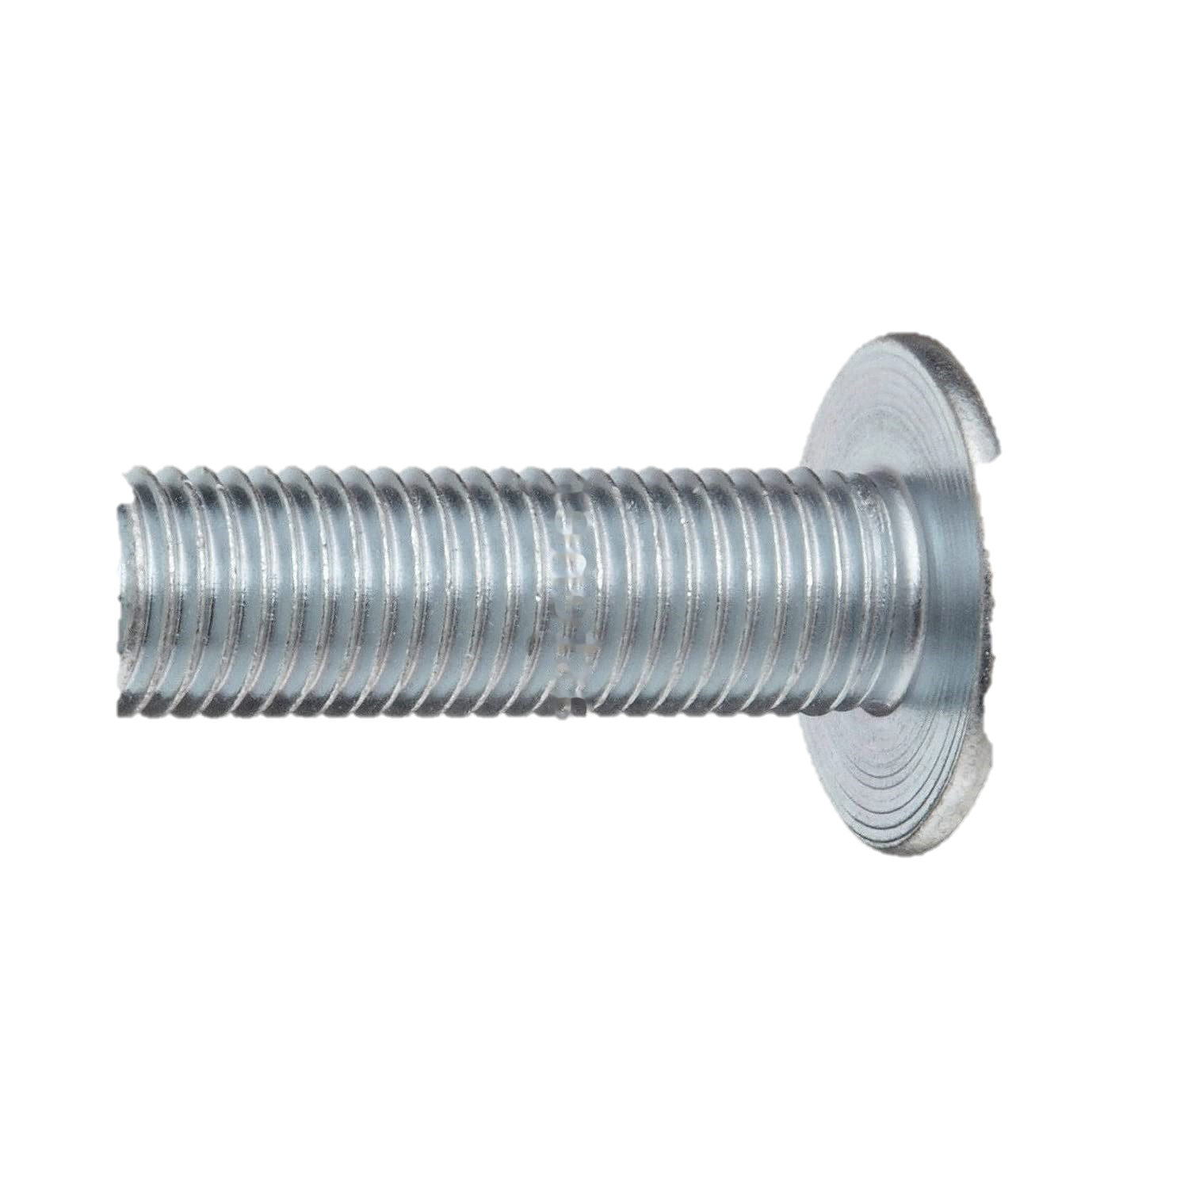
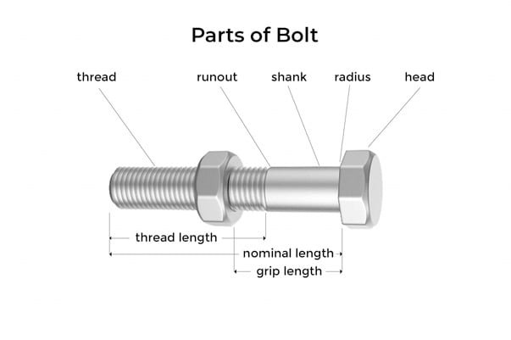
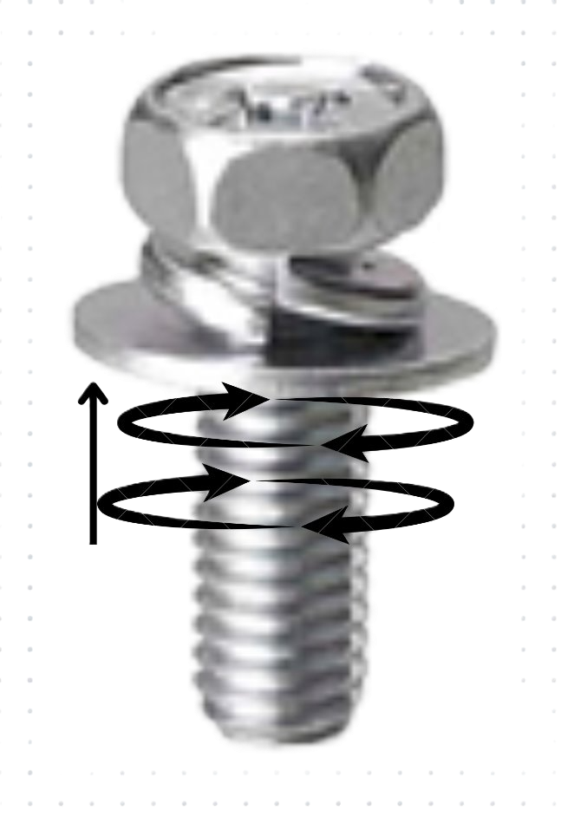
Bolt Washer Prep
2.1
M8 Washer
M8x25mm Cassette Bolts (12)
Shank
Prep a washer and M8x25mm bolt by placing the washer onto the bolt shank, such that the washer sits directly behind the bolt head. Repeat this for 12 washer-bolt pairings.
Bolt with washer:

Slide 13
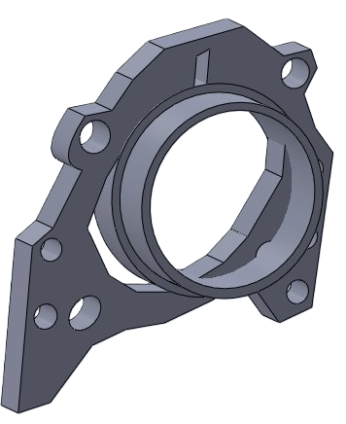
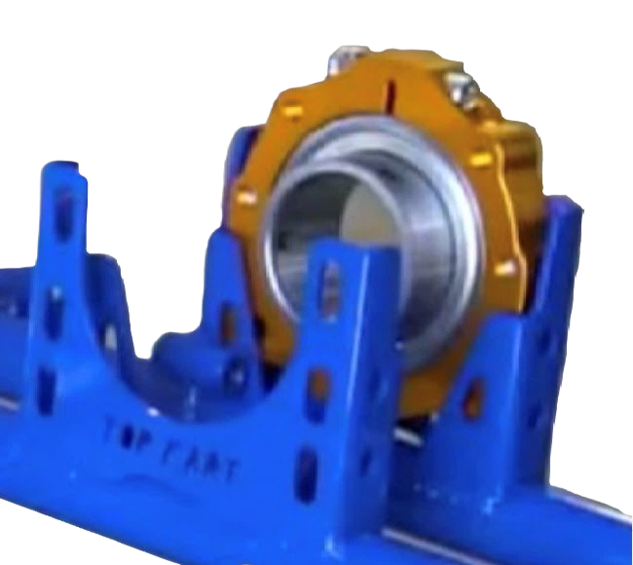
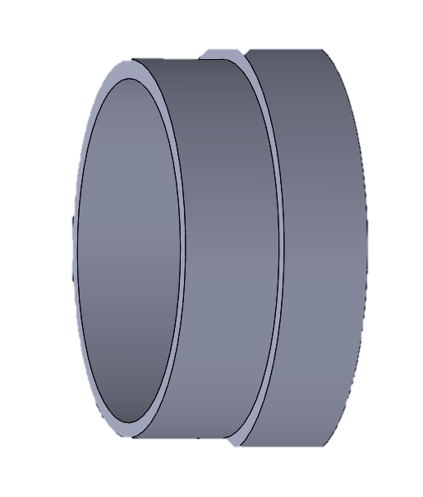
Cassette Installation
2.2
Cassette with Bearing
Place the cassette into the frame hanger so that the set screws section of the bearing is facing inwards.
Set screw section
Cassette in frame hanger oriented correctly

Slide 14
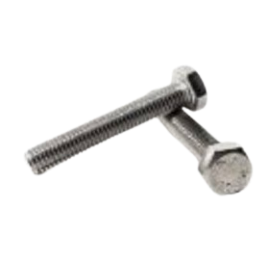
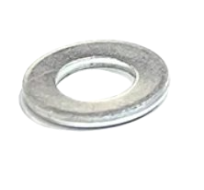
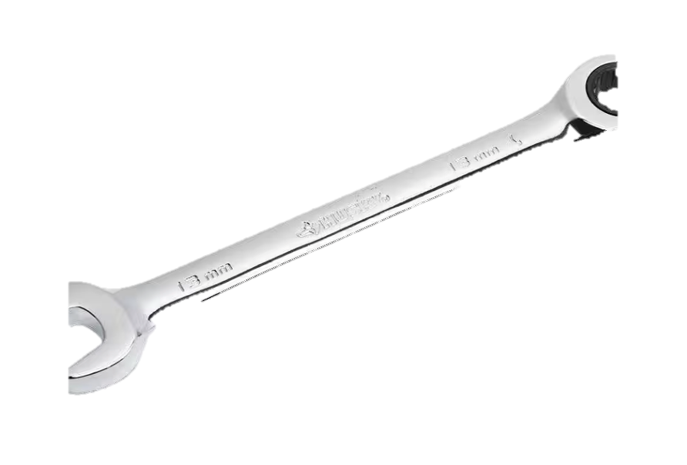
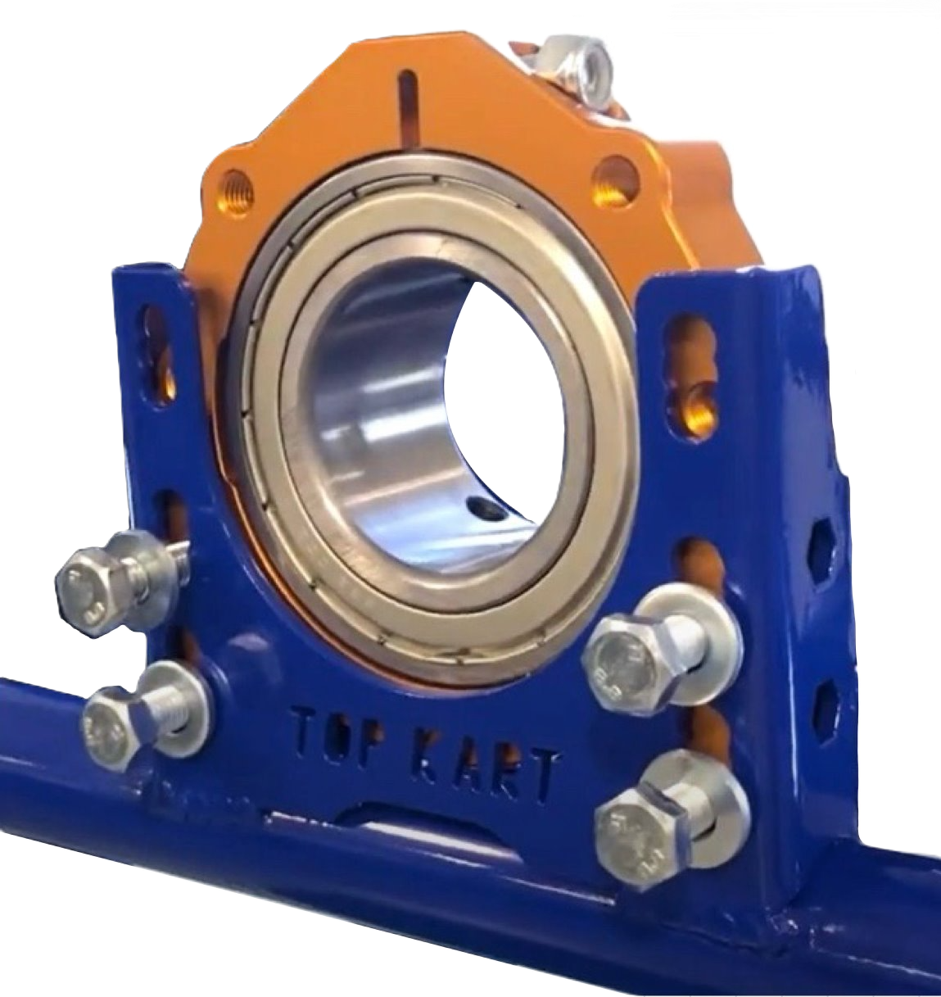
Cassette Bolts
2.3
M8x1.5x25mm Cassette Bolts (12)
M10 Flat Washer (18)
13mm Wrench
*start with the motor side and repeat for brake side
Insert cassette bolt with washer into the right-most bottom hole.
Screw in by hand until it remains firmly in hole without additional support.
Repeat for remaining 5 holes, starting with the bottom row and working upwards by row.
Note that the top row of holes should remain open.
3
4
1
Numbers indicate order of insertion of bolts​
2

Slide 15
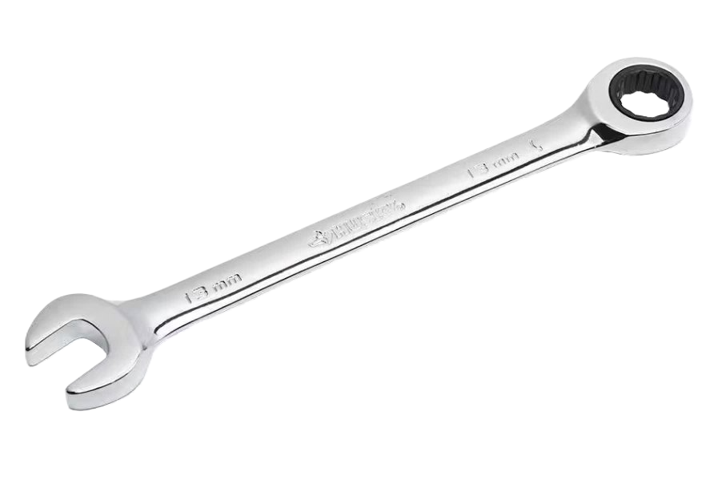
Cassette Bolts (pt2)
2.3
M10x1.5x25mm Cassette Bolts (12)
M10 Flat Washer (18)
13mm Wrench
*start with the motor side and repeat for brake side
4. Go back and tighten all bolts by hand until the washer is snuggly pressed between the cassette and the bolt head.
5. Finish tightening all bolts with a 13mm wrench.
6. Repeat exactly for brake side.
3
4
1
Numbers indicate order of insertion of bolts​
2

Slide 16
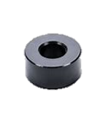
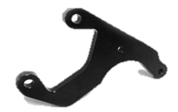
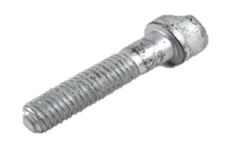
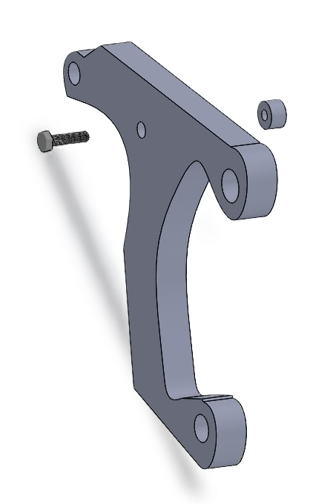
D.30 Caliper Bracket Prep
2.4
Economy Bracket Caliper Spacer
Economy Caliper Bracket
M8x45 Cap Bolt
Prep a spacer and caliper bracket by inserting a M10x45 bolt through the middle hole of the caliper bracket so that the bolt head is pressed against the caliper bracket.
Then put the spacer on the threads of the bolt so that the caliper bracket is sandwiched between the spacer and the bolt head.
16

Slide 17
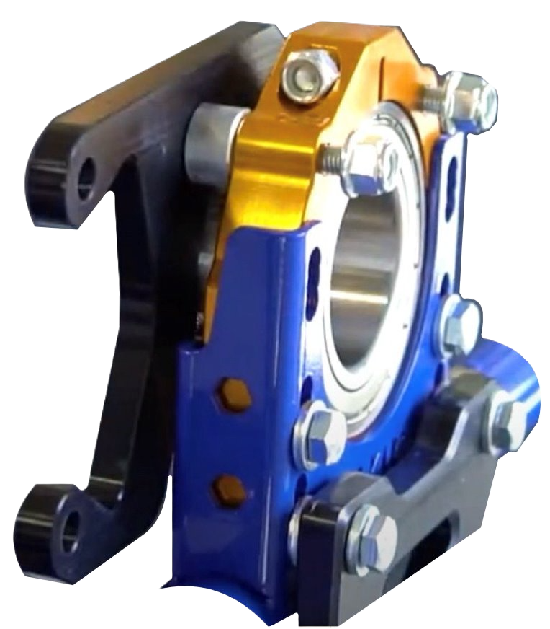
Economy Caliper Bracket Instillation
2.5a
Prepped Economy Bracket
50mm Aluminum Bearing Cassette
On the inside of the brake side cassette, attach the caliper bracket to the top holes by inserting the prepped caliper with spacer and bolt into the top right hole and tightening by hand until the spacer is firmly held between the caliper bracket and the cassette.
17

Slide 18
Economy Caliper Bracket Instillation
2.5b
For the second bolt of the caliper bracket, first hold a spacer in front of the left hole so that it is sandwiched between the caliper and cassette. Then insert the bolt through the caliper, spacer, and cassette.
Place an M8 Nylon nut on the backside of each bolt and tighten by hand as much as possible.
Prepped Economy Bracket
50mm Aluminum Bearing Cassette
18

Slide 19



Brake Caliper Installation
2.6
Brake Caliper
M10x110 bolt
M10 Washer
Insert an M10x110 bolt with M10 washer into the front hole of the economy caliper bracket. Then push it through the entire brake caliper. Repeat for bottom hole of economy caliper bracket.
Place an M10 nut on the backside of each bolt and tighten with 17 mm Allen Wrench.
1
2
19

Slide 20
Step 3: Axle (3:18-6:25)
Rear Axle Assembly

Slide 21
Axle Alignment
3.1
1.Stand behind the kart on the brake side.
2. Insert the axle into the brake-side bearing and push it through until it is directly in front of (but not through) the motor-side bearing.
3. The axle should be directly aligned with the opening of the opposing bearing. If it is not aligned, then adjust the axle by hitting it in the direction opposite of misalignment.
4. Remove axle from bearings and repeat exactly on the motor side.
5. After aligning the axle on both sides, insert the axle through both bearings, starting from the motor-side bearing. Make sure that the axle is still moving easily through the bearings.
6. Tighten both cassette pinch bolts with a 5mm hex key.
21

Slide 22

Brake Disc Installation
3.2a
50mm Complete Brake Disc
Stand behind the kart with the brake disc in your left hand. With your right hand, slide the brake pad side of the axle out of its bearing.
Position the brake disc between the brake caliper and the axle, with the pinch bolts of the brake hub facing right (towards the chassis).
Keyway Under Brake Disk
22

Slide 23


Brake Disc Installation
3.2b
50mm Complete Brake Disc
2 Peg Key
Keyway Under Brake Disk
Then slide the axle through the disc so that the keyway is on the axle. Once the disc is held in place, insert key into the designated spots on the axle. Continue sliding the axle back through the brake caliper and bearing until the key is inserted fully into the keyway.
23

Slide 24


Centering Axle
3.3
30mm PKT Axles
Tape Measurer
Center the axle. Use a tape measure to determine the length of the axle extending past the bearing on each side of the kart. Shift the axle so that the length is the same on both sides.
Measure distance between axle end and bearing
24

Slide 25


Secure Axle Position
3.4
50mm PKT Axles
4mm Allen Wrench
Tighten the set screw of each bearing using a 4mm Allen Wrench. Tighten until you feel the set screw contact the axle, then tighten another half a turn.
Bearing Set Screw
25

Slide 26


Secure Brake Disc
3.5
M6x30
5mm Allen Wrench
Brake Disk Pinch Bolt
Center the brake disc over the brake pads. After centering, tighten the brake disc hub's two pinch bolts with a 5mm Allen wrench.
Brake Disk Centered Between Brake Pads
26

Slide 27
Step 4: Wheel Hub (6:26-7:35)
Rear Axle Assembly

Slide 28

Wheel Hub Keyway Installation
4.1a
2 Peg Key
Key under wheel hub
*start with the brake side and then repeat for motor side as instructed in next steps.
Place the key onto the end of the axle and push the 50mm rear wheel hub onto the end of the axle until it stops.
28

Slide 29



Brake Side Wheel Hub Installation
4.1b
Brake/Sprocket Hub Pinch Bolt M6 x 30
6 mm Allen Wrench
*start with the brake side and then repeat for motor side as instructed in next steps.
Pinch Bolt
Tighten the two M6x30 pinch bolts with an 6mm Allen wrench.
29

Slide 30



Sprocket Installation
4.2
50mm Sprocket Carrier
2 Peg Keyway
1. For the motor side, place the axle keyway closest to the bearing and slide the sprocket over it.
2. Repeat keyway and wheel hub installation on the motor side as instructed in 4A and 4B.
Key under sprocket hub
Installed sprocket
30

Slide 31


Motor Mount Stop Bolt
4.3
M10 Motor Stop Bolt x 30
6 mm Allen Wrench
Place an M10 nut on the threads of the motor mount stop bolt.
Insert the bolt with nut into the side of the frame hanger, as instructed in the image to the right.
Bolt Goes Here
31

Slide 32
Appendix and References
Rear Axle Assembly

Slide 33

Top Kart Video Demonstration
33

