Slide 1
Brake System Module
EV Kart Manual
EPICS

Slide 2
Table of Contents
Topic | Page
Overview | 3
Tools | 4
Parts | 5
Understanding Tools Nomenclature | 8
Step 1: Bearings | 9
Step 2: Cassettes | 11
Step 3: Axle | 20
Step 4: Wheel Hub | 27
Appendix and References | 32

Slide 3
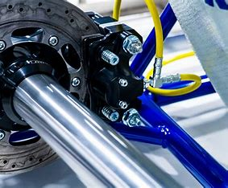
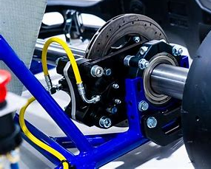
Overview
This module will be divided into four steps:
  Master Cylinder
  Brake Line
  Brake Rod
  Brake Safety Cable

Slide 4
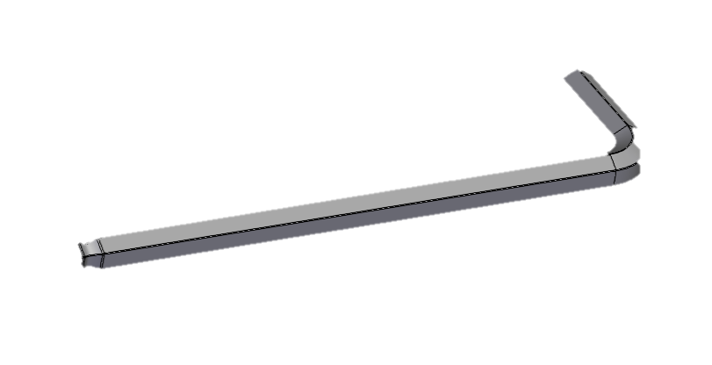
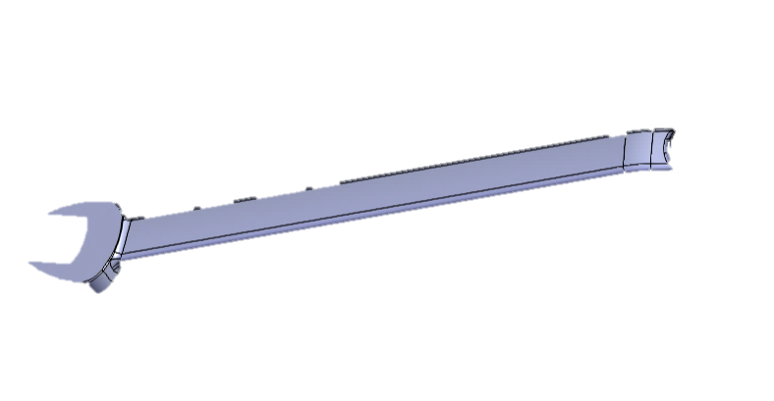
Tools
Required Tools for Module
1.
2.
5mm and 6mm Allen Wrench
(Optional) 13/17mm Wrench

Slide 5
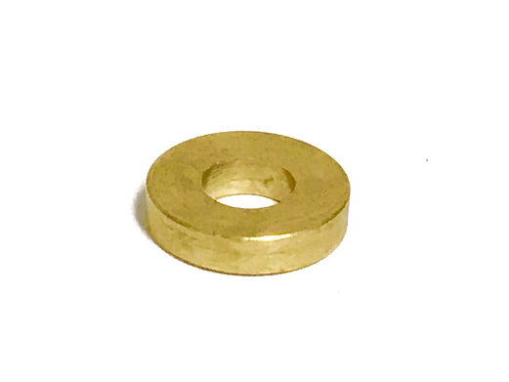
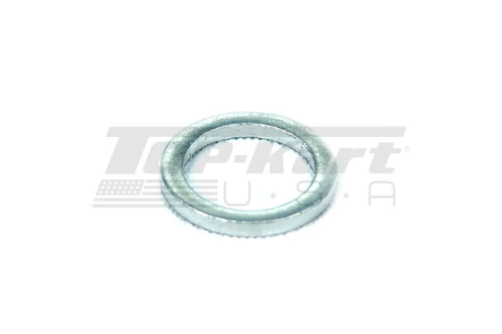
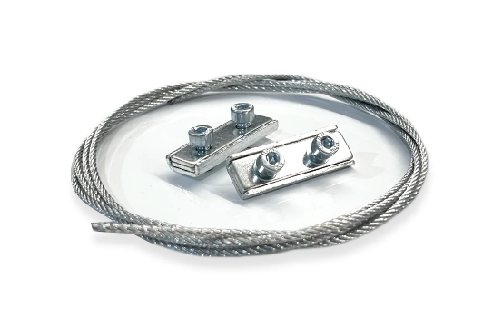
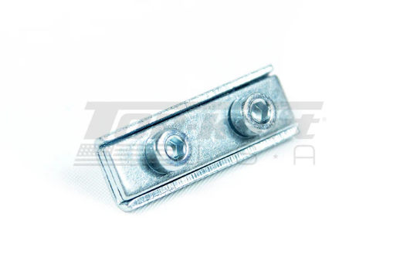
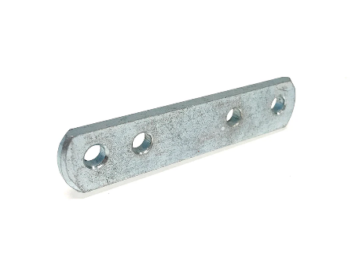
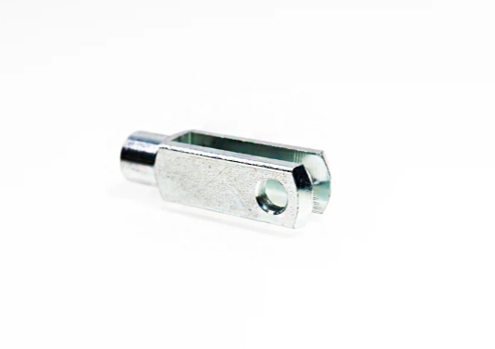
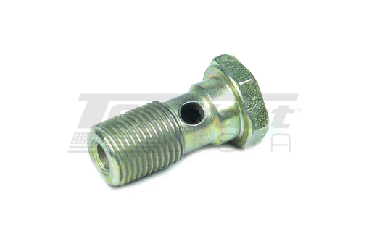
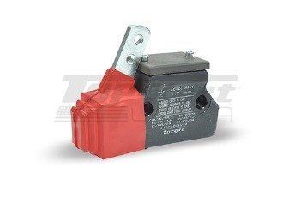
Parts
Required Parts for Module
Brass Washer
Master Cylinder Cap Washer
Brake Safety Line
Double Screw Clamp
Master Cylinder Lever
Brake Safety Cable Fork
Brake Line Connector
Master Cylinder

Slide 6
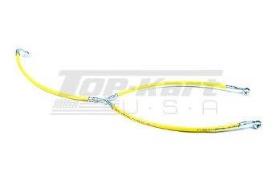

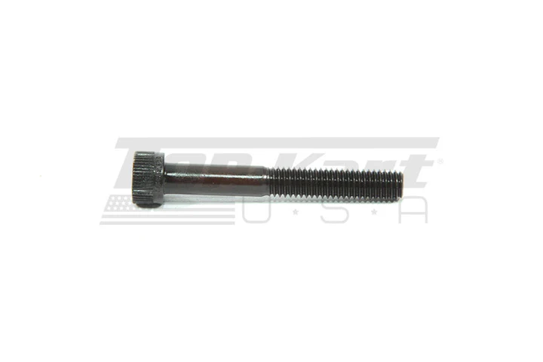
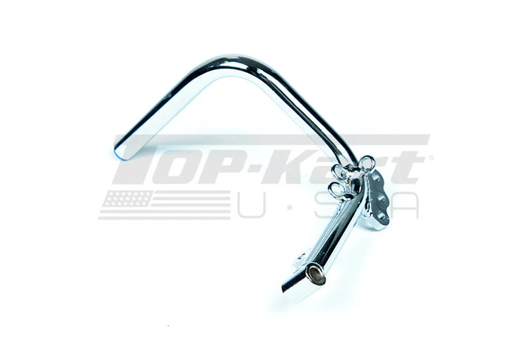
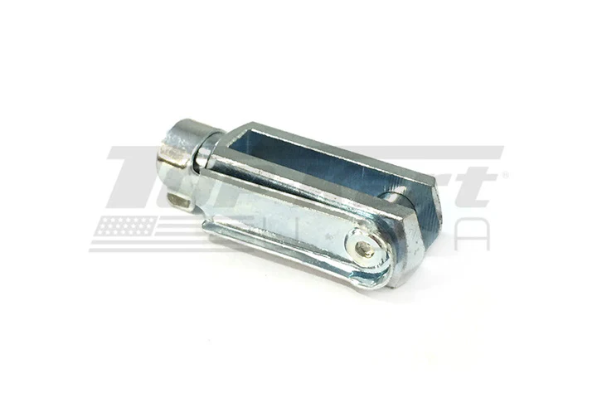
Parts
Required Parts for Module
Brake Line
Brake Flash Rod
M6 X 45 Master Cylinder Bolt
Brake Pedal
Long Brake Fork Celvis

Slide 7
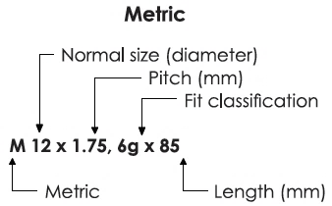

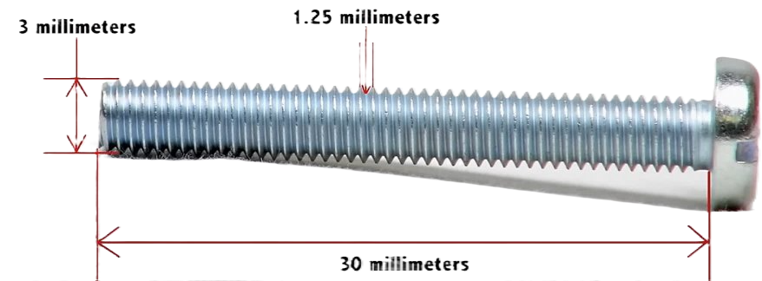
Understanding Tool Nomenclature
Metric Terminology:
Example:
*all measurements in this guide will exclude pitch and fit classification

Slide 8
Step 1: Master Cylinder (0:33-1:00)
Brake Assembly

Slide 9
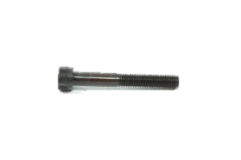
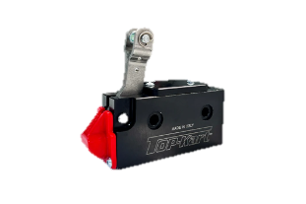
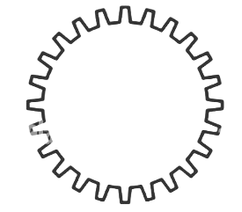
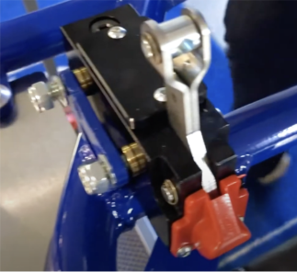
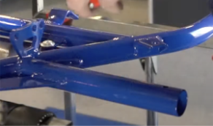
Master Cylinder Mount
1.1
Master Cylinder Bolt M6 x 45
Master Cylinder
Brass Washer
Locate the master cylinder mount
Insert bolts through the master cylinder.
Place brass washers on ends of bolts protruding from the master cylinder such that brass washers are between master cylinder and frame bracket.
Align ends of the bolts with bracket holes and push through the frame.
Master Cylinder Mount

Slide 10
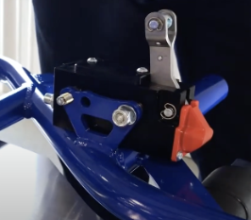
Secure Master Cylinder
1.2
Master Cylinder Bolt M6 x 45
Master Cylinder
Place Master Cylinder Cap Washer onto the bolts and screw the nut onto the washer.
Tighten them firmly using a wrench to prevent movement.

Slide 11
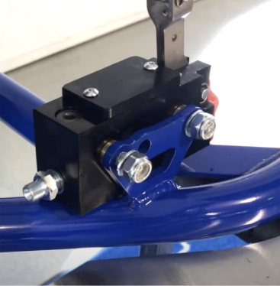
Secure Master Cylinder
1.3
Master Cylinder Bolt M6 x 45
Master Cylinder
Locate the fitting on the back of the master cylinder.
Ensure it is tightened properly to prevent fluid leaks.
Rear Fitting

Slide 12
Step 2: Brake Line (1:00-2:20)
Brake Assembly

Slide 13
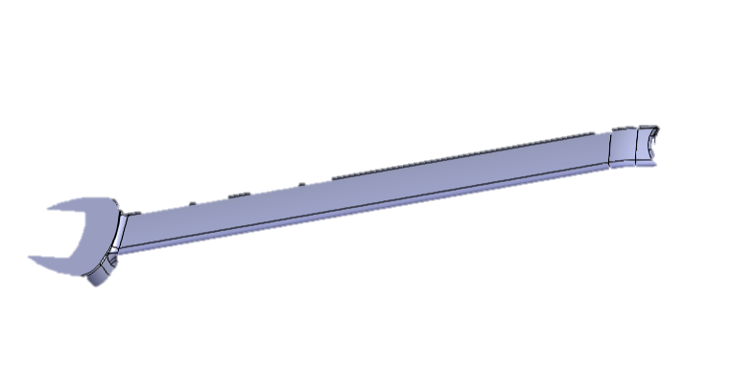
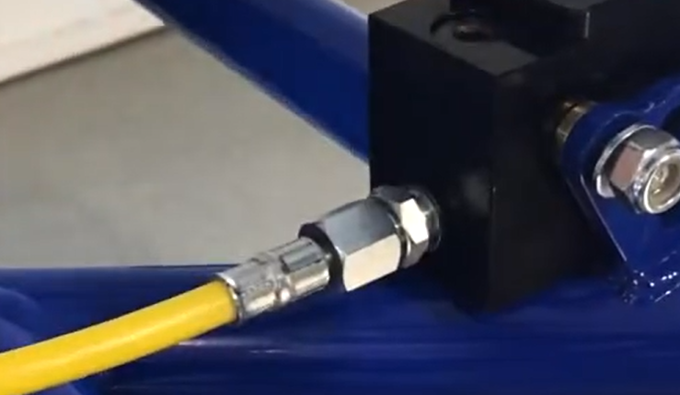
Master Cylinder Connection
2.1
Brake Line
13 mm Wrench
1. Locate the yellow brake line with a single-end fitting.
2. Screw this end into the rear fitting of the master cylinder.
3. Use a wrench at the end to ensure the line is not loose (do not overtighten).

Slide 14
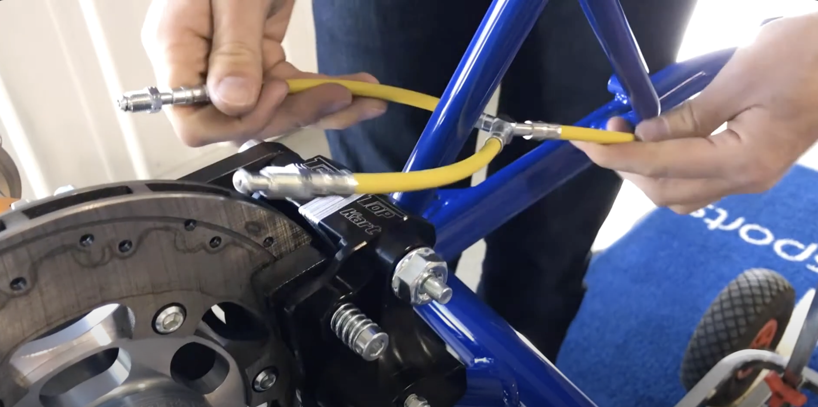
Brake Line Routing
2.2
Brake Line
  Identify the Y-shaped split in the brake line.
  Run each side of the split around the frame strut post.
Frame Strut Post

Slide 15

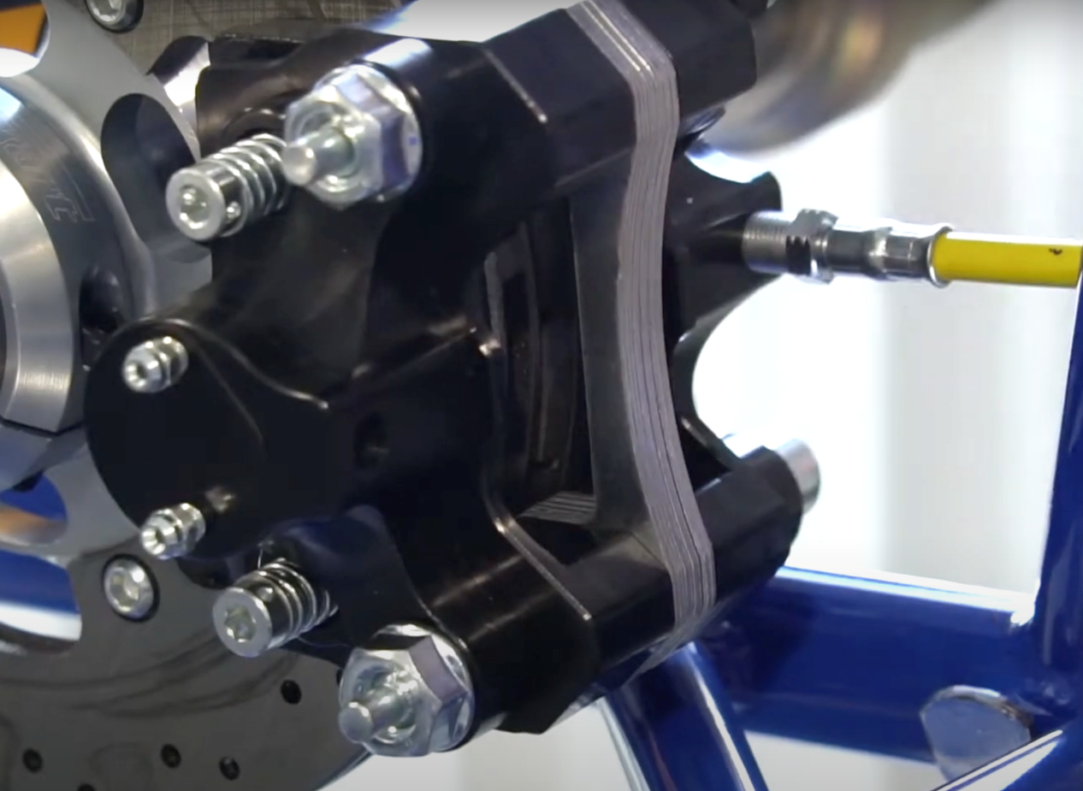
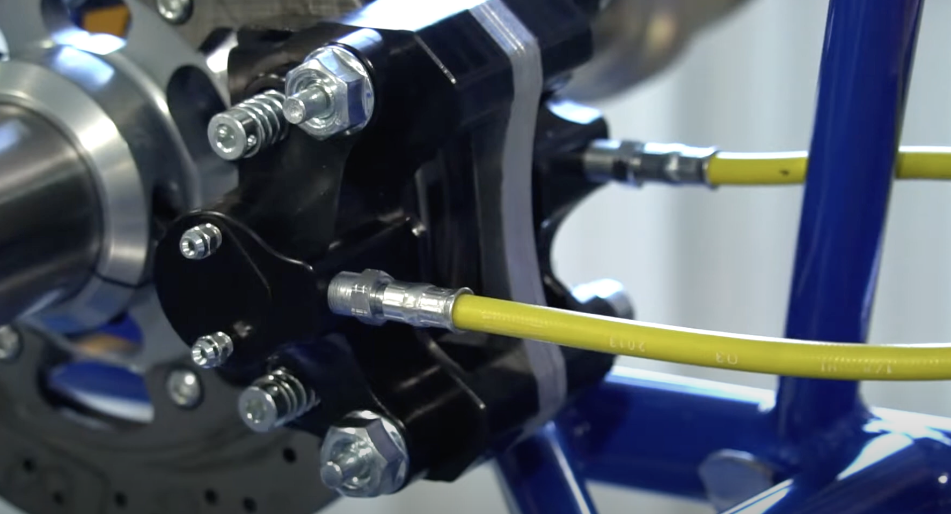
Brake Line – Caliper Connection
2.3
13 mm Wrench
Align each brake line end with the caliper fittings.
Carefully screw in each fitting by hand first. NOTE: both ends must be completely parallel, or line will become damaged
Tighten with a wrench, ensuring no cross-threading occurs.

Slide 16
Step 3: Brake Rod (2:20-3:11)
Brake Assembly

Slide 17
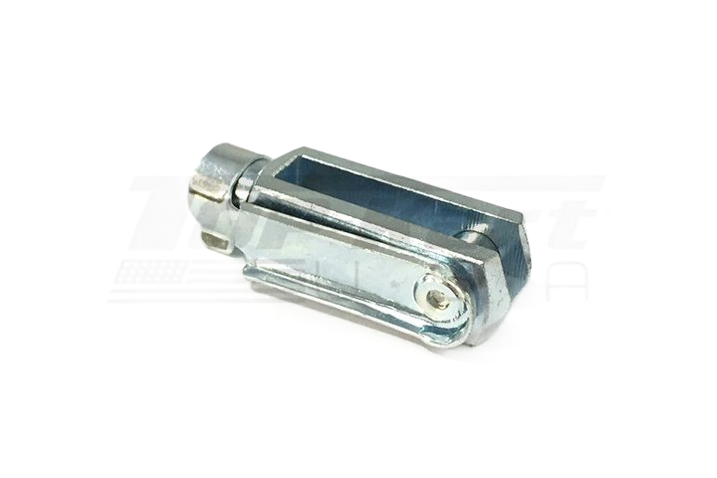
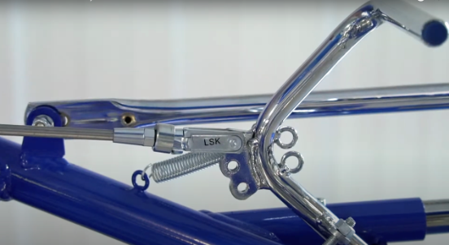
Pedal Attachment
3.1
Brake Rod
Brake Fork Clasp
Locate the three mounting holes on the brake pedal.
Insert the open end of the rod around the top hole of the pedal and secure it with a clasp.
Clasp over top hole
17

Slide 18
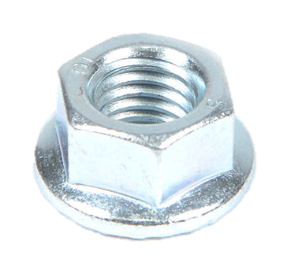
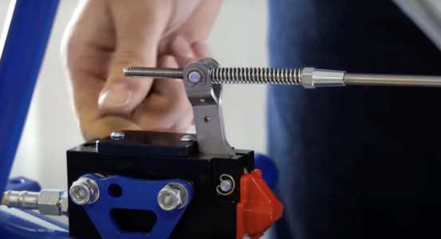
Master Cylinder Attachment
3.2
Safety Nut
Remove the bolts at the end of the brake rod
Push back the rod and align it with the swivel piece on the master cylinder.
Insert it through the swivel hole.
18
Notes:
******WE ARE MISSING BOTH BOLTS PARTS******

Slide 19
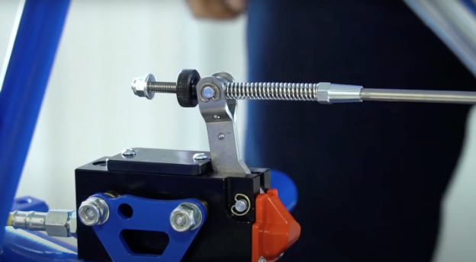
Securing Rod
3.3
Safety Nut
Safety Nut
Screw on adjuster nut at end of rod and tighten it to swivel hole. Once it has pressure, turn 2-3 times to apply light tension on the rod.
Hand tighten the safety nut onto the end of the rod.
Adjuster Nut
19
Notes:
Add the

Slide 20
Step 4: Brake Safety Cable (3:11-3:35)
Rear Axle Assembly

Slide 21
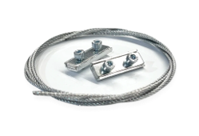
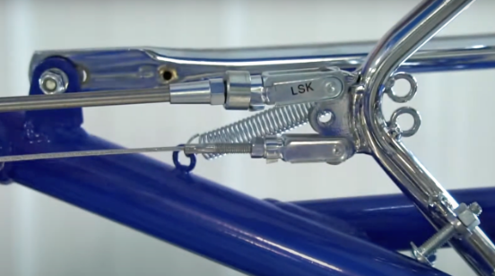
Pedal Attachment
4.1
Brake Safety Line
1. Insert one end of the cable into the bottom hole of the brake pedal.
2. Secure it using the clasp.
21

Slide 22
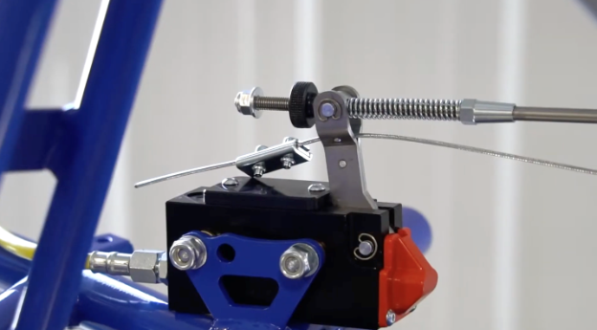
Master Cylinder Attachment
4.2
Brake Safety Line
Run the cable through the wider section of the master cylinder (below the rod).
22

Slide 23
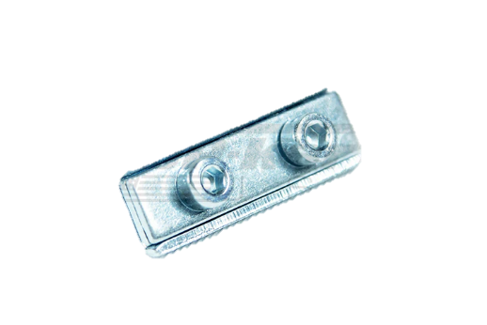
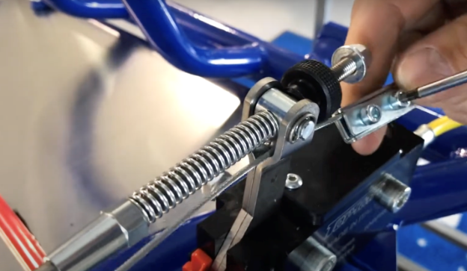
Secure Cable
4.3
Double Screw Clamp
Brake Safety Line
Attach a double screw clamp to the cable’s loose end.
Tighten the screws firmly to hold the cable in place.
23

Slide 24
Appendix and References
Brake Assembly

Slide 25
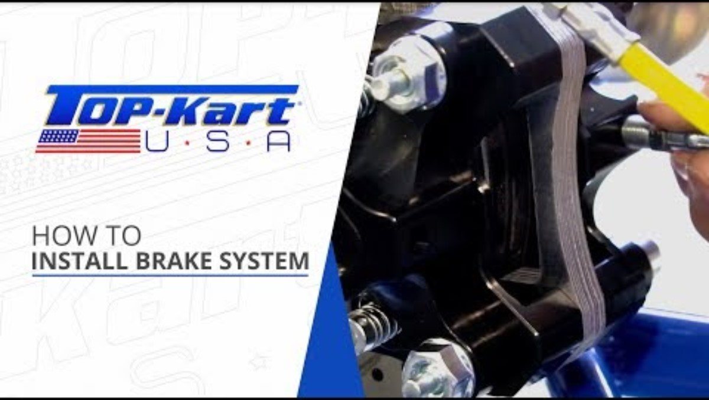
Top Kart Video Demonstration
25

