Slide 1
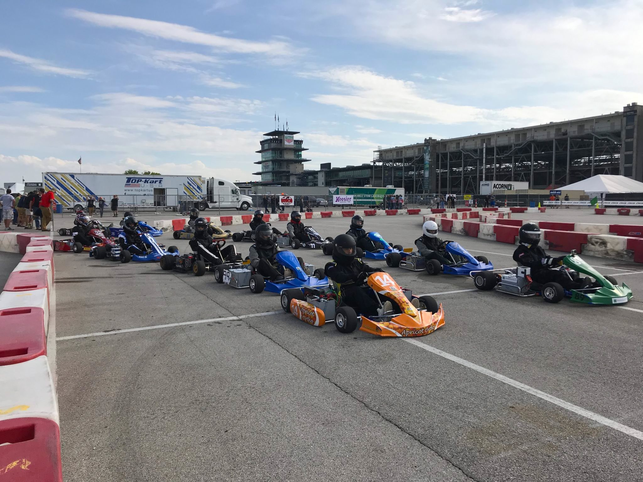

BASIC DRIVER SAFETY INFORMATION
CLASS 101

Slide 2
Introduction
BASIC DRIVER SAFETY INFORMATION / CLASS 101
Racing is defined as: to compete in a race or to go or move at a high speed. Racing is a lot more complex than that definition.
The purpose of this introduction is to make some sense of what you have been doing or are about to undertake. Racing by nature is very dangerous and even potentially deadly If you ever feel like the role of the driver is overwhelming or unsafe you owe it to yourself and everyone around you to ask or demand that you not be put in that position. Again ask or demand that you not be put in that position.
This instructional packet is to make you a better informed driver. It is not going to guarantee that you will never be hurt or injured or worse while competing in a motorized vehicle.

Slide 3
Introduction
BASIC DRIVER SAFETY INFORMATION / CLASS 101
The Basics
A go-kart has four wheels, a seat, a steering mechanism, a throttle pedal, a brake peddle, and in our case, an electric motor, controller, contactor and batteries. It is not a concession kart or a fun or yard kart, it is a competition go-kart. When the kart is energized or under its own power you become it’s master, it will respond to any and all of your input. Press the throttle and it will move forward, press the brake and it will slow to a stop, turn the wheel and you will change direction. YOU AND ONLY YOU have control over it.
Safety Tech
As the operator it is your responsibility to ensure that your go-kart is compliant to all safety requirements of the series. You as a driver must fill out a safety check sheet, then pass that sheet on to your school advisor, teacher or administrator. Once they have given you the ok you are then able to operate the vehicle.

Slide 4


Flag definitions
BASIC DRIVER SAFETY INFORMATION / CLASS 101
RED Flag
Should you see a RED flag being issued you should immediately raise your hand and begin to slow to a stop off of the race line. Stay in your kart until told to exit by an official. Switch your power to OFF. NO WORK can be done to your kart under a red flag unless instructed to by and official.
Yellow flag
Should you see a YELLOW flag you must raise your hand and slow down to a crawl, you may not advance position under a yellow flag, if you were about to pass or made the pass under YELLOW you need to relinquish that position. Under the Purdue rules any YELLOW on track is to be regarded as a full course yellow. All go-karts must bunch back up, single file and wait for instruction from officials on track.

Slide 5


Flag definitions
BASIC DRIVER SAFETY INFORMATION / CLASS 101
GREEN Flag
When you see a GREEN flag your race has begun, proceed at your pace. If you pass the flagman and no flags are waved you should proceed with caution It is a green flag condition, however you must always be aware on the action directly ahead of you.
Black flag
Should you see a BLACK flag you must slowly exit the track at the designated pit exit. There is an issue that needs to be addressed with you or your kart and failure to adhere will result in a disqualification from the event.

Slide 6

Flag definitions
BASIC DRIVER SAFETY INFORMATION / CLASS 101
rolled black Flag
Should you be given a rolled BLACK flag you have done something that has been pointed out to the officials that is deemed dangerous, hazardous or unsportsmanlike driving and you must correct it. If you are noticed again by an official you will be given the BLACK flag.
Blue flag
Should you see a BLUE flag, this will inform you that the lead karts are approaching, it is your responsibility to give them the right away and the racing line if possible. Point to the direction you want them to pass you on. Do not impede the processes of the passing karts. This flag on small tracks is very hard to issue for all faster karts, you the driver of the lapping karts are responsible for navigating slower traffic as well.

Slide 7


Flag definitions
BASIC DRIVER SAFETY INFORMATION / CLASS 101
WHITE Flag
When you see a WHITE flag there is one lap left in your race. The flag will be given to the leader as he/she passes the head flagman.
black and checkered flag
These will signal that your race has come to and end, you must slow down and exit the track. The race is under review for some reason. If you won the race please cycle around to the flagman and await instructions.

Slide 8


Flag definitions
BASIC DRIVER SAFETY INFORMATION / CLASS 101
Checkered Flag
This will signal that your race is over. Slow down and exit the track. If you won the race, cycle around back to the flagman and you will be given the CHECKERED flag to take with you on a victory lap. Return it to the flagman after your lap and exit the track.
Green and Yellow flags
If you see the GREEN and YELLOW flags being shown, this is the same as a RED flag. (SEE RED FLAG Details)

Slide 9
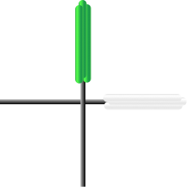

Flag definitions
BASIC DRIVER SAFETY INFORMATION / CLASS 101
ROLLED Crossed Green and White Flags
If you see two rolled flags crossed by the flagman, this will inform you that approximately half of the race is over.
ROLLED Green and White flags
If you see two rolled flags or double sticks held horizonal or vertical this will inform you that there is two laps left in your race

Slide 10
driving scenarios
BASIC DRIVER SAFETY INFORMATION / CLASS 101
Blocking or defensive driving
When racing you are allowed to protect your position, HOWEVER, how you do this could become a driving infraction and a cause of a rolled or waved BLACK flag. The rule is simple, you are allowed to change your position on the track ONE time defensively as you approach the next corner. Changing many times as you approach the next turn will result in a rolled BLACK flag or even a BLACK flag. You do not want to get the reputation of a person who abuses this rule.

Slide 11
driving scenarios
BASIC DRIVER SAFETY INFORMATION / CLASS 101
Stopping on hot track
If you are forced to stop on track due to and accident or mechanical failure, put both hands in the air to get the attention of other drivers an officials, when it is safe to do so, remove your kart from the race line or surface, move to a safe place.

Slide 12
driving scenarios
BASIC DRIVER SAFETY INFORMATION / CLASS 101
Accidents on track
If you are involved in an accident on track and are able to continue safely you will be placed on the tail of the field. If you spin and make no contact with the accident you will be allowed to retake your spot. If however you spin on your own and a yellow is issued you will be placed on the tail of the field.
Unsafe Driving
If you demonstrate one of the following, poor driving skills, poor judgment on track, or the violation of flags or on track procedures you may be disqualified from an event.
Unsportsmanlike Driving
From the moment you enter until you exit the track surface your driving will be observed. Unnecessary blocking, chopping crowding, bumping or pushing other karts will be deemed as unsportsmanlike driving and will result in a penalty.
Practicing out of class
You may not practice outside of your class unless instructed to by an official. Doing so will result in a penalty.

Slide 13
driving scenarios
BASIC DRIVER SAFETY INFORMATION / CLASS 101
90 second rule
If after your class is sent off the grid to begin your race and your kart is unable to leave with your class, you will be awarded 90 seconds to be able to leave the grid under pow-er. If unable to do so, your race is over. The time begins after the final kart rolls off the grid.
Scaling
After your race is finished you are required to scale your kart. This weight must be recorded by a race official. Failure to do so will result in a disqualification. No one may be within and arms reach of you at any point until you have been released from the scale area or tech area. This “no touch” zone happens the moment the checkered flag is dis-played.
Post Tech
If required by an official you and one crew member must present your kart to the technical inspection area. No more than one other person may accompany you to tech. That person should have a tool bag with him that can remove most of the items connected with the electrical system. If more that one additional person is in tech you may be dis-qualified.

Slide 14
driving scenarios
BASIC DRIVER SAFETY INFORMATION / CLASS 101
Race startS
The process of beginning a race is called the START.
We begin all heats or races with a two by two format start. The pole position is always on the inside of the first corner after the start finish line. The second fastest qualifier will be on the outside the pole position, third fastest will line up behind the pole position so on and so forth.
The pole position will set the pace to begin the race. That pace will be slow and Constant until you approach the acceleration cone, at that point you are able to increase speed.
No driver may pass any karts until they have passed the acceleration cone. You must stay in formation until you pass that cone.
A failed start due to issues on the front row may cause the second row to advance to the front row, problems further back may result in a green flag and penalties issued after the race. If there is a failed start, every one must raise there hand to inform drivers behind them that the race did not begin.
Listen for instructions in the drivers meeting about how many warm up laps you will be given. On your last warm up lap is when you will slow down and bunch up two by two.

Slide 15
Operation of a go-kart
BASIC DRIVER SAFETY INFORMATION / CLASS 101
Before you enter a track you should have done a track walk, even if you are familiar with the track. Things change and you need to be aware of those changes. During that track walk pay attention to braking points, apexes, and issues that could effect your race.
You must have your race suit on, neck brace, gloves, shoes and helmet on before you enter a race kart.
The proper way to enter and exit a go-kart is thru the seat. To enter you stand in the seat and lower your body into the seat. To exit you pull yourself up into the seat then step out. Please use caution getting into and out of a go-kart. Always insure that your power switch is off before exiting.
Once in the seat, you should give a “Clear” or other waring word to your crew chief, once you hear an “ALL Clear” or other safety response back you may then energize your race kart and prepare for instruction to enter the track surface.
Entering a track you need to pay attention the grid Stewart if available or insure that no other karts are approaching and enter off the race line.

Slide 16
Operation of a go-kart
BASIC DRIVER SAFETY INFORMATION / CLASS 101
Get up to speed safely, keep in mind that a track surface may be dirty or damp and your tires will be cold, all factors that could be hazardous to you and your fellow competitors.
Use your out lap to get a feel for the track conditions while trying to put as much heat in your tires as possible.
Once you feel you are able to increase speed do so.
Should you spin or make contact with a barrier or other kart, raise your had to inform other drivers. If you are able to continue do so safely. If you need assistance keep your hand up and wait for an official.
When exiting the track raise your hand and move off the race line then exit safely and come to a complete stop far off the pit lane.
Before you exit your kart, flip the switch to off. Exit your kart and push the emergency switch off as well.

Slide 17
Operation of a go-kart
BASIC DRIVER SAFETY INFORMATION / CLASS 101
Should the throttle stick open, the controller cause the engine to takeoff with no throttle input or some other issues cause the motor to run without your assistance, shut the power or keyed switch off. Apply the brakes and come to a safe stop. If you can reach the emergency kill switch depress it as well.
Keep your hands and feet inside of the go-kart at all times. Never attempt to stop a moving go-kart by dragging your hands and feet or by trying to stop a moving wheel with your hands or feet.
Keep your hands and the hands of others away from the sprocket, gear and chain. When adjusting , checking or lubing these items insure that the power is off, both keyed/ switched and emergency stop.
Never operate the go-kart when there are people in the general area of where you intend to operate it. Never operate the go-kart near objects such as vehicles, light poles, curbs, walls or other objects that you could strike.
Never operate your go-kart in damp or wet conditions.

Slide 18
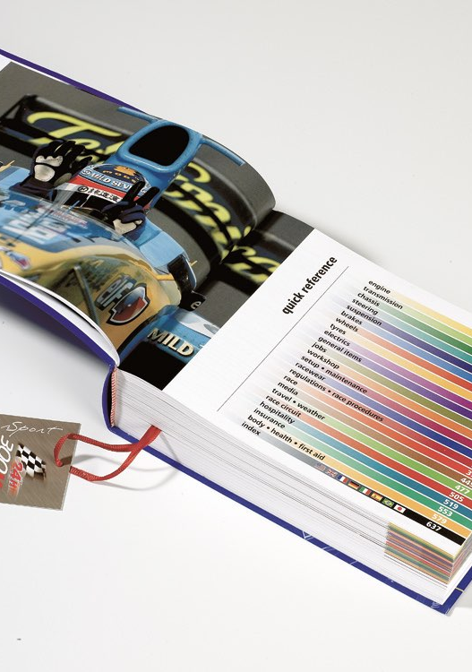
Racing terminology
BASIC DRIVER SAFETY INFORMATION / CLASS 101
Apex — A point in a turn that you aim for and exit from. Usually a point that will allow you to use the most track surface.
Straight Line Braking — As it implies, you are braking in a straight line.
Trail Braking — As you enter a turn you ride the brake through turn to modulate speed.
Oversteer — Having to put more input into the turning of the wheel to make the kart change direction. Sometimes referred to as “Push”.
Understeer — Having to counter-steer the wheel to keep the back end from sliding out. Sometimes referred to as “Loose”.

Slide 19
Racing terminology
BASIC DRIVER SAFETY INFORMATION / CLASS 101
Tight — When a kart will not release from the track surface.
Hopping — When you feel the kart hoping or skipping while turning due to overall chassis grip.
Camber — The angle of tilt in or out from vertical on the spindle.
Caster — The angle of tilt forward or back on the spindle.

Slide 20
unwritten rules and regulations
BASIC DRIVER SAFETY INFORMATION / CLASS 101
No communication with the driver at any time during an event weekend when he/she is behind the wheel on track.
No gearbox or torque convertors.
No alterations to the supplied frame.
Involvement in an accident or causing a yellow or red flag—you will be placed on the tail of the field.
JUST BECAUSE THE RULE BOOK DOES NO SPECIFY THAT YOU CANNOT, DO NOT ASSUME THAT YOU CAN. We have the final say if we believe a part, change, modification, design or system constitutes an attempt to “beat the rules”.

Slide 21
https://www.flexiquiz.com/SC/N/101-Basic-Driver-Safety-Information

