Slide 1
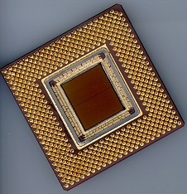
ECE 477 Digital Systems Senior Design Project
© 2014 by D. G. Meyer
Module 4
Power Supply Design

Slide 2
Outline
Switch mode power supply theory
forward converter
flyback converter
Switching regulators
step-down switching converter
step-up switching capacitor charge pump
DC-DC converters
Battery management
Taking the heat

Slide 3
Switch Mode Power Supply (SMPS)
input rectifier
chopper
isolation
output rectifier
output filter
control
isolation
Switching approach based on high-frequency voltage ⇒ A.C. input (line voltage) immediately rectified to produce high-voltage D.C.
Chopper FET creates a high-frequency signal fed to transformer
High frequency ⇒ smaller transformer (less metal, less weight, lower cost)…but, more components
Adjusting chopper’s duty cycle provides regulation

Slide 4
Basic Forward (Buck) Converter
+
Forward (“buck”) converter transfers energy while the chopper is conducting
Transformer provides secondary charging circuit during conduction phase (chopper on)
When chopper turns off, choke releases its magnetic energy and current continues to flow into output capacitor

Slide 5
Basic Flyback Converter
+
Note phase of isolation transformer – while the chopper is conducting current in the primary, current is not allowed to flow in the secondary
Primary becomes storage device opposing current flow by creating a magnetic field
When chopper turns off, stored magnetic field collapses and energy is transferred to the secondary

Slide 6
Switching Regulator – Basic Idea
feedback
+
Vout
Regulation achieved by changing pulse width and/or pulse frequency
Done “automatically” by switching regulator IC
Typically over 90% efficient
TRADEOFF: lower current output than typical linear regulator circuit, and more external components; also, higher noise

Slide 7
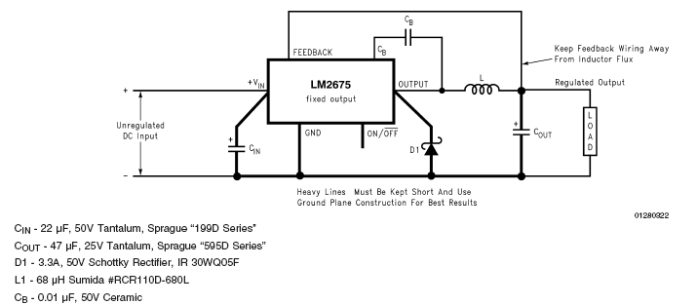
Step-Down Switching Converter: LM 2675
(fixed) 3.3, 5, 12 VDC and (adjustable) 1.21 – 37 V versions
Up to 1 amp
Up to 96% efficient
Five external components

Slide 8
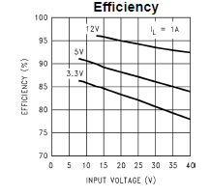
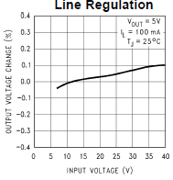
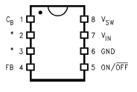
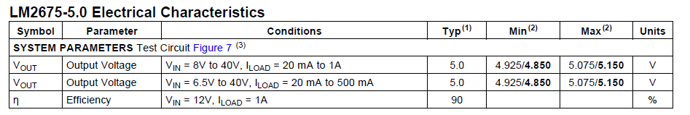
Step-Down Switching Converter: LM 2675

Slide 9
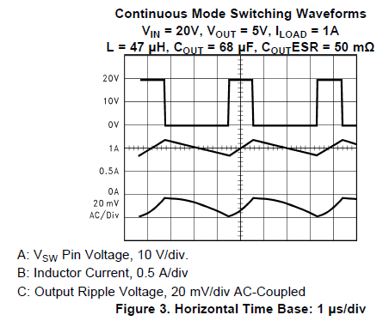
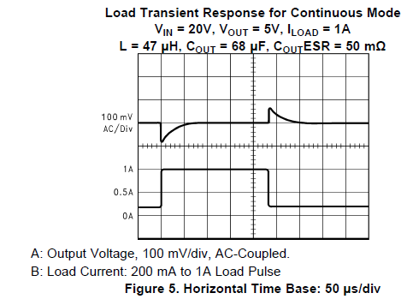
Step-Down Switching Converter: LM 2675

Slide 10
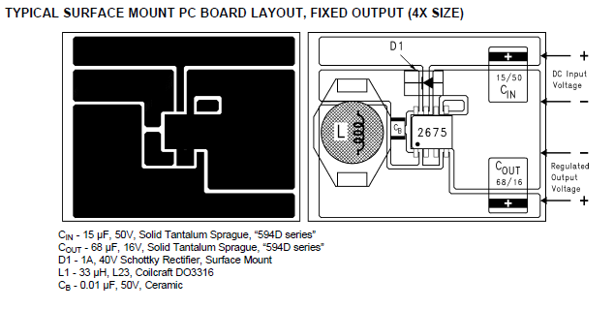
Step-Down Switching Converter: LM 2675

Slide 11
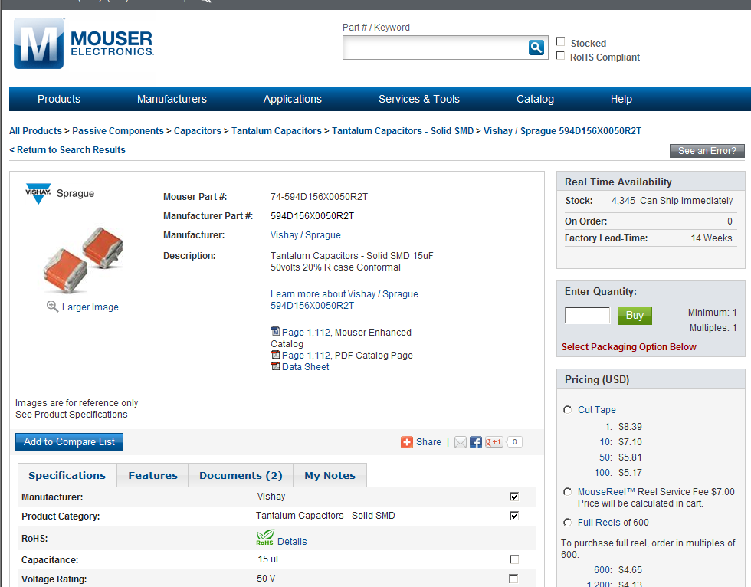
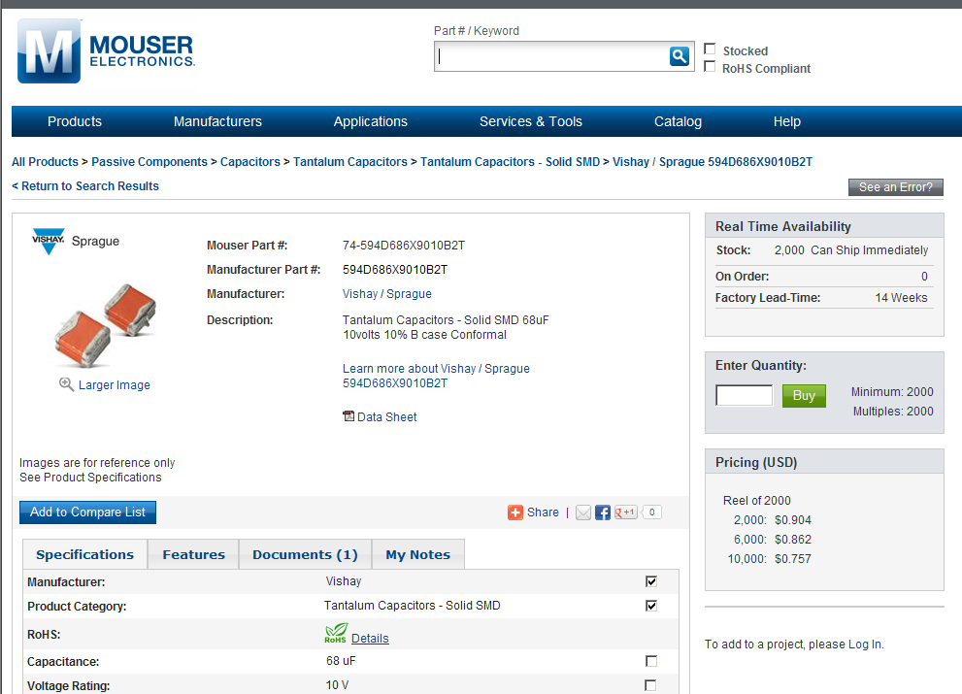
PCB Tutorial Exercise

Slide 12
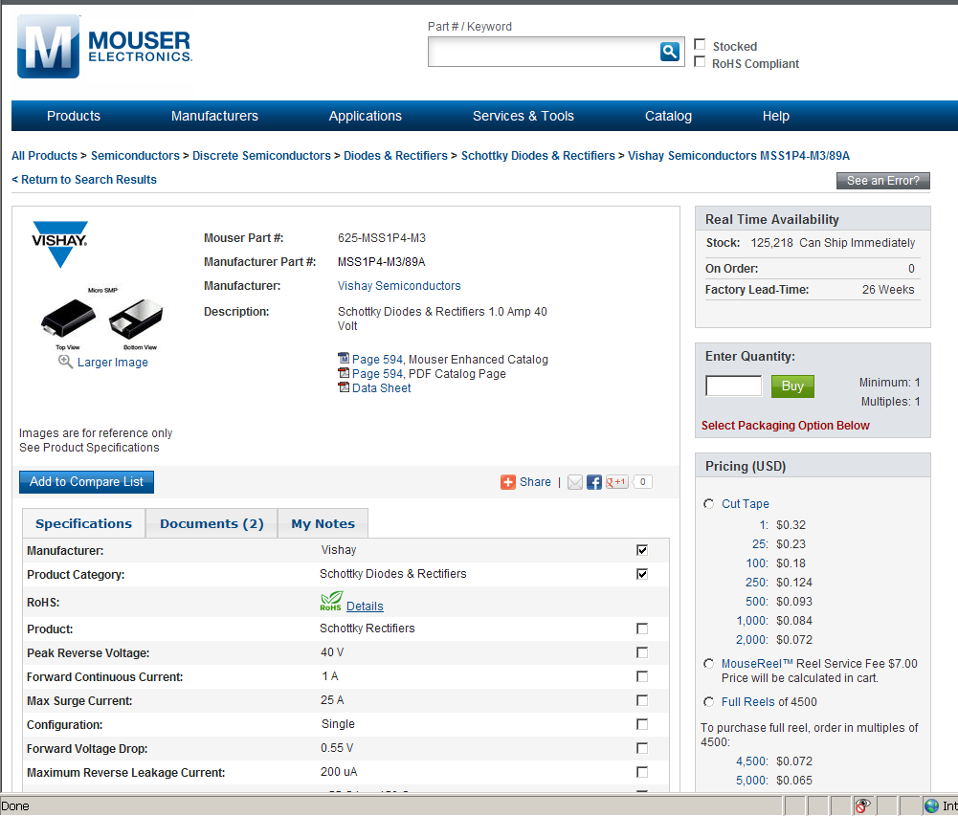
PCB Tutorial Exercise

Slide 13
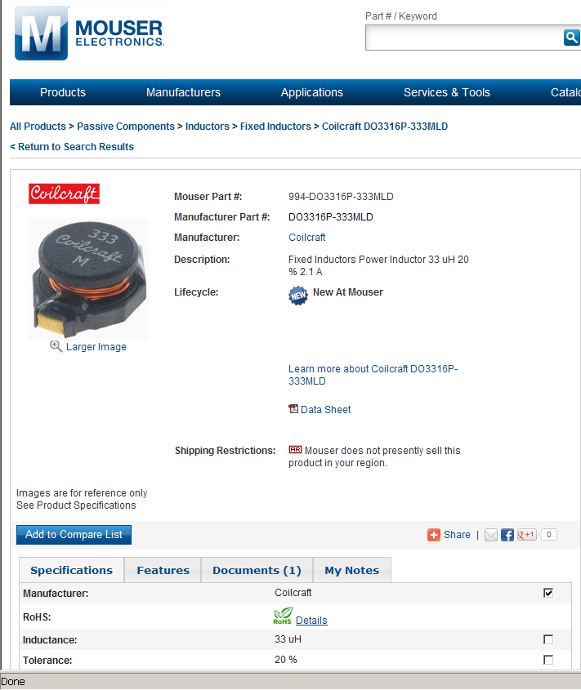
PCB Tutorial Exercise

Slide 14
PCB Tutorial Exercise
Standard 1206 type surface mount ceramic capacitor

Slide 15
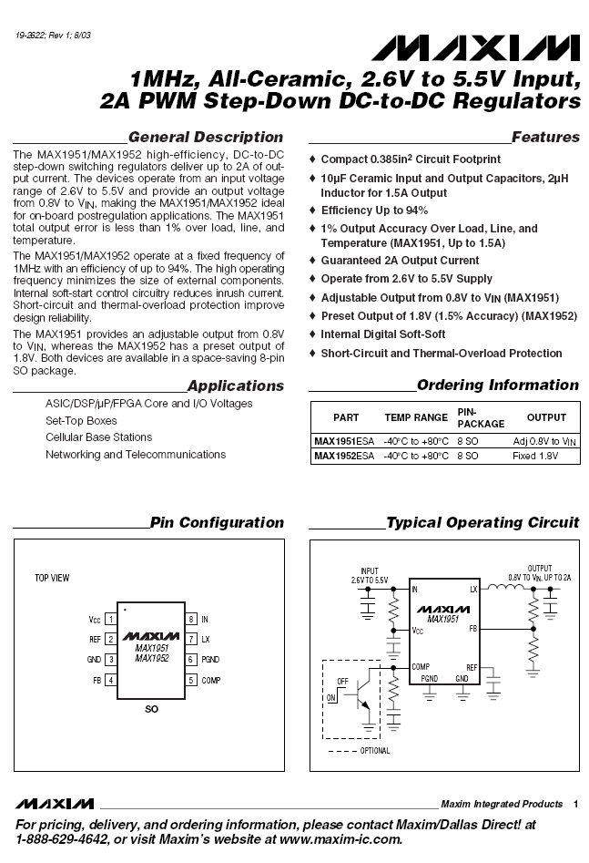
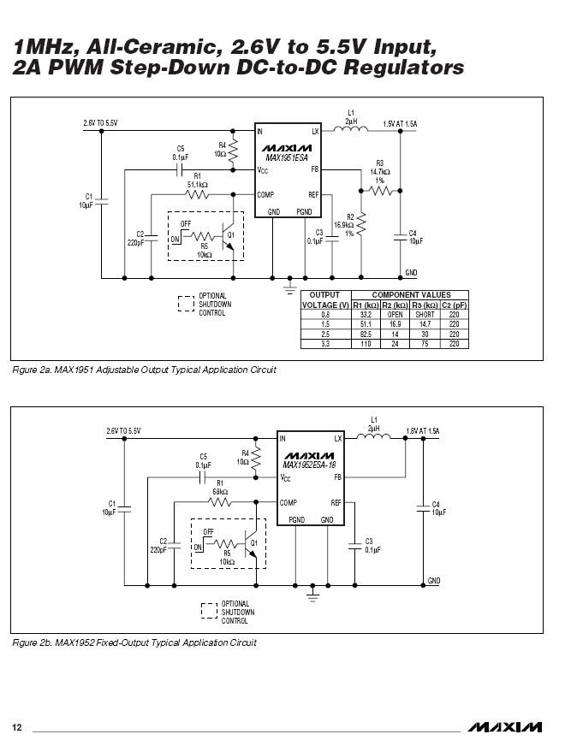

Slide 16
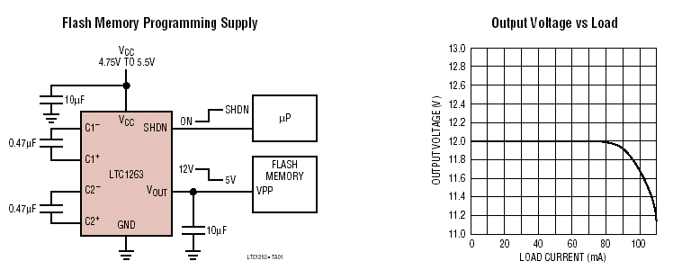
Switched Capacitor Charge Pump Step-Up Converter
Based on LTC1263 www.linear-tech.com
Produces 12 VDC @ 60 mA from V_{CC} as low as 4.75 V
Four external components

Slide 17
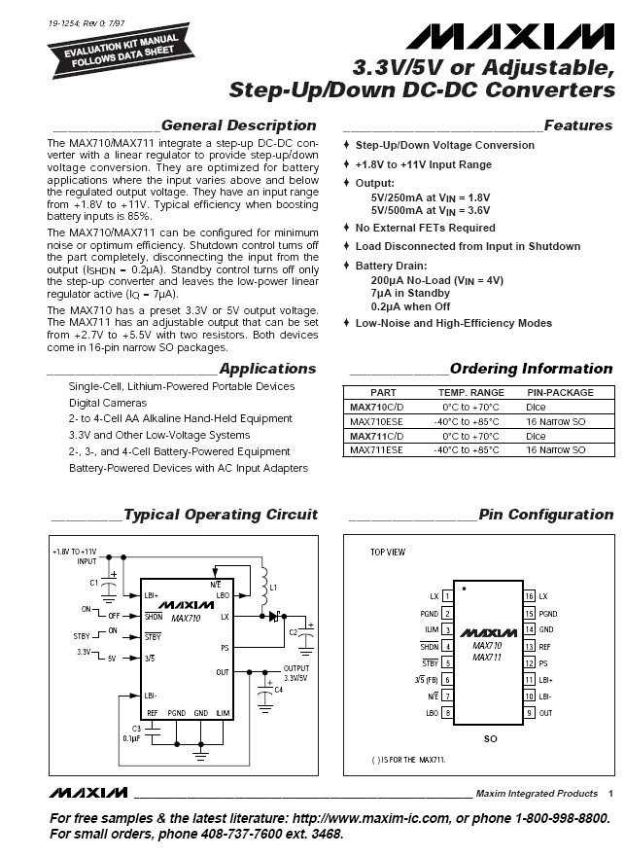
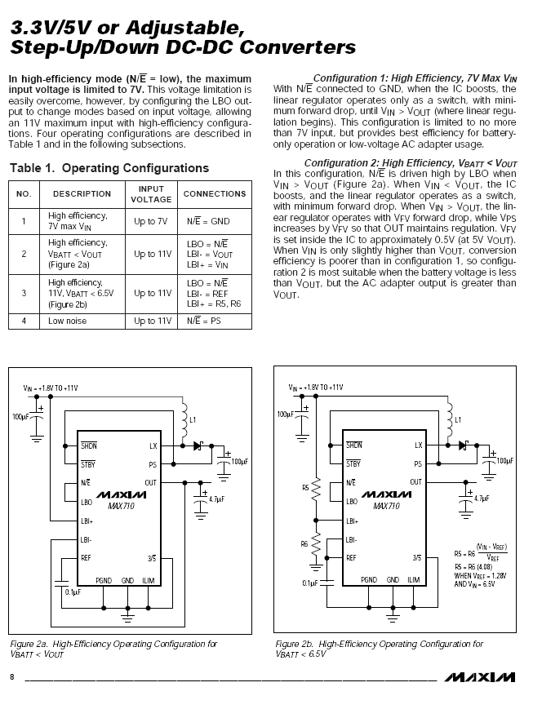

Slide 18
Important Notes About DC-DC Converters
While chip size and heat dissipation are reduced, component properties and physical layout become more critical…
Inductors and output capacitors typically need to be “low ESR” type – pay close attention to component data sheets
“Analog” ground for DC-DC must be separate from all other grounds on PCB
Certain nodes in layout are critical to keep traces short and wide to reduce parasitic inductance and capacitance
Failure to follow manufacturer’s recommended layout and component selection criteria will (most likely) result in non-operation of the circuit and many hours spent in debugging and fly-wiring

Slide 19
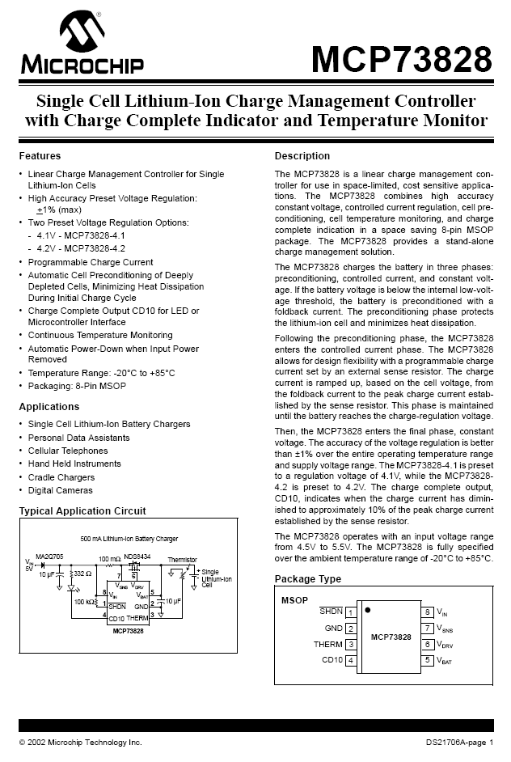
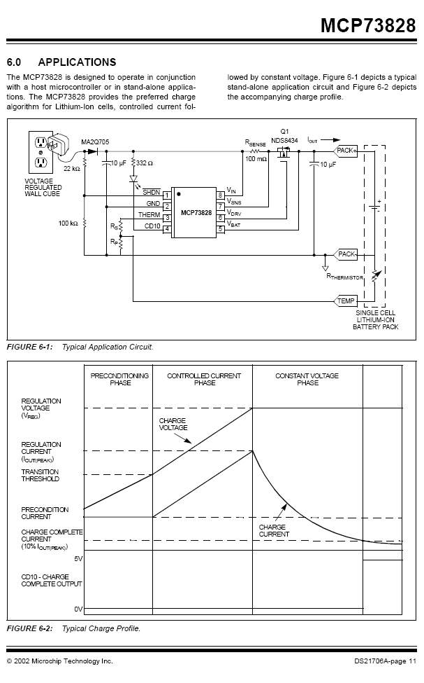

Slide 20
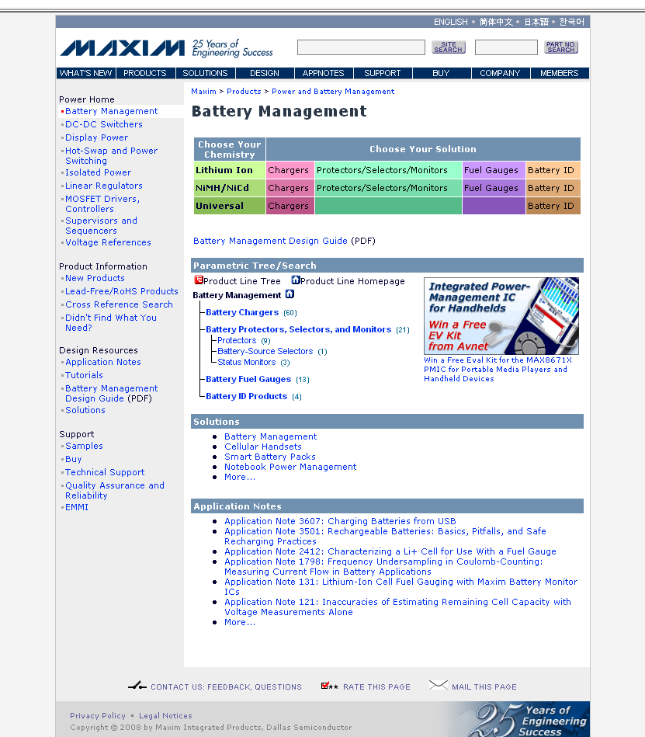

Slide 21
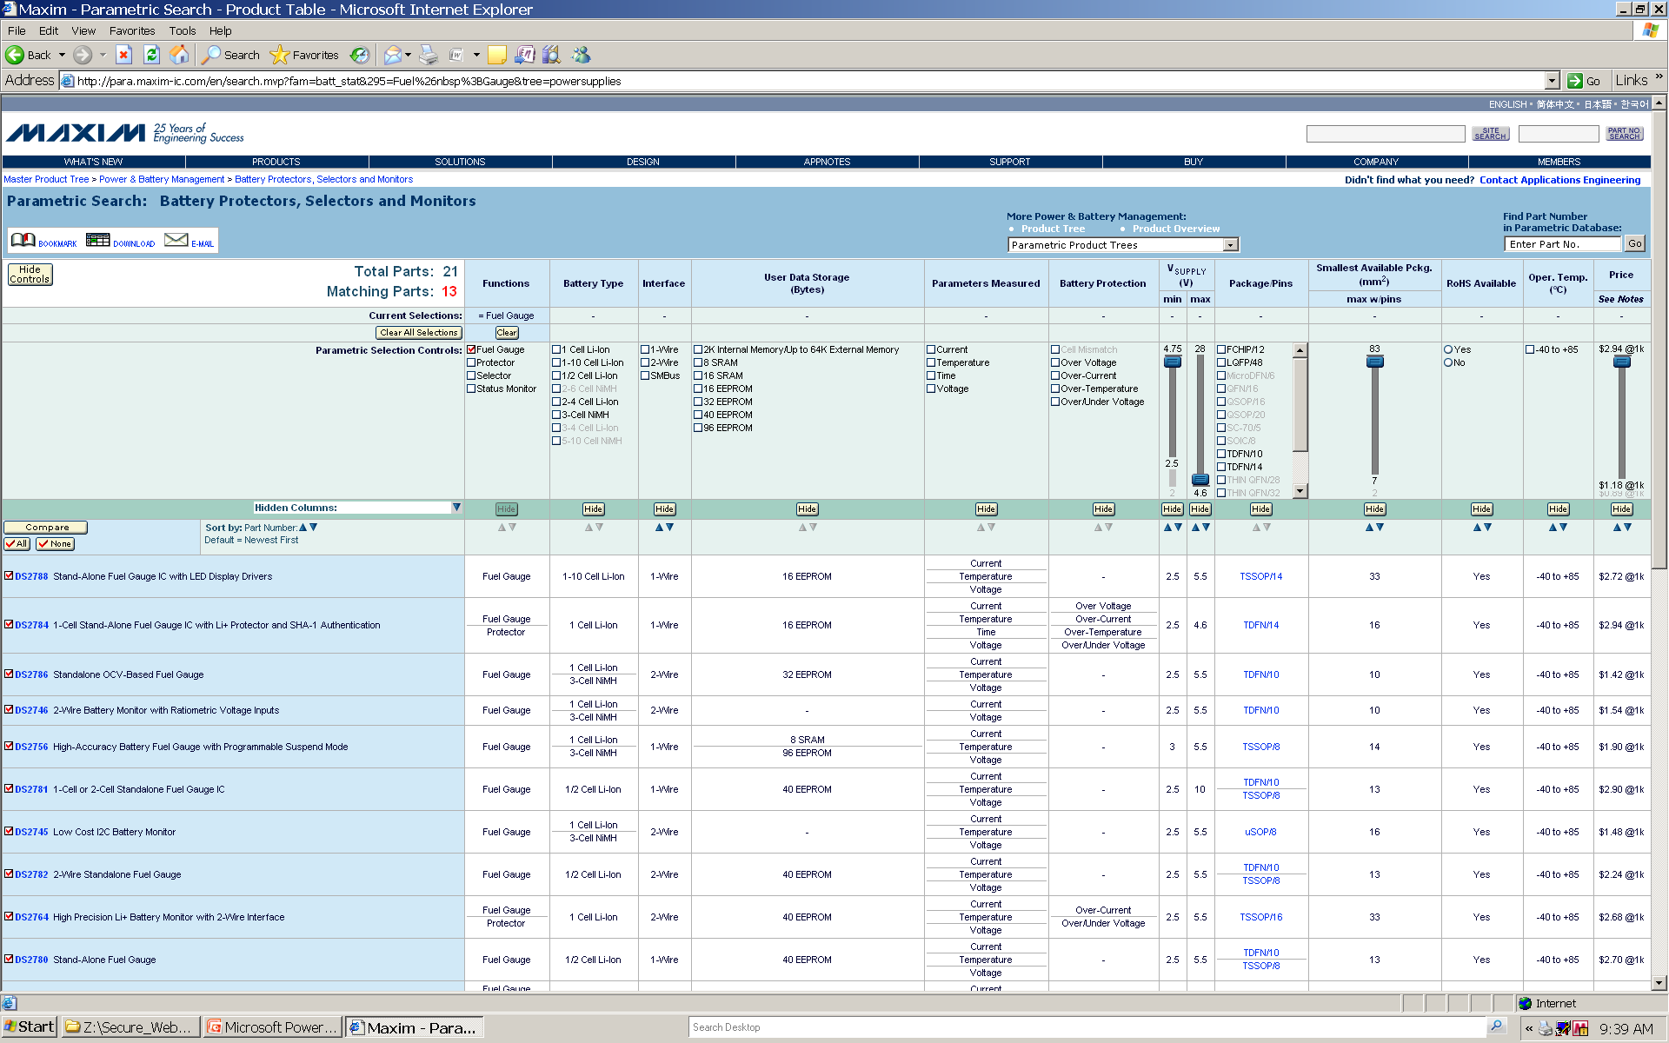

Slide 22
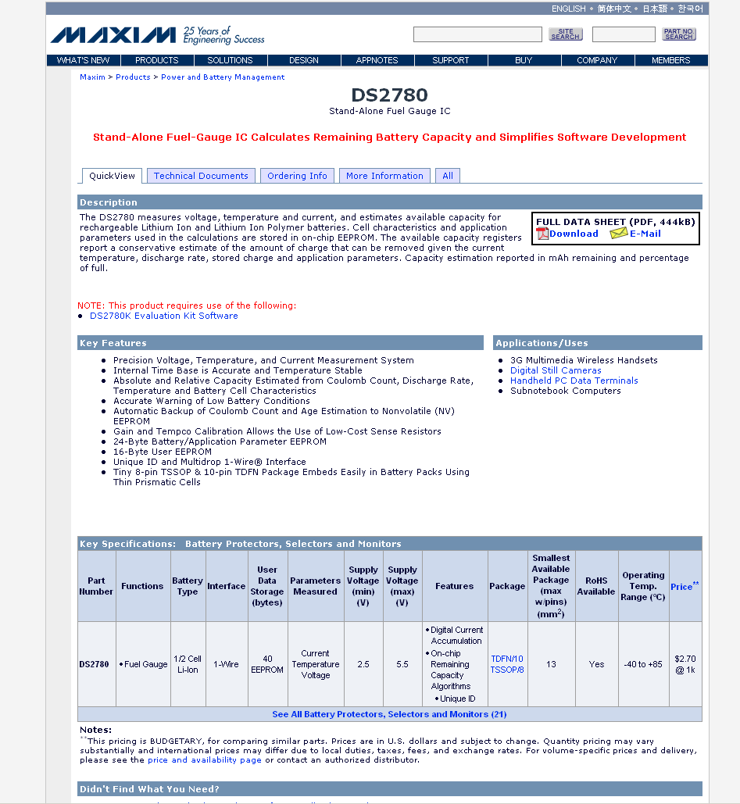

Slide 23
Taking the Heat
Sometimes a properly sized HEAT SINK is required to help a discrete device dissipate heat
Idea of THERMAL RESISTANCE ⇒ measured in ºC/W (temperature rise per watt dissipated) ⇒ “lower thermal resistance is better”
Thermal resistance is ~ inversely proportional to price.

Slide 24
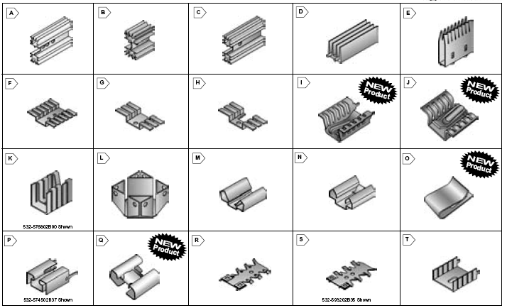
Source: http://www.mouser.com

Slide 25
More Thought Question Analysis
Need to pick properly sized HEAT SINK to help device dissipate heat
Idea of THERMAL RESISTANCE ⇒ measured in ºC/W (temperature rise per watt dissipated) ⇒ “lower thermal resistance is better”
Example: For first case analyzed (6 VAC secondary), let’s say we don’t want heat sink/junction temperature to rise more than 10º C above ambient temperature ⇒ need a thermal resistance of approx 10º C/ 3.5 W ≅ 3
Thermalloy choice “B” comes close (3.4) – see chart

Slide 26
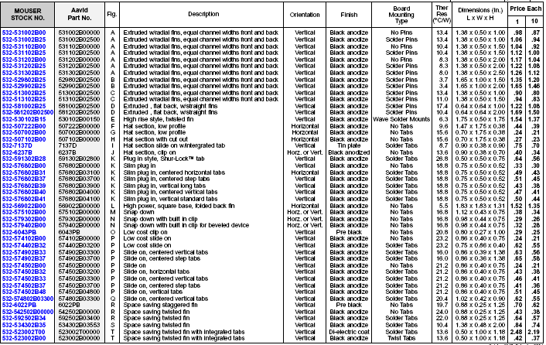

Slide 27
3.4

Slide 28
More Thought Question Analysis
Need to pick properly sized HEAT SINK to help device dissipate heat
Idea of THERMAL RESISTANCE ⇒ measured in ºC/W (temperature rise per watt dissipated) ⇒ “lower thermal resistance is better”
Example: For first case analyzed (6 VAC secondary), let’s say we don’t want heat sink/junction temperature to rise more than 10º C above ambient temperature ⇒ need a thermal resistance of approx 10º C/ 3.5 W ≅ 3
Thermalloy choice “B” comes close (3.4) – see chart
What if we’re “cheap” (only want to spend $0.43 for the heat sink instead of $1.66)? – choice “R” has a thermal resistance of 24 ⇒ will experience 24 x 3.5 = 84º C temperature rise – ouch!!
P.S. Don’t forget to use HEAT SINK COMPOUND

Slide 30
24

