Slide 1
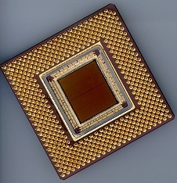
ECE 477 Digital Systems Senior Design Project
© 2013 by D. G. Meyer
Module 6
Power Supply Design

Slide 2
Outline - 1
Basic half-wave power supply
Half-wave ripple analysis
Basic full-wave supply
Full-wave ripple analysis
Thought questions
Thought question analysis

Slide 3
Basic Half-Wave Supply
+
A.C. “wall wart”
Question: Why is this called a “half-wave” circuit?
Answer: Only half of the cycles are delivered to the load

Slide 4
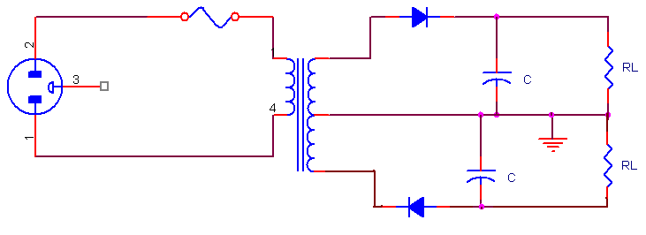
Basic Half-Wave Dual Polarity Supply
+
CT
-

Slide 5
Analysis
ripple
no-load = V_{N}
loaded = V_{L}
3/240 sec = 12.5 ms
Question: What transformer secondary voltage is required to obtain V_{N} = 5.0 VDC?
5.0/√2 ≅ 3.5 VAC
Note: Amount of ripple is proportional to load and inversely proportional to size of filter capacitor
Analysis: Can calculate value of C based on amount of ripple willing to tolerate at a particular load

Slide 6
Analysis
ripple ≤ 0.01 V @ 0.5A load
no-load = V_{N}
loaded = V_{L}
3/240 sec = 12.5 ms
Example: Have 500 mA load ⇒ RL = V_{L}/I_{L} = 5/0.5 = 10Ω
Assume we want no more than 10 mV of ripple ⇒ solve for C given that V_{L} @ t=12.5 ms is ≥ 4.99 V with R_{L} = 10Ω
V_{L} = V_{N} x e^{-t/RC} ⇒ t = -R_{L} x C x ln(V_{L}/V_{N})
0.0125 = -10 x C x ln(4.99/5.00) = -10 x C x (-2 x 10⁻³)
= C x (2 x 10⁻²) ⇒ C = 0.0125/(2 x 10⁻²) = 0.625 F = 625,000 μF

Slide 7
Basic Full-Wave Supply
+
A.C. “wall wart”
Question: Why is this called a “full-wave” circuit?
Answer: All cycles (+/-) are delivered to the load

Slide 8
Analysis
ripple
no-load = V_{N}
loaded = V_{L}
1/240 sec = 4.2 ms
Question: What transformer secondary voltage is required to obtain V_{N} = 5.0 VDC?
5.0/√2 ≅ 3.5 VAC
Note: Amount of ripple is proportional to load and inversely proportional to size of filter capacitor
Analysis: Can calculate value of C based on amount of ripple willing to tolerate at a particular load

Slide 9
Analysis
ripple ≤ 0.01 V @ 0.5A load
no-load = V_{N}
loaded = V_{L}
1/240 sec = 4.2 ms
Example: Have 500 mA load ⇒ RL = V_{L}/I_{L} = 5/0.5 = 10Ω
Assume we want no more than 10 mV of ripple ⇒ solve for C given that V_{L} @ t=4.2 ms is ≥ 4.99 V with R_{L} = 10Ω
V_{L} = V_{N} x e^{-t/RC} ⇒ t = -R_{L} x C x ln(V_{L}/V_{N})
0.0042 = -10 x C x ln(4.99/5.00) = -10 x C x (-2 x 10⁻³)
= C x (2 x 10⁻²) ⇒ C = 0.0042/(2 x 10⁻²) = 0.21 F = 210,000 μF

Slide 10
Analysis
ripple ≤ 0.1 V @ 0.5A load
no-load = V_{N}
loaded = V_{L}
1/240 sec = 4.2 ms
Example: Still have 500 mA load ⇒ RL = V_{L}/I_{L} = 5/0.5 = 10Ω
Now assume we are willing to tolerate 100 mV of ripple ⇒ solve for C given that V_{L} @ t=4.2 ms is ≥ 4.9 V with R_{L} = 10Ω
V_{L} = V_{N} x e^{-t/RC} ⇒ t = -R_{L} x C x ln(V_{L}/V_{N})
0.0042 = -10 x C x ln(4.90/5.00) = -10 x C x (-2 x 10⁻²)
= C x (2 x 10⁻¹) ⇒ C = 0.0042/(2 x 10⁻¹) = 0.021 F = 21,000 μF

Slide 11
Thought Questions
Question: What’s inside a basic (unregulated) D.C. “wall-wart”?
Answer: Not much…
+
Unregulated D.C. “wall-wart”

Slide 12
Thought Questions
Question: What value of C is typically used in a garden-variety D.C. wall-wart?
Answer: 2000μF (or less)
Question: If you purchase an “N-volt” unregulated D.C. wall-wart, what is V_{N} (the “no-load output”) likely to be?
Answer: N·√2 (“not good for anything sensitive”)

Slide 13
Thought Question Analysis
Assume still have 500 mA load ⇒ RL = V_{L}/I_{L} = 5/0.5 = 10Ω and that the D.C. wall-wart has C = 2000 μF
Also assume V_{N} = 5.0 VDC
Solve for V_{L} @ t=4.2 ms given R_{L} = 10Ω and C = 2000 μF
V_{L} = V_{N} x e^{- t/RC} ⇒ V_{L} = 5 x e^{- 0.0042/0.02} = 5 x e^{­ 0.21}
= 5 x 0.81 = 4.05 ⇒ 0.95 V of ripple
Question: Is such a supply (unregulated D.C. wall-wart) suitable for operating a microcontroller?
Answer: NO – way too much ripple

Slide 14
Outline - 2
Basic linear regulator circuits
Linear regulator analysis
More thought questions and analysis
Heat sinks / thermal resistance
Low-dropout (LDO) linear regulators
Battery backup, management, and recharging

Slide 15
Basic Positive Voltage Linear Regulator
filter cap
+
A.C. “wall wart”
HF noise suppression cap
78XX-series linear regulator IC (XX= 05,12,15 typ)
⇒ can withstand a lot of ripple on input and still produce a low noise, well-regulated output
⇒ needs input voltage VN ≅ 2.5 V higher than regulated output (VL) to work properly
⇒ VL + 2.5 VDC = Regulator DROPOUT VOLTAGE

Slide 16
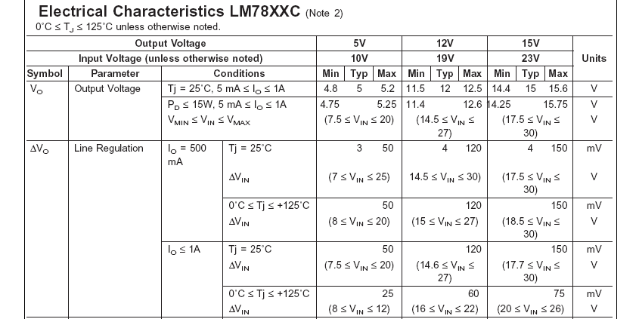
Source: http://www.nationalsemiconductor.com

Slide 17
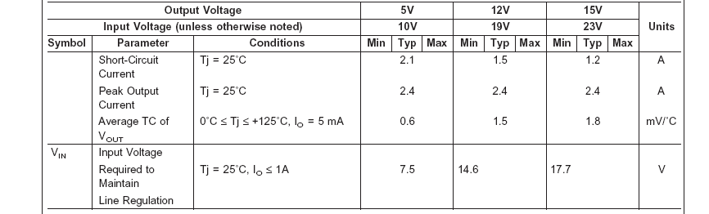
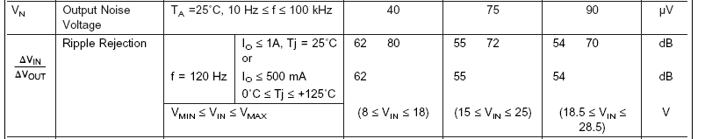

Slide 18
Basic Negative Voltage Linear Regulator
filter cap
+
A.C. “wall wart”
HF noise suppression cap
79XX-series linear regulator IC (XX= 05,12,15 typ)
⇒ used when negative supply voltage needed
⇒ both positive and negative supply regulators can “co-exist” (need CENTER-TAP A.C. transformer)
⇒ same dropout voltage as positive regulators

Slide 19
Analysis
ripple that can be tolerated
dropout = 2.5 V min
no-load = V_{N}
regulated = V_{L}
1/240 sec = 4.2 ms
Design constraints: Need to pick transformer secondary voltage and filter capacitor C1 such that V_{N} – ripple voltage ≥ DROPOUT VOLTAGE = V_{L} + 2.5
Note: The larger V_{N} is, the greater the voltage drop will be across the regulator ⇒ larger power (and heat!) dissipation…but the smaller V_{N} is, the bigger C1 will need to be to minimize the ripple voltage

Slide 20
Analysis
ripple = 1V
dropout = 2.5 V min
no-load = V_{N}
regulated = V_{L}
Example: For a regulated 5 VDC supply, pick V_{N} ≅ 8.5 V, so amount of ripple that can be tolerated is 1 V ⇒ transformer secondary required is 6 VAC
No load: quiescent current is approximately 6 mA ⇒ power dissipation is 8.5 x 0.006 = 51 mW
Full load (1A): 3.5 V @ 1A drops across regulator (assuming no ripple) ⇒ power dissipation = 3.5 X 1 = 3.5 W
Efficiency: 5V @ 1A (5W) delivered to load, but 3.5W dissipated by regulator ⇒ 5.0/8.5 ≅ 59% efficient

Slide 21
Analysis
ripple = 1V
dropout = 2.5 V min
V_{N} = 8.5
V_{L} = 5.0
1/240 sec = 4.2 ms
Calculate C1: Have 8.5V @ 1A load (voltage dropped across regulator is part of load) ⇒ R_{L} = V_{L}/I_{L} = 8.5Ω
Assume we want no more than 1 V of ripple ⇒ solve for C1 given that V_{Nmin} @ t=4.2 ms is ≥ 7.5 V with R_{L} = 8.5Ω
V_{L} = V_{N} x e^{-t/RC} ⇒ t = -R_{L} x C1 x ln(V_{Nmin}/V_{Nmax})
0.0042 = -8.5 x C1 x ln(7.5/8.5) = -8.5 x C x (-0.125) ⇒ C1 ≅ 3960 μF

Slide 22
Thought Question
Question: What will happen if we increase the transformer secondary voltage significantly (e.g., to 12 VAC)? ⇒ V_{N} ≅ 17 VDC
⇒ should be able to tolerate more ripple and “get by” with a much smaller C1, but power dissipation will increase and efficiency will decrease
ripple = 9.5V
dropout = 2.5 V min
V_{N} = 17 VDC
V_{L} = 5 VDC

Slide 23
Thought Question Analysis
No load: quiescent current is (still) approximately 6 mA ⇒ power dissipation is 17 x 0.006 = 102 mW
Full load (1A): 12 V @ 1A drops across regulator (assuming no ripple) ⇒ power dissipation = 12 X 1 = 12 W
Efficiency: 5V @ 1A (5W) delivered to load, but 12W dissipated by regulator ⇒ 5.0/17.0 ≅ 29% efficient
Calculate C1: Have 17V @ 1A load (voltage dropped across regulator is part of load) ⇒ R_{L} = V_{L}/I_{L} = 17Ω
Assume we want no more than 9.5 V of ripple ⇒ solve for C1 given that V_{Nmin} @ t=4.2 ms is ≥ 7.5 V with R_{L} = 17Ω
V_{L} = V_{N} x e-t/RC ⇒ t = -R_{L} x C1 x ln(V_{Nmin}/V_{Nmax})
0.0042 = -17 x C1 x ln(7.5/17) = -17 x C1 x (-0.82) = 13.9 x C1 ⇒ C1 ≅ 300 μF much smaller than previous case

Slide 24
Another Thought Question (or Two)
Question: Can you think of any applications where we might be willing to tolerate this kind of inefficiency?
Answer: Application with 12 VDC motor and 5 VDC microcontroller
Question: How much heat is 5-10 W? What do we need to do with it? What will it cause if we don’t do with it what we need to do with it??
- relatively speaking, a LOT
- dissipate it
- premature device failure

Slide 25
More Thought Question Analysis
Need to pick properly sized HEAT SINK to help device dissipate heat
Idea of THERMAL RESISTANCE ⇒ measured in ºC/W (temperature rise per watt dissipated) ⇒ “lower thermal resistance is better”
Thermal resistance is ~ inversely proportional to price.

Slide 26
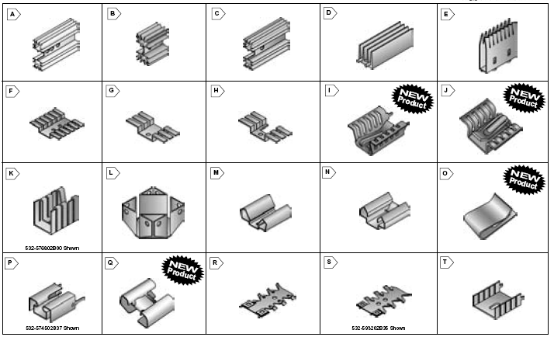
Source: http://www.mouser.com

Slide 27
More Thought Question Analysis
Need to pick properly sized HEAT SINK to help device dissipate heat
Idea of THERMAL RESISTANCE ⇒ measured in ºC/W (temperature rise per watt dissipated) ⇒ “lower thermal resistance is better”
Example: For first case analyzed (6 VAC secondary), let’s say we don’t want heat sink/junction temperature to rise more than 10º C above ambient temperature ⇒ need a thermal resistance of approx 10º C/ 3.5 W ≅ 3
Thermalloy choice “B” comes close (3.4) – see chart

Slide 28
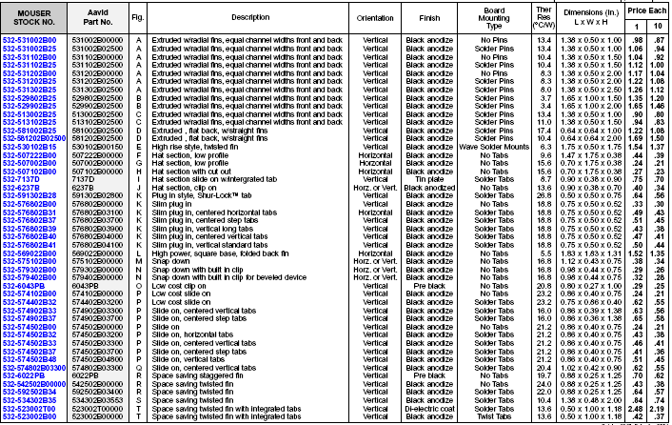

Slide 29
3.4

Slide 30
More Thought Question Analysis
Need to pick properly sized HEAT SINK to help device dissipate heat
Idea of THERMAL RESISTANCE ⇒ measured in ºC/W (temperature rise per watt dissipated) ⇒ “lower thermal resistance is better”
Example: For first case analyzed (6 VAC secondary), let’s say we don’t want heat sink/junction temperature to rise more than 10º C above ambient temperature ⇒ need a thermal resistance of approx 10º C/ 3.5 W ≅ 3
Thermalloy choice “B” comes close (3.4) – see chart
What if we’re “cheap” (only want to spend $0.43 for the heat sink instead of $1.66)? – choice “R” has a thermal resistance of 24 ⇒ will experience 24 x 3.5 = 84º C temperature rise – ouch!!
P.S. Don’t forget to use HEAT SINK COMPOUND

Slide 32
24

Slide 33
Low Dropout (LDO) Linear Regulator
filter cap
+
A.C. “wall wart”
HF noise suppression cap
Example: Micrel MIC2915X-series
⇒ dropout voltage is only 0.3-0.4 V (compared with 2.5 V for the standard 78XX-series regulators)
⇒ tradeoff with LDO regulators is that since the dropout voltage is lower, the amount of input ripple that can be tolerated is lower than a “standard” regulator

Slide 34
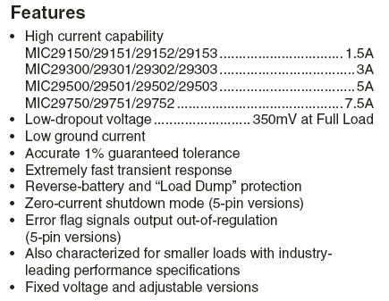
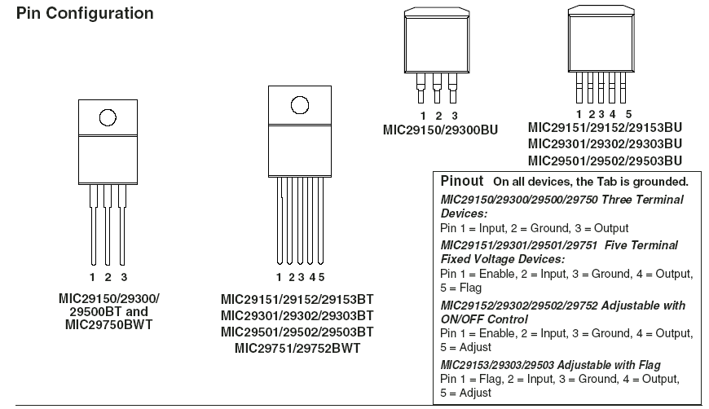

Slide 35
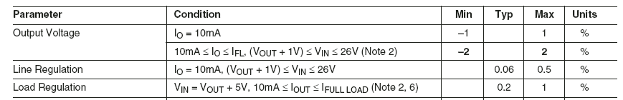
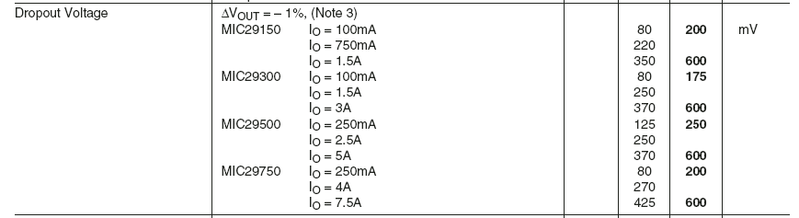

Slide 36
78xx “Flashback” for comparison…

Slide 37
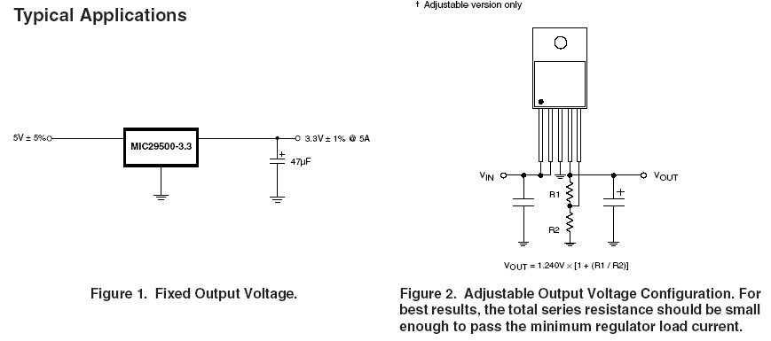

Slide 38
Analysis
ripple = 0.6V
dropout = 0.4 V
V_{N} = 6 V
V_{L} = 5 V
transformer secondary is 4.25 VAC
1/240 sec = 4.2 ms
Calculate C1: Have 6V @ 1A load (voltage dropped across regulator is part of load) ⇒ R_{L} = V_{L}/I_{L} = 6Ω
Assume we want no more than 0.6 V of ripple ⇒ solve for C1 given that V_{Nmin} @ t=4.2 ms is ≥ 5.4 V with R_{L} = 6Ω
V_{L} = V_{N} x e^{-t/RC} ⇒ t = -R_{L} x C1 x ln(V_{Nmin}/V_{Nmax})
0.0042 = -6 x C1 x ln(5.4/6.0) = -6 x C x (-0.105) = C x 0.632 ⇒ C1 ≅ 6650 μF bigger than “standard” case!

Slide 39
Analysis
No load: quiescent current is approximately 8 mA ⇒ power dissipation is 6 x 0.008 = 48 mW
Full load (1A): 6 V @ 1A drops across regulator (assuming no ripple) ⇒ power dissipation = 6 X 1 = 6 W
Efficiency: 5V @ 1A (5W) delivered to load, but 1 W dissipated by regulator ⇒ 5.0/6.0 ≅ 83% efficient
Heat sink: Let’s say we don’t want heat sink/junction temperature to rise more than 10º C above ambient temperature ⇒ need a thermal resistance of approx 10º C/ 1 W ≅ 10 ⇒ use Thermalloy choice “A” ($1.04)

Slide 41
10

Slide 42
Battery Backup
Now that we have a reasonably efficient way to build a regulated power supply, how can we add battery backup capability?
V_{N} must take into account diode drop
+
+
A.C. “wall wart”
“steering diodes”
Theory of operation: D2 is reversed biased (and D1 is forward biased) as long as A.C. supply operational; when V_{N} falls below V_{B}, D2 becomes forward biased (and D1 becomes reverse biased) and battery supply takes over
Note: V_{B} must be greater than or equal to (V_{L} + dropout voltage + diode drop) but less than V_{N}

Slide 43
Analysis
V_{N} must take into account diode drop
+
+
A.C. “wall wart”
“steering diodes”
Example: Let’s say want 5 VDC regulated supply, then the minimum V_{B} = V_{L} + dropout voltage + diode drop = 5.0 + 0.4 + 0.6 = 6.0 V (note that here we do not have to worry about ripple – why?) If alkaline batteries are used, we can get “real close” (e.g., four AA or AAA cells = 6 VDC). This provides the lower limit on V_{N}, which must be greater than V_{B} = 6.0 V at “maximum ripple” to prevent battery drain. We can now calculate C1 and transformer secondary voltage based on amount of ripple willing to tolerate.

Slide 44
Analysis
ripple < 0.8V
diode drop = 0.6V
dropout = 0.4 V
V_{N} = 7 V
V_{B} = 6 V
V_{L} = 5 V
transformer secondary is 5.0 VAC
1/240 sec = 4.2 ms
Calculate C1: Have 7V @ 1A load (voltage dropped across diode + regulator is part of load) ⇒ R_{L} = V_{L}/I_{L} = 7Ω
Assume we want no more than 0.8 V of ripple ⇒ solve for C1 given that V_{Nmin} @ t=4.2 ms is ≥ 6.2 V with R_{L} = 7Ω
V_{L} = V_{N} x e^{-t/RC} ⇒ t = -R_{L} x C1 x ln(V_{Nmin}/V_{Nmax})
0.0042 = -7 x C1 x ln(6.2/7.0) = -7 x C1 x (-0.121) = C1 x 0.85 ⇒ C1 ≅ 5000 μF

Slide 45
Analysis
ripple < 1.0V
diode drop = 0.6V
dropout = 0.4 V
V_{N} = 7 V
V_{B} = 6 V
V_{L} = 5 V
transformer secondary is 5.0 VAC
1/240 sec = 4.2 ms
Full load (1A): 7 V @ 1A drops across diode + regulator (assuming no ripple) ⇒ power dissipation = 7 X 1 = 7 W
Efficiency: 5V @ 1A (5W) delivered to load, but 2 W dissipated by diode + regulator ⇒ 5.0/7.0 ≅ 71% efficient
Backup Mode: 6V @ 1A drops across diode + regulator ⇒ power dissipation = 6 X 1 = 6 W ⇒ efficiency = 5.0/6.0 = 83%
Question: What changes if we want a rechargeable backup?

Slide 46
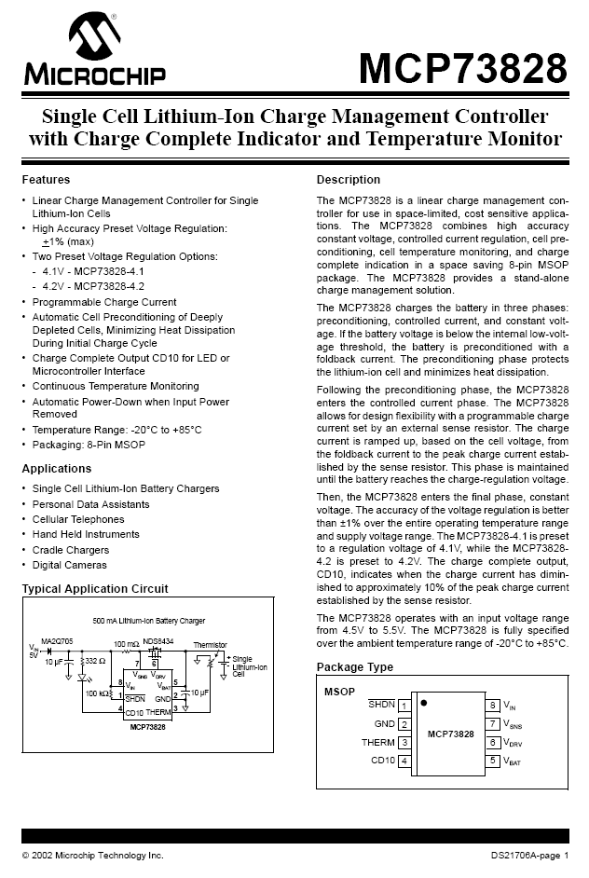
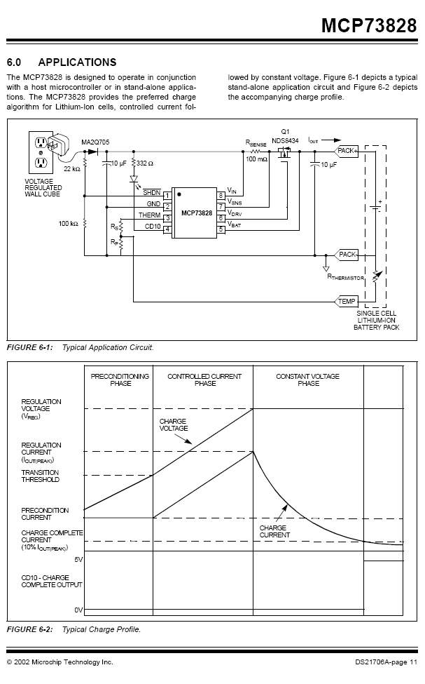

Slide 47
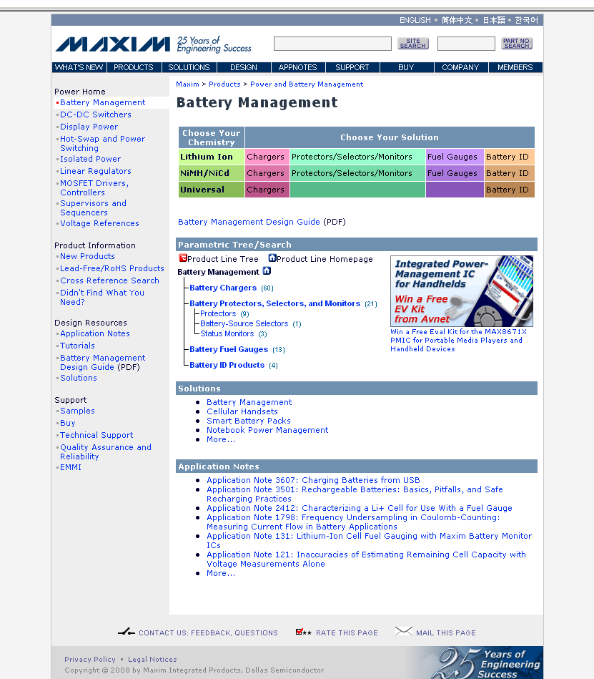

Slide 48
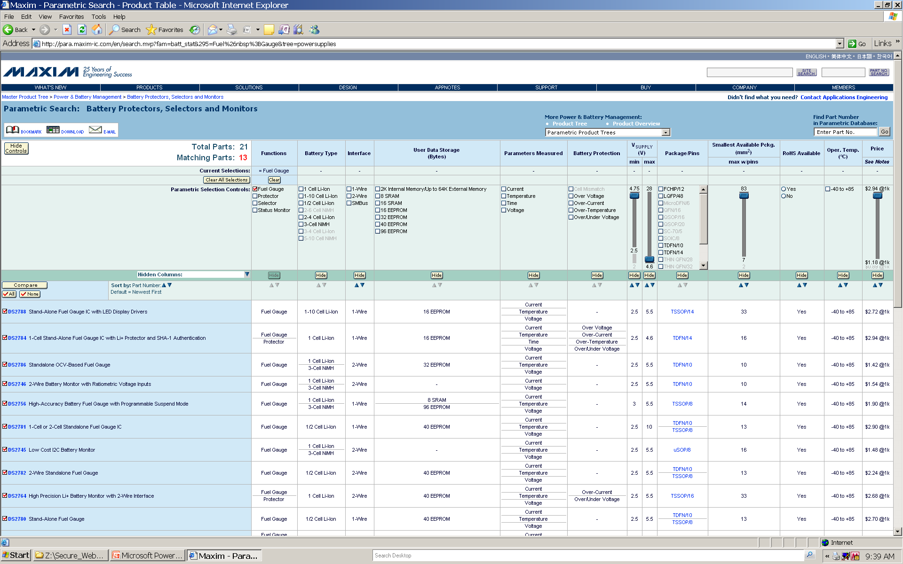

Slide 49
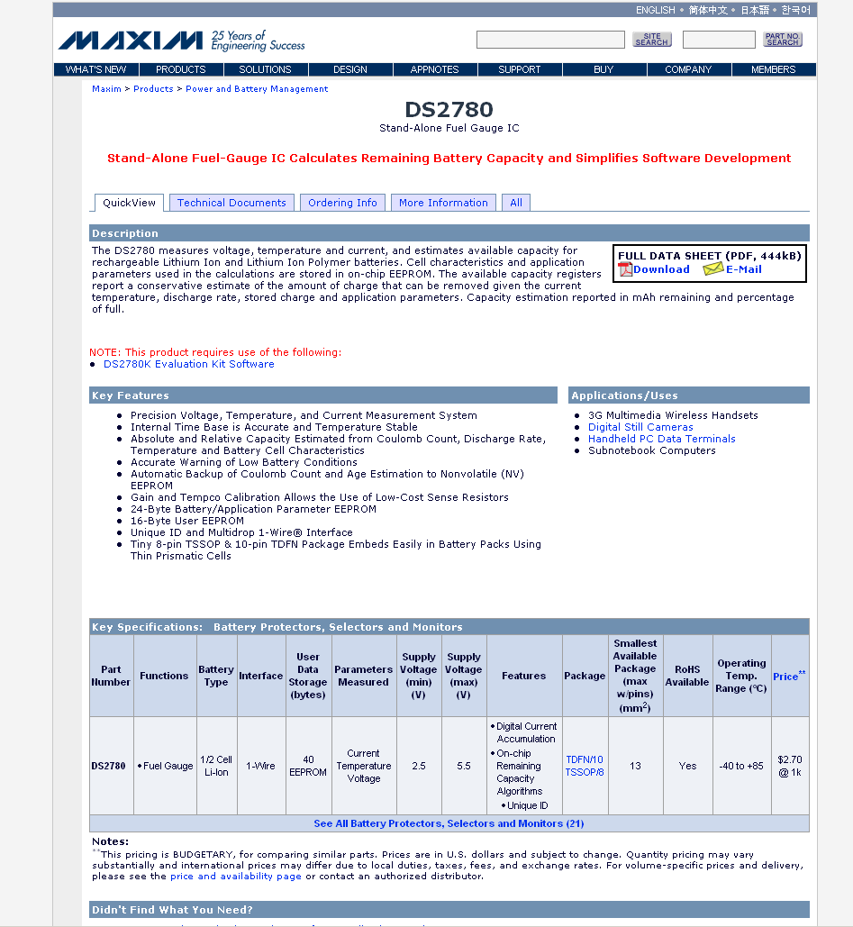

Slide 50
Outline - 3
Switch mode power supply
forward converter
flyback converter
Switching regulators
step-down switching converter
step-up switching capacitor charge pump
DC-DC converters

Slide 51
Switch Mode Power Supply (SMPS)
input rectifier
chopper
isolation
output rectifier
output filter
control
isolation
Switching approach based on high-frequency voltage ⇒ A.C. input (line voltage) immediately rectified to produce high-voltage D.C.
Chopper FET creates a high-frequency signal fed to transformer
High frequency ⇒ smaller transformer (less metal, less weight, lower cost)…but, more components
Adjusting chopper’s duty cycle provides regulation

Slide 52
Basic Forward (Buck) Converter
+
Forward (“buck”) converter transfers energy while the chopper is conducting
Transformer provides secondary charging circuit during conduction phase (chopper on)
When chopper turns off, choke releases its magnetic energy and current continues to flow into output capacitor

Slide 53
Basic Flyback Converter
+
Note phase of isolation transformer – while the chopper is conducting current in the primary, current is not allowed to flow in the secondary
Primary becomes storage device opposing current flow by creating a magnetic field
When chopper turns off, stored magnetic field collapses and energy is transferred to the secondary

Slide 54
Switching Regulator – Basic Idea
feedback
+
Vout
Regulation achieved by changing pulse width and/or pulse frequency
Done “automatically” by switching regulator IC
Typically over 90% efficient
TRADEOFF: lower current output than typical linear regulator circuit, and more external components; also, higher noise

Slide 55
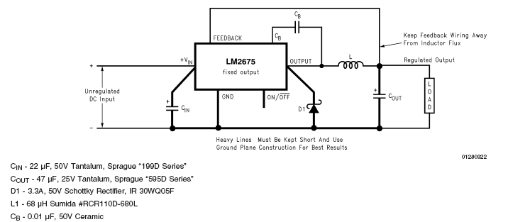
Step-Down Switching Converter: LM 2675
(fixed) 3.3, 5, 12 VDC and (adjustable) 1.21 – 37 V versions
Up to 1 amp
Up to 96% efficient
Five external components

Slide 56
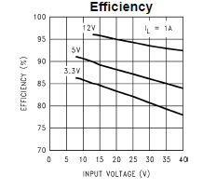
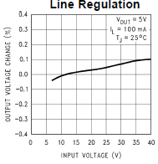
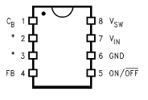
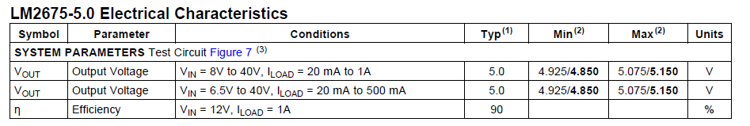
Step-Down Switching Converter: LM 2675

Slide 57
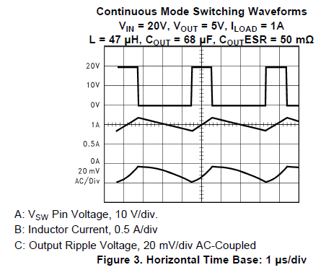
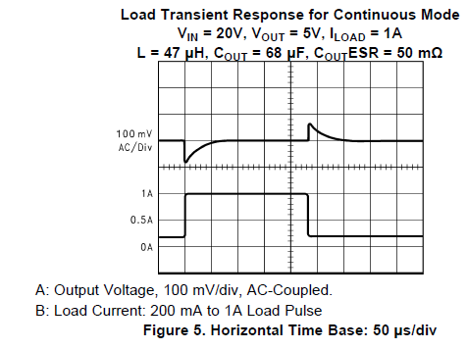
Step-Down Switching Converter: LM 2675

Slide 58
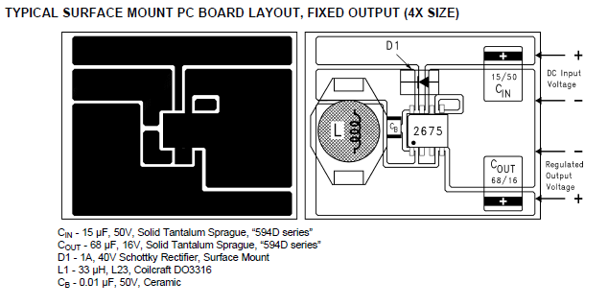
Step-Down Switching Converter: LM 2675

Slide 59
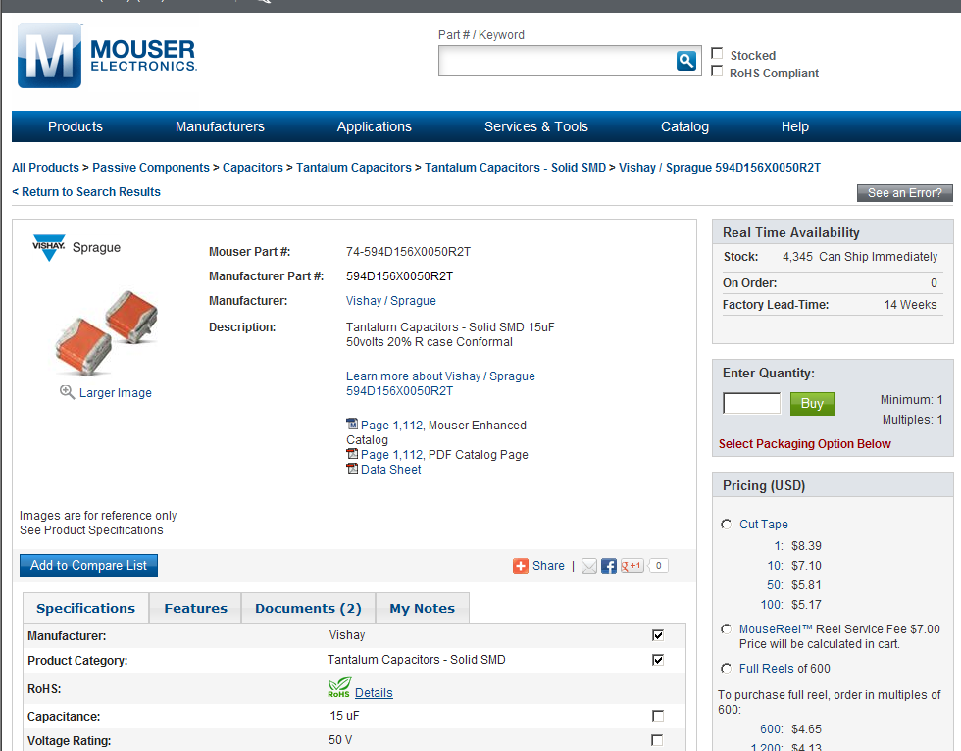
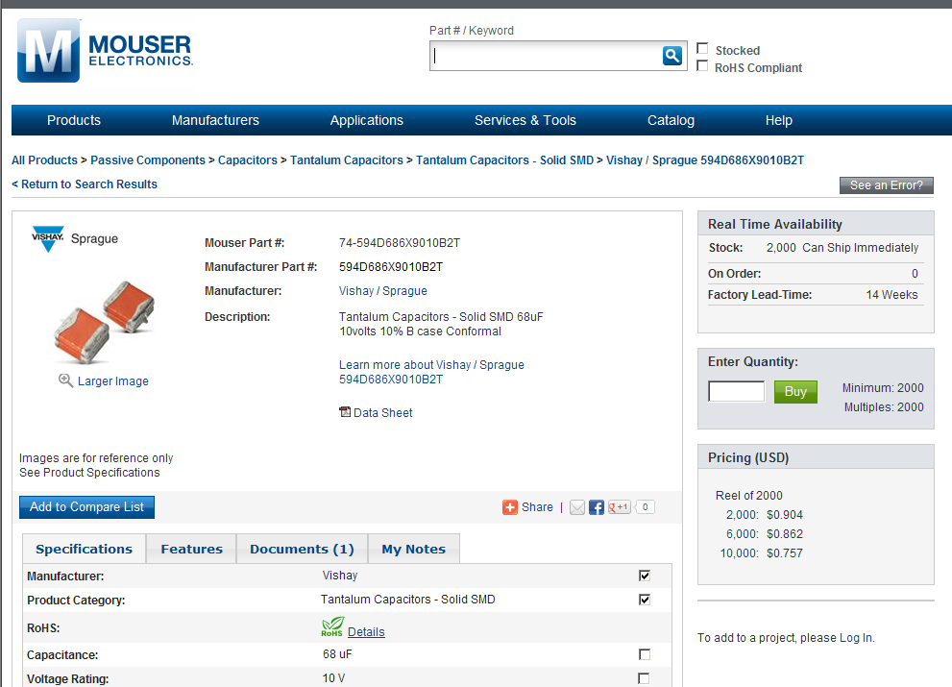
PCB Tutorial Exercise

Slide 60
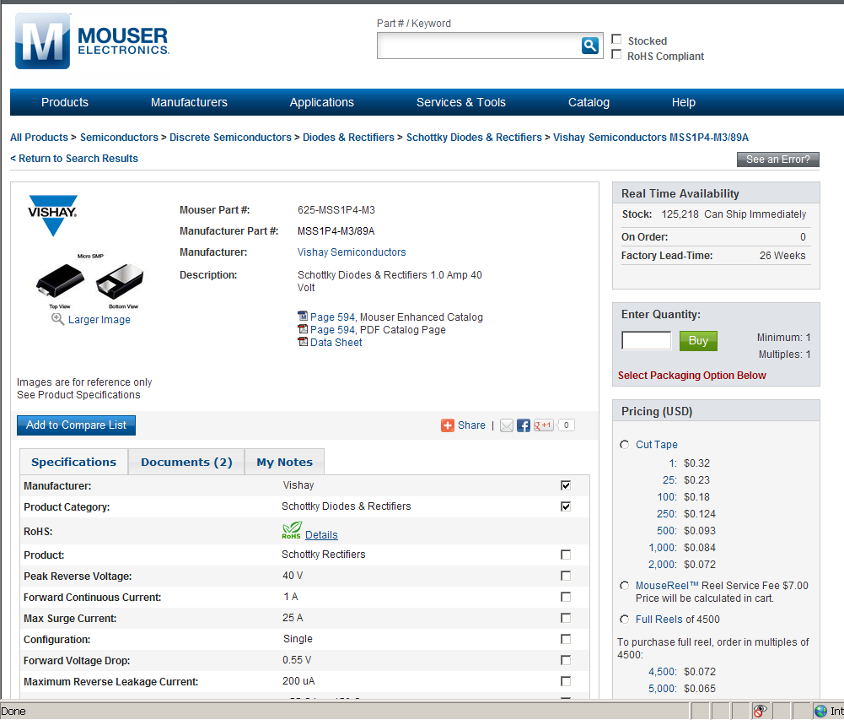
PCB Tutorial Exercise

Slide 61
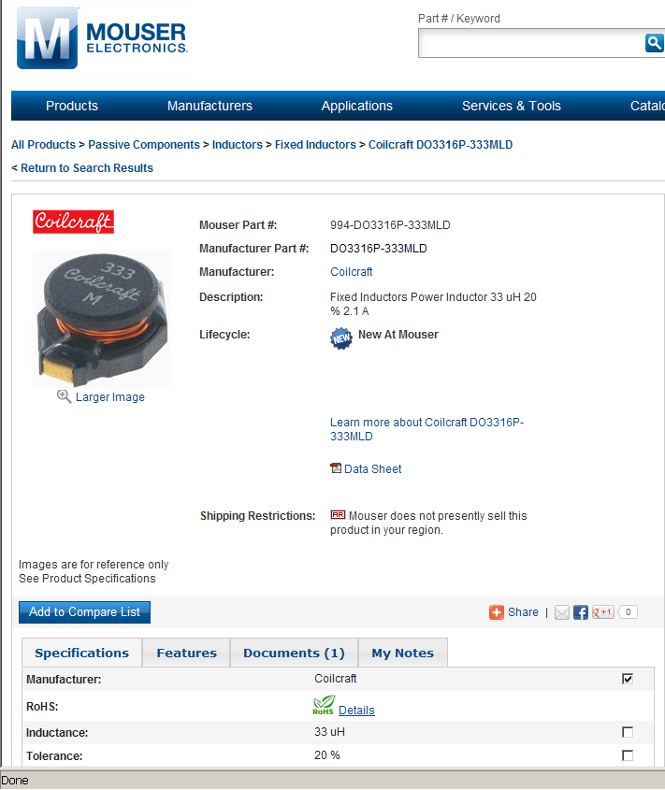
PCB Tutorial Exercise

Slide 62
PCB Tutorial Exercise
Standard 1206 type surface mount ceramic capacitor

Slide 63
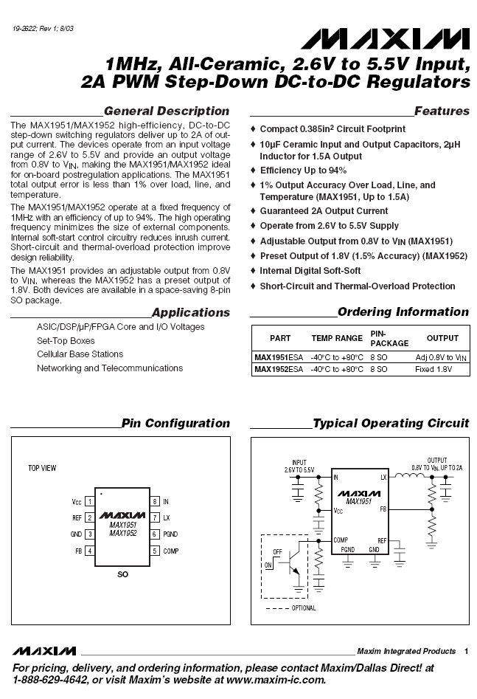
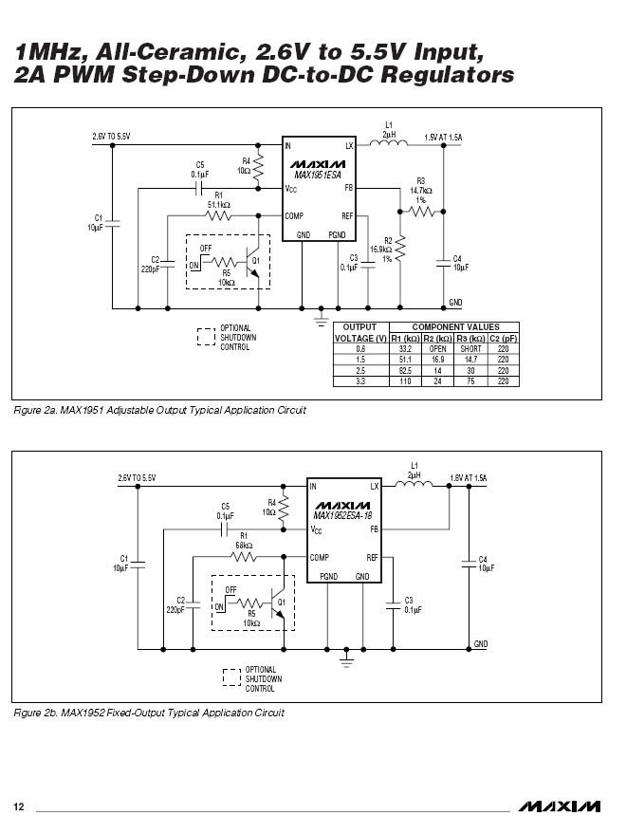

Slide 64
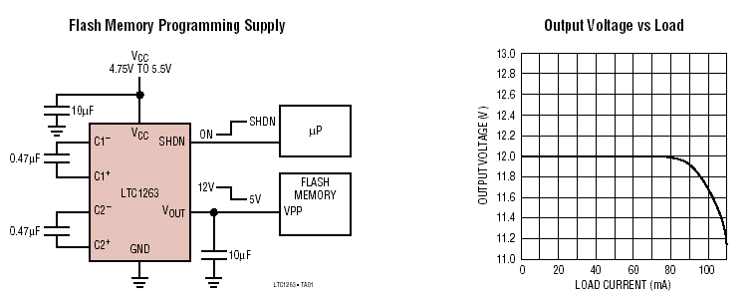
Switched Capacitor Charge Pump Step-Up Converter
Based on LTC1263 www.linear-tech.com
Produces 12 VDC @ 60 mA from V_{CC} as low as 4.75 V
Four external components

Slide 65
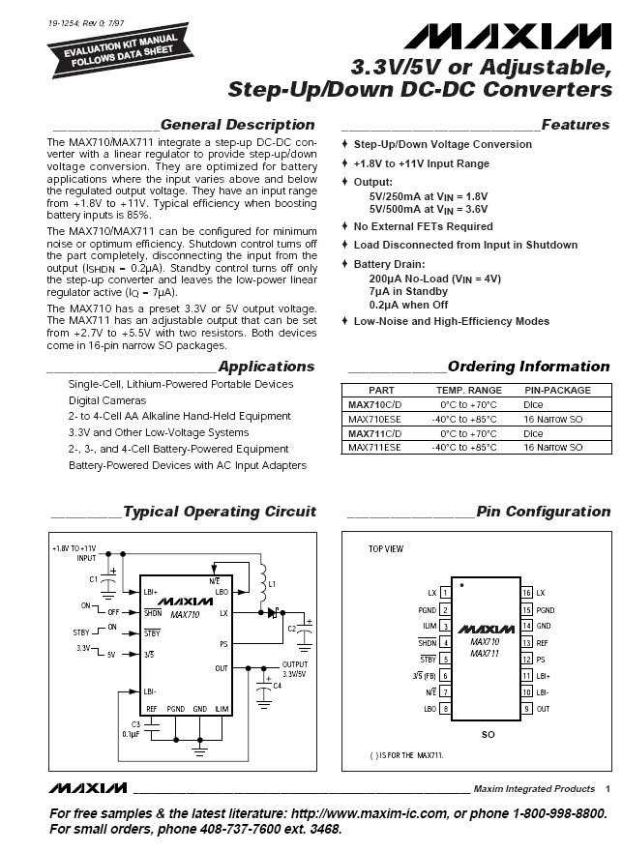
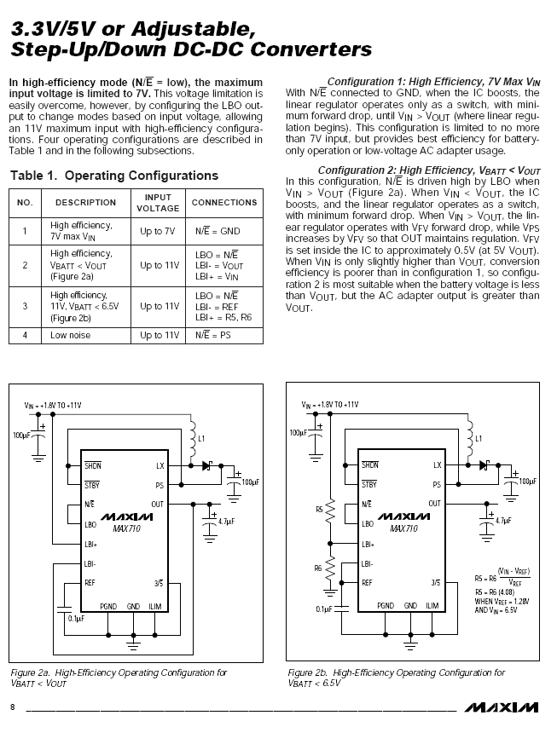

Slide 66
Important Notes About DC-DC Converters
While chip size and heat dissipation are reduced, component properties and physical layout become more critical…
Inductors and output capacitors typically need to be “low ESR” type – pay close attention to component data sheets
“Analog” ground for DC-DC must be separate from all other grounds on PCB
Certain nodes in layout are critical to keep traces short and wide to reduce parasitic inductance and capacitance
Failure to follow manufacturer’s recommended layout and component selection criteria will (most likely) result in non-operation of the circuit and many hours spent in debugging and fly-wiring

Slide 67
ECE 477 – Module 6 Clicker Quiz

Slide 68
V_{F} = 0.7
9 VAC
1. Given that the transformer secondary is rated at 9 V and that the forward voltage of each diode is 0.7 V, then VN (the no-load D.C. output voltage) will be approximately:
7.6 V
8.3 V
10.75 V
11.33 V
12.73 V
none of the above
Notes:
D (11.33)

Slide 69
V_{F} = 0.7
9 VAC
1. Given that the transformer secondary is rated at 9 V and that the forward voltage of each diode is 0.7 V, then VN (the no-load D.C. output voltage) will be approximately:
7.6 V
8.3 V
10.75 V
11.33 V
12.73 V
none of the above
Notes:
D

Slide 70
V_{F} = 0.7
9 VAC
2. Given that the transformer secondary is rated at 9 V and that the forward voltage of each diode is 0.7 V, calculate the efficiency operating at full load (1 amp) if a 7805 is used:
39%
44%
47%
56%
100%
none of the above
Notes:
B (44%)

Slide 71
V_{F} = 0.7
9 VAC
2. Given that the transformer secondary is rated at 9 V and that the forward voltage of each diode is 0.7 V, calculate the efficiency operating at full load (1 amp) if a 7805 is used:
39%
44%
47%
56%
100%
none of the above
Notes:
B

Slide 72
V_{F} = 0.7
9 VAC
3. Given that the 7805 has a dropout voltage of 2.5 V, calculate the amount of ripple that can be tolerated (rounded to the nearest 0.1 V) when sizing C1:
0.1 V
0.8 V
2.5 V
3.8 V
8.8 V
none of the above
Notes:
D (3.8)

Slide 73
V_{F} = 0.7
9 VAC
3. Given that the 7805 has a dropout voltage of 2.5 V, calculate the amount of ripple that can be tolerated (rounded to the nearest 0.1 V) when sizing C1:
0.1 V
0.8 V
2.5 V
3.8 V
8.8 V
none of the above
Notes:
D

Slide 74
V_{F} = 0.7
9 VAC
4. Based on similar linear power supply examples covered in Module 6, the size of C1 for the design above should be on the order of:
10 µF
100 µF
1000 µF
10,000 µF
100,000 µF
none of the above
Notes:
C

Slide 75
V_{F} = 0.7
9 VAC
4. Based on similar linear power supply examples covered in Module 6, the size of C1 for the design above should be on the order of:
10 µF
100 µF
1000 µF
10,000 µF
100,000 µF
none of the above
Notes:
C

Slide 76
V_{F} = 0.7
9 VAC
5. If the junction temperature of the 7805 is to rise no more than 20° C above ambient temperature, then the thermal resistance of its heat sink should be no more than:
0.3
1.0
3.2
6.4
12.8
none of the above
Notes:
C

Slide 77
V_{F} = 0.7
9 VAC
5. If the junction temperature of the 7805 is to rise no more than 20° C above ambient temperature, then the thermal resistance of its heat sink should be no more than:
0.3
1.0
3.2
6.4
12.8
none of the above
Notes:
C

Slide 78
STANDARD 5V REGULATOR
Dropout = 2.5 V
VN = 8 V
Ripple = 0.5 V max
6. Assuming a ripple tolerance of 0.5 V, the maximum efficiency at full load (1 A) that can be achieved with a 5 V regulator circuit based on a standard linear regulator (that has a dropout voltage of 2.5 V) is approximately:
50%
60%
63%
70%
none of the above
Notes:
B = 5/8 = 62.5%

Slide 79
STANDARD 5V REGULATOR
Dropout = 2.5 V
VN = 8 V
Ripple = 0.5 V max
6. Assuming a ripple tolerance of 0.5 V, the maximum efficiency at full load (1 A) that can be achieved with a 5 V regulator circuit based on a standard linear regulator (that has a dropout voltage of 2.5 V) is approximately:
50%
60%
63%
70%
none of the above
Notes:
B = 5/8 = 62.5%

Slide 80
LOW-DROPOUT 5V REGULATOR
Dropout = 0.5 V
VN = 6 V
Ripple = 0.5 V max
7. Assuming a ripple tolerance of 0.5 V, the maximum efficiency at full load (1 A) that can be achieved with a 5 V regulator circuit based on a low-dropout linear regulator (that has a dropout voltage of 0.5 V) is approximately:
70%
77%
83%
91%
none of the above
Notes:
C = 5/6 = 83%

Slide 81
LOW-DROPOUT 5V REGULATOR
Dropout = 0.5 V
VN = 6 V
Ripple = 0.5 V max
7. Assuming a ripple tolerance of 0.5 V, the maximum efficiency at full load (1 A) that can be achieved with a 5 V regulator circuit based on a low-dropout linear regulator (that has a dropout voltage of 0.5 V) is approximately:
70%
77%
83%
91%
none of the above
Notes:
C = 5/6 = 83%

Slide 82
LOW-DROPOUT 5V REGULATOR
Dropout = 0.5 V
VN = 6 V
Ripple = 0.5 V max
8. The minimum value of C1 that should be used for this low-dropout 5V 1 A power supply design is approximately:
2000 µF
4000 µF
8000 µF
10,000 µF
none of the above
HINT:
t = -R_{L} x C1 x ln(V_{Nmin}/V_{Nmax}), where t = 0.0042
Notes:
C = 8000 0.0042 = -6 x C1 x ln(5.5/6.0) = C1 x 0.522 C1 = 8046 µF

Slide 83
LOW-DROPOUT 5V REGULATOR
Dropout = 0.5 V
VN = 6 V
Ripple = 0.5 V max
8. The minimum value of C1 that should be used for this low-dropout 5V 1 A power supply design is approximately:
2000 µF
4000 µF
8000 µF
10,000 µF
none of the above
HINT:
0.0042 = -6 x C1 x ln(5.5/6.0) = C1 x 0.522
C1 = 8046 µF
Notes:
C = 8000 0.0042 = -6 x C1 x ln(5.5/6.0) = C1 x 0.522 C1 = 8046 µF

Slide 84
LOW-DROPOUT 5V REGULATOR
Dropout = 0.5 V
V_{F} = 0.6
VN = 6 V
Ripple = 0.5 V max
9. Assuming each diode in the bridge rectifier has a forward voltage of 0.6 V, the transformer (RMS) secondary voltage should be rated at approximately:
4.5 VAC
5.1 VAC
6.3 VAC
9.0 VAC
none of the above
Notes:
B: X * sqrt(2) – 1.2 = 6, X * sqrt(2) = 7.2 , X = 7.2/sqrt(2) = 5.1 V

Slide 85
LOW-DROPOUT 5V REGULATOR
Dropout = 0.5 V
V_{F} = 0.6
VN = 6 V
Ripple = 0.5 V max
9. Assuming each diode in the bridge rectifier has a forward voltage of 0.6 V, the transformer (RMS) secondary voltage should be rated at approximately:
4.5 VAC
5.1 VAC
6.3 VAC
9.0 VAC
none of the above
(X_{rms}* √2) – 1.2 = 6
X_{rms}* √2 = 7.2
X_{rms} = 7.2 / √2 = 5.1 V
Notes:
B: X * sqrt(2) – 1.2 = 6, X * sqrt(2) = 7.2 , X = 7.2/sqrt(2) = 5.1 V

Slide 86
LOW-DROPOUT 5V REGULATOR
Dropout = 0.5 V
V_{F} = 0.6
10. What if, when doing a parts search, you can only find suitable transformers that have secondary voltage ratings of 5.0 VAC or 6.3 VAC?
pick the 5.0 VAC transformer and increase C1 to 10,000 µF
pick the 6.3 VAC transformer and decrease C1 to 2000 µF
pick the 5.0 VAC transformer and leave C1 at 8000 µF
pick the 6.3 VAC transformer and leave C1 at 8000 µF
none of the above
Notes:
A

Slide 87
LOW-DROPOUT 5V REGULATOR
Dropout = 0.5 V
V_{F} = 0.6
10. What if, when doing a parts search, you can only find suitable transformers that have secondary voltage ratings of 5.0 VAC or 6.3 VAC?
pick the 5.0 VAC transformer and increase C1 to 10,000 µF
pick the 6.3 VAC transformer and decrease C1 to 2000 µF
pick the 5.0 VAC transformer and leave C1 at 8000 µF
pick the 6.3 VAC transformer and leave C1 at 8000 µF
none of the above
Notes:
A

