Slide 1
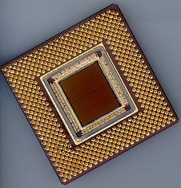
ECE 477 Digital Systems Senior Design Project
© 2013 by D. G. Meyer
Module 3
Microcontrollers for Embedded Applications

Slide 2
Outline
General μC Selection Guidelines
Memory Requirements / Types
Development Environment
Interfacing / Bus Expansion
PIC Microcontrollers
Atmel Microcontrollers
Freescale Microcontrollers
Analog Devices DSPs
ATOM Boards
ARM Modules

Slide 3
General μC Selection Guidelines
Memory requirements/types
Beware of hidden liabilities
Data acquisition (ADC) buffers
Large file storage (mp3)
Library routines (floating point emulation, printf)
Nonvolatile memory
Flash (code, static data)
in-circuit programmable?
programming “dongle” availability?
programming connector requirements?
EEPROM (storage of calibration or configuration parameters, history data, control panel settings)
granularity of erase/write?
software driver availability?

Slide 4
General μC Selection Guidelines
Volatile memory (SRAM)
stack
heap
I/O buffers
run-time variables
(generally no executable code except for “specialty functions” like erasing and reprogramming a sector in Flash)
note initialization requirements when system boots

Slide 5
General μC Selection Guidelines
Interfacing/Bus Expansion
Number of general purpose I/O pins
programmable data direction?
programmable pull device?
Bus expansion capability
multiplexed or simplex external bus?
“glue logic” requirements?
Number/types of integrated peripherals (objective: want to “match” project requirements to μC capabilities)

Slide 6
General μC Selection Guidelines
Development environment
Useful to have an asynchronous serial port dedicated to debugging
Useful to have spare I/O pins dedicated to debugging (e.g., “heartbeat” LED)
In-circuit programmable Flash available for quickly downloading and testing code revs (but typically require a “programming dongle” so be sure to include a header/connector on your PCB)
BDM (background debug mode) VERY helpful be sure to include a 6-pin BDM header on your PCB if using a Freescale microcontroller
Assembler/Compiler/Linker/Loader/(Simulator)?

Slide 7
General μC Selection Guidelines
Carefully note package options available
QFP, SOIC, and SSOP types generally preferable
QFN type “doable” (but avoid if possible)
watch out for “tabs” on bottom of chip
DIP types OK (good for prototyping) but compromise PCB density
avoid PGA and BGA
Price/availability
get at least two more than you need of every IC
now (sooner rather than later)

Slide 8
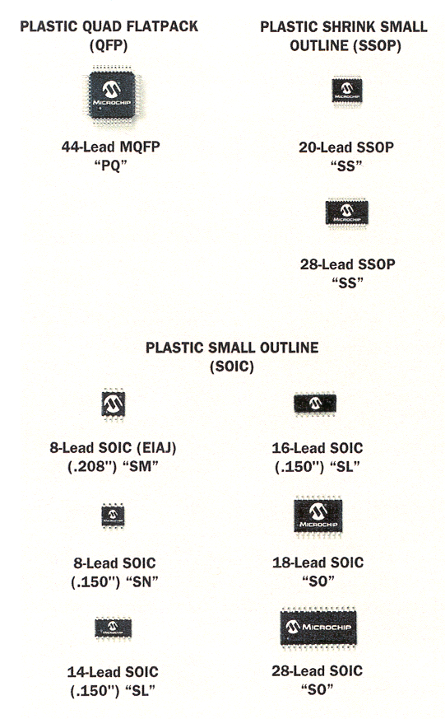
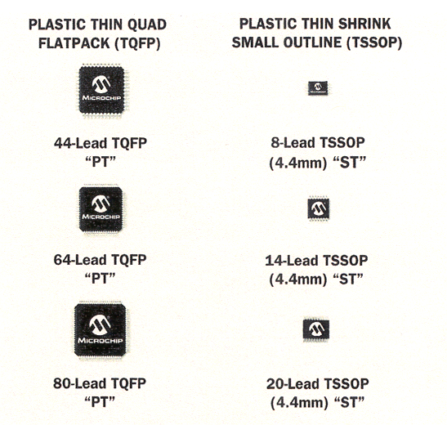
Package Options (Sample)

Slide 9
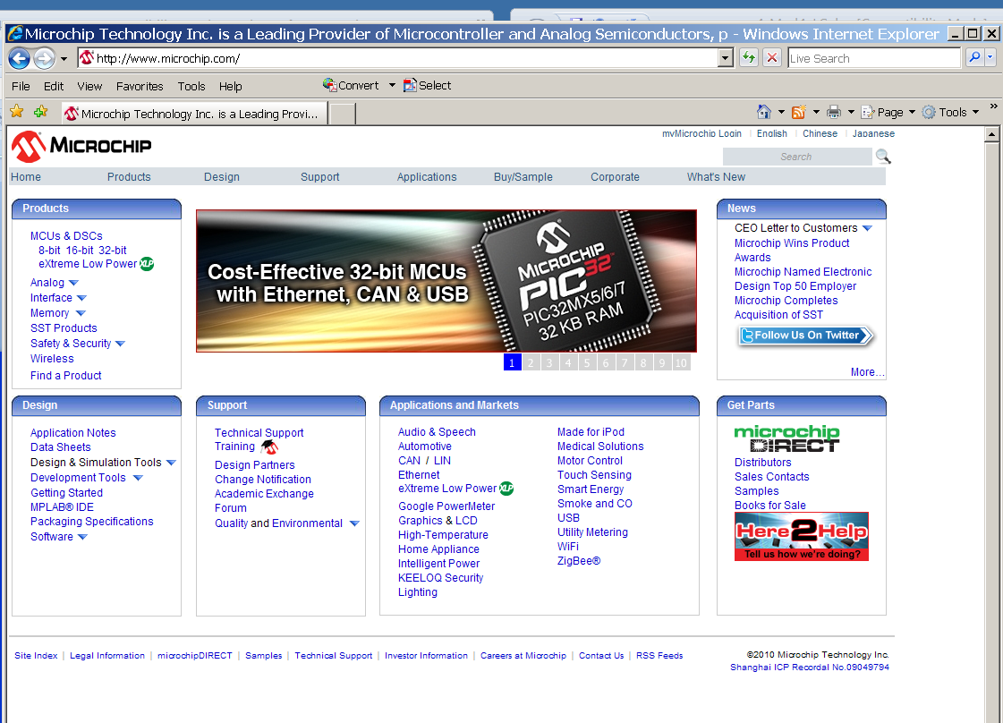
http://www.microchip.com

Slide 10
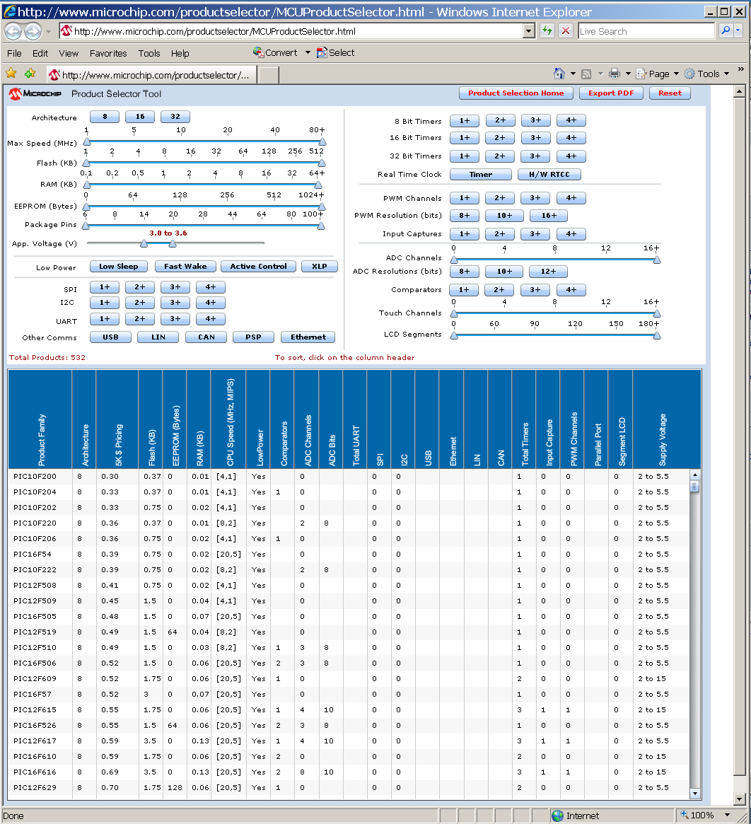

Slide 11
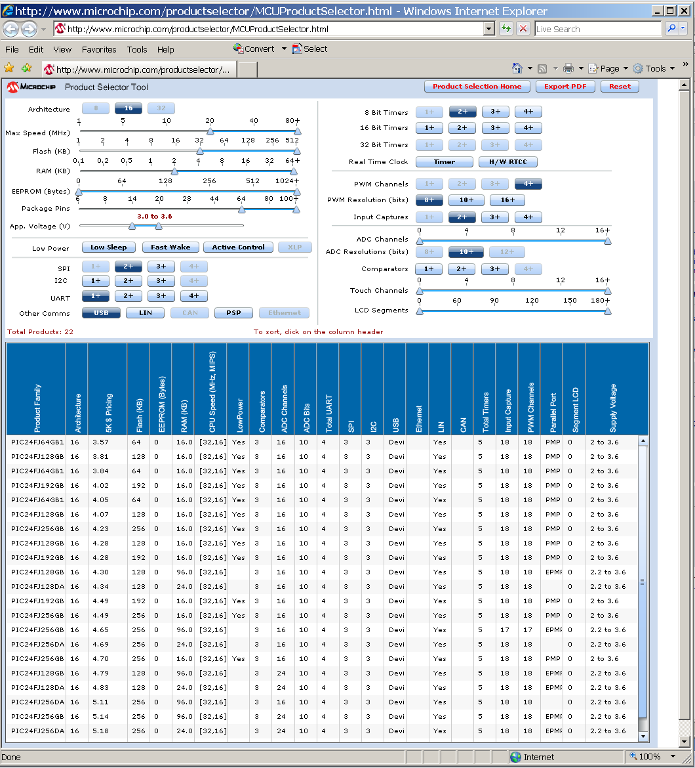

Slide 12
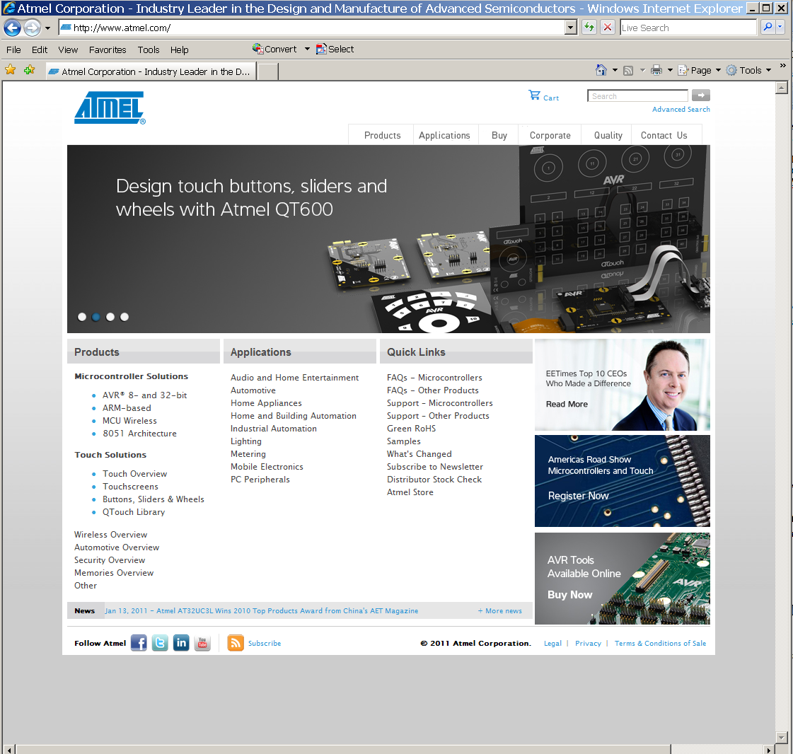
www.atmel.com

Slide 13
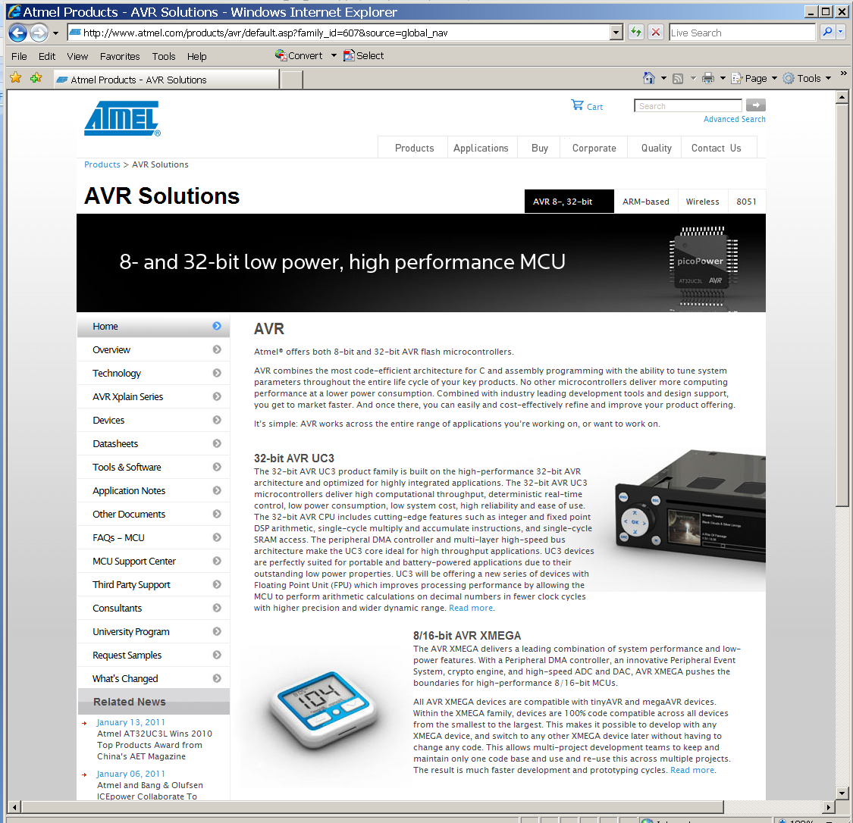

Slide 14
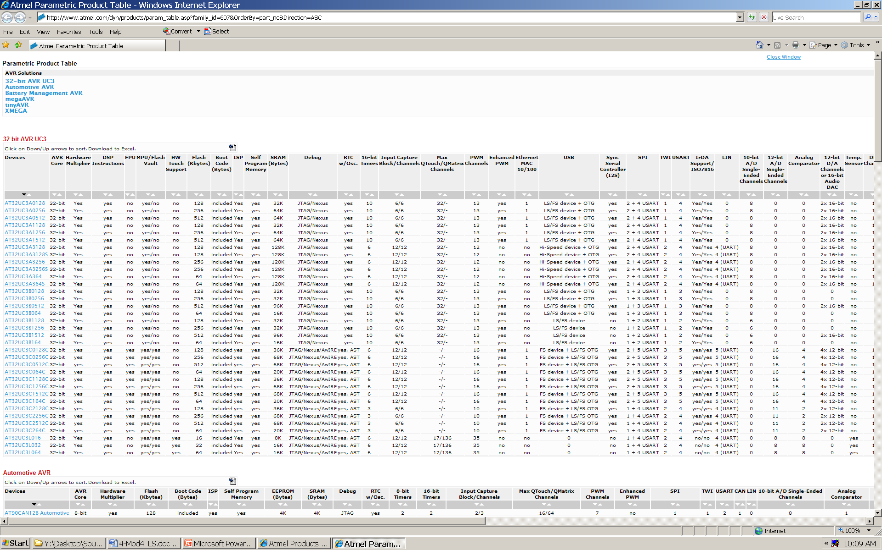
Parametric Product Table

Slide 15
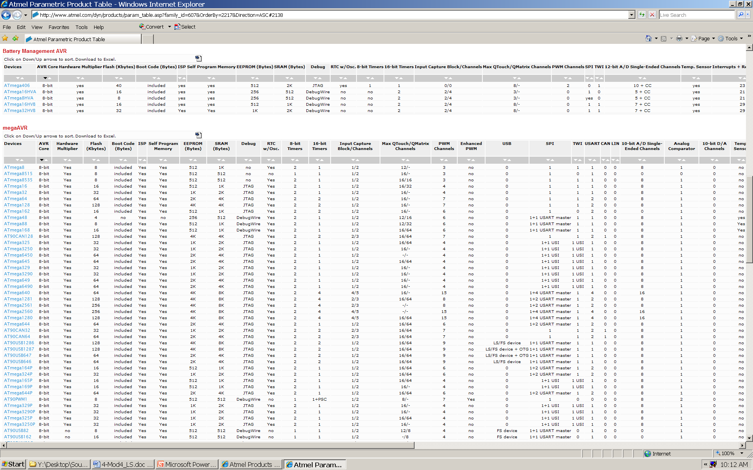
Parametric Product Table…

Slide 16
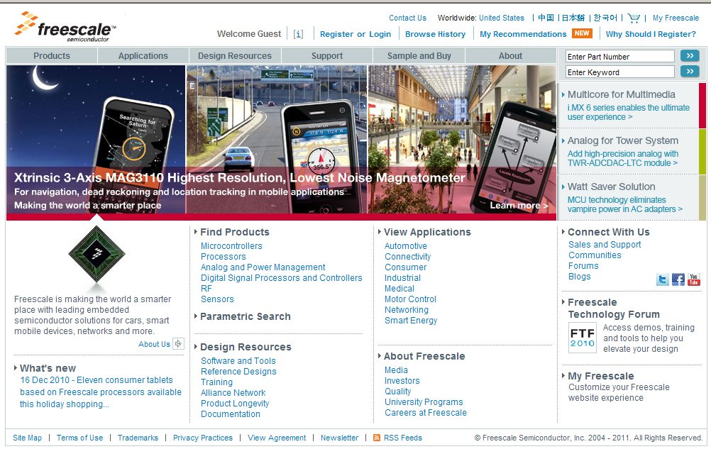
www.freescale.com

Slide 17
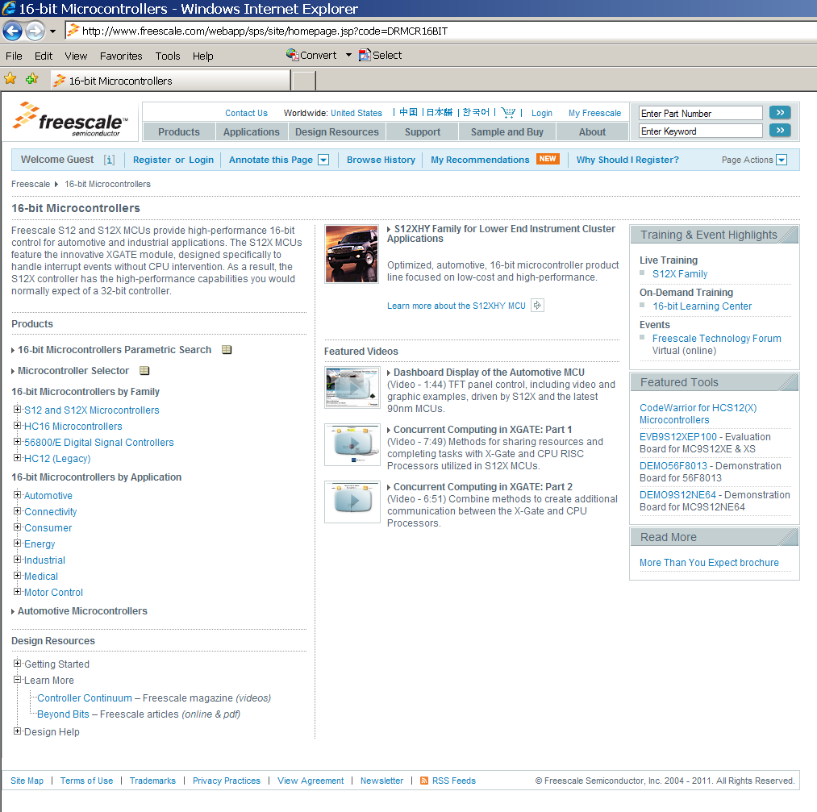

Slide 18
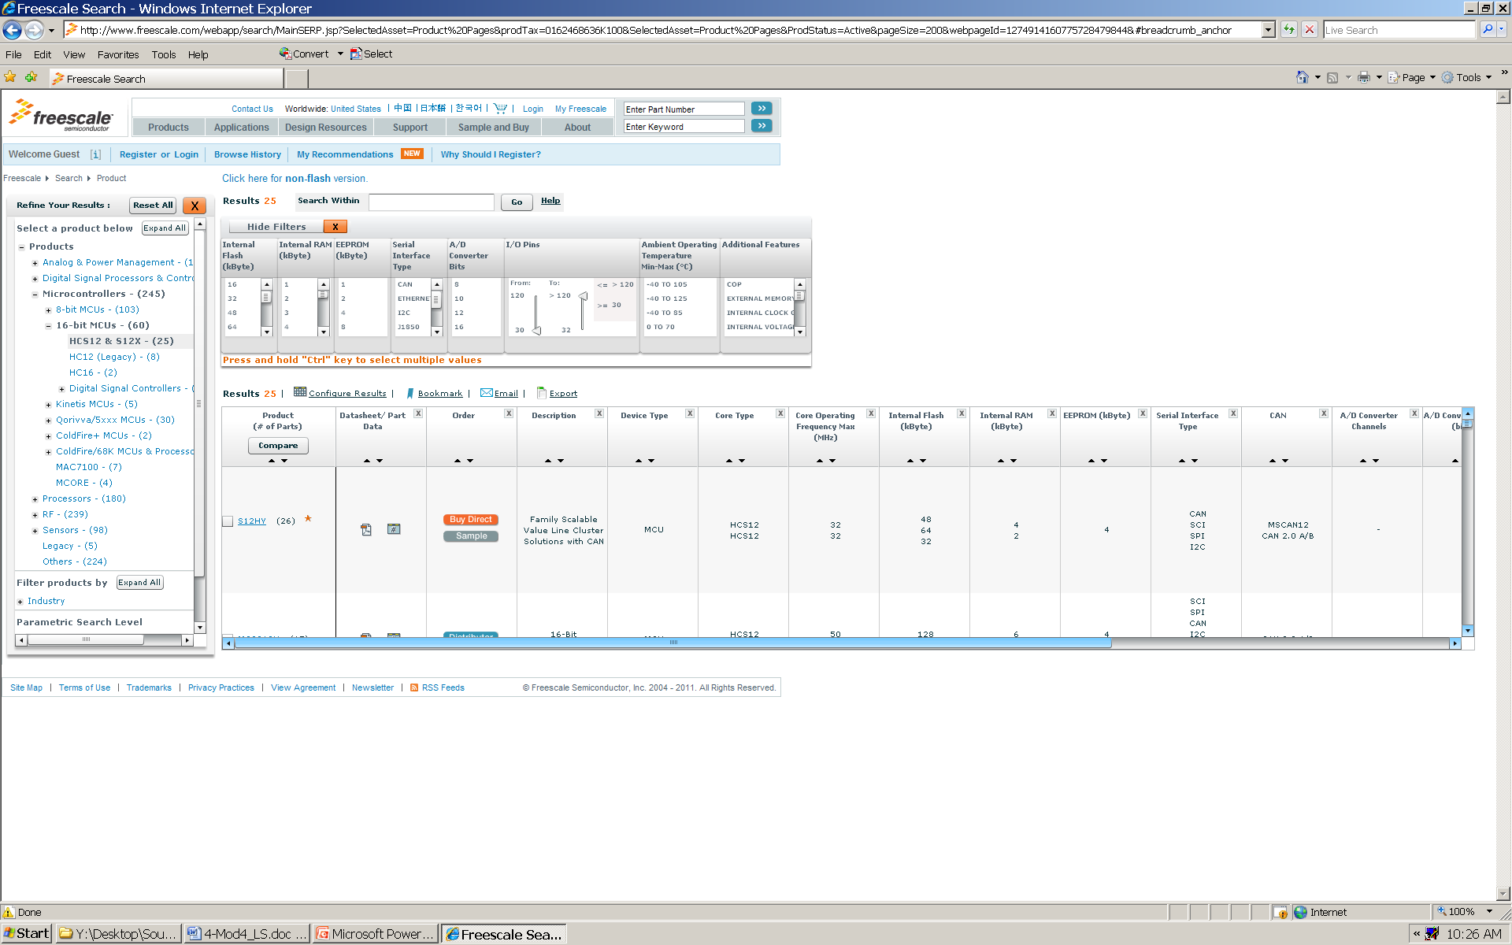
Freescale 16-bit Parametric Product Table

Slide 19
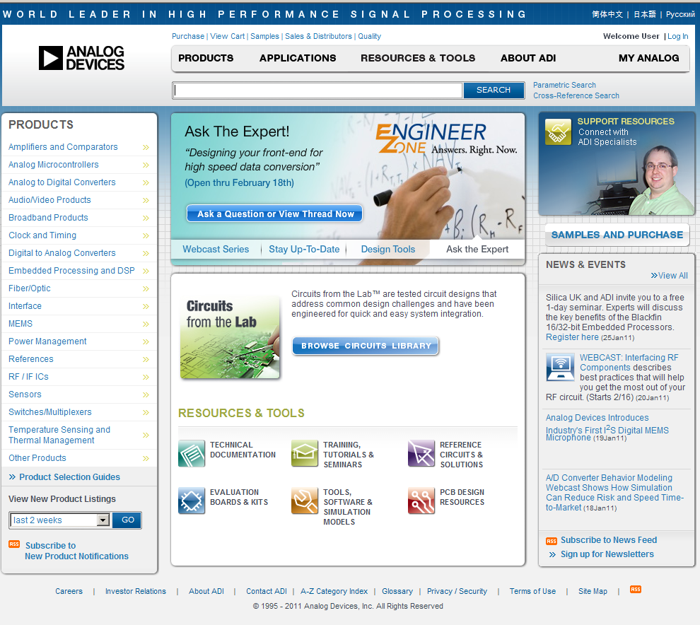
www.analog.com

Slide 20
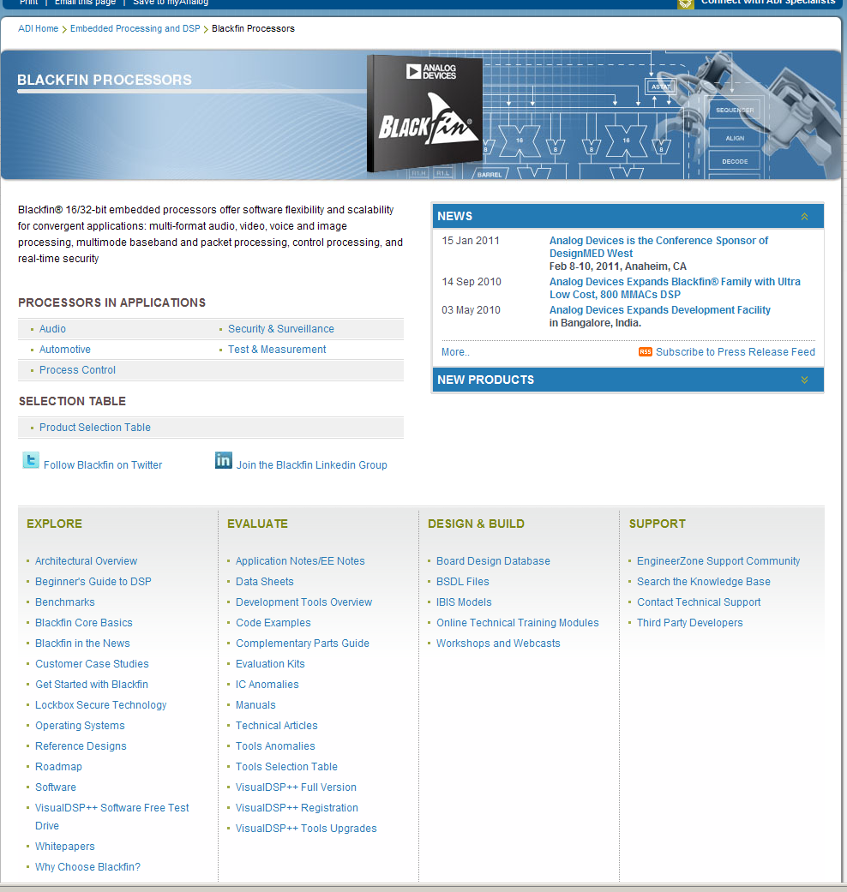

Slide 21
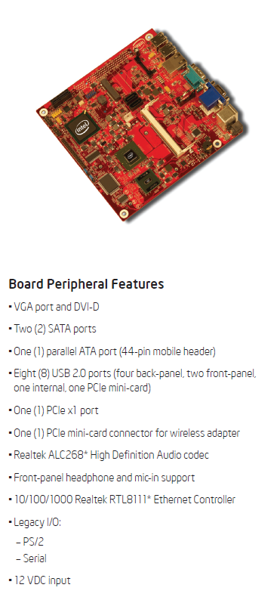
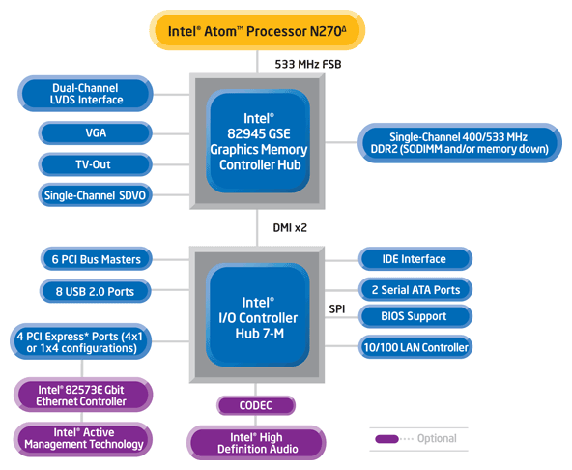
http://www.intel.com/products/processor/atom/index.htm

Slide 22
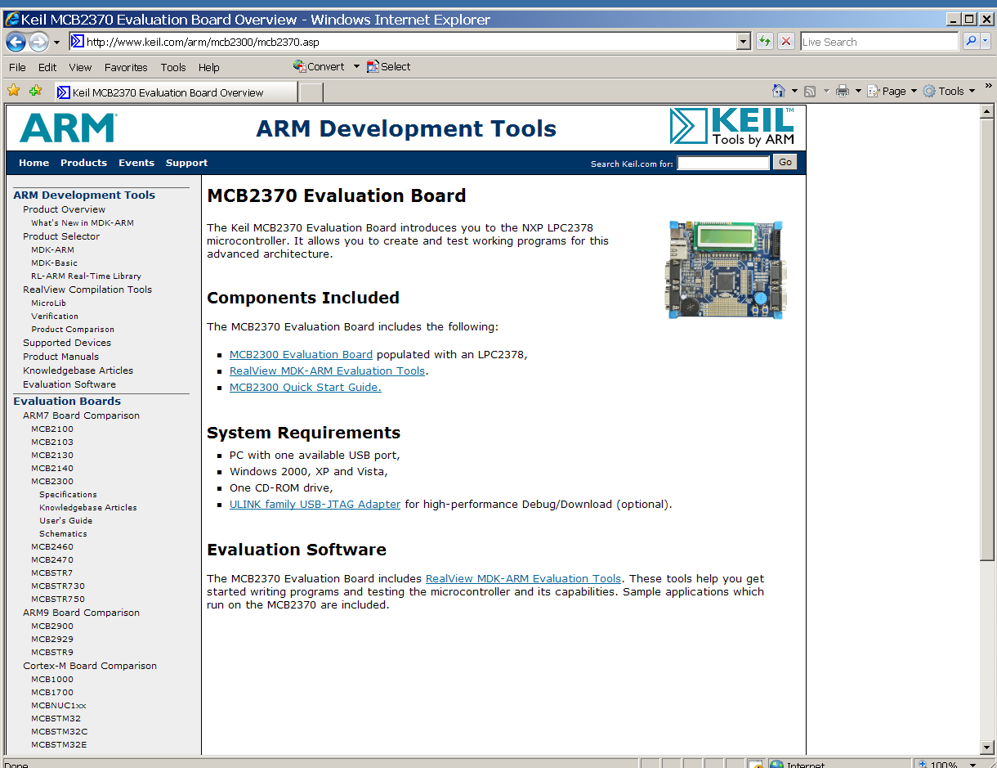
http://www.keil.com/mcb2300/mcb2370.asp

