Slide 1
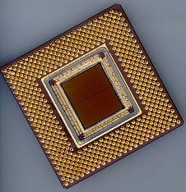
ECE 477 Digital Systems Senior Design Project
Module 2
Digital System Hardware Design Considerations

Slide 2
ECE 477 Digital Systems Senior Design Project
Module 2-A
Logic Levels and Noise Margins

Slide 3
Reading Assignment: DDPP 4th Ed., pp. 96-103 Learning Objectives:
Identify key information contained in a logic device data sheet
Calculate the DC noise immunity margin of a logic circuit and describe the consequences of an insufficient margin
Describe the consequences of a “non-ideal” voltage applied to a logic gate input
Describe how unused (“spare”) CMOS inputs should be terminated

Slide 4
Outline
Overview
Data sheets
Noise
Logic levels and noise margins
Non-ideal inputs
Unused (“spare”) inputs
Electrostatic discharge

Slide 5
Overview
Objective: To be able to design real circuits using CMOS or other logic families
need to ensure that the “digital abstraction” is valid for a given circuit
need to provide adequate engineering design margins to ensure that a circuit will work properly under a variety of conditions
need to be able to read and understand data sheets and specifications, in order to create reliable and robust real-world circuits and systems

Slide 6
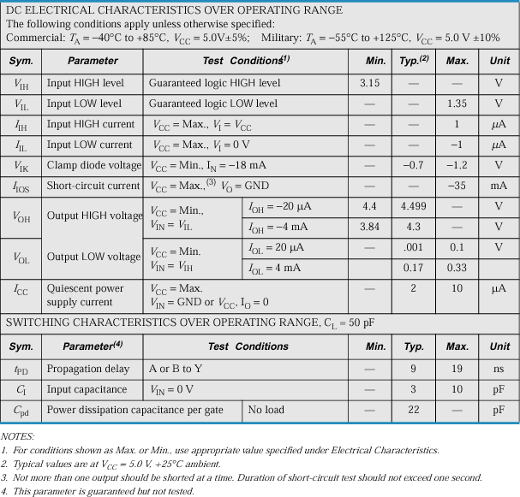
Data Sheet for a Typical CMOS Device

Slide 7
Noise
The main reason for providing engineering design margins is to ensure proper operation in the presence of noise
Examples of noise sources:
cosmic rays
magnetic fields generated by machinery
power supply disturbances
the “switching action” of the logic circuits themselves

Slide 8
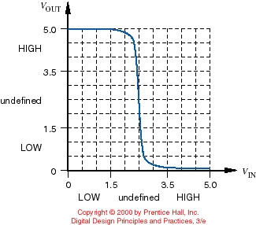
Logic Levels and Noise Margins
Typical input-output transfer characteristic of a CMOS inverter
Problem: Typical, NOT guaranteed!

Slide 9
Logic Levels and Noise Margins
Factors that cause the transfer characteristic to vary
power supply voltage
temperature
output loading
conditions under which a device was fabricated
Sound engineering practice dictates that we use more “conservative” specifications for LOW and HIGH

Slide 10
Logic Levels and Noise Margins
Definitions:
VOH_{min} - the minimum output voltage in the HIGH state
VIH_{min} - the minimum input voltage guaranteed to be recognized as a HIGH
VIL_{max} - the maximum input voltage guaranteed to be recognized as a LOW
VOL_{max} - the maximum output voltage in the LOW state

Slide 11
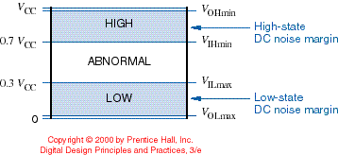
Logic Levels and Noise Margins
CMOS levels are typically a function of the power supply “rails”
VOH_{min} Vcc – 0.1v
VIH_{min} 70% of Vcc
VIL_{max} 30% of Vcc
VOL_{max} GND + 0.1v
DC noise margin is a measure of how much noise it takes to corrupt a worst-case output voltage into a value that may not be recognized properly by an input

Slide 12
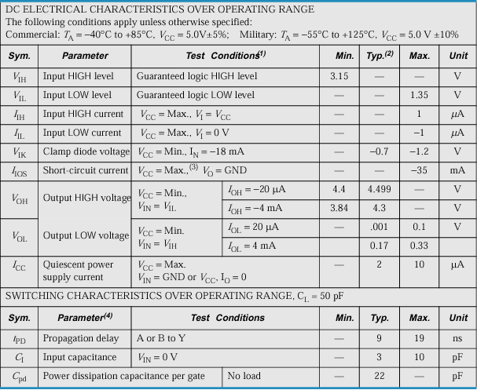
Data Sheet for a Typical CMOS Device

Slide 13
Logic Levels and Noise Margins
Calculation of DC noise margin (or the “noise immunity margin”)
Example: HC-series CMOS
DCNM = min (VOH_{min} – VIH_{min}, VIL_{max} – VOL_{max})
DCNM = min (4.4 – 3.15, 1.35 – 0.1)
= 1.25 v

Slide 14
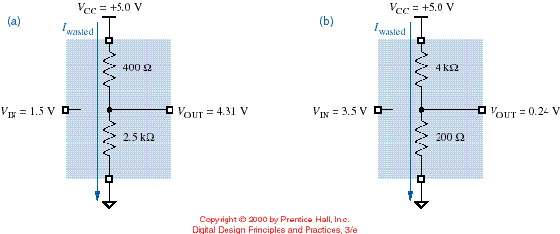
Non-ideal Inputs
If the inputs to a CMOS circuit are not close to the Vcc / GND rails, the “on” transistor may not be fully on and the “off” transistor may not be fully off – causing power dissipation of the device to increase

Slide 15
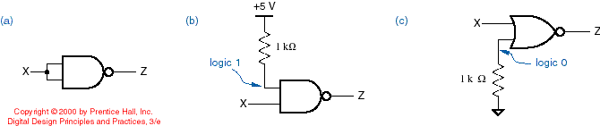
Unused (“Spare”) Inputs
Unused (“spare”) CMOS inputs should never be left unconnected (“floating”)
A small amount of circuit noise can temporarily make a floating input look HIGH
Instead, unused inputs should be:
tied to another input of the same gate
tied HIGH (for AND and NAND gates)
tied LOW (for OR and NOR gates)
note: most microcontrollers have programmable “pull” devices on input ports
pull-up resistor
pull-down resistor

Slide 16
Electrostatic Discharge
CMOS device inputs are subject to damage from electrostatic discharge (ESD)
Apply these precautions in lab:
before handling a CMOS device, touch a source of earth ground
transport CMOS devices in conductive bags, foam, or tubes
handle circuit boards containing CMOS devices by the edges; touch a ground terminal on the board to earth ground before “poking around with it”
use anti-static mats and wrist bands (be sure to connect to earth ground)

Slide 17
ECE 477 Digital Systems Senior Design Project
Module 2-B
Current Sourcing and Sinking

Slide 18
Reading Assignment: DDPP 4th Ed., pp. 103-114 Learning Objectives:
Identify key information contained in a logic device data sheet
Describe the relationship between logic gate output voltage swing and current sourcing/sinking capability
Describe the difference between “DC loads” and “CMOS loads”
Calculate V_{OL} and V_{OH} of a logic gate based on the “on” resistance of the active device and the amount of current sourced (I_{OH}) or sunk (I_{OL}) by the gate output
Calculate logic gate fan-out and identify a practical lower limit
Calculate the value of current limiting resistor needed for driving an LED
Describe the deleterious effects associates with loading a gate output beyond its rated specifications

Slide 19
Outline
Sourcing and sinking current
CMOS and DC loads
Fan-out
Driving LEDs
Effects of excessive loading

Slide 20
Sourcing and Sinking Current
CMOS gate inputs have a very high impedance and consume very little current from the circuits that drive them
IIL the maximum current that flows into the input in the LOW state
IIH the maximum current that flows into the input in the HIGH state
For CMOS logic, the input current is very small (about one microamp) – it takes very little power to maintain a CMOS input in either the HIGH or LOW state

Slide 21
Sourcing and Sinking Current
IC manufacturers specify a maximum load for the output in each state (HIGH or LOW) and guarantee a worst-case output voltage for that load
IOL_{max} - the maximum current that the output can “sink” in the LOW state while still maintaining an output voltage no greater than VOL_{max}
IOH_{max} - the maximum current that the output can “source” in the HIGH state while still maintaining an output voltage no less than VOH_{min}

Slide 22
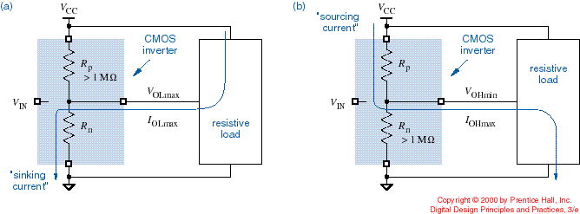
Sourcing and Sinking Current
Circuit definitions of IOL_{max} and IOH_{max}
X
X
current arrow
NOTE: Convention is for the input/output current arrows to point “in”
sinking current (positive)
sourcing current (negative)

Slide 23
Sourcing and Sinking Current
Often times gate outputs need to drive devices that require a non-trivial amount of current to operate – called a resistive load or DC load
When driving a resistive load, the output of a CMOS circuit is not nearly as ideal as described previously
In either output state, the CMOS output transistor that is “on” has a non-zero resistance, and a load connected to its output terminal will cause a voltage drop across this resistance

Slide 24
CMOS and DC Loads
Consequently, most CMOS devices have two sets of loading specifications:
“CMOS loads” – device output connected to other CMOS inputs, which require very little current to recognize a “high” input or “low” input
“DC loads” – device output connected to resistive loads (devices that consume significant current, typically several milliamps)
Note: With “DC loads” the output voltage swing of a CMOS circuit may significantly degrade

Slide 25
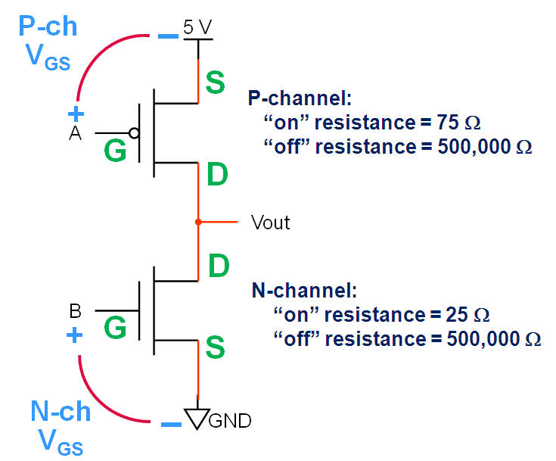
Example: Inverter - Current Sourcing
Calculate V_{OH} and I_{OH} for A=B=0V
Current SOURCING configuration
DC Load is 500 Ω resistor between V_{out} and GND
P-ch device is “on” (R_{DS} = 75 Ω)
N-ch device is “off” (R_{DS} = 500,000 Ω )
Load impedance is 500,000 Ω in parallel with 500 Ω ≈ 500 Ω
V_{OH} ≈ 5 x (500 / 575) ≈ 4.35 V
I_{OH} ≈ 5 / (75 + 500) ≈ 0.0087 A (8.7 mA)
500 Ω
Note: In the current SOURCING configuration, the inverter output is active high (“asserted high”); the N-channel pull-down virtually “disappears”

Slide 26
Example: Inverter - Current Sinking
Calculate V_{OL} and I_{OL} for A=B=5V
Current SINKING configuration
DC Load is 500 Ω resistor between 5 V supply and V_{out}
P-ch device is “off” (R_{DS} = 500,000 Ω)
N-ch device is “on” (R_{DS} = 25 Ω )
Load impedance is 500,000 Ω in parallel with 500 Ω ≈ 500 Ω
V_{OL} ≈ 5 x (25 / 525) ≈ 0.24 V
I_{OL} ≈ 5 / (25 + 500) ≈ 0.0095 A (9.5 mA)
500 Ω
Note: In the current SINKING configuration, the inverter output is active low (“asserted low”); the P-channel pull-up virtually “disappears”

Slide 27
Fan-out
Definition: The number of gate inputs that a gate output can drive without exceeding its worst-case loading specifications
depends on characteristics of both the output device and the inputs being driven
must be examined for both the “sourcing” and “sinking” cases
limitations due to capacitive loading (impact on rise/fall times may be more of a limiting factor than fan-out or DCNM)
Fan-out = min ( IOH_{max} / IIH, IOL_{max} / IIL)

Slide 28
Data Sheet for a Typical CMOS Device

Slide 29
Fan-out Calculation
Example: HC-series CMOS
Fan-out = min ( IOH_{max} / IIH, IOL_{max} / IIL )
= min (0.02 mA / 0.001 mA, -0.02 mA / -0.001 mA)
= 20
Note: DC fan-out is considerably greater in this case if the output voltage swing is degraded … but DCNM is lower and signal transitions times are longer, causing speed degradation

Slide 30
Practical Fan-out
In a practical application, a gate output may drive a “mixture” of loads
HIGH-state fan-out – The sum of the IIHmax values of all the driven inputs must be less than or equal to the IOHmax of the driving output
LOW-state fan-out – The sum of the IILmax values of all the driven inputs must be less than or equal to the IOLmax of the driving output
The “practical” fan-out is the minimum of the HIGH- and LOW-state fan-outs

Slide 31
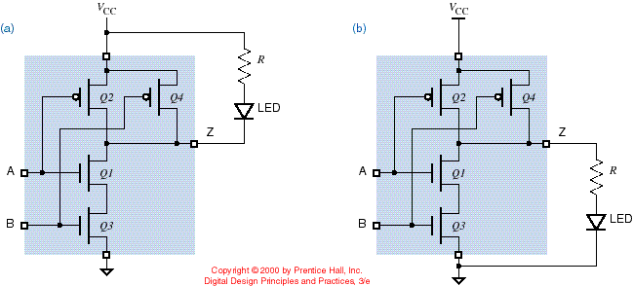
Driving LEDs
LEDS represent “DC loads” and can be interfaced to a CMOS gate output either by sinking current (LOW output) or sourcing current (HIGH output)
Question: Which method is generally preferred?

Slide 32
Example: Based on the data provided in Table 3-3 of the course text, calculate the value of the LED current limiting resistor for the worst case current sinking configuration. Also calculate the amount of power dissipated by the current limiting resistor. Assume V_{LED} is 1.9 volts.

Slide 33
Table 3.3 from DDPP

Slide 34
SOLUTION:
V_{R} = 5.0 – V_{LED} – V_{OL} = 5.0 – 1.9 – 0.33 = 2.77 V
NOTE: Here, use “Max” value indicated for V_{OL} of 0.33 V
R = V_{R}/I_{OL} = 2.77/0.004 = 693 Ω
P_{R} = R x I_{OL}² = 693 x (0.004)² = 11.1 milliwatts
NOTE: Can also calculate power dissipation of resistor using V_{R} x I_{OL} or (V_{R}²)/R
4.0 mA
0.33 VDC

Slide 35
Example: Based on the data provided in Table 3-3 of the course text, calculate the value of the LED current limiting resistor for the worst case current sourcing configuration. Also calculate the amount of power dissipated by the current limiting resistor. Assume V_{LED} is 1.9 volts.

Slide 36
Table 3.3 from DDPP

Slide 37
SOLUTION:
V_{R} = V_{OH} – V_{LED} = 3.84 – 1.9 = 1.94 V
NOTE: Here, use “Min” value indicated for V_{OH} of 3.84 V
R = V_{R}/I_{OH} = 1.94/0.004 = 485 Ω
P_{R} = R x I_{OH}² = 485 x (0.004)² = 7.8 milliwatts
NOTE: Can also calculate power dissipation of resistor using V_{R} x I_{OH} or (V_{R}²)/R
4.0 mA
3.84 VDC

Slide 38
Effects of Excessive Loading
Loading a gate output beyond its rated fan-out can have several deleterious effects:
in the LOW state, the output voltage (VOL) may increase beyond VOL_{max}
in the HIGH state, the output voltage (VOH) may fall below VOH_{min}
output rise and fall times may increase beyond their specifications
the operating temperature of the device may increase, thereby reducing the reliability of the device and eventually causing device failure

Slide 39
Example – DCNM, Family A → Family B
Family “A”
V_{CC} = 5 V | V_{OH} = 4.4 V | V_{OL} = 0.40 V | V_{IH} = 3.60 V | V_{IL} = 1.60 V
V_{TH} = (V_{OH} – V_{OL})/2 | I_{OH} = -4 mA | I_{OL} = 4 mA | I_{IH} = 0.4 μA | I_{IL} = -0.4 μA
Family “B”
V_{CC} = 5 V | V_{OH} = 3.3 V | V_{OL} = 0.30 V | V_{IH} = 2.60 V | V_{IL} = 1.60 V
V_{TH} = (V_{OH} – V_{OL})/2 | I_{OH} = -400 μA | I_{OL} = 8 mA | I_{IH} = 40 μA | I_{IL} = -0.4 mA
DCNM _{A→B} = min(4.4-2.6, 1.6-0.4) = 1.2V
Question: Is this a “good” DCNM (for 5 V CMOS logic)?

Slide 40
Example – DCNM, Family B → Family A
Family “A”
V_{CC} = 5 V | V_{OH} = 4.4 V | V_{OL} = 0.40 V | V_{IH} = 3.60 V | V_{IL} = 1.60 V
V_{TH} = (V_{OH} – V_{OL})/2 | I_{OH} = -4 mA | I_{OL} = 4 mA | I_{IH} = 0.4 μA | I_{IL} = -0.4 μA
Family “B”
V_{CC} = 5 V | V_{OH} = 3.3 V | V_{OL} = 0.30 V | V_{IH} = 2.60 V | V_{IL} = 1.60 V
V_{TH} = (V_{OH} – V_{OL})/2 | I_{OH} = -400 μA | I_{OL} = 8 mA | I_{IH} = 40 μA | I_{IL} = -0.4 mA
DCNM _{B→A} = min(3.3-3.6, 1.6-0.3) = -0.3V
Question: What is the consequence of a negative DCNM?
What is the minimum DCNM required? DCNM > 0

Slide 41
Example – Fan-out, Family A → Family B
Family “A”
V_{CC} = 5 V | V_{OH} = 4.4 V | V_{OL} = 0.40 V | V_{IH} = 3.60 V | V_{IL} = 1.60 V
V_{TH} = (V_{OH} – V_{OL})/2 | I_{OH} = -4 mA | I_{OL} = 4 mA | I_{IH} = 0.4 μA | I_{IL} = -0.4 μA
Family “B”
V_{CC} = 5 V | V_{OH} = 3.3 V | V_{OL} = 0.30 V | V_{IH} = 2.60 V | V_{IL} = 1.60 V
V_{TH} = (V_{OH} – V_{OL})/2 | I_{OH} = -400 μA | I_{OL} = 8 mA | I_{IH} = 40 μA | I_{IL} = -0.4 mA
Fanout _{A→B} = min(4 / 0.04, 4 / 0.4) = 10
Note: Current arrows for I_{O} and I_{I} point in opposite directions
Question: Is it possible for the fan-out to be negative? NO!

Slide 42
Example – Fan-out, Family B → Family A
Family “A”
V_{CC} = 5 V | V_{OH} = 4.4 V | V_{OL} = 0.40 V | V_{IH} = 3.60 V | V_{IL} = 1.60 V
V_{TH} = (V_{OH} – V_{OL})/2 | I_{OH} = -4 mA | I_{OL} = 4 mA | I_{IH} = 0.4 μA | I_{IL} = -0.4 μA
Family “B”
V_{CC} = 5 V | V_{OH} = 3.3 V | V_{OL} = 0.30 V | V_{IH} = 2.60 V | V_{IL} = 1.60 V
V_{TH} = (V_{OH} – V_{OL})/2 | I_{OH} = -400 μA | I_{OL} = 8 mA | I_{IH} = 40 μA | I_{IL} = -0.4 mA
Fanout _{B→A} = min(400/0.4, 8/0.0004) = 1000
Question: What is the minimum fan-out required?
Fan-out ≥ 1

Slide 43
ECE 477 Digital Systems Senior Design Project
Module 2-C
Propagation Delay and Transition Time

Slide 44
Reading Assignment: DDPP 4th Ed., pp. 114-122 Learning Objectives:
Define propagation delay and list the factors that contribute to it
Define transition time and list the factors that contribute to it
Estimate the transition time of a CMOS gate output based on the “on” resistance of the active device and the capacitive load
Describe ways in which load capacitance can be minimized

Slide 45
Outline
Overview
Propagation delay
Transition time
Equivalent circuit transition time analysis
Calculation
Estimation
Load capacitance

Slide 46
Overview
The speed and power dissipation of a CMOS device depend on the dynamic (“AC”) characteristics of the device and its load
Logic designers must carefully examine the effects of output loading and redesign where the loading is too high
Speed (performance) depends on two characteristics:
propagation delay
transition time

Slide 47
Time Matters
Logic gates require a certain amount of “think time” to produce a new output in response to changing inputs – referred to as the propagation delay of the gate
Logic gate outputs can not change from a low voltage to a high voltage (or vice-versa) “instantaneously” – referred to as the transition time of the gate
A timing diagram can be used to show how a logic circuit responds to time-varying input signals

Slide 48
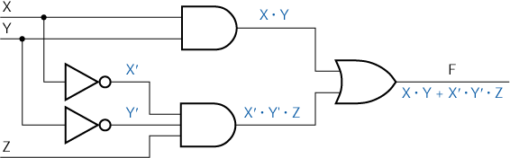
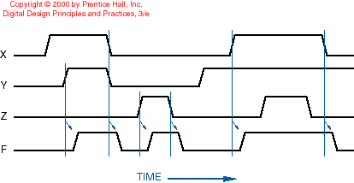
Time Matters
Time response of a combinational circuit

Slide 49
Propagation Delay – Definition
Definition: The electrical path from a particular input signal of a logic element to its output signal is called a signal path
Definition: The amount of time it takes for a change in an input signal to cause a corresponding change in a gate’s output signal is called the propagation delay (tp)
The propagation delay for an output signal going from LOW-to-HIGH (tPLH) may be different than the propagation delay of that signal going from HIGH-to-LOW (tPHL)

Slide 50
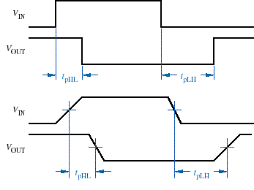
Propagation Delay – Measurement
Ignoring rise and fall times
Measured at midpoints of transitions

Slide 51
Propagation Delay – Why Non-zero
Several factors lead to non-zero propagation delays in CMOS circuits:
the rate at which transistors change state is influenced both by semiconductor physics and the circuit environment (input signal transition time, input capacitance, and output loading)
multistage devices (e.g., non-inverting gates) may require several internal transistors to change state before the output can change state

Slide 52
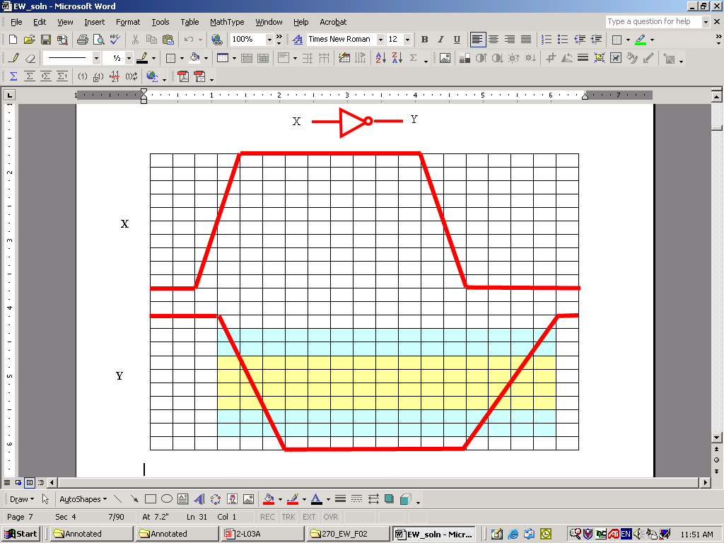
Example – Propagation Delay Measurement
Find each of the following, rounded to the nearest ½ ns (assume each division is 1 ns)
Rise propagation delay (t_{PLH}) = 3 ns
Fall propagation delay (t_{PHL}) = 1.5 ns

Slide 53
Transition Time – Definition
Definition: The amount of time that the output of a logic circuit takes to change from one state to another
rise time (tr or tTLH): the time an output signal takes to transition from low-to-high
fall time (tf or tTHL): the time an output signal takes to transition from high-to-low
Gate outputs can not change state instantaneously (i.e., with a transition time of zero) because they need to charge the stray capacitance of the wires and other components they drive

Slide 54
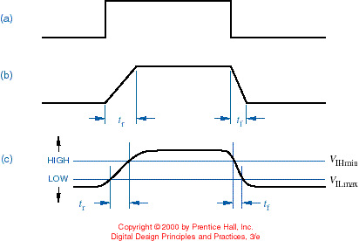
Transition Time – Measurement
“ideal”
“less ideal”
“reality”
Note: tf is typically not equal to tr

Slide 55
Transition Time – Endpoints
To avoid difficulties in defining the endpoints, transition times are normally measured one of two different ways:
at the boundaries of the valid logic levels (i.e., VIH_{min} and VIL_{max})
at the 10% and 90% points of the output waveform
Using the first convention (above), the rise and fall times indicate how long it takes for an output signal to pass through the (undefined) indeterminate region between LOW and HIGH

Slide 56
Example – Transition Time Measurement
Find each of the following, rounded to the nearest ½ ns (assume each division is 1 ns)
Rise time (t_{TLH}) based on Wakerly’s (30%-70%) definition = 2 ns
Rise time (t_{TLH}) based on standard 10%-90% definition = 3.5 ns
Fall time (t_{THL}) based on Wakerly’s (70%-30%) definition = 1 ns
Fall time (t_{THL}) based on standard 90%-10% definition = 2.5 ns

Slide 57
Transition Time – Factors
The transition times of a CMOS circuit depend mainly on two factors:
the “on” transistor resistance
the load capacitance
Stray capacitance (called an “AC load”) arises from at least three different sources:
output circuits – including transistors, internal wiring, and packaging
wiring that connects a gate output to other gate inputs
input circuits – including transistors, internal wiring, and packaging

Slide 58
Transition Time – Equivalent Circuit
A gate output’s load can be modeled by an equivalent load circuit with 3 components:
RL and VL represent the DC load – they determine the steady state voltages and currents present and do not have much effect on transition times
CL represents the AC (capacitive) load – it determines the voltages and currents present while the output is changing, as well as how long it takes to change from one state to another

Slide 59
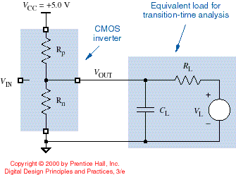
Equivalent Circuit for Transition Time Analysis of a CMOS Output

Slide 60
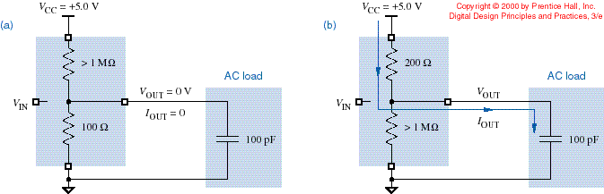
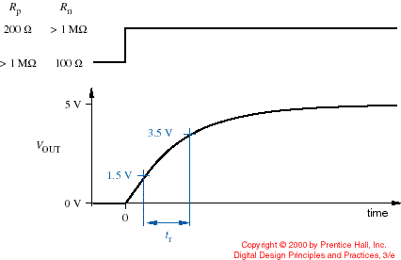
Model of a CMOS LOW-to-HIGH Transition (with Negligible DC Load)
Capacitor is initially discharged
C_{L}
R_{P}
rise time
VIH_{min}
The time constant is R_{P}C_{L}
VIL_{max}

Slide 61
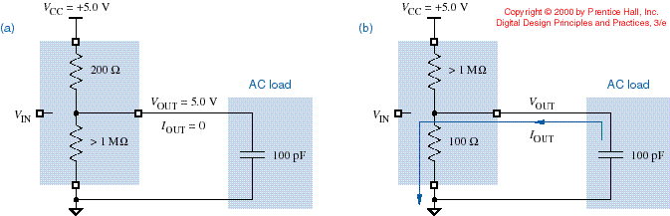
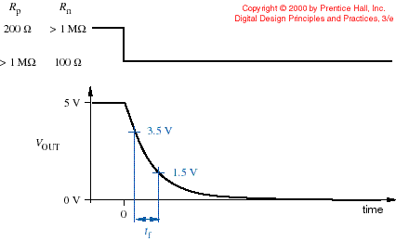
Model of a CMOS HIGH-to-LOW Transition (with Negligible DC Load)
Capacitor is initially charged
C_{L}
R_{N}
fall time
VIH_{min}
The time constant is R_{N}C_{L}
VIL_{max}

Slide 62
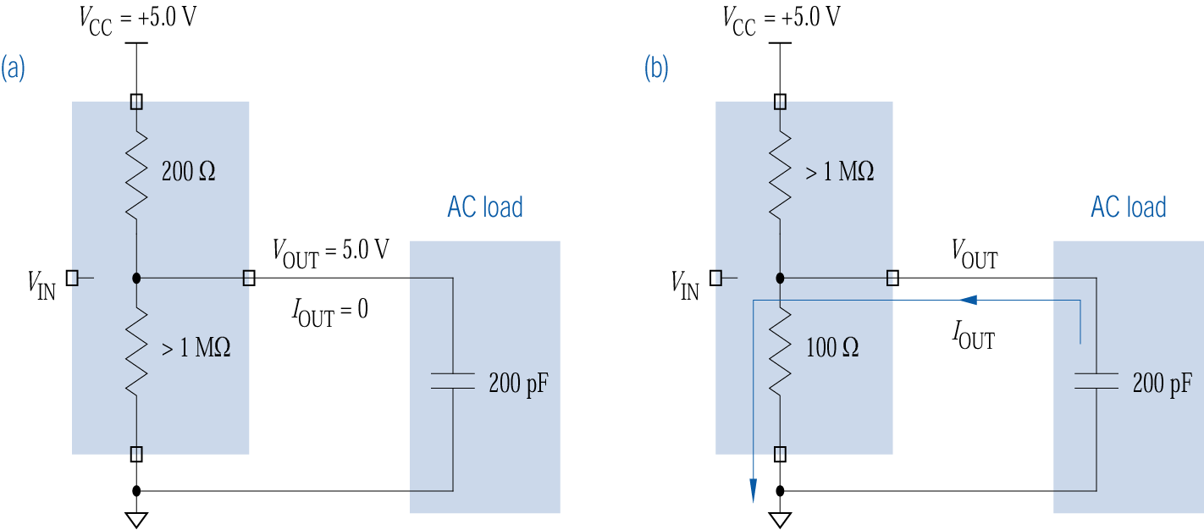
Example
Given that a CMOS inverter’s P-channel MOSFET has an ON resistance of 200Ω, that its N-channel MOSFET has an ON resistance of 100Ω, and that the capacitive (or AC) load C_{L} = 200 pF, calculate the fall time
initial conditions

Slide 63
Example – Fall Time Calculation
Given that a CMOS inverter’s P-channel MOSFET has an ON resistance of 200Ω, that its N-channel MOSFET has an ON resistance of 100Ω, and that the capacitive (or AC) load C_{L} = 200 pF, calculate the fall time
initial conditions
output goes low

Slide 64
Example – Fall Time Calculation
V_{IHmin}
V_{ILmax}
t = –R_{n}∗C_{L}∗ln (V_{out}/V_{DD})
= –100∗200∗10^{–12}∗ln (V_{out} / 5.0)
= –20∗10⁻⁹∗ln (V_{out} / 5.0)
t_{3.5} = –20∗10⁻⁹∗ln (3.5/5.0) = 7.13 ns
t_{1.5} = –20∗10⁻⁹∗ln (1.5/5.0) = 24.08 ns
t_{PHL} = t_{f} (fall time) = 24.08 – 7.13 = 16.95 ns
Note: Calculated transition times are sensitive to the choice of logic levels (i.e., V_{IHmin} and V_{ILmax})

Slide 65
Transition Time Estimation
Rule of Thumb: In practical circuits, the transition time can be estimated using the RC time constant of the charging or discharging circuit

Slide 66
Example – Transition Time Estimates
Given that a CMOS inverter’s P-channel MOSFET has an ON resistance of 200Ω, that its N-channel MOSFET has an ON resistance of 100Ω, and that the capacitive (or “A.C.”) load C_{L} = 200 pF, estimate the fall time and rise time
Fall time estimate:
R_{N} X C_{L} = 100 X 200 pF
= 1 X 10² X 2 X 10⁻¹⁰
= 2 X 10⁻⁸ = 20 X 10⁻⁹
= 20 ns
Rise time estimate:
R_{P} X C_{L} = 200 X 200 pF
= 2 X 10² X 2 X 10⁻¹⁰
= 4 X 10⁻⁸ = 40 X 10⁻⁹
= 40 ns

Slide 67
Load Capacitance
Conclusion: An increase in load capacitance causes an increase in the RC time constant and a corresponding increase in the output transition (rise/fall) times
Load capacitance must be minimized to obtain high circuit performance – this can be achieved by:
minimizing the number of inputs driven by a given signal
creating multiple copies of the signal (using “buffers”)
careful physical layout of the circuit

Slide 68
ECE 477 Digital Systems Senior Design Project
Module 2-D
Power Consumption and Decoupling

Slide 69
Reading Assignment: DDPP 4th Ed., pp. 122-124 Learning Objectives:
Identify sources of dynamic power dissipation
Plot power dissipation of CMOS logic circuits as a function of operating frequency
Plot power dissipation of CMOS logic circuits as a function of power supply voltage
Describe the function and utility of decoupling capacitors

Slide 70
Outline
Overview
Dynamic power dissipation
Power dissipation as a function of operating frequency
Power dissipation as a function of supply voltage
Current spikes and decoupling

Slide 71
Overview
Definition: The power dissipation (consumption) of a CMOS circuit whose output is not changing is called static (quiescent) power dissipation
Most CMOS circuits have very low static power dissipation
CMOS circuits only dissipate a significant amount of power during transitions – this is called dynamic power dissipation

Slide 72
Dynamic Power Dissipation
Sources of dynamic power dissipation:
the partial “short-circuiting” of the CMOS output structure (e.g., when the input voltage is not close to one of the power supply rails) – called “P_{T}” (power due to output transitions)
the capacitive load on the output (power is dissipated in the “on” resistance of the active transistor to charge/discharge the capacitive load) – called “P_{L}” (power due to charging/discharging load)

Slide 73
Power Consumption
Total dynamic power dissipation (P_{T} + P_{L}) is proportional to the square of the power supply voltage times the transition frequency
Conclusions:
power dissipation increases linearly as the frequency of operation increases
reducing the power supply voltage results in a quadratic reduction of the power dissipation

Slide 74
Example - A microcontroller can operate over a frequency range of 0 Hz to 10 MHz, and dissipates 100 mW when operated at 10 MHz; plot its power dissipation over the specified frequency range

Slide 75
Example - A microcontroller can operate over a power supply range of 1 to 5 volts, and dissipates 100 mW when operated at 5 VDC; plot its power dissipation over the specified power supply range
100 x (4/5)² = 64
100 x (3/5)² = 36
100 x (2/5)² = 16
100 x (1/5)² = 4

Slide 76
Current Spikes and Decoupling
When a CMOS gate output changes state, the P- and N-channel transistors are both partially on simultaneously, causing a current spike
Current spikes often show up as noise on the power supply and ground connections
Decoupling capacitors (between Vcc and GND) must be distributed throughout a printed circuit board (PCB) to serve as a source of instantaneous current during output transitions – this helps mitigate noise and improve signal quality

Slide 77
Decoupling Capacitors
Decoupling capacitors should be located as physically close as possible to each IC
Use 0.1 μF decoupling capacitors for system frequencies up to 15 MHz
Above 15 MHz, use 0.01 μF decoupling capacitors

Slide 78
ECE 477 Digital Systems Senior Design Project
Module 2-E
Three-State and Open-Drain Outputs

Slide 79
Reading Assignment: DDPP 4th Ed., pp. 132-136, 138-141 Learning Objectives:
Define high-impedance state and describe the operation of a tri-state buffer
Define open drain as it applies to a CMOS logic gate output and calculate the value of pull-up resistor needed
Describe how to create “wired logic” functions using open drain logic gates
Calculate the value of pull-up resistor needed for an open drain logic gate

Slide 80
Outline
Three-state (tri-state) outputs
CMOS tri-state buffer circuit
Tri-state buffer application – buses
Tri-state buffer float delay
Open drain outputs
Driving LEDs
Wired logic
Pull-up resistor calculations

Slide 81
Three-State (Tri-State) Outputs
Definition: A gate output that has a third “electrical state” is called a three-state output (or tri-state output)
This third electrical state is called the high impedance, Hi-Z, or floating state
In the high impedance state, the gate output effectively appears to be disconnected from the rest of the circuit
Three-state devices have an extra input, typically called the Output Enable (OE), for enabling data to “flow through” the device (when asserted) or placing the output in the high impedance state (when negated)

Slide 82
Basic CMOS Logic Circuit Revisited
Calculate V_{out} for the case A=5V, B=0
P-ch device is “off” (R_{DS} = 500,000 Ω)
N-ch device is “off” (R_{DS} = 500,000 Ω )
V_{out} = 5 x (500,000 / 1,000,000) = 2.5 V
P_{dissipation} = 5² / 1,000,000 = 0.025 mW
Here, Vout is effectively disconnected (in the “Hi-Z state”) when A is high and B is low
Use OE (output enable) signal to force A high and B low when OE is negated

Slide 83
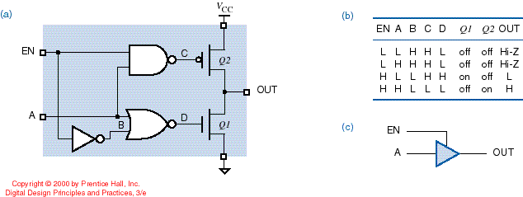
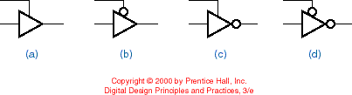
CMOS Tri-State Buffer Circuit
H
L
Hi-Z
L
L
Basic variations: The buffer may be inverting or non-inverting, and the tri-state enable can either be active low or active high

Slide 84
CMOS Tri-State Buffer Circuit
H
H
L
L
H
Basic variations: The buffer may be inverting or non-inverting, and the tri-state enable can either be active low or active high

Slide 85
CMOS Tri-State Buffer Circuit
L
H
H
H
L
Basic variations: The buffer may be inverting or non-inverting, and the tri-state enable can either be active low or active high

Slide 86
Tri-State Buffer Application – Buses
The most common use of tri-state buffers is to create data buses over which digital subsystems can (bi-directionally) send and receive data
Definition: A bus is a collection of signals with a “common purpose” (e.g., sending the address of an item in memory, sending the data to be written to memory, etc.)
A bus transceiver contains pairs of tri-state buffers connected in opposite directions between each pair of pins, so that data can be transferred in either direction

Slide 87
Tri-State Buffer Float Delay
Tri-state outputs are typically designed so that they go into the Hi-Z (high impedance) state faster than they come out of the Hi-Z state (i.e., t_{pLZ} and t_{pHZ} are both less than t_{pZL} and t_{pZH})
The time it takes to go from a “driven” state (valid logic level) to the Hi-Z “floating” state is called the float delay
Given this “rule”, if one tri-state device is disabled and another tri-state device is enabled simultaneously, then the first device will get off the bus before the second one gets on – this helps prevent fighting

Slide 88
Open-Drain Outputs
Definition: A CMOS output structure that does not include a P-channel (pull-up) transistor is called an open-drain output
An open-drain output is in one of two states: LOW or “open” (i.e., disconnected)
An underscored diamond (or “O.D.”) is used to indicate that an output is open drain
An open-drain output requires an external pull-up resistor to passively pull it high in the “open” state (since the output structure does NOT include a P-channel active pull-up)

Slide 89
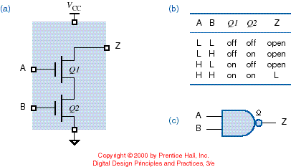
Open-Drain CMOS NAND Gate
H
H
O.D.
Symbol that denotes an open-drain output

Slide 90
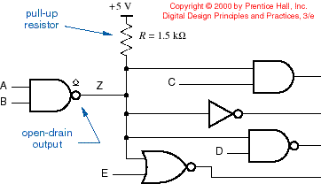
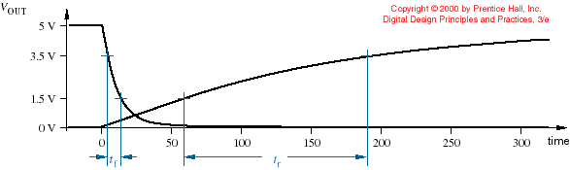
Open-Drain Gate Driving a Load
O.D.
Note: Rise time of an OD output is much slower than that of a standard gate

Slide 91
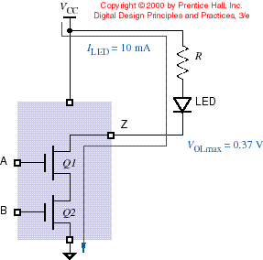
Driving LEDs
One application for open-drain outputs is driving light-emitting diodes (LEDs)
O.D. outputs can typically sink more current than conventional gates
R = (VCC – VOL – VLED) / ILED

Slide 92
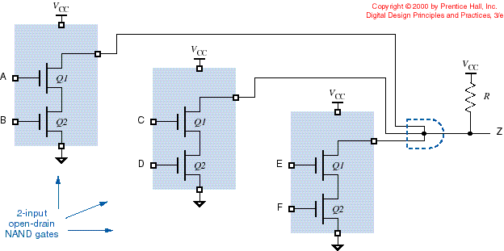
Wired Logic
Definition: Wired logic is performed if the outputs of several open-drain gates are tied together with a single pull-up resistor
NOT an actual gate!
Caution: This ONLY works for open-drain outputs!

Slide 93
Pull-up Resistor Calculations
In open-drain applications, two calculations bracket the allowable values of the pull-up resistor R:
LOW The sum of the current through R plus the LOW state input currents of the gate inputs driven must not exceed the IOL_{max} of the active device
HIGH The voltage drop across R in the HIGH state must not reduce the output voltage below the VIH_{min} of the driven gate inputs

Slide 94
Example - Calculate a suitable value of pull-up resistor to use with the following circuit:
Specifications (hypothetical data):
Off-state leakage current of O.D. NAND gate output: +3 μA
I_{IH} and I_{IL} required by inverter input: ±1 μA
V_{IH} desired for inverter input: 4.9 V
I_{OL} _{max} of O.D. NAND gate output: +10 mA @ V_{OL} = 0.3 V

Slide 95
Solution, maximum R Value – based on V_{IH} desired
+
V_{R}

10 μA
3 μA
1 μA
L
L
3 μA
L
L
V_{R} = 0.1 V I_{R} = 10 μA
R_{max} = 0.1/0.00001 = 10,000 Ω
3 μA
L
L
Specifications (hypothetical data):
Off-state leakage current of O.D. NAND gate output: +3 μA
I_{IH} and I_{IL} required by inverter input: ±1 μA
V_{IH} desired for inverter input: 4.9 V
I_{OL} _{max} of O.D. NAND gate output: +10 mA @ V_{OL} = 0.3 V

Slide 96
Solution, minimum R Value – based on I_{OL max} of one gate
This represents the “worst case” for I_{OL} – why?
+
V_{R}

Here, can safely ignore leakage and I_{IL} currents – why?
≈ 10 mA
3 μA
1 μA
L
L
3 μA
L
L
V_{R} = 4.7 V I_{R} ≈ 10 mA
R_{min} = 4.7/0.01 = 470 Ω
10 mA
H
H
Specifications (hypothetical data):
Off-state leakage current of O.D. NAND gate output: +3 μA
I_{IH} and I_{IL} required by inverter input: ±1 μA
V_{IH} desired for inverter input: 4.9 V
I_{OL} _{max} of O.D. NAND gate output: +10 mA @ V_{OL} = 0.3 V

Slide 97
Conclusion – a pull-up resistor ranging from 470 Ω (R_{min}) to 10,000 Ω (R_{max}) will satisfy the specified constraints
Note: Picking R_{min} will minimize the rise time, while picking R_{max} will minimize the power dissipation
Specifications (hypothetical data):
Off-state leakage current of O.D. NAND gate output: +3 μA
I_{IH} and I_{IL} required by inverter input: ±1 μA
V_{IH} desired for inverter input: 4.9 V
I_{OL} _{max} of O.D. NAND gate output: +10 mA @ V_{OL} = 0.3 V

Slide 98
Follow-up – “prove” the “worst case” scenario (R = 470 Ω)
This represents the “worst case” for I_{OL} – why?
Power dissipation of circuit is I_{R}² x R_{eq} = 0.01² x 500 ≈ 50 mW
+
V_{R}

≈ 10 mA
3 μA
1 μA
L
L
3 μA
Means that the “on” resistance of an O.D. NAND gate used here is V_{OL} / I_{OLmax} = 0.3/0.01 = 30 Ω
L
L
10 mA
The equivalent load impedance of circuit (across power supply) is 470+30 = 500 Ω
H
H
Specifications (hypothetical data):
Off-state leakage current of O.D. NAND gate output: +3 μA
I_{IH} and I_{IL} required by inverter input: ±1 μA
V_{IH} desired for inverter input: 4.9 V
I_{OL} _{max} of O.D. NAND gate output: +10 mA @ V_{OL} = 0.3 V

Slide 99
Follow-up – “prove” the “worst case” scenario (R = 470 Ω)
Can still safely ignore leakage and I_{IL} currents – why?
Power dissipation of circuit is I_{R}² x R_{eq} = 0.0103² x 485 ≈ 51.5 mW
+
V_{R}

≈ 10.3 mA
3 μA
1 μA
L
L
5.15 mA
H
H
5.15 mA
H
H
Next, turn on two O.D. gates
The equivalent load impedance of circuit is 470+15 = 485 Ω (because have two 30 Ω “on” resistances in parallel)
I_{R} is now 5 / 485 = 0.0103 A = 10.3 mA, which is split between the two gates that are “on”

Slide 100
Follow-up – “prove” the “worst case” scenario (R = 470 Ω)
Can still safely ignore leakage and I_{IL} currents – why?
Power dissipation of circuit is I_{R}² x R_{eq} = 0.0104² x 480 ≈ 52 mW
+
V_{R}

≈ 10.4 mA
3.47 mA
1 μA
H
H
3.47 mA
Conclusions: As more O.D. gates are turned on, the amount of current each of them (individually) has to sink is reduced; therefore, the first case (single gate “on”) is the “worst” one with respect to I_{OL.}
Also, power dissipation increases slightly as more O.D. gates are turned on.
H
H
3.47 mA
H
H
Finally, turn on all three O.D. gates
The equivalent load impedance of circuit is 470+10 = 480 Ω (because have three 30 Ω “on” resistances in parallel)
I_{R} is now 5 / 480 = 0.0104 A = 10.4 mA, which is split among the three gates that are “on”

Slide 101
Follow-up – compare power dissipation of circuit using R_{min} vs. R_{max} as the pull-up resistor
+
V_{R}

≈ 0.5 mA
R_{max} (10,000 Ω)
0.167 mA
1 μA
H
H
0.167 mA
For case where all gates are on:
R_{eq} = 10,000 + 10 = 10,010 Ω
(recall “on” resistance of each gate is 30 Ω)
I_{R} ≈ 5 / 10,010 ≈ 0.5 mA (note - split among three gate outputs)
P_{dissipation} = I_{R}² x R_{eq} ≈ 2.5 mW
H
H
0.167 mA
H
H
Note: V_{IL} of inverter is nearly 0 V

Slide 102
Follow-up – compare power dissipation of circuit using R_{min} vs. R_{max} as the pull-up resistor
+
V_{R}

10 μA
R_{max} (10,000 Ω)
3 μA
1 μA
L
L
3 μA
L
L
For case where all gates are off:
V_{R} = 0.1 V I_{R} = 10 μA
P_{dissipation} = I_{R}² x R = 1 μW
3 μA
L
L
Conclusion: Power dissipation when R_{max} is used does not exceed 2.5 mW (vs. 52 mW for R_{min}); therefore, use of R_{max} minimizes the power dissipation
Note: V_{IH} of inverter is 4.9 V

Slide 103
Follow-up – compare rise time estimates of circuit using R_{min} vs. R_{max} as the pull-up resistor
Here, need to know the capacitive load (C_{L}); for the sake of analysis, assume it is 100 pF
Comparison:
For R_{min,} rise time estimate is 470 x 100 x 10⁻¹² = 47 ns
For R_{max,} rise time estimate is 10,000 x 100 x 10⁻¹² = 1000 ns
Conclusion: rise time for R_{max} case is considerably longer

Slide 104
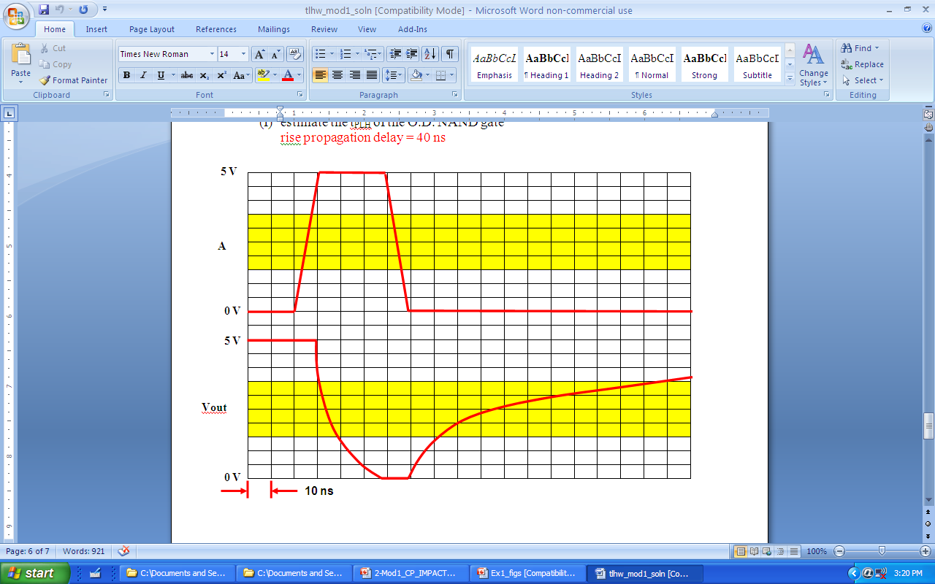
Example – Estimate the “on” resistance of an O.D. gate and pull-up resistor value based on rise/fall times

Slide 105
Example – Estimate the “on” resistance of an O.D. gate and pull-up resistor value based on rise/fall times
fall time = 10 ns = R_{on} x 100 pF → R_{on} = 100Ω

Slide 106
Example – Estimate the “on” resistance of an O.D. gate and pull-up resistor value based on rise/fall times
rise time = 100 ns = R_{pull-up} x 100 pF → R_{pull-up} = 1000 Ω

