Slide 1
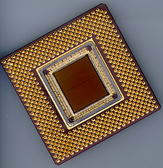
ECE 477 Digital Systems Senior Design Project
© 2014 by D. G. Meyer
Module 9
Board Assembly and Soldering Techniques

Slide 2
Outline
“I’ve got my board, now what?”
“Which end of this thing gets hot?”
“Flux is your friend.”
“Static is your enemy.”
“Do unto your iron, as you would have it do unto you.”
“Everything is awesome, everything is cool when we’re part of a team.”

Slide 3
“I’ve got my board, now what?” - 1
Visually inspect board against printout of top/bottom copper
Confirm footprint and drill size of all parts
Minimum trace: 0.0049”
Minimum space: 0.0045”
Minimum finished hole size: 0.010”
If necessary, use drill press in lab to drill out any holes that need to be enlarged (e.g., headers)
Problem: your vias will already be plated!
Look for shorted traces and traces that got etched away (will be limited need to do this)
Using a sharp hobby knife, carefully scrape away copper that did not get etched between traces
“Fly wire” any traces that got etched away
If “major” problems – contact fab house for replacement

Slide 4
“I’ve got my board, now what?” - 2
“Ohm out” traces, especially those with vias
probably not essential if you used traces > 8mil
Install power supply components (diodes, voltage regulators, filter capacitors, etc.)
never ever attempt to solder a “live circuit”
test and “burn in” your power supply
measure all supply voltages and look at them on an oscilloscope to determine how “quiet” they are
make sure correct supply voltage appears at correct pins of each IC and that, under load (a resistor), are within tolerance
note that some SMPS circuits will not function without a load – use an appropriately sized resistor

Slide 5
“I’ve got my board, now what?” - 3
Install all bulk and bypass capacitors and test all supply rails again to make sure nothing got “shorted” in the process
Install microcontroller, reset circuit, crystal (or oscillator) circuit, flash programming header, and any other test points/headers
power up the board and “smoke test” (hint: if the microcontroller starts to get warm real fast, something is wrong!)
load a simple “heartbeat” program that toggles a port pin – verify basic functionality

Slide 6
“I’ve got my board, now what?” - 4
Install RS232 level translator chip (where applicable) and associated components (9-pin D connector, capacitors, etc.)
power up and “smoke test”
load a simple program that “echoes” data to/from a virtual terminal – verify basic functionality “HELLO WORLD”
Add each interface circuit to your board block-by-block and “smoke test” each one as well as test/verify functionality

Slide 7
“I’ve got my board, now what?” - 5
It is very important that each interface circuit be constructed and tested block-by-block!
Don’t add “new” circuitry until all the “existing” circuitry is fully functional!!
NOTE: If you need to “fly wire” any signal traces, use 30 gauge “wire-wrap” wire (use thicker wire, e.g., solid 24 gauge, for power and ground connections)

Slide 8
“Which end of this thing gets hot?” - 1
Heat transfer: solder will flow from the colder region to the warmer region if it can
Secret
choose the right iron tip (and temperature) so the warm region will be effective
position the iron correctly so the solder flows in a path that makes sense
provide an environment for the solder to flow – need flux and clean, smooth metal surface
never ever attempt to solder a “live circuit”

Slide 9
“Which end of this thing gets hot?” - 2
Tip selection
different types: point, blade, chisel
bottom line: want to “match” geometry of surface area warmed by tip with geometry of surface area to be soldered
conical (point) tip → circular area
screwdriver (blade) tip → rectangular area
chisel tip → triangular region
if the tip is too small, it is difficult to get enough heat transfer for the solder to flow
if the tip is too large, the flow of solder cannot be contained in a small area

Slide 10
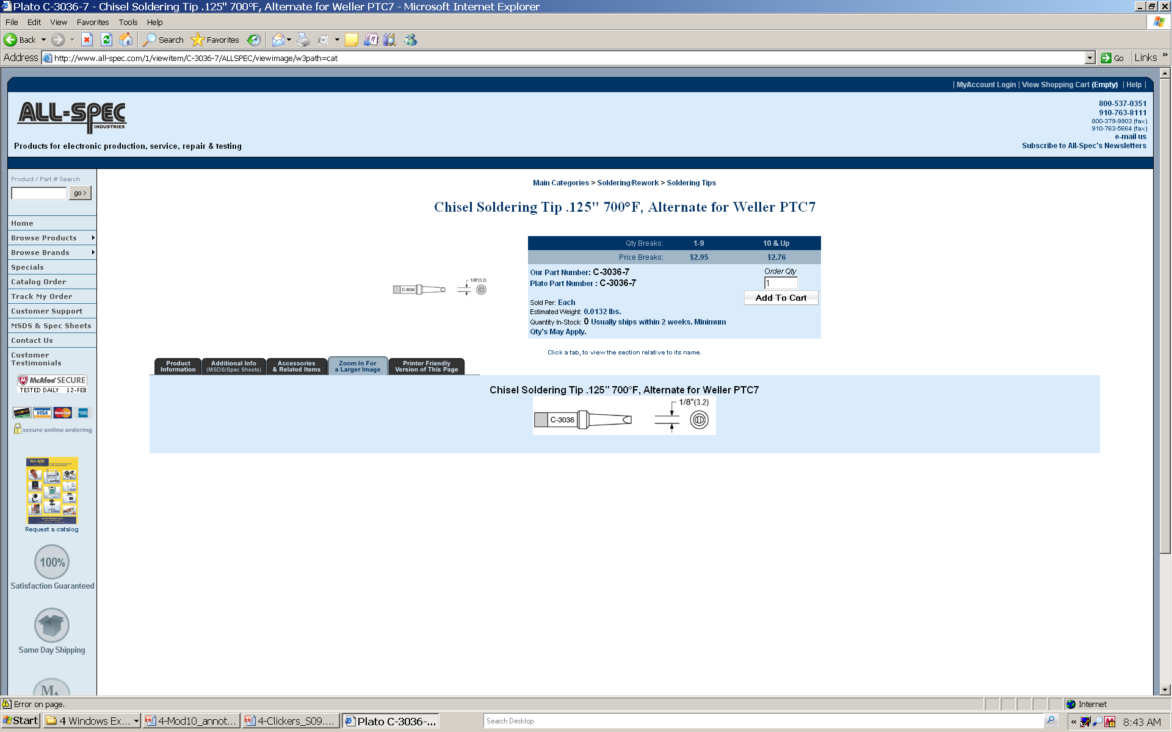
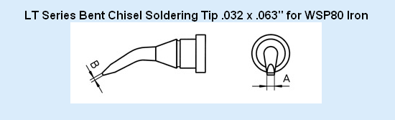

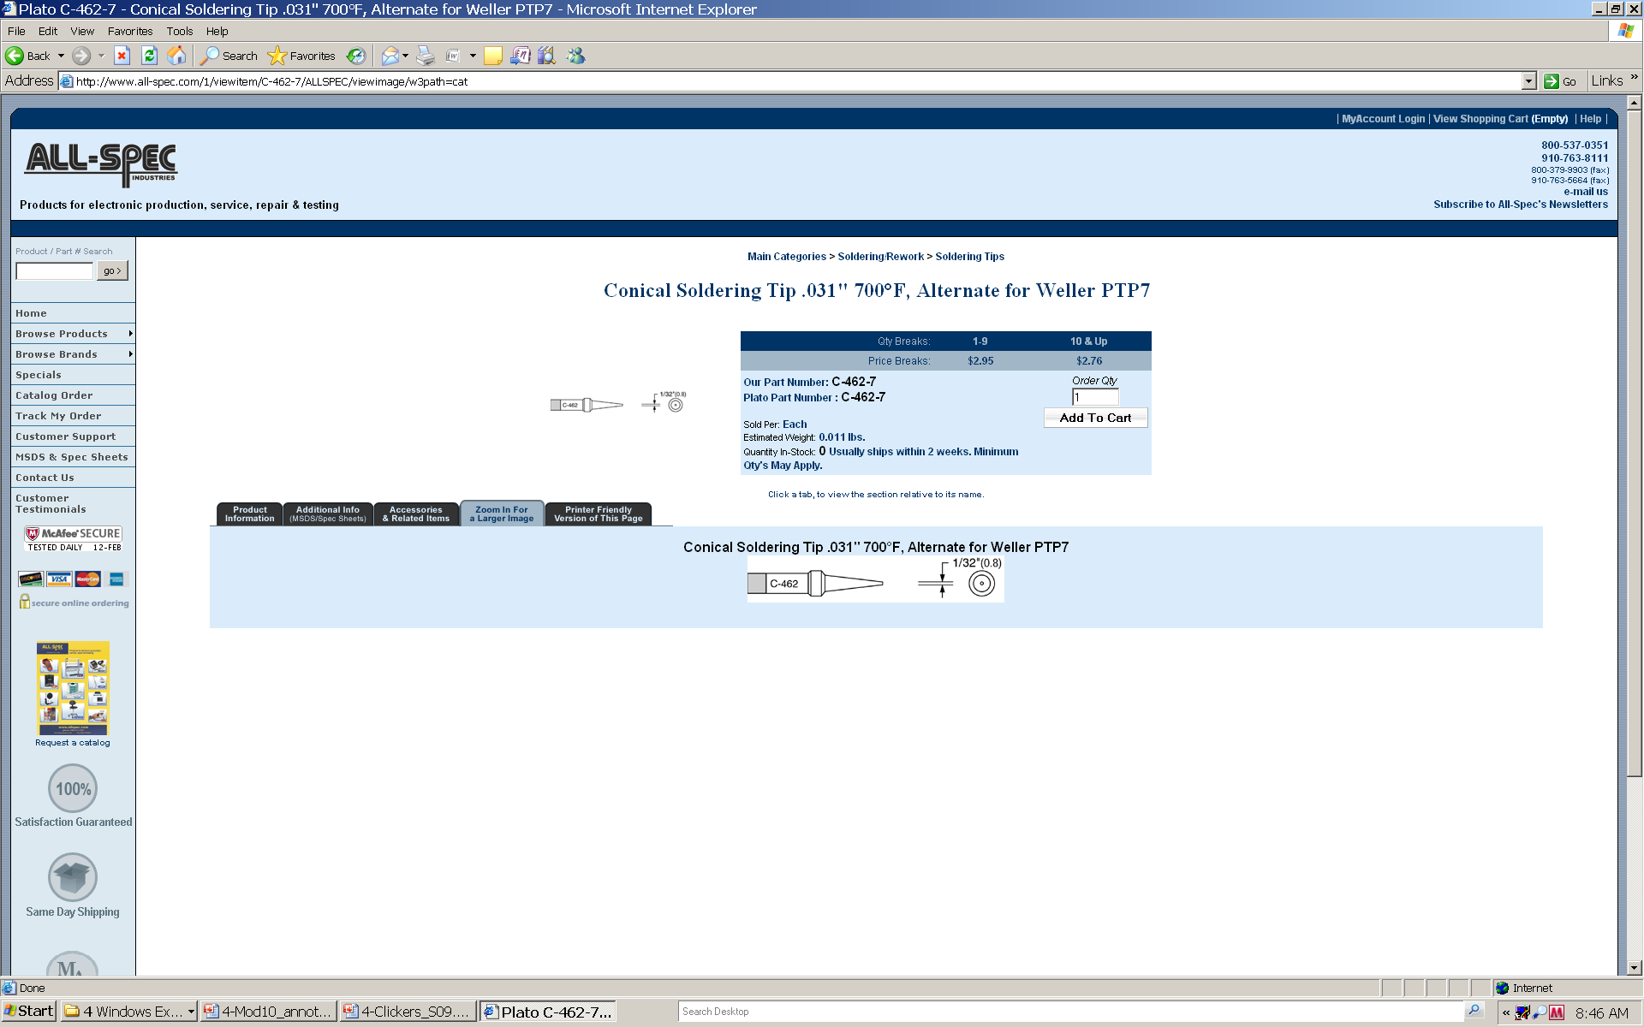
Name That Tip
chisel (bevel)
bent chisel
screwdriver (blade)
conical (point)

Slide 11
“Which end of this thing gets hot?” - 3
Tip selection
note that chisel (bevel) and screwdriver tips can be very useful for:
soldering groups of pins “at once” on surface-mount devices
removing “solder bridges” among several pins at once
Basic soldering technique
if needed, apply flux with pen/brush (e.g., for fine-pitch surface-mount components)
heat area with iron tip (2-3 seconds)
apply solder and allow to flow
remove heat and allow to cool

Slide 12
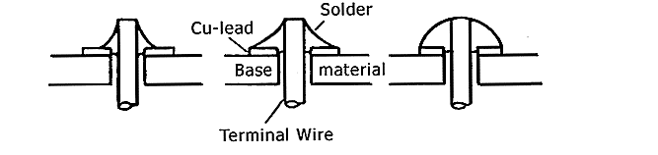
Using the Right Amount of Solder
Minimal b) Optimal c) Excessive
see http://www.elexp.com/t_solder.htm

Slide 13
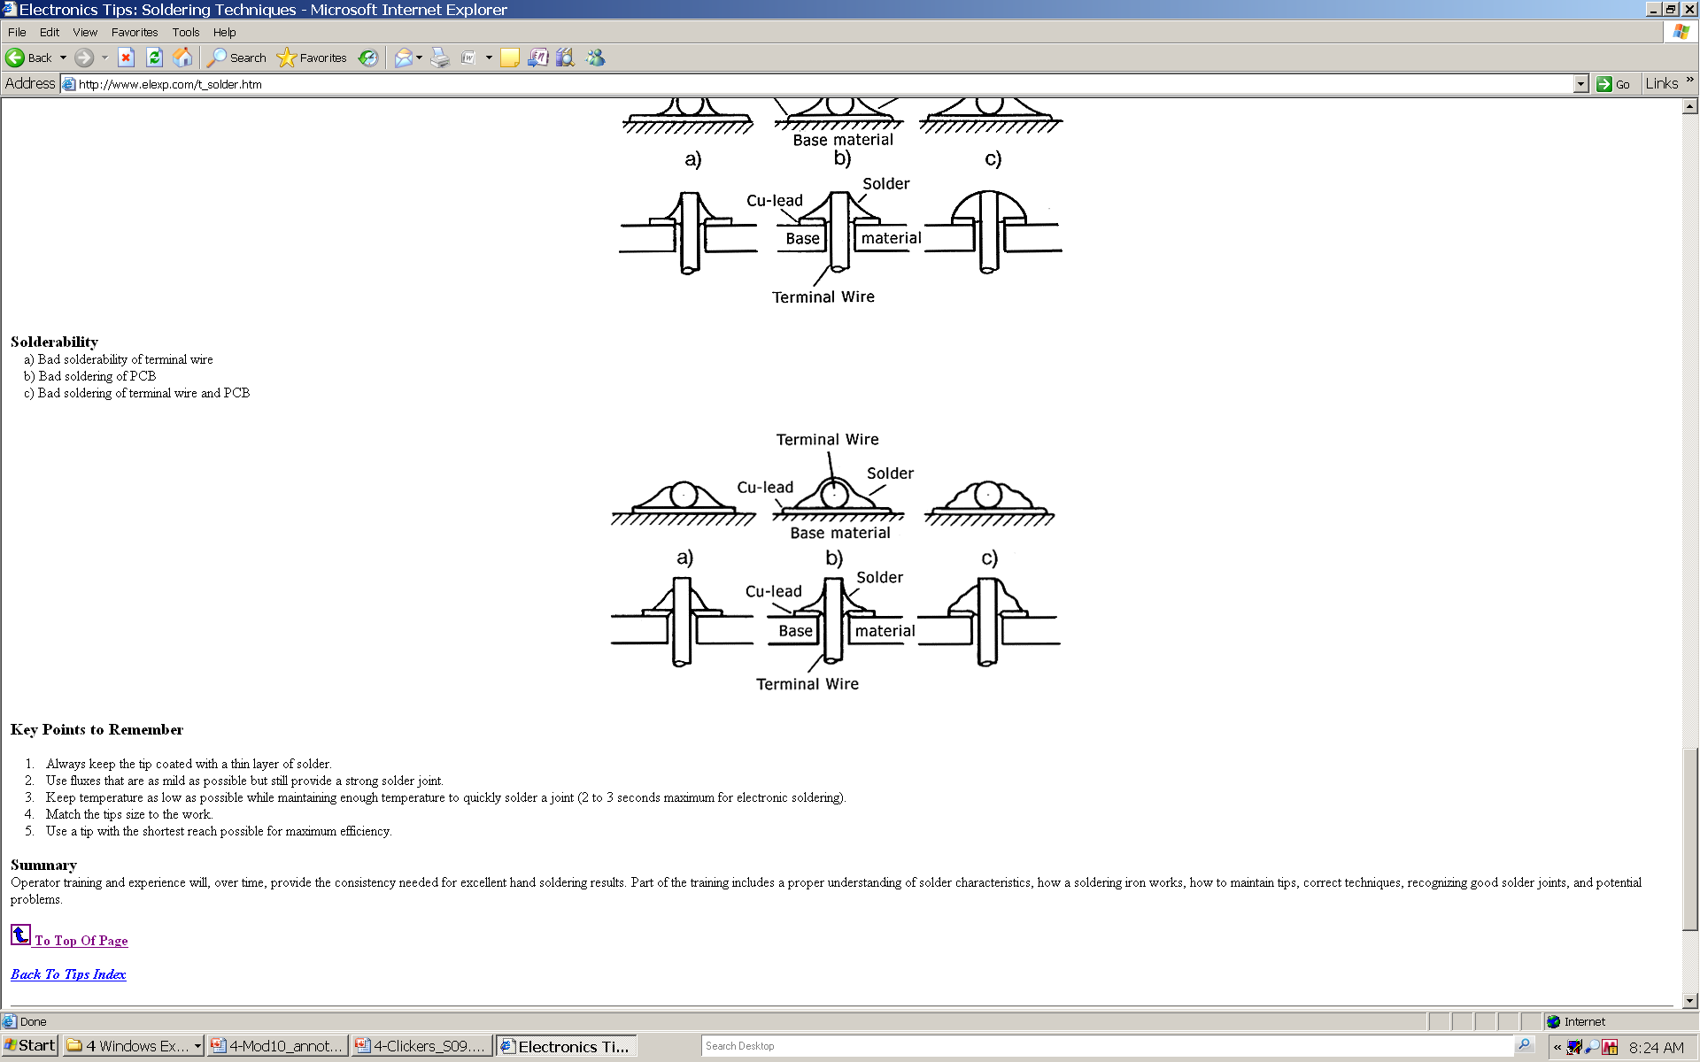
What’s Wrong With These Pictures?
see http://www.elexp.com/t_solder.htm

Slide 14
What’s Wrong With These Pictures?
Bad soldering of terminal wire
see http://www.elexp.com/t_solder.htm

Slide 15
What’s Wrong With These Pictures?
Bad soldering of terminal wire
Bad soldering of PCB pad
see http://www.elexp.com/t_solder.htm

Slide 16
What’s Wrong With These Pictures?
Bad soldering of terminal wire
Bad soldering of both (solder did not flow properly)
Bad soldering of PCB pad
see http://www.elexp.com/t_solder.htm

Slide 17
“Which end of this thing gets hot?” - 4
Solder removal (de-soldering)
apply flux (if necessary)
heat area to be de-soldered (surface-mount parts require a special heat gun to do this)
use solder wick (copper braid) or “solder sucker” to remove solder
Cautions
“cold” solder joints (solder did not flow)
too much heat (components will be damaged and/or traces will peel off board)
access (be careful about assembly order!)
examine solder joints of surface mount components using microscope

Slide 18
“Flux is your friend.”
Flux is a liquid in which solder can flow
Most “electronic” solder contains some flux
Without flux, solder will be pasty and sticky (refuse to flow)
The secret to soldering is using flux to make solder flow, and then controlling the heat so it flows under control

Slide 19
“Static is your enemy.”
Many of the parts you will be using are static sensitive (can be damaged by ESD)
To avoid damaging your components, do all of your board construction on the anti-static (gray or blue) mats in lab
When soldering, use an anti-static wrist band and make sure it is connected to ground

Slide 20
“Do unto your iron, as you would have it do unto you.”
Wet the sponge with distilled water before you begin
Choose the iron with the appropriate tip for the job and set the temperature accordingly (bent chisel is a good place to start)
Tin and clean the tip before starting
Clean the tip frequently during use
Tin the tip when you are finished and TURN OFF the iron
Use soldering irons only for soldering!

Slide 21
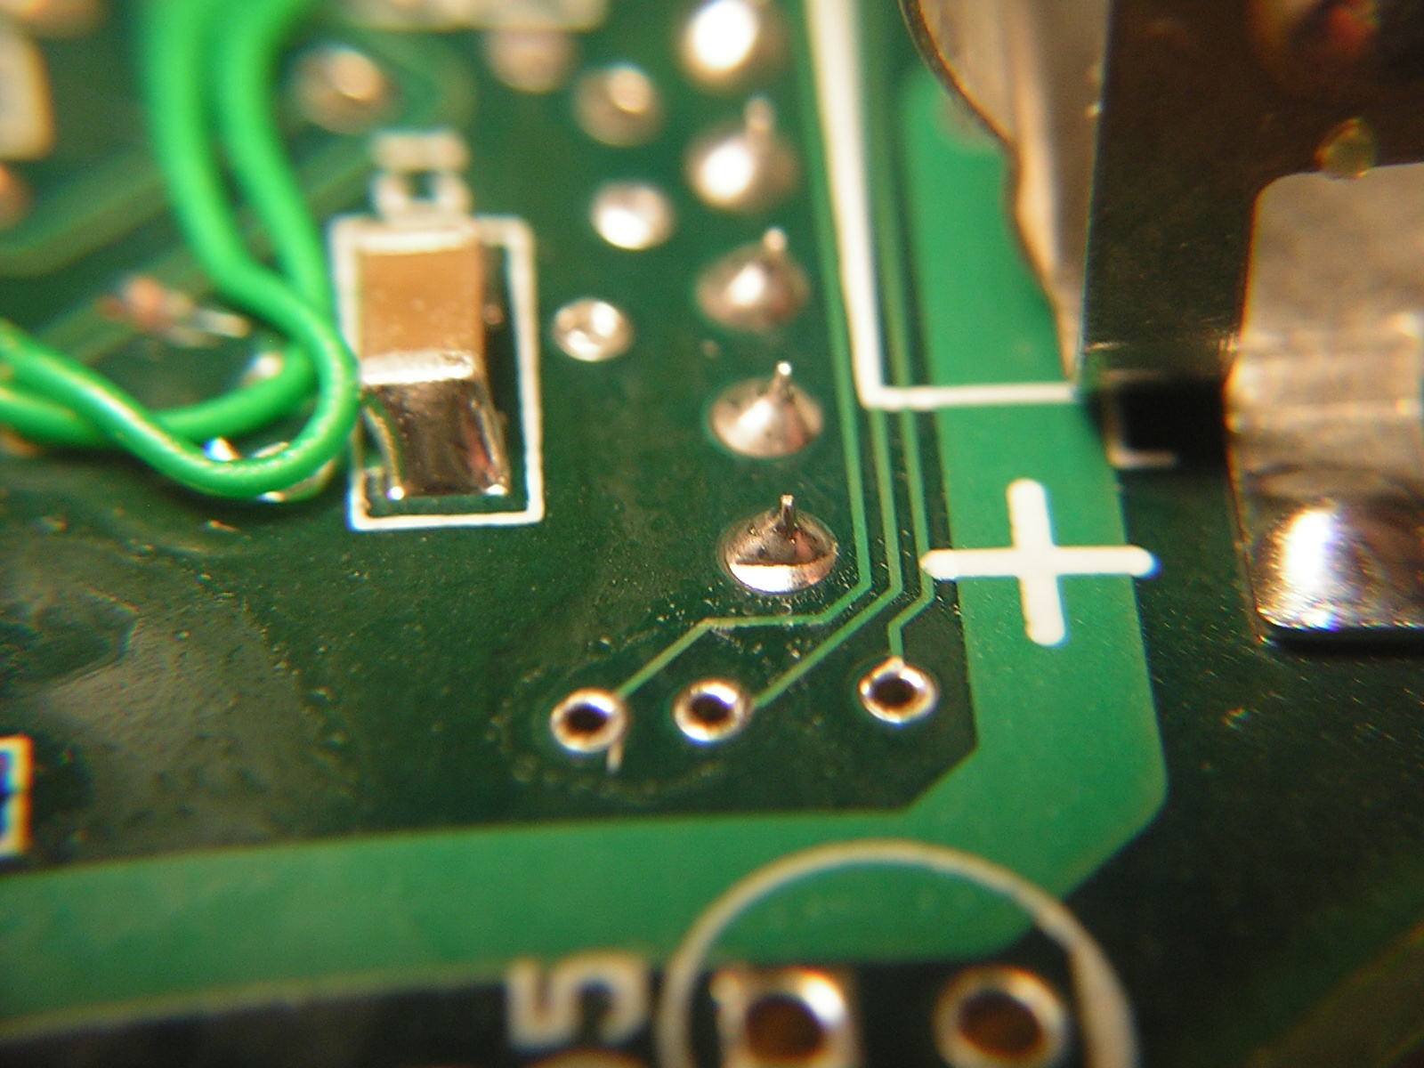
conical (point) tip

Slide 22
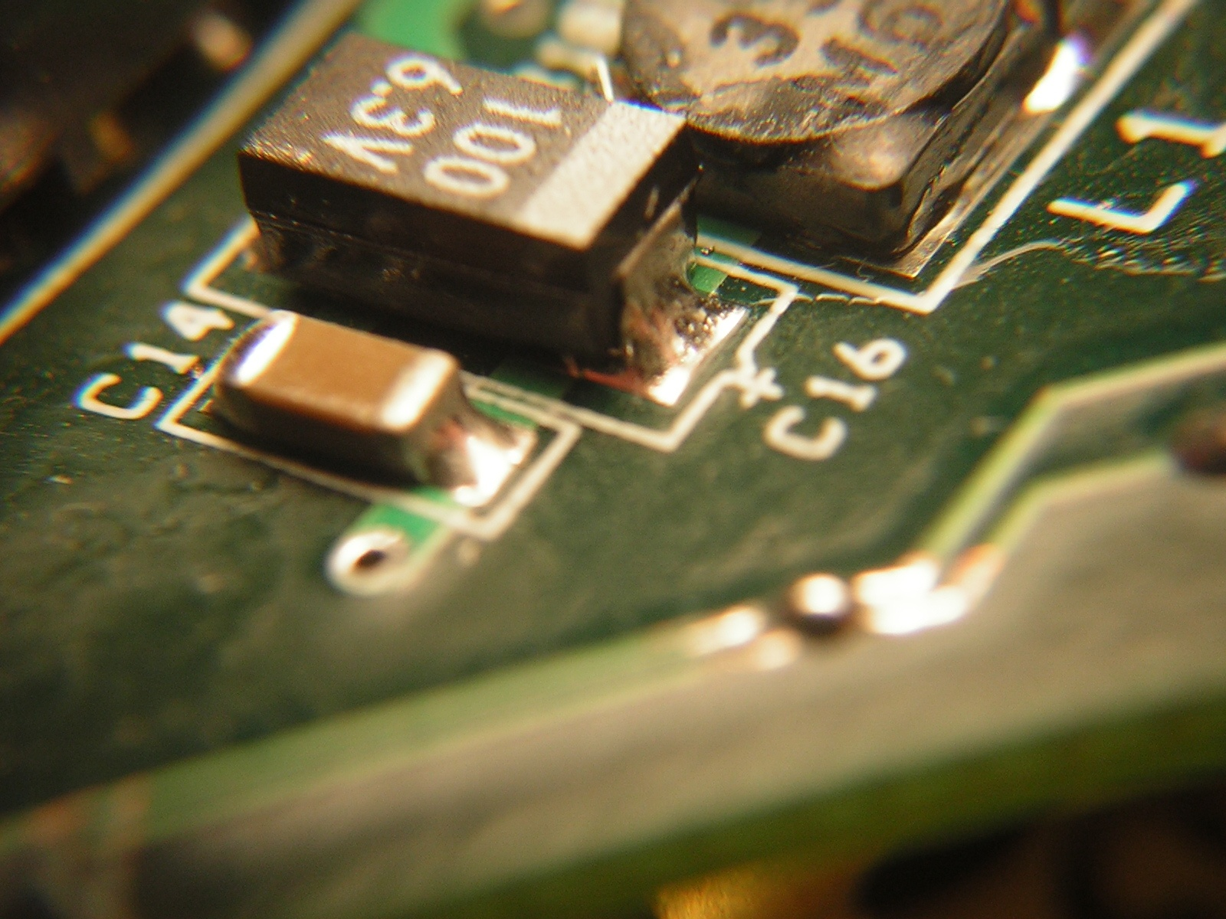
screwdriver (blade) tip

Slide 23
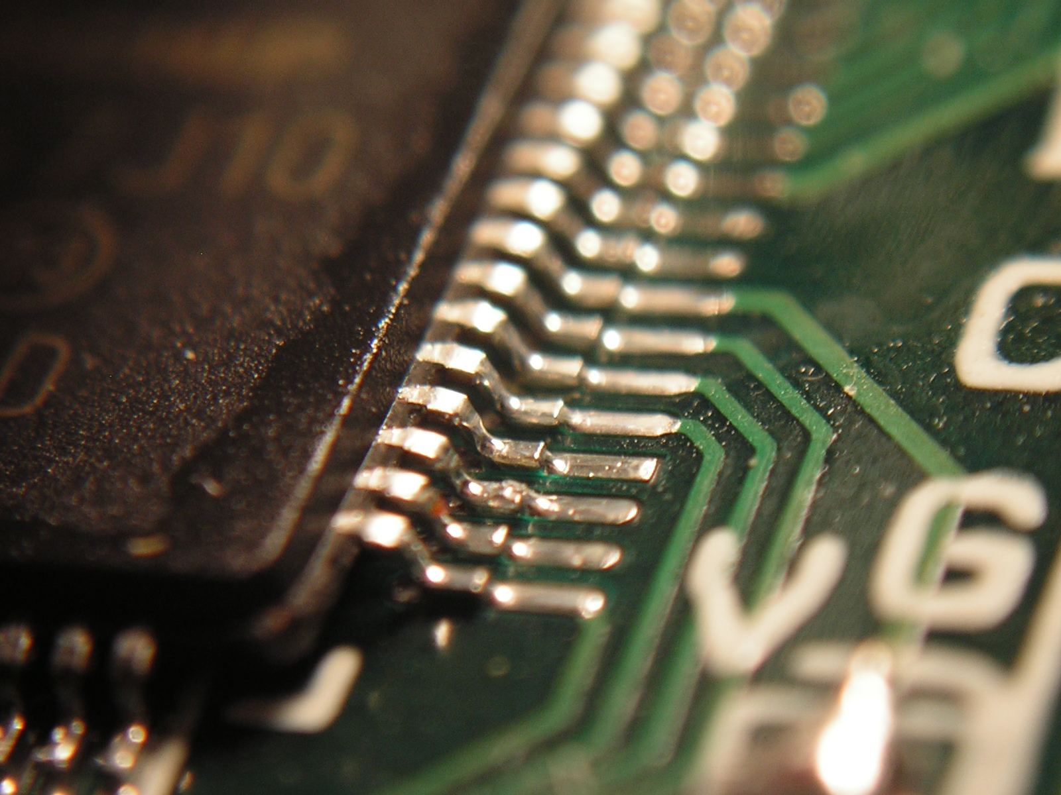
chisel (bevel) tip

Slide 24
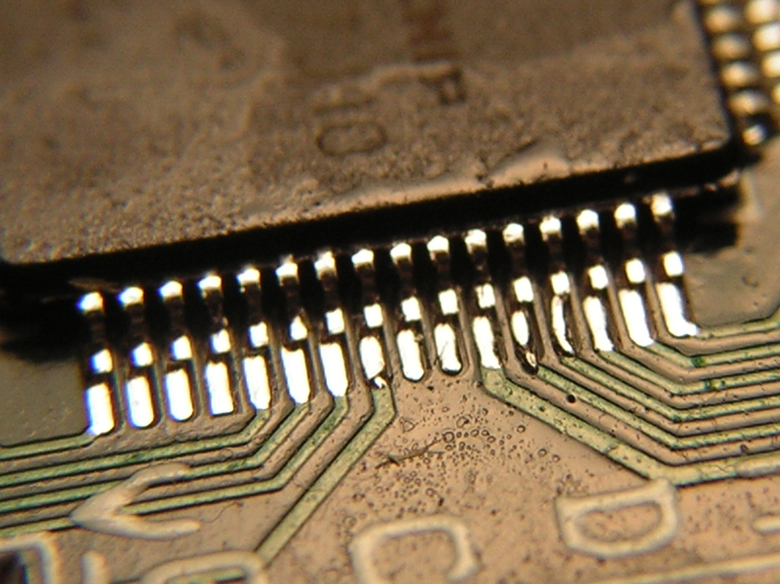

Slide 25
“Everything is awesome, everything is cool when we’re part of a team.”
Professional SMT Soldering Demo
Fine Pitch Drag Soldering
Leaded vs. Lead-Free Solder
Circuit Board Manufacturing
SMD Removal Using a Chip Quik Kit
Everything is Awesome!

