Slide 1
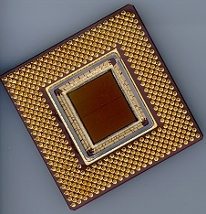
ECE 477 Digital Systems Senior Design Project
© 2014 by D. G. Meyer
Module 7
Project Documentation Standards

Slide 2
Reference: Wakerly DDPP 4th ed, pp. 342-370 Instructional Objectives:
To review the foundations of structured digital system design
To review logic design documentation standards
To review how to draw timing diagrams and use timing specifications

Slide 3
Outline
Documentation standards
Guidelines
Electrical schematic homework

Slide 4
Documentation Standards
Good documentation is essential for correct design and efficient maintenance
A documentation package should contain:
abstract
specifications/requirements
block diagram
packaging
electrical schematic, narrative description
PCB layout diagram, narrative description
software organization, narrative description
bill of materials
timing diagram
structured logic device description (HDL)
user manual

Slide 5
Abstract
An Augmented Reality Simulator that allows multiple users to interact in a mobile, outdoor environment simulation. A central control unit will coordinate the game play while per-player headsets will appropriately overlay game-object pixels on a semi-transparent panel that is suspended in front of the users’ eyes. This product is intended to be used for gaming and other potential simulations that require an augmented environment.

Slide 6
Specifications
The Augmented Reality Simulator consists of two primary components: a single immotile central control unit (CCU), and multiple per-user mobile headsets. A user chooses the desired simulation (e.g. game or virtual tour) via the CCU, which is equipped with a keypad and LCD display. The CCU will then wirelessly transmit all simulation-relevant data (e.g. 2D images, 3D models, and if the headsets were equipped with speakers, audio files) to the headsets, which the CCU will later reference by index. The CCU will then signal the start of the simulation to the headsets, and then coordinate game logic throughout the simulation by taking into account the periodic sensor (IMU, GPS) readings returned by each headset. Each headset will also make use of its sensor readings by rendering the image depending on user head orientation, geospatial location, and status in the game/virtual tour.

Slide 7
Requirements

Slide 8
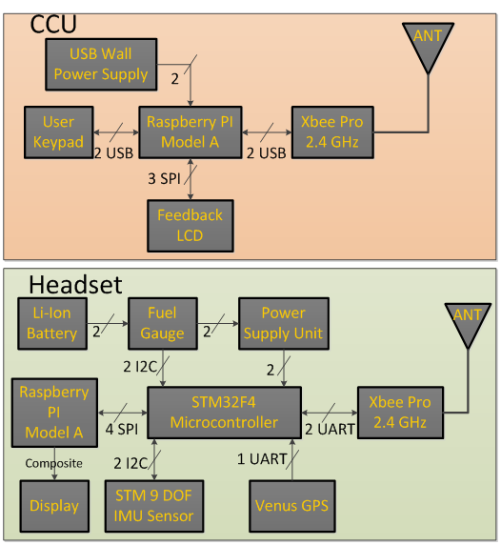
Block Diagram

Slide 9
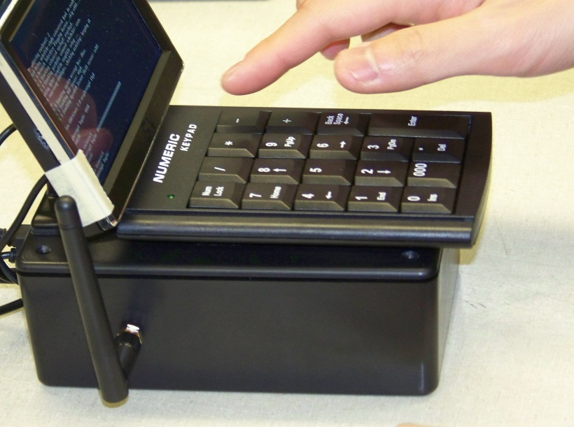
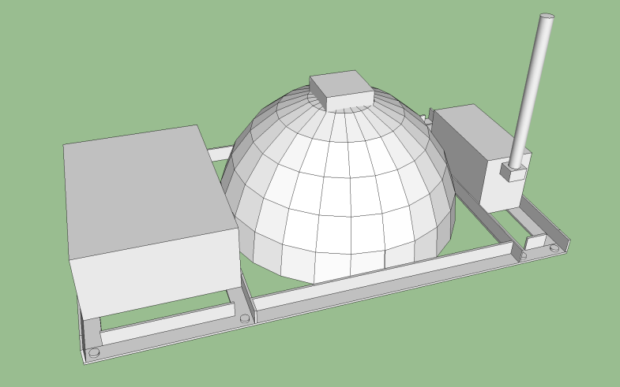
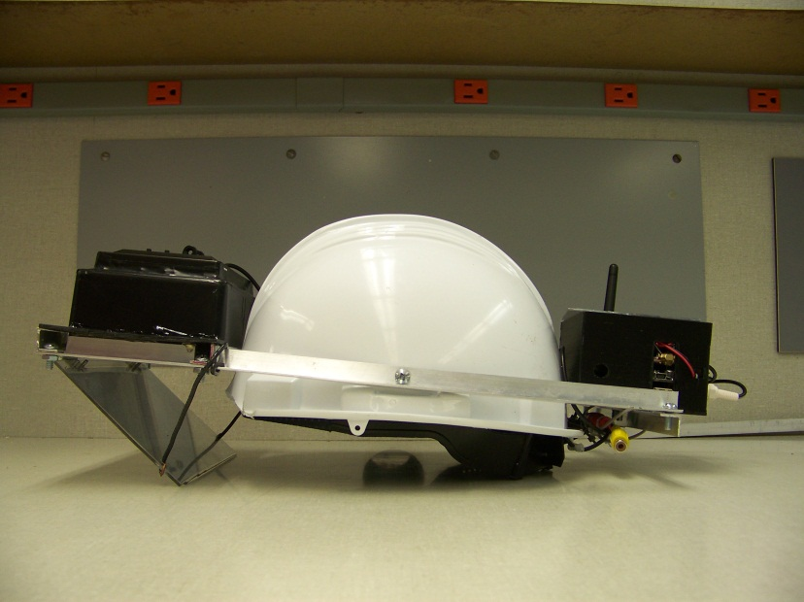
Packaging

Slide 10
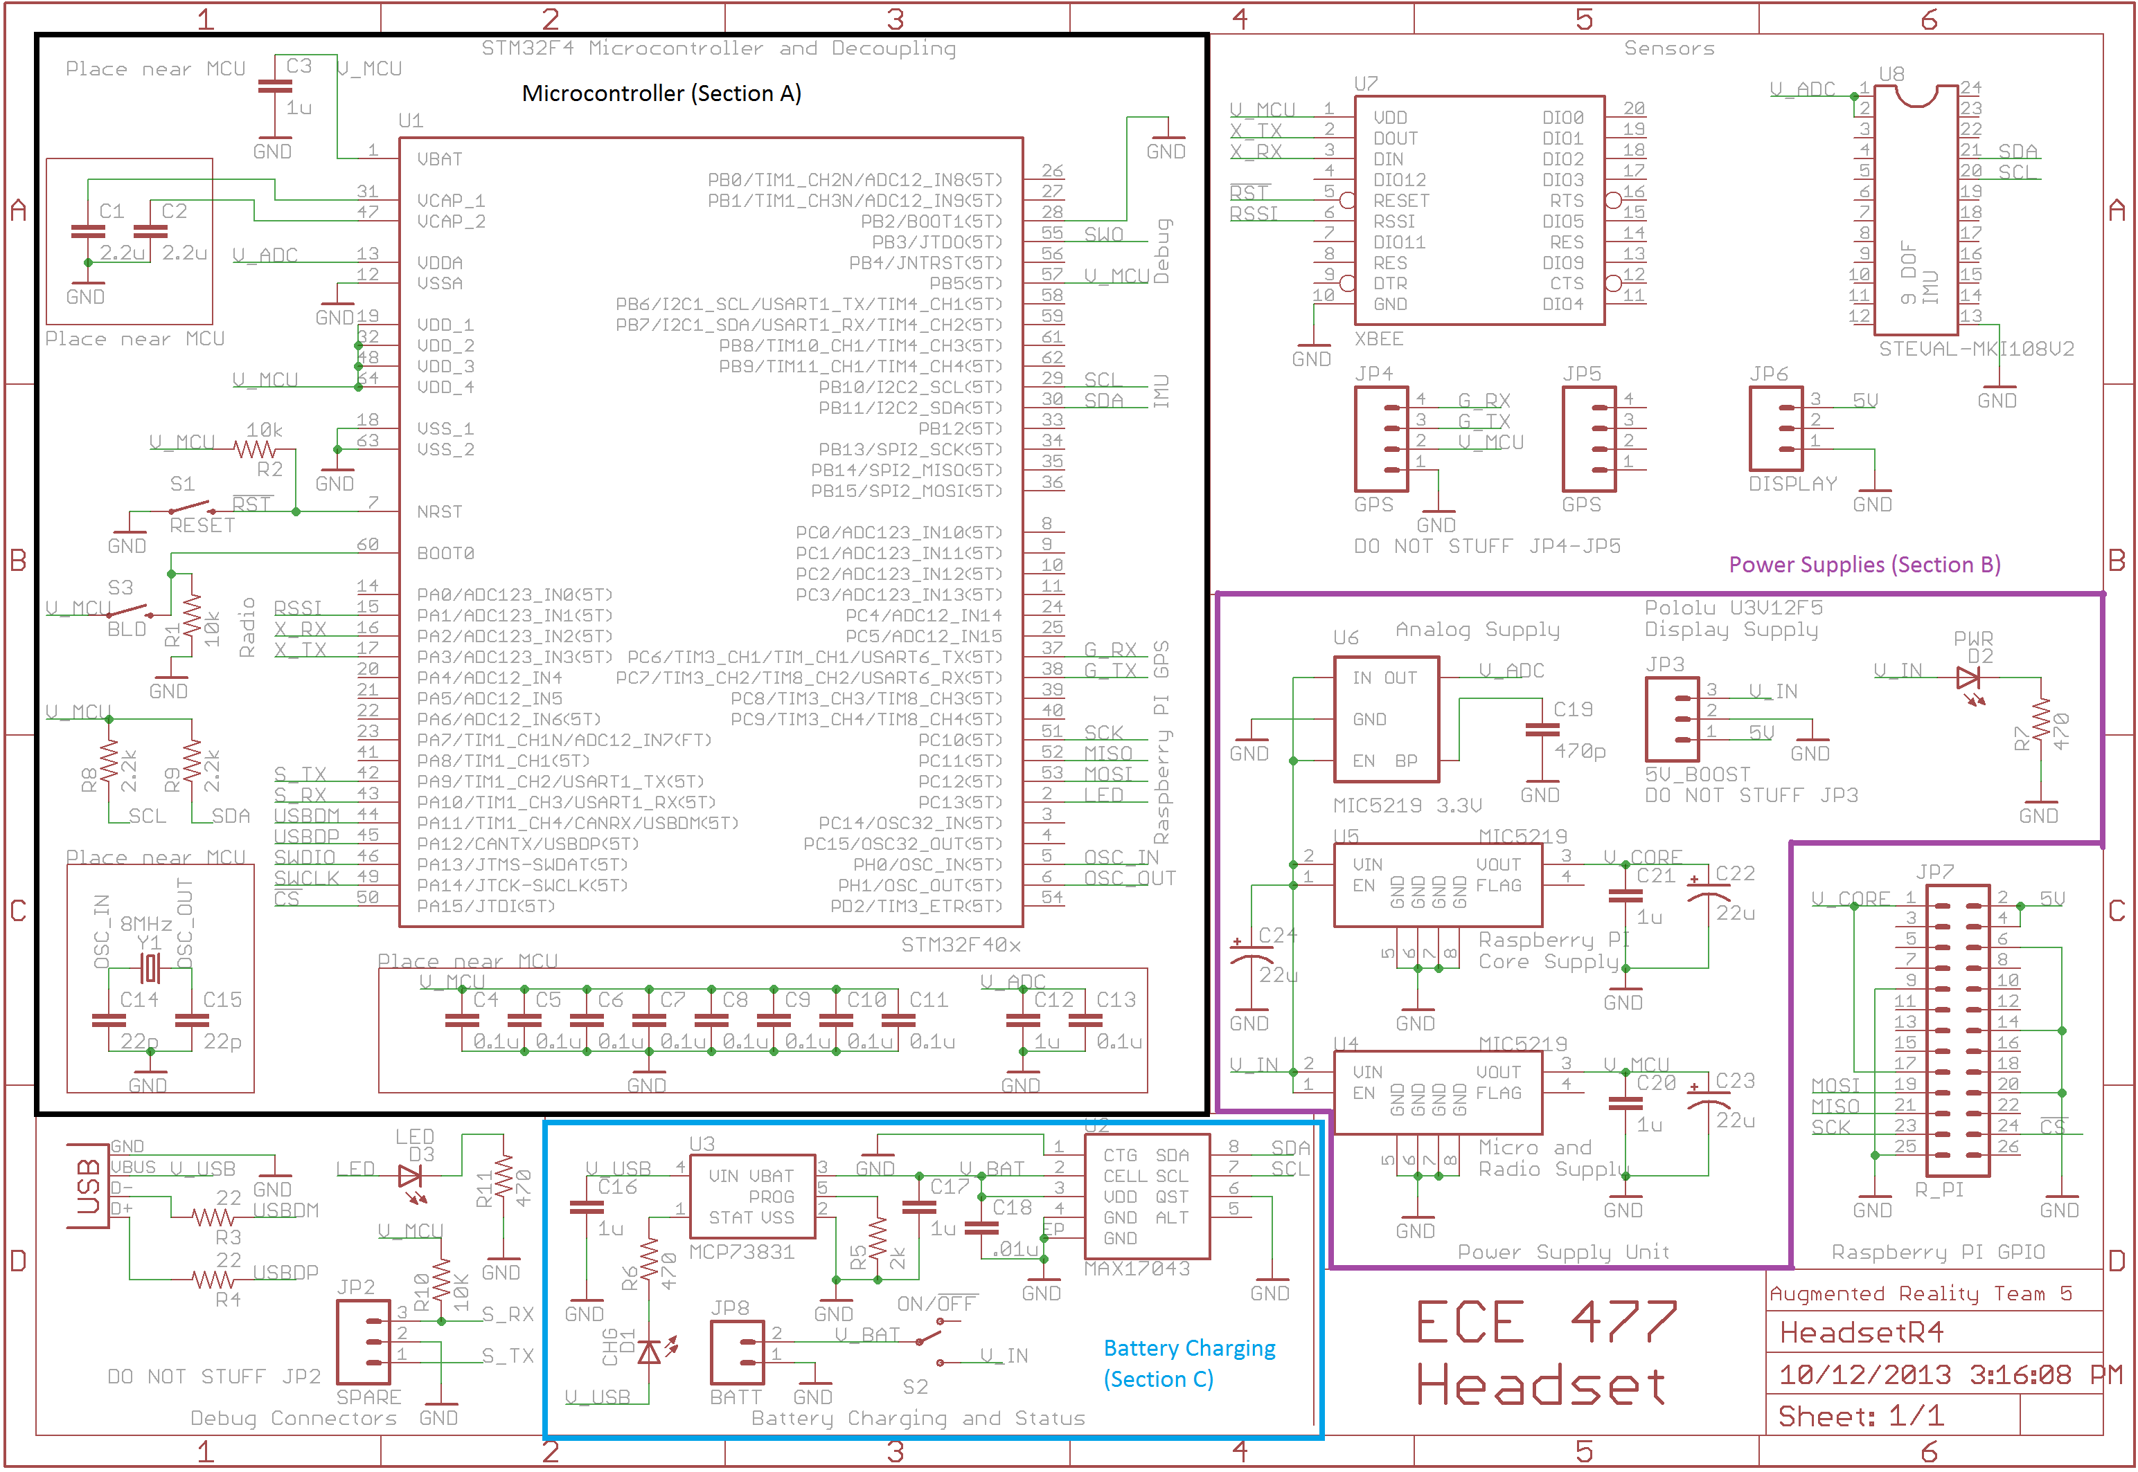
Electrical Schematic

Slide 11
Circuit Narrative
The augmented reality system comprises multiple battery-powered headsets controlled by a microcontroller and one Raspberry Pi, and a single central control unit controlled by one Raspberry Pi.
Upon insertion of a 3.7V lithium ion battery into the headset, or the contact closure of the battery’s on/off switch, the battery’s voltage is connected to the input of 4 power supplies, the input of the battery “fuel gauge”, and the output of the battery charger. A polarized battery header will be used to prevent the physical insertion of the battery in the wrong polarity direction. The single battery powers all components of the headset except for the battery charger, which is optionally powered by an external 5V source in the form of a USB connection. Three of the four power supplies are low dropout (LDO) regulators which altogether supply 3.3V to the IMU sensors, GPS, Raspberry Pi, microcontroller, and XBee radio. The fourth power supply is integrated in the LCD package, and accepts the battery’s 3.7V directly. Once the IMU sensors are powered, they are capable of transmitting raw sensor data to the microcontroller for processing via I²C protocol [34]. The battery fuel gauge will similarly communicate the battery’s charge to the microcontroller via I²C [22]. The Raspberry Pi will communicate with the microcontroller via SPI, and both the GPS and XBee modules will communicate with the microcontroller via the USART protocol [35, 6].

Slide 12
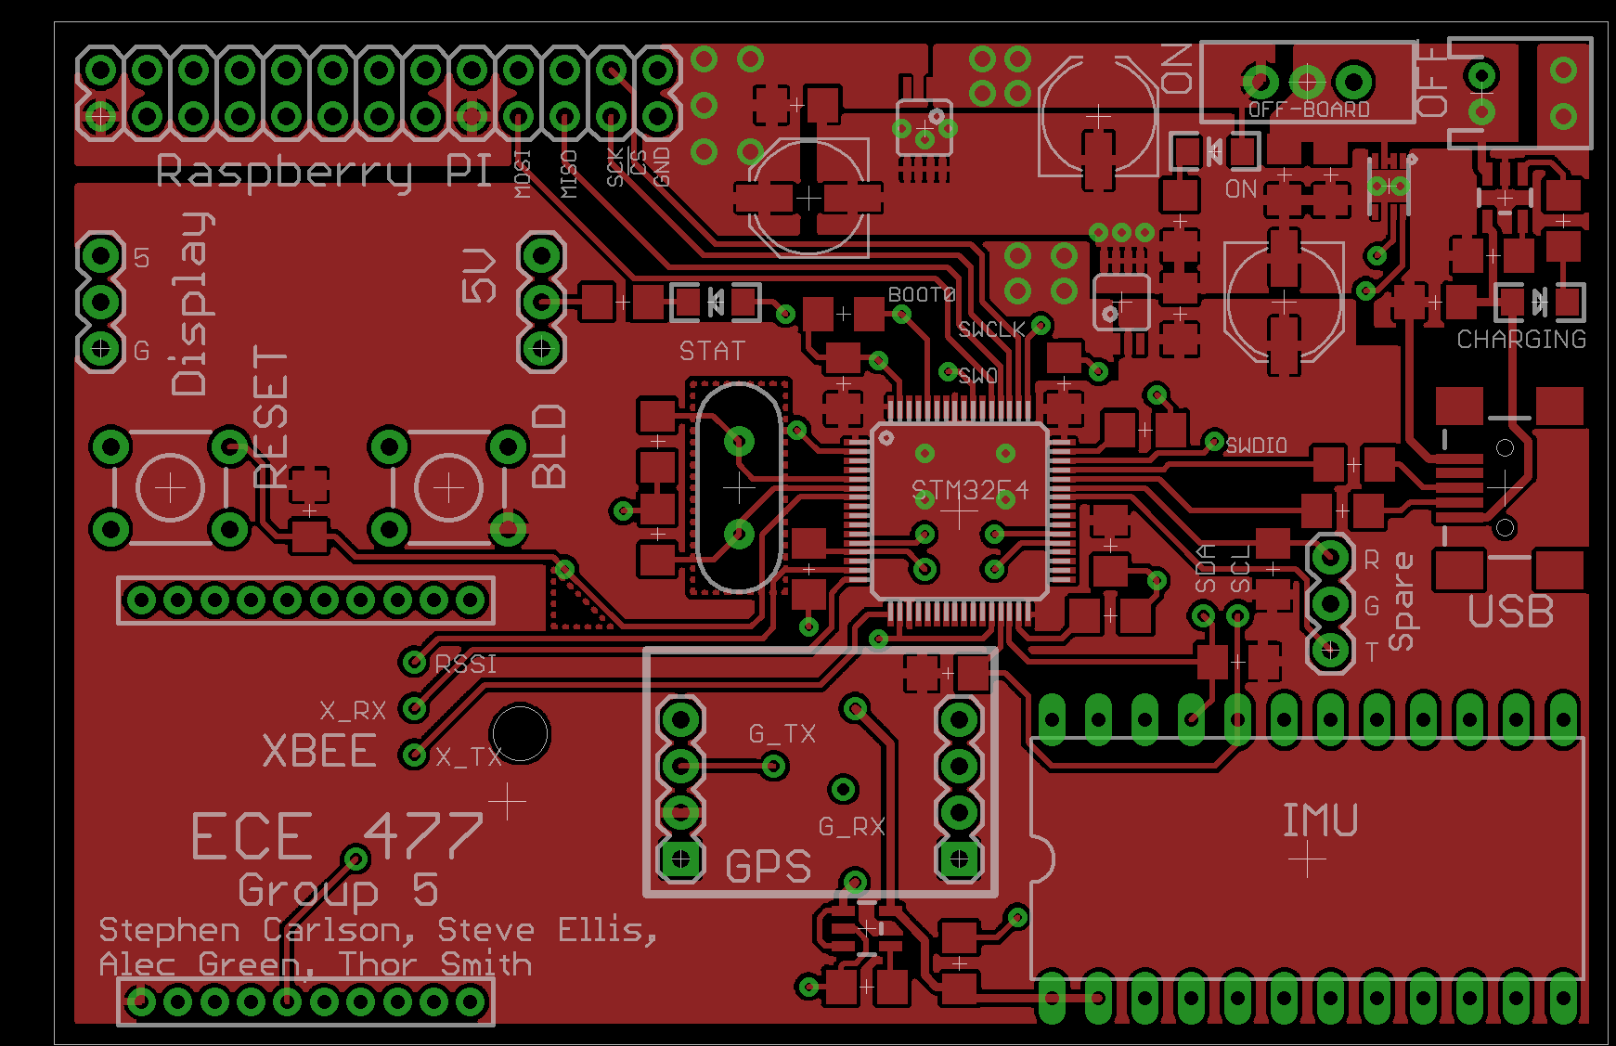
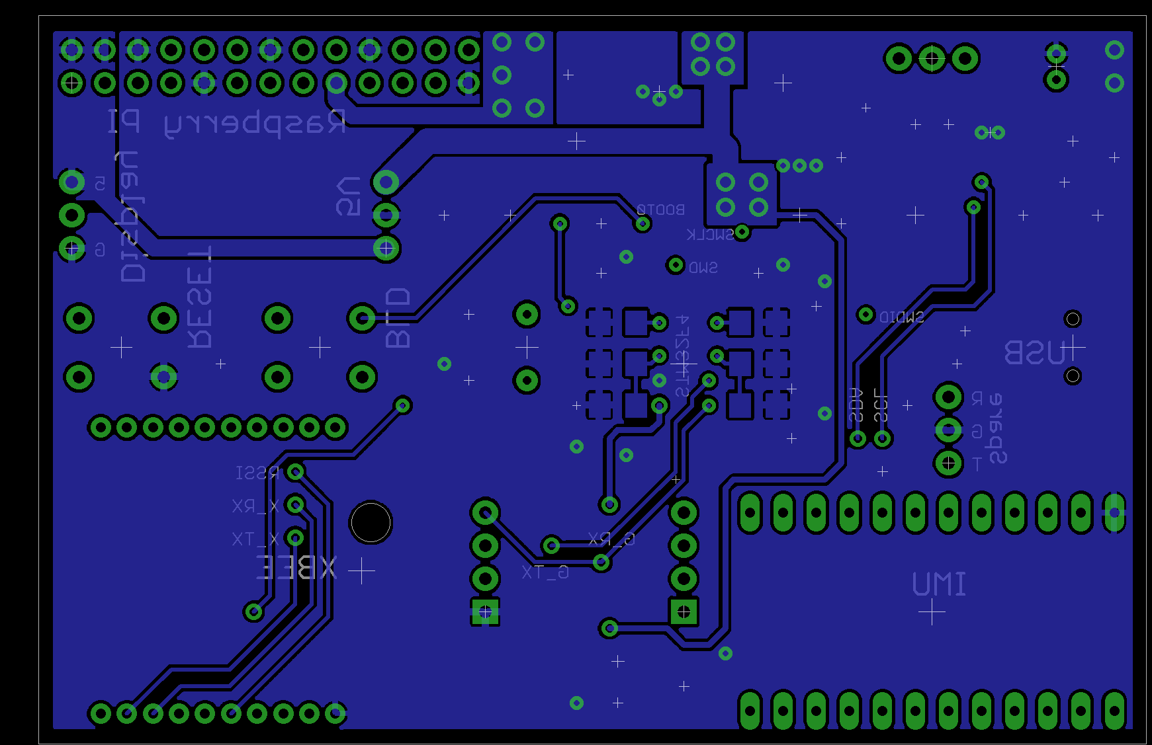
PCB Layout

Slide 13
PCB Narrative
Several of the components of this project, most notably the USB boot loader described in the microcontroller datasheet, depend on a stable clock source. Therefore, an external crystal oscillator in a through-hole package was utilized with the recommended load capacitance of 20pF [36]. As the traces leading to the crystal also add impedance, the EAGLE “run length-freq-ri” tool was used to match the oscillator trace lengths within 8mil. The crystal was also placed as close as possible to the microcontroller while still allowing a component-free area around the oscillator to limit noise coupling. Similarly, the same method was used to match the USB data traces to significantly less than the stated 50mil length tolerance [5].
Part placement near the microcontroller was also a major concern. In order for the PCB to be physically possible to route, pin assignments with multiple equivalent options on the microcontroller were chosen to limit the number of crossing signals. Careful effort was also spent in placing parts to minimize the number of traces looping around the microcontroller and interfering with power routing as shown in Figure 9.1. After placement was finalized, the most convenient spare I/O pins were brought out to pads and a spare serial port was connected to an unpopulated header for debugging and future expansion. Two spare LEDs also aid in debugging.

Slide 14
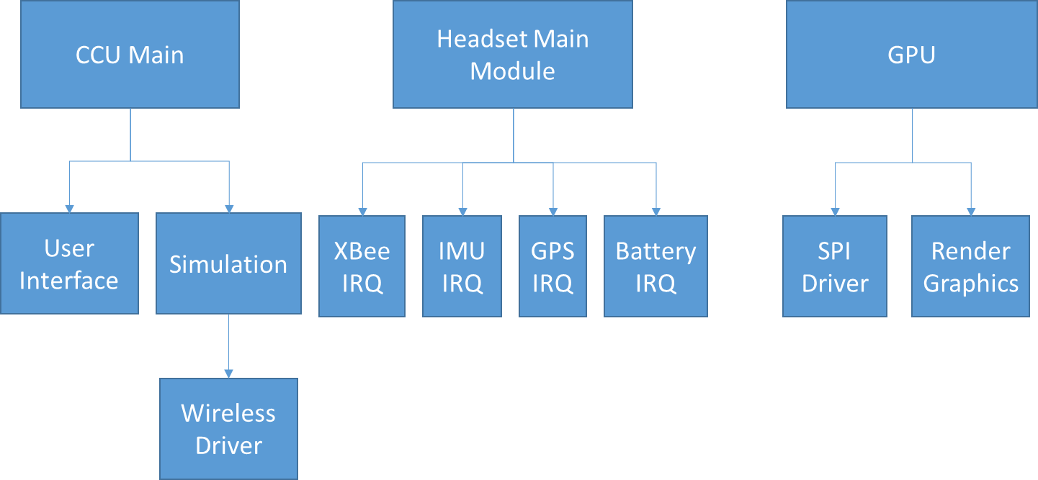
Software Organization

Slide 15
Software Narrative
Figure 10.5 shows the hierarchical arrangement of the various code modules included in our design. The code modules in our design are: the central control unit user interface, the central control unit simulation, the headset main module, the headset GPS IRQ, the headset IMU IRQ, the headset battery IRQ, the headset XBee IRQ, and the headset GPU.
The central control unit user interface is written in Python Tkinter [30]. Tkinter was chosen because a complex user interface is not needed, and because the author is familiar with the software. The user interface launches on startup of the central control unit and begins looking for available headsets to join in simulations. The user is able to choose available headsets and add them. The simulation allows a user to select a simulation to run. After selecting a simulation, the rules and hazards are explained to the user. The GUI will then launch the simulation and wait for it to end.
The central control unit simulation will first load image and object data to all headsets through wireless communication. It will then proceed to send updates about the position of the image and object data to the user. Updates about the headsets position will be periodically processed and collision detection will be performed to determine simulation events to be triggered. Due to limited accuracy of the GPS, virtual objects will be made large (approximately 2 meters) for the purposes of detecting collisions.

Slide 16
Bill of Materials

Slide 17
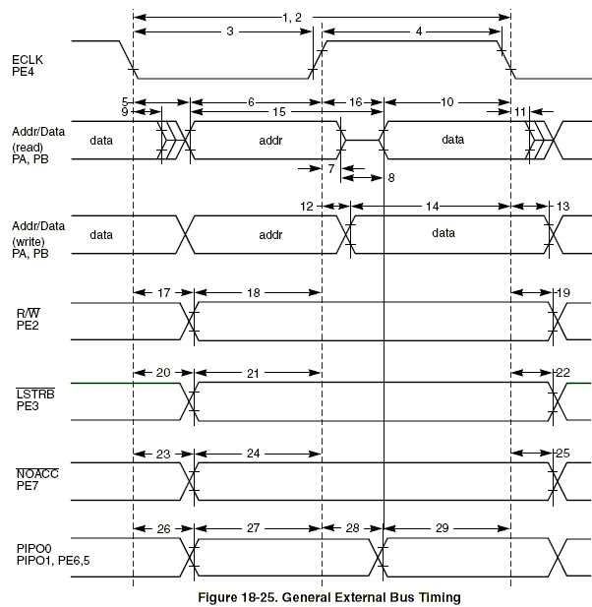
Timing Diagram

Slide 18
User Manual

Slide 19
Guidelines
Schematics
Active levels for pins
Timing diagrams

Slide 20
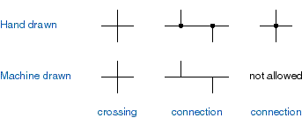
Schematic Guidelines
Logic diagrams and schematics should be drawn with gates in their “normal” orientation (inputs on left, outputs on right)
A complete schematic page should be drawn with system inputs on the left and outputs on the right
Line crossings and connections

Slide 21
Schematic Guidelines (2)
Pin names on custom footprints should be descriptive, but not so long that they overlap other pin names (quad packs…)
Either physical or logical arrangement is okay, but try to be consistent throughout document
Use power / ground symbols
For power, show net alias on schematic

Slide 22
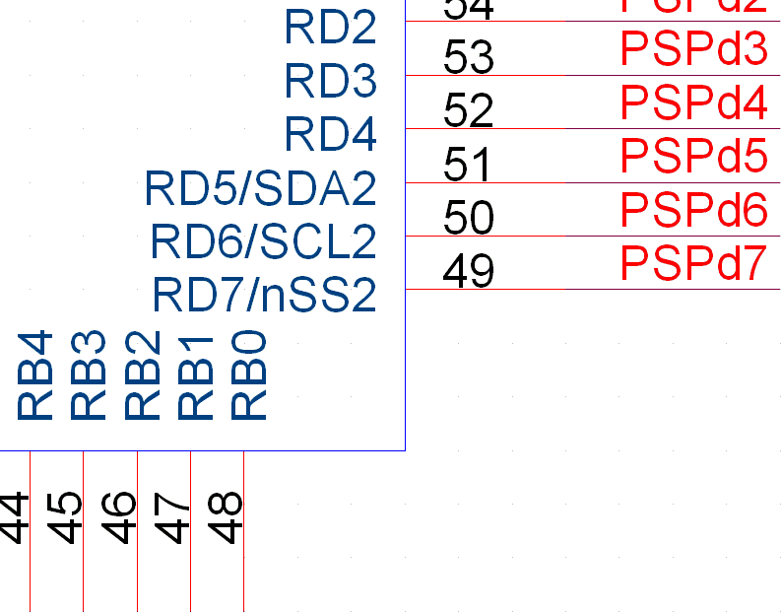
Schematic Guidelines (3)

Slide 23
Schematic Guidelines (4)
Polarized / non-polarized capacitors
Value
Tolerance
Voltage
Footprint
Diode types
PN / Ge, etc.
Schottky
Zener
designate by part #
+

Slide 24
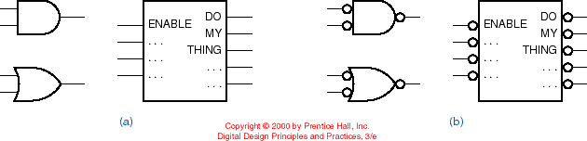
Active Levels for Pins
When we draw a logic symbol, we think of a function being performed “inside” that symbolic outline
Use inversion bubbles to indicate pins that are active low

Slide 25
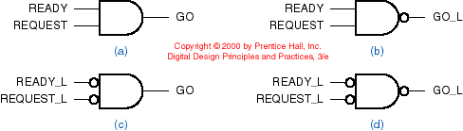
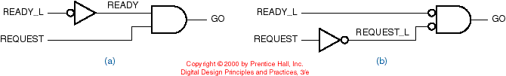
Active Levels for Pins (2)
It is very helpful to use net aliases with an _L suffix to indicate active low for those signals that are active low

Slide 26
Timing Diagrams
A timing diagram illustrates the logical behavior of signals in a digital circuit as a function of time
They are used to explain the timing relationship among signals within a system and to define the timing requirements of external signals applied to the system
Arrows are sometimes drawn to show causality (which input transitions cause which output transitions)

Slide 27
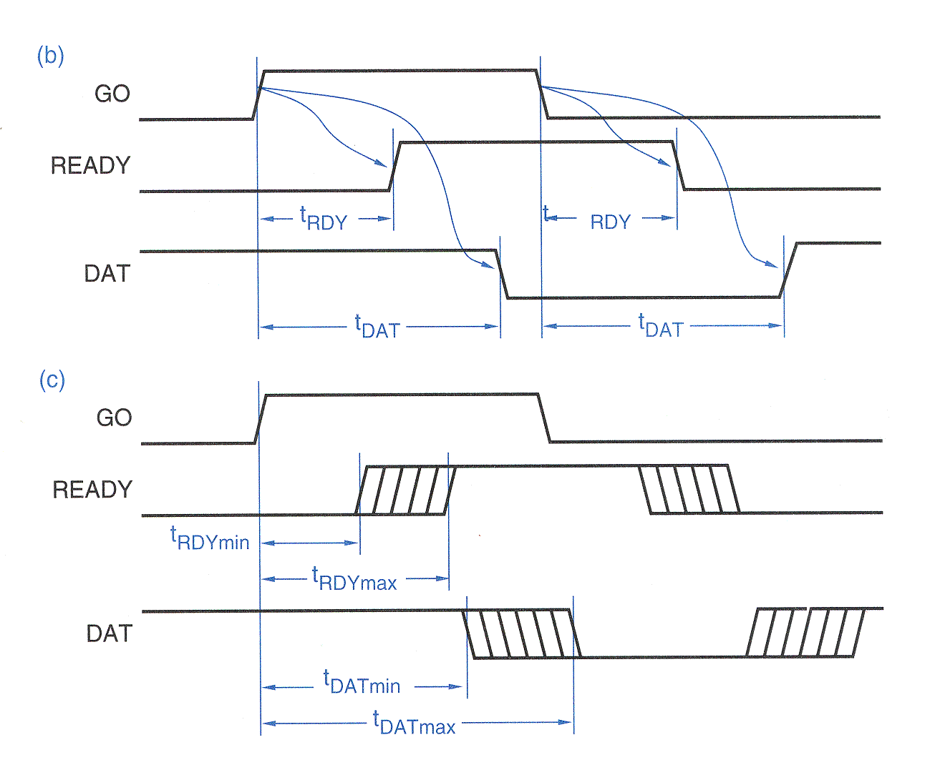
Timing Diagrams
Combinational circuit timing diagram

Slide 28
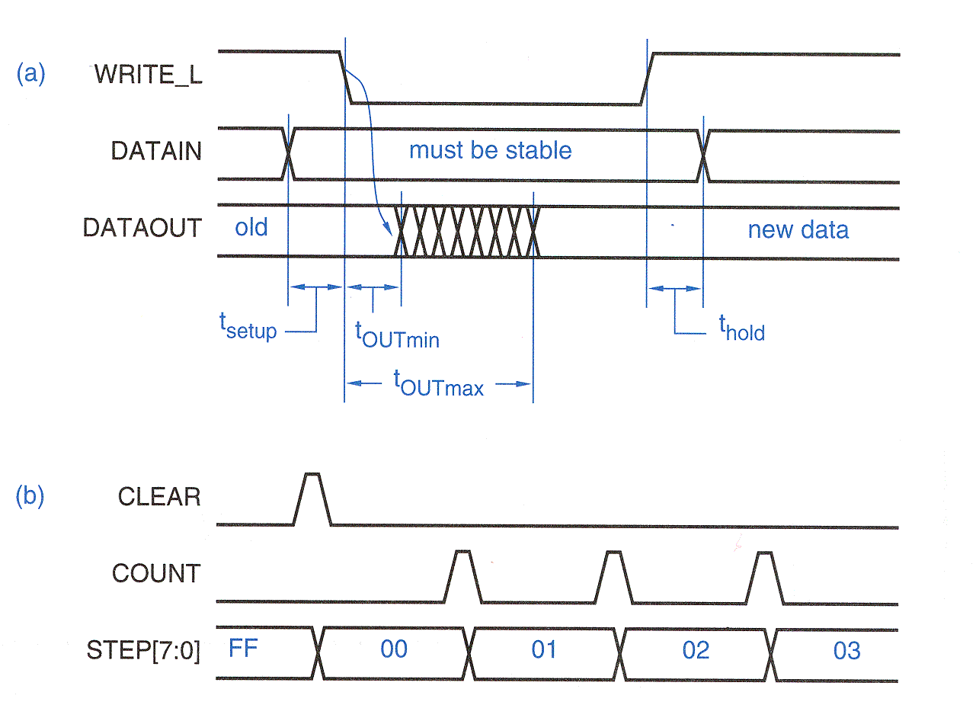
Timing Diagrams
Timing diagrams for “data” signals

Slide 29
Timing Specifications
A combinational circuit with many inputs and outputs has many different paths
Each path in a combinational circuit may have a different propagation delay
The propagation delay when an output changes from LOW to HIGH (t_{PLH}) may be different than the delay when it changes from HIGH to LOW (t_{PHL})
Timing specifications in data sheets usually provide minimum, typical, and maximum values for each propagation delay path

Slide 30
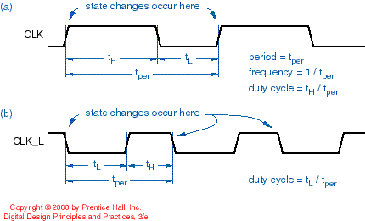
Clock Signals (active high/low)

Slide 31
Timing Diagrams and Specifications
For synchronous systems, timing diagrams can be used to show the relationship between the clock and various input, output, and internal signals
clock frequency (f) = 1/t_{clk}
duty cycle = t_{H}/(t_{H}+t_{L})
time high
time low
flip-flop C→Q prop delay
clock period
comb output prop delay
flip-flop setup and hold times

Slide 32
Electrical Schematic Homework
Theory of operation. Describe the function and operating mode of each major subsection of the circuit, as well as how the subsections relate to each other. Discuss the function and operating mode of major components, including rationale for choice of operating frequency, supply voltage(s), etc, not rationale for the choice of the component. Do not rehash the manufacturers’ data sheets for the parts. Tell us how the parts work in your circuit.

Slide 33
Electrical Schematic Homework
Hardware design narrative. Discuss which subsystems of the microcontroller will be used and how they will be used. Discuss the port assignments of the microcontroller and why specific ports were chosen for specific functions. Include power, ground, and bypass capacitor considerations. For the other major subsystems, discuss any specific configuration choices and how they affect the interconnection between these subsystems and the microcontroller. Reference the schematic in this discussion.

