Slide 1
Power supply
Design considerations

Slide 2
Outline
DC-DC conversion and voltage regulation
Buck: Regulating wall-wart/battery output to desired voltage
Boost: Size constrained systems (Run off single AAA, for example)
Sources
Plugged-in
AC-DC conversion
Short answer: use third party supplies
DC-DC conversion
Battery-based
High current draw vs. Low current draw
Rechargeable vs. non-rechargeable

Slide 3
Voltage regulation – Why?
Variable voltage drop based on current draw
Internal resistance, wire resistance
Spurious resets on current spikes
Signals are typically in supply range
Rail-to-rail ➔ Ground to VCC
Narrower range is common
Supply noise ➔ Noisy signals

Slide 4
Imaginary perfect regulator
Efficiency = 100%
Input power = output power
V_{in} * I_{in} = V_{out} * I_{load}
Vout is constant; no ripple
What do we have to give up in practice?
Efficiency, High quality (low ripple), low cost/footprint
Pick any two.
Efficiency
Cost/
footprint
Low ripple/
quality of regulation

Slide 5
Linear regulators (including LDOs)
Two major categories
Linear regulators (including LDOs)
Switching regulators (aka switchers)
Linear regulators
Wasteful (thermal waste of energy)
Power dissipation = V_{in} * I_{load}
Useful work = V_{out} * I_{load}
Small voltage buck and/or low load current
5V → 3.3V,
Efficiency
Linear regulators
Cost/
footprint
Low ripple/
quality of regulation

Slide 6
Switching regulators
Switching regulator
($$$)
Switching regulator ($)
High efficiency
85%-96%
Noisy
Average voltage is well-regulated
A/C noise component
Efficiency
Cost/
footprint
Low ripple/
quality of regulation

Slide 7
Tips
For fixed voltage with very low dropout, look for custom regulator
E.g. MCP 1700 with < 180mV dropout, up to 250mA
Can get 3.3V regulation on LiPo batteries (3.7V)
Good old 78xx (fixed and variable regulators in family)
2V dropout
Switching regulators
Pre-packaged drop-in regulator (e.g., OKR-T/3-W12-C)
7805 drop-in replacement (e.g., Murata 78xxSR)
Using discrete regulator ICs
Delicate designs. Use passives and layout recommended in datasheet

Slide 8
Heat Sink
Pay attention to heat thermal issues
More important in Linear regulators
Follow datasheet recommendations
Will need understanding of current demands of your project

Slide 9
Boost DC/DC conversion
Common case: Buck (step-down) regulation
Extreme low power:
Operate on 1 AA battery or button cell
Boost to more reasonable supply.
Typically low-current draw
Maybe a sensor or low-duty cycle application
Lots of boost converter ICs
Attiny43U (Microcontroller with built-in boost converter)
Operates down to 0.7V

Slide 10
Battery power: Terminology
“Cell” single chamber of electrochemical reaction
Battery: array of cells
Array size possibly 1
Primary: irreversible chemical reaction
Chemical energy ➔ electrical energy
Non rechargeable
Secondary: chemical energy ⬄ electrical energy ⬄ chemical energy
Rechargeable

Slide 11
Characteristics of interest
Form factor : AA, AAA, 18500, 2032 etc
Voltage
Current draw
Capacity
Not simple; depends on current draw
Leakage/Self-discharge
Energy loss on the shelf
Energy density, power density

Slide 12
Chemistry
Primary
Alkaline
Cell voltage 1.5V
Button cell
1.35-1.55V (Silver/Zinc/Mercury)
Lithium – Family of chemistries
1.5-3.7V
Secondary
Lithum-ion (totally different from Lithium) 3.6-3.7V
NiCad 1.2V
NiMH 1.2V
Lithium-ion polymer (LiPo) 4.2-2.7V (Nom: 3.7V)
LiFePO4 3.2-3.3 V

Slide 13
Capacity
500 mAH @ 3.7V
50 mA for 10 hours
25 mA for 20 hours
500 mA for 1 hour
5A for 6 minutes
No!
Depends on discharge profile

Slide 14
Non-rechargeable
Alkaline : Good old stuff
AA, AAA, C, D : 1.5V
Lithium : Typically sold as ultra long-life
Do not ignore
Useful when:
Relatively long useful life
Relatively low current draw OR Relatively rare unplugged operation

Slide 15
Other advanced issues:
Wireless charging:
Inductive coupling
Qi – broadly used in mobile industry
Solar charging
In-circuit recharging
Careful - charging profiles
Serious safety issue (High energy density in personal devices)
Microcontroller-driven power management
Battery monitoring issues
Thermoelectric

Slide 16
Backup battery
Very common use-case
Normal use and battery recharge when plugged in
Battery operation when not plugged in
Seamless transition
Two assumptions
Rechargeable battery
Safe charging
What if non-rechargeable? (E.g., smoke alarms)
What if trickle charging is inadequate?

Slide 17
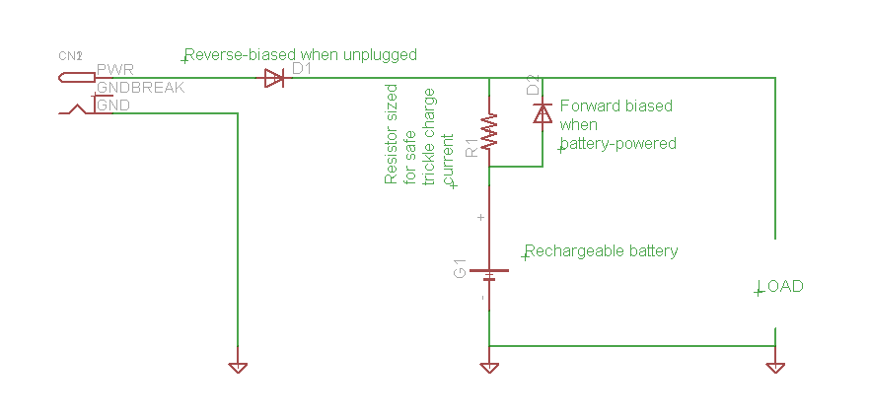
Simple backup battery

Slide 18
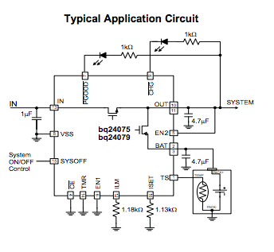
Power Management ICs
E.g. TI BQ24072 (For Li+)
Charging + Dynamic power-path
for battery backup
Other similar ICs for other
Chemistry
Note: Thermistor input

Slide 19
Inductive coupling
Air core coupling
High losses
Fairly widespread standard : Qi
Not available in small quantities
Some hobby parts available
Magnetic material core
Equivalent to transformer, but with separable coils
Secondary coil in toothbrush; Primary coil and core in charging base

Slide 20
Solar charging
Always use to drive battery charger
Use battery to provide stable power supply
Size capacity to ensure statistical guarantees of availability
Assume panel sized to fully-charge battery in 4 hours
Probability of 4 hours of direct sunlight each day = 0.7 (say)
Probability of 4 hours of direct sunlight in two days = 0.91 = 1 - (1-0.7) (1-0.7)
Probability ...... 3 days > 0.97
If battery sized for three days of operation, 97% probability of never running out.
Similar process for more sophisticated weather/climate models

Slide 21
Power management
Sleep/low-power states
Important for battery-powered systems
Selective
Some peripherals/sub-blocks in low-power states when not used
Whole chip
Questions to ask?
Programmed wakeup? Via interrupts? Need physical wakeup?
Is duty cycle low enough?

Slide 22
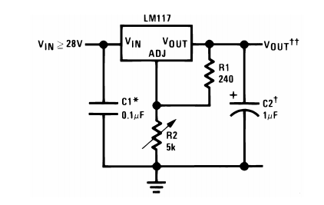
Voltage Regulator (Selected data)
LM 117
Adjustable voltage regulator
Vout to Adj = 1.25V (Invariant)
Negligible current through Adj
Everything else follows
Reason about voltage Vout

Slide 23
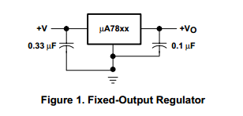
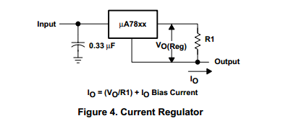
Other Linear regulators
7805 : Very similar
Simpler for fixed output
Vout-Adj voltage = 5V
Very similar reasoning
Can be used to design adjustable regulators
Can be used as current regulators
Constant current source (LED drivers)

Slide 24
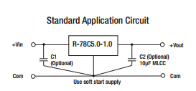
Drop-in Replacement Switching regulator (DC-DC)
Pin compatible
Examples
ReCom R-78Cxx-1.0
Equivalent parts from Murata

Slide 25
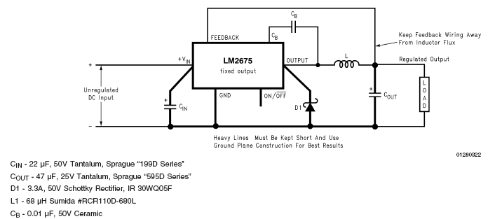
Step-Down Switching Converter: LM 2675
(fixed) 3.3, 5, 12 VDC and (adjustable) 1.21 – 37 V versions
Up to 1 amp
Up to 96% efficient
Five external components

Slide 26
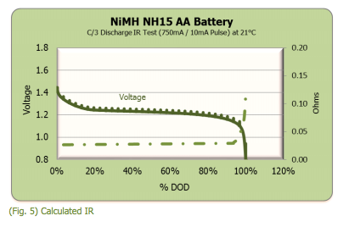
Battery monitoring
Simple voltage-based approach
Plateaus in discharge curve
Possibly depends on chemistry
Fuel gauge ICs
Source: Energizer.com

Slide 27
Heat sink
Idea of THERMAL RESISTANCE
Measured in ºC/W (temperature rise per watt dissipated)
Lower thermal resistance is better
Thermal resistance is ~ inversely proportional to price
1W dissipation
Design goal: heat sink/junction temperature not to exceed 10º C above ambient temperature
Need a thermal resistance of approx 10º C/ 1 W ≅ 10
Airflow reduces thermal resistance

