Slide 1
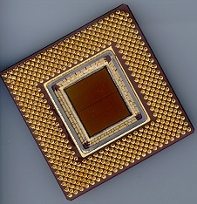
ECE 477 Digital Systems
Senior Design Project
© 2014 by D. G. Meyer
Module 3
PCB Fabrication and Layout

Slide 2
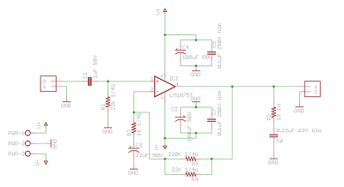
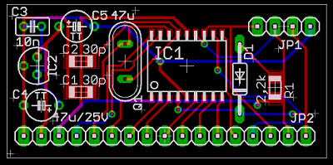
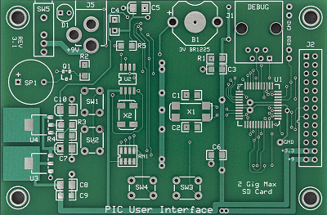
Overview
Objective: To understand what printed circuit boards are, how they are created, and basic guidelines on PCB design

Slide 3
Anatomy of a PCB
Quick overview:
  Copper foil
  Substrate
  Lamination
  Etch
  Drill
  Plate
  Solder mask
  Silkscreen

Slide 4
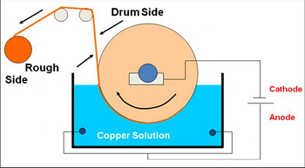
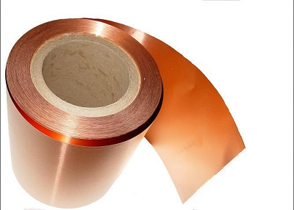
Anatomy of a PCB
Copper foil
  electro-plated onto a large drum then scraped off (typical)
  one side very smooth, one rough

Slide 5
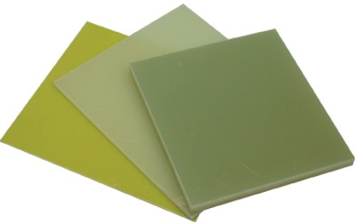

Anatomy of a PCB
Substrate
  FR4 (fiberglass reinforced multi-functional epoxy)
  others: FR2
Lamination
  copper foil applied to both sides of laminate and then bonded using heat and pressure

Slide 6
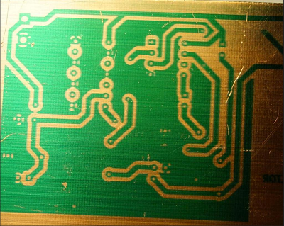
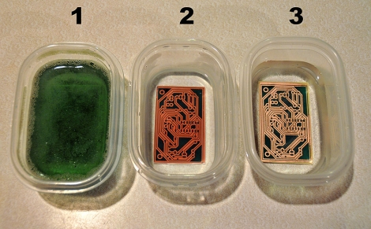
Anatomy of a PCB (3/8)
Etching
  Circuit first realized here
  Etch-resist applied, pattern is exposed

Slide 7
Anatomy of a PCB
Etching
  Uncured resist is washed off and then the pattern is etched
  common etchants: FeCl, Ammonia
  solvent/abrasive wash to remove etch-resist
  PCB then washed to remove residues from solvents and abrasive process

Slide 8
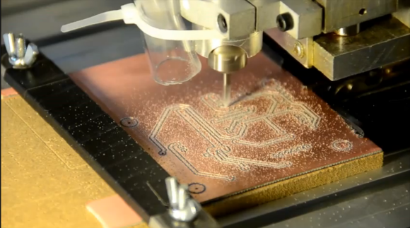
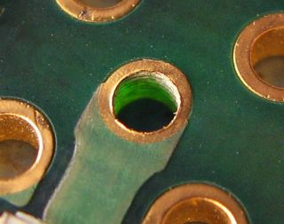
Anatomy of a PCB
Drill / Plate
  This is how the connections are made between layers
  Holes drilled through where connections are desired

Slide 9

Anatomy of a PCB
Drill / Plate
  PCB then immersed in a plating solution where a thin layer of copper forms inside the barrel of the hole
  Once enough copper is deposited this way, then on to electro-plating, where ~1 mil of copper is plated on
  If a gold-plate finish is required, typically applied at this time

Slide 10
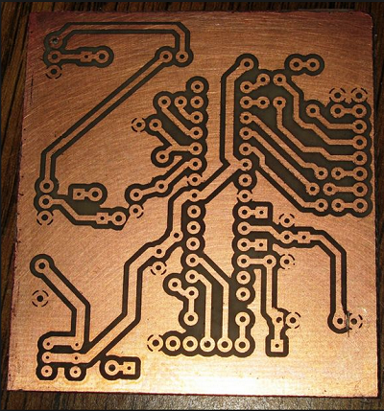
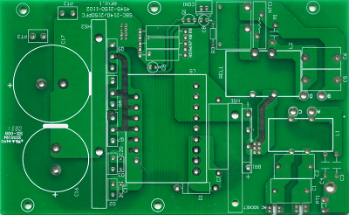
Anatomy of a PCB
Solder mask
  Protects metal from corrosion, short circuits
  Also prevents solder from sticking
  applied as a liquid, then cured with UV
  Many colors available, green most common

Slide 11
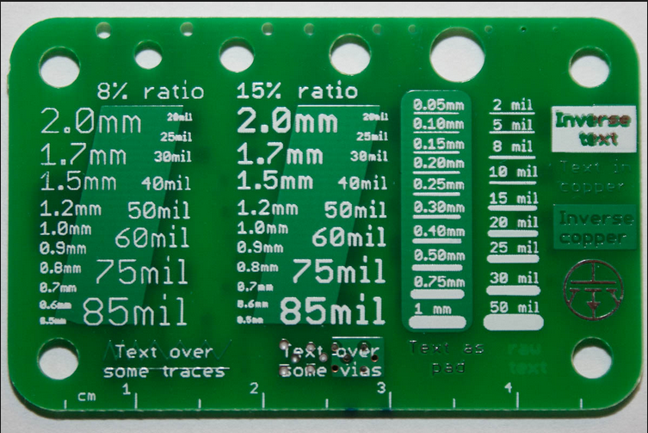
Anatomy of a PCB
Silkscreen (legend)
  labels everything: components, notes, warnings, logos
  similar process to making T-shirts
  applied as a liquid, then cured
  several colors, white most common

Slide 12
PCB Terminology
Pin – A plated through hole used to connect the terminal of a part
Pad – A flat conductive surface for connecting the terminal of a part
Via – A plated through hole used for signal routing
Trace – A wire or 1 dimensional electrical connection
Signal Plane – A 2 dimensional electrical connection (commonly used for ground)

Slide 13
Typical PCB fabrication tolerances
Notation: 1 mil = 1 “milli-inch” = 0.001 in.
Drills: +5/-3 mils diameter, 5 mil center
  smallest drill size 20 mil
Layer-to-layer alignment: +/- 3 mils
Etched feature size: +/- 1 mil
  Trace size (isolate): 6 mil
  ≥ 8 mil trace/isolate recommended
Solder mask size: +/- 3 mil
Silkscreen size: +/- 10 mil

Slide 14
Basic Layout Guidelines
Minimum recommended trace/space 10-12 mil
Power and ground traces should be sized for current being passed (width/current charts available online)
Follow all manufacturer layout recommendations
Decoupling capacitors should be placed as close to each IC as possible
Provide space and mechanical support for connectors, heat sinks, and standoffs (used for mounting board)
Incorporate headers or vias for verification and debugging

Slide 15
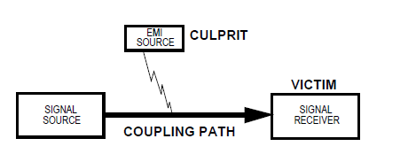
EMI Considerations
Source of EMI include microcontrollers, electrostatic discharges, transmitters, transient power components, AC supplies, and lightning
Within a microcontroller system, the digital clock circuitry is usually the biggest generator of wide-band noise

Slide 16
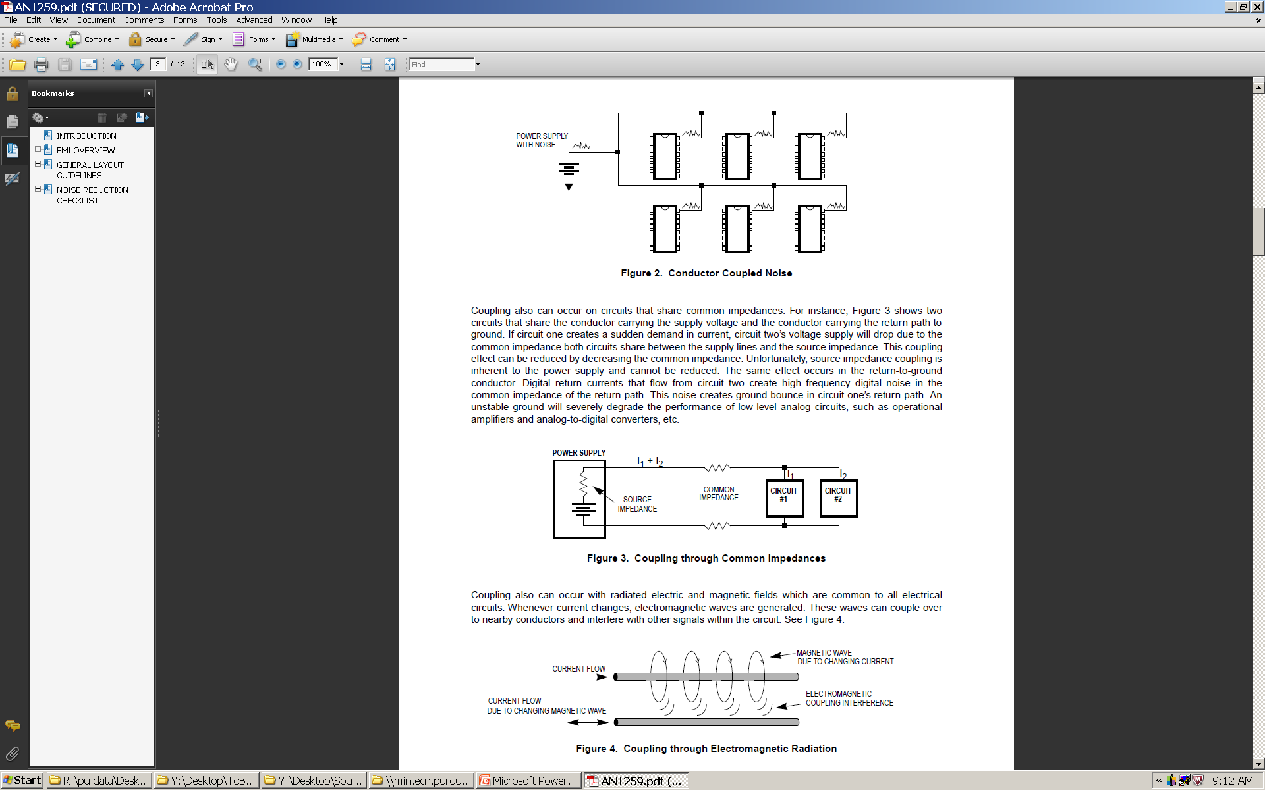
EMI Coupling Paths
Through conductors (wire running through a noisy environment)

Slide 17
EMI Coupling Paths (2)
Through common impedances (shared power supply and ground wires)

Slide 18
EMI Coupling Paths (3)
Through electromagnetic radiation

Slide 19
Designing for Electromagnetic Compatibility (EMC)
A circuit is electrically compatible if it does not affect and or become affected by its environment
Remedies
  Decrease emissions – can be suppressed at source through proper system design (and possibly adding shielding to contain the emission)
  Increase immunity – susceptibility to noise can be decreased by “hardening” the circuit’s design and using shielding to protect the circuit

Slide 20
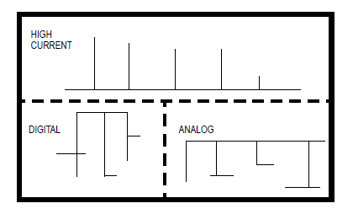
General Layout Guidelines
Separation of circuits on a PCB
  pay close attention to the potential routing of circuits between subsystems

Slide 21
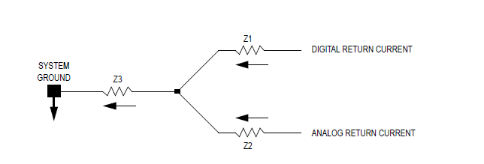
General Layout Guidelines
Ground layout is an important PCB layout design consideration – most EMI problems can be resolved using practical and efficient grounding methods
Dynamic DC offset can be created that produces a high-frequency AC component of noise that affects low-level analog circuitry

Slide 22
General Layout Guidelines
Ground layout design tips
  Separate digital and analog circuits where possible
  Use signal planes, especially ground planes, whenever possible
  If a ground plane is uneconomical, use single-point (star-point) grounding – lowers common impedance coupling among subsystems
  To decrease trace inductance, use short, wide traces
  Use 135-degree turns instead of 90-degree turns to decrease transmission reflections
  Decrease the size of all ground loops as much as possible (e.g., single-point power system)

Slide 23
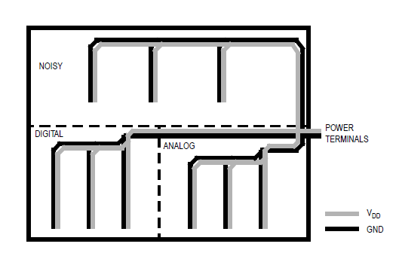
General Layout Guidelines
Single-point power system for 2-layer PCB

Slide 24
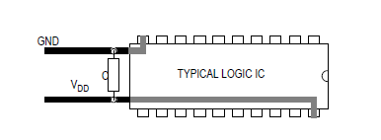
General Layout Guidelines
IC decoupling capacitor placement
  should be as physically close to IC as possible (for surface mount components, place capacitor halfway between V_{DD} and GND)
  use 0.1 µF (surface mount, ceramic) decoupling capacitors for system frequencies up to 15 MHz
  above 15 MHz, use 0.01 µF decoupling capacitors

Slide 25
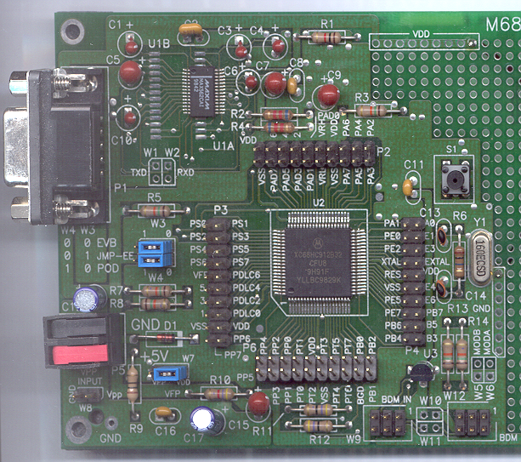
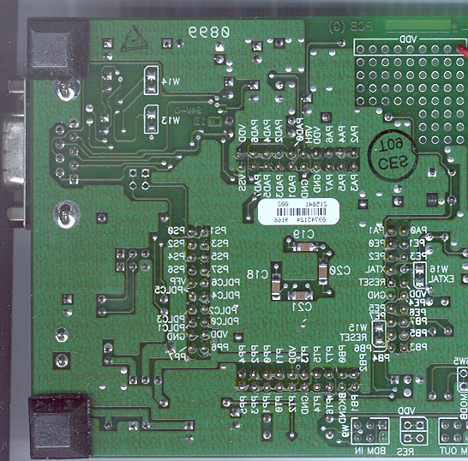
Location of Bypass Capacitors for 68HC12

Slide 26
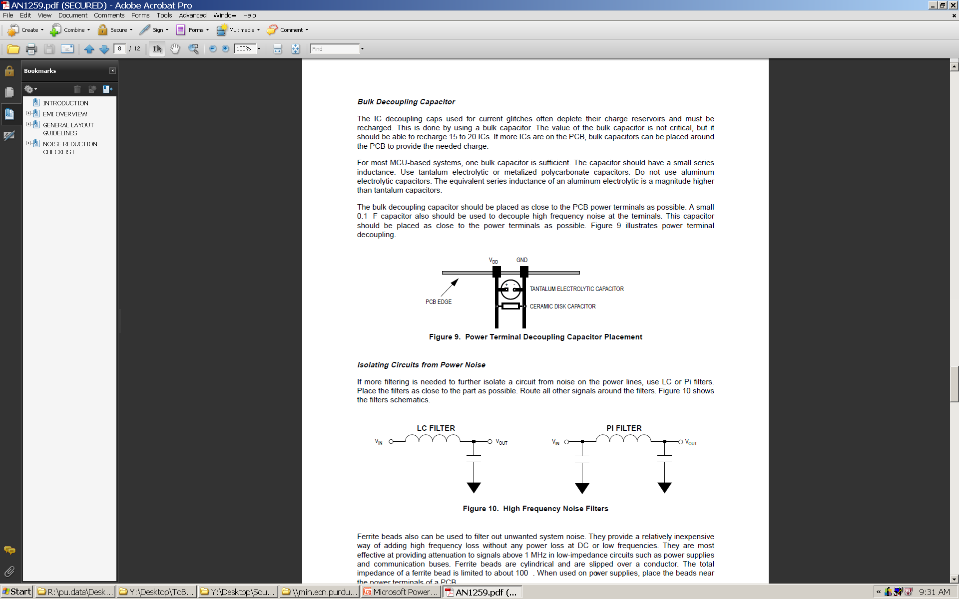
General Layout Guidelines
Power terminal decoupling capacitor placement
  Sometimes called a “bulk” capacitor – should be placed as close to the power input terminal (connector) as possible
  A small (0.1 µF capacitor should also be used to decouple high frequency noise at the power input terminal
  Purpose of bulk capacitor is to help recharge the IC decoupling capacitors
  Value is not critical, but should be able to recharge 15-20 ICs (multiple bulk capacitors may be used if there are more than 15-20 ICs)

Slide 27
General Layout Guidelines
High frequency noise filters
  Use if additional filtering needed to isolate a circuit for noise on the power lines (e.g., RF modules)
  Place filter as close to part as possible
  Ferrite beads can also be used to filter out unwanted system noise (especially on cables)

Slide 28
General Layout Guidelines
Signal layout
  Most sensitive digital signals usually clock, reset, and interrupt lines
  If analog and digital signals must cross one another, make sure the lines cross each other at 90° angles (reduces cross-coupling)

Slide 29
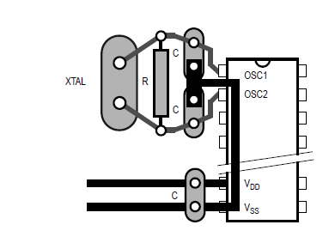
General Layout Guidelines
Crystal or ceramic resonator circuit layout

Slide 30
Layout Tips - 1
Keep parts that belong close together on layout close together on schematic
Print layout in 1:1 scale and compare footprints with your actual parts before ordering PCBs
Position parts carefully first, route second (“measure twice, cut once”)
Avoid trace angles ≤ 90° in routing whenever possible (PCB layout tool enforces this)
Separate digital/analog grounds, and tie together at a single point only

Slide 31
Layout Tips - 2
Use larger power traces and orient your power supplies and supply lines near where they are used, and put them in a place where they won’t interfere (e.g., away from GPS or RF modules)
Provide an ample number of test points (suggest header that breaks out all significant microcontroller signal pins)

Slide 32
Layout Tips - 3
Be sure to include relevant board information in the silkscreen layer of your board (name, date, board revision, etc.)
Be aware that connector pin-out may differ based on gender (watch out for inadvertent “mirroring” of pin-out)
Start even earlier than you thought you would have to start

