Slide 1
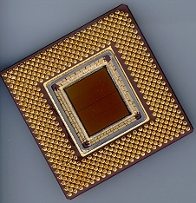
ECE 477 Digital Systems Senior Design Project
© 2014 by D. G. Meyer
Module 3
PCB Fabrication and Layout

Slide 2
Outline
Overview
PCB fabrication process
Typical PCB fabrication tolerances
Basic layout guidelines
EMI considerations (reference: AN1259)
Layout tips

Slide 3
Overview
Objective: To understand the PCB fabrication process and the impacts this has on PCB design
No fabrication process is ideal
machine tolerances
chemical processes
We can design for it!
tolerances are well-understood
with understanding, we can design for the manufacturing tolerances

Slide 4
PCB fabrication process (1/5)
Quick overview:
Copper foil
Substrate
Lamination
Etch
Drill
Plate
Solder mask
Silkscreen (legend)

Slide 5
PCB fabrication process (2/5)
Copper foil
electro-plated onto a large drum then scraped off (typical)
one side very smooth, one rough
Substrate
FR4 (fiberglass reinforced multi-functional epoxy)
others: FR2
various Tg (glass transition temperature)
Lamination
copper foil applied to both sides of laminate and then bonded using heat and pressure

Slide 6
PCB fabrication process (3/5)
Etching
this is where the circuit becomes real
etch-resist applied, pattern is exposed
uncured resist is washed off and then the pattern is etched
common etchants: FeCl, Ammonia
solvent/abrasive wash to remove etch-resist
PCB then washed to remove residues from solvents and abrasive process

Slide 7
PCB fabrication process (4/5)
Drill / Plate
this is how the connections are made between layers
holes drilled through where connections are desired
PCB then immersed in a plating solution where a thin layer of copper forms inside the barrel of the hole
once enough copper is deposited this way, then on to electro-plating, where ~1 mil of copper is plated on
if a gold-plate finish is required, typically applied at this time

Slide 8
PCB fabrication process (5/5)
Solder mask
protects metal from corrosion, short circuits
also prevents solder from sticking
applied as a liquid, then cured with UV
myriad of colors available, green most common
Silkscreen (legend)
labels everything: components, notes, warnings, logos
similar process to making T-shirts
applied as a liquid, then cured
several colors, white most common

Slide 9
Typical PCB fabrication tolerances
Drills: +5/-3 mils diameter, 5 mil center
drill sizing and plating tolerance
smallest drill size 20 mil
Layer-to-layer alignment: +/- 3 mils
Minimum annular ring: 5 mils
minimum pad: hole size + 20 mil
Etched feature size: +/- 1 mil
smallest trace/space: 6/6, 8/8 preferred
Solder mask registration: +/- 3 mil
Silkscreen registration: +/- 10 mil

Slide 10
More about annular rings
5mil
Example VIA
pads on opposite layers
connected by a plated hole
ideal configuration shown
Registration tolerance
5 mils
Remainder is called annular ring
If there is not enough remaining metal, the via will not make a reliable connection
5mil

Slide 11
Basic Layout Guidelines
Minimum trace/space size should be 10-12 mil
Power and ground traces should be as “big as possible” (at least 40-60 mil, 100 mil better)
Decoupling capacitors should be placed as close to each IC as possible – follow each manufacturer’s recommendations for size and quantity
Use surface mount components to save space
Provide space and mechanical support for connectors, heat sinks, and standoffs (used to mount board in case)
Incorporate headers to provide access to key signals

Slide 12
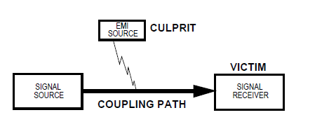
EMI Considerations
Source of EMI include microcontrollers, electrostatic discharges, transmitters, transient power components, AC supplies, and lightning
Within a microcontroller system, the digital clock circuitry is usually the biggest generator of wide-band noise

Slide 13
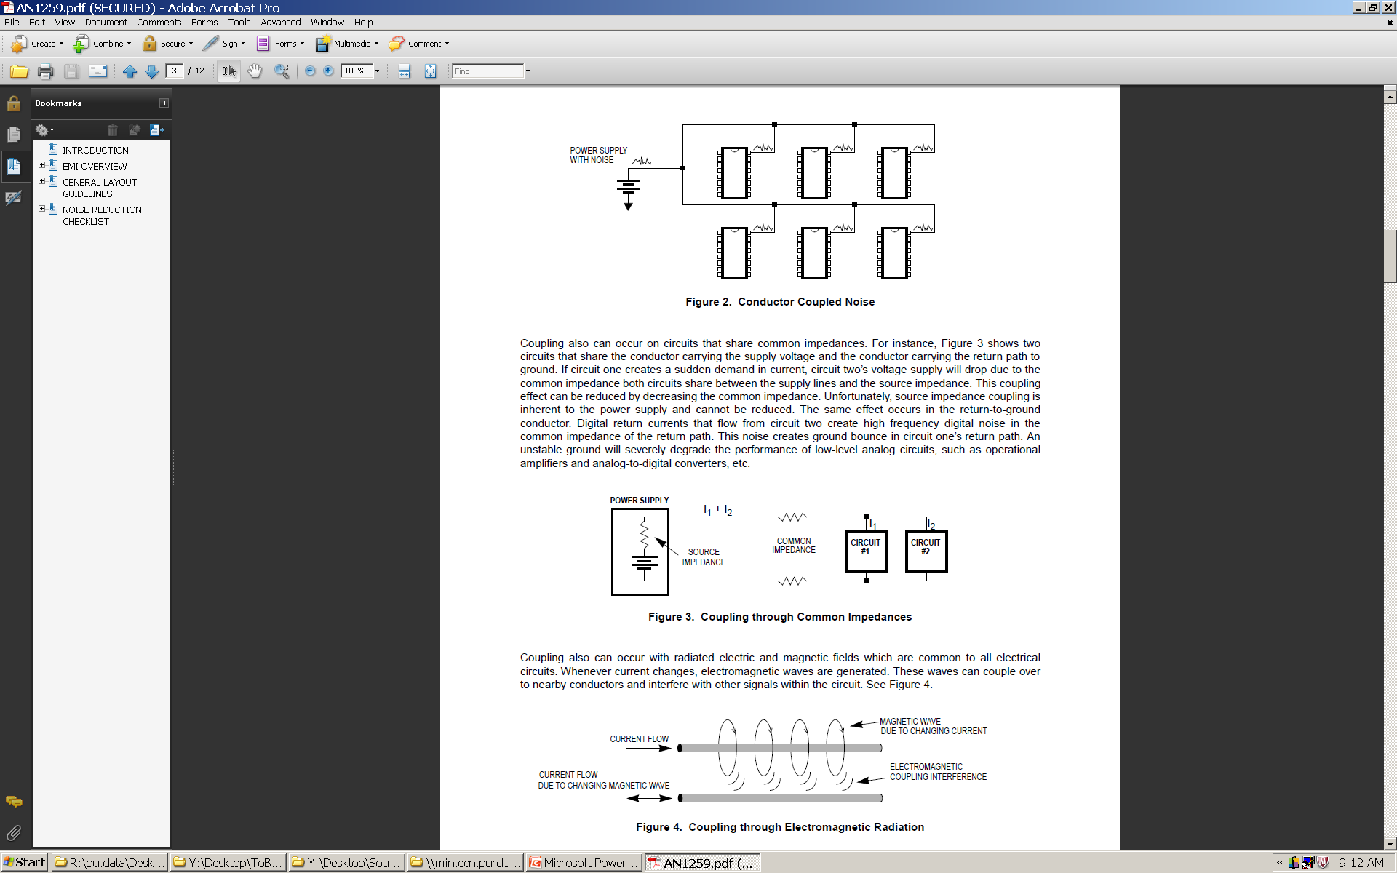
EMI Coupling Paths
Through conductors (wire running through a noisy environment)

Slide 14
EMI Coupling Paths (2)
Through common impedances (shared power supply and ground wires)

Slide 15
EMI Coupling Paths (3)
Through electromagnetic radiation

Slide 16
Designing for Electromagnetic Compatibility (EMC)
A circuit is electrically compatible if it does not affect and or become affected by its environment
Remedies
decrease emissions – can be suppressed at source through proper system design (and possibly adding shielding to contain the emission)
increase immunity – susceptibility to noise can be decreased by “hardening” the circuit’s design and using shielding to protect the circuit

Slide 17
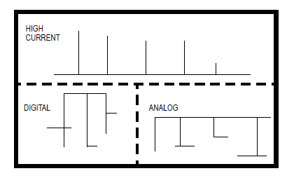
General Layout Guidelines
Separation of circuits on a PCB
pay close attention to the potential routing of circuits between subsystems

Slide 18
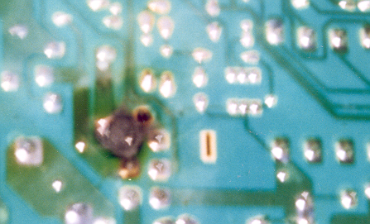
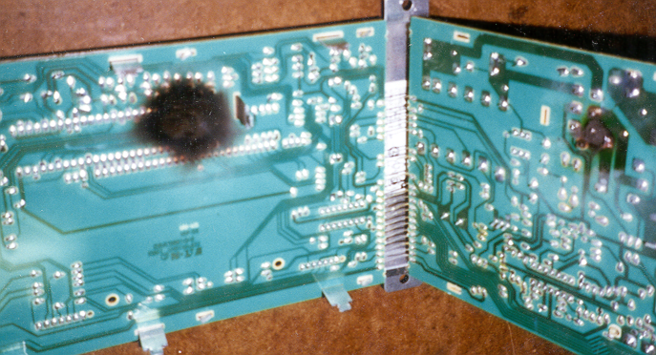
An Undersized Trace

Slide 19
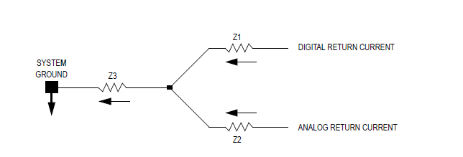
General Layout Guidelines
Ground layout is the most important PCB layout design consideration – most EMI problems can be resolved using practical and efficient grounding methods
Noise can be coupled into other circuits by common impedance
Dynamic DC offset can be created that produces a high-frequency AC component of noise that affects low-level analog circuitry

Slide 20
General Layout Guidelines
Ground layout design tips
separate digital logic and low-level analog circuits
provide as many parallel pathways to ground as possible (becomes a “ground plane” in the limit, and decreases inductance of ground return)
if ground plane is uneconomical, use single-point (star-point) grounding – lowers common impedance coupling among subsystems
to decrease trace inductance, use as short and wide a trace as possible
use 45-degree turns instead of 90-degree turns to decrease transmission reflections
decrease the size of all ground loops as much as possible (e.g., single-point power system)

Slide 21
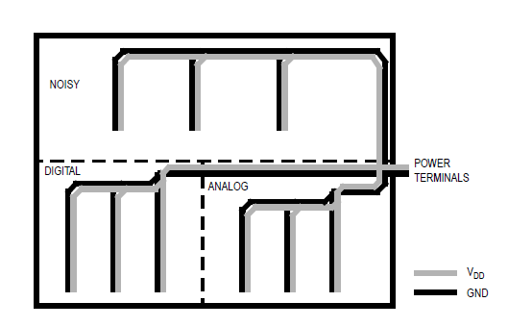
General Layout Guidelines
Single-point power system for 2-layer PCB

Slide 22
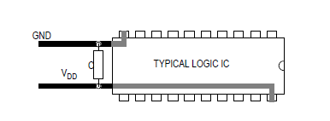
General Layout Guidelines
IC decoupling capacitor placement
should be as physically close to IC as possible (for surface mount components, place capacitor halfway between V_{DD} and GND)
use 0.1 µF (surface mount, ceramic) decoupling capacitors for system frequencies up to 15 MHz
above 15 MHz, use 0.01 µF decoupling capacitors

Slide 23
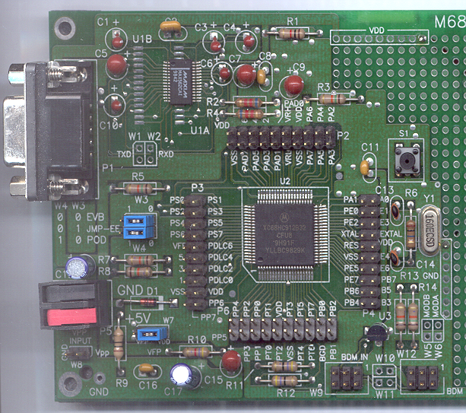
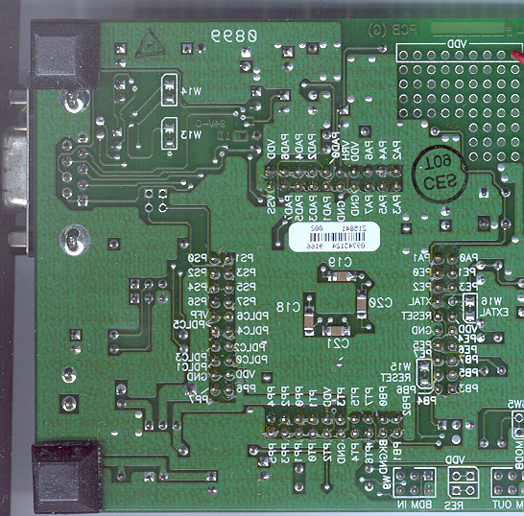
Location of Bypass Capacitors for 68HC12

Slide 24
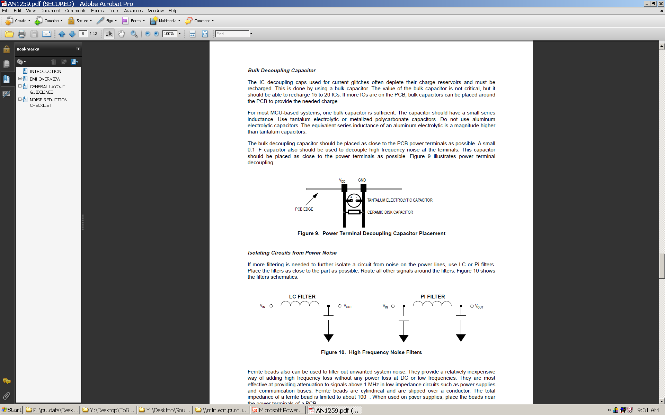
General Layout Guidelines
Power terminal decoupling capacitor placement
sometimes called a “bulk” capacitor – should be placed as close to the power input terminal (connector) as possible
a small (0.1 µF capacitor should also be used to decouple high frequency noise at the power input terminal
purpose of bulk capacitor is to help recharge the IC decoupling capacitors
value is not critical, but should be able to recharge 15-20 ICs (multiple bulk capacitors may be used if there are more than 15-20 ICs)

Slide 25
General Layout Guidelines
High frequency noise filters
use if additional filtering needed to isolate a circuit for noise on the power lines (e.g., RF modules)
place filter as close to part as possible
ferrite beads can also be used to filter out unwanted system noise (especially on cables)

Slide 26
General Layout Guidelines
Signal layout
most sensitive digital signals are clock, reset, and interrupt lines
if analog and digital signals have to be mixed, make sure the lines cross each other at 90° angles (reduces cross-coupling)
ATD performance can be severely impacted by reference voltage source (route traces directly from power supply and low-pass filter using combination of 1 KΩ resistor and 1.0 µF capacitor)

Slide 27
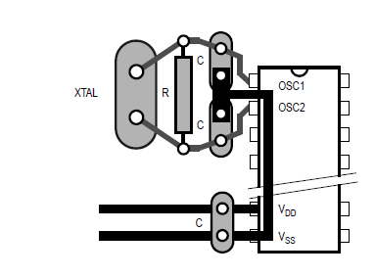
General Layout Guidelines
Crystal or ceramic resonator circuit layout

Slide 28
Layout Tips - 1
Keep parts that belong close together on layout close together on schematic (especially bypass capacitors)
Print layout in 1:1 scale and compare footprints with your actual parts before doing any routing
Position parts carefully first, route second (“measure twice, cut once”)
Always follow current-carrying guidelines when determining trace sizes, especially power and ground traces
Minimize vias in signal routing, but don’t be afraid to use them

Slide 29
Layout Tips - 2
Avoid trace angles ≤ 90° in routing whenever possible (PCB layout tool enforces this)
Take mounting into consideration (route connectors on bottom side, and save space for standoffs/screws)
Use copper pour for ground when possible to reduce noise/EMI
Separate digital/analog grounds, and tie together at a single point only
Type 1206 surface mount resistors and capacitors are recommended

Slide 30
Layout Tips - 3
Use larger power traces and orient your power supplies and supply lines near where they are used, and put them in a place where they will have minimum interference (e.g., away from GPS or RF modules)
If a clean (rising) edge is needed, be sure to match the impedance of the trace to the IC with a resistor next to the IC driving the signal
Provide an ample number of test points (suggest header that breaks out all significant microcontroller signal pins)

Slide 31
Layout Tips - 4
Outline board in copper (required as part of board manufacturing process)
Be sure to include relevant board information in the silkscreen layer of your board (name, date, board revision, etc.)
Be aware that connector pin-out may differ based on gender (watch out for inadvertent “mirroring” of pin-out)
Start even earlier than you thought you would have to start

Slide 32
Tolerances for your PCB
Course account pays for only one board – we will not buy you a “replacement”
If the fab house (http://www.4pcb.com) makes a mistake (rare), they will promptly re-make your board
Although some tolerances listed are better, please follow our rules for best results

Slide 33


Slide 34


