Slide 1
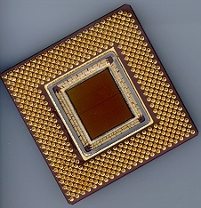
ECE 477 Digital Systems Senior Design Project
© 2014 by D. G. Meyer
Module 2
Embedded System Hardware Interfacing

Slide 2
Outline
Level Translation
Line Drivers and Receivers
Switching D.C. Loads
Optically Isolation
Keypads (Switch Matrices)
Switch De-bouncer
Rotary Pulse Generators (RPG)
PWM Applications/Interfaces
Position Control and Stepper Motors
Servos
LCD Interface
Digitally Controlled Potentiometer
Temperature and Humidity
Compass
Accelerometer
Hall Effect Sensor
Pressure (Force) Sensor
Ultrasonic Range Sensor
IR Remote Control Decoding
RF Serial Link
AC Loads

Slide 3
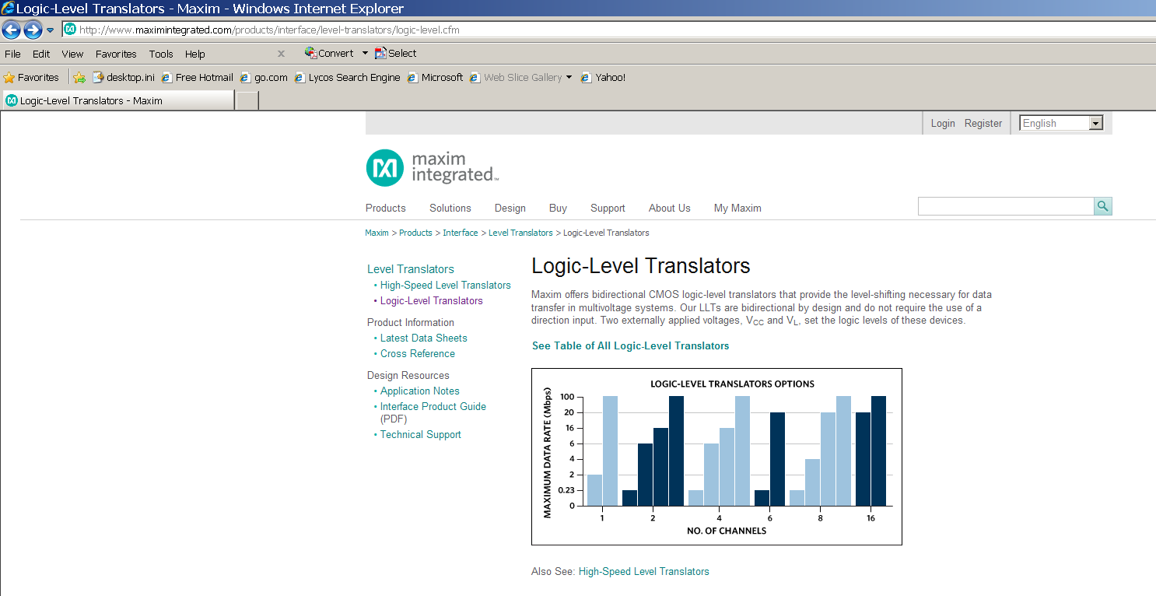
Level Translation
Needed for interfacing CMOS families operating at different supply voltages

Slide 4
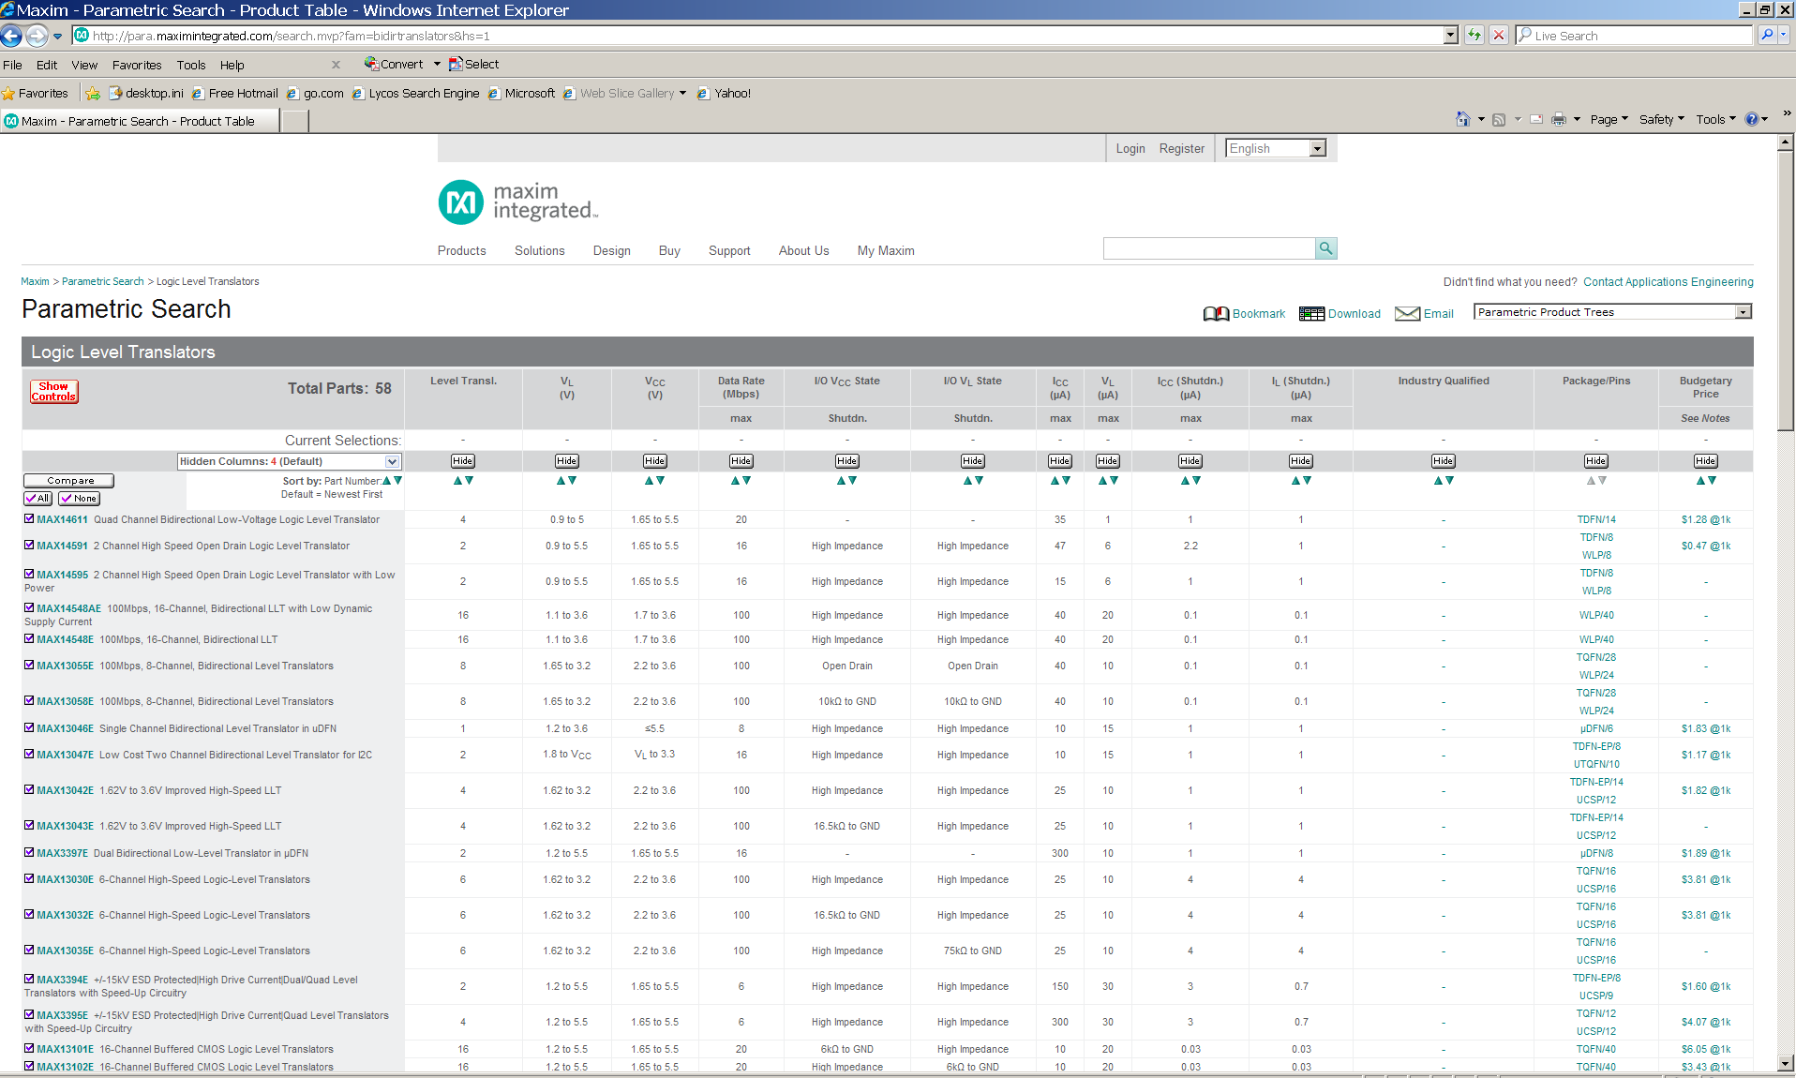
Level Translation

Slide 5
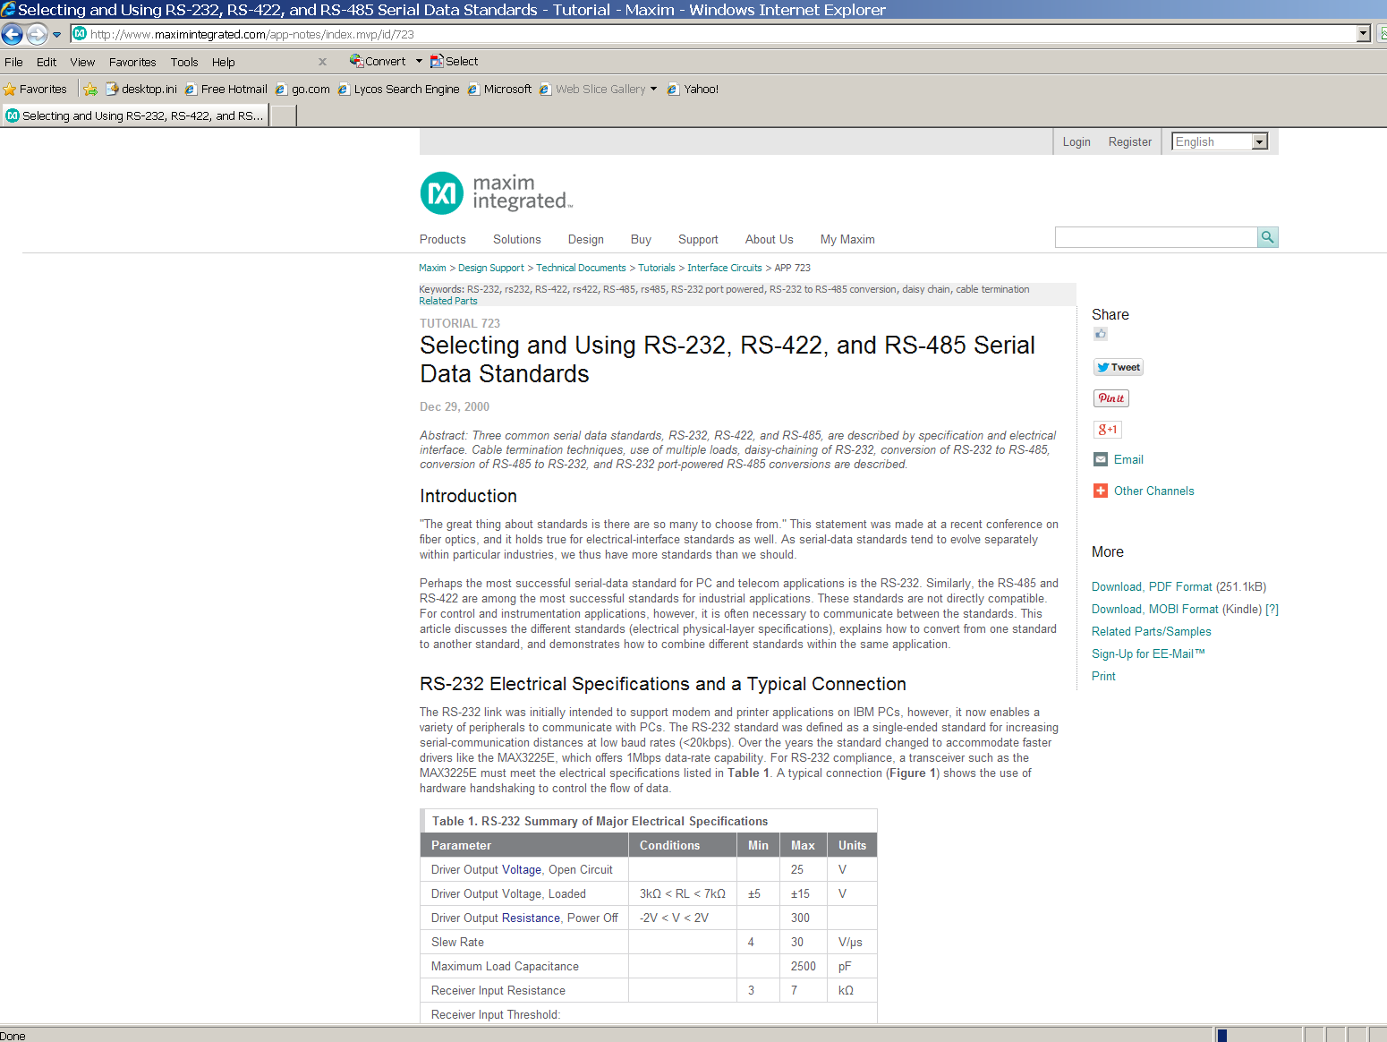
Line Drivers and Receivers
Needed for driving (long) cables based on various standards (e.g., RS 232, RS 422, RS 485, etc.)

Slide 6
Switching D.C. Loads
Basic BJT-based switching circuit (“saturated mode”)
V_{L}
“current-controlled (low side) switch”
LOAD
C
Port Pin
B
NPN BJT
I_{C} = h_{FE} x I_{B}
E
Choose BJT based on following parameters
I_{Cmax continuous}
V_{CE breakdown}
h_{FE} (D.C. current gain), also called β

Slide 7
Switching D.C. Loads
Basic MOSFET-based switching circuit
V_{L}
“voltage-controlled (low side) switch”
LOAD
D
Port Pin
G
N-channel power MOSFET
S
Choose MOSFET based on following parameters
I_{Dmax} continuous
V_{DS} breakdown
r_{DS (on)} (drain-to-source “on” resistance)

Slide 8
Switching D.C. Loads
Tradeoffs
BJTs: may require a significant amount of base current to drive into saturation (typically need Darlington for high h_{FE} at high I_{c})
MOSFETs: require virtually no gate current to operate, less chance of thermal runaway than BJT
Inductive loads require arc suppression diode
Energy stored in an inductive load must be dissipated, otherwise the “inductive kickback” can damage the switching device

Slide 9
Switching D.C. Loads
Use optical isolation to protect microcontroller
V_{L}
Vcc
LOAD
NPN BJT
active low port pin
R1
Assume Vcc = 5 V, V_{LED} = 1.5 V, and V_{OL} @ 10 mA = 0.8V
⇒ R1 = 2.7/0.01 = 270Ω

Slide 10
Switching D.C. Loads
Use optical isolation to protect microcontroller
V_{L}
Vcc
V_{L}
LOAD
NPN BJT
R2
active low port pin
R1
Assume Vcc = 5 V, V_{LED} = 1.5 V, and V_{OL} @ 10 mA = 0.8V
⇒ R1 = 2.7/0.01 = 270Ω P_{R1}=0.027W

Slide 11
Switching D.C. Loads
Use optical isolation to protect microcontroller
V_{L}
Vcc
V_{L}
LOAD
NPN BJT
R2
active low port pin
R1
Assume switching 1 amp load, and that h_{FE} of transistor is 100 ⇒ need 10 mA of base current to saturate transistor (assume V_{BEsat} of transistor is 0.7 V, and that V_{CEsat} of photo transistor is 0.3 V)
⇒ R2 = (V_{L} – 1)/0.01 If V_{L}=18V, R2=1700ohms, P_{R2}=0.17W

Slide 12
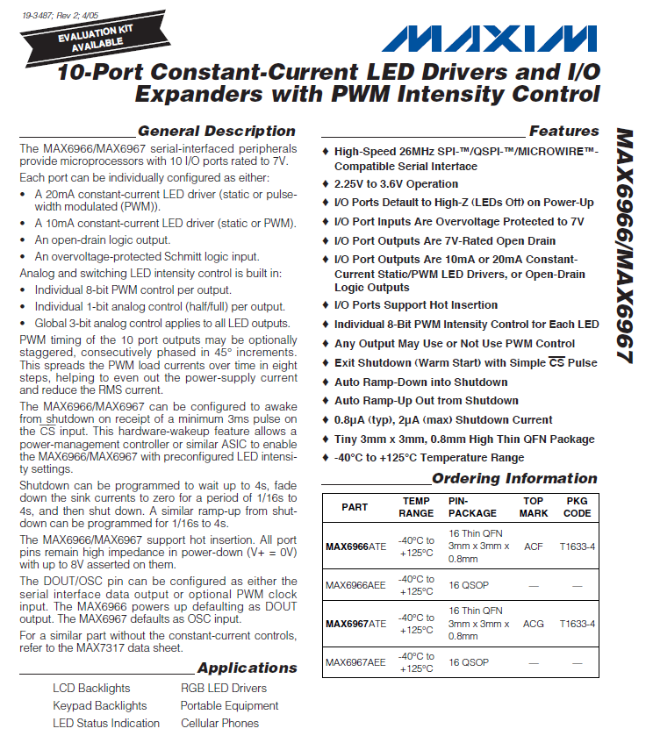

Slide 13
Optically-Isolated Inputs
Off-board (external, remotely located) switch/data inputs should be optically isolated
helps reduce noise
helps prevent ESD-induced damage
prevents “strange” voltages from entering board
eliminates ground loops

Slide 14
Optically-Isolated Inputs
Off-board (external, remotely located) switch/data inputs should be optically isolated
helps reduce noise
helps prevent ESD-induced damage
prevents “strange” voltages from entering board
eliminates ground loops
Vcc
| +
L = closed
H = open
Isolated Power Supply (or Battery)
Remote Switch

Slide 15
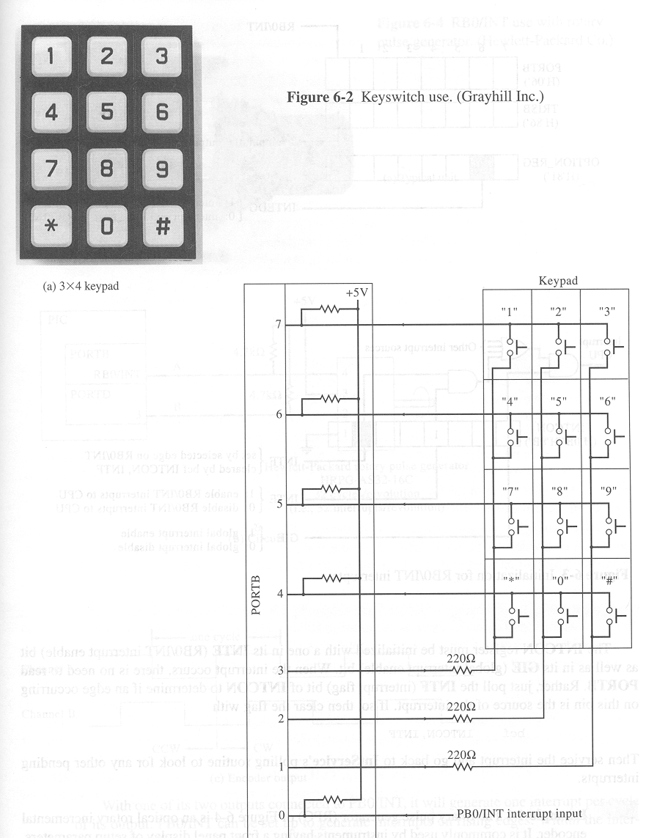
Scanned Keypad
row return lines
active low column scan lines

Slide 16
Scanned Keypad
H
H
H
H
row return lines
active low column scan lines
H
H
L

Slide 17
Scanned Keypad
H
H
H
H
row return lines
active low column scan lines
H
L
H

Slide 18
Scanned Keypad
H
H
H
H
row return lines
active low column scan lines
L
H
H

Slide 19
Scanned Keypad
H
H
H
H
row return lines
active low column scan lines
H
H
L

Slide 20
Scanned Keypad
H
H
H
H
row return lines
active low column scan lines
H
L
H

Slide 21
Scanned Keypad
H
L
H
H
row return lines
active low column scan lines
L
H
H

Slide 22
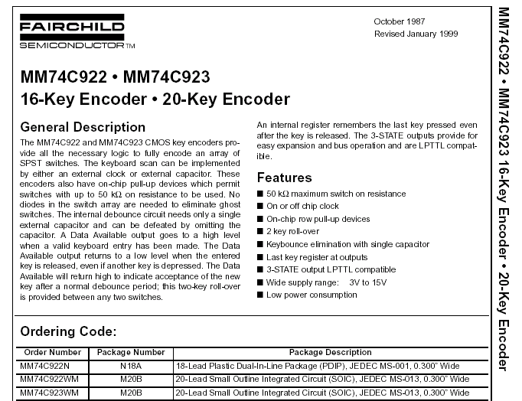
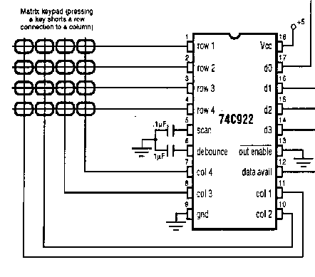
Keypad Encoder

Slide 23
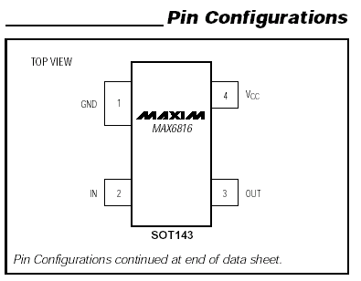
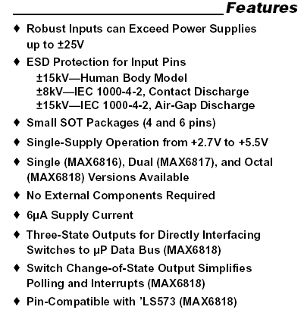
Switch Debouncer

Slide 24
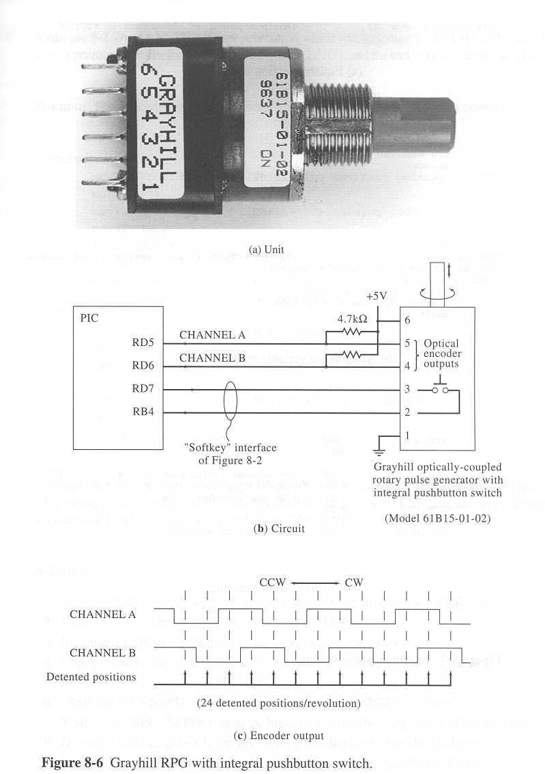
Rotary Pulse Generator (RPG)

Slide 25
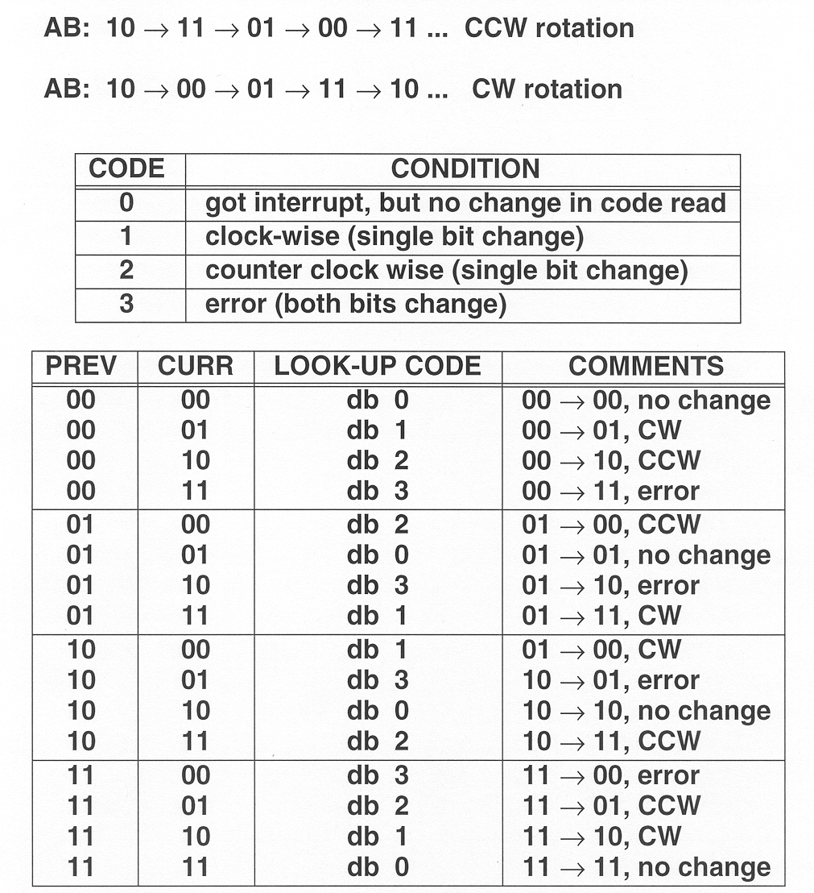
RPGs
Determine direction of rotation by concatenating “previous” and “current” codes, and using as look-up table index

Slide 26
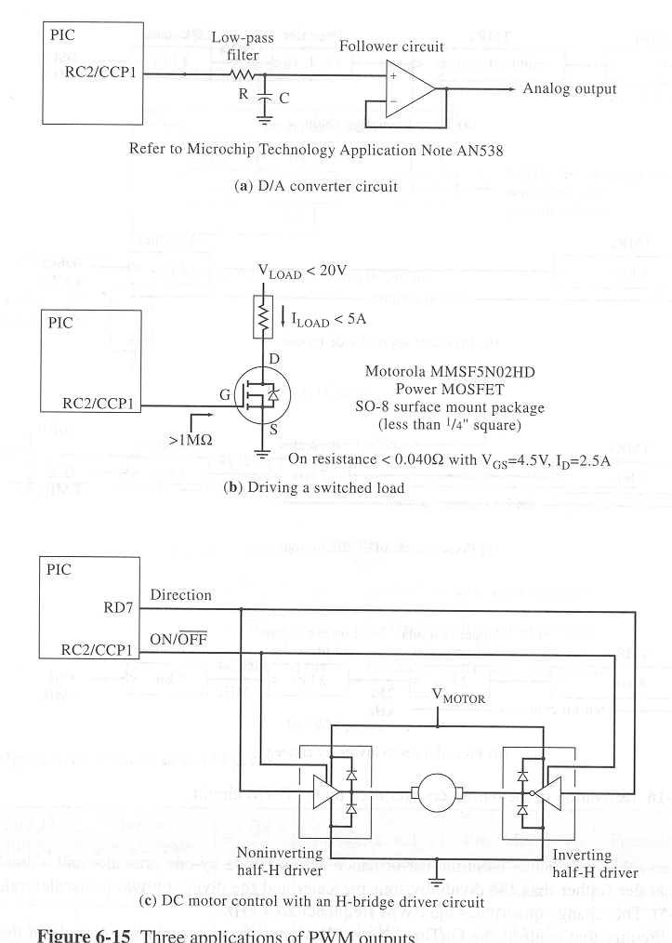
PWM Applications/Interfaces
Simple D/A converter
PWM

Slide 27
PWM Applications/Interfaces
Driving a switched load
Limitation: Capacitive load of MOSFET may limit switching frequency
PWM

Slide 28
PWM Applications/Interfaces
Motor speed and direction using H-bridge
PWM

Slide 29
“H Bridge”
V+
V+
motor
V-
V-
“coasting”

Slide 30
“H Bridge”
V+
V+
motor
+
-
V-
V-
“forward”

Slide 31
“H Bridge”
V+
V+
motor
-
+
V-
V-
“reverse”

Slide 32
“H Bridge”
V+
V+
motor
-
-
V-
V-
“braking”

Slide 33
PWM Applications/Interfaces
Motor speed and direction using H-bridge
PWM

Slide 34
Notes about H-bridges
H-bridge MUST be suitably sized for motor – measure inrush current of motor BEFORE buying H-bridge
Often need “dead time” between phases of driving the H-bridge input to prevent shoot-through (turn-off delay)
Use “snubber” diodes to protect H-bridge from inductive kickback from motor
Carefully check all specifications of H-bridge, specifically turn-off time, max frequency, R_{DS}, max supply voltage, V_{IH-min}, V_{IL-max}, etc.

Slide 35

Position Control
Position control
required in many applications
complications
inertia/mechanical loading
startup torque different than run torque (inrush)
gear backlash
stepping actuators are a good solution for many positioning problems
Rotational and linear versions available
why steppers are a good choice
high resolution without gearing
fast positioning (up to 1000 steps/sec)
position error (usually) does not accumulate
wide range of high and low torque (large/small) available
simple/efficient drive circuitry

Slide 36
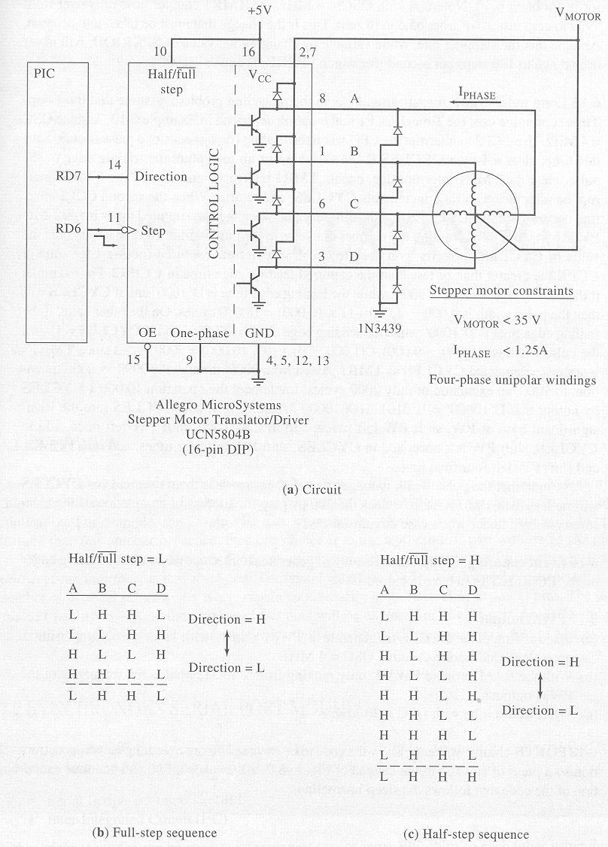
Stepper Motor Interface

Slide 37
A
B
C
V_{motor}
D

Slide 38
L
Y
L
0 1
1 1
H
X
0 0
1 0
V_{MOTOR}
H
FULL STEP MODE

Slide 39
H
Y
L
0 1
1 1
L
X
0 0
1 0
V_{MOTOR}
H
FULL STEP MODE

Slide 40
H
Y
H
0 1
1 1
L
X
0 0
1 0
V_{MOTOR}
L
FULL STEP MODE

Slide 41
L
Y
H
0 1
1 1
H
X
0 0
1 0
V_{MOTOR}
L
FULL STEP MODE

Slide 42
L
Y
L
0 1
1 1
H
X
0 0
1 0
V_{MOTOR}
H
FULL STEP MODE

Slide 43
L
Y
H
0 1
1 1
H
X
0 0
1 0
V_{MOTOR}
H
HALF STEP MODE

Slide 44
L
Y
L
0 1
1 1
H
X
0 0
1 0
V_{MOTOR}
H
HALF STEP MODE

Slide 45
H
Y
L
0 1
1 1
H
X
0 0
1 0
V_{MOTOR}
H
HALF STEP MODE

Slide 46
H
Y
L
0 1
1 1
L
X
0 0
1 0
V_{MOTOR}
H
HALF STEP MODE

Slide 47
H
Y
H
0 1
1 1
L
X
0 0
1 0
V_{MOTOR}
H
HALF STEP MODE

Slide 48
H
Y
H
0 1
1 1
L
X
0 0
1 0
V_{MOTOR}
L
HALF STEP MODE

Slide 49
H
Y
H
0 1
1 1
H
X
0 0
1 0
V_{MOTOR}
L
HALF STEP MODE

Slide 50
L
Y
H
0 1
1 1
H
X
0 0
1 0
V_{MOTOR}
L
HALF STEP MODE

Slide 51
L
Y
H
0 1
1 1
H
X
0 0
1 0
V_{MOTOR}
H
HALF STEP MODE

Slide 52
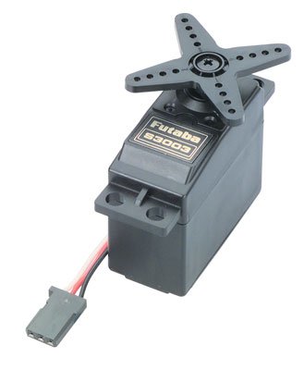
Hobbyist Servos
Position control
Single-wire interface
Can not rotate more than ~270°
why servos are a good choice
Low overhead for control – logic-level interface
Simple interface (PWM)
Pulse width (0.9-2.9µs)
Refresh period (12-20ms)
why servos may not be a good choice
Limited range of motion
Lower torque

Slide 53
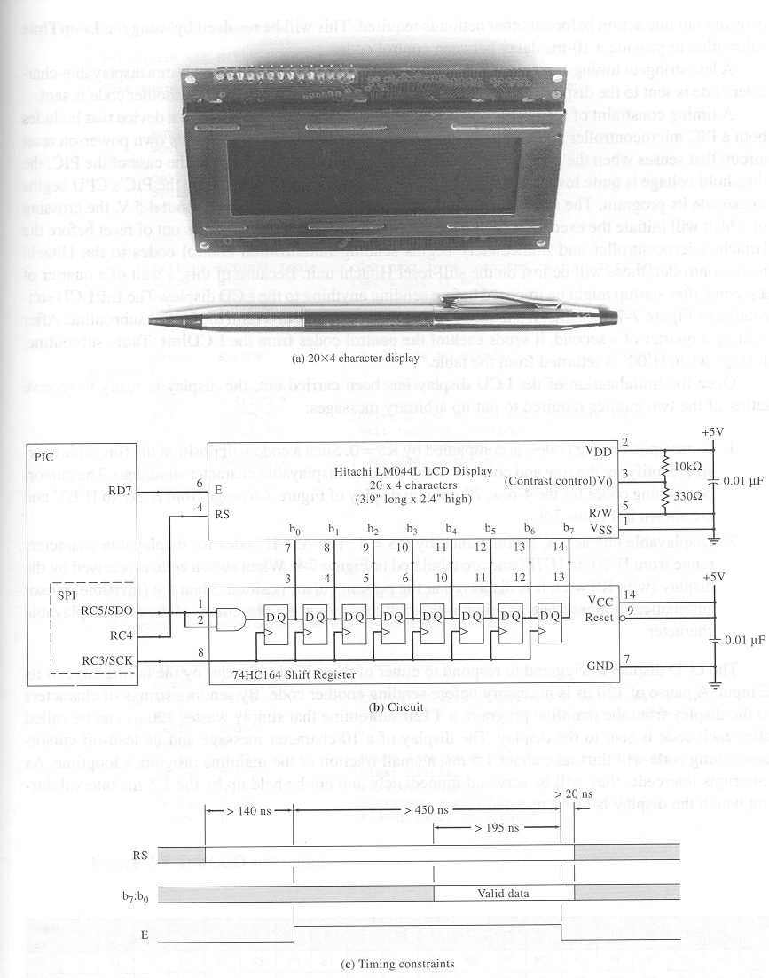
Basic LCD Interface

Slide 54
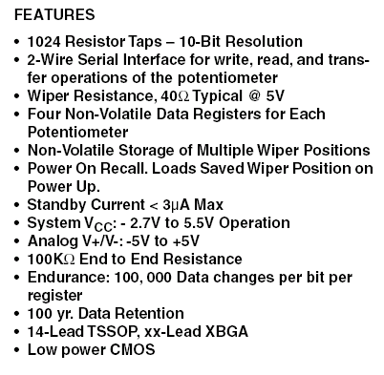
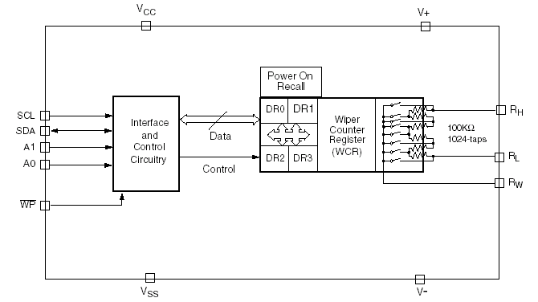
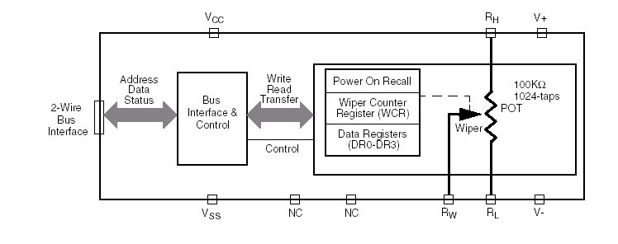

Digitally Controlled Potentiometer

Slide 55
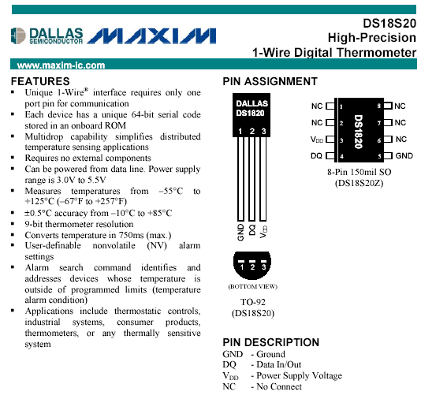
Digital Thermometer

Slide 56
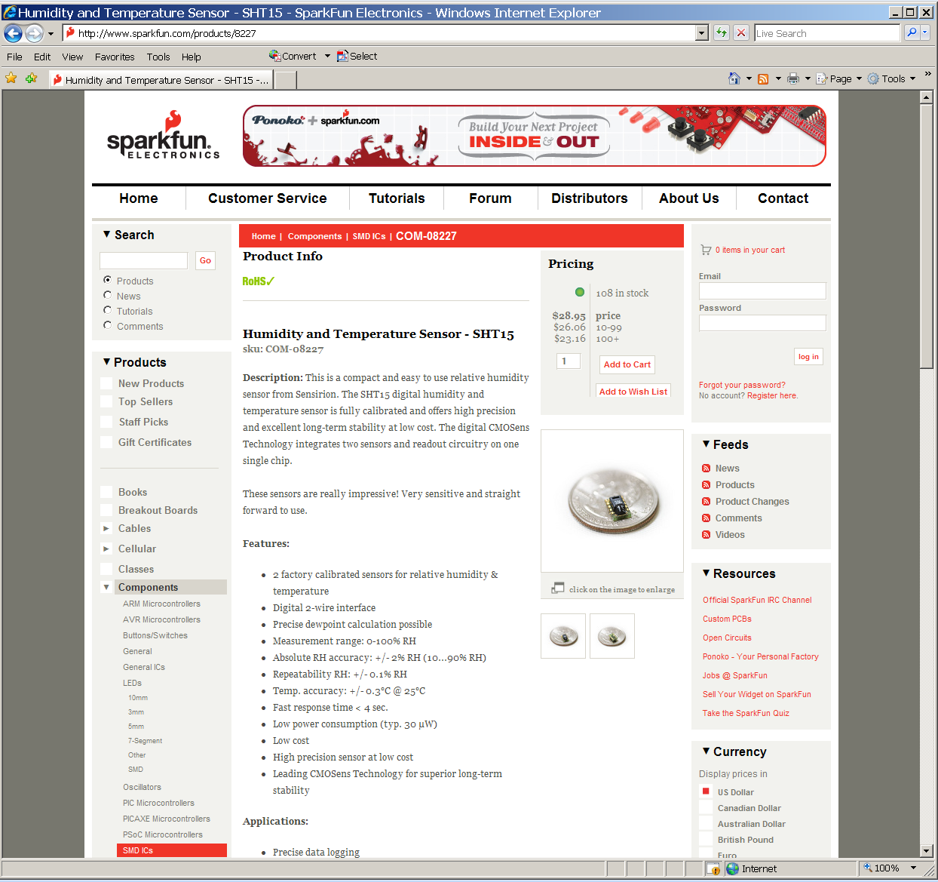
Humidity and Temperature Sensor

Slide 57
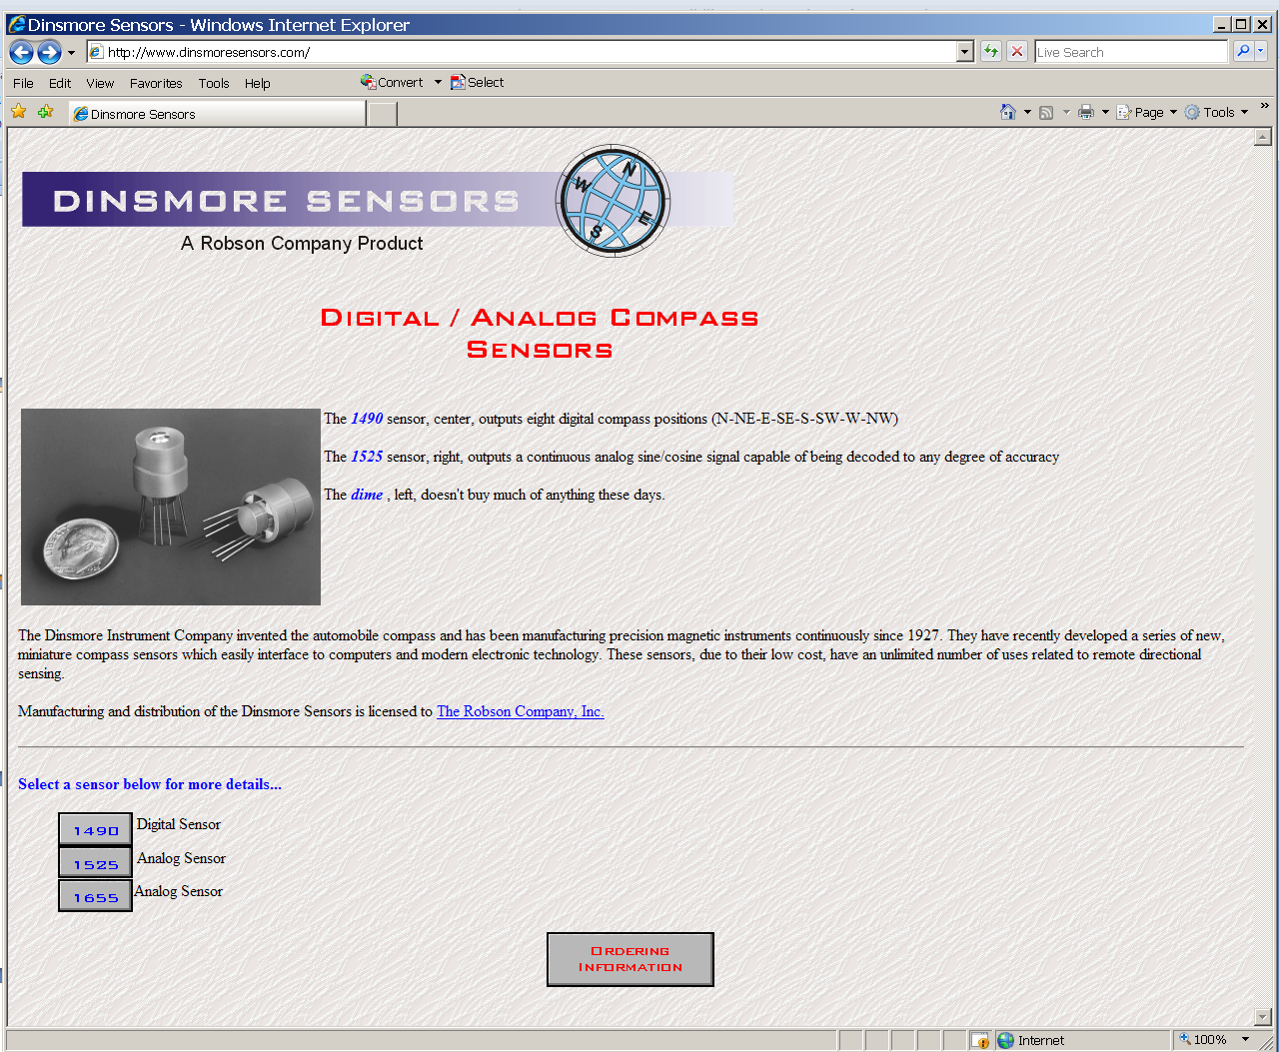
Digital/Analog Compass

Slide 58
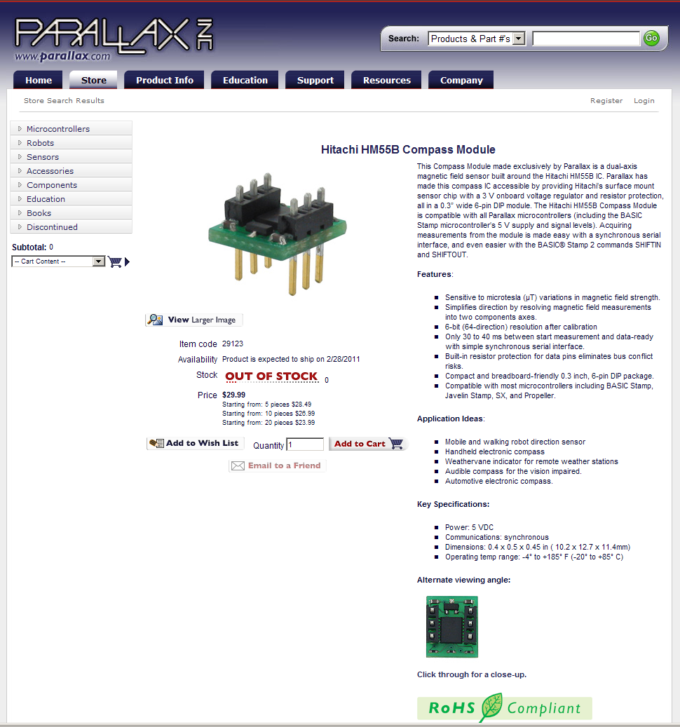
Digital Compass

Slide 59
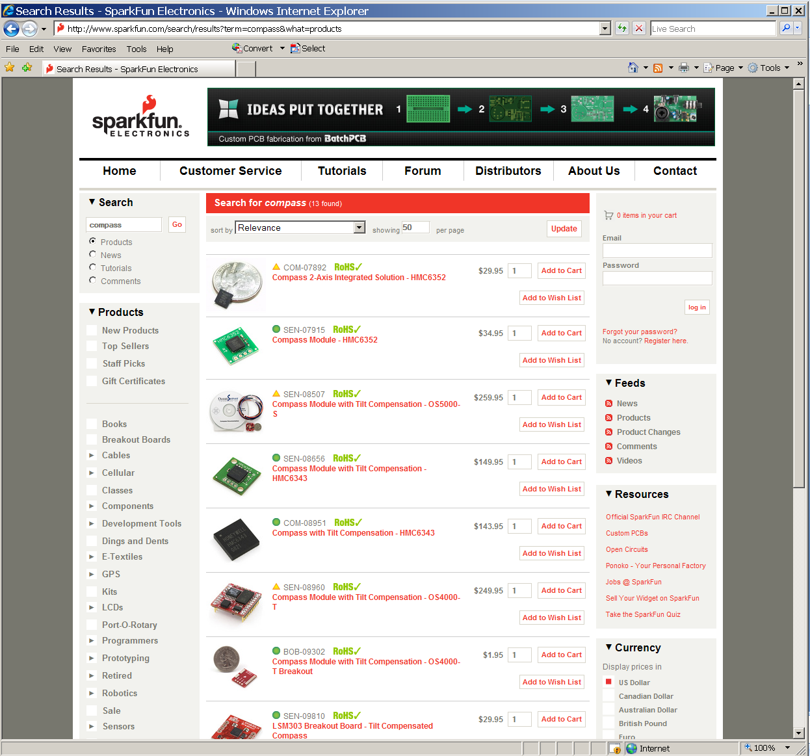
Digital Compass

Slide 60
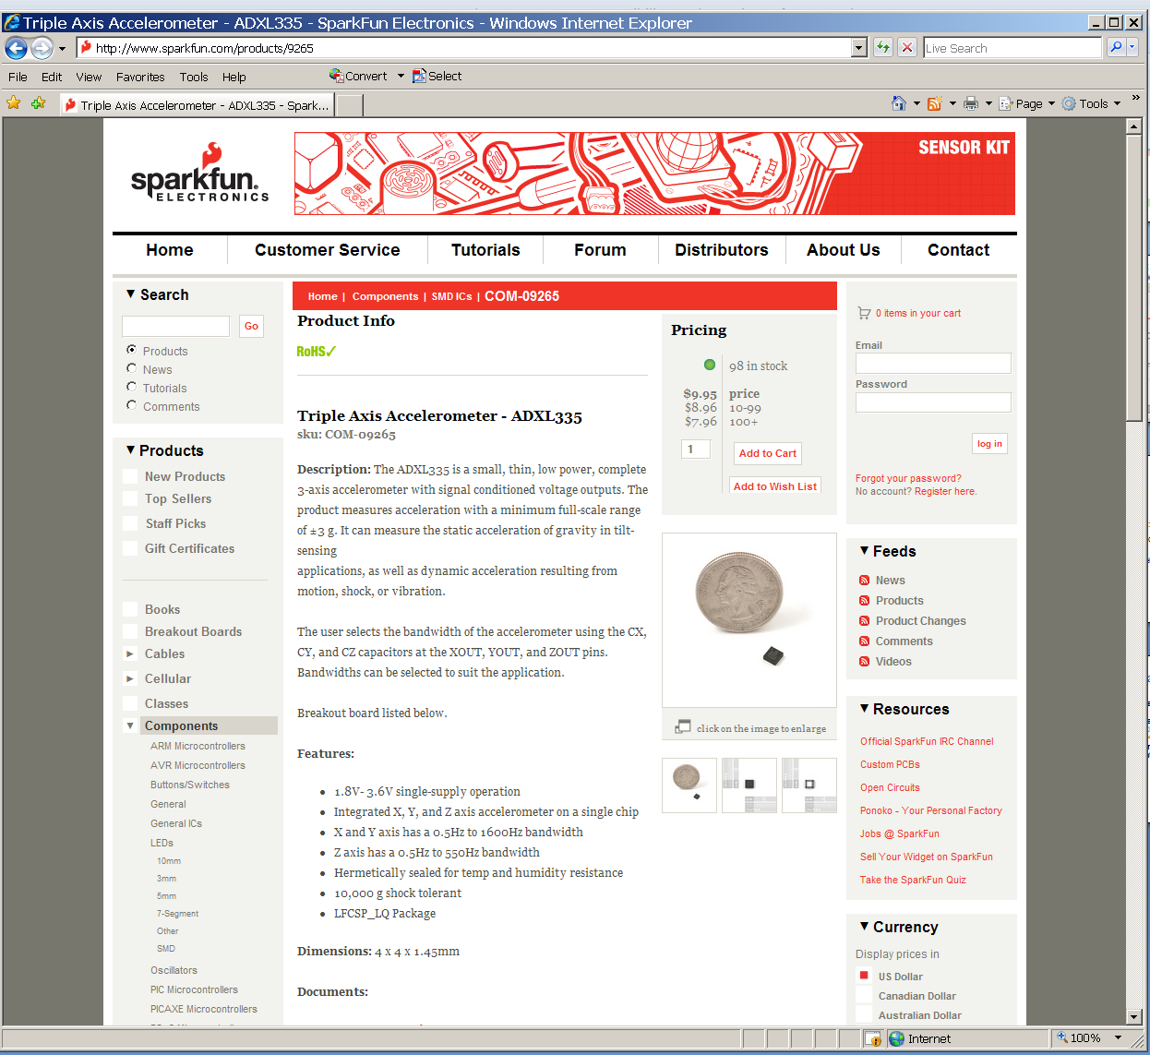
Accelerometer

Slide 61
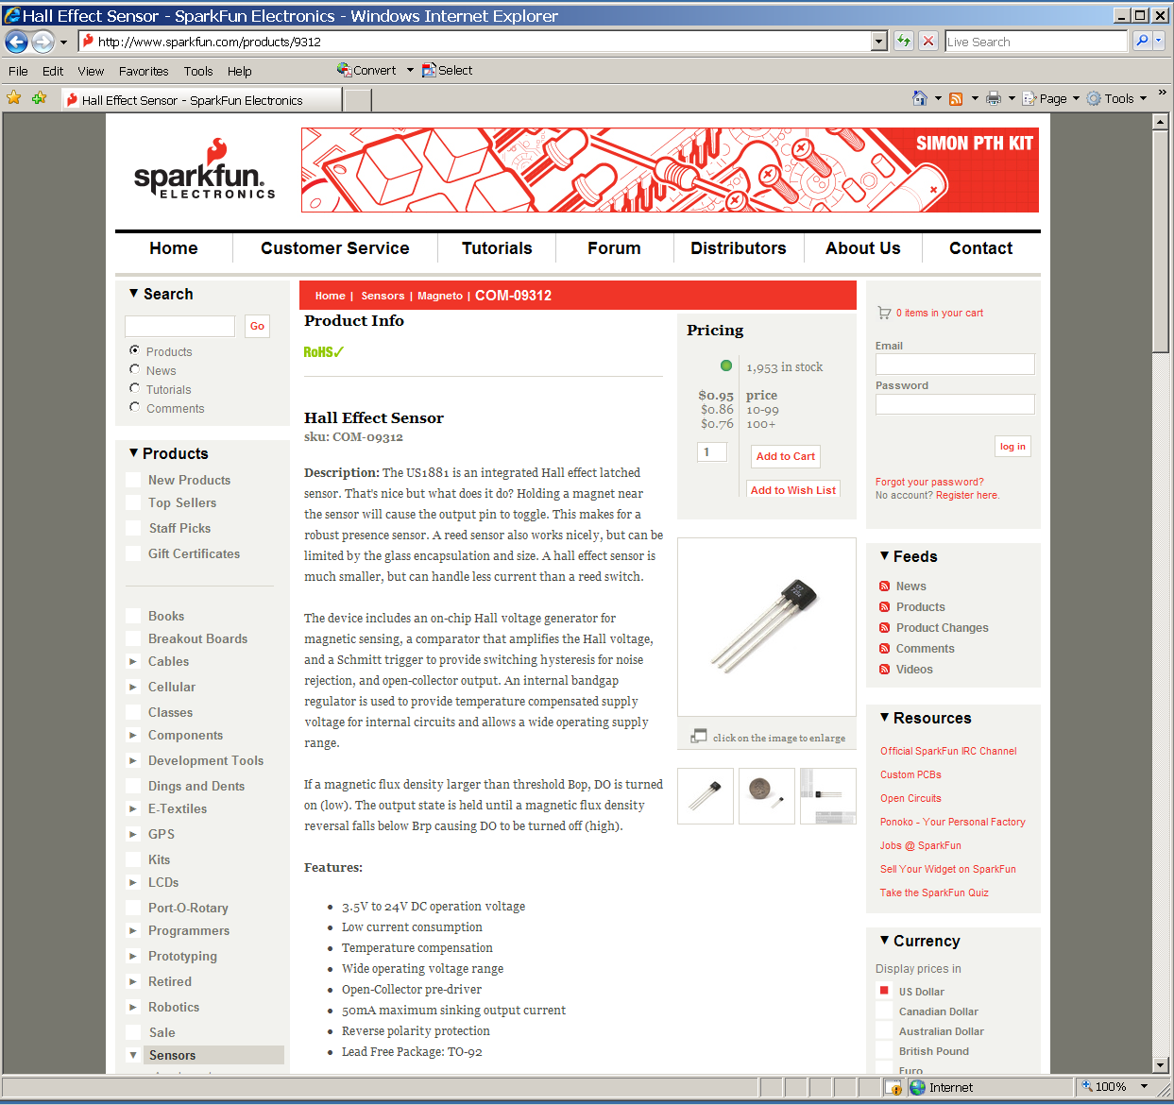
Hall Effect Sensor

Slide 62
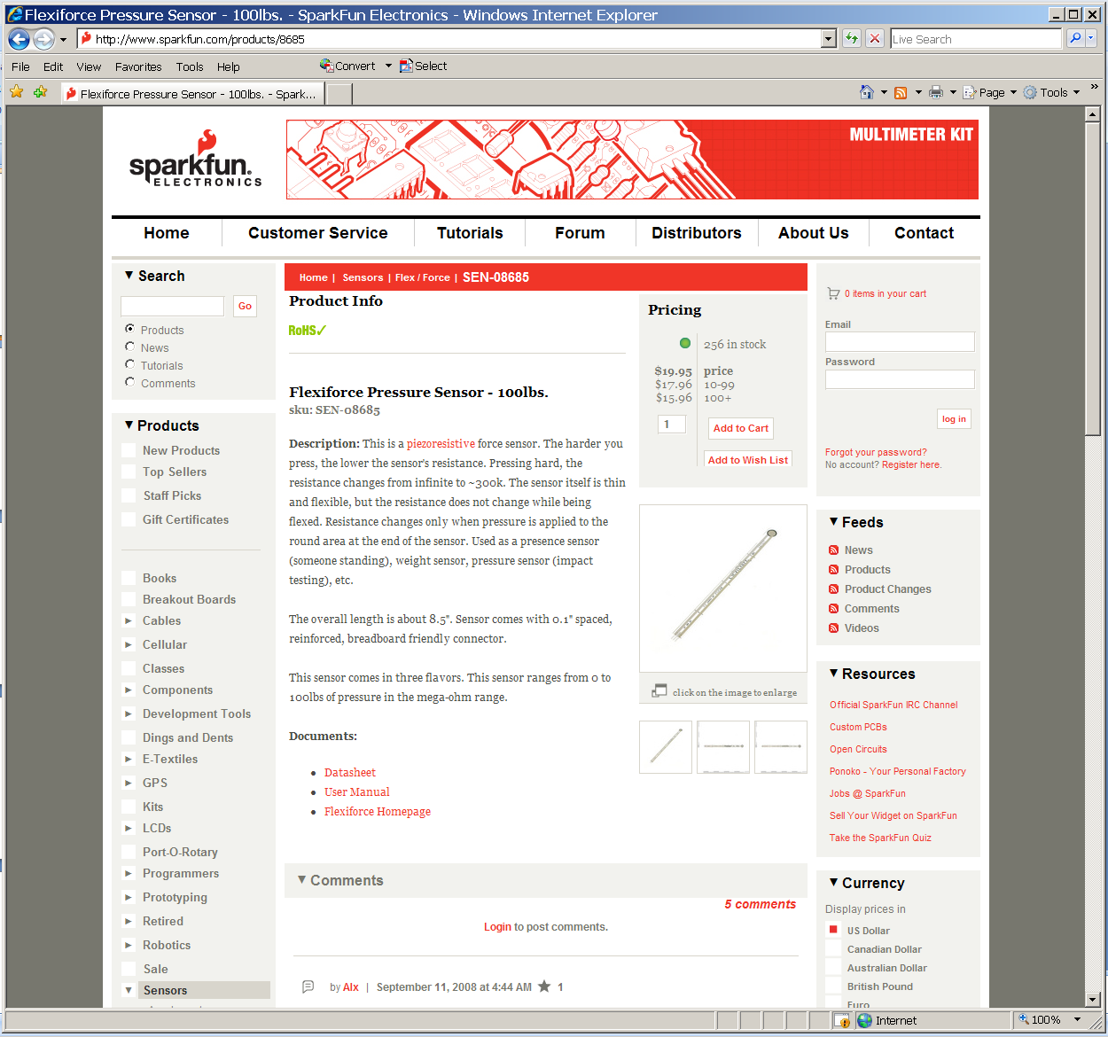
Pressure (Force) Sensor

Slide 63
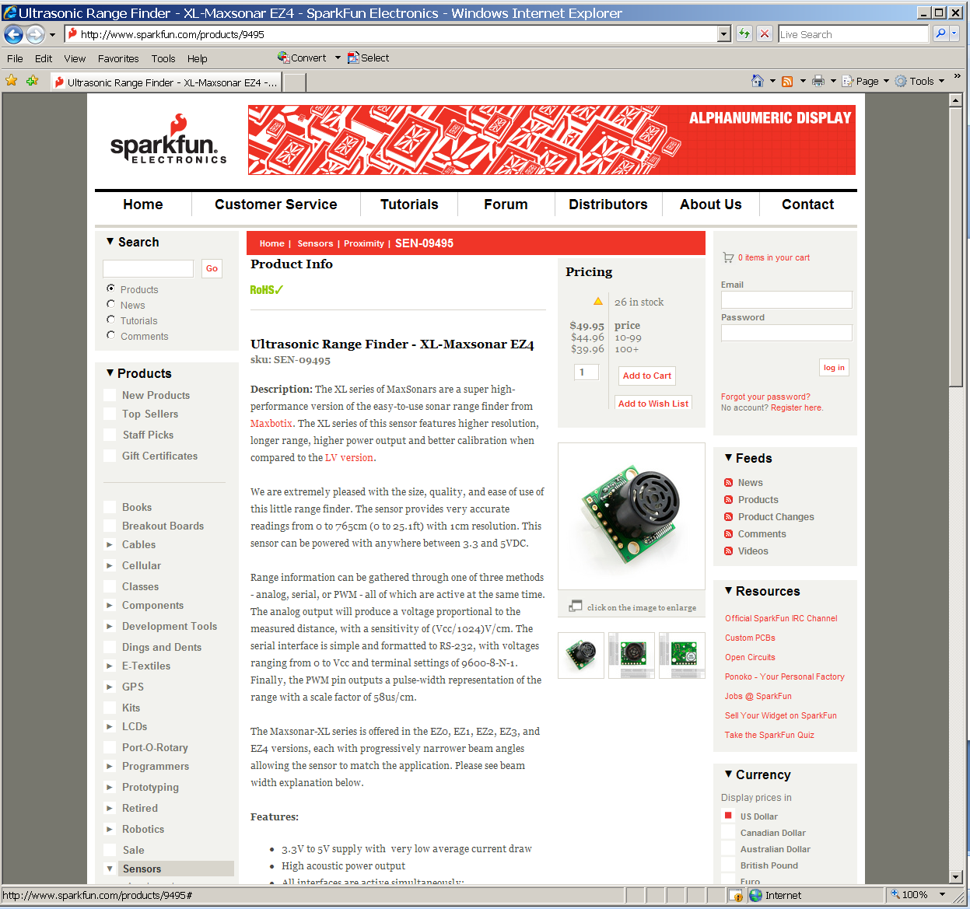
Ultrasonic Range Finder

Slide 64
Smart sensors
Value-added sensors
Sense, process/distill, translate
Abstraction layers
A few selected sensors (may be relevant to a few projects this year)
Not recommendation/endorsement

Slide 65
IMU (Inertial measurement unit)
Degrees of freedom (DOF)
Multiple measurements
3-axis gyro
3-axis accelerometer
3-axis magnetometer
Measurements accessible via standard interfaces
I2C, SPI etc.

Slide 66
Pixy
Sensing visual (color-based objects)
Pixy
Not camera output
Object positions
Object id based on color signatures
Updated object positions every 20 ms (50Hz)
Interfacing
SPI, I2C, UART, Analog X/Y
Do not forget power demands

Slide 67
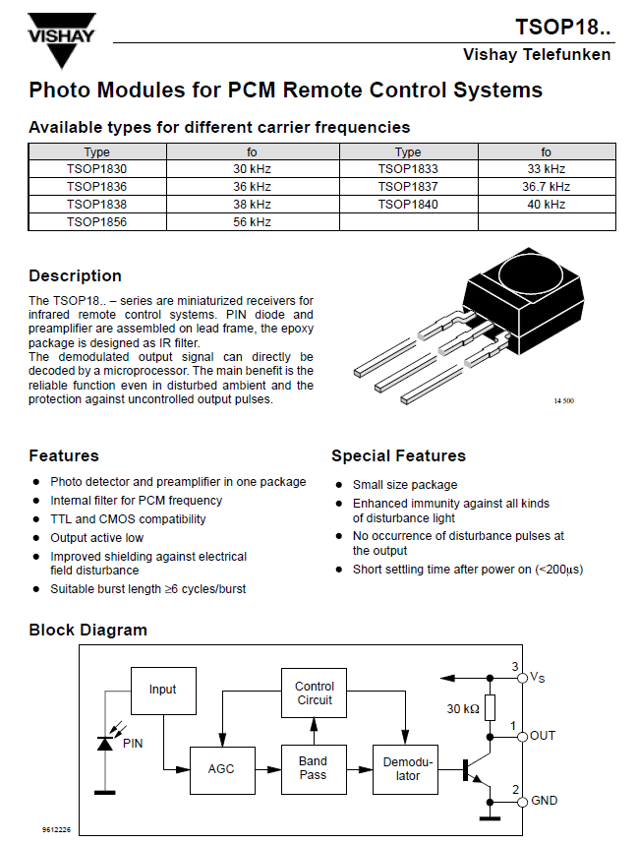
IR Remote

Slide 68
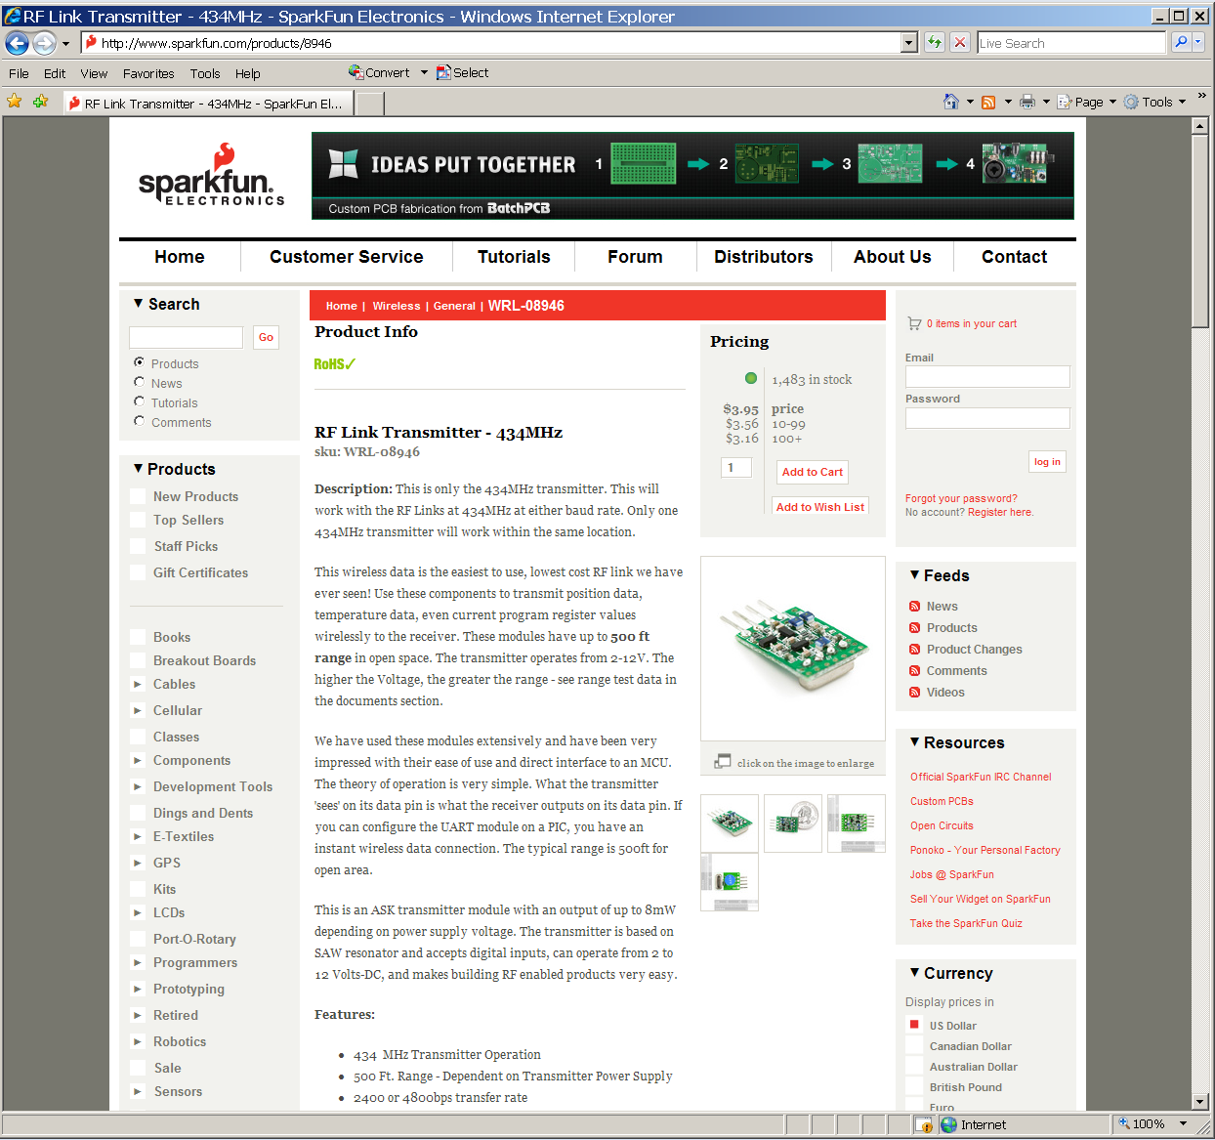
RF Link (Transmitter)

Slide 69
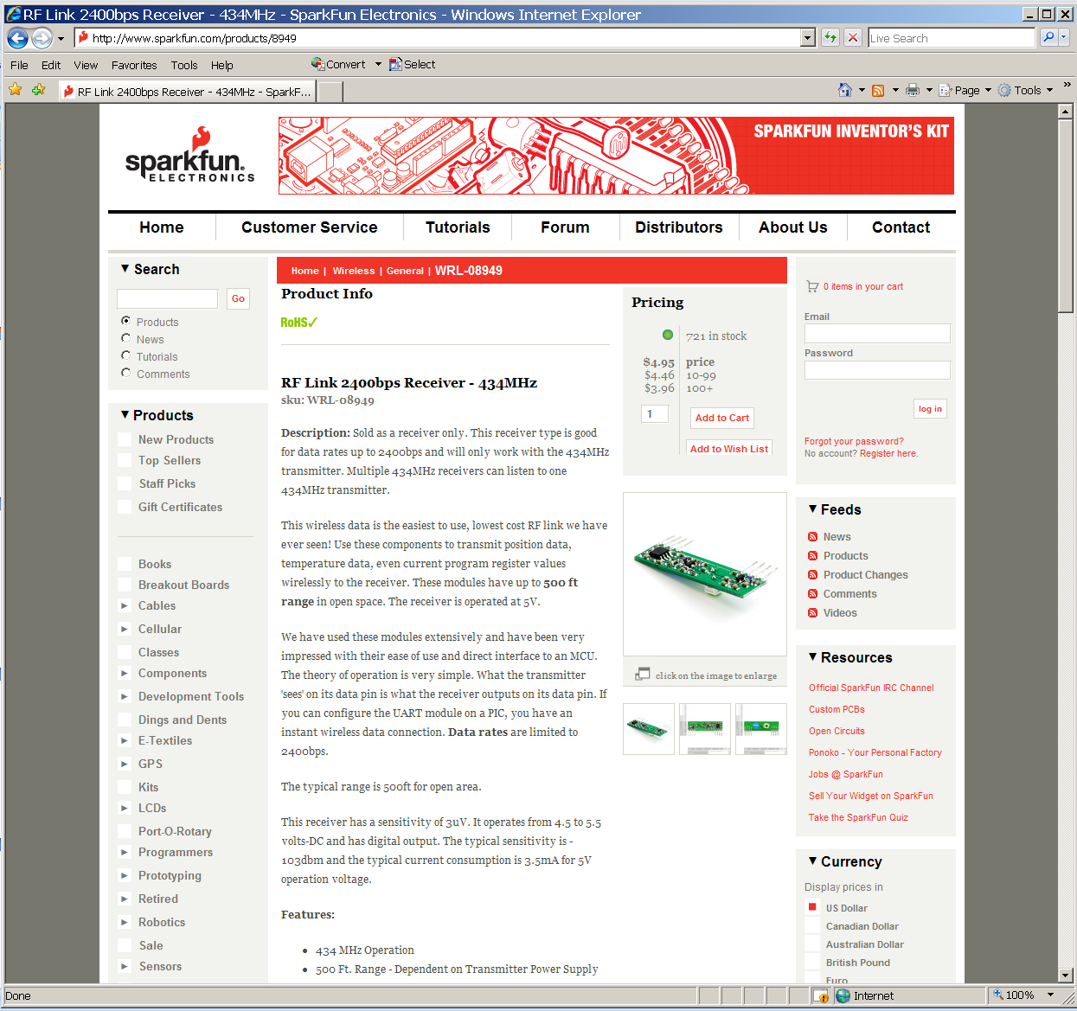
RF Link (Receiver)

Slide 70

X-10 Protocol Devices
Communication via existing A.C. wiring
Computer interface available
Modules for appliance control and lamp dimming

