Slide 1
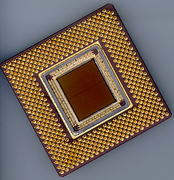
ECE 477 Digital Systems Senior Design Project
© 2014 by D. G. Meyer
Module 13
Environmental Impact Lifecycle Analysis
and Ethical Challenges

Slide 2
Outline
Environmental Impact Lifecycle Analysis
Ethical Challenges

Slide 3
Why Study Environmental Impact in Electrical and Computer Engineering?
Accreditation agencies (ABET) deem it an important part of all engineering curricula, including EE and CmpE
“Environmental issues have become central to much engineering design and practice. Yet environmental questions remain peripheral, and sometimes absent from, most engineering education.” R. A. Frosch, Harvard University

Slide 4
Why Study Environmental Impact in Electrical and Computer Engineering?
Idea of “best engineering practice” – environmental factors are an important element of this
“The university can and must play a central role in developing the concept of industrial ecology and institutionalizing its practice” J. Ehrenfeld, MIT

Slide 5
Why Study Environmental Impact in Electrical and Computer Engineering?
Ideas of “environmentally smart engineering education”, “green engineering”, and “sustainable development”
“It is expected that commonplace practice of sustainable development and business practice will evolve over time, either by choice or catastrophe.” F. Splitt, Northwestern University

Slide 6
Why Study Environmental Impact in Electrical and Computer Engineering?
Potential impact
“Engineers have a greater potential impact on our environmental inheritance than members of any other profession and we, therefore, have a greater obligation and responsibility to see to its care. It is a daunting responsibility, replete with ethical and professional pitfalls. Engineering universities and colleges have a duty to make their graduates aware of these responsibilities.” M. McPherson, Virginia Polytechnic Institute

Slide 7
Some Basic Questions...
What are some of the environmental product lifecycle issues associated with the manufacture, use, and disposal of electronic devices?
What obligation is there to lengthen the useful lifetime of a product to the extent possible?
What obligation is there to reduce the energy consumption of a product to the extent possible?
What would be an effective means for addressing these issues, and what role should government regulation (vs. the “free market”) play?

Slide 8
Some Examples...
Most electronic products are not inherently biodegradable, resulting in disposal/recycling issues
Hazardous chemicals are used in the manufacture of integrated circuits and printed circuit boards
Manufacture of LCD panels requires sulfur hexafluoride (believed to be responsible for 29% of “global warming”), and the lamps contain mercury
Compact fluorescent lamps (CFLs) contain mercury
Manufacture of touch screens currently requires raw materials in short known supply (Indium tin oxide)
Some products that use rechargeable batteries (lead acid, NiCd) are potentially environmentally hazardous

Slide 9
Clicker Quiz
Over its entire product lifecycle (assume 200,000 miles) – including manufacture, regular use, repair/maintenance, and disposal/recycling - the following vehicle will have the smallest overall environmental impact:
Chevy Volt (Electric)
Toyota Prius (Hybrid)
Honda Civic (Conventional)
Reference

Slide 10
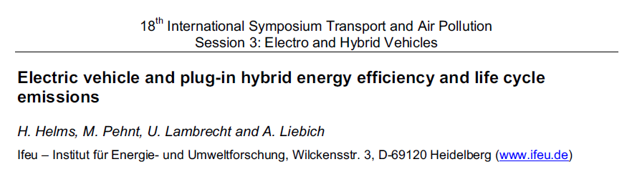
Clicker Quiz
Over its entire product lifecycle (assume 200,000 miles) – including manufacture, regular use, repair/maintenance, and disposal/recycling - the following vehicle will have the smallest overall environmental impact:
Chevy Volt (Electric)
Toyota Prius (Hybrid)
Honda Civic (Conventional)
“The presented results show, that electric vehicles charged with additional renewable energies lead to a significant improvement in the greenhouse gas balance, whereas other electricity sources lead to no substantial improvement or even higher life cycle emissions.”

Slide 11
Clicker Quiz
“The impact of anthropogenic (human-caused) climate change should be the dominant environmental impact product lifecycle consideration and serve as the basis for public policy.”
agree
disagree

Slide 12
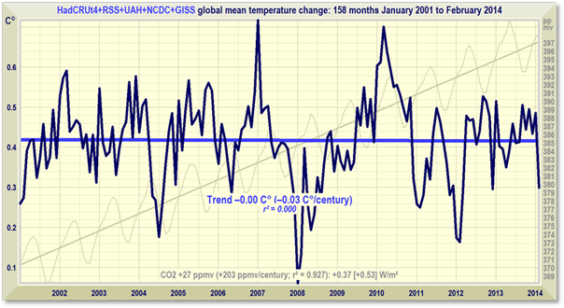
Clicker Quiz
“The impact of anthropogenic (human-caused) climate change should be the dominant environmental impact product lifecycle consideration and serve as the basis for public policy.”
agree
disagree
INCONVENIENT FACT:
There has been no increase in global mean temperature for 158 months, despite a considerable increase in atmospheric CO₂ over this period.

Slide 13
Environmental Lifecycle Impact Analysis
Outline the environment impact of your product at various stages of its life-cycle
manufacture (natural resources, hazardous chemicals, energy)
normal use (expected product lifetime, EMI, energy consumed when both “on” and “off”)
disposal/recycling (instructions for hazardous waste handling and disassembly/recycling)
Discuss how you would address each of these environmental impact concerns

Slide 14
Team Exercise – Part 1
Over the life-cycle of the product you are designing, cite a potential environmental impact and describe how you would address it.

Slide 15
Why Study Ethics in Electrical and Computer Engineering?
Accreditation agencies (ABET) deem it an important part of all engineering curricula, including EE and CmpE
Virtually all professional societies have a code of ethics
IEEE
ACM

Slide 16
Some Basic Questions...
What forms the basis of our views and our understanding of ethics?
Why is ethical behavior important to society (or, what would happen if the issue of ethics was completely disregarded)?
How can ethical practices best be learned, promoted, and ensured?

Slide 17
Where in the Computer Engineering Curriculum Should Ethics be Addressed?
A multi-dimensional issue
computer hardware (CPU, peripherals)
computer software (embedded code)
computer system (hardware-software synergy)
A digital systems senior design project course encompasses all the above, and thus serves as a good context for including ethics in a computer engineering degree program.

Slide 18
What Are Some Consequences of Unethical Practices?
“Obvious” ones…
creating and deploying malware
hacking, breaking into systems, sniffing packets
stealing passwords or credit card numbers
sending “fake” E-mail messages
Are these “harmless pranks”? What are the implications for computer hardware/software engineers?

Slide 19
What Are Some Consequences of Unethical Practices?
“Not-so-obvious” ones…
shipping hardware or software with known bugs
shipping systems that have not been thoroughly tested (certified) for product safety
What are some potential consequences of design flaws such as these?

Slide 20
Focus on Product Safety Issues
When has a product been “tested enough” to ensure operator safety under various operating conditions and failure modes?
How long is a company liable for injuries resulting from safety-related product failures?
Who, in a given company, is responsible for ensuring that a product has been “adequately” and/or “reasonably” designed and tested to ensure operator safety?

Slide 21
Specific Example - A Computer Numerically Controlled Lathe
variable speed motor
cutting tool
chuck
robot arm
metal stock

Slide 22
CNC Lathe Characteristics
Mechanical system with large inertial forces
Flying metal debris generated as part of the milling process must be safely contained
Multiple embedded microprocessors
Embedded control software (firmware)
Operator programs written in a special language designed for milling parts (production mode)

Slide 23
Question: What Mechanisms or Design Features Should Be Employed in a CNC Lathe to Ensure Operator Safety?
Mechanical
safety shields to prevent flying debris from hitting the operator
mechanical limit switches that shut entire system down if “robot arm” out-of-range
Computer control hardware
feedback sensors to monitor position, motor speed, operating temperature, etc.

Slide 24
Question: What Mechanisms or Design Features Should Be Employed in a CNC Lathe to Ensure Operator Safety?
Embedded software (firmware)
code to monitor feedback sensors, report status, and shut down system if dangerous operating conditions develop
mechanism to reset processor/shut down system if software execution disrupted (“watchdog”)
User “milling” programs
automatic identification of commands/parameters that might cause dangerous operating conditions

Slide 25
Question: How Should a Product Be Tested to Ensure It Performs Safely?
Two aspects of operational safety
safety under “normal” operating conditions
safety in the event of malfunction
hardware failures
components (integrated circuits, discrete parts)
sensors, cables
software failures
control code bug
transient execution error (due to power glitch/noise)

Slide 26
Back to Focus on Product Safety Issues
Who, in a given company, is responsible for ensuring that a product has been “adequately” and/or “reasonably” designed and tested to ensure operator safety?
How should a product be tested to ensure operator safety under all possible conditions?
What kinds of tests should be performed to “simulate” various failure modes?
When has a product been “tested enough” to verify “graceful shutdown” in the event of failure?

Slide 27
Ethical Impact Analysis
Outline the ethical challenges your team would have to resolve in the process of bringing your design to market
testing under a variety of operating conditions
placement of warning labels
providing cautions in user documentation
adding safety mechanisms
Discuss how you would address each of these challenges

Slide 28
Team Exercise – Part 2
In the process of bringing your design to market, cite a potential ethical challenge and describe how you would address it.

