Slide 1
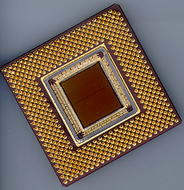
ECE 477 Digital Systems Senior Design Project
Spring 2014 Edition
Module 12
Designing for Reliability, Maintainability, and Safety

Slide 2
Outline
Introduction
Component Failures and Wear
Mean Time To/Before Failure (MTTF/MTBF)
Heat Controller Example
Failure Rate Calculation
Improving System Availability
Failure Mode & Effects Analysis (FMEA)
Criticality Analysis (FMECA)
Fault Tree Analysis (FTA)
Software and Watchdogs
Maintainability
Standards and Compliance
Reference: “Designing for Reliability, Maintainability, and Safety – Parts 1, 2, and 3”, Circuit Cellar, December 2000, January 2001, April 2001.

Slide 3
Introduction
Reliability, maintainability, and safety integral to product development
Tradeoffs between requirements and cost
Reducing probability of failure is expensive
Given little potential for personal injury, the primary consideration is manufacturing cost vs. potential customer unhappiness
There are UL, IEC, FCC standards (possibly others) to be met

Slide 4
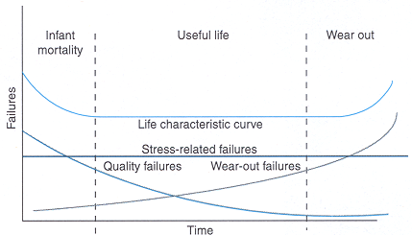
Component Failures
Electronic components can most often be modeled by constant failure rate (λ)
Leads to exponential failure distribution
Same probability of failure in the next hour regardless of whether it is new or used
but…see May 2011 IEEE Spectrum feature article on “Transistor Aging”

Slide 5
Component Failures
Components do not “age” or “degrade” with use – constant failure rate unrelated to hours of use (under certain conditions)
Equivalent information is gained testing10 units for 10,000 hours vs. testing 1000 units for 100 hours
“Impossible” 10⁻⁹ failure as likely to happen in the first 5 minutes of operation as 114,000 years from now
Infant mortality reduced by robust designs, manufacturing process control, and “shake and bake”

Slide 6
Definition of Failure Rate
Units: usually given in terms of unit failures per million hours, i.e., [10⁻⁶ units/hr) (given just one unit is involved)
Not really a probability, but rather an “expected value”
More intuitive way to describe: “unit failures per million hours per unit”, i.e., [fails/(10⁶ hour × unit)]
Equivalent to:
number of failures per unit per million hours
number of failures/hour given 1 million units in field (assuming failed units are replaced)

Slide 7
Definition of Failure Rate
Given λ_{p} × 10⁻⁶ [fails/(hr × unit)], N [units] in the field and T [hours]
expected number of failures in T hours
F (no. of failures) = λ_{p} × 10⁻⁶ fails/(hr × unit) × N units × T hours
F = λ_{p} × 10⁻⁶ × N × T failures (all other units cancel out)
example: given 1000 units in the field (at all times), and λ_{p} = 2 × 10⁻⁶, how many failures would you expect in one year?
F = 2 × 10⁻⁶ fails/(hr × unit) × 1000 units × (365 × 24) hours = 17.52

Slide 8
Definition of Failure Rate
Given λ_{p} × 10⁻⁶ [fails/(hr × unit)], N [units] in the field and T [hours]
expected number of failures in T hours
F (no. of failures) = λ_{p} × 10⁻⁶ fails/(hr × unit) × N units × T hours
F = λ_{p} × 10⁻⁶ × N × T failures (all other units cancel out)
suppose you are aiming for no more than one unit failure per week with 10,000 units in the field – what is an acceptable failure rate?
F = λ_{p} × 10⁻⁶ × N × T failures
λ_{p} × 10⁻⁶ = F/(N × T) = 1 failure / (10,000 × 7 × 24 hrs) = 0.595×10⁻⁶ failures per unit per hour

Slide 9
Clicker Quiz

Slide 10
How long is 10⁶ hours?
41,667 days
1370 months
114 years
all of the above
none of the above
Notes:
1-D

Slide 11
Given a failure rate of 1 x 10⁻⁶ units/hr, should you be “happy” if a if a typical single unit only fails once in 114 years on average ?
yes
no
Notes:
2-A

Slide 12
How long between unit failures will it be if you have 1 million units in use?
0.1 hour (6 minutes)
1 hour
10 hours
1,000 hours
1,000,000 hours
Notes:
3-B

Slide 13
Is this rate acceptable if this failure causes serious injury?
yes
no
Notes:
4-B

Slide 14
Component Wear*
If, based on observation, failure rate does depend on time used, it may be due to wear caused by improper derating
Well-derated electronic systems seldom reach the point of wear-out failure
Well-derated = working at < 30-40% of specified ratings
Heat is the main reliability killer – even a small reduction will have a significant effect
*See also “An Odometer for CPUs,” IEEE Spectrum, May 2011

Slide 15
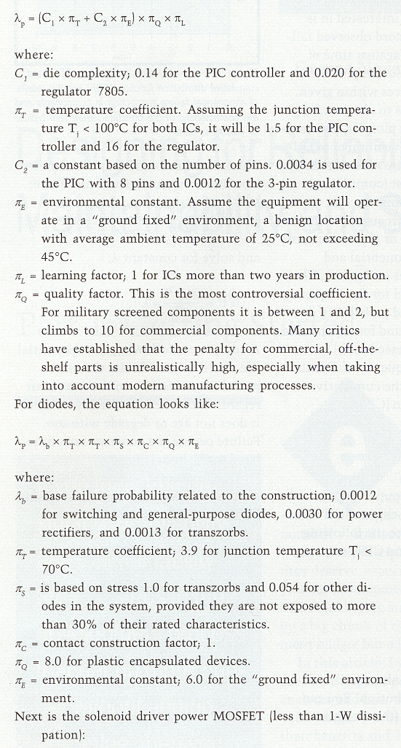
Reliability Models for Components
Calculated value is λ_{p}, the predicted number of failures per 10⁶ hours of operation
Examples (Mil-Hdbk 217F):
Microelectronic Circuits
Diodes

Slide 16
Microelectronic Circuits (see 5.1 p.23ff of Mil-Hdbk 217F)
(based on # of gates or transistors or on type of micro, e.g., 8bit, 16bit, etc)
Notes:
C1 - based on # of gates or # of transistors

Slide 17
Expectations for Homework
Choose hottest and/or most complex components
Which are your hottest/most complex components?
Choose most closely related MIL-HDBK-217F model
List assumptions and rationale for parameter values used
Present information as table or bullet list

Slide 18
MTTF/MTBF
For irreparable parts, use mean time to failure (MTTF) = 1/λ for components with an exponential life distribution
For assemblies with repairable parts, mean time between failure (MTBF) is appropriate
Field returns are always a more powerful statement of performance than statistical predictions
Reliability models are conservative
equipment generally outperforms the statistics (well designed equipment)

Slide 19
Heat Controller Example
Gas-fired burner to maintain hot-tub water temperature within a specified tolerance
Possibility of personal injury if controller malfunctions
Performing hazard analysis and modifying the design based on results obtained
important for showing “reasonable care” in court (reduction of liability)

Slide 20
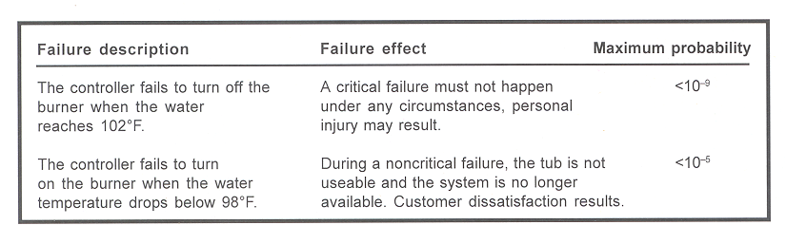
Heat Controller Example
Simple hazard analysis
10⁻⁹ generally accepted as “never” (50% chance of failure after 79,000 years of continuous operation)
BTW: with 1M units in field, never occurs once every 6 weeks

Slide 21
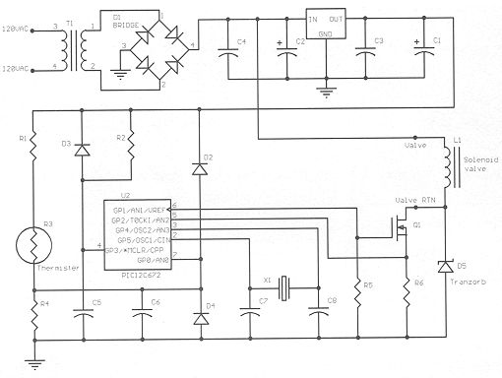
Initial Circuit Design
What is the purpose of R3, Q1, and D5?

Slide 22
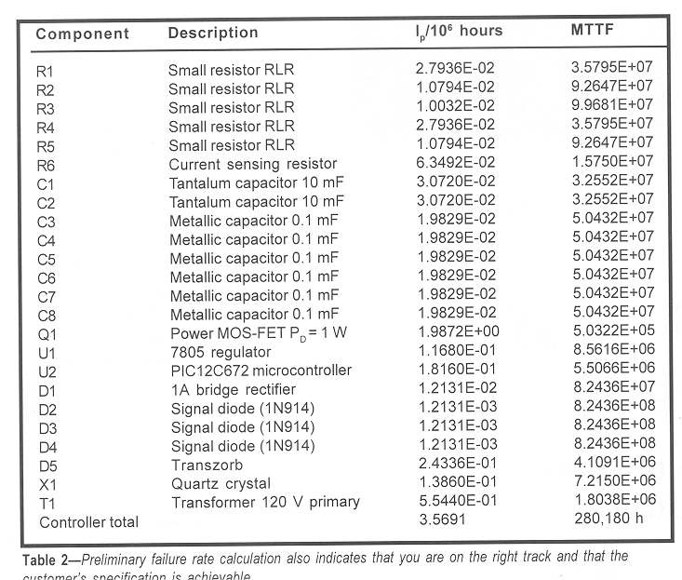
Preliminary Failure Rate Calculation

Slide 23
Improving System Availability
Components with greater failure rates than the rest (Q1, U1, U2, D5, T1, X1)
Q1, U1, U2 work at conservatively estimated junction temperature of 100°C
efficient heat sinking can reduce junction temperature to 50ºC (∆T = P_{diss} x R_{th}) T = T_{ambient} + ∆T
Transzorb D5 & diodes D2, D3 conduct during infrequent transients only
reduce their contribution by applying a duty cycle
Design T1 to run at a lower temperature to improve its reliability

Slide 24
Improving System Availability
Implementing these steps
Increase MTBF from 280,000 hours to 714,000 hr.
λ_{p} = 1.4 [failures/10⁶ hours]
For the remaining analysis (Part 2), the results of these calculations will be used to evaluate and improve product safety

Slide 25
The Rest of the Story…
Designing a functional product represents about 30% of the design effort
Making sure a product always fails in a safe, predictable manner takes the remaining 70%
Law of diminishing returns: exercise good judgment in adding safety features
Keep in balance: safety features and possibility of “nuisance alarms” (failures resulting from added complexity)
Utilize built-in self-test (BIST)

Slide 26
FMEA
Bottom-up review of a system
Examine components for failure modes
Note how failures propagate through system
Study effects on system behavior
Leads to design review and possibly changes to eliminate weaknesses

Slide 27
FMECA
Addition of criticality analysis
Not necessary to examine every component
Multiple components may have same failure effect
Rearrange design into functional blocks
consider component failures within those blocks that may be critical
Create chart listing possible failures
block, failure mode, possible cause, failure effects, method of detection, criticality, and probability*
* probability calculation not required for homework

Slide 28
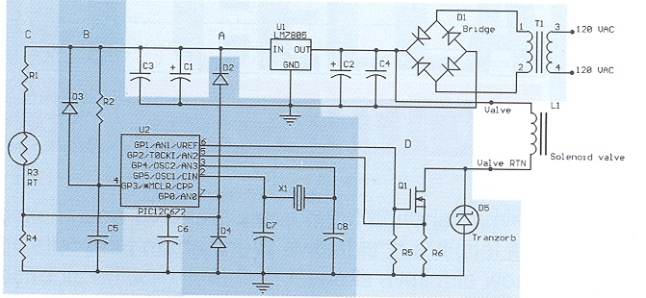
Original Circuit
What would be the effect of a failure of R3, Q1, or D5?
(what if they fail open? shorted?)

Slide 29
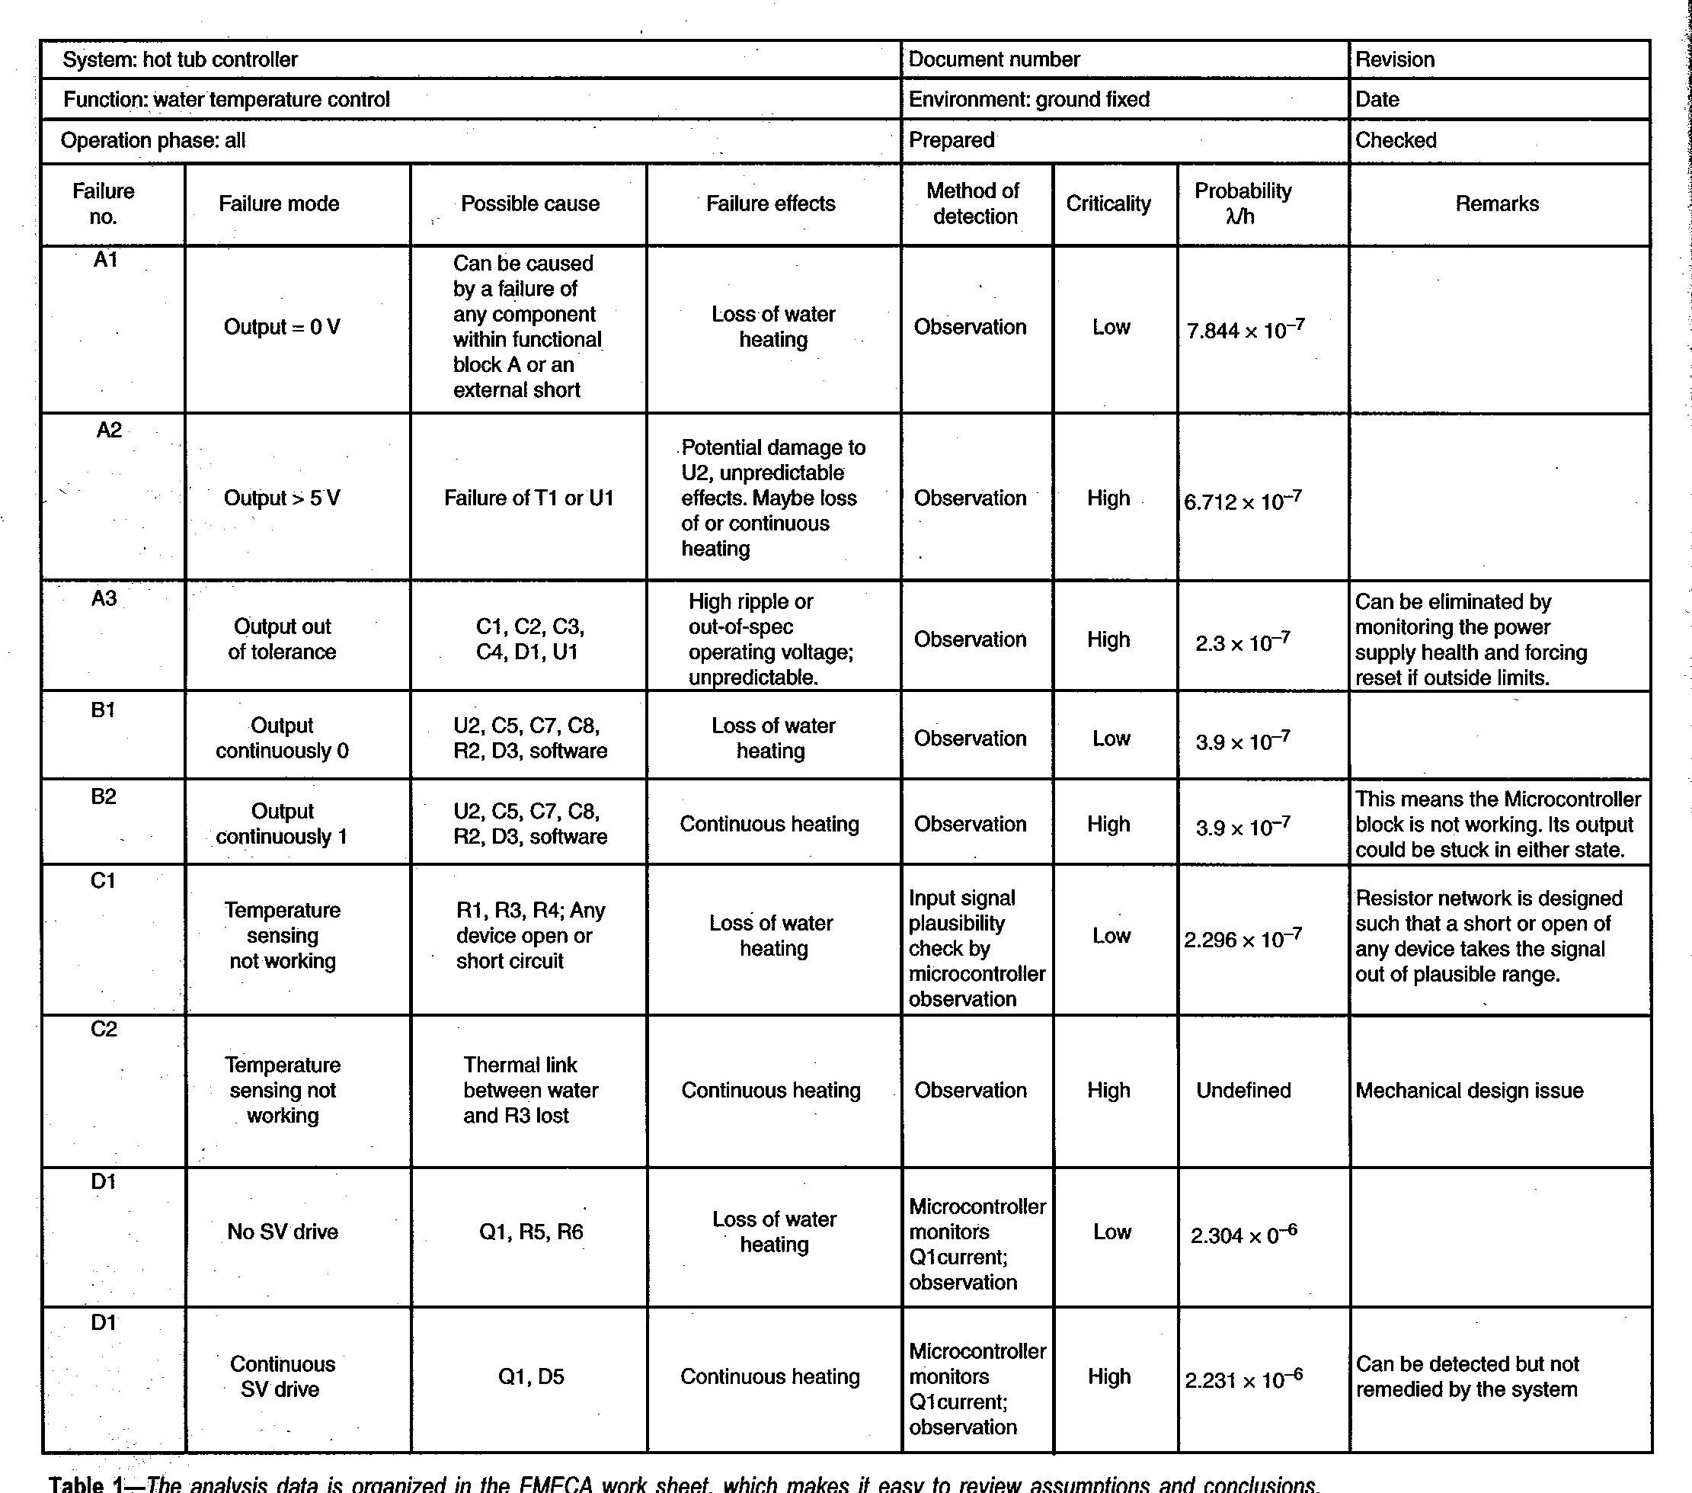
*
Power supply
Note: some causes of 0 V could be overheat, fire, or chemical
hazard, could then be a critical failure.

Slide 30
Failure Cause/Mode/Effect/Criticality (use Circuit Cellar article for examples, but these are the course definitions)
Cause – failure of a device
open circuit, short circuit, or change in device behavior
for complex devices, could be failure of a particular feature (e.g., caused by “stuck at” fault of microcontroller port pin)
list all components that could produce this failure mode
Mode – related to method of diagnosis
observable or measurable behavior of component or sub-circuit resulting from a device failure.
something you might observe when probing internals of the system with a multi-meter, scope, or logic analyzer.
Effect – external behavior of entire system
for hot tub, it either overheats or under-heats the water
for most systems – possibility of fire or damage to other components, external or internal
Criticality – how serious are the consequences
High: _involves potential injury, requires rate ≤ 10⁻⁹_
Medium (optional): _renders system unrepairable_____________
Low: _inconvenience to user, required rate typically > 10⁻⁶______

Slide 31
Original Circuit

Slide 32
micro
temp. sense

Slide 33
Original Circuit

Slide 34
solenoid drive
D2

Slide 35
High Criticality Failures
A2 – power supply over-voltage
A3 – power supply out of tolerance (too high or too low)
B2 – micro failure or software malfunction
C2 – temperature sensor
D2 – solenoid drive

Slide 36
In Class Team Exercise
Part 1: Define criticality levels for your project
low
medium
high
Part 2: Identify one potential high criticality failure mode
descriptive name
potential cause
effect

Slide 37
Fault Tree Analysis (FTA)
Purpose: estimate probability of a particular failure mode or set of failure modes
Top-down graphical analysis
Starts with top event of interest
Builds fault tree using Boolean logic and symbols
Incorporating known failure probabilities (same as used in FMECA) yields probability of event of interest
OR probabilities added (accurate only for small probabilities)
AND probabilities multiplied

Slide 38
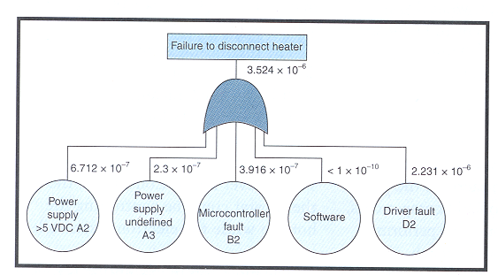

Slide 39
Probability of Failure
note: for small t, P_{F} ≅ λ
P_{F} = 1 - e^{-λt}
For P_{F} = 0.5 (50% chance of uncontrolled heating), it takes 22 years of operation given λ = 3.5424 X 10⁻⁶
NOT GOOD ENOUGH FOR A SYSTEM THAT CAN POTENTIALLY CAUSE INJURY – NEED λ = 10⁻⁹
(78,767 years for P_{F} = 50%)

Slide 40
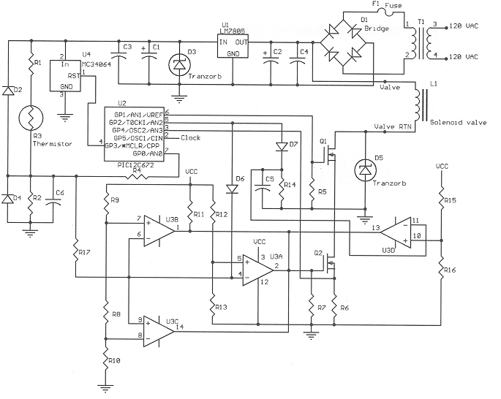
Adding Hardware Monitors
(and monitors for the hardware monitors)
power-on-reset device monitors supply voltage, resets micro
wired OR of
comparators
monitor C5 voltage as a heartbeat check on PIC
Monitor L1/Q1/Q2 current
check thermistor voltage
Allow micro to insert fault as a self-test
bad notation

Slide 41
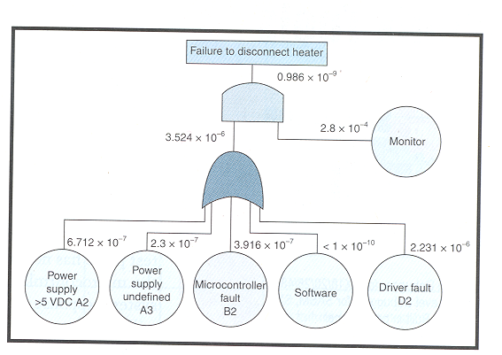
Adding Hardware Monitor

Slide 42
Added Redundancy
Microcontroller – performs sanity check on thermistor output
short/open would cause voltage to move out of plausible range
abrupt change in temperature would indicate fault
Comparators (monitor circuit)
turn off Q2 if temperature exceeds upper limit
provide window for plausibility testing of temperature sensor
Difficult part: eliminating dormant failures (all faults must be detected)

Slide 43
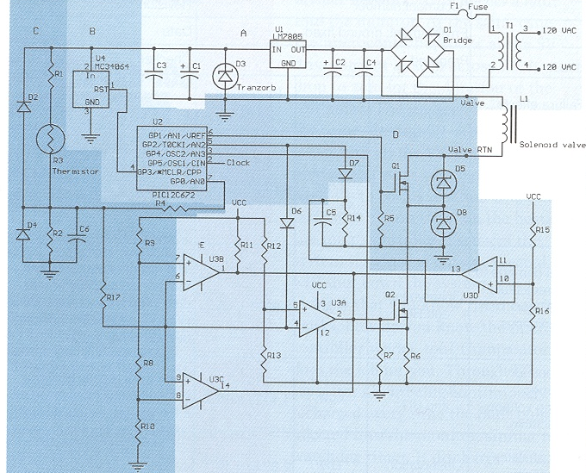
Final Design
software monitors, built-in-test

Slide 44
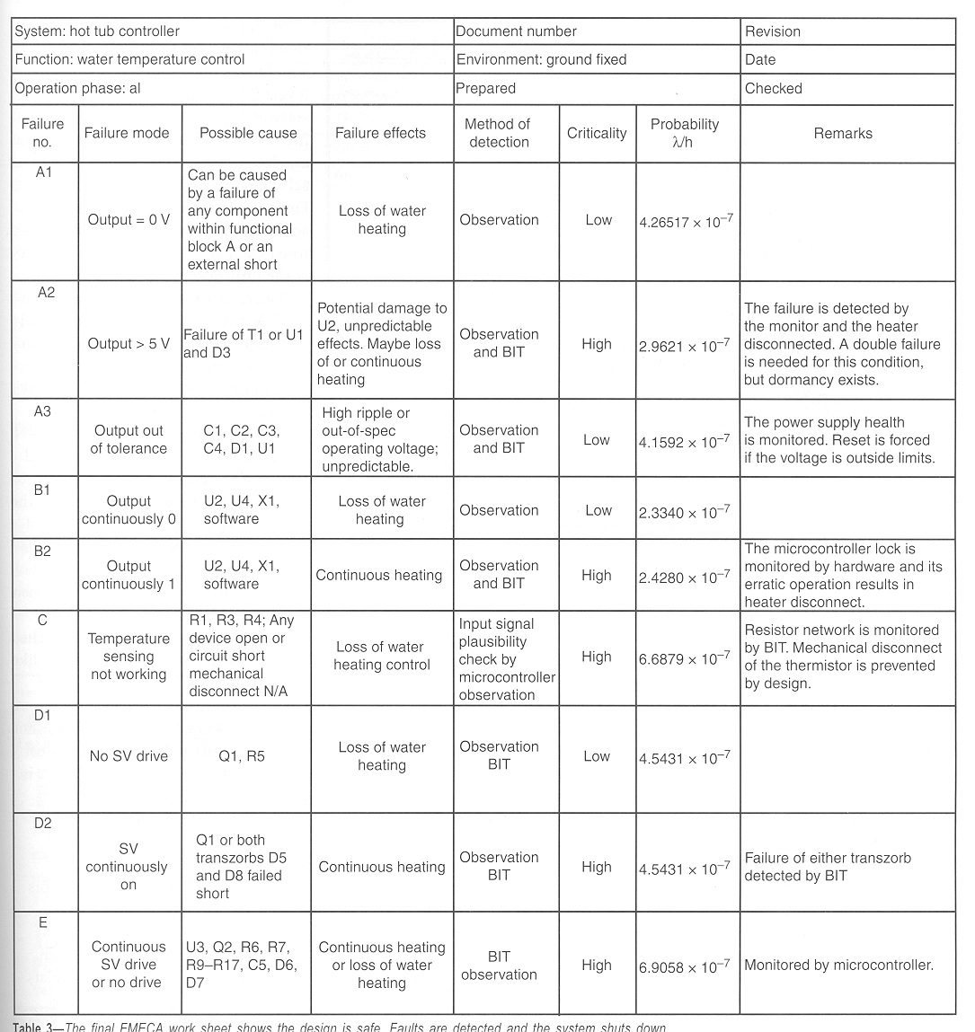
*
* assumes the analog circuitry can tolerate higher voltages

Slide 45
IMPORTANT RESULT: All high criticality failures are monitored

Slide 46
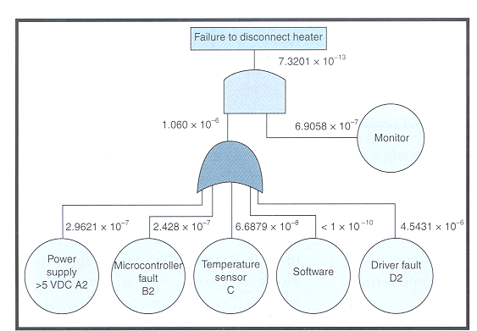
Final Design
-7

Slide 47
Software and Watchdogs
Role of watchdog timer is to reset processor if “strobe timeout” occurs
Problem: watchdogs integral to microcontroller are no more reliable than microcontroller itself
External watchdogs “better”, but have to make sure that it is prevented from being strobed in the event of failures/bugs
Possible solution: make watchdog respond to a “key” (that would be difficult for failed software/bug to generate)

Slide 48
Maintainability
Reliability predication indicates that after 10,000 units shipped, will need to service two problems per day
Keep customers happy with quick repair turn-around time (TAT)
Repair will most likely be by replacement (“line replaceable units” – LRU)
Maintainability analysis generates data showing the time needed to identify the faulty LRU, the time to replace it, and the time to re-test the system
Mean-time-to-repair (MTTR)

Slide 49
Standards & Compliance
Many categories in consumer electronics:
Arcade, Amusement and Gaming Machines -- Bowling and Billiard Equipment -- Cable and Satellite Communication Equipment -- Circuit Components for Use in Audio/Video Equipment -- Commercial Audio and Radio Equipment, Systems and Accessories -- Low Voltage Portable Electronics; Household Audio and Video Equipment -- Musical Instruments -- Professional, Commercial and Household Use Equipment.
Example of a category relevant to ECE 477
IEC 62368-1 Audio/Video, Information and Communication Technology Equipment – Safety Requirements. Published Jan. 2010, UL & CSA versions, Feb. 2011

Slide 50
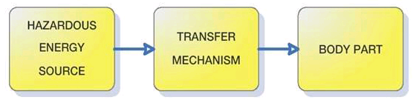
From electronicdesign.com
The ABCs of IEC 62368-1, An Emerging Safety Standard
Date Posted: October 22, 2010
Hazard Based Safety Engineering
Energy sources: electrical, thermal, kinetic, and radiated
To prevent pain or injury, either the energy source can be designed to levels incapable of causing pain or injury, or safeguards such as insulation can be designed into the product to prevent the energy transfer to the body part.

