Slide 1
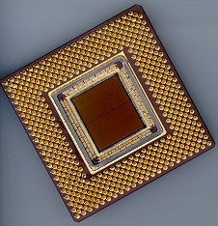
ECE 477 Digital Systems Senior Design Project
© 2014 by D. G. Meyer
Module 11
Patent Infringement Liability

Slide 2
Outline
Introduction
Patent Searches
Patent Infringement
Literal
Doctrine of Equivalents
Avoiding Infringement
Why There Are Lawyers...
Examples

Slide 3
Introduction
Primary purpose of patent is to protect intellectual property:
Congress shall have the power . . . to promote the progress of science and useful arts, by securing for limited times to authors and inventors the exclusive right to their respective writings and discoveries.
U.S. Constitution - Article 1, Section 8

Slide 4
Introduction
Patent = Right to Exclude
Prevent others from making, using or selling your invention
Right to exclude ≠ Right to make
May not own all required components
Need for licensing
Patent is not needed to manufacture a product
Duration = 20 years from filing date

Slide 5
Introduction
Patent requirements:
Useful
Novel
Non-Obvious
Patent contains:
Written description
Drawings/schematics
Claims

Slide 6
Patent Searches
Applying for a patent requires
extensive search of prior art
protracted negotiation with assigned patent officer
patent lawyer
Many on-line patent search engines are available – see www.freepatentsonline.com
The official web site of the U.S. Patent Office is – www.uspto.gov (printed copies of “old” patents available for a small fee)

Slide 7
Patent Infringement
Best time to search for possible patent infringement is at product conception stage
If the possibility of infringement exists, either:
eliminate infringing function from your design
modify your design so that the infringing function is performed in a “substantially different way”
Types of infringement
literal
doctrine of equivalents

Slide 8
Literal Infringement
Exactly same function performed exactly the same way
Should be “obvious”
Either eliminate this function from your design -or- obtain license/pay royalty fee to use this function
Note that “simply adding additional features” does not eliminate infringement

Slide 9
Doctrine of Equivalents
Substantially same function performed substantially the same way
Hypothetical examples
for fastening pieces of wood together, does a screw perform “substantially the same function” in “substantially the same way” as a nail?
for reproducing recorded music, does a vinyl LP perform “substantially the same function” in “substantially the same way” as a CD?
for the purpose of recognizing an access code, does software running on a microcontroller perform “substantially the same function” in “substantially the same way” as a state machine realized with discrete flip-flops and gates?

Slide 10
Doctrine of Equivalents
Need a clear understanding of mechanism (“way”) – the mechanism is the function of interest in analyzing infringement liability under the doctrine of equivalents
hypothetical #1: “fastening” is not what is “patented”; rather, the fastening mechanism (ribbing on nail vs. threads on screw)
hypothetical #2: “music reproduction” is not what is “patented”; rather, the music reproduction mechanism (needle vibration following molded groove vs. optically reading digital data from pits molded into plastic disc)
hypothetical #3: “recognizing an access code” is not what is “patented”; rather, the access code recognition mechanism (software running on a generic embedded microcontroller vs. discrete hardware realizing a state machine)

Slide 11
Doctrine of Equivalents
Stated another way, is the “software” implementation of any function the equivalent of a (digital) hardware implementation of that function under the doctrine of equivalents?
Answer: “hard to say” – this is why there are patent lawyers!
No case to date where software ruled the equivalent of hardware per se – but have been cases where functions (“algorithms”) of hardware and software devices ruled as performed in “substantially the same way”

Slide 12
Doctrine of Equivalents
Discussion: What are some of the differences between a microcontroller-based “software” realization of a given function and a “discrete hardware” realization?
development tools
design process
clocking source / clock rate
execution (sequential vs. parallel)
ease of modification

Slide 13
Avoiding Infringement
Designing around
Licensing
Straight license
Cross-license
Acquiring subject patent
Declaratory judgment action
Ceasing manufacturing

Slide 14
Why There Are Lawyers
Construe meaning of words “substantially”, “novel”, “non-obvious”, “useful”, etc.
Construe claim construction and interpret claim language (pretrial Markman hearing)
Perform prior art search
Problem 1: some individuals/companies obtain patents for the sole purpose of suing others (usually for functions most “skilled in the art” would consider “obvious” based on prior art)
Problem 2: a substantial number of “bad patents” have been issued (for devices that don’t even work)
Problem 3: “bad people” have been known to take advantage of “bad patents”

Slide 15
Why There Are Lawyers
Major concern: limited technical expertise of lawyers, judges, and jury pools
Lawsuits are typically very expensive and often take years to resolve
Questions
How can judges and juries with limited expertise decide cases involving hardware/software?
What could be done to make it harder for “bad people” to profit from “bad patents”?

Slide 16
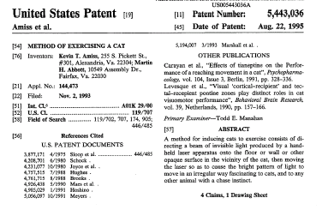
A “Bad” (“Stupid”) Patent

Slide 17
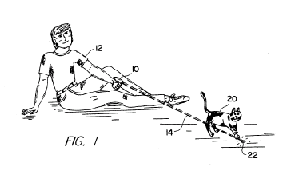
A “Bad” (“Stupid”) Patent

Slide 18
Patent Reform Act of 2011
Leahy-Smith America Invents Act (AIA), signed into law on September 16, 2011
Represents the most significant change to patent law since 1952
Switches U.S. patent system from a “first to invent” to a “first to file” system, eliminates interference proceedings, and develops post-grant opposition

Slide 19
Patent Reform Act of 2011
First-Inverter-to-File
move US further toward first-to-file system
discourages patent awards based on “secret knowledge”
each patent application given an “effective filing date”
patentability judged on whether any prior art was available prior to the filing date (retain one-year grace period, but only for inventor’s own disclosures)
obviousness also judged as of the effective filing date
Damages
specific procedures and checks added on how a judge manages the damages portion of a case (identify methodologies and factors that are relevant to the determination of damages)
court required to consider either party’s contentions regarding evidentiary base

Slide 20
Patent Reform Act of 2011
Enhanced damages
historically based on “willful” (or “reckless”) infringement, allowing the court to increase damages up to 3 times the amount found or assessed
codified: infringement is not deemed “willful” unless claimant proves by clear and convincing evidence that accused infringer’s conduct with respect to the patent was objectively reckless (i.e. that the infringer was acting despite an objectively high likelihood that his actions constituted infringement of a valid patent)
accusations of willful infringement must be pled with particularity (proof of knowledge of patent is insufficient to establish willful infringement)
in a “close case” there will be no willful infringement

Slide 21
Patent Reform Act of 2011
Third-Party Challenges to Patent Rights
pre-issuance third-party submissions (allows a third party to submit any printed publication along with a description of the relevance to the USPTO during examination of pending patent application)
third-party requested post grant review (would allow a third party to present essentially any legal challenge to the validity of at least one claim…but must be filed within 9 months of issuance)
inter partes review proceedings (once 9-month window expired, a third party can request reconsideration of novelty and obviousness issues based on prior art patents and printed publications)

Slide 22
Patent Reform Act of 2011
False marking
false marking lawsuits would be eliminated except for ones filed by the US government or by a competitor that can prove competitive injury (a false marking involves use of the name or imitation of the name of a patentee or patent number)
Best mode
intended to prevent “less-than-full” patent disclosures by documenting only an inferior implementation of the patent
excludes failure to disclose a best mode from being used as a basis for invalidating an issued patent
PTO will still have a duty to only issue patents where the best mode requirement has been satisfied

Slide 23
Patent Reform Act of 2011
Concerns
further entrenchment of market incumbents
falling rate of startup formation
falling levels of venture capital
diminished incentives for investment and development
greater options for accused infringers and weakened rights of patentees
“better solution” would be to issue higher quality patents in the first place to help avoid the overhead (and possible inequities) associated with the reexamination process…(?)

Slide 24
Example Patent: 4,596,900
Date Filed: June 23, 1983
Date Issued: June 24, 1986
Abstract: A phone-line-linked, tone-operated control apparatus in accordance with the invention comprises a detecting circuit coupled to a telephone line for detecting at least one predetermined sequence of predetermined tone signals received on the telephone line and for producing a corresponding sequence detection signal. An additional control circuit is responsive to the sequence detection signal for producing a corresponding control signal. Preferably, a break-in prevention circuit prevents access to the control apparatus unless a predetermined access code is first given.

Slide 25
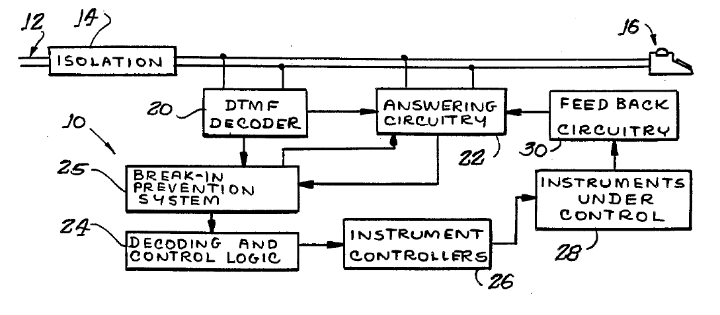
Example Patent: 4,596,900
Block Diagram

Slide 26
Example Patent: 4,596,900
Claim 1: A phone-line-linked, tone-operated control apparatus comprising: detecting means coupled to receive tone signals from said phone line, for detecting at least one predetermined sequence of predetermined tone signals and for producing a corresponding sequence detection signal; control means responsive to said sequence detection signal for producing a corresponding control signal; wherein said detecting means comprises first detecting means for producing a first detection signal in response to a first predetermined sequence of predetermined tone signals and a second detection signal in response to a second predetermined sequence of predetermined tone signals; wherein said control means is responsive to said first detection signal for producing a corresponding first control signal and responsive to said second detection signal for producing a corresponding second control signal; wherein said control means comprises dual state means capable of producing one of said first control signal and said second control signal at a time; and wherein said first and said second detecting means further include gating means coupled in circuit for disabling production of said first and said second detection signals respectively in response to said second control signal and said first control signal, respectively.

Slide 27
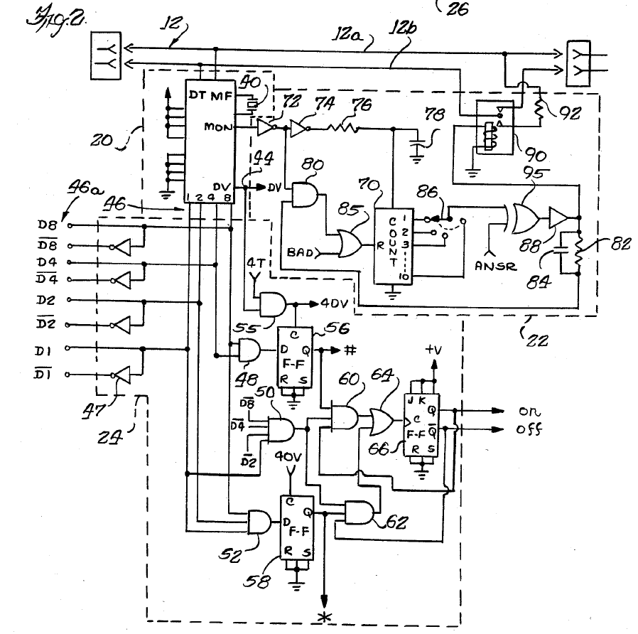
Example Patent: 4,596,900
Claim 1 Circuit

Slide 28
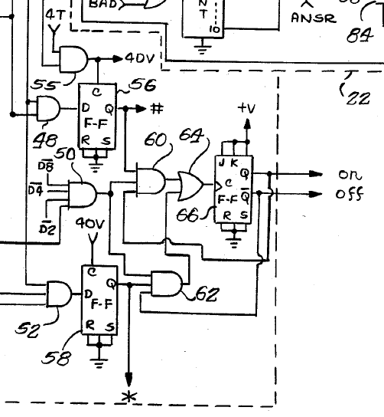
first sequence detection signal
detecting means (plus DTMF decoder)
gating means
dual-state means
first and second control signals
second sequence detection signal
Reference: Column 5, Line 52 of Detailed Description

Slide 29
Example Patent: 4,596,900
Is Claim 1… A → yes / B → no
novel?
non-obvious to someone skilled in the art?
useful?
Would a “software” implementation of this claim infringe on this patent under the doctrine of equivalents? A → yes / B → no

Slide 30
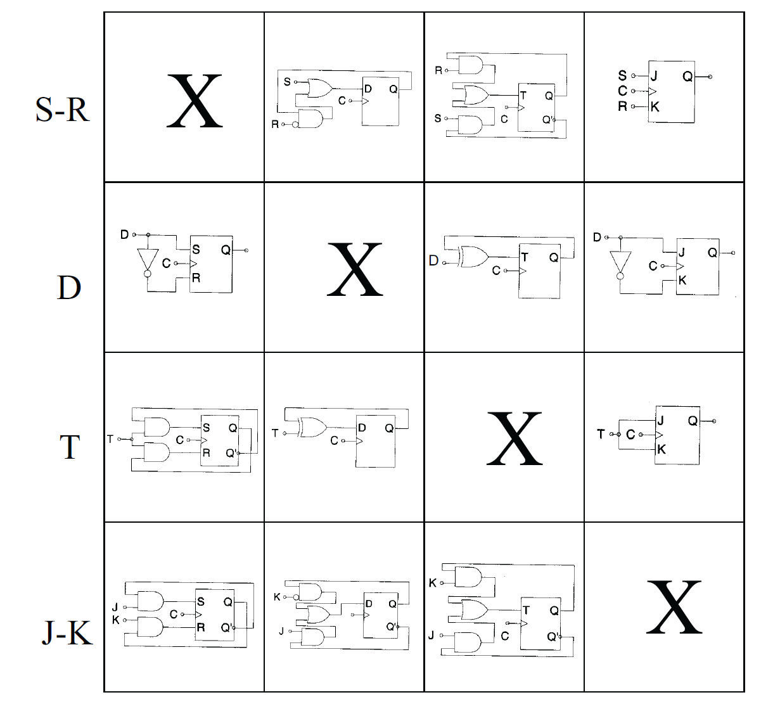

Slide 31
Example Patent: 4,596,900
Claim 5: A phone-line-linked, tone-operated control apparatus comprising: detecting means coupled to receive tone signals from said phone line, for detecting at least one predetermined sequence of predetermined tone signals and for producing a corresponding sequence detection signal; control means responsive to said sequence detection signal for producing a corresponding control signal; access limiting circuit means coupled with said detecting means for preventing production of said sequence detection signal until an access sequence comprising a further predetermined sequence of predetermined tone signals is first received on said phone line; wherein said access limiting means includes gate means coupled with said detecting means for normally preventing response thereof to said tone signals, and counter means coupled to said gate means and responsive to said tone signals for causing said gate means to enable operation of said detecting means following a predetermined number of tone signals received thereby.

Slide 32
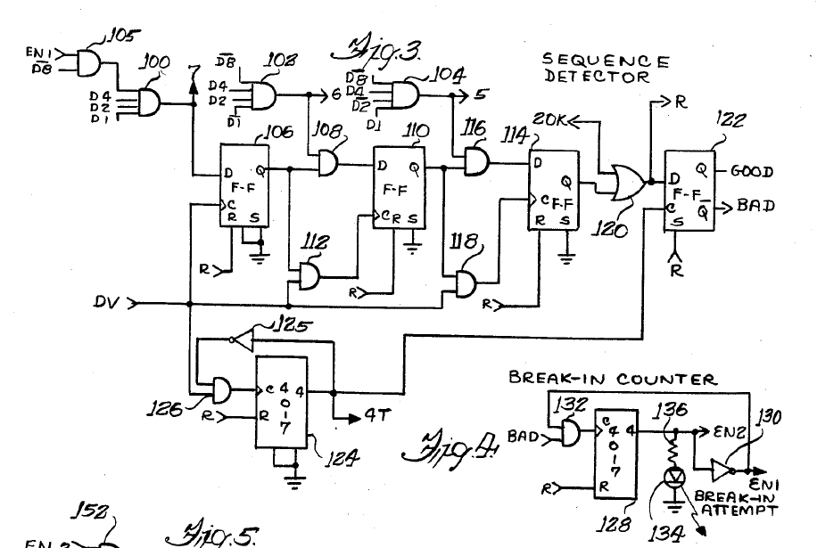
Example Patent: 4,596,900
access limiting sequence detector
Claim 5 Circuit
counter means

Slide 33
Example Patent: 4,596,900
Is Claim 5… A → yes / B → no
novel?
non-obvious to someone skilled in the art?
useful?
Would a “software” implementation of this claim infringe on this patent under the doctrine of equivalents? A → yes / B → no

