Slide 1
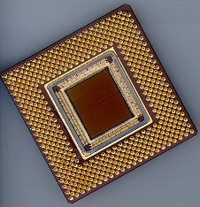
ECE 477 Digital Systems Senior Design Project
© 2014 by D. G. Meyer
Module 1
General Guidelines

Slide 2
Outline
Lab Notebook Guidelines
On-Line Documentation Guidelines
Patent Liability Guidelines
Microcontroller Selection Guidelines
Memory Requirements / Types
Development Environment
Interfacing / Bus Expansion
Motherboard Selections Guidelines
Prerequisite Review Guidelines

Slide 3
Lab Notebooks – Individual
Used to keep track of all observations, modifications, “buggy behavior”, etc., for a product under development
All observations, modifications, redesigns, comments, notes to yourself, etc., should be documented as they occur, NOT “after the fact”
Each individual will be required to maintain an on-line lab notebook on their team’s project webpage
This is NOT a BLOG !!!!

Slide 4
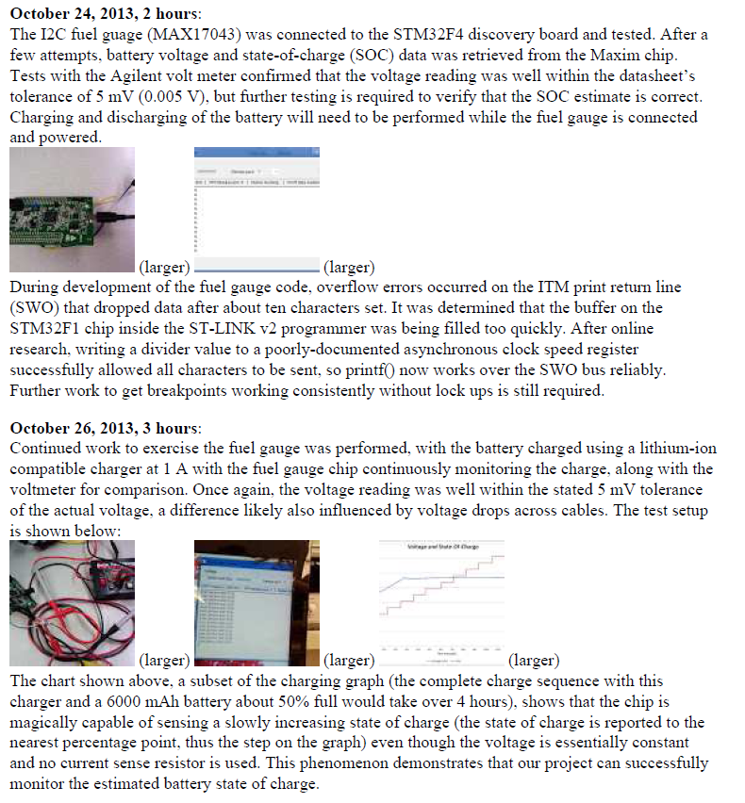
Entries will be done in HTML, but may include scanned sheets and digital pictures as well as links to hardware or software source files -most important thing is to keep it current!
Individual Lab Notebook Entries

Slide 5
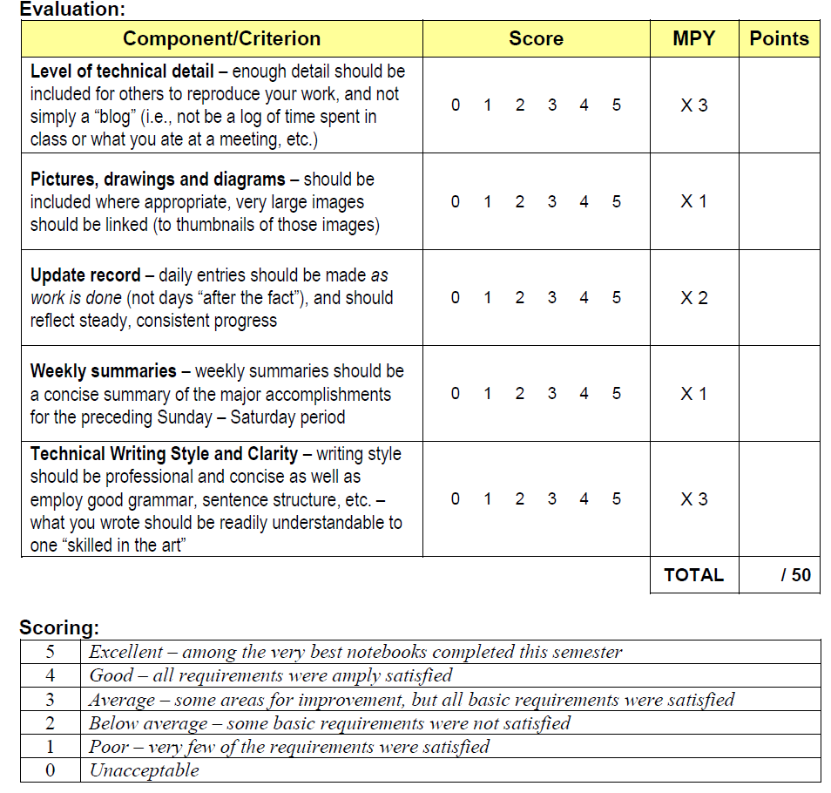
Lab Notebook Evaluation Form

Slide 6
Lab Notebook Evaluation
Level of technical detail
Can we reproduce what you did from what is written in your notebook?
No “blogs”
Appropriateness
Is the content directly related to the project?
No “personal remarks” (what you ate, etc.)
Pictures, diagrams, etc.
Need to aid in understanding work done
Thumbnail large images to reduce inline image size (generally do not need high-res images for most lab notebook entries)

Slide 7
Lab Notebook Evaluation
Update Record
must be within 2-3 days of actual work
Weekly summaries
2-3 sentences highlighting main points of week’s work
Technical writing style
use 3rd person
future employers may see your notebook

Slide 8
On-Line Documentation Guidelines
In addition to individual lab notebooks, each group should maintain on-line hardware and software documentation
data sheets
application notes
schematics
code listings
Use a version control system (your choice) to manage updates and track changes

Slide 9
Hardware Documentation
Include text describing changes made to each revision of the schematic
Include information about test setups and prototyping breadboards
Include any “debugging notes” or general observations useful to the hardware portion of the team
Update schematic as you prototype and prototype as much as possible of your schematic

Slide 10
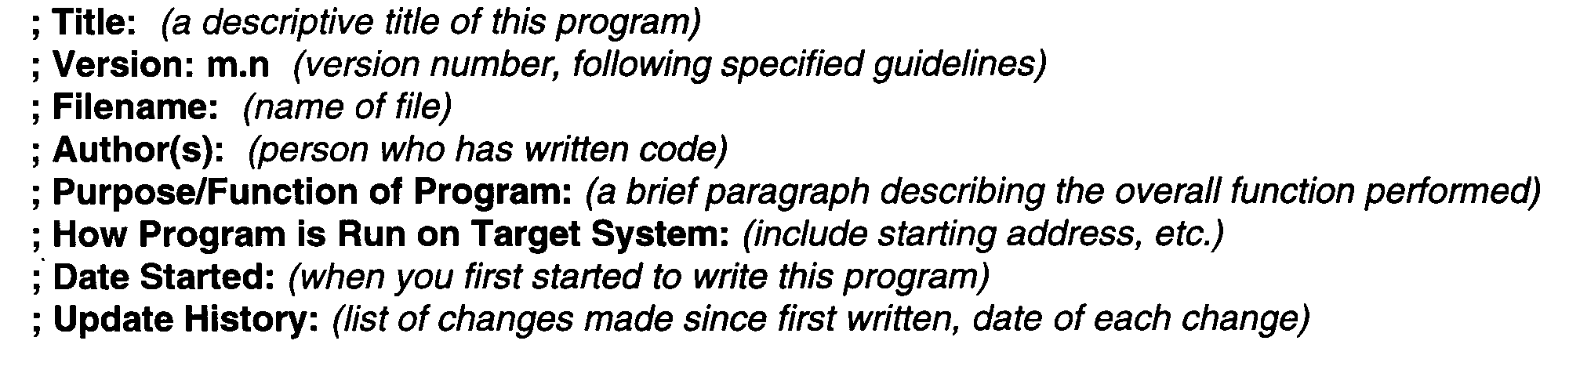
Software Documentation
Include diagnostic routines developed
note which SW version they work with
As part of header of each software module, include complete history of modifications

Slide 11
Patent Liability Guidelines
Primary purpose of patent is to protect intellectual property:
Congress shall have the power . . . to promote the progress of science and useful arts, by securing for limited times to authors and inventors the exclusive right to their respective writings and discoveries.
U.S. Constitution - Article 1, Section 8

Slide 12
Patent Liability Guidelines
Patent = Right to Exclude
Prevent others from making, using or selling your invention
Right to exclude ≠ Right to make
May not own all required components
Need for licensing
Patent is not needed to manufacture a product
Duration = 20 years from filing date

Slide 13
Patent Liability Guidelines
Patent requirements:
Useful
Novel
Non-Obvious
Patent contains:
Written description
Drawings/schematics
Claims

Slide 14
Patent Liability Guidelines
Applying for a patent requires
extensive search of prior art
protracted negotiation with assigned patent officer
patent lawyer
Many on-line patent search engines are available – see www.freepatentsonline.com or google.com/patents
The official web site of the U.S. Patent Office is – www.uspto.gov (printed copies of “old” patents available for a small fee)

Slide 15
Patent Liability Guidelines
Best time to search for possible patent infringement is at product conception stage
If the possibility of infringement exists, either:
eliminate infringing function from your design
modify your design so that the infringing function is performed in a “substantially different way”
Types of infringement
literal
doctrine of equivalents

Slide 16
Literal Infringement
Exactly same function performed exactly the same way
Should be “obvious”
Either eliminate this function from your design -or- obtain license/pay royalty fee to use this function
Note that “simply adding additional features” does not eliminate infringement

Slide 17
Doctrine of Equivalents
Substantially same function performed substantially the same way
Hypothetical examples
for fastening pieces of wood together, does a screw perform “substantially the same function” in “substantially the same way” as a nail?
for reproducing recorded music, does a vinyl LP perform “substantially the same function” in “substantially the same way” as a CD?
for the purpose of recognizing an access code (PIN) , does software running on a microcontroller perform “substantially the same function” in “substantially the same way” as a state machine realized with discrete flip-flops and gates?

Slide 18
Doctrine of Equivalents
Need a clear understanding of mechanism (“way”) – the mechanism is the function of interest in analyzing infringement liability under the doctrine of equivalents
hypothetical #1: “fastening” is not what is “patented”; rather, the fastening mechanism (ribbing on nail vs. threads on screw)
hypothetical #2: “music reproduction” is not what is “patented”; rather, the music reproduction mechanism (needle vibration following molded groove vs. optically reading digital data from pits molded into plastic disc)
hypothetical #3: “recognizing an access code” is not what is “patented”; rather, the access code recognition mechanism (software running on a generic embedded microcontroller vs. discrete custom hardware realizing a state machine)

Slide 19
Doctrine of Equivalents
Stated another way, is the “software” implementation of any function the equivalent of a (digital) hardware implementation of that function under the doctrine of equivalents?
Answer: “hard to say” – this is why there are patent lawyers!
No case to date where software ruled the equivalent of hardware per se – but have been cases where functions (“algorithms”) of hardware and software devices ruled as performed in “substantially the same way”

Slide 20
Avoiding Infringement
Designing around
Licensing
Straight license
Cross-license
Acquiring subject patent
Declaratory judgment action
Ceasing manufacturing

Slide 21
Microcontroller Selection Guidelines
Memory requirements/types
Beware of hidden liabilities
Data acquisition (ADC) buffers
Large file storage (mp3)
Library routines (floating point emulation, printf)
Nonvolatile memory
Flash (code, static data)
in-circuit programmable?
programming “dongle” availability?
programming connector requirements?
EEPROM (storage of calibration or configuration parameters, history data, control panel settings)
granularity of erase/write?
software driver availability?

Slide 22
Microcontroller Selection Guidelines
Volatile memory (SRAM)
stack
heap
I/O buffers
run-time variables
(generally no executable code except for “specialty functions” like erasing and reprogramming a sector in Flash)
note initialization requirements when system boots

Slide 23
Microcontroller Selection Guidelines
Interfacing/Bus Expansion
Number of general purpose I/O pins
programmable data direction?
programmable pull device?
Bus expansion capability
multiplexed or simplex external bus?
“glue logic” requirements?
Number/types of integrated peripherals
Golden Microcontroller Selection Rule: “match” project requirements to μC capabilities as closely as practicable

Slide 24
Microcontroller Selection Guidelines
Development environment
Useful to have an asynchronous serial port dedicated to debugging
Useful to have spare I/O pins dedicated to debugging (e.g., “heartbeat” LED)
In-circuit programmable Flash available for quickly downloading and testing code revs (but typically require a “programming dongle” so be sure to include a header/connector on your PCB)
BDM (background debug mode) VERY helpful be sure to include a 6-pin BDM header on your PCB if using a Freescale microcontroller
Assembler/Compiler/Linker/Loader/(Simulator)?

Slide 25
Microcontroller Selection Guidelines
Carefully note package options available
QFP, SOIC, and SSOP types generally preferable
QFN type “doable” (but avoid if possible)
watch out for “tabs” on bottom of chip
DIP types OK (good for prototyping) but compromise PCB density
avoid PGA and BGA
Price/availability
get at least two more than you need of every IC
now (sooner rather than later)

Slide 26
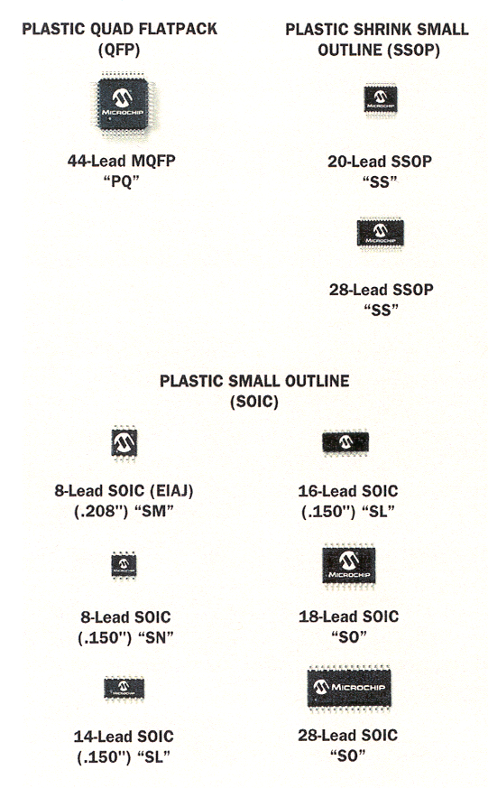
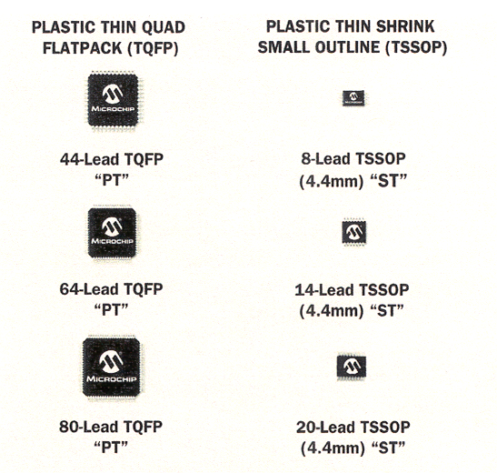
Package Options (Sample)

Slide 27
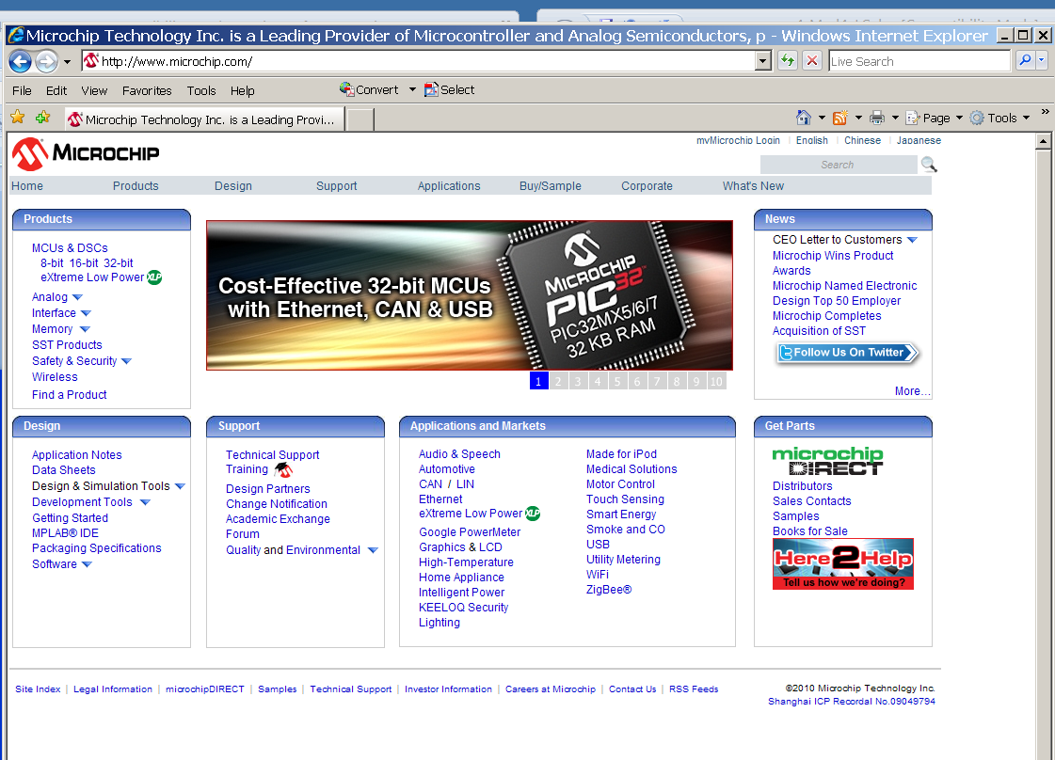
http://www.microchip.com

Slide 28
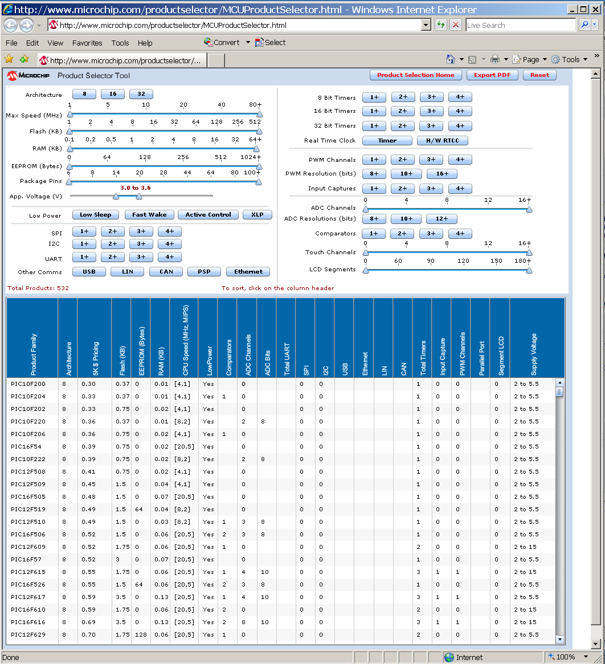

Slide 29
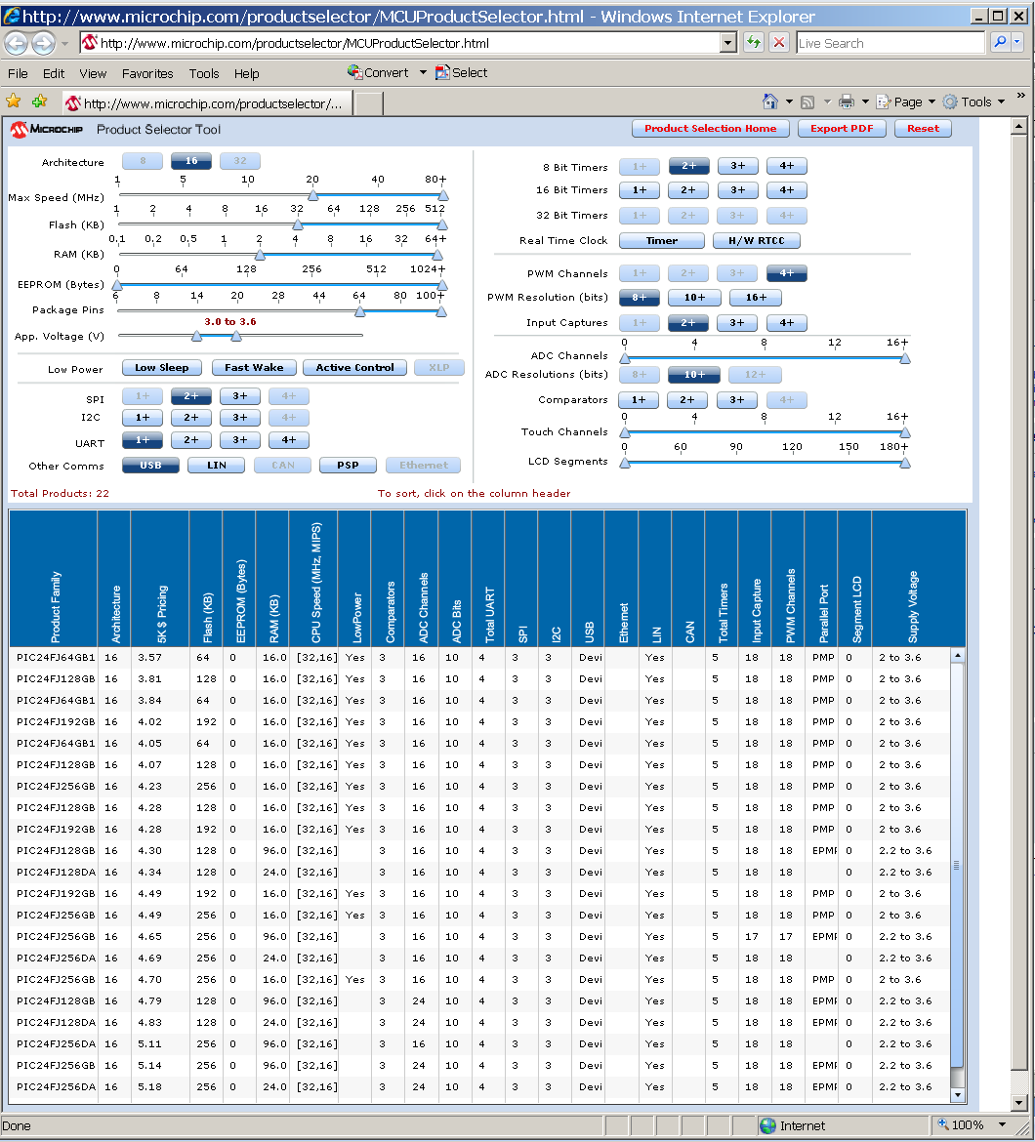

Slide 30
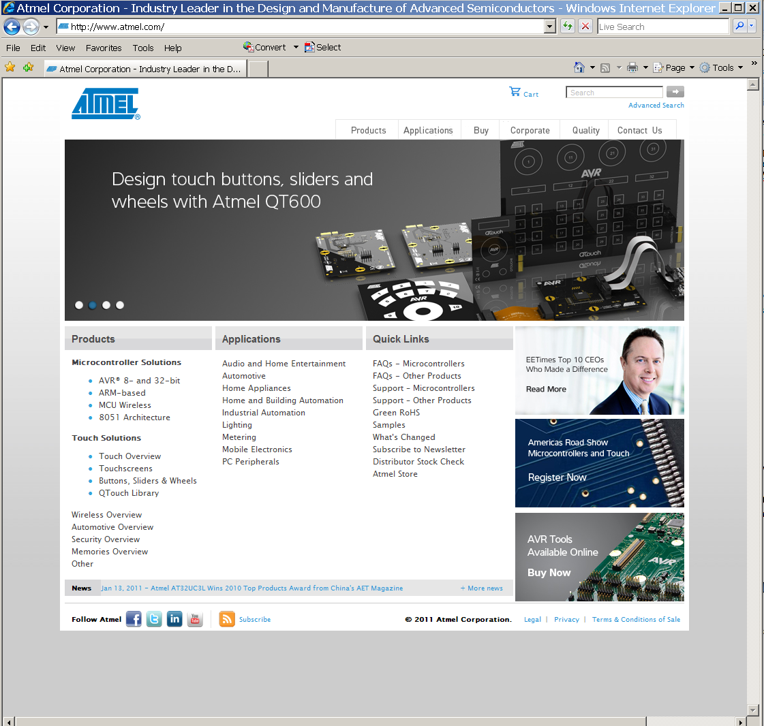
www.atmel.com

Slide 31
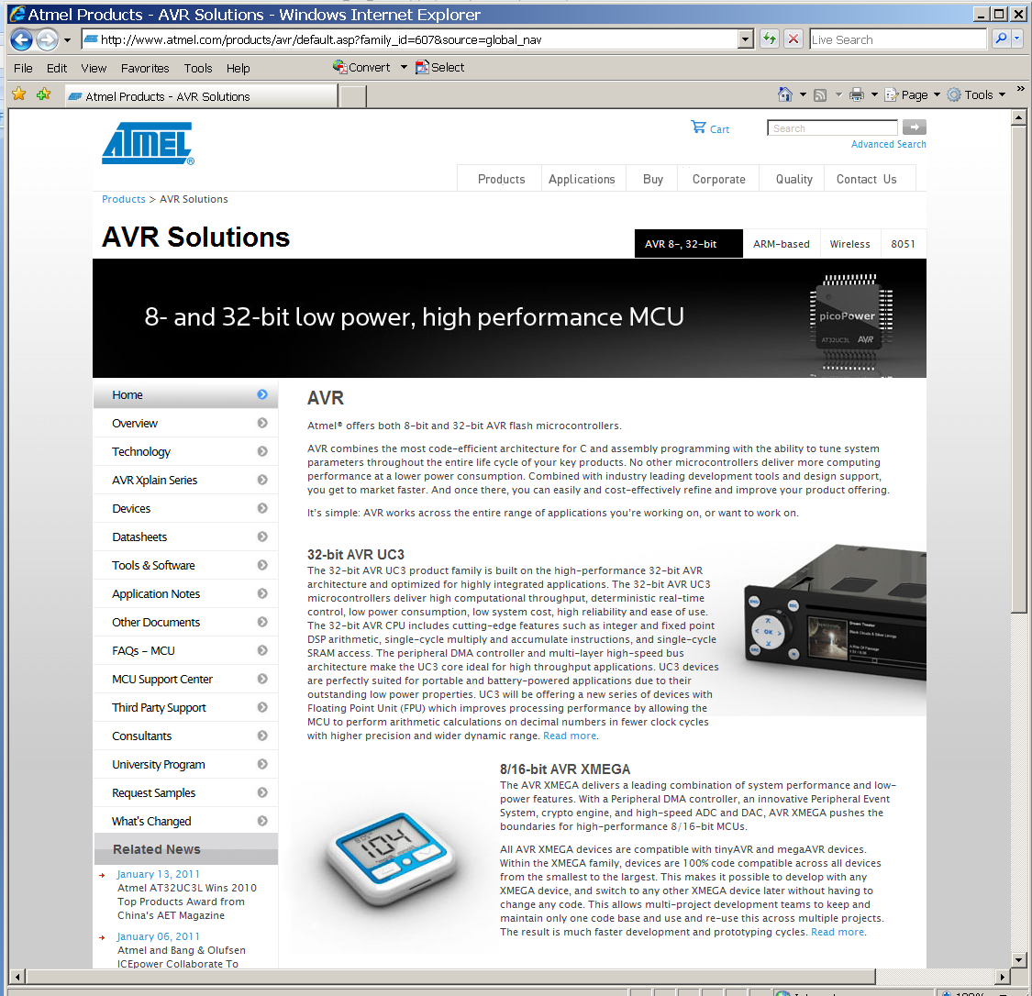

Slide 32
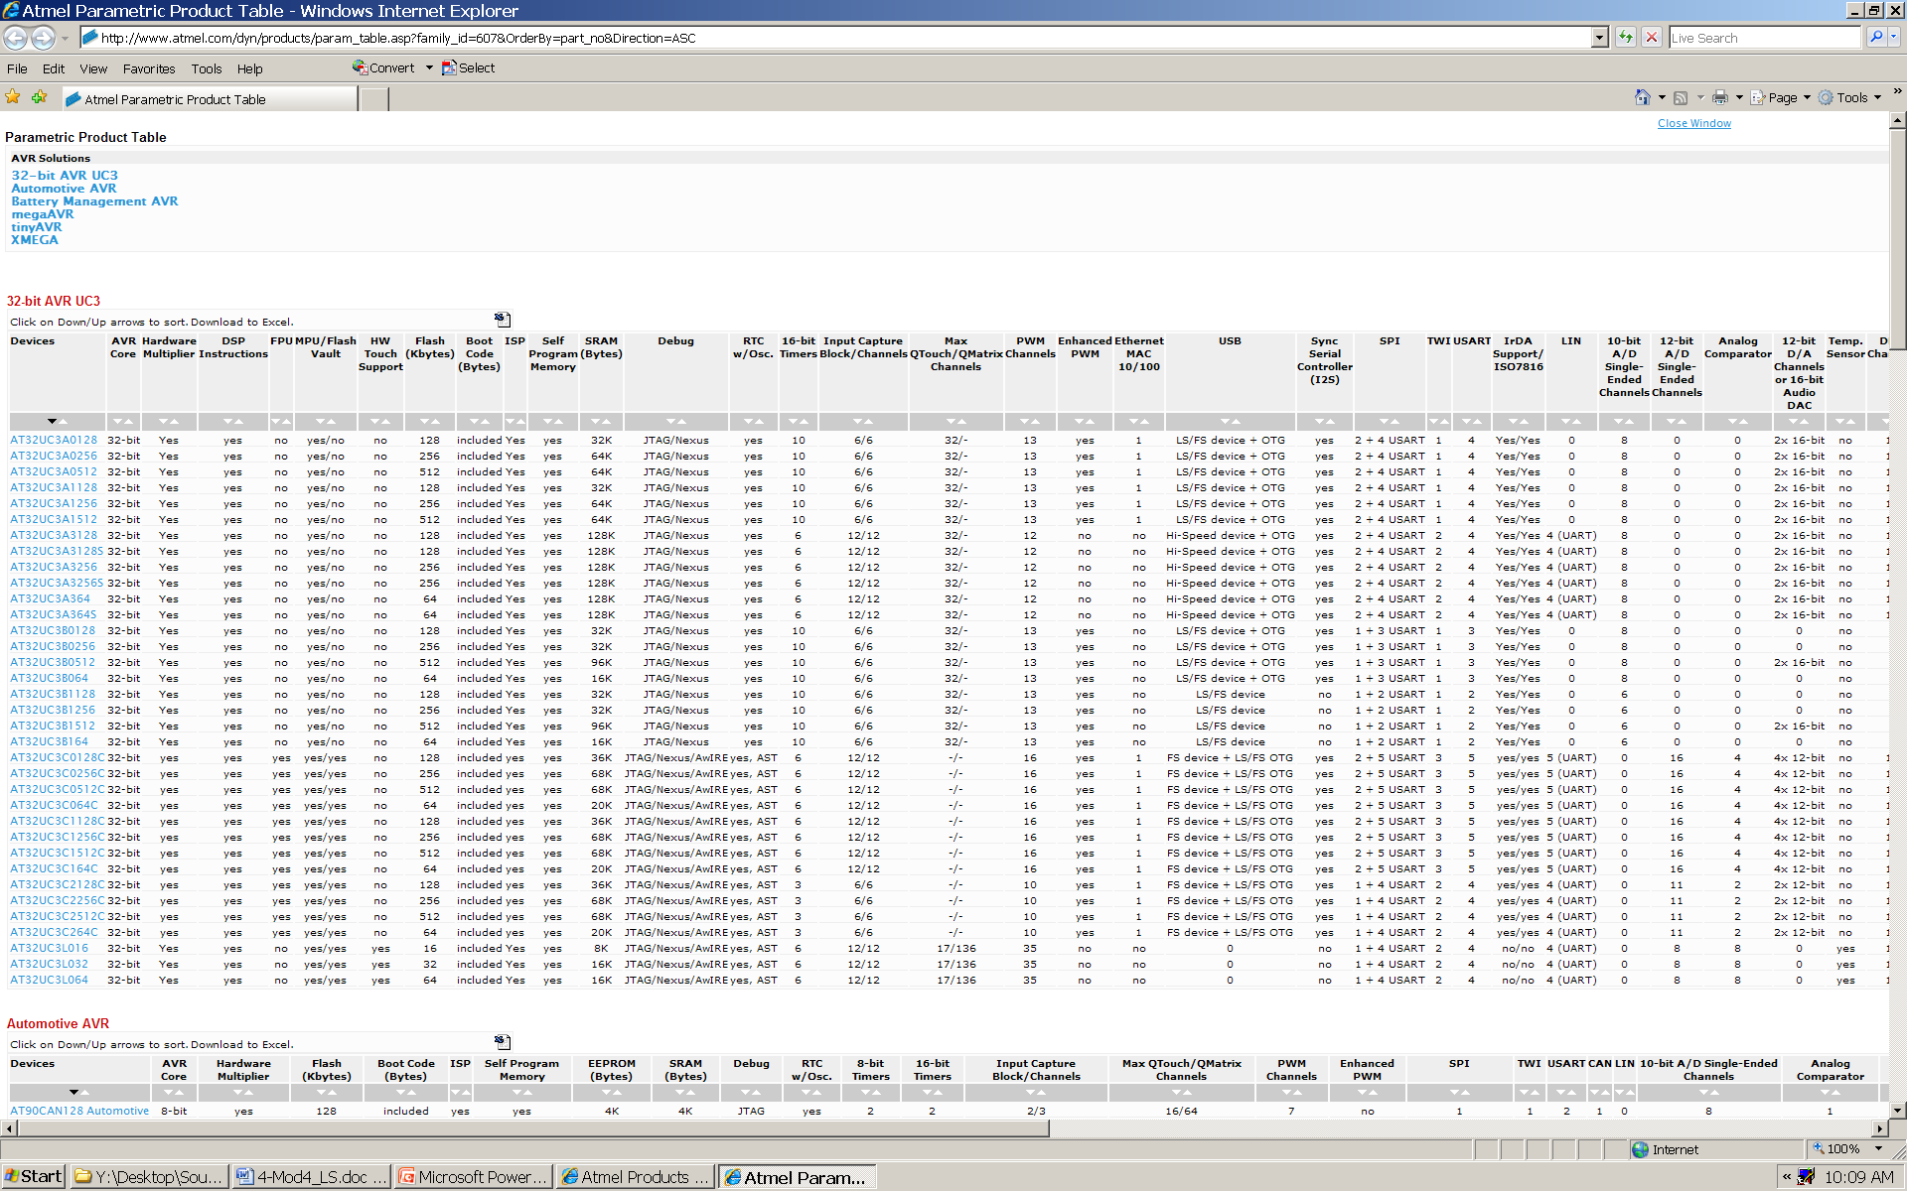
Parametric Product Table

Slide 33
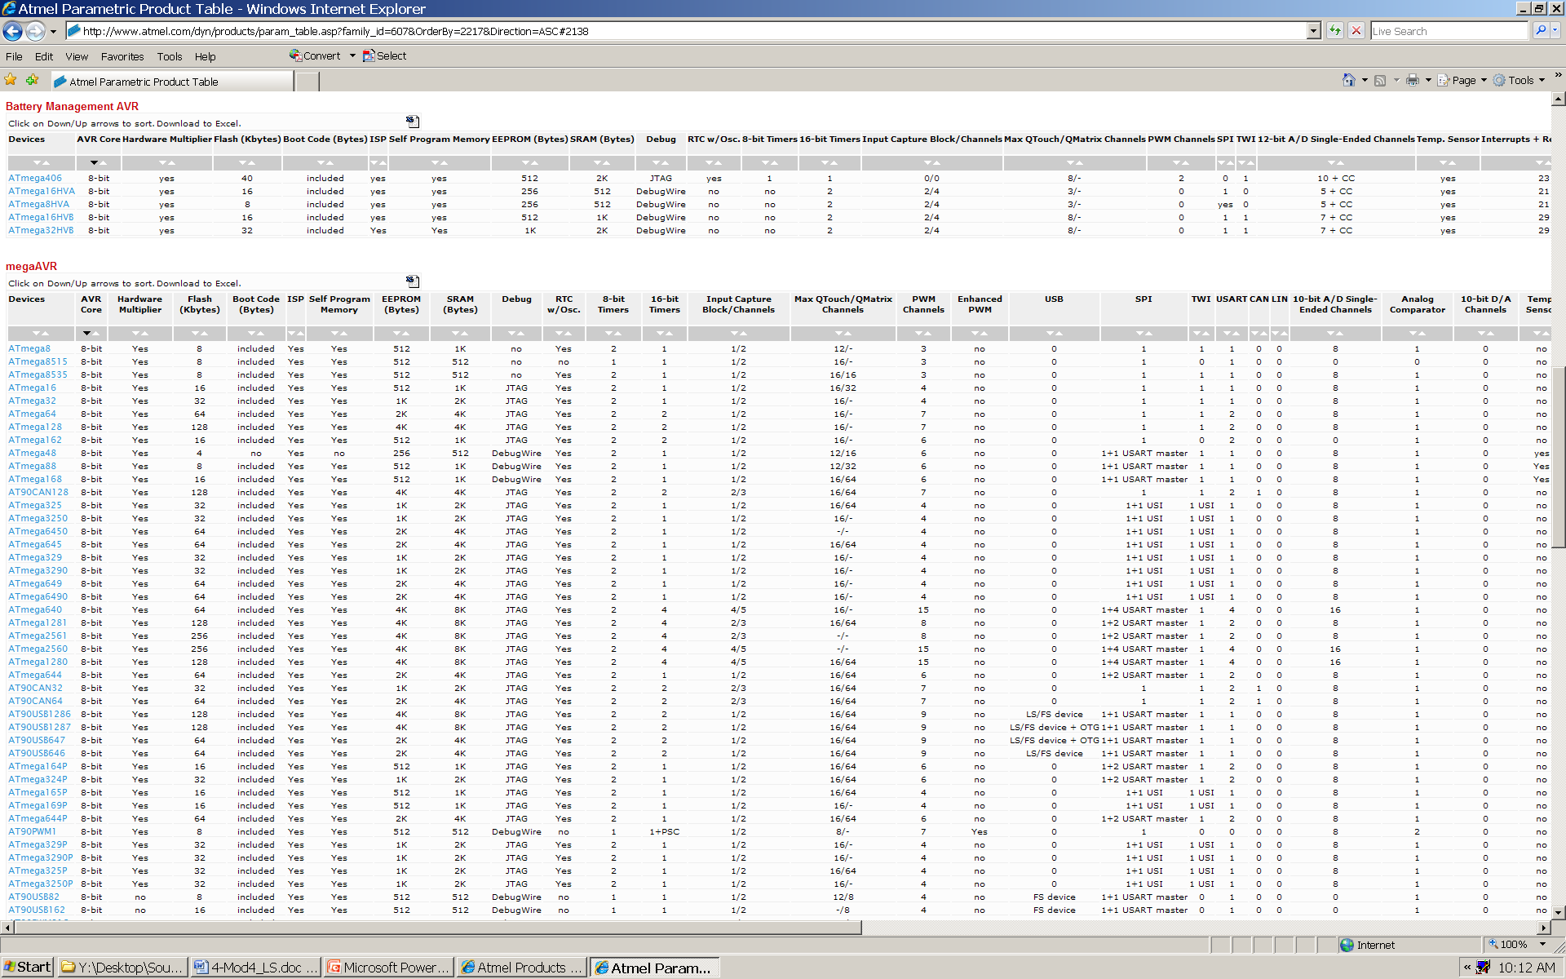
Parametric Product Table…

Slide 34

www.freescale.com

Slide 35
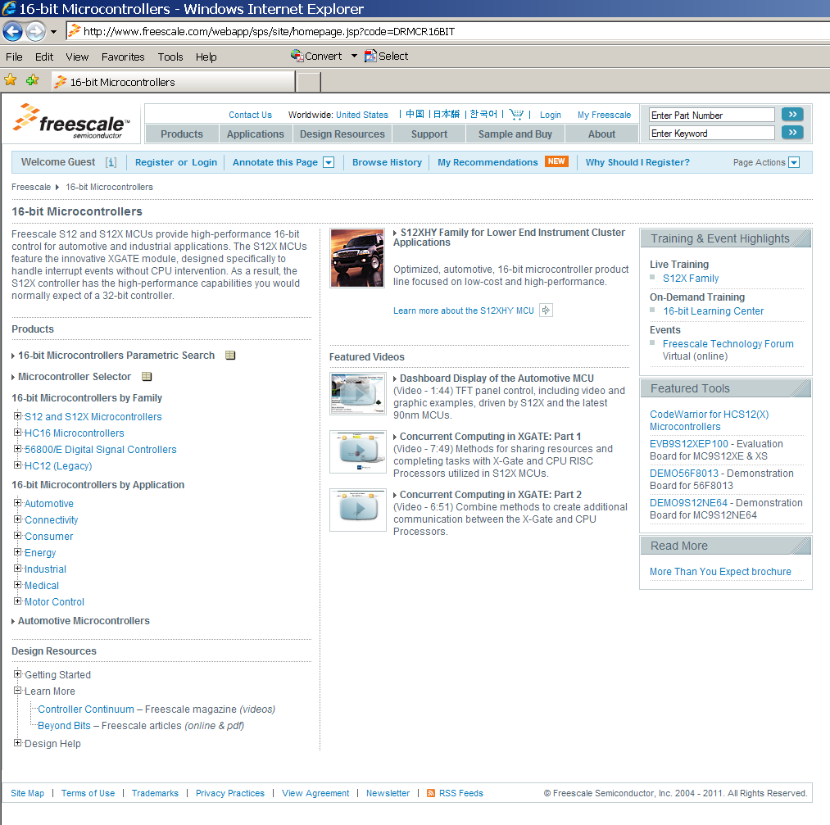

Slide 36
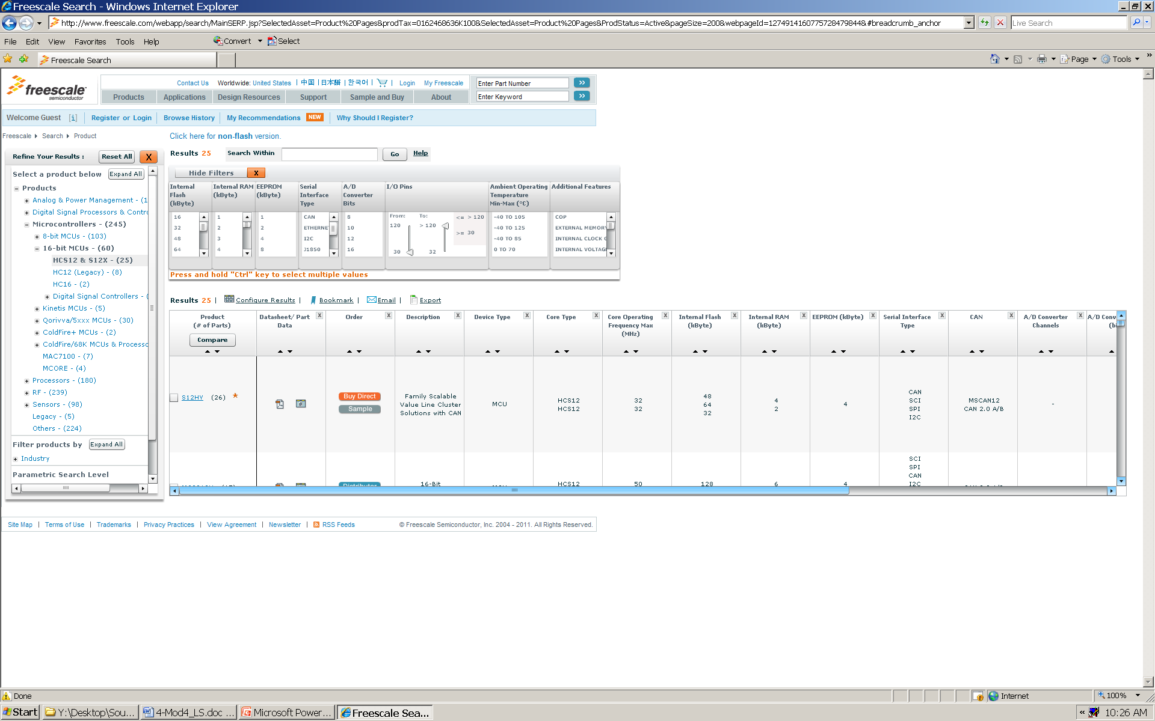
Freescale 16-bit Parametric Product Table

Slide 37

www.analog.com

Slide 38
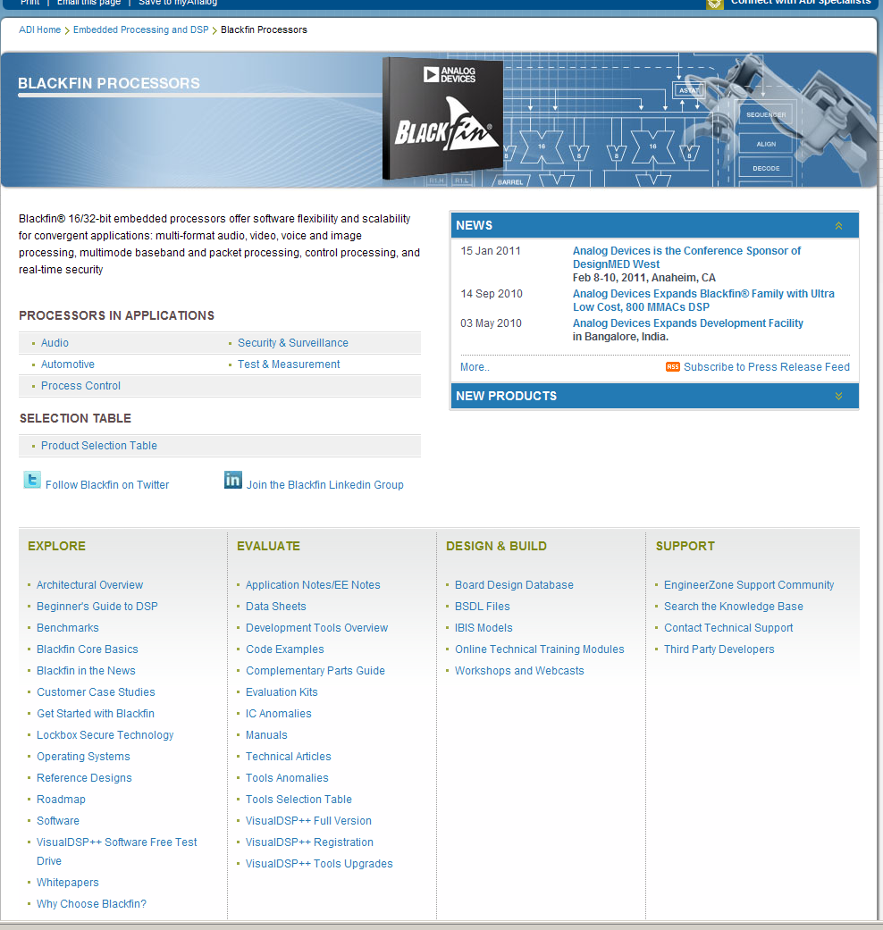

Slide 39
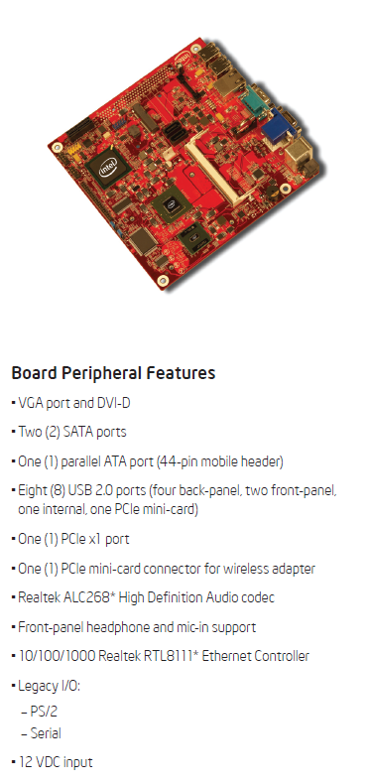
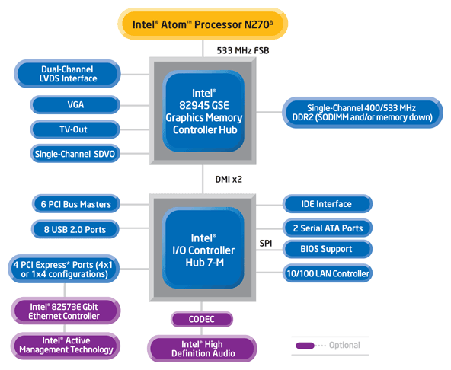
http://www.intel.com/products/processor/atom/index.htm

Slide 40
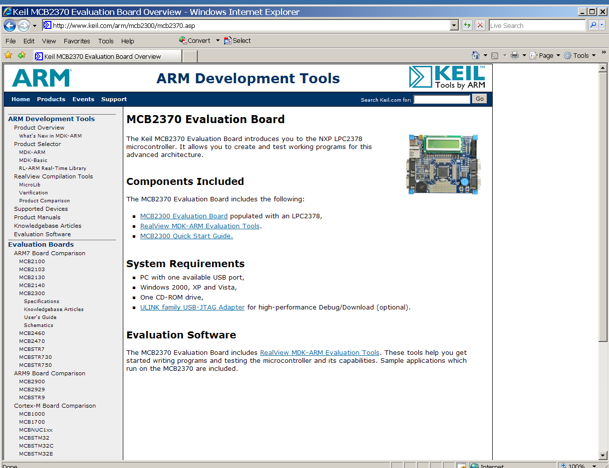
http://www.keil.com/mcb2300/mcb2370.asp

Slide 41
Prerequisite Review Guidelines
Topics from ECE 270 (Module 1) you should review include:
How to read/interpret data sheets
Logic levels and noise margins
Interfacing different families of CMOS logic
Electrostatic discharge
Sourcing and sinking currents
Propagation delay and transition time
Effects of capacitive and resistive loads
Power dissipation as a function of supply voltage and switching frequency
Current spikes and decoupling
Three-state and open-drain outputs

Slide 42
Prerequisite Review Guidelines
Topics from ECE 362 you should review include:
Embedded application software organization
SCI and SPI applications
ATD applications and analog signal conditioning
TIM applications
PWM applications and interfaces
Switching D.C. loads
Optical isolation of inputs and outputs
Keypad (switch matrix) and contact closure de-bouncing
Rotary pulse generators (RPG)
Position control, stepper motors, (hobbyist) servos
LCD interface
I/O expansion using shift registers
Bus timing analysis

