Slide 1
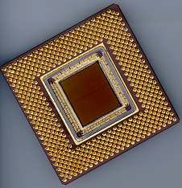
ECE 477 Digital Systems Senior Design Project
Special Session
Laboratory Notebook Bootcamp

Slide 2
Outline
Importance of Lab Notebooks
Notes About Lab Notebooks
Pictures
Weekly Summaries
Update Record
Writing Style
Technical Detail

Slide 3
Importance of Lab Notebooks
Good documentation standards (a valuable skill in industry)
Allow others to reproduce your work
A non-trivial portion of your 477 grade (initial 2%, midterm 4%, final 6%)
An ABET outcome (60+% required on the final notebook to pass the course)

Slide 4
Notes About Lab Notebooks
Use the provided template for lab notebook formatting (we thought it might be okay for you to use whatever template you wanted… we thought wrong)
Lab notebooks are an INDIVIDUAL effort
DO NOT copy other team members entries or weekly summaries
DO NOT use your entries to describe the work of other team members

Slide 5
How Are Lab Notebooks Graded?
Level of technical detail (Weight: 3)
Pictures, drawings, and diagrams (Weight: 1)
Update record (Weight: 2)
Weekly summaries (Weight: 1)
Technical writing style and clarity (Weight: 3)

Slide 6
Level of Technical Detail
Along with writing style, the “meat” of your lab notebook
How well are you explaining what you are doing? To what degree could somebody reproduce your work from what you have written?
Use of hyperlinks to outside sources and material

Slide 7
Level of Technical Detail
Technically-detailed entries answer these questions completely and concisely (where appropriate):
What did you work on?
How did you work on it? (What tools, test setups, etc. did you use?)
What was the result, and how does this affect the project?
What did you learn?
What next steps need to be taken on the project?

Slide 8
Good Technical Detail Example:
The feedback from today's presentation brought several discussions to the table: (1) The sensors on the quad-rotor will be housed in a carbon fiber modeling, which sounds very difficult and time consuming to accomplish. Luckily, MRAV has a contact in the ME department with a tool that can cater to our exact needs. (2) Another concern (also involving the sensors) was that the propellers might obstruct the viewing angle of the position sensors and give us false measurements. The other option would be to place the sensors on the outer most edges of the quad-rotor. The sensors, unfortunately, do NOT recognize any readings within a 6 inch range. With this in mind, placing the position sensors in the middle seems best. Testing will determine the obstruction issue, but a potential solution to that would be to raise the sensors higher.

Slide 9
Bad Technical Detail Example:
Met with John and Brian to work on the website.

Slide 10
Pictures
Provide a means of understanding what you’re doing beyond text descriptions
Worth ~1kword* apiece
The more the better (at least 2-3 unique, relevant pictures per week)
DO use a thumbnail that links to a larger picture (not just hyperlinks to pictures, please)
DO use .jpg or .png image formats (no .tiff or .bmp, please)
*1kword = 1000 words, per marketing conventions. Sorry binary fans.

Slide 11
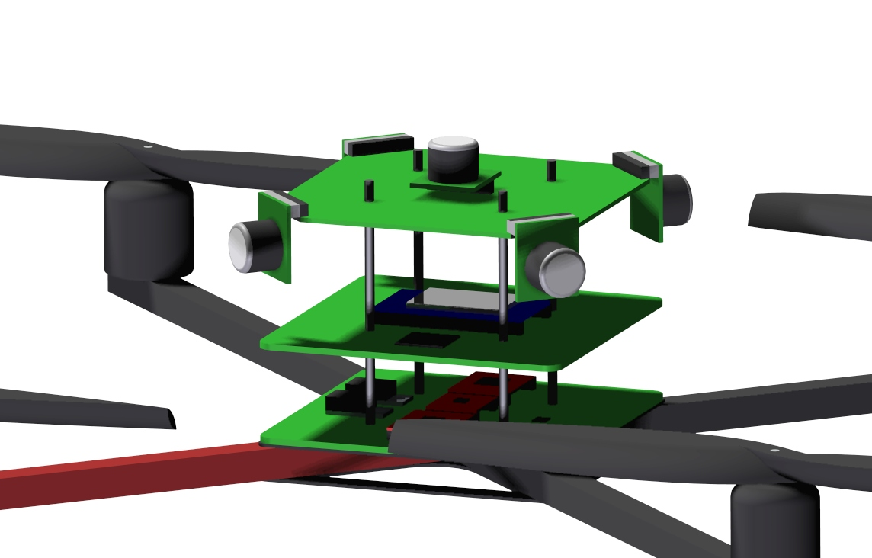
Examples of Relevant Pictures
CAD/3D Models:

Slide 12
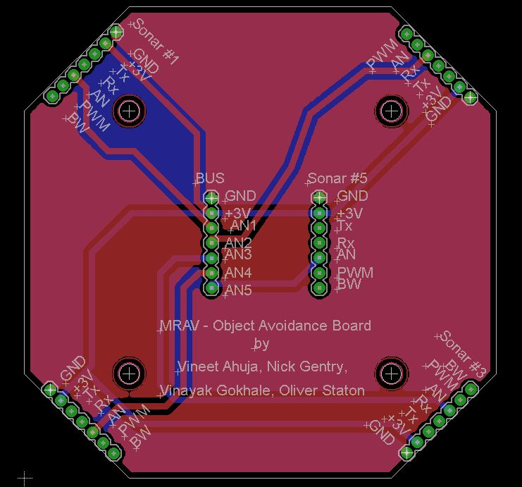
Examples of Relevant Pictures
Schematics and PCB Layouts:

Slide 13
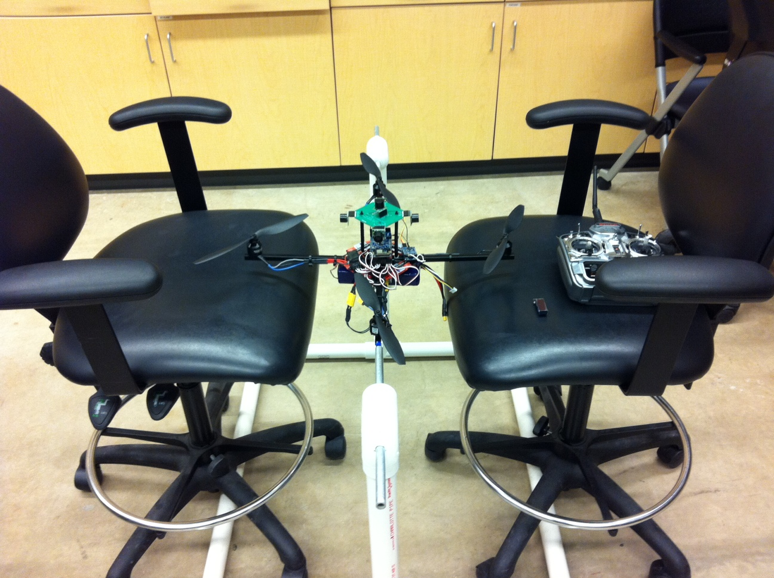
Examples of Relevant Pictures
Project Photos, Test Setups, Demos, etc.:

Slide 14
Examples of Relevant Pictures
GUI Screenshots
Program Flowcharts
Program Function Call Diagrams
Algorithm Illustrations
Data structure Visualizations
Computer Simulation Output
Comparison Tables

Slide 15
Weekly Summaries
Summarize your week’s project progress in a concise, clear format (2-3 sentences)
DO use 2-3 complete sentences
DO talk about your project progess
DON’T use short phrases or fragments
DON’T talk about homework or non-project related tasks (such as working on the website, etc.)

Slide 16
Weekly Summaries
A Good Weekly Summary:
This week the majority of the PCB was completed. Due to routing considerations, the middle board layout was converted to a four-layered design. For routing reasons, the dimensions of the bottom and middle boards were increased.
A Bad Weekly Summary:
Completed packaging design (homework #4), progress on smartphone code.

Slide 17
Update Record
Reflects steady, consistent progress towards project completion
DO write entries “as events happen” (within 3 days of when event was written in lab)
DO write entries regularly (every 3 days, or more often if there is progress to be reported)
School holidays such as spring or fall break aren’t required for update record (though write ‘em if you got ‘em)
Recommendation: jot down quick notes of what you do in lab to remind you later, then write in detail later

Slide 18
Writing Style
Ability to adequately describe technical material
DO use complete sentences (include subject; “Worked on code” is not a complete sentence)
DO use correct grammar (nothing more annoy too grader then bad grammar)
DO use correct spelling (consider using a spell check aware editor such as Notepad++ and then transferring those files to the team website)

