Slide 1
ETHICS CASE STUDIES
Focus on Product Safety
When has a product been “tested enough” to ensure operator safety under various operating conditions and failure modes?
How long is a company liable for injuries resulting from safety-related product failures?
Who, in a given company, is responsible for ensuring that a product has been “adequately” and/or “reasonably” designed and tested to ensure operator safety

Slide 2
ETHICS CASE STUDIES
CNC (Computer Numerically Controlled) Lathe
variable speed motor
cutting tool
chuck
robot arm
metal stock

Slide 3
ETHICS CASE STUDIES
CNC Lathe Characteristics
Mechanical system with large inertial forces
Flying metal debris generated as part of the milling process must be safely contained
Multiple embedded microprocessors
Embedded control software (firmware)
Operator programs written in a special language designed for milling parts (production mode)

Slide 4
ETHICS CASE STUDIES
CNC Mechanisms/Features to Ensure Operator Safety
Mechanical
  safety shields to prevent flying debris from hitting the operator
  mechanical limit switches that shut entire system down if “robot arm” out-of-range
Computer control hardware
  feedback sensors to monitor position, motor speed, operating temperature, etc.

Slide 5
ETHICS CASE STUDIES
CNC Mechanisms/Features to Ensure Operator Safety
Embedded software (firmware)
  code to monitor feedback sensors, report status, and shut down system if dangerous operating conditions develop
  mechanism to reset processor/shut down system if software execution disrupted (“watchdog”)
User “milling” programs
  automatic identification of commands/parameters that might cause dangerous operating conditions

Slide 6
ETHICS CASE STUDIES
CNC Product Testing to Ensure Safe Operation
Two aspects of operational safety
  safety under “normal” operating conditions
  safety in the event of malfunction
    hardware failures
      components (integrated circuits, discrete parts)
      sensors, cables
    software failures
      control code bug
      transient execution error (due to power glitch/noise)

Slide 7
ETHICS CASE STUDIES
CNC Product Safety Issues
Who, in a given company, is responsible for ensuring that a product has been “adequately” and/or “reasonably” designed and tested to ensure operator safety?
How should a product be tested to ensure operator safety under all possible conditions?
What kinds of tests should be performed to “simulate” various failure modes?
When has a product been “tested enough” to verify “graceful shutdown” in the event of failure?

Slide 8
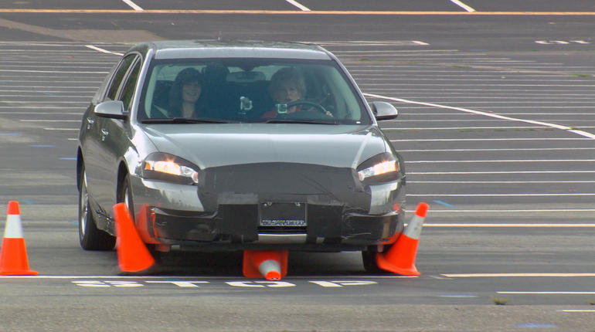
ETHICS CASE STUDIES
Hacked Car
CBS 60 Minutes – No real security on the Internet
FEBRUARY 5, 2015, 5:29 PM. Lesley Stahl reports on the U.S. military’s Defense Advanced Research Projects Agency (DARPA) and Dan Kaufman, who heads its software unit, working on cyber warfare and making the Internet more secure.

Slide 9
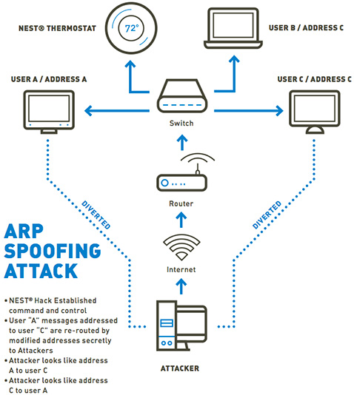
ETHICS CASE STUDIES
Nest Hacking Vulnerability
TrapX confirmed the design flaws discovered in the Nest Learning Thermostat. They validated the attack vector presented at the Black Hat 2014 Conference by compromising the device and an entire home network.
"While the Nest Learning Thermostat has relatively robust security compared to most IoT devices, the attack vectors presented at Black Hat enabled our lab to completely compromise the device within our Advanced Test Bed Facility (ATBF)…"

Slide 10
ETHICAL Impact ANALYSIS
Homework Assignment
Outline the ethical challenges your team would have to resolve in the process of bringing your design to market
  testing under a variety of operating conditions
  placement of warning labels
  providing cautions in user documentation
  adding safety mechanisms
Discuss how you would address each of these challenges

