Slide 1
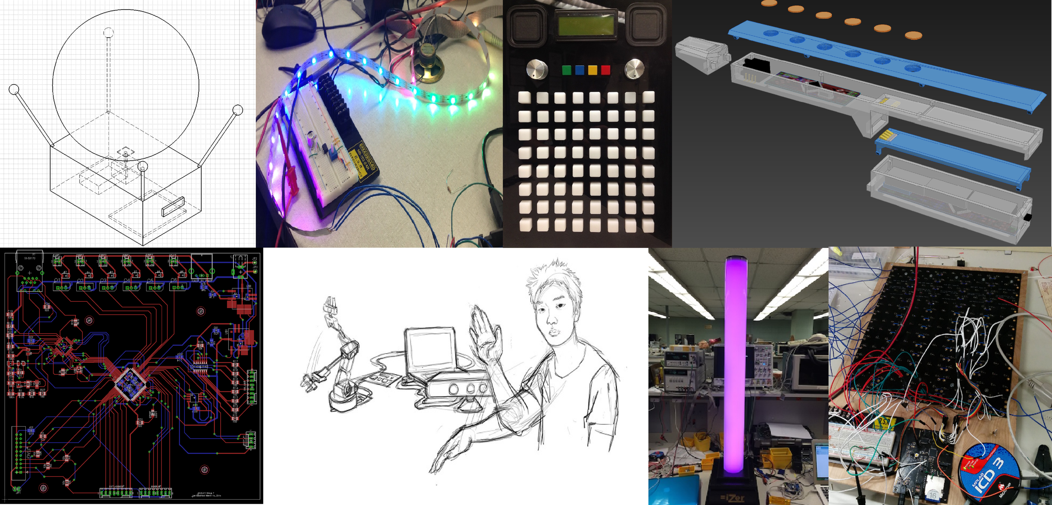
Senior Design Info Session
Introduction to ECE 477
George Hadley ©2014, Images Property of their Respective Owners.

Slide 2
Outline
Course Staff
Course Overview
Design Project
Course Schedule/Calendar
Course Website
Sample Past Projects
Registration Procedures

Slide 3
Course Staff
George Hadley (ghadley@purdue.edu)
Course Coordination and Development
David Meyer (meyer@ecn.purdue.edu)
Professor-In-Charge / Spring Lecture Professor
Mithuna Thottethodi (mithuna@ecn.purdue.edu)
Fall Lecture Professor
Mark Johnson (mcjohnso@purdue.edu)
Director of Instructional Labs
Todd Wild (toddwild@purdue.edu)
Industrial Design Project Manager
Joseph Bougher (bougher@purdue.edu)
Digital Systems Laboratory Engineer
Additional details can be found under the website About → Staff tab

Slide 4
Course Overview
Course Description:
A structured approach to the development and integration of embedded microcontroller hardware and software that provides senior-level students with significant design experience applying microcontrollers to a wide range of embedded systems.
Objective:
  To provide practical experience developing integrated hardware and software…which students will most likely encounter in industry.

Slide 5
Course Overview
Lectures:
  Tuesdays and Thursdays
  Topics include professional and design components
  Lecture dates and topics listed on Course Calendar
Mandatory Lab (MANLAB):
Wednesdays (two sections available – all four team members must register for the same section)
Used to assess progress, provide feedback, and improve student/staff communication
Attendance will be taken and is MANDATORY (no more than two unexcused absences allowed)

Slide 6
Course Overview
Midterm Design Review and Final Presentation:
Formal presentations given before classmates, course staff, and project sponsors
Opportunity to showcase prototyping progress and final deliverables
Weekly Progress Updates:
Used to detail individual design activities and progress
Evaluated numerous times throughout the semester (one of the five course outcomes)
ECE Design Showcase:
Opportunity to showcase completed projects to faculty, students, and project sponsors

Slide 7
DESIGN PROJECT
Teams:
    Four students each (no exceptions), self-selected
    established prior to submission of project proposal
Projects:
  Open-ended, team-specified and of personal interest to at least two team members
  Tractable, yet “difficult enough”
  Must satisfy five general and five project-specific success criteria
  Opportunity to develop communication and teamwork skills that will be needed in industry

Slide 8
DESIGN PROJECT
Basic Project Specifications:
Must utilize a microcontroller (that has good hardware and software development tools, such as PIC, Atmel, TI, Freescale)
May also utilize a CPLD or FPGA
May also utilize a “motherboard” (Atom / ARM / R-Pi)
Must interface to something: sensor, keypad, LCD, GPS, … using USB, Ethernet, I2C, RS232, IR, RF, …
Requires the design and fabrication of a two-layer custom printed circuit board (PCB)
Must be neatly packaged, without requiring extensive mechanical design and/or construction

Slide 9
DESIGN PROJECT
Project Hardware:
  Prototyping Hardware: any hardware you use to prototype aspects of your design
  Final Hardware: hardware used to satisfy PSSCs, grades, and course outcomes
  Q: Can we use <x> to prototype our design?
  A: Sure, go right ahead.
  Q: Can we use <Arduino or similarly trivial breakout board, etc.> in our final design?
  A: Probably not.
  Q: We’re unsure if <piece of hardware> is allowed, what should we do?
  A: Contact course staff.

Slide 10
DESIGN PROJECT
Online Collaboration Policy:
Use of github, Sourceforge, Google Code, etc. is allowed BUT…
  all students must maintain an online progress report using provided formatting
  all students must maintain a project website hosted on the provided server space
Open source and third-party libraries may be used, provided they are properly attributed
Accepting patches and modifications from third parties to team member source code is explicitly forbidden
cheating and other forms of academic dishonesty will result in automatic course failure (so don’t do it)

Slide 11
Course Schedule/Calendar
Weeks 1-4: Concept Development:
Functional Project Proposal: “Our idea seems sound… what do we need to get started?”
Functional Analysis: “How will our project be used? What are our project’s requirements?”
Electrical and Software Overviews: “At a high level, how will our project function?”
Component Analysis and Bill of Materials: “What parts does our project need to use?”
Ordering/Acquisition of parts, tools, and prototyping hardware

Slide 12
Course Schedule/Calendar
Weeks 5-9: Design:
Mechanical Overview: “What will our project look like? What form factor does it need to fit within?”
Software Formalization: “What software components will our design use? How will we verify and test the software?”
Printed Circuit Board Layout
Midterm Design Review
PCB Submission and Verification

Slide 13
Course Schedule/Calendar
Weeks 10-15: Testing and Integration:
Legal Analysis: “What steps must be taken to ensure our project can be legally sold to our customers?”
Reliability and Safety Analysis: “What risks are associated with use of our product? What parts are most likely to fail?”
Ethical and Environmental Analysis: “What resources does our project use? How can we responsibly manage our project’s life cycle? What ethical issues does our project present?”
User Manual: Guide to your project for the end user
Week 16: Success Criteria Demos, Final Presentations, and Final Documentation

Slide 14
Course Website
https://engineering.purdue.edu/ece477
About – general course overview, staff information, history
Course – assignments, lectures, documents, policies, processes
Teams – information about current teams and links to their project websites
Archive – information about past teams and links to websites
Sponsors – information for corporate sponsors
Incoming – registration information for prospective students
Contact – course account email link for communications

Slide 15
Sample Past Projects

Slide 16

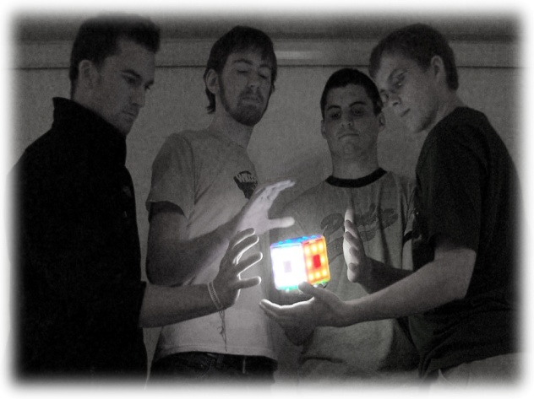
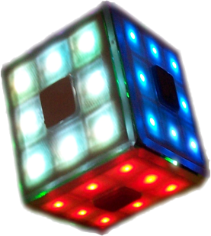
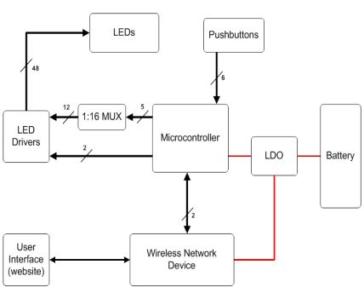
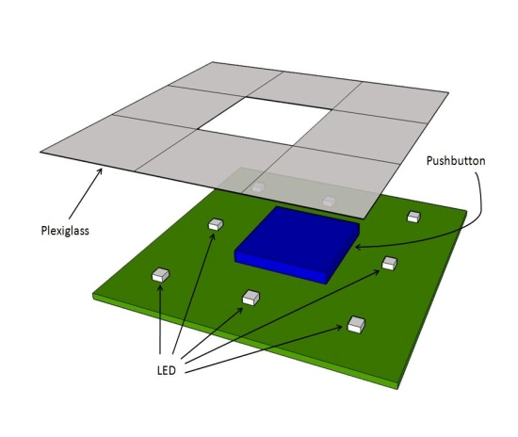
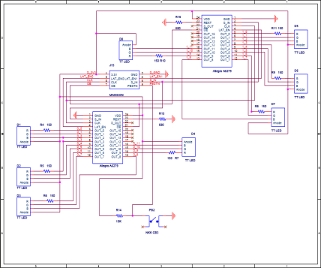
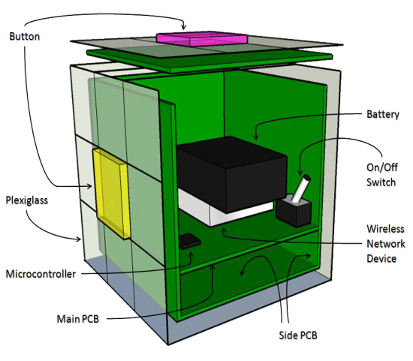
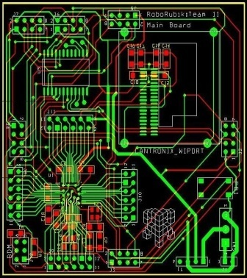
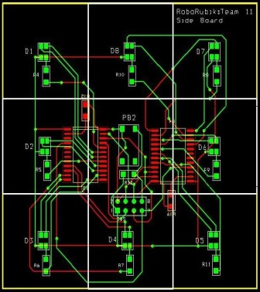
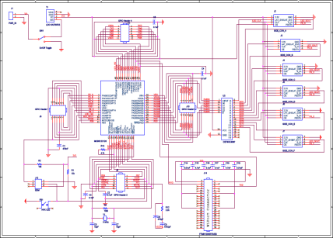


ECE 477 Digital Systems Senior Design Project − Spring 2008
Design
Device
RoboRubik
Block Diagram
Tyler
Heck
Dave Bukiet
Erik Carron
Casey Kloiber
RoboRubik is a self-contained automated Rubik's Cube solver.
You can scramble and solve it just like a normal Rubik’s Cube. If you get stuck, you can get hints as to what your next move should be. RoboRubik comes with an embedded user interface accessed through any device with wireless networking ability. It’s a fun and simple way to learn about and play with one of the most beloved puzzles in the world.
Side PCB
Schematic
Side PCB Sketch
Development
Main PCB
Schematic
Main PCB
Side PCB
Cut-away Sketch
Digijock(ette)-Strength Digital System DesignTM
© 2008 RoboRubik

Slide 17
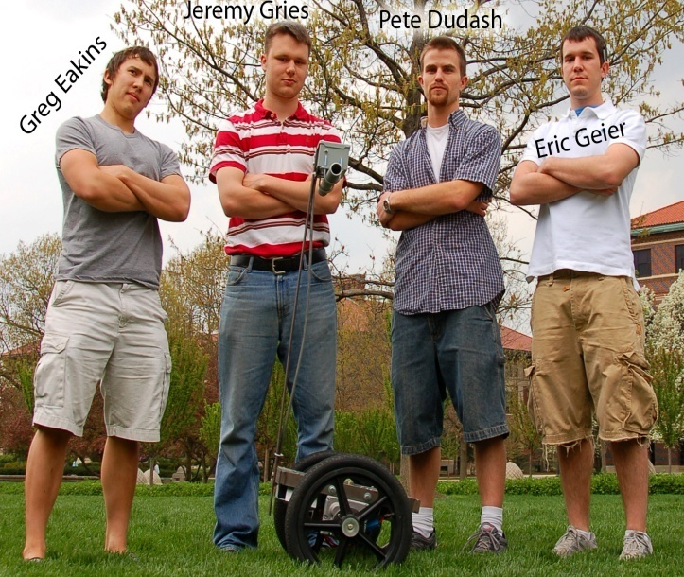
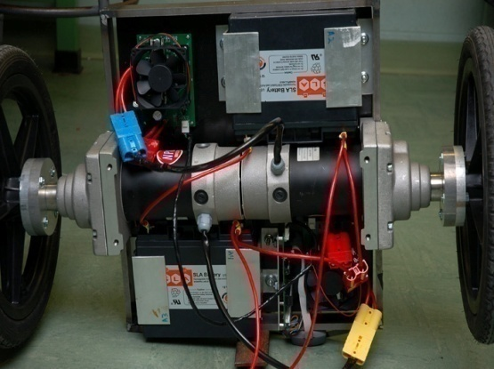
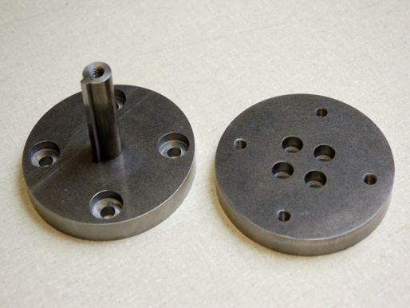
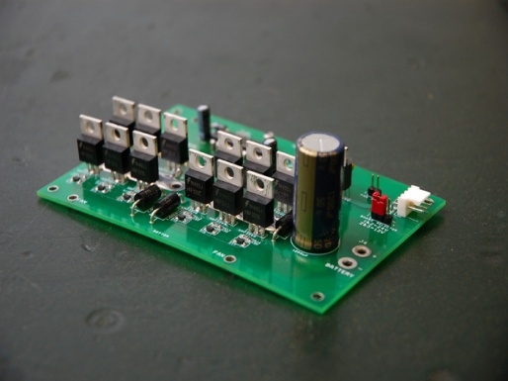
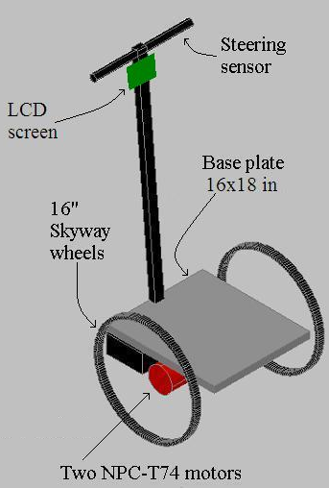
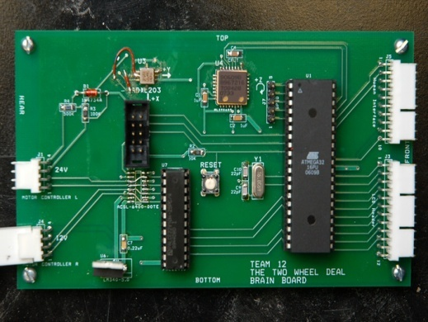
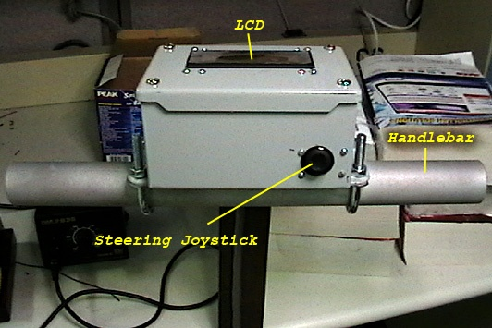
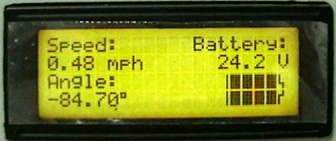

ECE 477 Digital Systems Senior Design Project − Spring 2008
The Two Wheel Deal
Packaging Layout
Wheel Hubs
Motor Controller PCB
Preliminary Chassis Design
The Two Wheel Deal is a vehicle used for transporting a single rider on two wheels. The design uses an accelerometer and gyroscope to sense when the center of gravity is not directly over the axis of the wheels. It then drives the wheels in order to keep the vehicle balanced. The LCD screen displays battery life, speed, and tilt angle.
Microcontroller PCB
User Interface
LCD Display
Digijock(ette)-Strength Digital System DesignTM

Slide 18
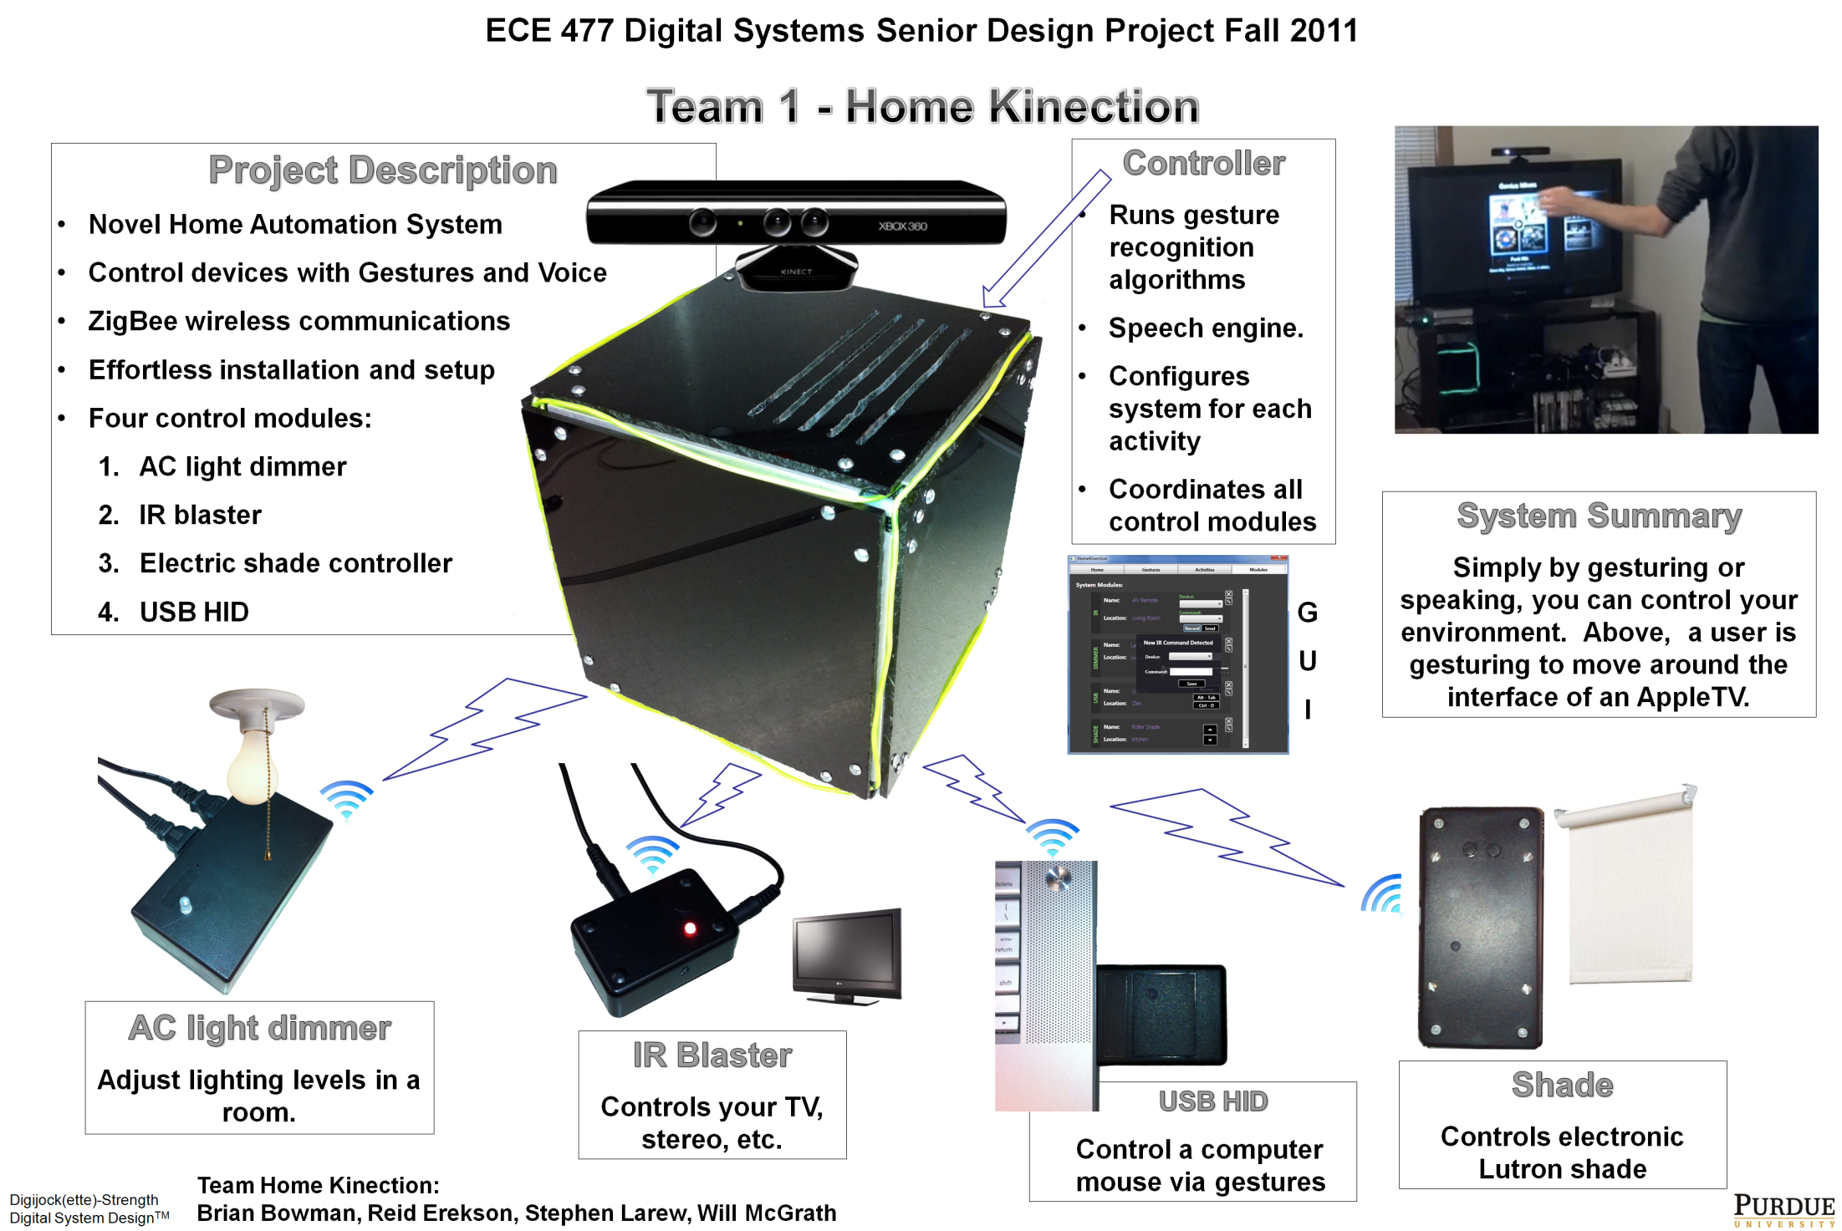

Slide 19

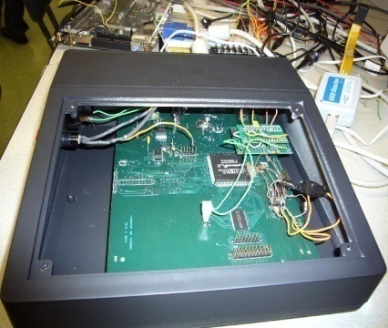
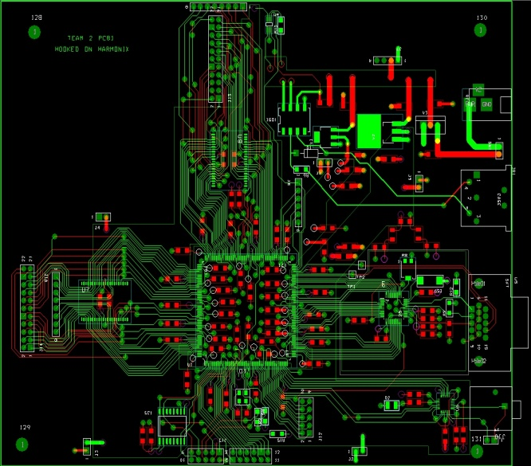
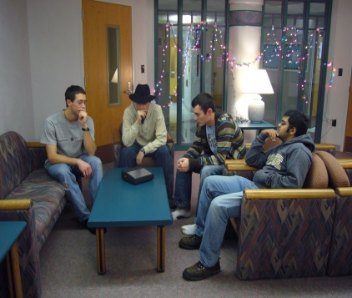
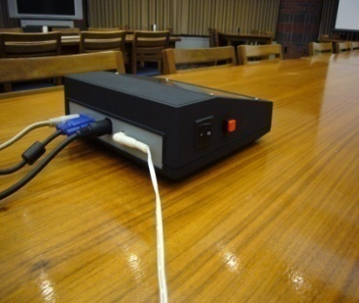
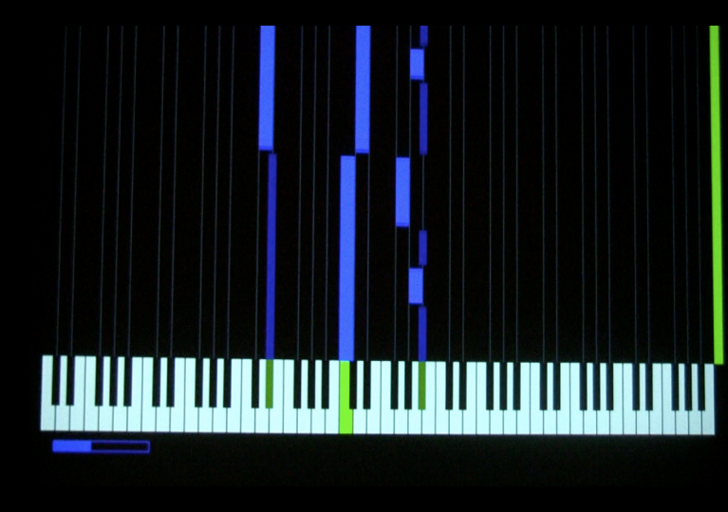
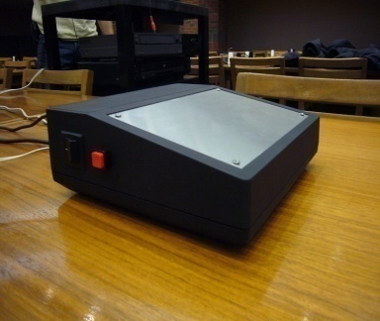
ECE 477 Digital Systems Senior Design Project − Fall 2007
Team 2: Hooked on Harmonix
Final Printed Circuit Board (PCB)
Hooked on Harmonix is a learning tool that teaches the user valuable piano skills while providing an entertaining experience at the same time.
4-layer Printed Circuit Board (PCB)
Synopsis: The user selects one of several MIDI tracks stored in Flash memory, and the corresponding file is parsed outputting bars of appropriate length to a standard computer monitor. Performance from a standard MIDI keyboard is judged and graded when the song is finished.
I/O Ports (from left): Audio Output, VGA output, MIDI input, power input
User input from standard MIDI keyboard is compared to stored MIDI song file
Digijock(ette)-Strength Digital System DesignTM

Slide 20
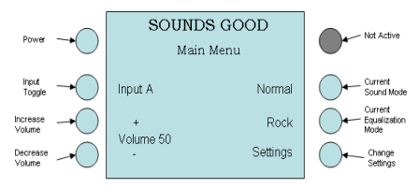
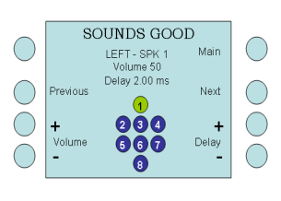
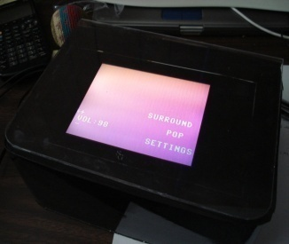
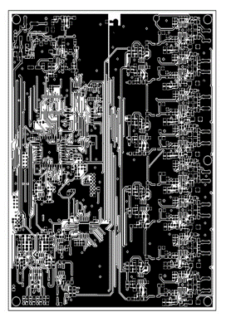
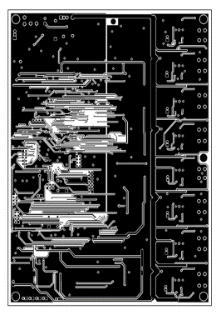
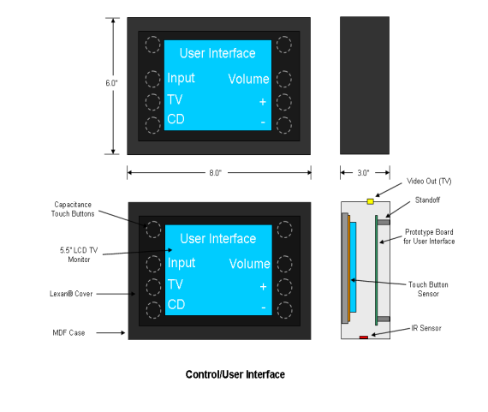
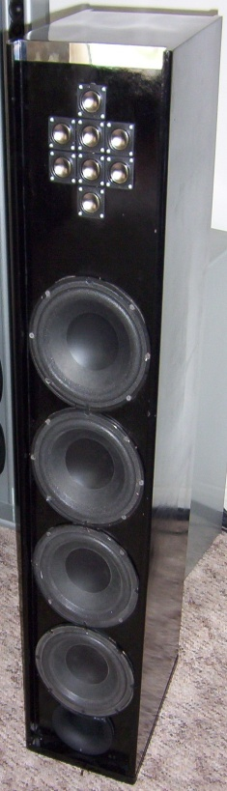
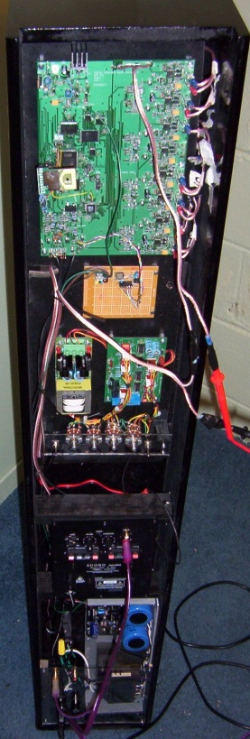
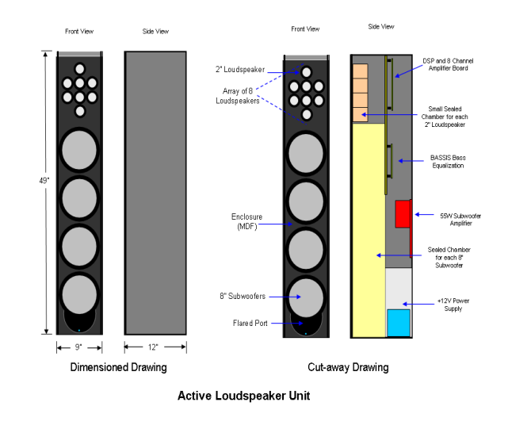
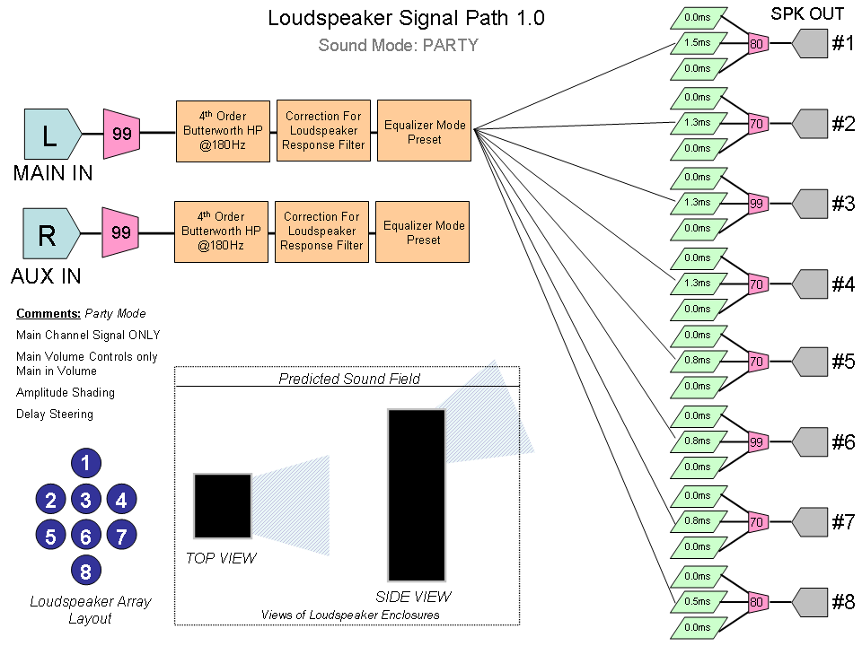
ECE 477 Digital Systems Senior Design Project − Spring 2007
SOUNDS GOOD / DS³ Digital Steerable Sound System
Joe Land, Ben Fogle, James O’Carroll, Elizabeth Strehlow
PROJECT DESCRIPTION:
USER INTERFACE UNIT:
USER MENUS CONCEPT:
Digitally Steerable Sound System, allows for non-ideal placement of speakers
Six Preset Equalization Modes
Wireless Control Interface
PCB LAYOUT:
ILLUSTRATION OF CONCEPT:
LOUDSPEAKER UNIT:
Top Copper
Bottom Copper
SIGNAL PATH:
FRONT
BACK
Digijock(ette)-Strength Digital System DesignTM

Slide 21
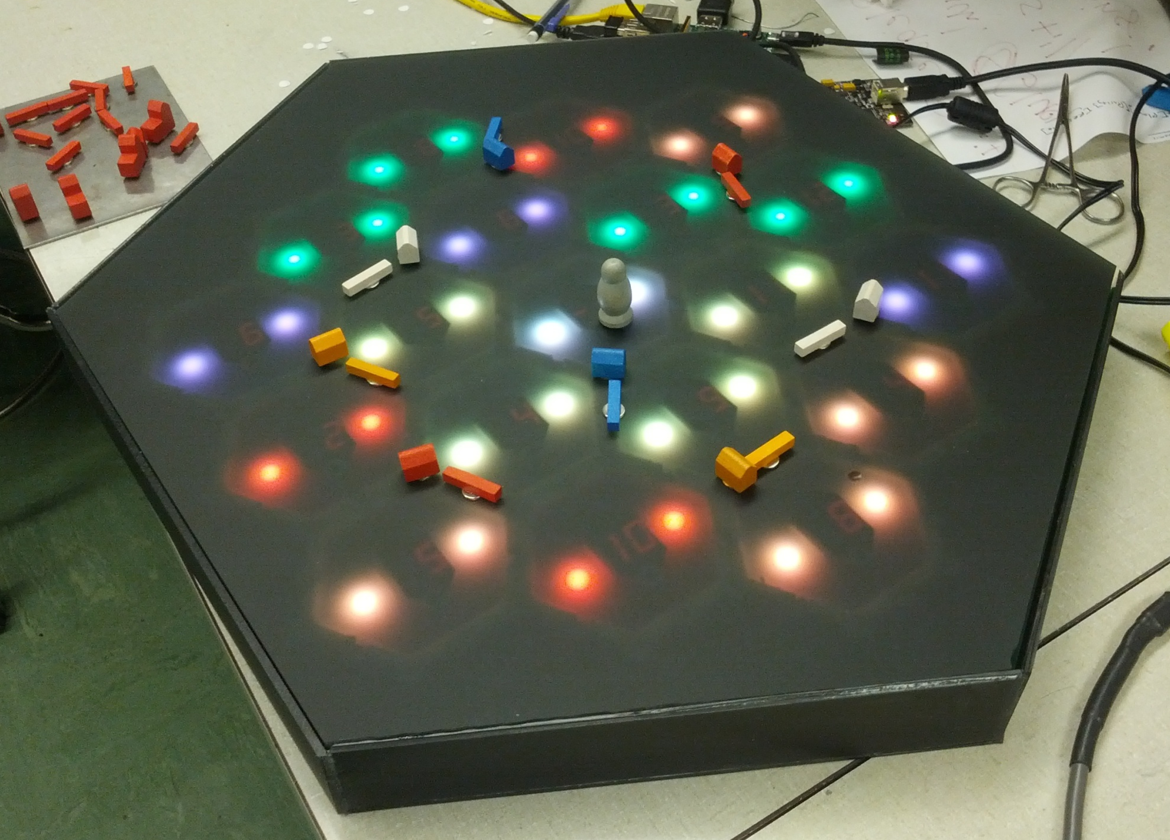
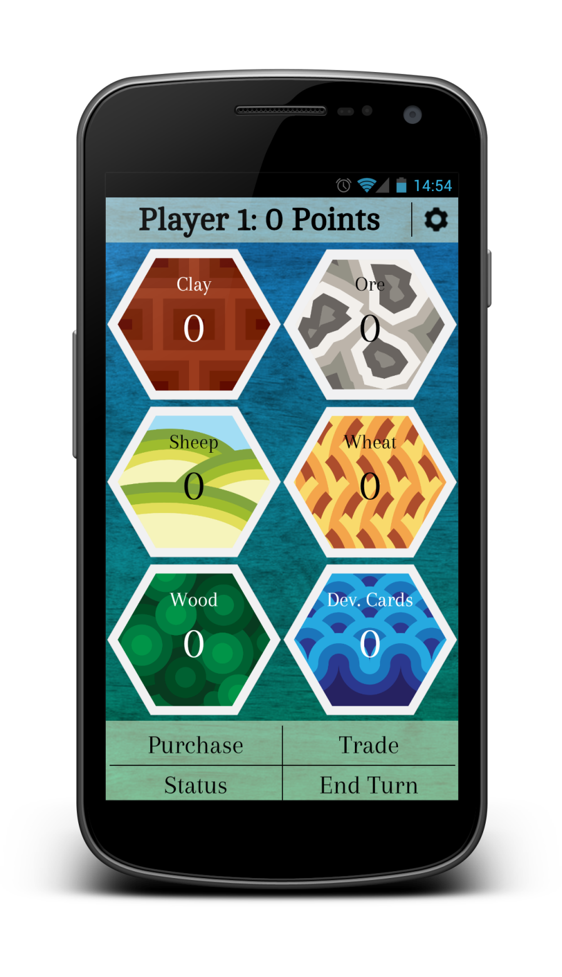
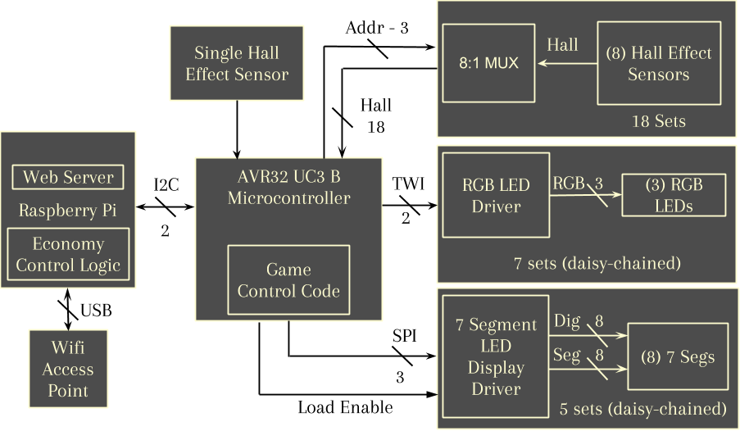
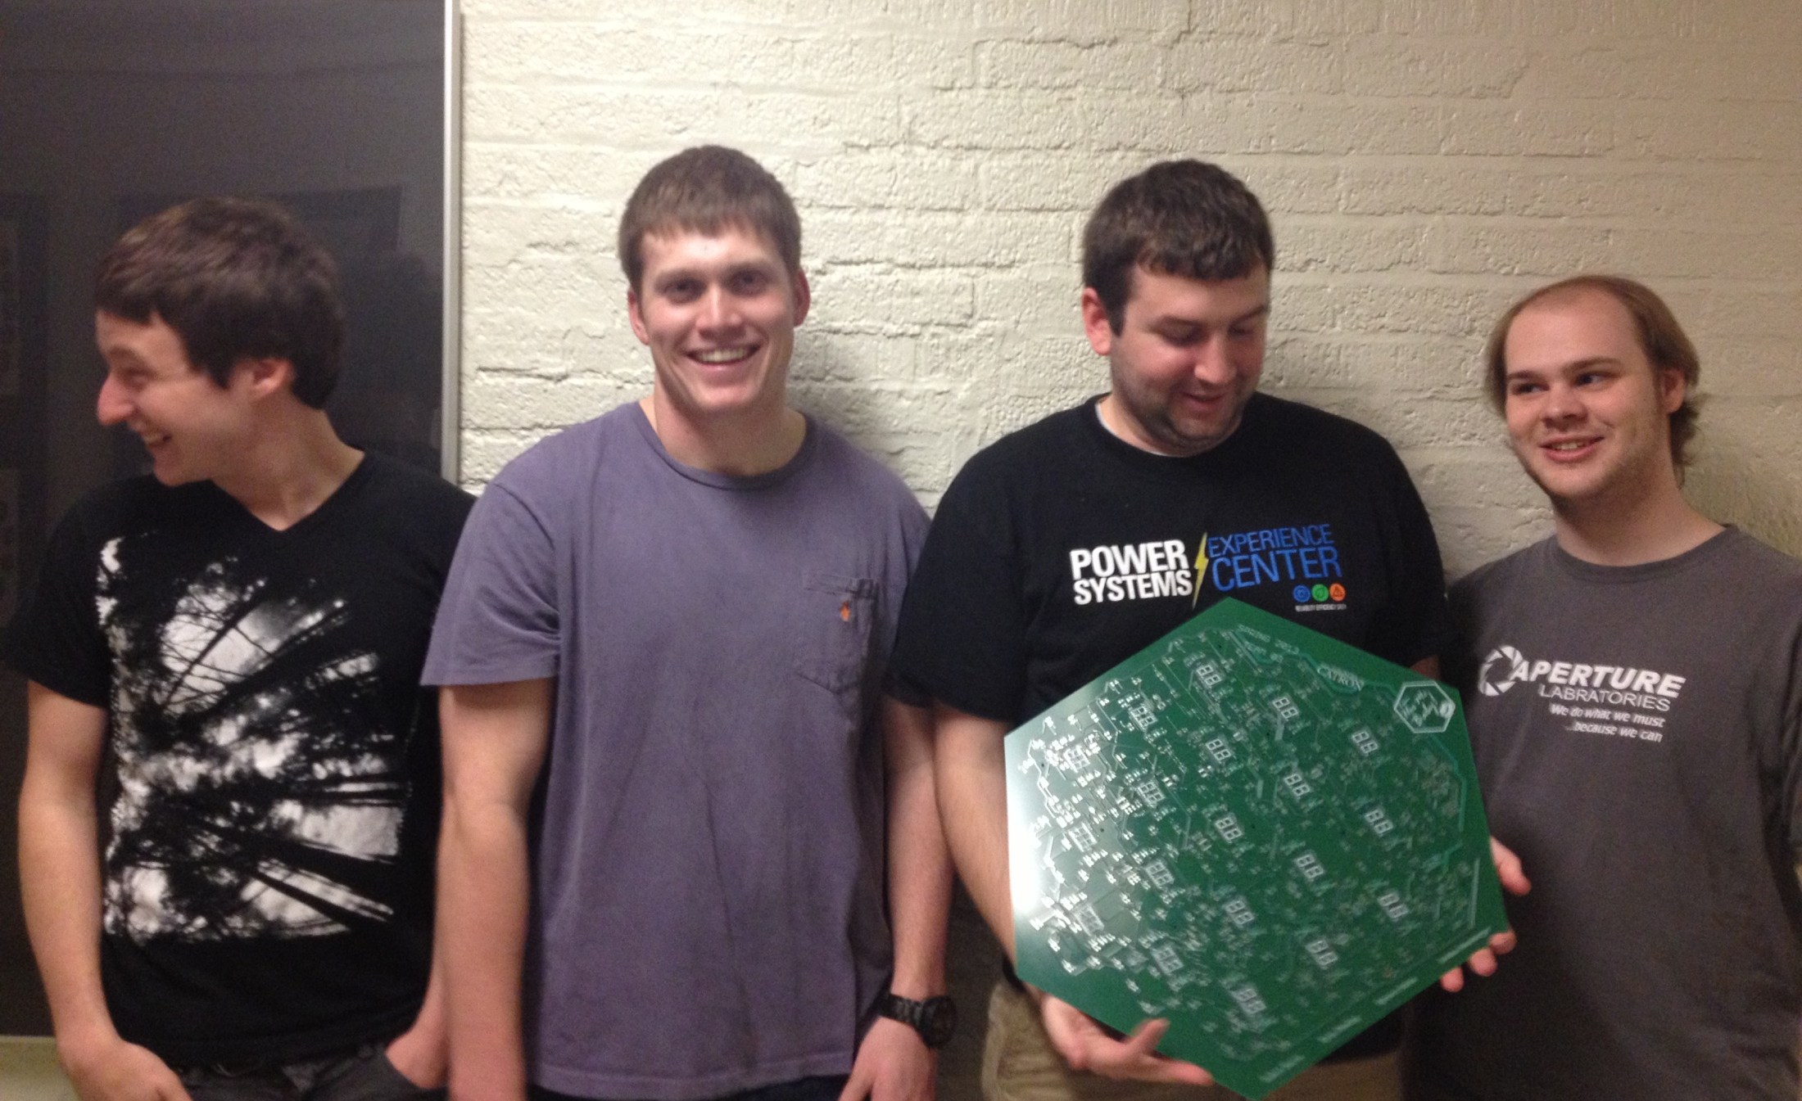

ECE 477 Digital Systems Senior Design Project − Spring 2013
THE HACKERS OF
CATRON
The Hackers of Catron is an electronic board game based around the incredibly popular game The Settlers of Catan. The object of the game is to create the largest settlement on the island of Catron, by obtaining and trading various resources.
Features
Generates a random arrangement of resource hexagons
Automatically assigns resources to players after rolling the dice via the web app
Resources are viewed, traded, and purchased in the web app
Playable on any device with Wi-Fi and a modern browser
No external wireless network necessary
Enforces correct piece placement with visual feedback
Web Application
A Game in Progress
Ryan Pawling
Robert Harris
Josh Hunsberger
Spencer Julian
Block Diagram
PCB Layout
Digijock(ette)-Strength Digital System DesignTM
Transforming Ideas Into Reality
Notes:
Robert’s Comments:
Renamed “Features Include” to “Features” and “PCB Design Layout” to “PCB Layout”. I think it sounds a little better to be more concise. Changed up the features list (changed wording and added note about external network). Changed the spacing of the features section so that it is more evenly spaced between the text above and image below. Also changed the font size of all of the captions to be 48 (they were 46) like the features section title. Changed player names to Calibri so that it matches the rest of the poster better.
Spencer’s Comments from before:
Fonts were just recommendations, not requirements, so I changed them. I find it amusing how they contradict themselves often on the poster information page. Removed the clip art and twisted the phone back around – the phone looked really out of place like that because of the shadow. The clip art was mostly just distracting, and didn’t really seem to serve a purpose, since the features already specify “wi-fi”. I also removed the raspberry pi and logo, as it seemed a bit unnecessary for showing a brief overview of our project, and seemed to just be there to take up space. At that point I was left with a layout that was basically three columns with no real focal point, so I opted to move it around a bit. I really didn’t want to move them around too much, but they needed at least a little push. I also added descriptions for all the remaining images and added our names. I’d like to use more than just black for a font color, but nothing really seems to go well with this. We could do a really dark red and it would still work (despite their caution, if it’s dark enough it doesn’t matter), but I’m not 100% sure. I originally replaced the typed title with our logo, then I discovered why it wasn’t replaced with our logo. I wish I had made it bigger to start with…ah, well.

Slide 22
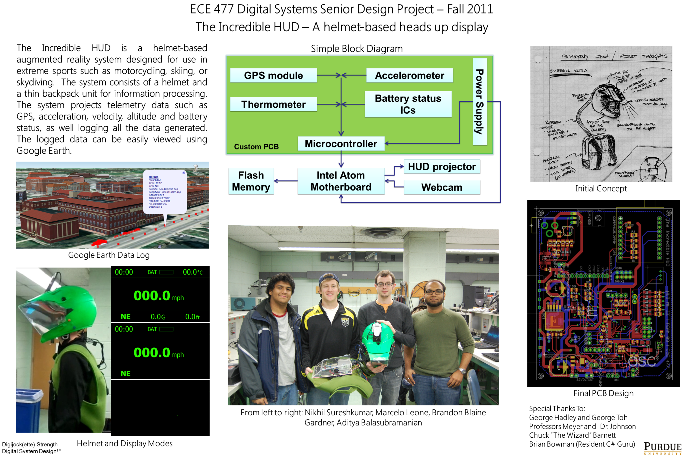

Slide 23
REGISTRATION PROCEDURES
Form a team of four students and designate a team leader (if you do not have a team, email ece477@ecn.purdue.edu to request inclusion on the posted “free agent” list)
Email ece477@ecn.purdue.edu to request a preliminary team ID (PTID) – should only be done by team leader
Visit https://engineering.purdue.edu/ece477, click on the Incoming tab, then follow the Registration link; download the Initial Project Proposal skeleton file
After carefully completing your project proposal, return to the ECE 477 Incoming → Registration page and upload your proposal file (.docx only) via the Submission portal using your assigned PTID (done by team leader only)

Slide 24
REGISTRATION PROCEDURES
Course staff will evaluate proposals in the order received; once reviewed, a “marked up” copy of the proposal will be emailed to the team leader (target one week turn-around)
  If your proposal is accepted, your team will be assigned an “official” team number and added to the Registered Teams page (team members will receive an override to register for ECE 477 at this time)
  If your proposal is rejected, your team will have one week to revise the proposal and resubmit it
  If an acceptable proposal is not submitted within the allotted time, your team’s assigned PTID will be nullified and you will basically have to start the process over

