Slide 1
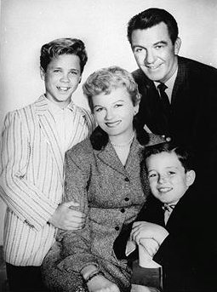
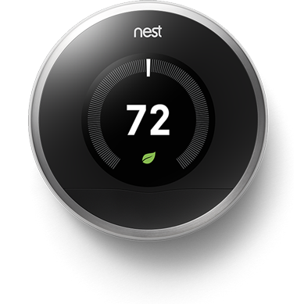
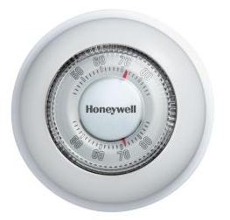

Case Study 2:
NEST LEARNING Thermostat
D. G. Meyer ©2015, Images Property of their Respective Owners

Slide 2
Background
Nest Labs Company History
Headquartered in Palo Alto, California
Designs and manufactures sensor-driven, Wi-Fi enabled, self-learning (programmable) thermostats and smoke detectors
Co-founded by former Apple engineers Tony Fadell and Matt Rogers in 2010
First product was Nest Learning Thermostat (2011), inspired by Fadell’s motivation to build a better “electronic” thermostat than those currently available
Google acquired Nest Labs for $3.2B early in 2014
Nest purchased Dropcam for $555M later in 2014
Latest product is Nest Protect (Smoke and Carbon Monoxide detector with voice alerts)

Slide 3
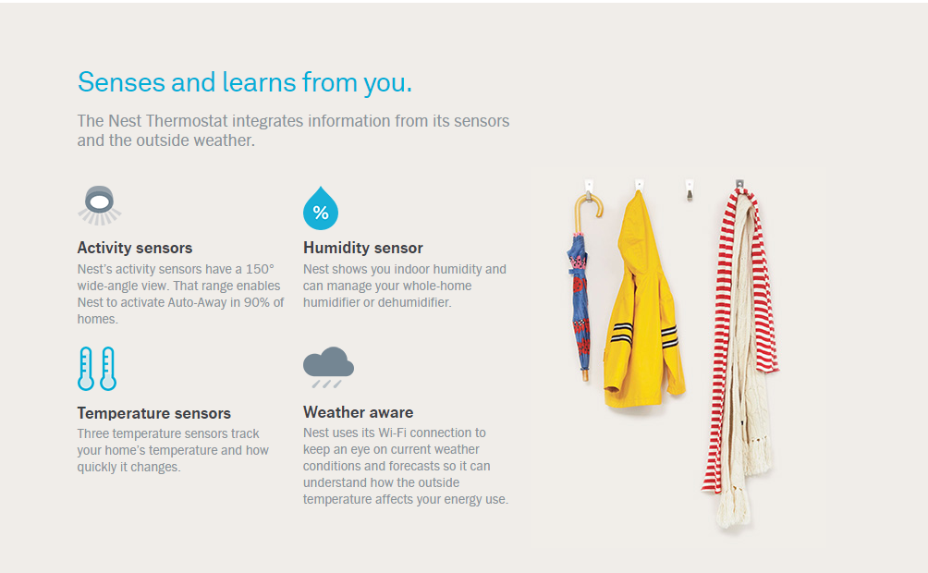
Background
How Nest Learns

Slide 4
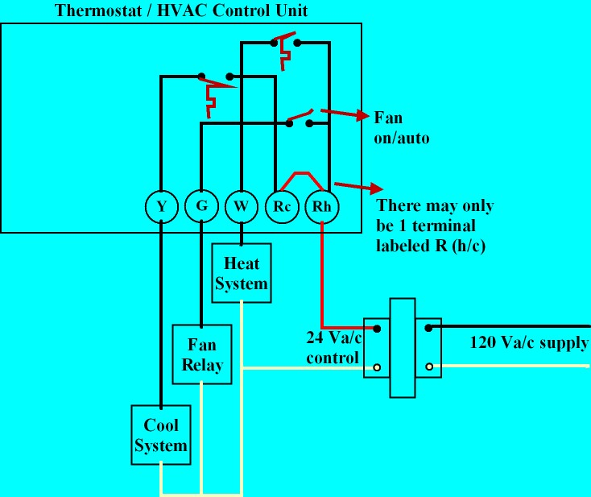
BACKGROUND
Basic 4-Wire Circuit Thermostat Circuit
Questions:
What is unknown?
What signal is (generally) not available at the thermostat?
What are implications of the need to switch 24VAC at up to 1 A?
What are implications of the unknown load impedance?
What are the implied restrictions on how an electronic thermostat can be powered?

Slide 5
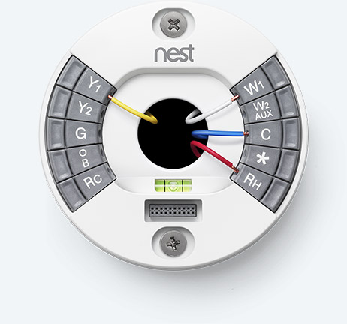
INTRODUCTION
Ease of Installation is Key Claim of Patent Application
US Patent Application US 2012/0273580 A1 (Nov. 1, 2012)
THERMOSTAT WITH SELF-CONFIGURING CONNECTIONS TO FACILITATE DO-IT-YOURSELF INSTALLATION
ABSTRACT A thermostat is configured for automated compatibility with HVAC systems that are either single-HVAC-transformer systems or dual-HVAC-transformer systems. The compatibility is automated in that a manual jumper installation is not required for adaptation to either single-HVAC-transformer systems or dual-HVAC-transformer systems. The thermostat has a plurality of HVAC wire connectors including a first call relay wire connector, a first power return wire connector, a second call relay wire connector, and a second power return wire connector. The thermostat is configured such that if the first and second external wires have been inserted into the first and second power return wire connectors, respectively, then the first and second power return wire connectors are electrically isolated from each other. Otherwise, the first and second power return wire connectors are electrically shorted together.

Slide 6
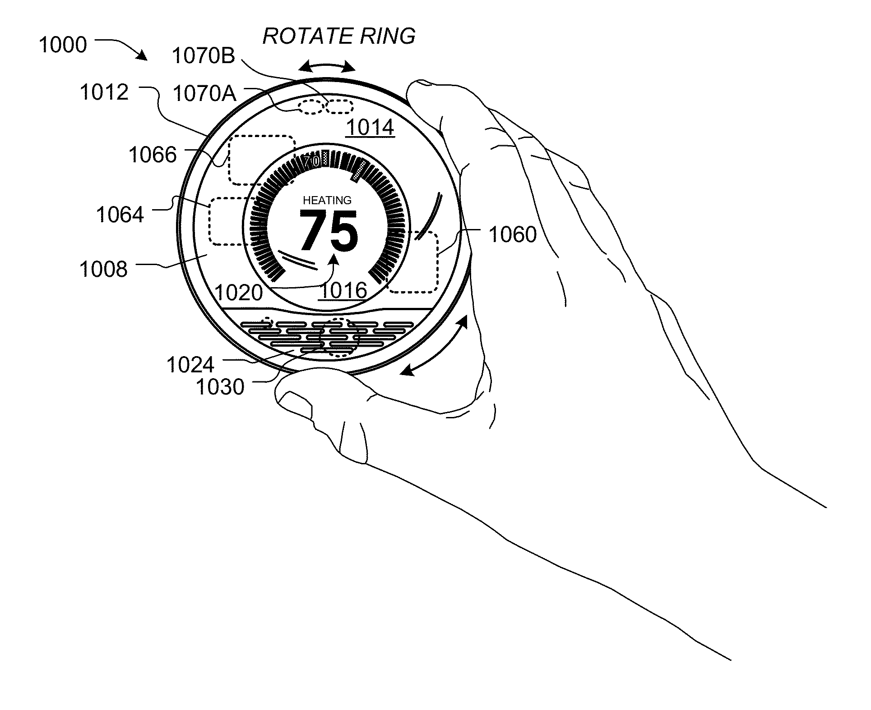
INTRODUCTION
Event Forecasting System is Key Claim of Issued Patent
US Patent 8,620,841 (filed Aug. 2012, issued Dec. 2013)
Dynamic distributed-sensor thermostat network for forecasting external events
ABSTRACT Systems and methods for forecasting events can be provided. A measurement database can store sensor measurements, each having been provided by a non-portable electronic device with a primary purpose unrelated to collecting measurements from a type of sensor that collected the measurement. A measurement set identifier can select a set of measurements. The electronic devices associated with the set of measurements can be in close geographical proximity relative to their geographical proximity to other devices. An inter-device correlator can access the set and collectively analyze the measurements. An event detector can determine whether an event occurred. An event forecaster can forecast a future event property. An alert engine can identify one or more entities to be alerted of the future event property, generate at least one alert identifying the future event property, and transmit at least one alert to the identified one or more entities.

Slide 7
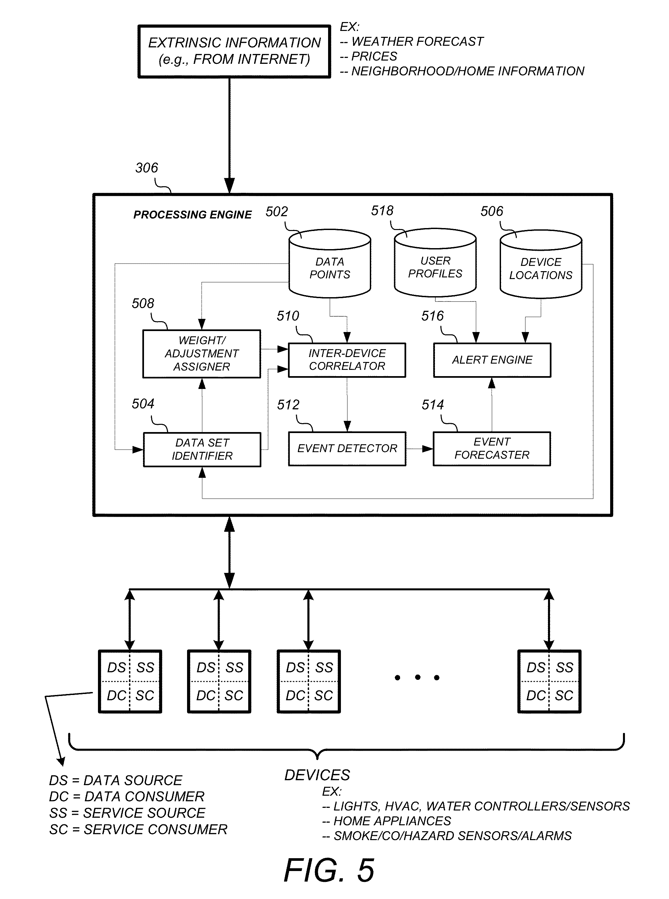
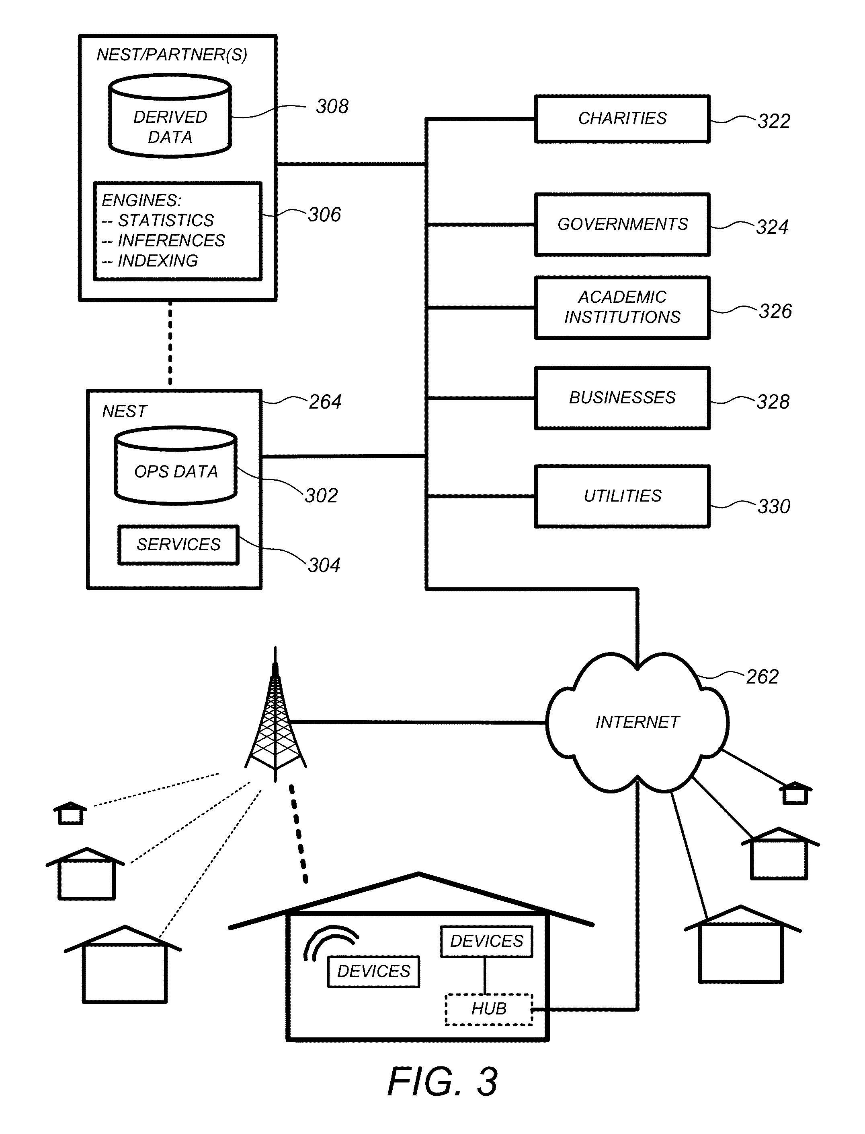
INTRODUCTION
Event Forecasting System is Key Claim of Issued Patent

Slide 8
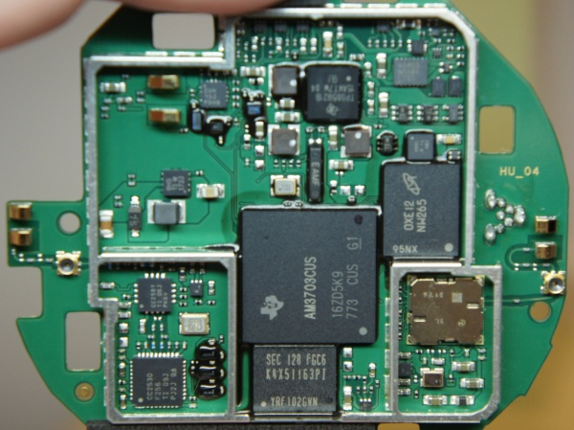
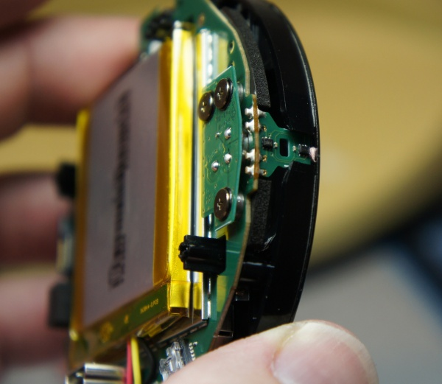
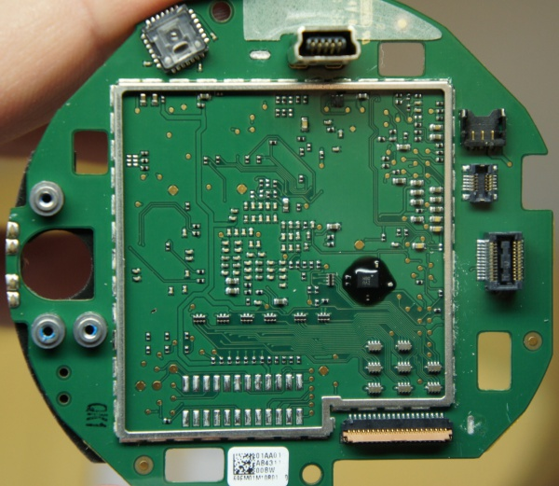
Introduction
What’s Inside

Slide 9
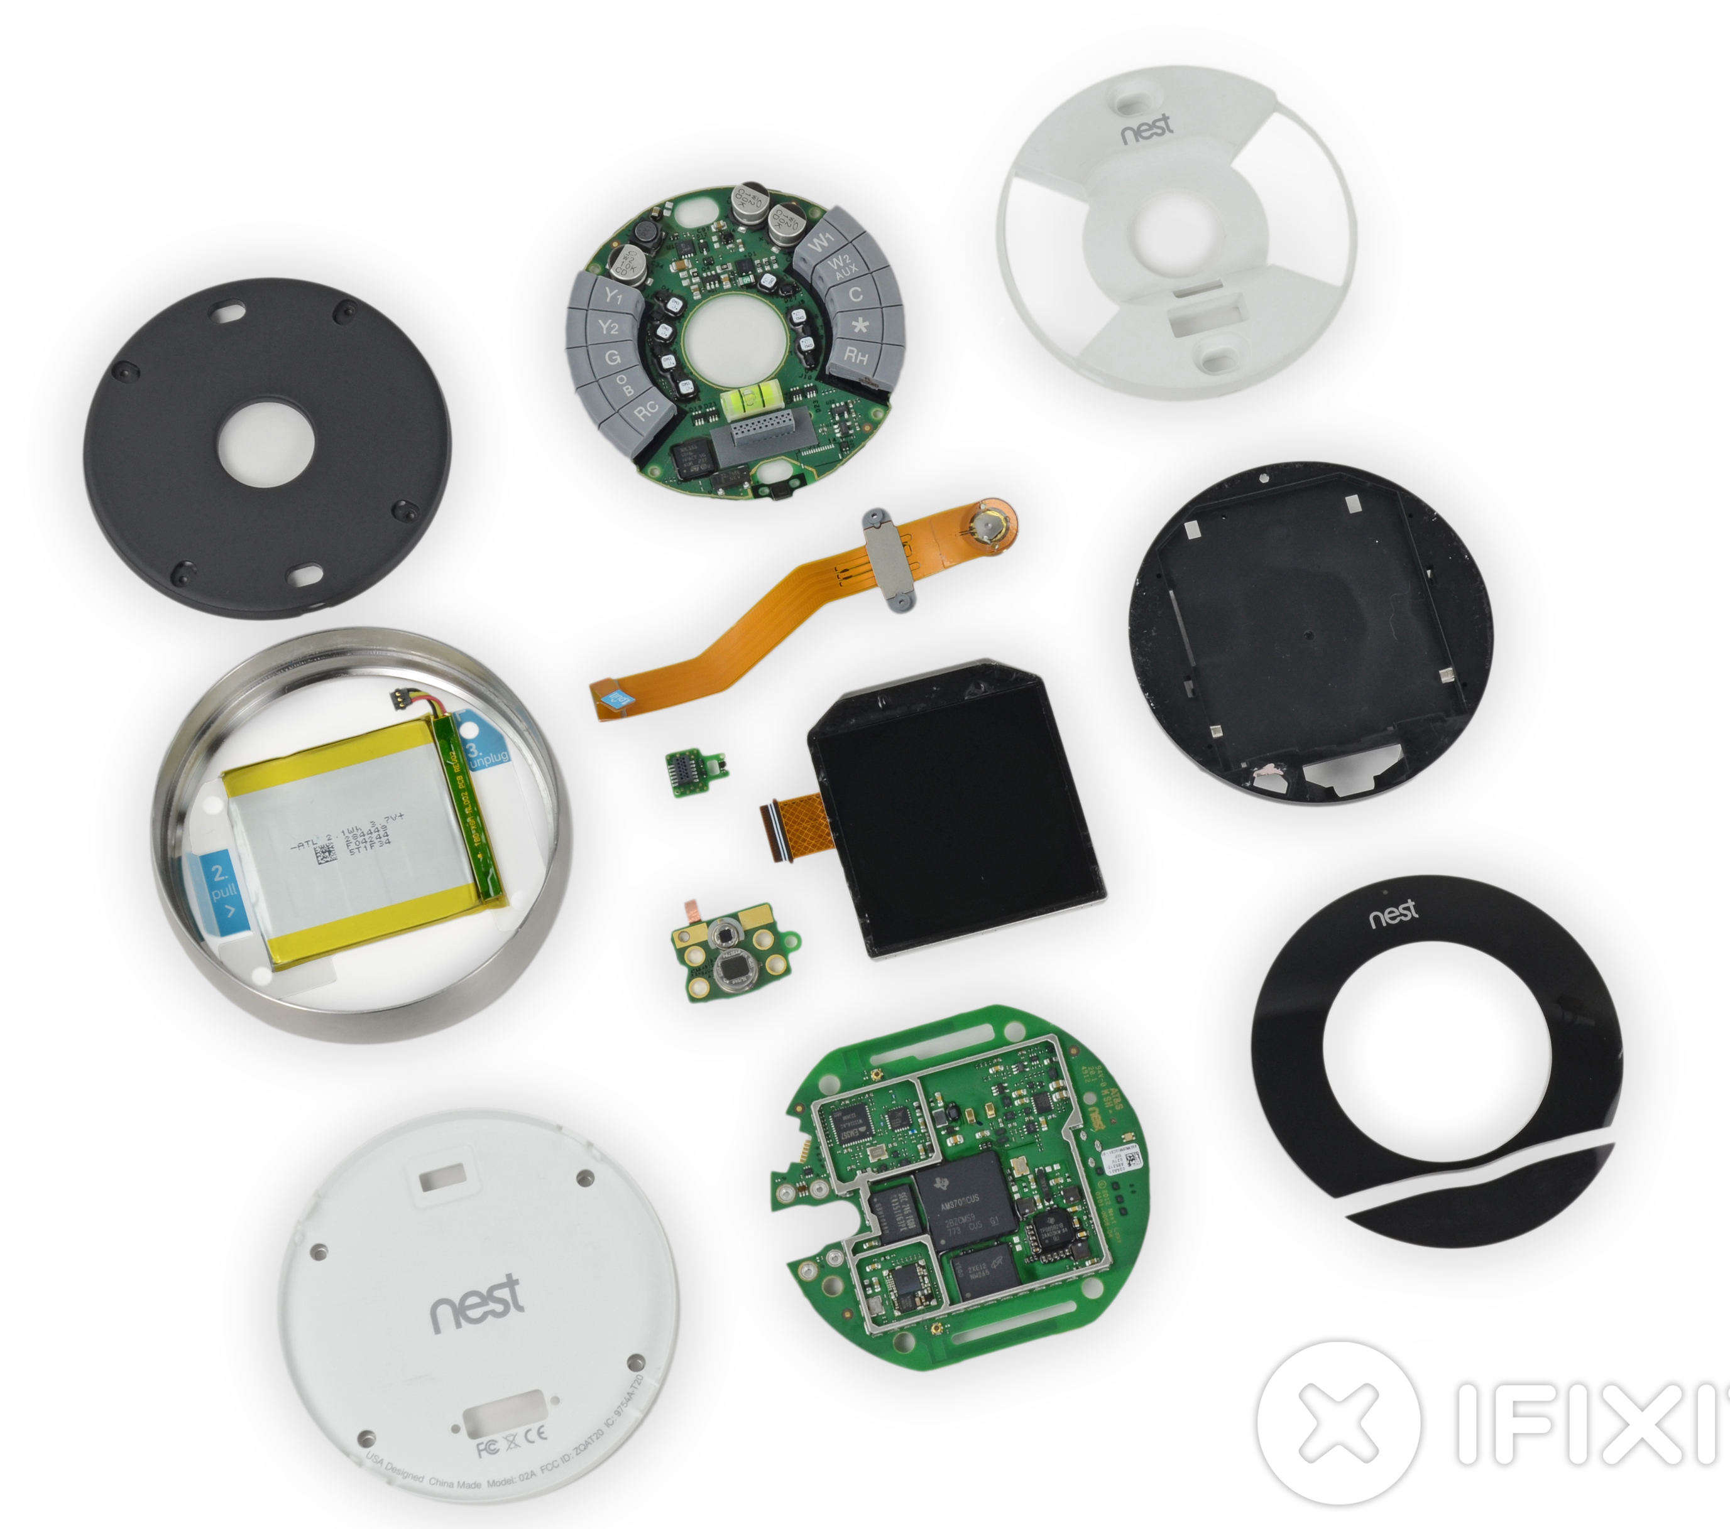
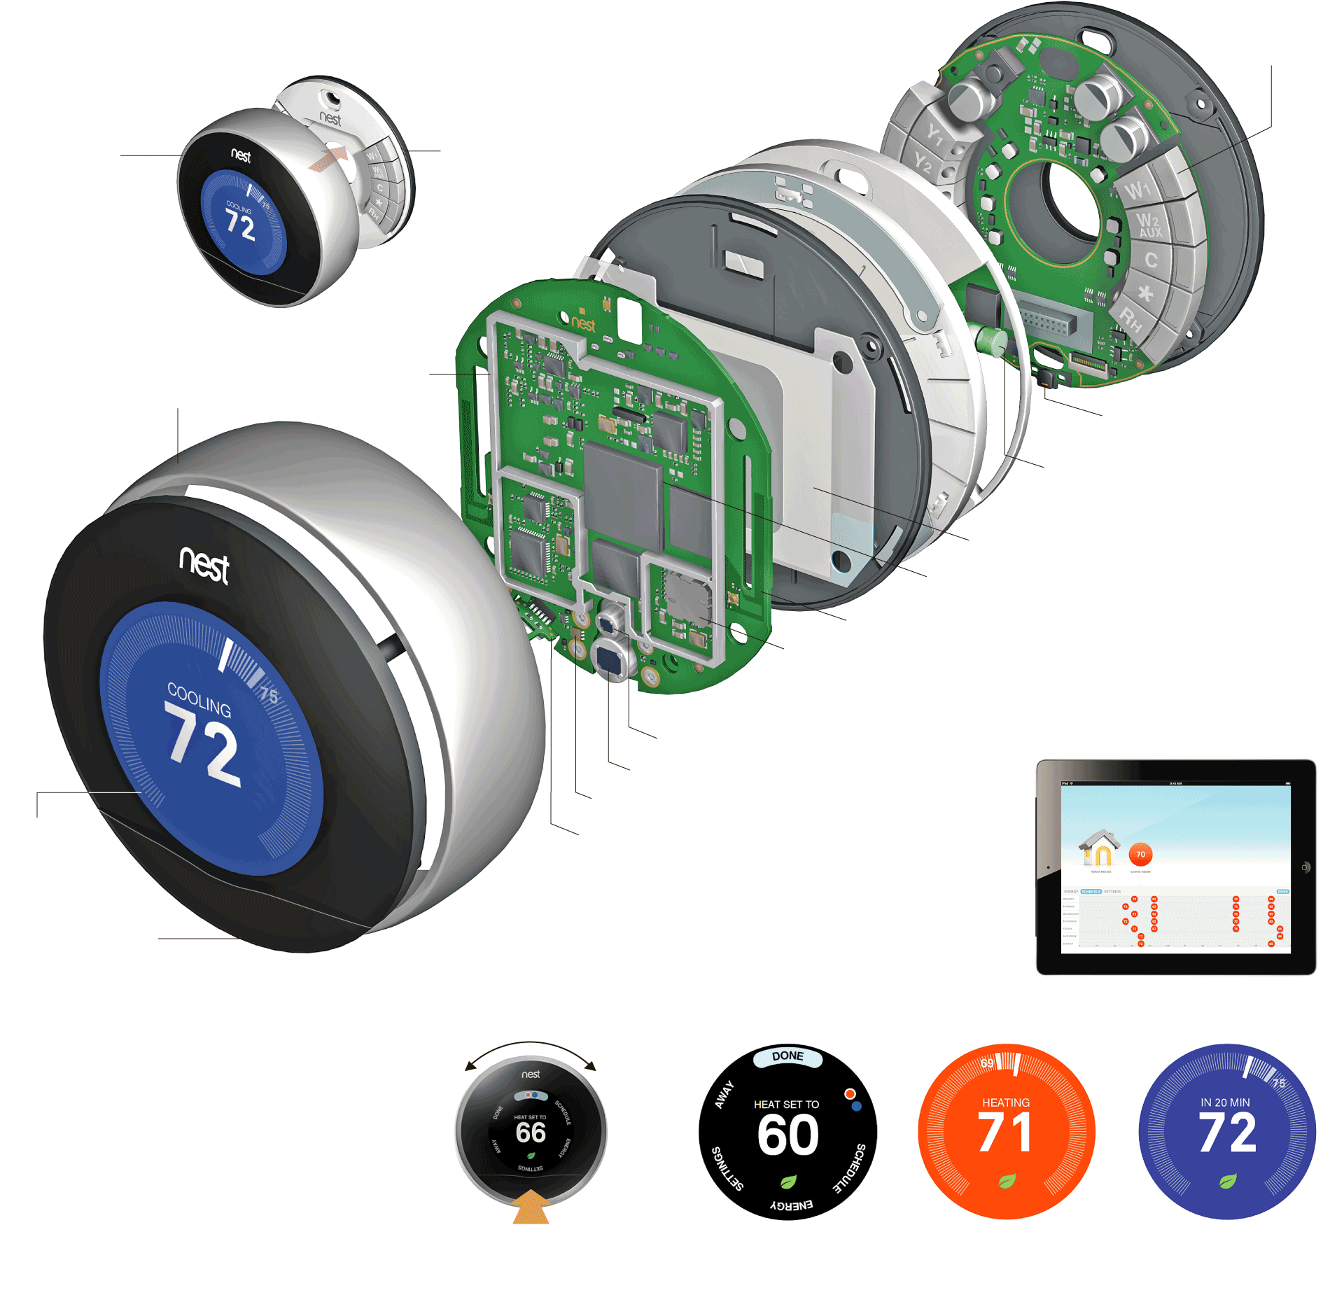
Introduction
What’s Inside

Slide 10
Introduction
Conceptual Block Diagram

Slide 11
Introduction
Block Diagram

Slide 12
Key Functions
Mechanical Causation of Insertion Sensing Signals

Slide 13
Key Functions
Accommodation of Single and Dual Transformer Installations

Slide 14
Schematic Details
Connection Sensing Mechanism
Use of auto-switching connectors for automatically selecting a source for power harvesting

Slide 15
Schematic Details
Connection Sensing Mechanism

Slide 16
Schematic Details
Power Supply - 1
“high voltage” buck converter

Slide 17
Schematic Details
Power Supply - 2
Bootstrap LDO

Slide 18
Schematic Details
Power Supply - 3
Battery LDO and charging circuitry

Slide 19
Schematic Details
Output Drive for Connection Between RC and W (or Y / G)
Most electronic thermostats accomplish this function (switching AC signals) using a relay or an (optically isolated) thyristor (triac or SCR) – why is such a complicated circuit used by the Nest Thermostat to perform essentially the same task?
Why is a transformer required?
Why is PWM used?

Slide 20
RELIABILITY & safety
FEMCA* of Power MOSFETs
Questions:
What happens if the MOSFETs heat up (even just a few degrees above ambient)?
What is the most likely cause of power MOSFET failure?
What happens if either or both MOSFETs fail open?
What happens if either or both MOSFETs fail shorted?
What is the criticality level of either of these failure modes?
*failure effects mode and criticality analysis

Slide 21
Reliability & SAFETY
Customer Complaints
I can't even begin to say how upset I am to have to title the Nest Learning Thermostat as "The Worst Thermostat EVER." For the "cool" factor and appearance it was in "A" in my book. I installed it in November 2014 and it worked like a charm... for 4 weeks. Then we came home to a house that was 80+ degrees in winter (in Buffalo no less) and found "the base unit was malfunctioning" preventing the nest from shutting off. The "overnight" Fed-Ex replacement arrived in 2 days which meant I had to manually turn on and off the furnace from the circuit breaker. The new nest worked great... for 3 weeks before it did the same thing. Another call to nest with their crazy long wait customer service stated this was a known issue and another unit would be sent... "overnight." Four (4) days later FedEx showed with my third unit in the same number of months and it worked again...well. Yesterday, after only 2 1/2 weeks from install, the Nest again malfunctioned and my phone call to their customer support agent and "senior" agent finally concluded my energy effecient Heil forced air gas furnace was "incompatable" to the nest. What?!?!? I have finally had it and went straight to Home Depot and purchased a Honeywell Smart Thermostat as a replacement. My last Honeywell thermostat lasted over 20 years and I'm just hopeful this one will last longer then the Nest's.

Slide 22
Reliability & SAFETY
Customer Complaints
“The NEST product was an interesting and fun gadget for a year and a half ... until control of it was taken away by someone during one of the coldest days of the year. As the house got colder and colder I worked through the NEST website looking for tech support to no avail. Finally Googling "NEST help" got me a contact number. During three hours of troubleshooting I found out that this thermostat was part of an energy savings program. NEST thought the thermostat was controlled by my local utility. I contract my local utility and they had no idea what I was talking about. I then went back to NEST and they still had no idea who was controlling the thermostat or how low the "Controller" whoever that was would let the temp fall. I worked with them a little longer in an attempt to opt out of this energy saving program and after three hours I told them thank you very much, but your time is up. I then replaced this thermostat with a conventional programmable thermostat. The NEST product is not ready for prime time.”
WOWWW The coldest day of the year, this is the second time NEST shut down heating system and said it wanted us to call nest service to come fix heating system. I had to reconnect old thermostat which corrected the issue. what a scam .;.; im wondering who had control of my house ???

Slide 23
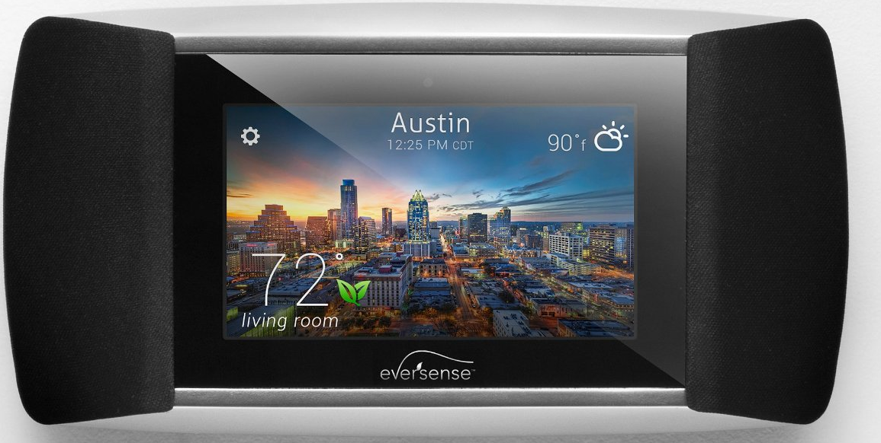
LEGAL
Patent Infringement
February 2012 - Honeywell filed a lawsuit claiming that some of its patents had been infringed by Nest (e.g., US 7,476,988 “Power Stealing Control Devices”)
May 2013 – Allure Energy filed lawsuit against Nest for newly issued patent US 8,442,695 “Auto-Adaptable Energy Management Apparatus” (filed November 2011)
Kevin Imes, president and CEO of Allure Energy, first began developing a smart thermostat in 2009, filing its patent application in 2010, to manage home temperature and energy usage. Allure Energy also developed and patented “Proximity Control Technology” that instantly adapts to a user’s daily schedule to provide automatic comfort and energy savings at home based on the distance a user may be from a residence.
“With our own capital, we created a smart and original thermostat control that also syncs music, reports local weather and offers energy tips, and filed all the required patent documentation well before Nest Labs launched its products.”

Slide 24
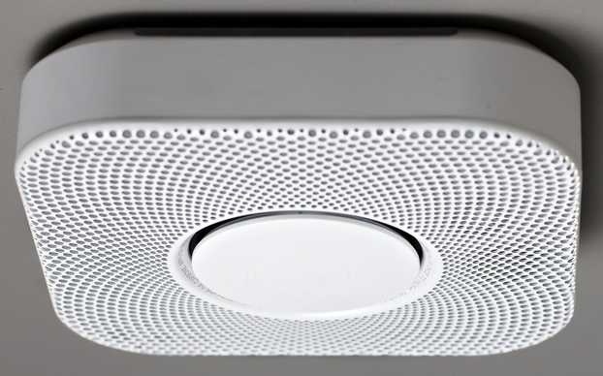
Legal
Patent Infringement
September 2013 – Nest announced patent license agreement with Intellectual Ventures, and acquired several patents (unclear how many)
November 2013 – BRK (First Alert) filed a lawsuit against Nest alleging infringement on six of its patents (e.g., location warning voice alerts)
The location warning system, BRK says, was laid out in a series of patents that cover using pre-recorded voice alerts to "describe the type of environmental condition detected or the location" of the detector that senses it. That "exclusive" technology was first used in a 2003 smoke detector, and the company says it's sold 1.8 million units with voice and location alarm systems since then.

Slide 25
Legal
Class Action Lawsuit
Claim (filed March 2014) – Faulty temperature readings actually cause an increase in energy cost, due to faceplate and base heating up by as much as 10° F
Complaint seeks $5M in damages, alleging Nest has violated warranty and consumer protection laws
“…customer reports and Defendant’s own admissions show that Nest is so defective it cannot correctly gauge ambient temperature.”

Slide 26
Ethics / Public Policy
Security of Personal Data
Energy use profiles could be collected by devices like Nest and sold by the likes of Google
No “consent clause” on use of this personal data is currently included with purchase agreement
One of the largest retail energy suppliers in North America, Direct Energy, has announced a partnership with Nest, the smart thermostat. The deal is designed to encourage adoption of Direct Energy's service as well as the smart home device in the U.S. The partnership will focus on offering incentives to customers who purchase Direct Energy utility services, an arrangement similar to the one launched in Alberta, Canada, earlier this year.
Nest's ability to penetrate the U.S. home market will likely get a boost from large scale partnerships like the one with Direct Energy, a dynamic that could make "smart homes" a more common phenomenon sooner than some might expect.

Slide 27
ETHICS / Public Policy
Security of Personal Data
Potential for abuse?

Slide 28
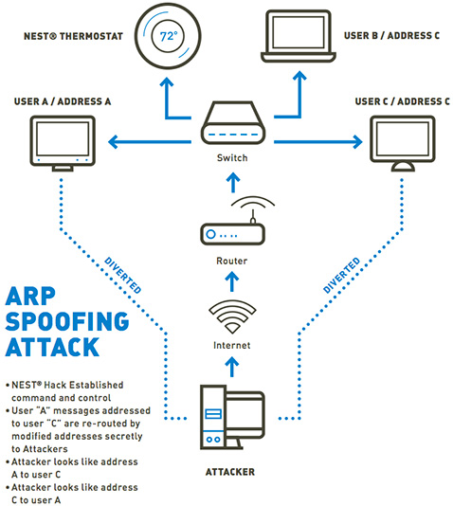
ETHICS / Public Policy
Hacking Vulnerability
TrapX confirmed the design flaws discovered in the Nest Learning Thermostat. They validated the attack vector presented at the Black Hat 2014 Conference by compromising the device and an entire home network.
"While the Nest Learning Thermostat has relatively robust security compared to most IoT devices, the attack vectors presented at Black Hat enabled our lab to completely compromise the device within our Advanced Test Bed Facility (ATBF)…"

