Slide 1
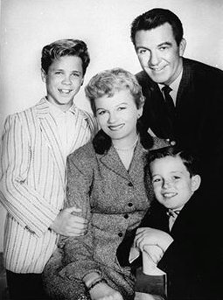
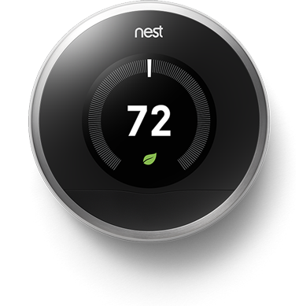
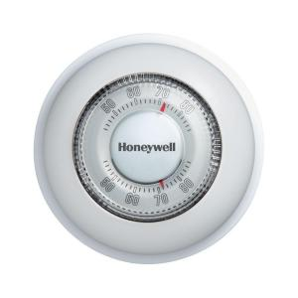

Professional Considerations in Digital System Design
Case Study: NEST LEARNING Thermostat
David G Meyer ©2020, Images Property of their Respective Owners

Slide 2
Outline – Professional Considerations in Digital System Design
Case Study: The NEST Learning Thermostat
  Company History
  How NEST Learns
  Common Thermostat Circuits
  IP Protected by Patents
  What’s Inside
  Block Diagram
  Key Functions
  Schematic Details
Professional Considerations: Case Study Applications
  Reliability & Safety
  Legal
  Environmental & Regulatory
  Ethical & Public Policy

Slide 3
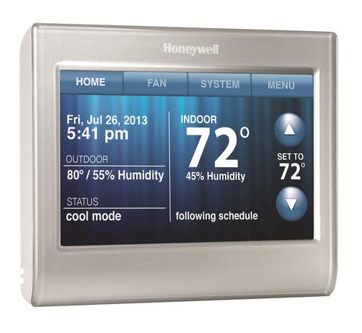
Clicker Quiz
Question 1
Indicate your “highest level” of experience with household thermostats:
  I know that 4 wires are required for the basic interface, and that the control signals operate at 24 VAC
  I have installed an electronic/smart thermostat
  I have installed a conventional/mechanical thermostat
  I understand that temperature control requires hysteresis, but have never installed a thermostat
  I only know if it’s too hot or cold, and how to adjust the thermostat accordingly

Slide 4
Background
Nest Labs Company History
Headquartered in Palo Alto, California
Designs and manufactures sensor-driven, Wi-Fi enabled, self-learning (programmable) thermostats and smoke detectors
Co-founded by former Apple engineers Tony Fadell and Matt Rogers in 2010
First product was Nest Learning Thermostat (2011), inspired by Fadell’s motivation to build a better “electronic” thermostat than those currently available
Google acquired Nest Labs for $3.2B early in 2014
Nest purchased Dropcam for $555M later in 2014
Latest products include Nest Protect (Smoke and Carbon Monoxide detector with voice alerts), Doorbell, and Lock

Slide 5
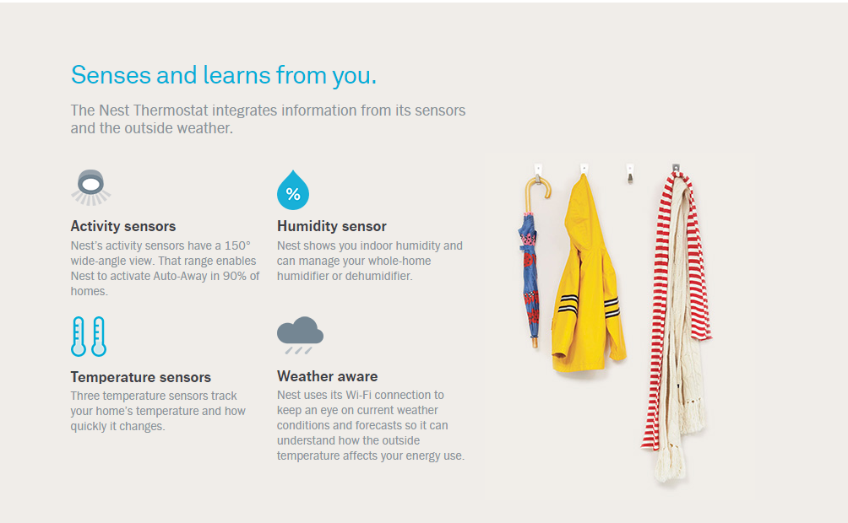
Background
How Nest Learns

Slide 6
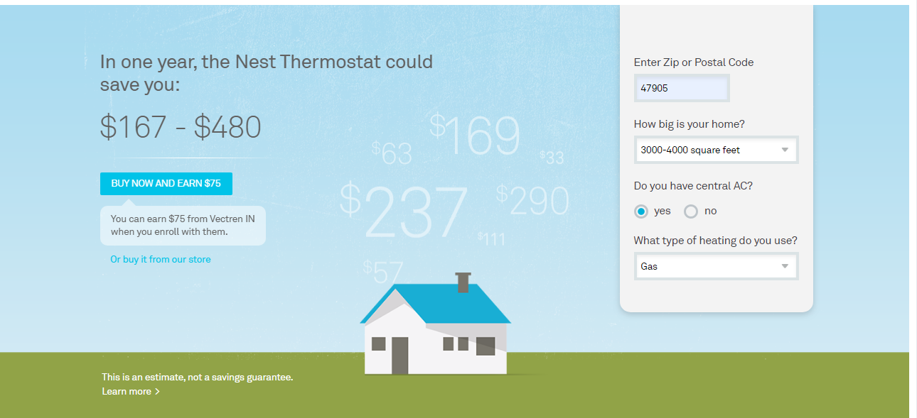
Background
Nest Learning Thermostat Energy Savings Claims

Slide 7
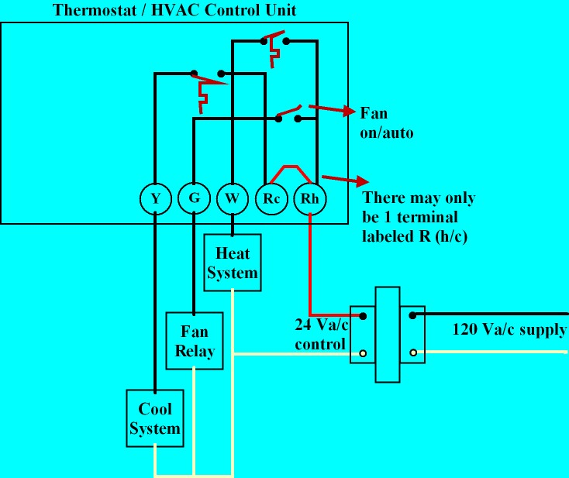
BACKGROUND
Basic 4-Wire Circuit Thermostat Circuit
Questions:
What is unknown?
What signal is (generally) not available at the thermostat?
What are implications of the need to switch 24VAC at up to 1 A?
What are implications of the unknown load impedance?
What are the implied restrictions on how an electronic thermostat can be powered?
common

Slide 8
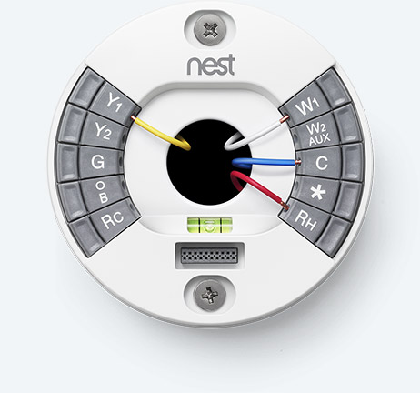
PATENTS
Ease of Installation
US Patent 8,523,083 (filed Jun. 2012, issued Sep. 2013)
THERMOSTAT WITH SELF-CONFIGURING CONNECTIONS TO FACILITATE DO-IT-YOURSELF INSTALLATION
ABSTRACT A thermostat is configured for automated compatibility with HVAC systems that are either single-HVAC-transformer systems or dual-HVAC-transformer systems. The compatibility is automated in that a manual jumper installation is not required for adaptation to either single-HVAC-transformer systems or dual-HVAC-transformer systems. The thermostat has a plurality of HVAC wire connectors including a first call relay wire connector, a first power return wire connector, a second call relay wire connector, and a second power return wire connector. The thermostat is configured such that if the first and second external wires have been inserted into the first and second power return wire connectors, respectively, then the first and second power return wire connectors are electrically isolated from each other. Otherwise, the first and second power return wire connectors are electrically shorted together.

Slide 9
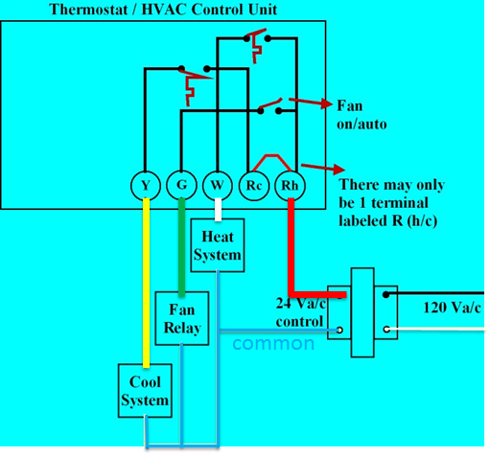
Clicker Quiz
Question 2
Contrary to the illustration from the Nest website reproduced here, the following wire connection (color) is typically not included in standard 4-wire household thermostat circuits:
  Red (R_{H} / R_{C})
  Yellow (Y)
  White (W)
  Blue (C)
  none of the above
Notes:
D – blue (there is no “common wire”)

Slide 10
Clicker Quiz
Question 2 - Answer
Contrary to the illustration from the Nest website reproduced here, the following wire connection (color) is typically not included in standard 4-wire household thermostat circuits:
  Red (R_{H} / R_{C})
  Yellow (Y)
  White (W)
  Blue (C)
  none of the above
Notes:
D – blue (there is no “common wire”)

Slide 11
Clicker Quiz
Question 3
For the thermostat wiring shown, the following HVAC function cannot be controlled from the thermostat:
  fan (air circulation) only
  dehumidification
  heating
  cooling
  none of the above
Notes:
D – blue (there is no “common wire”)

Slide 12
Clicker Quiz
Question 3 - Answer
For the thermostat wiring shown, the following HVAC function cannot be controlled from the thermostat:
  fan (air circulation) only
  dehumidification
  heating
  cooling
  none of the above
Notes:
D – blue (there is no “common wire”)

Slide 13
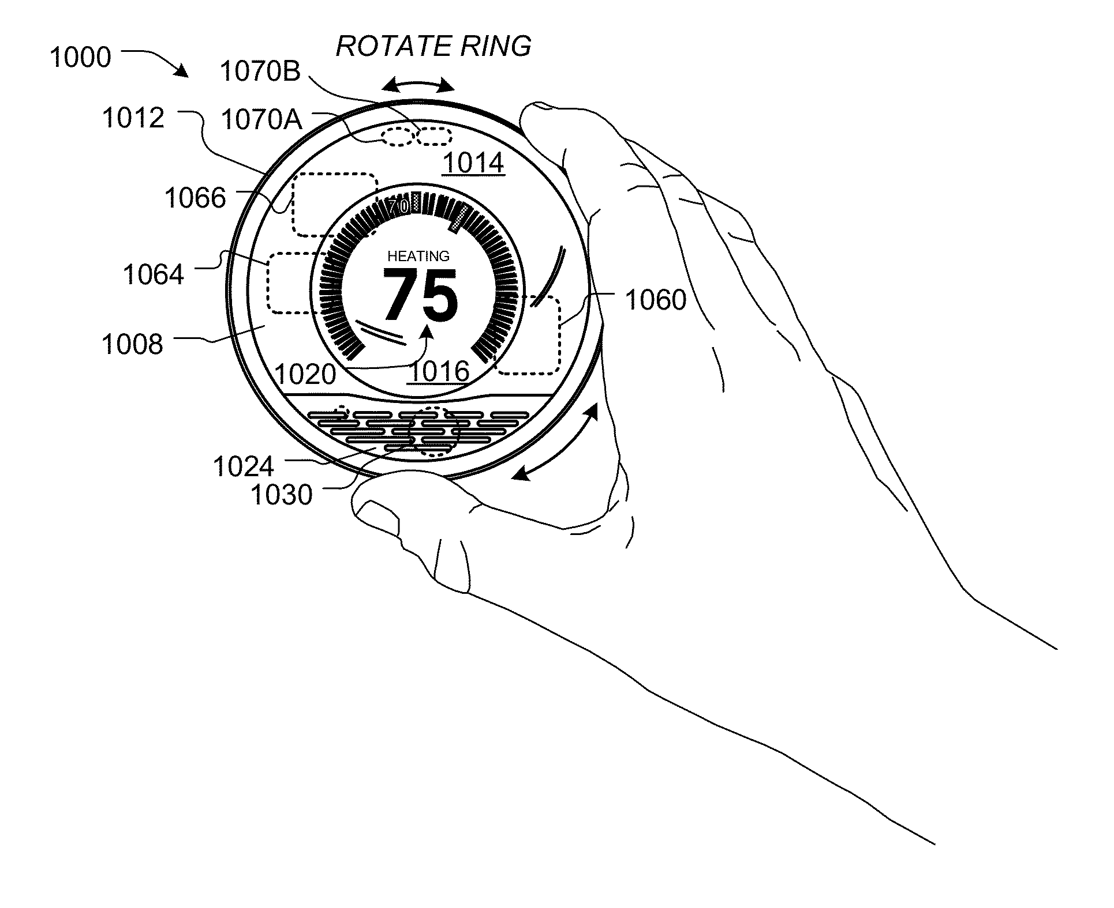
PATENTS
Event Forecasting System
US Patent 8,620,841 (filed Aug. 2012, issued Dec. 2013)
Dynamic distributed-sensor thermostat network for forecasting external events
ABSTRACT Systems and methods for forecasting events can be provided. A measurement database can store sensor measurements, each having been provided by a non-portable electronic device with a primary purpose unrelated to collecting measurements from a type of sensor that collected the measurement. A measurement set identifier can select a set of measurements. The electronic devices associated with the set of measurements can be in close geographical proximity relative to their geographical proximity to other devices. An inter-device correlator can access the set and collectively analyze the measurements. An event detector can determine whether an event occurred. An event forecaster can forecast a future event property. An alert engine can identify one or more entities to be alerted of the future event property, generate at least one alert identifying the future event property, and transmit at least one alert to the identified one or more entities.

Slide 14
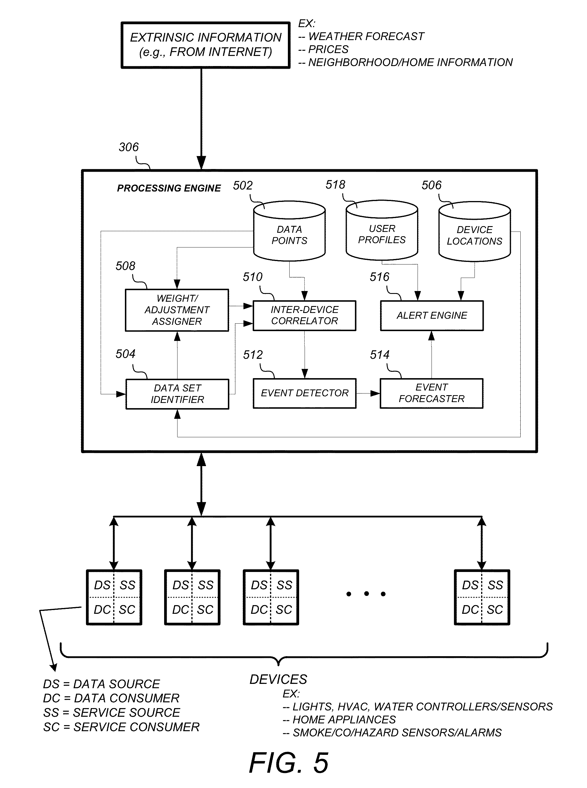
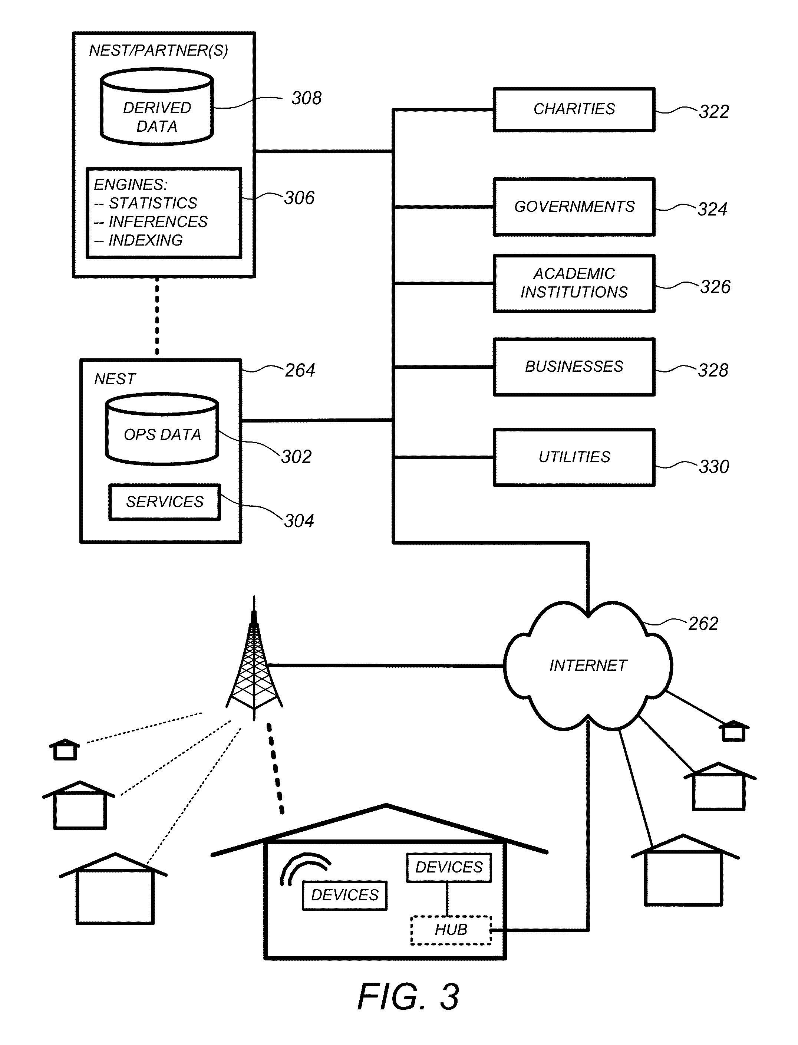
Patents
Event Forecasting System is Key Patent Claim

Slide 15
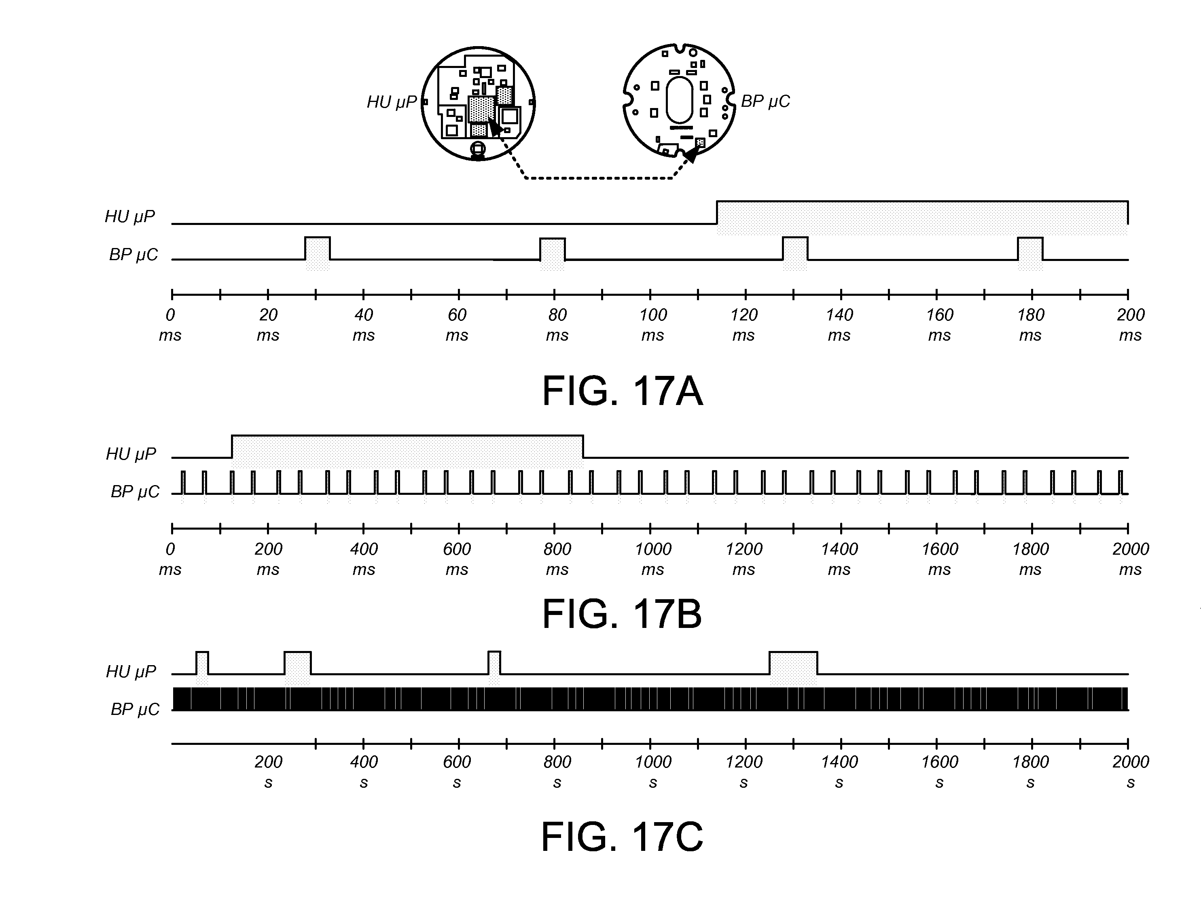
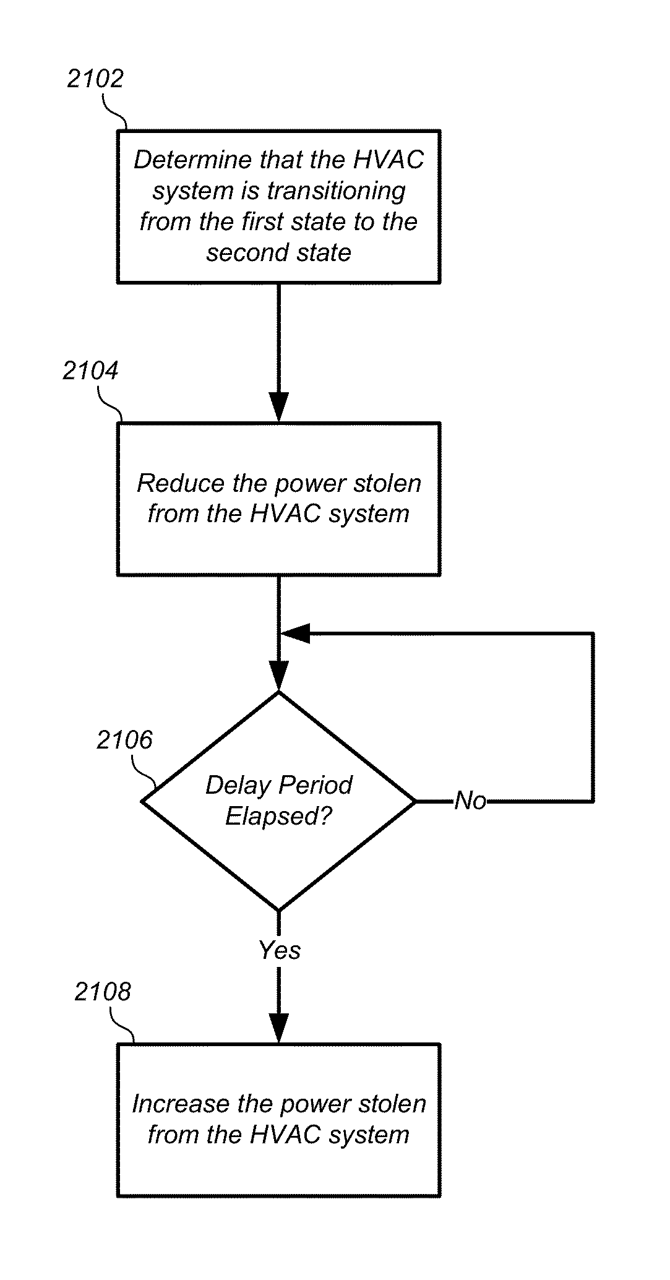
PATENTS
Advanced Energy Harvesting (“Power Stealing”) Strategy
US Patent 8,511,577 (filed Aug. 2012, issued Aug. 2013)
Thermostat with power stealing delay interval at transitions between power stealing states
ABSTRACT A thermostat includes a plurality of HVAC (heating, ventilation, and air conditioning) wire connectors including a connection to at least one call relay wire. The thermostat may also include a powering circuit, including a rechargeable battery, which is configured to provide electrical power to the thermostat by power stealing from a selected call relay wire. The power stealing may include an active power stealing mode, in which power is taken from the same selected call relay wire that is used to call for an HVAC function, and an inactive power stealing mode in which, in which no active call is being made. The powering circuit may be configured to substantially suspend (or at least reduce the level of) power stealing for at least a first time period following each transition of the thermostat from between operating states.

Slide 16
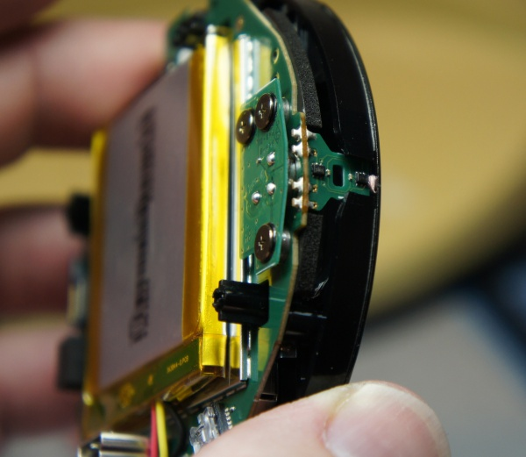
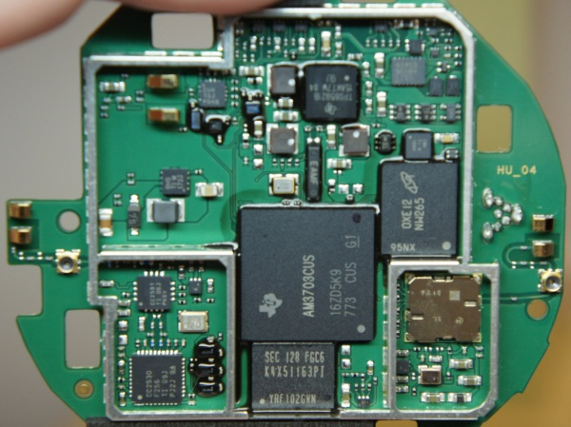
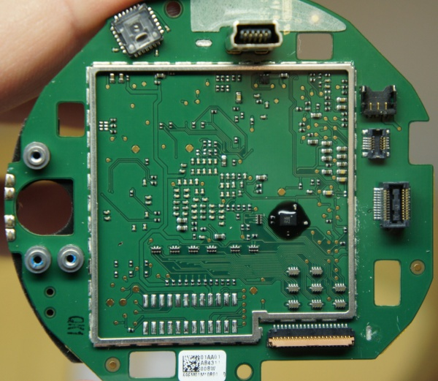
Overview
What’s Inside

Slide 17
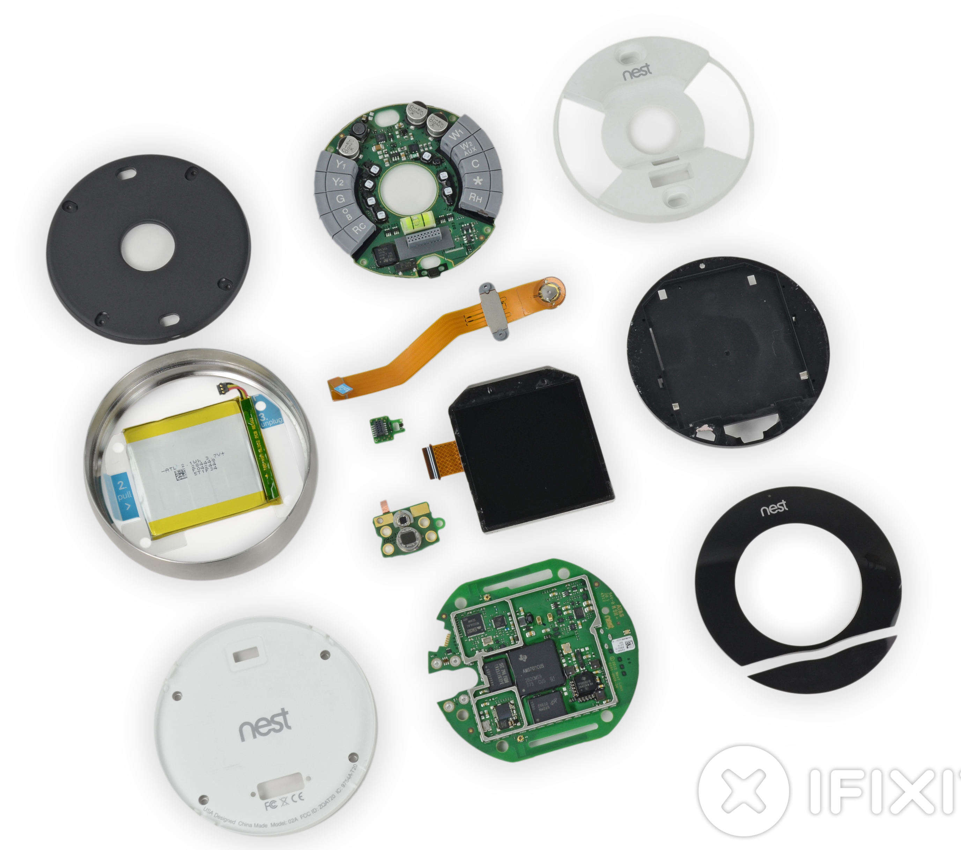
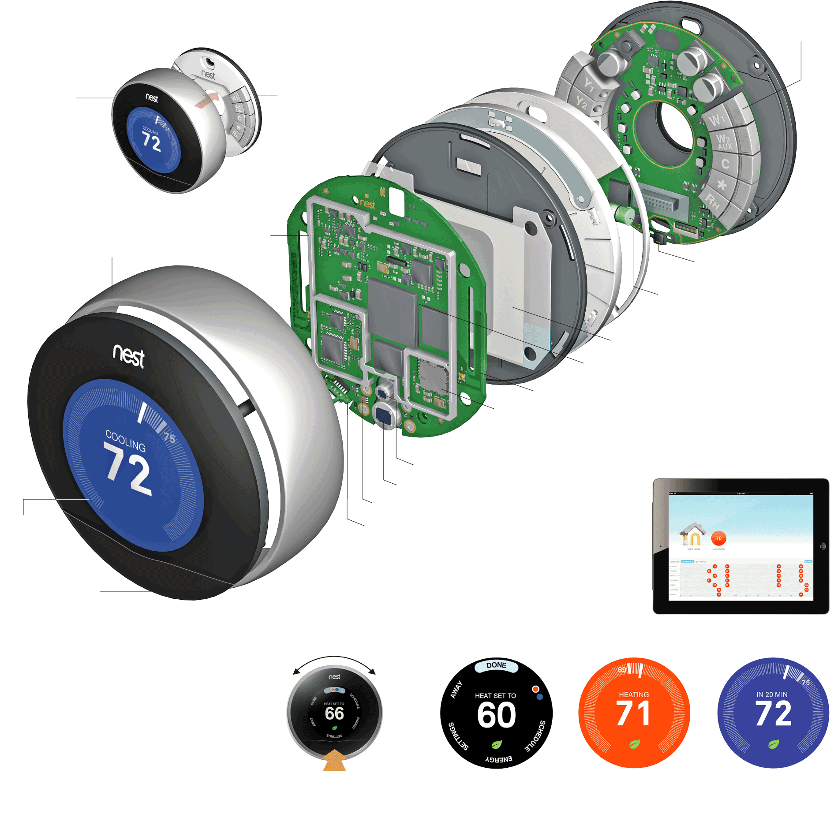
Overview
What’s Inside

Slide 18
Overview
Conceptual Block Diagram

Slide 19
Introduction
Block Diagram

Slide 20
Key Functions
Mechanical Causation of Insertion Sensing Signals
ARM Cortex-A8

Slide 21
Key Functions
Accommodation of Single and Dual Transformer Installations

Slide 22
Schematic Details
Connection Sensing Mechanism
Use of auto-switching connectors for automatically selecting a source for power harvesting

Slide 23
Schematic Details
Power Supply - 1
“high voltage” buck converter

Slide 24
Schematic Details
Power Supply - 2
Bootstrap LDO

Slide 25
Schematic Details
Power Supply - 3
Battery LDO and charging circuitry

Slide 26
Schematic Details
Output Drive for Connection Between RC and W (or Y / G)
Most electronic thermostats accomplish this function (switching 24 VAC signals) using a latching relay or an (optically isolated) thyristor (triac or SCR) – why is such a complicated circuit used by the Nest Thermostat to perform essentially the same task?
Why is a transformer required?
Why is PWM used?

Slide 27
Clicker Quiz
Question 4
Based on the preferred embodiment published in the patents, a fairly complicated circuit is used to provide essentially a “contact closure” between two terminals (like R_{C} and W₁ to control cooling). The reason given in the patent disclosure for using this circuit in place of a much simpler device (like a relay or SCR) is:
  to increase reliability
  to enable energy harvesting while the control contact is “closed”
  to enable energy harvesting while the control contact is “open”
  to eliminate the annoying “click” associated with relays
  none of the above
Notes:
D – blue (there is no “common wire”)

Slide 28
Clicker Quiz
Question 4 - Answer
Based on the preferred embodiment published in the patents, a fairly complicated circuit is used to provide essentially a “contact closure” between two terminals (like R_{C} and W₁ to control cooling). The reason given in the patent disclosure for using this circuit in place of a much simpler device (like a relay or SCR) is:
  to increase reliability
  to enable energy harvesting while the control contact is “closed”
  to enable energy harvesting while the control contact is “open”
  to eliminate the annoying “click” associated with relays
  none of the above
Notes:
D – blue (there is no “common wire”)

Slide 29
PATENTS
Advanced Energy Harvesting (“Power Stealing”) Strategy
US Patent 8,511,577 (filed Aug. 2012, issued Aug. 2013)
Thermostat with power stealing delay interval at transitions between power stealing states
ABSTRACT A thermostat includes a plurality of HVAC (heating, ventilation, and air conditioning) wire connectors including a connection to at least one call relay wire. The thermostat may also include a powering circuit, including a rechargeable battery, which is configured to provide electrical power to the thermostat by power stealing from a selected call relay wire. The power stealing may include an active power stealing mode, in which power is taken from the same selected call relay wire that is used to call for an HVAC function, and an inactive power stealing mode in which, in which no active call is being made. The powering circuit may be configured to substantially suspend (or at least reduce the level of) power stealing for at least a first time period following each transition of the thermostat from between operating states.

Slide 30
Outline – Professional Considerations in Digital System Design
Case Study: The NEST Learning Thermostat
  Company History
  How NEST Learns
  Common Thermostat Circuits
  IP Protected by Patents
  What’s Inside
  Block Diagram
  Key Functions
  Schematic Details
Professional Considerations: Case Study Applications
  Reliability & Safety
  Legal
  Environmental & Regulatory
  Ethics & Public Policy

Slide 31
RELIABILITY & safety
FEMCA* of Power MOSFETs
Questions:
What happens if the MOSFETs heat up (even just a few degrees above ambient)?
What is the most likely cause of power MOSFET failure?
What happens if either or both MOSFETs fail open?
What happens if either or both MOSFETs fail shorted?
What is the criticality level of either of these failure modes?
*failure effects mode and criticality analysis

Slide 32
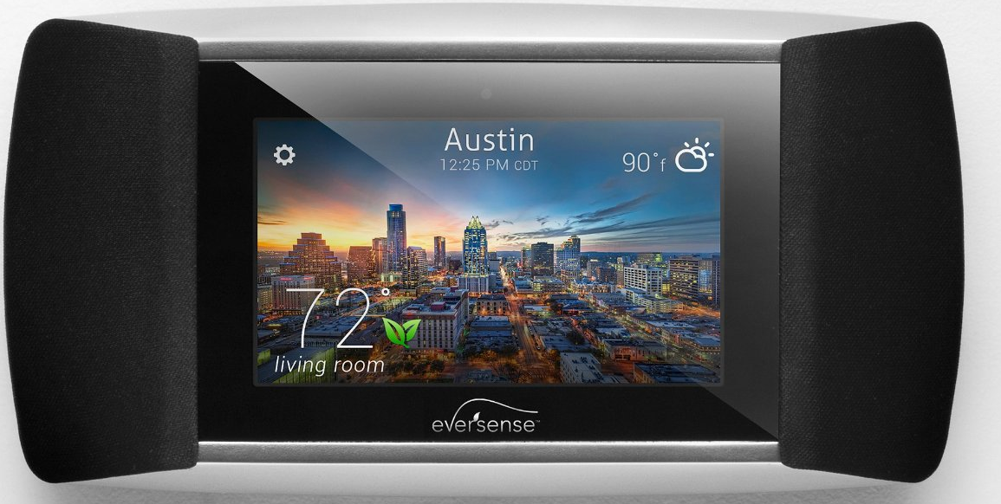
LEGAL
Patent Infringement
February 2012 - Honeywell filed a lawsuit claiming that some of its patents had been infringed by Nest (e.g., US 7,476,988 “Power Stealing Control Devices”)
May 2013 – Allure Energy filed lawsuit against Nest for newly issued patent US 8,442,695 “Auto-Adaptable Energy Management Apparatus” (filed November 2011)
Kevin Imes, president and CEO of Allure Energy, first began developing a smart thermostat in 2009, filing its patent application in 2010, to manage home temperature and energy usage. Allure Energy also developed and patented “Proximity Control Technology” that instantly adapts to a user’s daily schedule to provide automatic comfort and energy savings at home based on the distance a user may be from a residence.
“With our own capital, we created a smart and original thermostat control that also syncs music, reports local weather and offers energy tips, and filed all the required patent documentation well before Nest Labs launched its products.”

Slide 33
Environmental & Regulatory
Nest Learning Thermostat Energy Savings Claims
Homes using Vectren natural gas or Vectren electric as the primary heat source are eligible for this rebate. Dual fuel systems are not eligible.
Rebate available for existing homes only; new construction is not eligible.
"Smart" thermostat: Must be Wi-Fi capable and connected to the home. Must be ENERGY STAR certified as "Smart." Limit of two thermostats per home ("Wi-Fi" and/or "Smart").
Wi-Fi enabled thermostat: The product must be Wi-Fi capable and connected to the internet for programming and adjusting remotely. Limit of two Wi-Fi enabled thermostats per home ("Wi-Fi" and/or "Smart").

Slide 34
ETHICS & Public Policy
Security of Personal Data
Energy use profiles could be collected by devices like Nest and sold by data mining companies such as Google
No “consent clause” on use of this personal data is currently included with purchase agreement
Potential for abuse?

