Slide 1
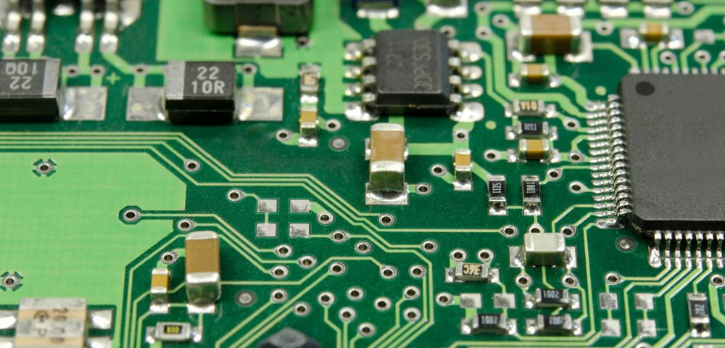
Hardware Design Techniques George Hadley ©2017, Images Property of their Respective Owners.
Notes:
Cover Image Source: http://images.wisegeek.com/circuit-board.jpg

Slide 2
Outline
IC Support Techniques (Clocks, Reset, Decoupling Caps)
Mechanical Considerations
Electromagnetic Interference (EMI)
Debugging and Verification Techniques
Other hardware techniques

Slide 3
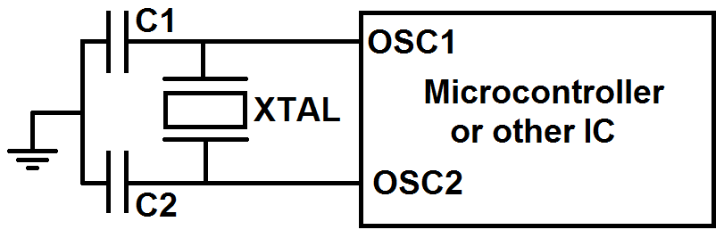
IC Support Techniques
Oscillator Circuits
Oscillators provide the clocking signal to digital ICs which allow them to function (i.e. VERY IMPORTANT)
Leave the area beneath and immediately around clock circuits free of graces and components (reduces EMI)
Clocks should be placed as close to ICs as possible
Clock traces should be as close to equal length as possible
Notes:
Oscillator Circuit Image Source: self-created.

Slide 4
IC Support Techniques
Support Capacitors Capacitors
Digital logic necessitates the switching of a circuit between high (energized) and low states quickly. To energize quickly, transistors in digital circuits require access to a small amount of on-demand current
Decoupling Capacitors: Small capacitors placed physically near digital ICs to provide internal transistors with an instantaneous source of current during switching (serve as “low pass filter” against high-frequency transient power events)
Bulk Capacitors: Larger capacitors placed on a circuit board to reliably supply power to decoupling capacitors in the face of power fluctuations (effectively “recharge” the decoupling capacitors)

Slide 5
IC Support Techniques
Support Capacitor Guidelines
Capacitance value:
Decoupling capacitors: 100nF – 1µF typical (large enough to store charge but small enough to react quickly), serve as “instantaneous” source of current to help minimize rise time of output signals
Bulk capacitors: Size not critical, 10uF – 100uF common (purpose is to recharge decoupling capacitors)
Physical placement:
Decoupling capacitors: Place as physically close to IC as possible. Common to place underneath (opposite side of board) from the IC
Bulk capacitor: Placement generally not critical

Slide 6
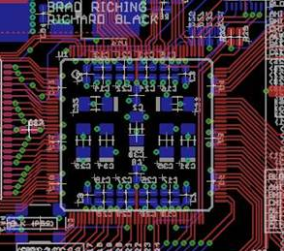
IC Support Techniques
Support Capacitor Placement
Notes:
Capacitor Placement Image Source: http://phdl.sourceforge.net/2.1/examples/images/ptzlanc/layout.jpg

Slide 7
IC Support Techniques
Reset Circuits
Microcontrollers and other ICs generally must be reset to a known state prior to actions such as programming, and a reset switch is a useful inclusion in nearly all digital circuits
Failure to properly handle device reset logic may result in spurious resets, failure to program the device, and unpredictable device behavior
Reset lines are generally active low, and pulled high during normal device operation

Slide 8
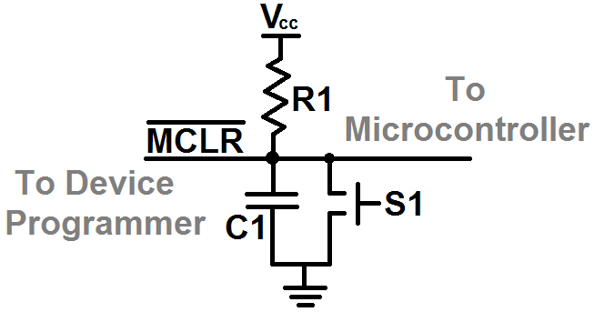
IC Support Techniques
Reset Circuit Example
Example microcontroller reset circuit
R1 should be chosen to pull reset line high (10kΩ typical)
C1 decouples reset line from high-frequency transient events
S1 reset switch; use of a tactile switch is recommended
Notes:
Reset Circuit Image Source: self-created

Slide 9
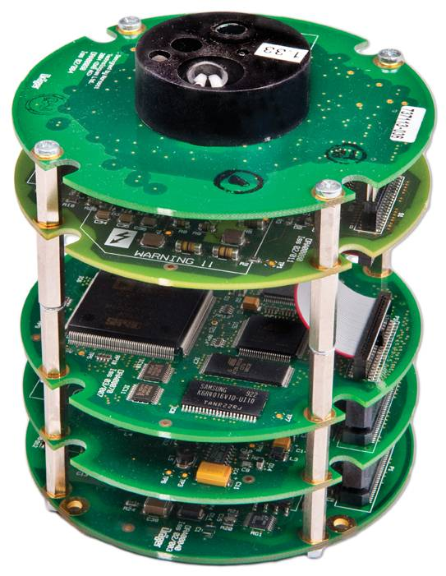
Mechanical Considerations
Space Conflicts and Accessibility
2D layout packages (such as Eagle) can sometimes miss important considerations in the Z-axis
Consider:
If 2+ boards are stacked, what will you be able to access in the covered area? (Answer: nothing)
How will your board fit into your packaging when you consider the height of “tall” components such as connectors and capacitors?
Notes:
Circuit Board Stack Image Source: http://britonems.co.uk/Portals/0/Content%20Images/Circular%20stack%20detector%20board%20-%202%20%5BSJF_0850%5D%20-%201994px.jpg

Slide 10
Mechanical Considerations
Space Conflicts and Accessibility Solutions
A few techniques to deal with space conflicts and accessibility:
When performing board layouts, ask yourself “How will this component work in 3 dimensional space? What could it run into?”
In 2D layout packages, include the X/Y dimensions of every component in the documentation (or other) layer. (For example, include the dimensions of a breakout board rather than a simple pin header to access it)
Use a 3D tool such as Eagle3D to generate a three dimensional model of your board to spot check for issues

Slide 11
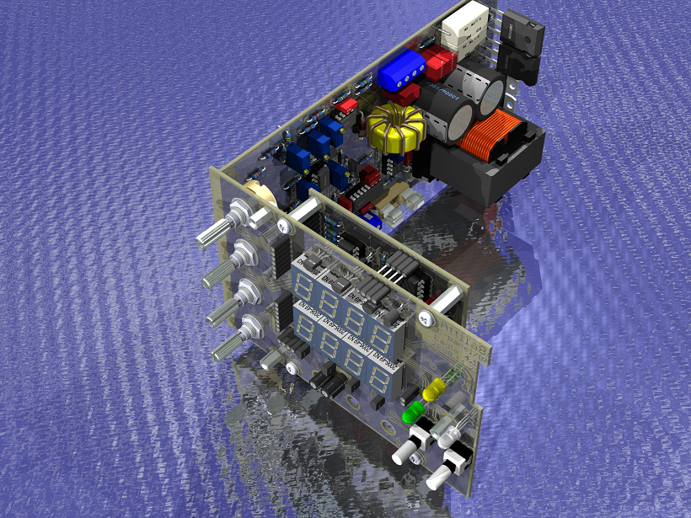
Mechanical Considerations
Space Conflicts and Accessibility Solutions
Example Eagle3D Output:
Notes:
Eagle3D Image Source: http://www.mikrocontroller.net/attachment/61523/SMPS_Labortap_III_Eagle3D.jpg

Slide 12
Mechanical Considerations
Connectors and Standoffs
Standoffs: Most circuit boards should include 3+ mounting holes to allow the board to be securely fastened to its project packaging
Surrounding mounting hole connections with grounded vias is a common practice for emissions and mechanical stability
Connectors: Place connectors and other user I/O (such as SD card slots or buttons/switches) on the edges of the board to enable easy access
Adding isolation and current limiting to offboard connections are common practices

Slide 13
Electromagnetic Interference
Motivating Question
Circuit boards often involve traces in close proximity to each other and switching digital waveforms
Q1: If noise is present on a conductor, what will the current/voltage characteristics be of any connected conductors?
Q2: What does the frequency response of a pulse function look like?
Q3: If two wires are placed close together and current flows through one of them, what will happen to the current/voltage of the second wire?
Notes:
Electromagnetic Coupling Image Source:
Square Wave Image Source:

Slide 14
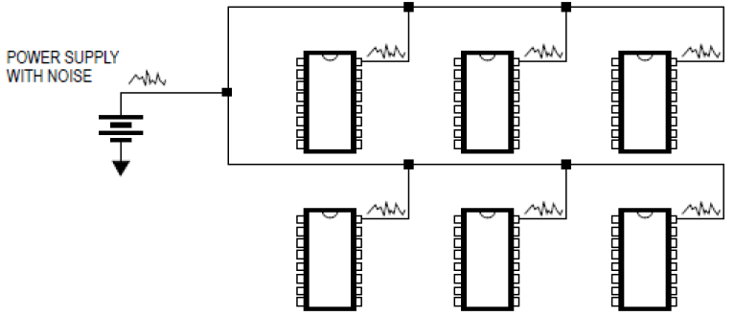
Electromagnetic Interference
Electromagnetic Interference
A1: Noise on a conductor will propagate to any shared conductors
Notes:
Conductor Coupling Image Source: obtained from previous lecture version by David Meyer

Slide 15
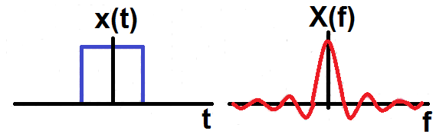
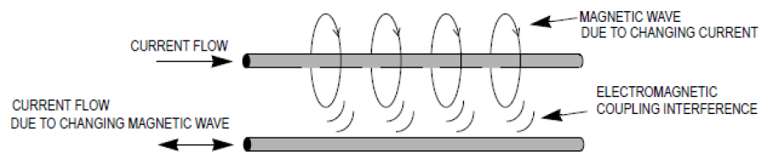
Electromagnetic Interference
Electromagnetic Interference
A2: Frequency content of a pulse function = wideband noise
A3: When wires are placed close together, electromagnetic coupling can occur
Notes:
Electromagnetic Coupling Image Source: obtained from previous lecture version by David Meyer
Square Wave Image Source: Self created

Slide 16
Electromagnetic Interference
Design for Electromagnetic Compatibility (EMC)
A circuit is electrically compatible if it does not affect or become affected by its environment
Remedies:
Decrease emissions – can be suppressed at the source through proper system design
Shielding – protect sensitive areas of the circuit from emissions
Increase noise immunity – susceptibility to noise can be decreased by “hardening” the circuit’s design

Slide 17
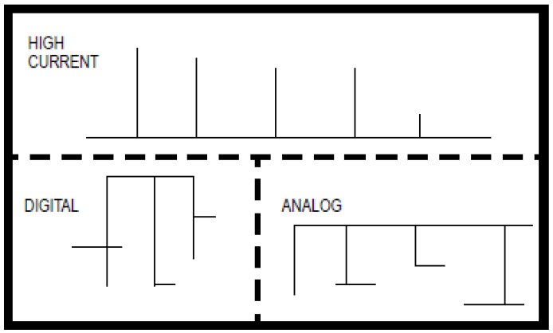
Electromagnetic Interference
Design for Electromagnetic Compatibility (EMC)
Separation of circuits on a PCB
Where possible, separate out circuits by function or type, and minimize interactions between subsystems:
Notes:
Circuit Separation Image Source: Obtained from previous lecture by David Meyer

Slide 18
Electromagnetic Interference
Design for Electromagnetic Compatibility (EMC)
Perpendicular Routing:
In spots where analog and digital lines must be routed through the same area of the board, routing them perpendicular to one another will help to minimize cross coupling
Ground plane shielding
Surrounding sensitive traces with a ground plane can help minimize noise introduction into the trace through other noise sources

Slide 19
Electromagnetic Interference
Design for Electromagnetic Compatibility (EMC)
Analog and Digital Grounding:
Generally, analog and digital circuits should be given separate analog ground (AGND) and digital grounds (GND). These circuits can then be joined together at a finite number of points.
Access to the analog ground can be controlled through the use of through-hole jumpers or solder bridges (sometimes referred to as a “0Ω” resistor)

Slide 20
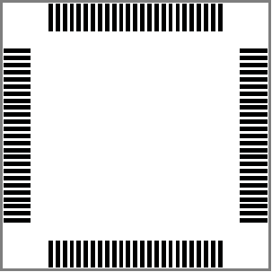
Debugging and Verification
Chip Polarity
IC packages usually involve some degree of rotational symmetry. In the footprint to the right, which pin is pin 1?
For every device that involves a specific polarity (diodes, LEDs, ICs, connectors, etc.) pin 1 should be clearly marked in a way that is easy to determine
Markings for device polarity should be visible even after components are soldered, for ease of debugging and verification (if pin marking is under an IC, then the IC will cover it up and slow down debugging later)
Notes:
Chip Polarity Image Source: http://www.electronicstefan.ro/wp-content/uploads/2013/01/footprint-PIC24FJ256DA210.png

Slide 21
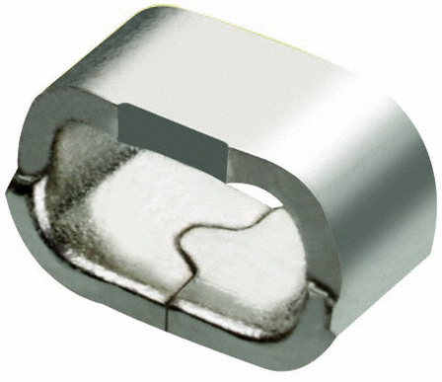
Debugging and Verification
Breakout Pins, Test Points, and LEDs
Hardware can be incorporated into designs to greatly improve the ease with which a project can be debugged
Breakout pins: Provide access to signals, debugging interfaces, and future functionality not yet in design
Test Points: Vias, pads, or other parts to provide access to signals with measurement tools
Debugging LEDs: Can be used to indicate code execution has reached a certain state in the code, indicate power is applied to the board (power led) and indicate the device is alive and executing (heartbeat LED)
Notes:
Test Point Image Source: http://media.digikey.com/Photos/Harwin/MFG_S1751-46R.jpg

Slide 22
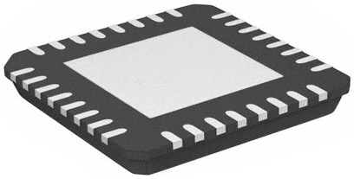
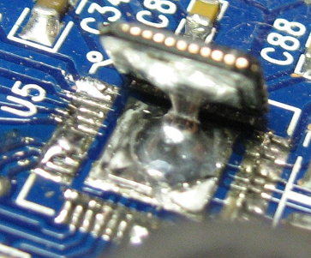
Other Hardware Techniques
Under Chip Pads
Some ICs feature exposed (under chip) pads on the bottom of the package for thermal, mechanical, or electrical reasons
Accessing these pads for soldering purposes generally requires the use of reflow soldering techniques
A workaround for hand soldering is to place vias with large diameter holes into the exposed chip pads. The holes must be large enough to allow the tip of a soldering iron to pass through, enabling the part to be soldered.
Notes:
Under Chip Pad Image Source: http://dangerousprototypes.com/wp-content/media/2012/05/32-VQFN-Exposed-Pad-RUZ.jpg
Exposed Pad Soldering Image Source: http://cdn.instructables.com/FRI/8ZCY/G0AMJFIT/FRI8ZCYG0AMJFIT.LARGE.jpg

Slide 23


Rock-Paper-Clippy
Clicker Quiz
Notes:
Image source: http://www.snorgtees.com/mexican-standoff

Slide 24
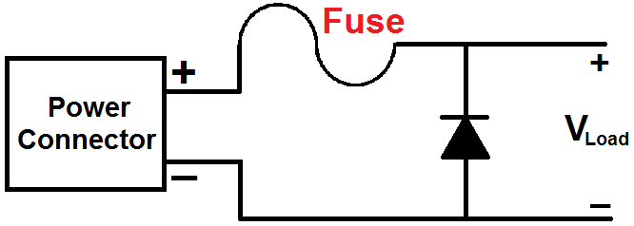
Question 1
The “helpful circuit” shown below can help protect your PCB (V_{LOAD}) against:
reverse polarity
excessive input voltage
excessive input current
being annoyed by Clippy
none of the above
?
Notes:
A

Slide 25
Question 2
A technique that can be used to minimize cross coupling between signals on a PCB:
decoupling capacitors
decoupling inductors
perpendicular trace routing
parallel trace routing
none of the above
Notes:
C

Slide 26
Question 3
The main reason decoupling capacitors should be placed physically close to the IC power/ground pins (i.e., using PCB traces that are as short as possible) is:
long PCB traces act like a distributed inductance that compromises the decoupling capacitor’s ability to provide a high-frequency source of instantaneous current
long PCB traces act like a distributed capacitance that effectively makes the decoupling capacitor’s value “too large” to effectively provide a high-frequency source of instantaneous current
long PCB traces effectively make the equivalent series resistance (ESR) of the decoupling capacitor too large to operate effectively
this is just “fake news” – it really doesn’t matter where the decoupling capacitors are located or how long the traces are!
none of the above
Notes:
A

Slide 27
Question 4
For the microcontroller reset circuit illustrated below, the purpose of C1 is to:
keep the microcontroller from resetting too quickly
help suppress high frequency noise on the MCLR input of the microcontroller
help reduce the rise time of the MCLR signal
help reduce the fall time of the MCLR signal
none of the above
HINT: C1 is typically 0.1 µF and R1 is 10 KΩ
Notes:
B

Slide 28
Question 5
The device illustrated below can be used for:
providing access to signals for measurement tools
reducing the noise emissions of signal cables
providing a strain relief for signal cables
sinking heat from semiconductor devices
none of the above
?
Notes:
A

Slide 29
Question 6
Reason(s) for providing exposed (under chip) pads on the bottom of the package include:
thermal
mechanical
electrical
all of the above
none of the above
Notes:
A

