Slide 1
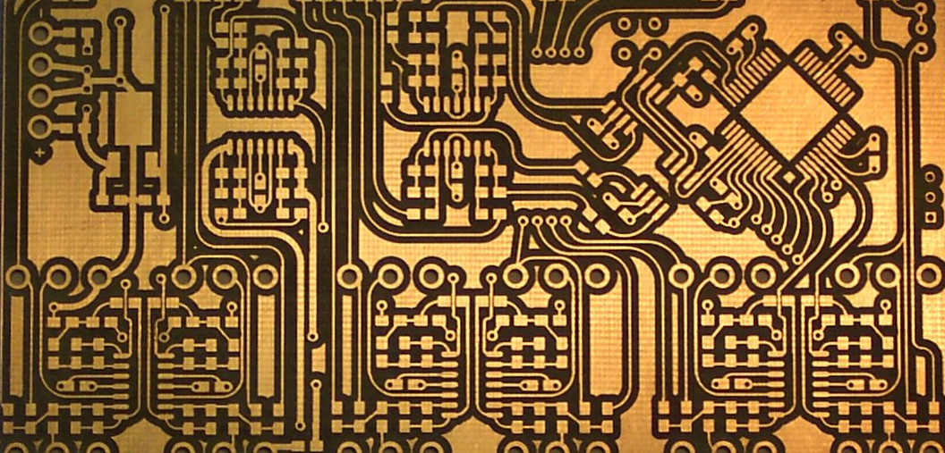
Hardware Design
Fundamentals
George Hadley ©2017, Images Property of their Respective Owners.
Notes:
PCB Cover Image Source:

Slide 2
Outline
PCB Design Objective
PCB Manufacturing Process
Design Automation Tools
The Design Process
Parts
Schematics
Layouts
DRC and Toolfile Generation
Ordering Circuit Boards
Miscellaneous PCB Topics

Slide 3
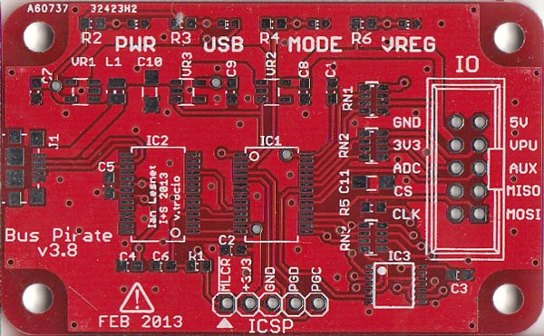
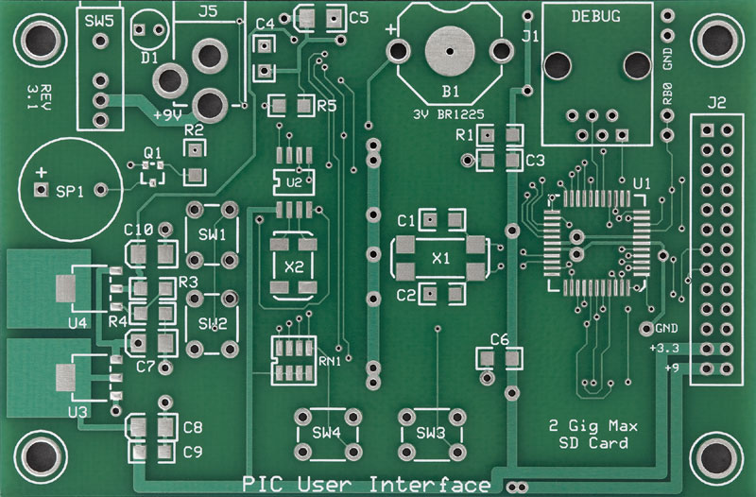
Objective
Q: What’s the “goal” of the hardware design process?
A: Well-designed circuit boards that connect electrical components while meeting electrical requirements (signal integrity, power, etc.)
Notes:
Bus Pirate Image Source: http://dangerousprototypes.com/wp-content/media/2014/11/buspiratev383.jpg
PIC User Interface Image Source: http://www.expresspcb.com/GSpecs/PhotoMiniBoardProPCB_800.jpg

Slide 4
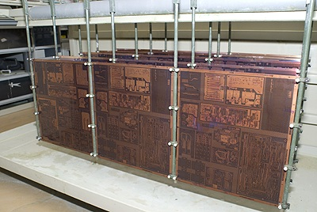
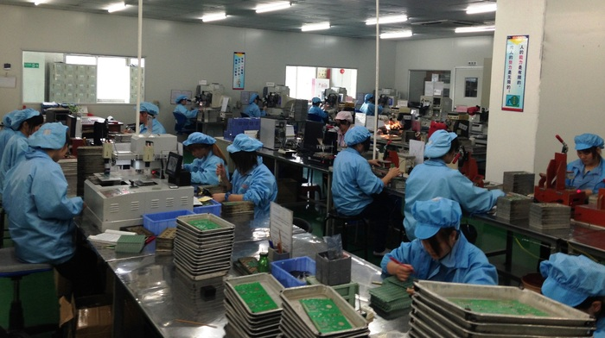
PCB Manufacturing Process
Overview
The printed circuit board (PCB) manufacturing process contains a number of steps:
Base Materials
Etching
Hole/via Drilling
Through-hole plating
Solder mask application
Silkscreen application
Electrical testing
Notes:
PCB Factory Image Source: https://s3.amazonaws.com/ksr/assets/001/896/068/01f95acc03dffb2222aa32097343ed16_large.JPG?1397825946
PCB Manufacturing Process Image Source: http://www.adafruit.com/blog/wp-content/uploads/2009/10/pp-pcb-pool-tag2-185-gross.jpg

Slide 5
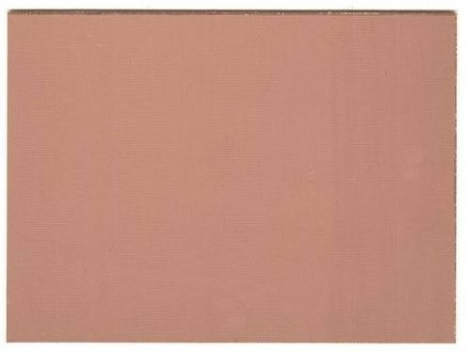
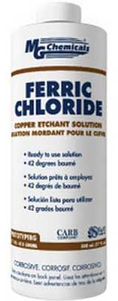
PCB Manufacturing Process
Base Materials
To make a (simple) circuit board, require:
PCB Blank: Substrate board (typically FR4) with copper laminated on both sides
Resist: A material which protects the copper on the board from the etchant
Etchant: A chemical solution used to dissolve copper on the circuit board
Notes:
Blank PCB Image Source: http://www.homediystuff.com/wp-content/uploads/2013/02/PCB-blank1.jpg
PCB Etchant Image Source: http://www.ace4parts.com/images/products/415-500ML.jpg

Slide 6
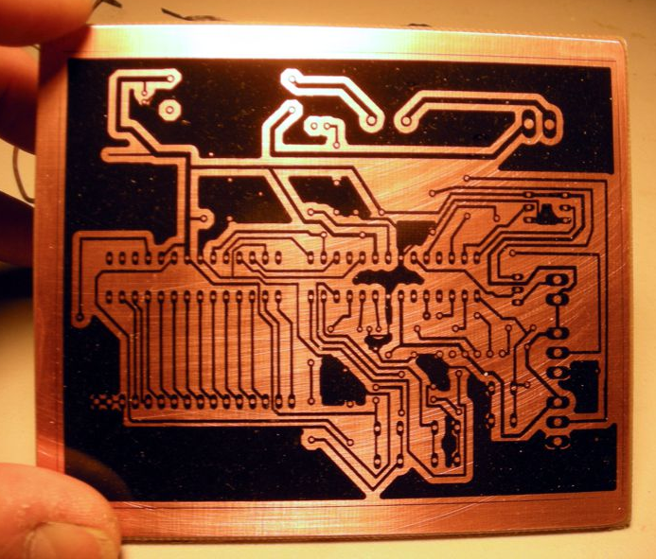
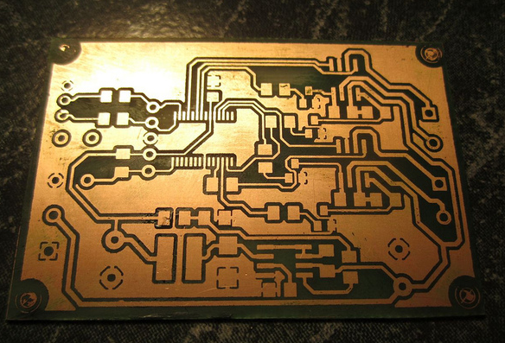
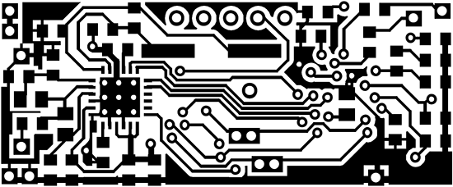
PCB Manufacturing Process
Etching
Resist is applied to the PCB in form of circuit mask (black regions indicate electrical signals/copper)
PCB is then immersed in etchant solution and allowed to sit. Etchant eats away areas of board not protected by resist.
Notes:
PCB Mask Image Source: https://www.keelog.com/images/wireless_keylogger_pcb_bottom2_big.gif
PCB w/ Mask Image Source: http://i61.photobucket.com/albums/h50/scottyjr/Electronics/PCB2_zps981d7d35.jpg
Etched PCB Image Source: http://thingiverse-production.s3.amazonaws.com/renders/9d/e7/c4/46/42/5660546690_d2af415c5b_b_display_large_preview_featured.jpg

Slide 7
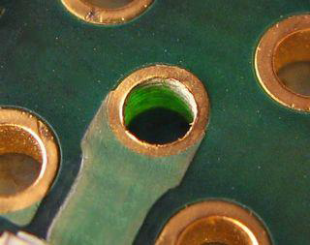
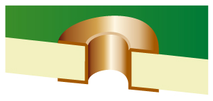
PCB Manufacturing Process
Drilling/Plating
A drill with fine-diameter bits is used for drilling holes
Holes used to connect signals between layers of the board are known as vias (also used for heat transfer)
To ensure electrical connection is made (even if drill isn’t precise), vias possess ring of copper known as an annular ring
Once drilled, vias
are electroplated
to ensure
conductive path
between board
layers
Notes:
Annular Ring Image Source: http://screamingcircuits.typepad.com/.a/6a00d8341c008a53ef0112790a20c828a4-popup
Plated Through Hole Image Source: http://www.priken.co.jp/site/img/substrate05.jpg

Slide 8
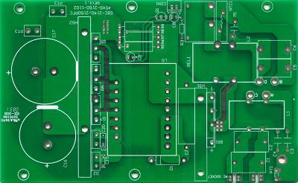
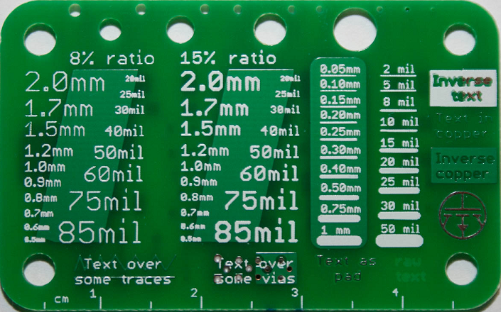
PCB Manufacturing Process
Soldermask/Silkscreen
Soldermask: Overlay material on PCB used to protect metal from corrosion, mitigate short circuits, and ease soldering (applied as a liquid, then cured with UV)
Several soldermask colors available, though green generally most common
Silkscreen: Layer printed on surface to assist with assembly, usage instructions, and other board information
Notes:
Soldermask Image Source: http://i01.i.aliimg.com/wsphoto/v1/2008196873_1/-font-b-Circuit-b-font-font-b-board-b-font-fpc-font-b-circuit-b.jpg
Silkscreen Image Source: http://www.justgeek.de/wp-content/uploads/2013/04/IMG_8514.jpg

Slide 9
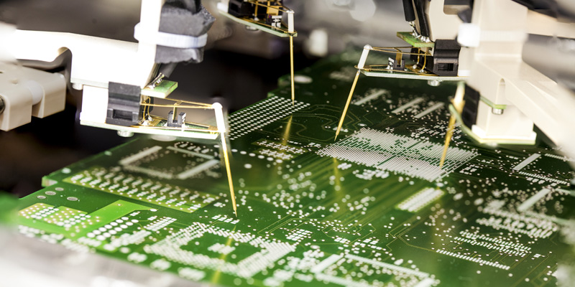
PCB Manufacturing Process
Electrical Testing
Once finished, boards are subjected to electrical tests to ensure electrical connectivity across boards and that the boards were manufactured correctly
In spite of such tests, students should carefully visually inspect boards upon reception to check for defects
Notes:
Electrical Testing Image Source: http://www.haeusermann.at/sites/default/files/styles/content_image_lightbox/public/articleimages/elektrical_test_pcb.png

Slide 10
Design Automation Tools
List of EDA Tool Suites
Many Electronic Design Automation (EDA) tool suites are available for circuit board design and simulation, such as:
Eagle: Easy-to-use, easy to learn, large hobbyist community http://www.cadsoftusa.com/
Altium: Simulation and advanced features, more professional, expensive http://www.altium.com/
KiCAD: Unrestricted free and open source software, used by CERN http://www.kicad-pcb.org/
OrCAD, Allegro, PADS, etc.: Other proprietary suites used in industry

Slide 11
The Design Process
Parts
In EDA suites such as Eagle, a part is an object which represents an electronic component used in a circuit board. Parts form associations between various views:
Symbol: A schematic representation of the component, featuring pins and pin names
Footprint: A PCB layout representation of the component, featuring dimensions on board, as well as various layers (copper, silkscreen, documentation, etc.) used in the final PCB
Part libraries are available in Eagle and online, or users can create their own parts (see tutorial)

Slide 12
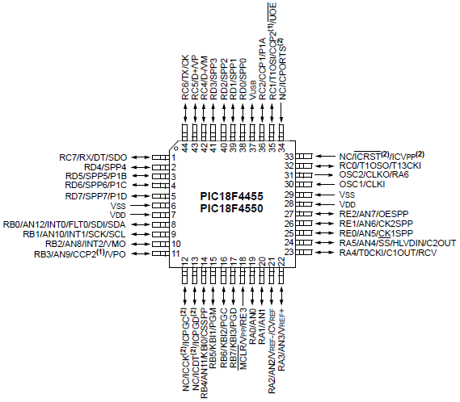
The Design Process
Parts – Tips and Tricks
Many ICs (especially microcontrollers) multiplex many functions onto each pin. Choose only those functions called for in your application to avoid schematic clutter
Many ICs have multiple pins which have the same name (VCC, GND, NC, etc.). Use
<Name>@n (n=1, 2, 3…) to
have pins with unique names
which display the same in
schematic view (Eagle only)
Notes:
Multiplexed Pin Functionality Image Source: http://ww1.microchip.com/downloads/en/DeviceDoc/39632e.pdf

Slide 13
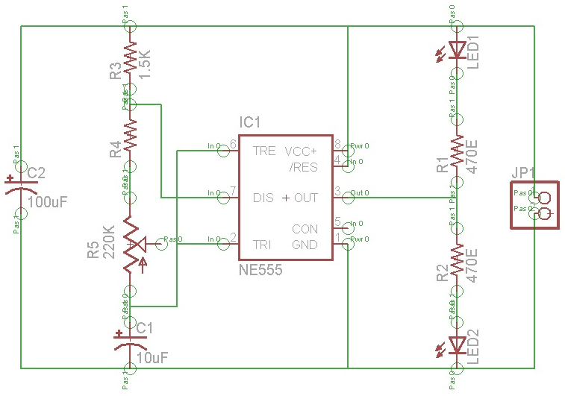
The Design Process
Schematics
Schematic: a symbolic representation of a circuit
Notes:
Eagle Schematic Image Source: https://amtek.files.wordpress.com/2010/10/eagle20.jpg

Slide 14
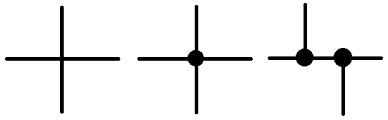
The Design Process
Schematics – Tips and Tricks
Electrical Rule Check (ERC): Can be run to check for issues that might escape visual inspection (such as signals that appear to be connected but actually are not)
Signals can be connected via net name rather than explicit wires to help clean up a schematic
Junction dots can be used to explicitly define electrical connections (where multiple wires cross dots are strongly recommended)
Notes:
Junction Dot Image Source: Self-created

Slide 15
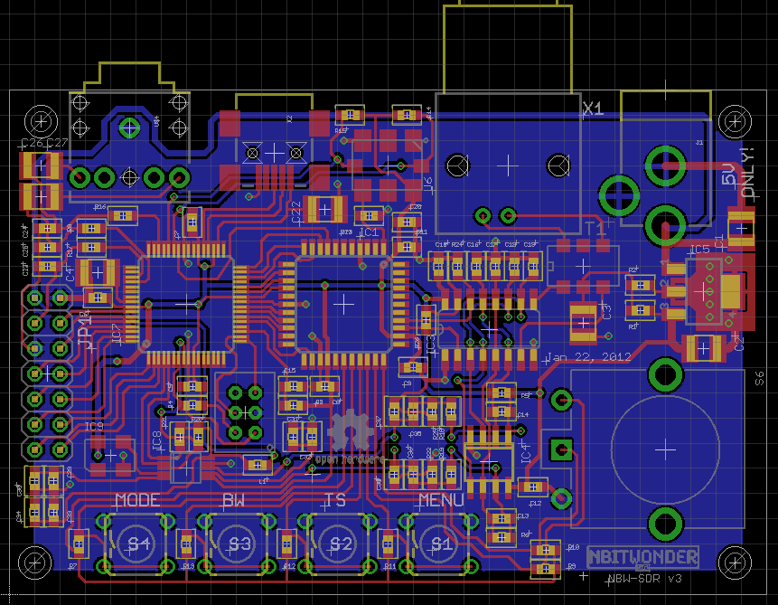
The Design Process
Layouts
Layout: an electrical representation of a circuit board corresponding to the design of the finished board
Notes:
Eagle Layout Image Source: https://github.com/NBitWonder/SDR/blob/master/Electrical/v3.0/SDRv3.brd

Slide 16
The Design Process
Layouts - Terminology
Pin: A plated through hole used to connect the terminal of a part
Pad: A flat conductive surface for connecting the terminal of a surface-mount part
Via: A plated through hole used to route signals between layers of a circuit board
Trace: A wire or 1-dimensional electrical connection
Signal Plane: A 2-dimensional electrical connection (commonly used for signals such as power and ground)
Mil (milli-inch): 1 mil = 0.001in.

Slide 17
The Design Process
Layouts – Fabrication Tolerances
Drills: 20 mil (min)
Tolerance: ±5 mils diameter, ±5 mil center
Layer-to-layer alignment: ±3 mils
Etched feature size: ±1 mil (min)
Isolated trace size: 6 mil (min) (≥8 mil recommended)
Solder mask size: ±3 mil (min)
Silkscreen size: ±10 mil (min)
Fabrication tolerances typically stored in Eagle design rule check (DRC) files

Slide 18
The Design Process
Layouts – General Layout Guidelines
Recommended trace/space: 10-16mil (general)
Power and ground traces should be sized for current being passed (trace width current capacity charts available online)
Follow all manufacturer PCB layout recommendations
Decoupling capacitors should be placed as close to associated ICs as possible
Provide space and mechanical support for connectors, heat sinks, and standoffs
Incorporate headers or vias for verification and debugging

Slide 19
The Design Process
Design Rule Check (DRC) and Tool File Generation
Once a layout has been completed, it must be checked to ensure it can be manufactured by the board house. This is done by running a Design Rule Check (DRC)
Once a design has been refined and passes DRC, a software tool (CAM processor, in the case of Eagle) must be run to generate the files used by the board house tools to assemble the boards.
The industry standard for PCB tool files is the Gerber standard (RS-274-X). One file is produced for each layer of the board (top/bottom copper, top/bottom silkscreen, top/bottom soldermask, drills, etc.). Gerber files can be viewed using a Gerber viewer

Slide 20
The Design Process
Ordering Circuit Boards
Gerber files necessary to produce a board are compressed into a zip archive, and sent out to a PCB service. Some popular PCB services:
Advanced Circuits: Fast turnaround times, US-based, ITAR http://www.4pcb.com/4pcb-monthly-specials.html
OSH Park: PCB panelization service, 3 board copies per design submitted, US-based https://oshpark.com/
Seeed Studio: Low cost, China-based, longer lead times (~4 weeks), other services available (3D printing, laser cutting, stencils, etc.) http://www.seeedstudio.com/
Various PCB services can be compared at http://pcbshopper.com

Slide 21
The Design Process
Ordering Circuit Boards 2
Depending on timeframe and features, circuit boards can be fairly cheap or incredibly expensive. Consider:
Turn Time: Time needed to manufacture (“turn”) the board. 1 day turns can cost hundreds of dollars. 1-2 week turns will cost much, much less
Shipping Time: Time needed to ship the boards. Shorter shipping times bring higher costs.
Custom Tooling: Features such as custom cutouts, board shapes, scoring or other cutting can quickly increase the cost of a board
Quantity: Major cost in PCB production is tooling. Once that cost has been paid additional boards are quite cheap

Slide 22
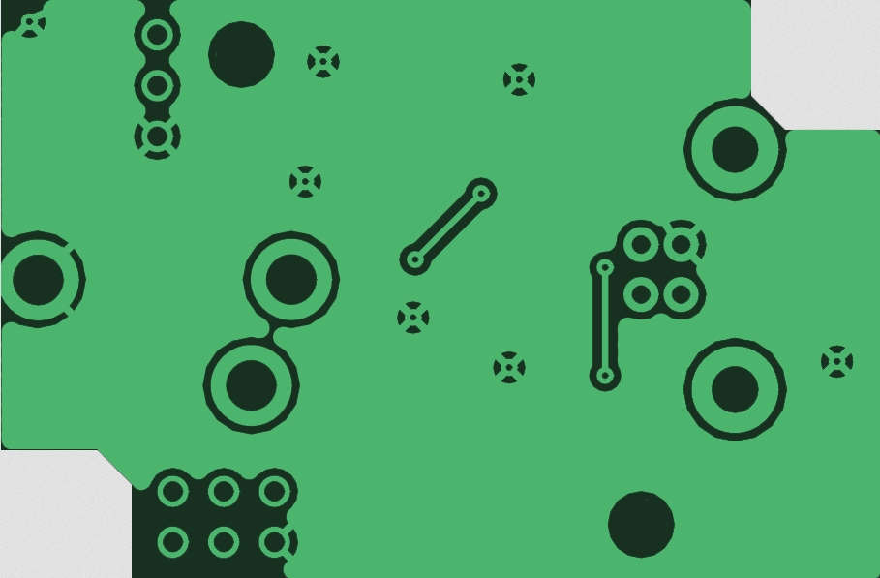
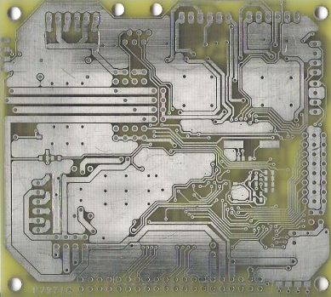
Miscellaneous PCB Topics
Signal Planes
Useful for creating large, low resistance signal paths
Allow easy connection for common signals (e.g. GND)
Saves copper (unused copper on a circuit board must be etched away)
Can be used as PCB heatsinks (reduce or eliminate the need for external, dedicated heatsinks)
Notes:
Copper Pour Image Source: http://upload.wikimedia.org/wikipedia/commons/d/d4/PCB_copper_pour_thermal_pads.png
Signal Plane Image Source: http://dangerousprototypes.com/forum/download/file.php?id=4191&t=1

Slide 23
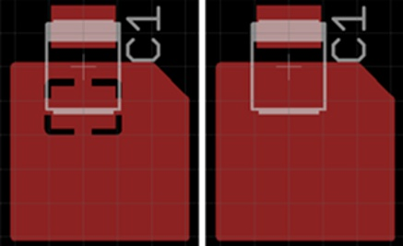
Miscellaneous PCB Topics
Thermal Relief
Electronic components must be soldered to boards; in order to solder (or desolder) a part, the copper of a component pin/pad must be raised to a sufficient temperature
If a pin/pad is given a direct connection to a thick trace or large signal plane, the trace or plane may act as a heatsink, preventing the pin/pad from reaching soldering temperature
Thermal Relief: Isolate a
pin/pad from direct
connection with large
trace/plane (heatsink)
Notes:
Custom Silkscreen Image Source: http://lucidtronix.com/system/attached_files/184/original/Screen_shot_2013-02-05_at_6.54.53_PM.png?1360108721

Slide 24
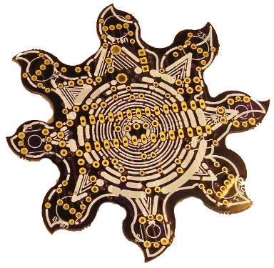
Miscellaneous PCB Topics
Silkscreen Topics
Every silkscreen layer should include:
Name of author(s) (ECE477 team members)
Name to identify the circuit board
Date last modified or revision number
Placing component values in silkscreen may be unnecessary; consider instead
giving components IDs (R1, C1,
L1, IC1, D1, S1, etc.) and using
table of values
Custom silkscreen images
can enable addition of custom
logos and image to circuit boards
Notes:
Custom Silkscreen Image Source: http://lucidtronix.com/system/attached_files/184/original/Screen_shot_2013-02-05_at_6.54.53_PM.png?1360108721

Slide 25
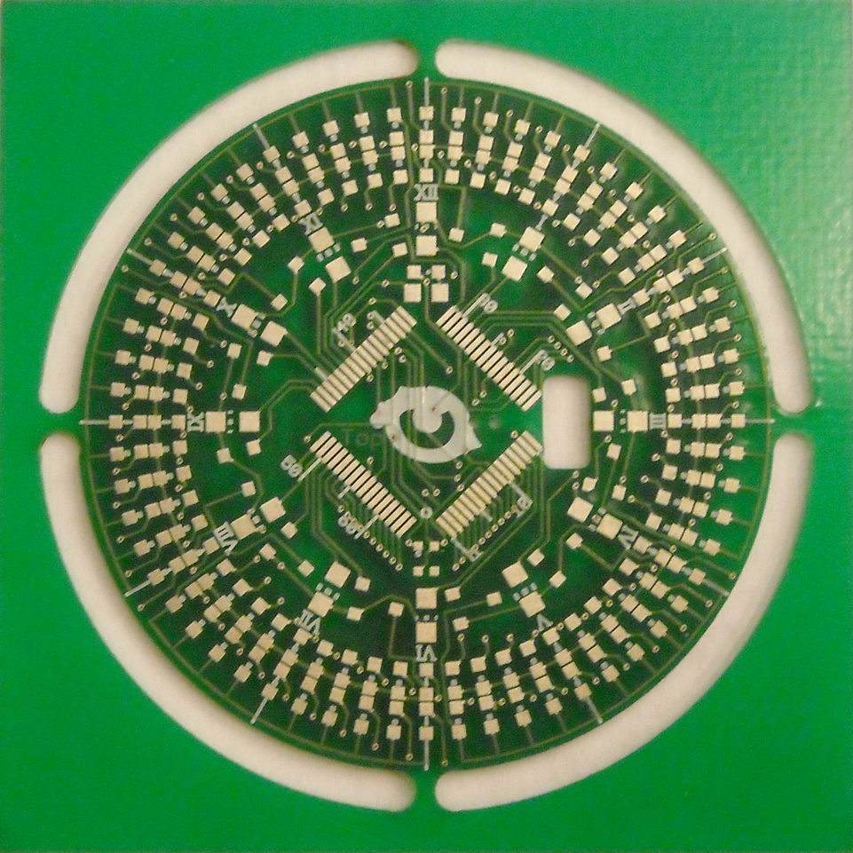
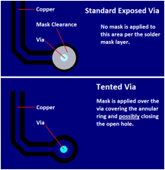
Miscellaneous PCB Topics
Other Miscellaneous Topics
Tented Vias: Design the board to allow the solder mask to run over the top of a via (provides unbroken surface for more legible silkscreen, etc.)
Polar Layouts: For use in
circular designs and RF
Notes:
Tented Via Image Source: http://www.pcbuniverse.com/article5_files/image002.gif
Polar Layout Image Source: http://www.eng.yale.edu/pep5/images/img_pocketwatch/led_pw_v1.0_pcb_front.jpg

Slide 26
Clicker Quiz

Slide 27
Question 1
A plated through hole used to route signals between layers of a circuit board is called a:
  pin
  via
  pad
  trace
  none of the above
Notes:
B

Slide 28
Question 2
In “PCB lingo” a mil is a:
  a factory where PCBs are made
  millimeter (.001 meter)
  milli-inch (0.001 inch)
  the space between traces
  none of the above
Notes:
C

Slide 29
Question 3
The lower pad to which the surface mount component designated “C1” is to be soldered utilizes the following:
  signal plane
  tented via
  exposed via
  thermal relief
  none of the above
Notes:
D

Slide 30
Question 4
The purpose of running a design rule check (DRC) on a completed layout is to:
  generate files used by board house tools to manufacture the boards
  auto-route PCB traces once the schematic is complete
  generate the silkscreen layer artwork
  ensure the layout can be manufactured by the board house
  none of the above
Notes:
D

