Slide 1

Embedded Software Development George Hadley ©2017, Images Property of their Respective Owners
Notes:
Binary Code Background Image Source: Self created

Slide 2
Outline
Embedded vs. General Purpose Programming
Layers of Abstraction (Hardware, Interface, Application)
Embedded Programming Models
Real Time Operating Systems
Definition of “Real Time” Systems
Definition of “Fail Safe” Systems
Revision Control Systems
Firmware Design Techniques

Slide 3
Embedded vs. General Purpose
What separates embedded and general purpose processor models?
“Flat” memory model (no virtual memory, hierarchy, or cache typically)
Limited SRAM data space and Flash program space
“Non-homogenous” memory types (SRAM, Flash, EEPROM, etc.)
Hardware interrupts – far more common in embedded programming than general purpose

Slide 4
Embedded vs. General Purpose
How do these differences influence the way in which code is written?
Avoid use of large library routines (i.e. printf)
Avoid dynamic memory allocation
Avoid complex data structures
Avoid recursive constructs
Increased awareness of declarations (char, int, long)
C code generally written in “macro assembly” style
Remember: floating point support emulated via lengthy software routines
Pre-compiled values (table lookup) sometimes better than software-based calculation methods (trig)

Slide 5
Layers of Abstraction
Objective: well-written software which is portable, easy to understand, maintainable, and has good performance
Solution: Separate software into various abstracted layers
Hardware: Direct drivers for various hardware devices (example: “send/receive data from SD card using SPI)
Physical: Layer between base hardware and “software”; hardware-specific details are abstracted (example: store/retrieve data from memory)
Application: User-specified device functionality (example: play a selected MP3 file)
Tradeoff: Increased abstraction increases portability, maintainability and clarity while reducing performance (memory requirements and speed)

Slide 6
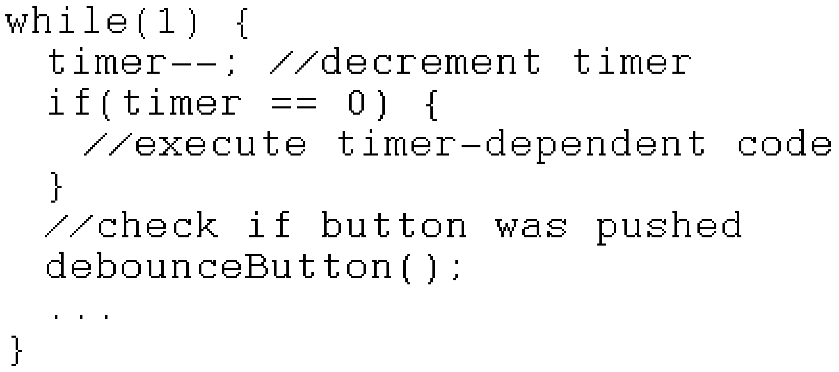
Embedded Programming Models
Program-Driven Approach
Polled (Program-Driven) Approach:
All code and checks are performed in a single loop
Advantage: code is simple to write and understand
Disadvantage: Latency of code difficult to determine; as code becomes more complex latency may grow very large
Notes:
Polled code image source: self-created.

Slide 7
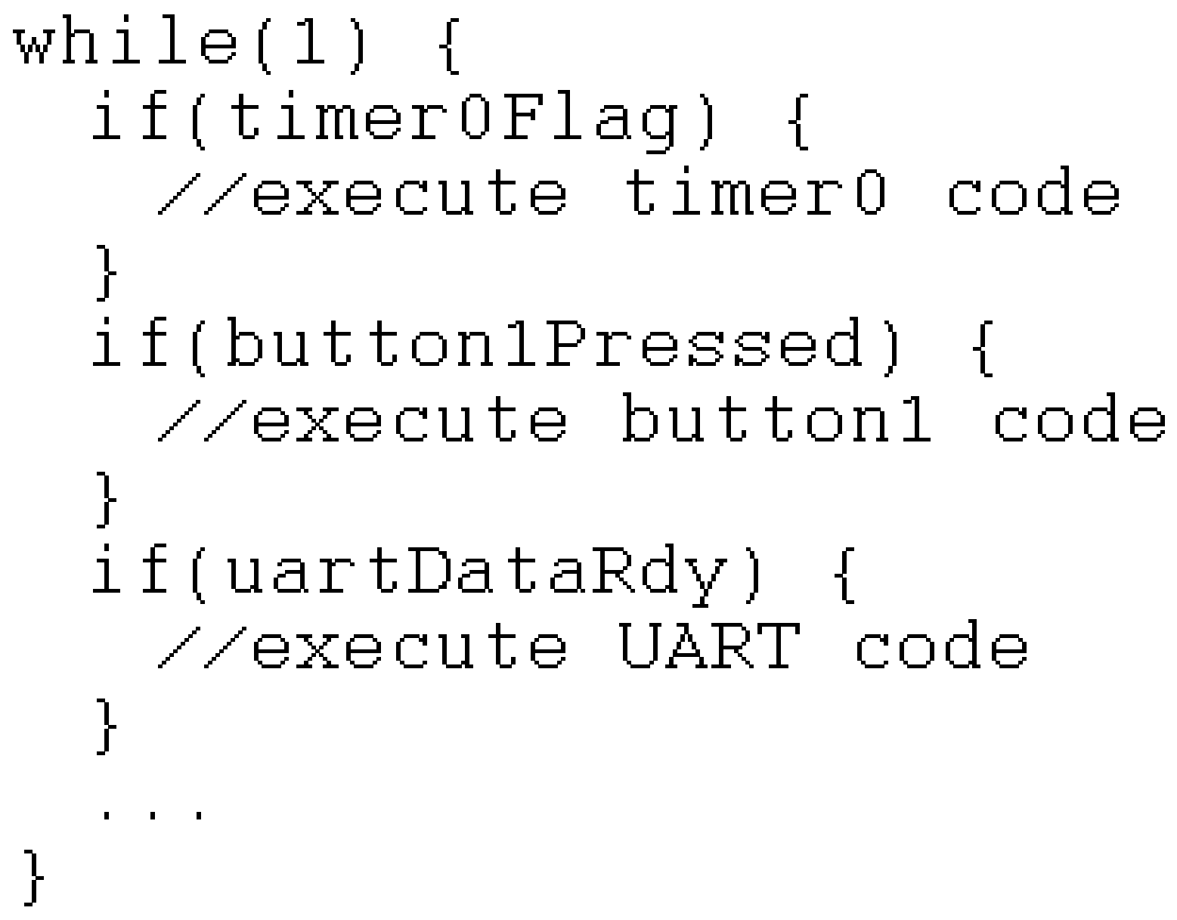
Embedded Programming Models
Flag-Driven Approach
Flag-Driven (State Machine) Approach:
Interrupt subroutines used to determine if certain conditions have been met (e.g. button presses, pending SPI/UART/I2C data, timer expiration) and set “flags”
Main loop then checks if flags have been set and runs corresponding code
Improved performance over polled designs; program flow slightly less straightforward
Notes:
Flag Driven Code Image Source: Self created.

Slide 8
Embedded Programming Models
Event-Driven Approach
Interrupt-Driven (Event-Driven) Approach:
Main loop performs device initializations then idles
All processing (post initialization) is performed in response to prioritized interrupts
Processor may sleep between interrupts to reduce power consumption
Advantages: High performance code, low power operation
Disadvantages: Program flow may be difficult to follow and understand

Slide 9
Embedded Programming Models
RTOS Approach
Real Time Operating System (RTOS) Approach:
All currently enabled system tasks are maintained within a data structure (tasks can be dynamically inserted or deleted)
Timing interrupts used to determine when tasks must be rolled in or out
Priority of enabled tasks can be changed by altering a task’s time-slice allocation

Slide 10


Real Time Operating Systems
A few popular RTOS kernels:
ChibiOS/RT: Compact, high performance RTOS for 8/16/32 bit microcontrollers
FreeRTOS: Small, compact RTOS supported on many different microcontroller families (34 at time of writing)
SafeRTOS: High-security variant of FreeRTOS
Integrity: High-security proprietary RTOS, used in military jets. Guaranteed computation times.
Notes:
ChibiOS/RT Logo Image Source: http://www.chibios.org/dokuwiki/lib/exe/fetch.php?cache=&w=116&h=116&media=logo.png
FreeRTOS Logo Image Source: http://www.freertos.org/logo.jpg

Slide 11
Real-Time Systems
Definition of “Real Time” Systems
“Our system will operate in real-time.” (But what does “real-time” mean?)
Real-time systems possess “mission critical” timing constraints (sampling rates, processing latency, etc.)
System latencies are known and tightly bounded
Typically event-driven
Low overhead context switching

Slide 12
Fail-Safe Systems
Definition of “Fail Safe” Systems
Fail-safe devices are designed in such a way that a failure will cause minimum or no harm to other devices or personnel
Examples of fail-safe behavior:
A computer controlled lock that is capable of being opened, without power, from the secure side of the lock
A milling device or tool that features a hardware-based emergency stop (device can be overridden without computer intervention)
A UAV that initiates an emergency landing when power drops below critical levels

Slide 13
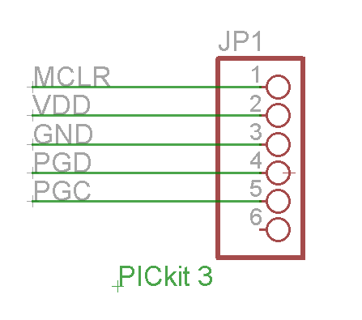
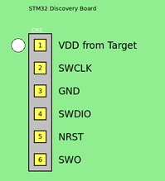
Microcontroller Programming
In order to program/debug bare microcontroller chips, device programming connections must be established
Some common programming interfaces:
JTAG: General microcontroller programming interface
ICSP: Microchip PIC proprietary interface
SWD: ARM Cortex serial programming interface
USB: Available interface on some ARM Cortex chips
Notes:
SWD Pinout Image Source: https://1.bp.blogspot.com/-I5jQd7-ZfCA/VzWUgpY6E4I/AAAAAAAAAjg/gNTb2ECB2qYWWm2X11dBsUBrVAe2bKJ6gCKgB/s1600/stl3.png
ICSP Pinout Image Source: http://www.mikrocontroller.net/attachment/257068/pickit3.png

Slide 14
Microcontroller Debugging
Modern embedded toolchains feature IDEs with many features:
Run/Stop Execution: Start and stop program execution
Breakpoints: Automatically pause program at line
Run to Line: Run to a given line in program, then pause (temporary breakpoint)
Variables/Registers/Expressions: Log variable values, register values, and other expressions (updated once microcontroller is paused)

Slide 15
Revision Control Systems
Revision Control Systems
Software is an increasingly complex and involved activity, and managing changes is a vital skill for any developer
Revision control systems provide the user with the ability to track and manage changes, restore source code from previous changes, and share changes with others
A few revision control systems:
git: Popular compact distributed version control system
mercurial: Simple, distributed version control system
Subversion (svn): Open source centralized version control system

Slide 16
Firmware Design Techniques
Device Configuration
Microcontrollers feature sets of configuration registers or bits which control their operation. Examples of device configuration options include:
Which clock source the microcontroller uses at startup
Which I/O lines will be used for programming functions
Device behavior in the event of a “brown-out” (brown-out reset, or BOR)
Behavior concerning watchdog timers (WDT)
Device behavior in the event of a stack under/overflow
Write protection
Configuration bits must be set within the code or IDE for a device to function properly

Slide 17
Firmware Design Techniques
Oscillator Configuration
Oscillators are the basis of all logic in a programmable device, and thus one of its most important components
All programmable devices support clocking from a variety of internal and external sources
Nearly all programmable devices support the ability to switch clock sources and scalars during device operation
Higher clock speed improves computational performance but burns more power
Notes:
Oscillator Wave Image Source: Self created.

Slide 18
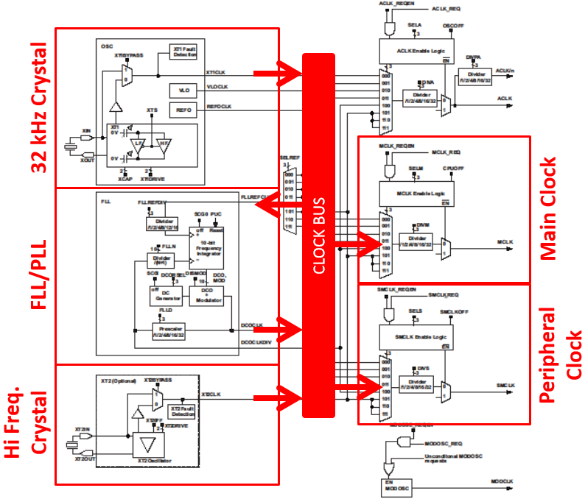
Firmware Design Techniques
Example Oscillator Block
Notes:
Oscillator Block Image Source: Acquired from previous version of this lecture, created by Brandon Blaine Gardner. Original oscillator block sourced from Texas Instruments microcontroller datasheet

Slide 19
Firmware Design Techniques
Oscillator Configuration
Some example pseudocode (note the use of #define): // 32 kHz watch crystal input on XT1
OSC_1_CONFIG_REG = CHOOSE_XT1;
// 32 kHz watch crystal = 32,768 Hz
// 32,768 Hz * 64 = 2,097,152 Hz (~2 MHz)
PLL_CONFIG_REG = CHOOSE_OSC_1 + MULTIPLY_BY_64;
// Main clock ~2 MHz
MAIN_CLK_CONFIG_REG = CHOOSE_PLL + DIVIDE_BY_0;
#define MAIN_CLOCK_FREQ 2097152 // in Hz
// Peripheral clock ~500 kHz ( 2097152 / 4 = 524288 )
PERIPH_CLK_CONFIG_REG = CHOOSE_PLL + DIVIDE_BY_4;
#define PERIPH_CLOCK_FREQ 524288 // in Hz

Slide 20
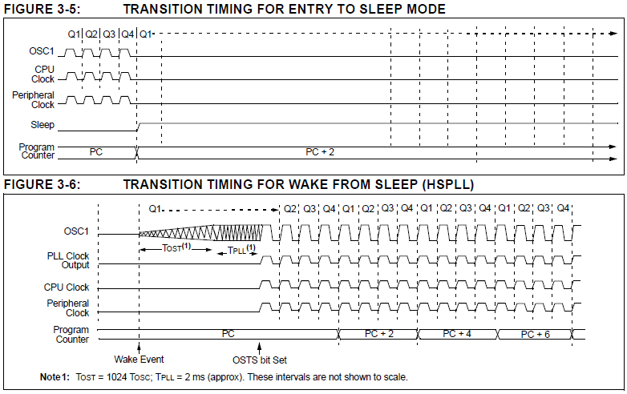
Firmware Design Techniques
Power Configuration
To conserve power, microcontrollers can be placed into a sleep state and then later awoken (via external interrupt, watchdog timer time-out, etc.)
Power management detailed in device datasheet
Notes:
Sleep Mode Waveforms Image Source: http://ww1.microchip.com/downloads/en/DeviceDoc/39632e.pdf

Slide 21
Firmware Design Techniques
Bootloaders
Depending on your project, it may be desirable to make changes to the code running on your project’s programmable devices after the code has shipped (firmware updates, feature unlocks, etc.)
Bootloader: A piece of code that runs at startup which accepts a program from an external source and writes it to the programmable device’s memory
Allows reprogramming over a number of potential interfaces (USB, Bluetooth, SD Card, Ethernet, etc.)
Small, open-source bootloaders exist for various microcontroller families, as well as tutorials for creating your own

Slide 22
Clicker Quiz

Slide 23
Question 1
An embedded programming model in which the main loop performs initializations then idles is the:
polled (program-driven) approach
flag-driven (state machine) approach
interrupt-driven (event-driven) approach
real time operating system (RTOS) approach
none of the above
Notes:
C

Slide 24
Question 2
A popular revision control system that can be used to track and manage software changes is:
git
get
got
gat
none of the above
Notes:
A

Slide 25
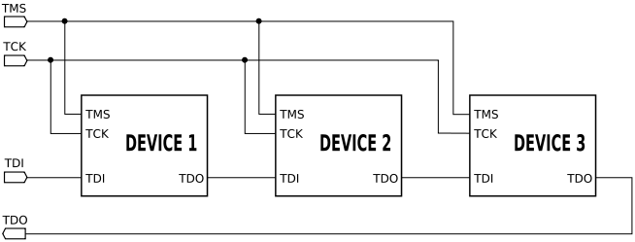
Question 3
JTAG is:
a general microcontroller programming interface
a Microchip PIC proprietary interface
an ARM Cortex serial programming interface
none of the above
Notes:
A

