Slide 1
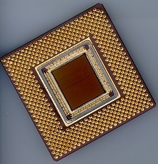
ECE 477 Digital Systems Senior Design Project
© 2014 by D. G. Meyer
Module 4
Power Supply Design

Slide 2
Outline
Switch mode power supply theory
forward converter
flyback converter
Switching regulators
step-down switching converter
step-up switching capacitor charge pump
DC-DC converters
Battery management
Basic full-wave power supply
low-dropout linear regulators
legacy linear regulators

Slide 3
Switch Mode Power Supply (SMPS)
input rectifier
chopper
isolation
output rectifier
output filter
control
isolation
Switching approach based on high-frequency voltage ⇒ A.C. input (line voltage) immediately rectified to produce high-voltage D.C.
Chopper FET creates a high-frequency signal fed to transformer
High frequency ⇒ smaller transformer (less metal, less weight, lower cost)…but, more components
Adjusting chopper’s duty cycle provides regulation

Slide 4
Basic Forward (Buck) Converter
+
Forward (“buck”) converter transfers energy while the chopper is conducting
Transformer provides secondary charging circuit during conduction phase (chopper on)
When chopper turns off, choke releases its magnetic energy and current continues to flow into output capacitor

Slide 5
Basic Flyback Converter
+
Note phase of isolation transformer – while the chopper is conducting current in the primary, current is not allowed to flow in the secondary
Primary becomes storage device opposing current flow by creating a magnetic field
When chopper turns off, stored magnetic field collapses and energy is transferred to the secondary

Slide 6
Switching Regulator – Basic Idea
feedback
+
Vout
Regulation achieved by changing pulse width and/or pulse frequency
Done “automatically” by switching regulator IC
Typically over 90% efficient
TRADEOFF: lower current output than typical linear regulator circuit, and more external components; also, higher noise

Slide 7
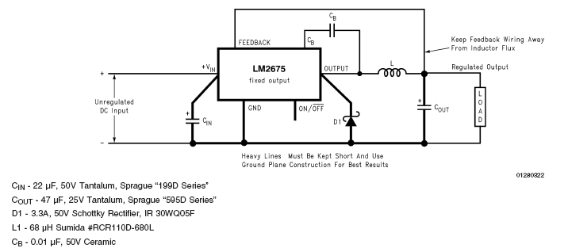
Step-Down Switching Converter: LM 2675
(fixed) 3.3, 5, 12 VDC and (adjustable) 1.21 – 37 V versions
Up to 1 amp
Up to 96% efficient
Five external components

Slide 8
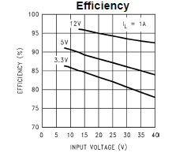
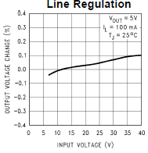
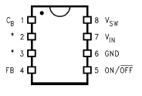
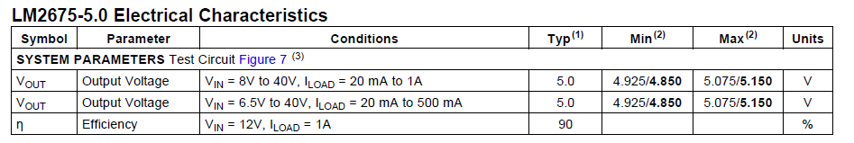
Step-Down Switching Converter: LM 2675

Slide 9
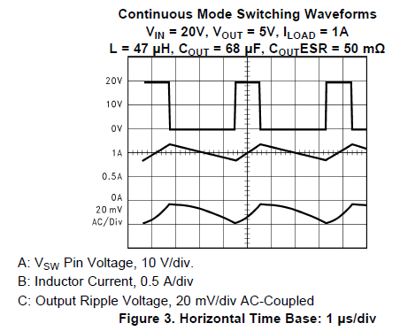
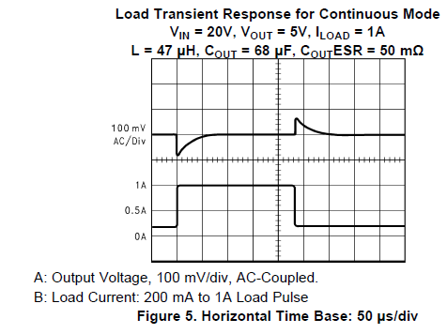
Step-Down Switching Converter: LM 2675

Slide 10
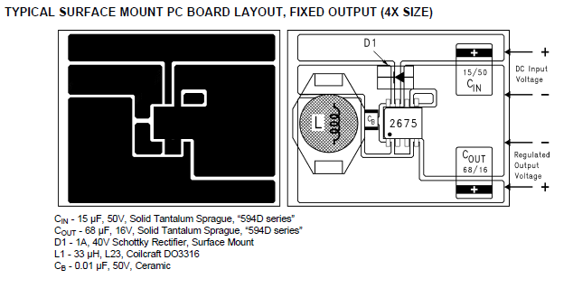
Step-Down Switching Converter: LM 2675

Slide 11
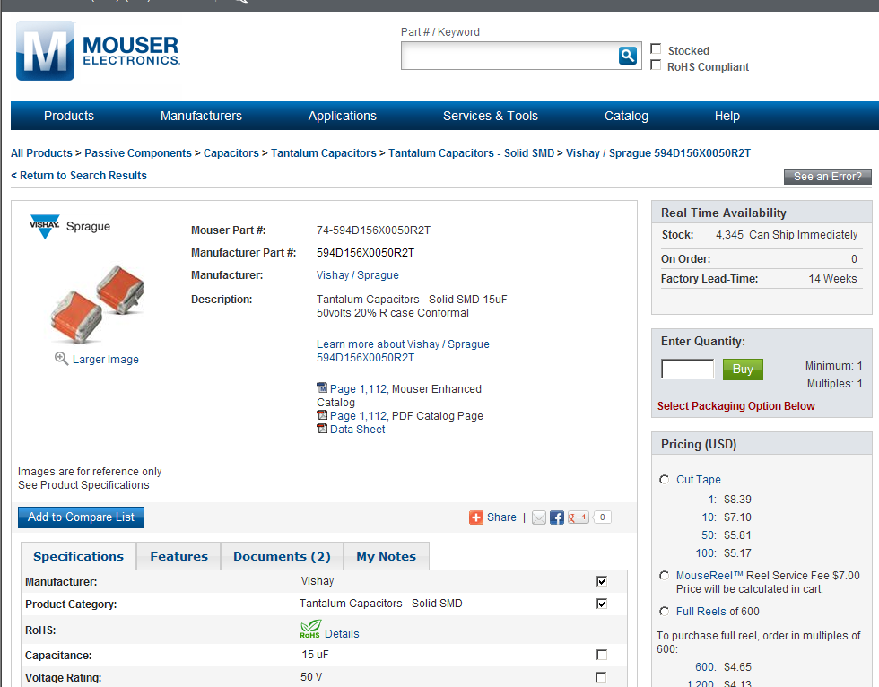
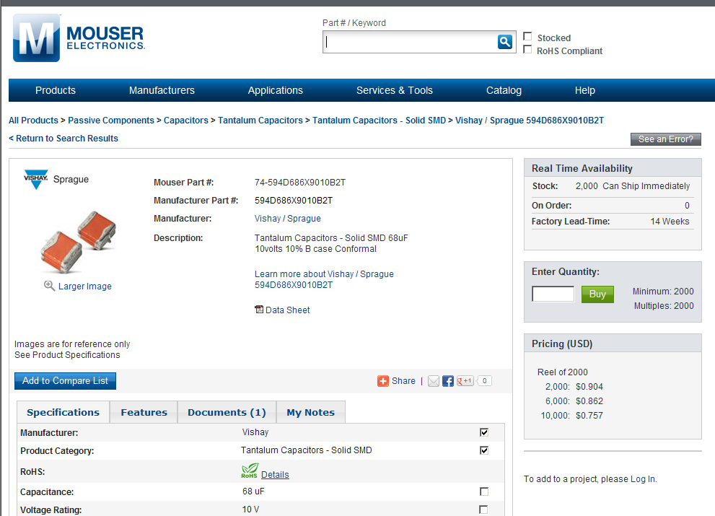
PCB Tutorial Exercise

Slide 12
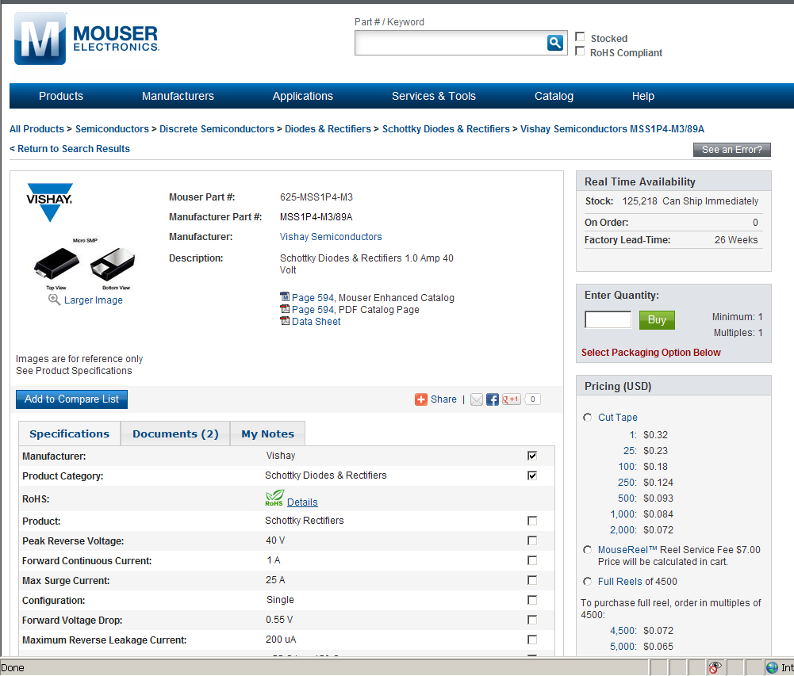
PCB Tutorial Exercise

Slide 13
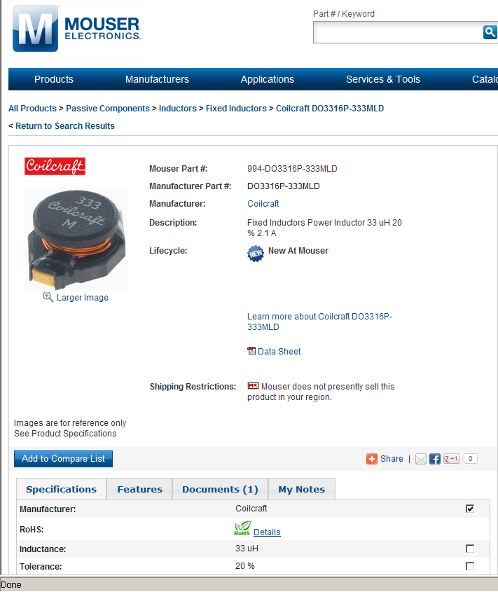
PCB Tutorial Exercise

Slide 14
PCB Tutorial Exercise
Standard 1206 type surface mount ceramic capacitor

Slide 15
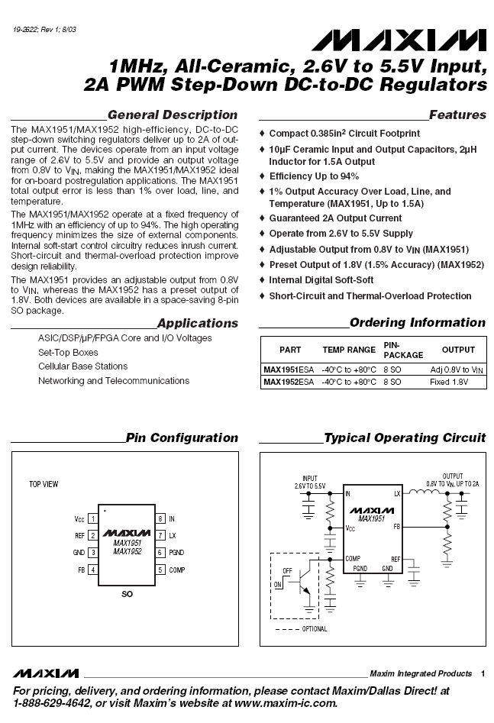
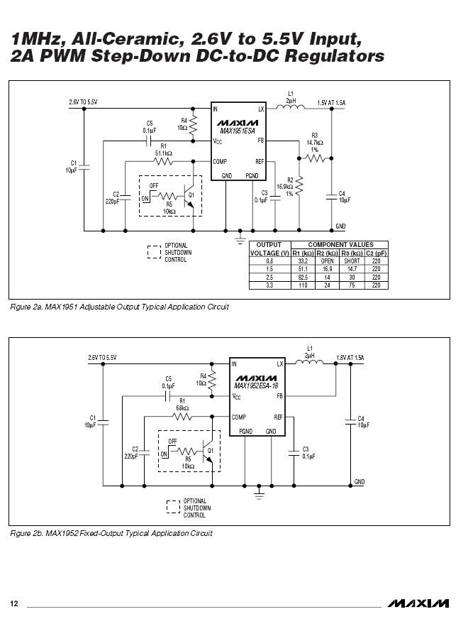

Slide 16
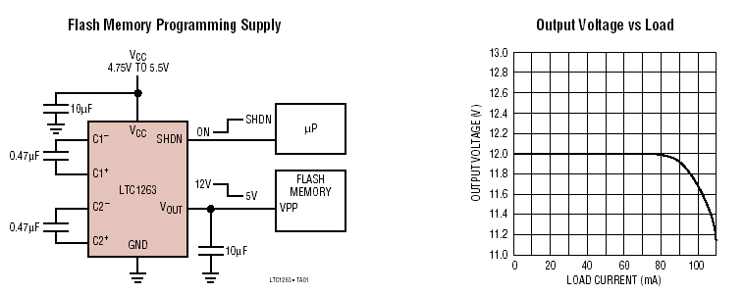
Switched Capacitor Charge Pump Step-Up Converter
Based on LTC1263 www.linear-tech.com
Produces 12 VDC @ 60 mA from V_{CC} as low as 4.75 V
Four external components

Slide 17
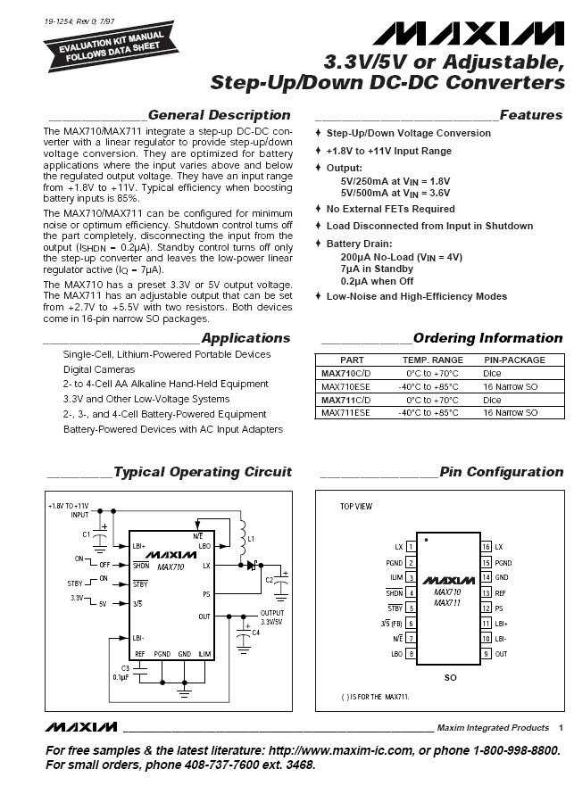
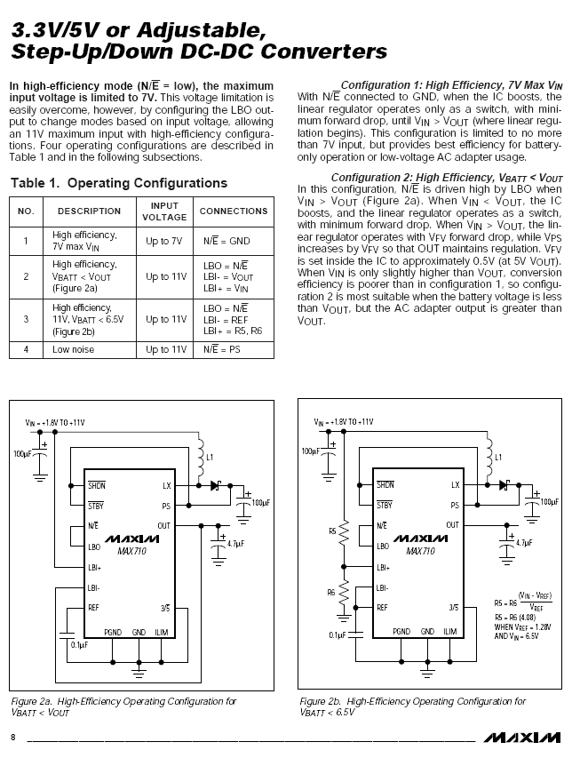

Slide 18
Important Notes About DC-DC Converters
While chip size and heat dissipation are reduced, component properties and physical layout become more critical…
Inductors and output capacitors typically need to be “low ESR” type – pay close attention to component data sheets
“Analog” ground for DC-DC must be separate from all other grounds on PCB
Certain nodes in layout are critical to keep PCB traces short and WIDE to reduce parasitic inductance and capacitance
Failure to follow manufacturer’s recommended layout and component selection criteria will (most likely) result in non-operation of the circuit and many hours spent in debugging and fly-wiring

Slide 19
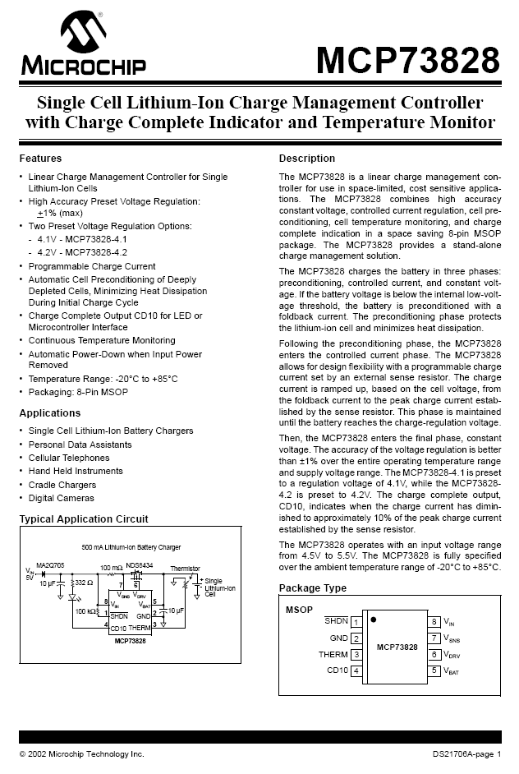
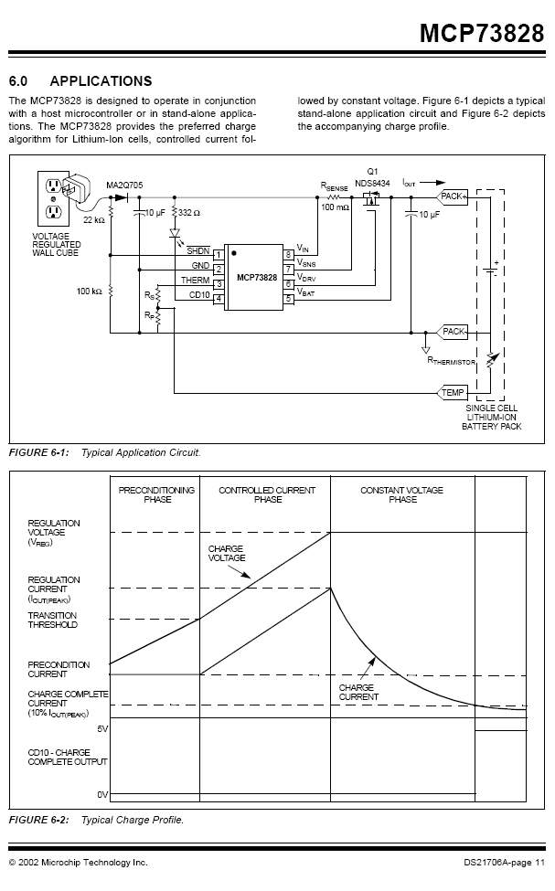

Slide 20
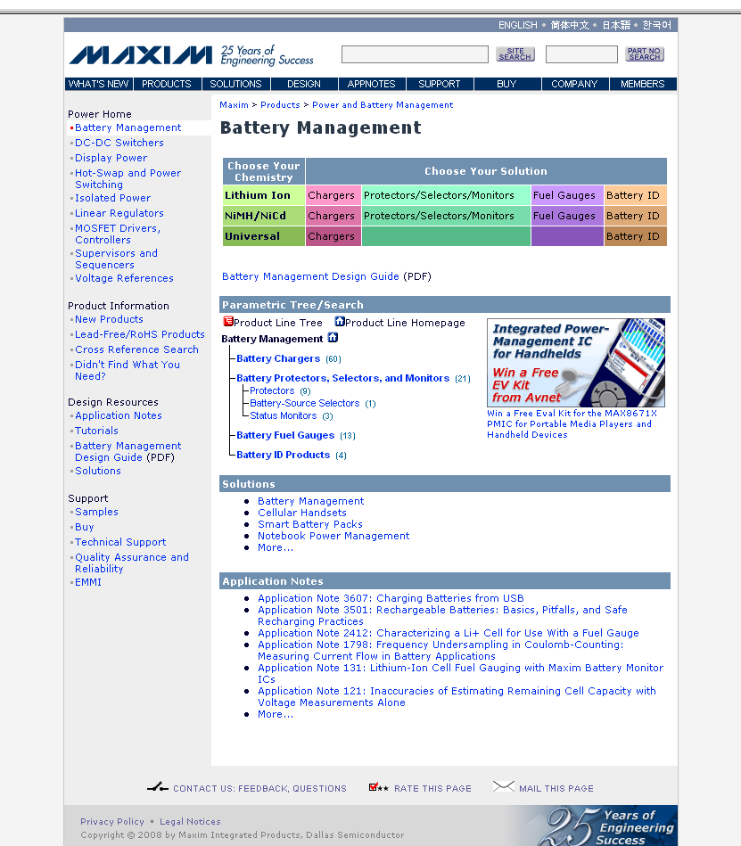

Slide 21
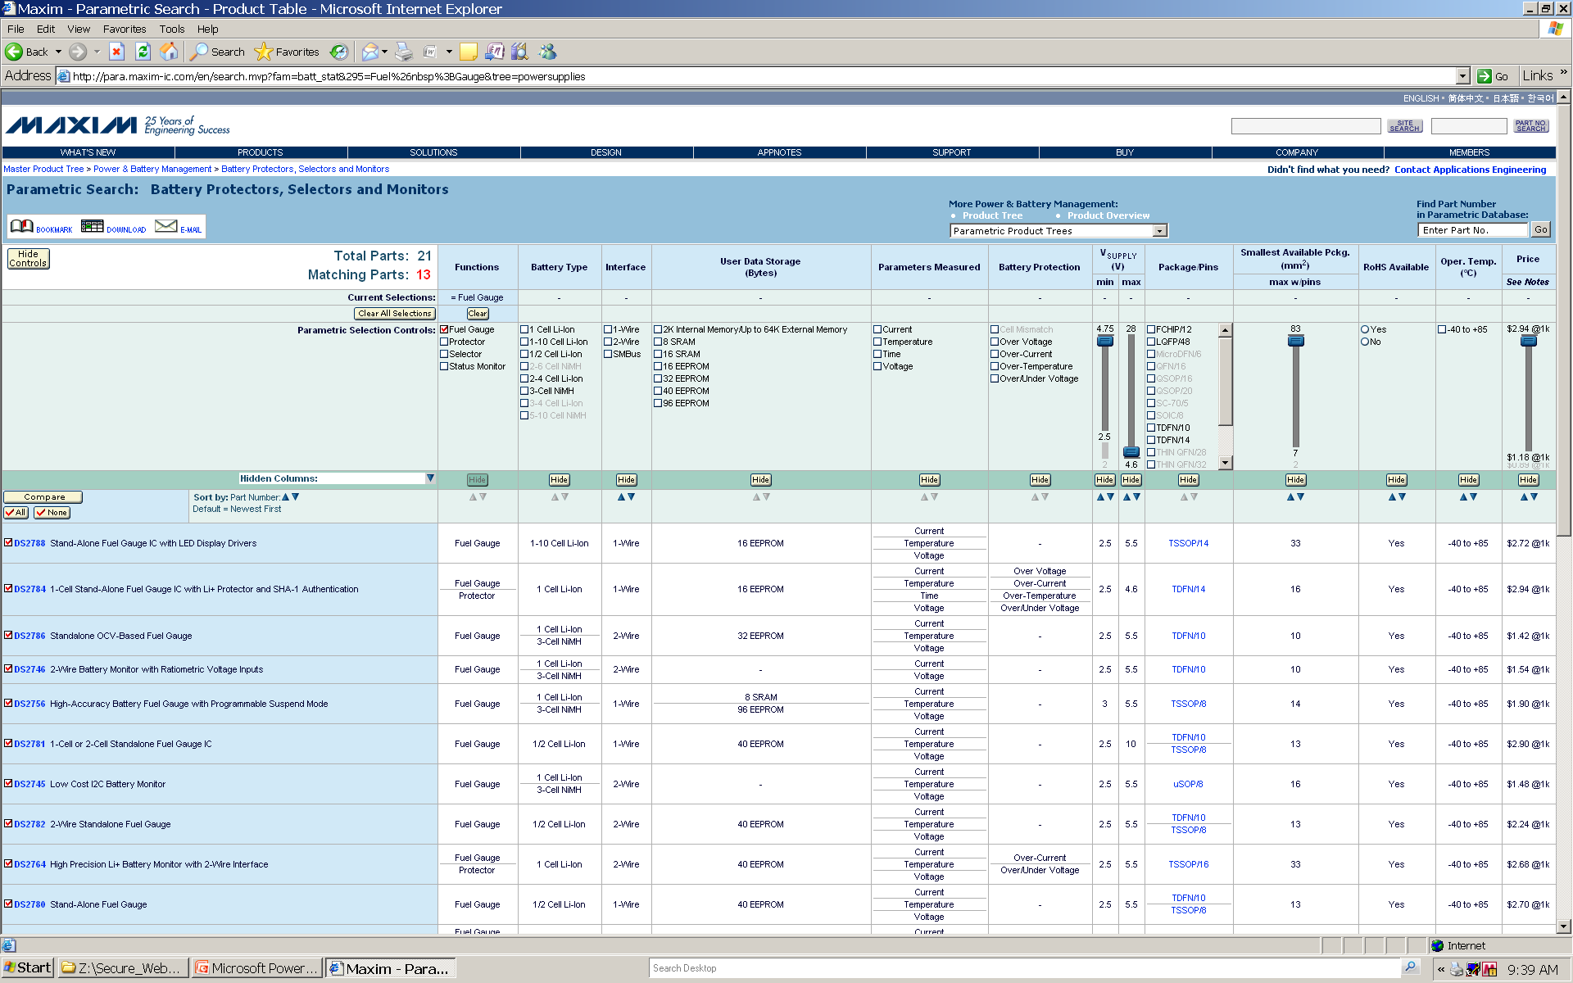

Slide 22
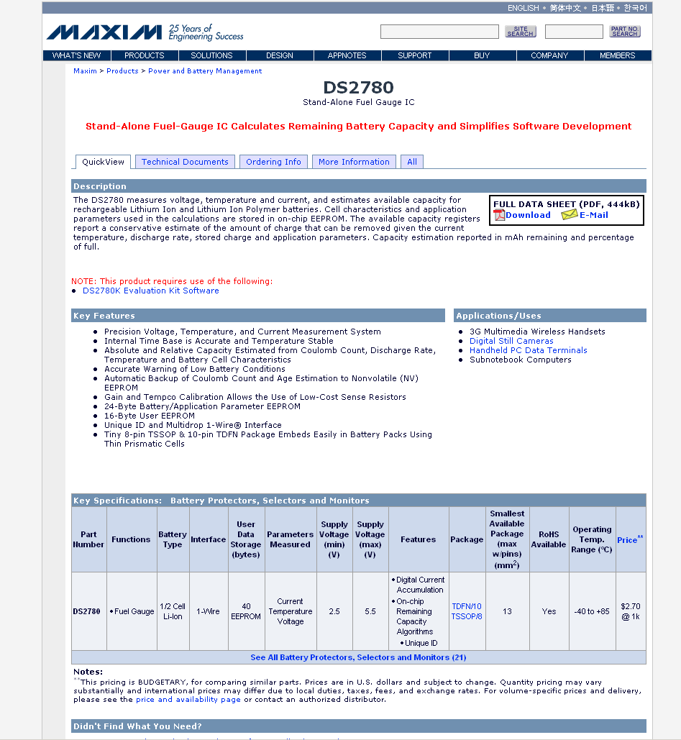

Slide 23
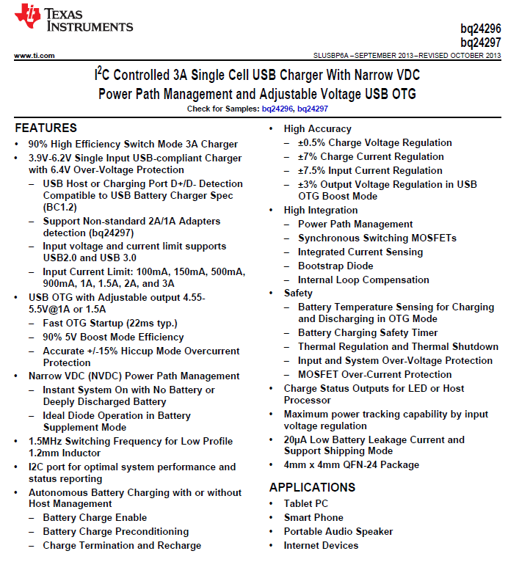

Slide 24
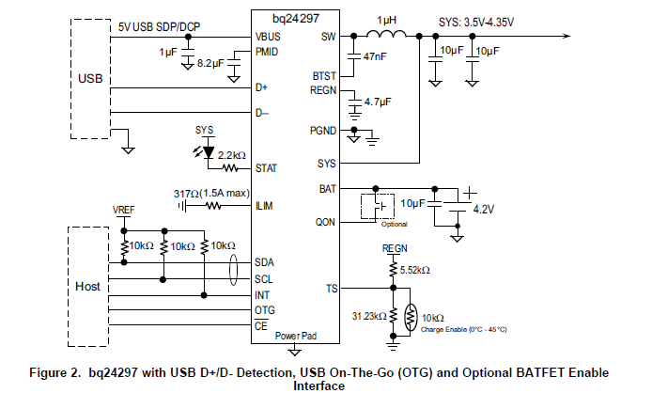

Slide 25
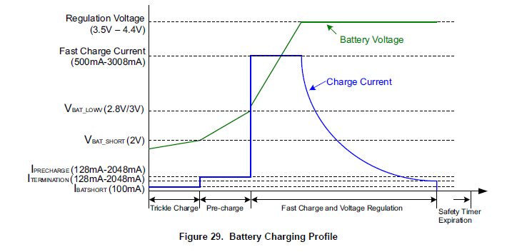

Slide 26
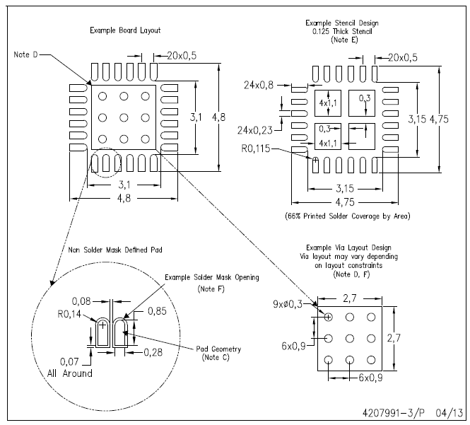

Slide 27
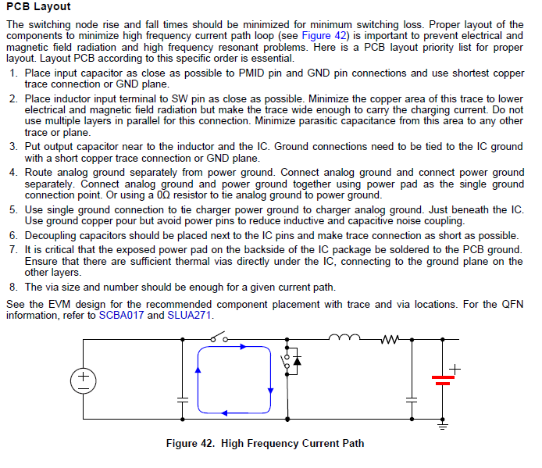

Slide 28
Basic Full-Wave Supply
+
A.C. “wall wart”
Question: Why is this called a “full-wave” circuit?
Answer: All cycles (+/-) are delivered to the load

Slide 29
Analysis
ripple
no-load = V_{N}
loaded = V_{L}
1/240 sec = 4.2 ms
Question: What transformer secondary voltage is required to obtain V_{N} = 5.0 VDC?
5.0/√2 ≅ 3.5 VAC
Note: Amount of ripple is proportional to load and inversely proportional to size of filter capacitor
Analysis: Can calculate value of C based on amount of ripple willing to tolerate at a particular load

Slide 30
Analysis
ripple ≤ 0.01 V @ 0.5A load
no-load = V_{N}
loaded = V_{L}
1/240 sec = 4.2 ms
Example: Have 500 mA load ⇒ RL = V_{L}/I_{L} = 5/0.5 = 10Ω
Assume we want no more than 10 mV of ripple ⇒ solve for C given that V_{L} @ t=4.2 ms is ≥ 4.99 V with R_{L} = 10Ω
V_{L} = V_{N} x e^{-t/RC} ⇒ t = -R_{L} x C x ln(V_{L}/V_{N})
0.0042 = -10 x C x ln(4.99/5.00) = -10 x C x (-2 x 10⁻³)
= C x (2 x 10⁻²) ⇒ C = 0.0042/(2 x 10⁻²) = 0.21 F = 210,000 μF

Slide 31
Analysis
ripple ≤ 0.1 V @ 0.5A load
no-load = V_{N}
loaded = V_{L}
1/240 sec = 4.2 ms
Example: Still have 500 mA load ⇒ RL = V_{L}/I_{L} = 5/0.5 = 10Ω
Now assume we are willing to tolerate 100 mV of ripple ⇒ solve for C given that V_{L} @ t=4.2 ms is ≥ 4.9 V with R_{L} = 10Ω
V_{L} = V_{N} x e^{-t/RC} ⇒ t = -R_{L} x C x ln(V_{L}/V_{N})
0.0042 = -10 x C x ln(4.90/5.00) = -10 x C x (-2 x 10⁻²)
= C x (2 x 10⁻¹) ⇒ C = 0.0042/(2 x 10⁻¹) = 0.021 F = 21,000 μF

Slide 32
Thought Questions
Question: What’s inside a basic (unregulated) D.C. “wall-wart”?
Answer: Not much…
+
Unregulated D.C. “wall-wart”

Slide 33
Thought Questions
Question: What value of C is typically used in a garden-variety D.C. wall-wart?
Answer: 2000μF (or less)
Question: If you purchase an “N-volt” unregulated D.C. wall-wart, what is V_{N} (the “no-load output”) likely to be?
Answer: N·√2 (“not good for anything sensitive”)

Slide 34
Thought Question Analysis
Assume still have 500 mA load ⇒ RL = V_{L}/I_{L} = 5/0.5 = 10Ω and that the D.C. wall-wart has C = 2000 μF
Also assume V_{N} = 5.0 VDC
Solve for V_{L} @ t=4.2 ms given R_{L} = 10Ω and C = 2000 μF
V_{L} = V_{N} x e^{- t/RC} ⇒ V_{L} = 5 x e^{- 0.0042/0.02} = 5 x e^{­ 0.21}
= 5 x 0.81 = 4.05 ⇒ 0.95 V of ripple
Question: Is such a supply (unregulated D.C. wall-wart) suitable for operating a microcontroller?
Answer: NO – way too much ripple

Slide 35
Low Dropout (LDO) Linear Regulator
filter cap
+
A.C. “wall wart”
HF noise suppression cap
Example: Micrel MIC2915X-series
⇒ dropout voltage is only 0.3-0.4 V (compared with 2.5 V for legacy linear regulators)
⇒ tradeoff with LDO regulators is that since the dropout voltage is lower, the amount of input ripple that can be tolerated is lower than a legacy linear regulator

Slide 36
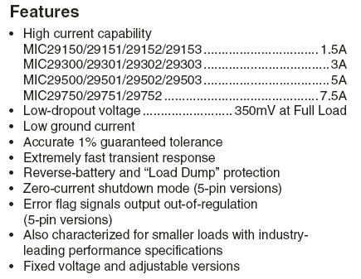
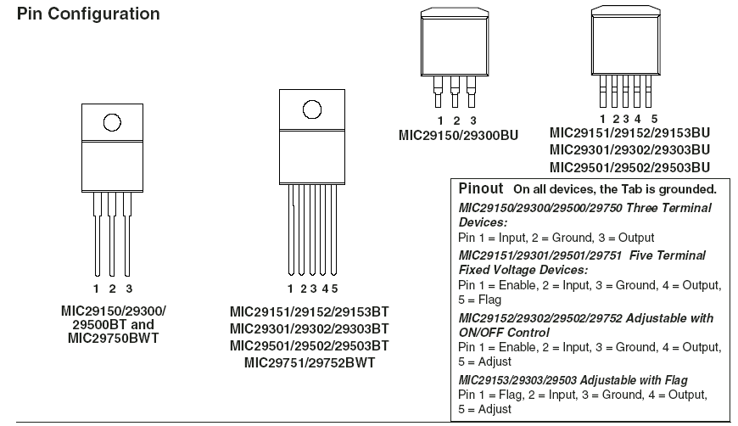

Slide 37
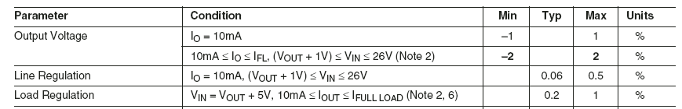
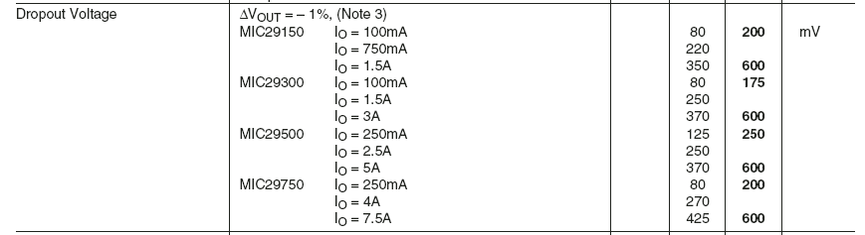

Slide 38
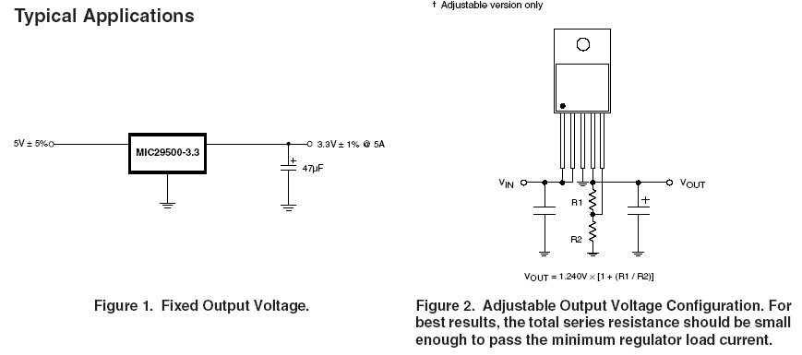

Slide 39
Analysis
ripple = 0.6V
dropout = 0.4 V
V_{N} = 6 V
V_{L} = 5 V
transformer secondary is 4.25 VAC
1/240 sec = 4.2 ms
Calculate C1: Have 6V @ 1A load (voltage dropped across regulator is part of load) ⇒ R_{L} = V_{L}/I_{L} = 6Ω
Assume we want no more than 0.6 V of ripple ⇒ solve for C1 given that V_{Nmin} @ t=4.2 ms is ≥ 5.4 V with R_{L} = 6Ω
V_{L} = V_{N} x e^{-t/RC} ⇒ t = -R_{L} x C1 x ln(V_{Nmin}/V_{Nmax})
0.0042 = -6 x C1 x ln(5.4/6.0) = -6 x C x (-0.105) = C x 0.632 ⇒ C1 ≅ 6650 μF bigger than “standard” case!

Slide 40
Analysis
No load: quiescent current is approximately 8 mA ⇒ power dissipation is 6 x 0.008 = 48 mW
Full load (1A): 6 V @ 1A drops across regulator (assuming no ripple) ⇒ power dissipation = 6 X 1 = 6 W
Efficiency: 5V @ 1A (5W) delivered to load, but 1 W dissipated by regulator ⇒ 5.0/6.0 ≅ 83% efficient
Heat sink: Needed to help device dissipate heat
Idea of THERMAL RESISTANCE ⇒ measured in ºC/W (temperature rise per watt dissipated) ⇒ “lower thermal resistance is better”
Thermal resistance is ~ inversely proportional to price
Let’s say we don’t want heat sink/junction temperature to rise more than 10º C above ambient temperature ⇒ need a thermal resistance of approx 10º C/ 1 W ≅ 10 ⇒ use Thermalloy choice “A” ($1.04)

Slide 41
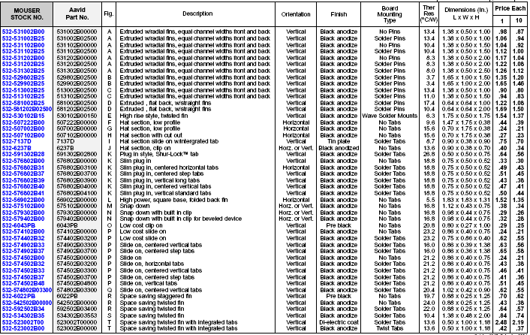

Slide 42
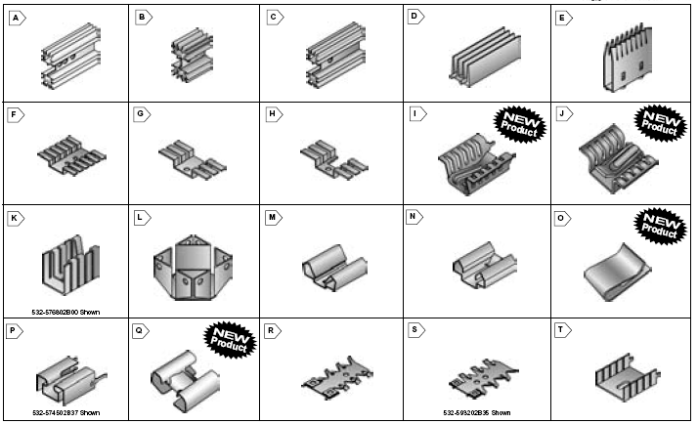
10

Slide 43
Basic Positive Voltage (Legacy) Linear Regulator
filter cap
+
A.C. “wall wart”
HF noise suppression cap
78XX-series linear regulator IC (XX= 05,12,15 typ)
⇒ can withstand a lot of ripple on input and still produce a low noise, well-regulated output
⇒ needs input voltage VN ≅ 2.5 V higher than regulated output (VL) to work properly
⇒ VL + 2.5 VDC = Regulator DROPOUT VOLTAGE

Slide 44
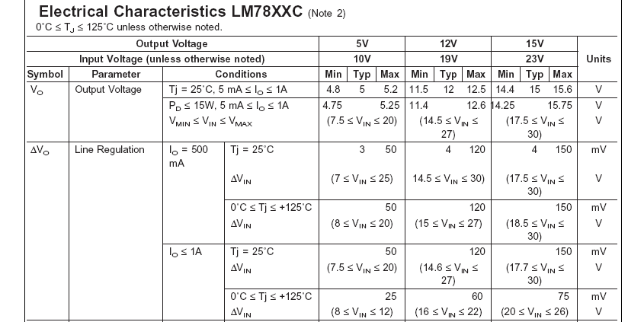
Source: http://www.nationalsemiconductor.com

Slide 45
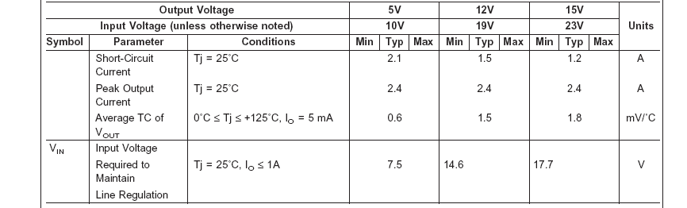
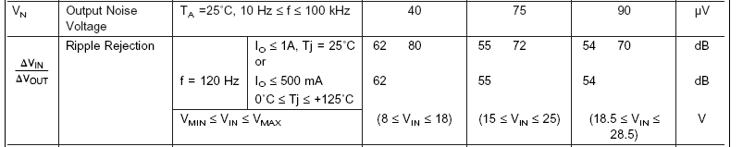

Slide 46
Basic Negative Voltage (Legacy) Linear Regulator
filter cap
+
A.C. “wall wart”
HF noise suppression cap
79XX-series linear regulator IC (XX= 05,12,15 typ)
⇒ used when negative supply voltage needed
⇒ both positive and negative supply regulators can “co-exist” (need CENTER-TAP A.C. transformer)
⇒ same dropout voltage as positive regulators

Slide 47
Analysis
ripple that can be tolerated
dropout = 2.5 V min
no-load = V_{N}
regulated = V_{L}
1/240 sec = 4.2 ms
Design constraints: Need to pick transformer secondary voltage and filter capacitor C1 such that V_{N} – ripple voltage ≥ DROPOUT VOLTAGE = V_{L} + 2.5
Note: The larger V_{N} is, the greater the voltage drop will be across the regulator ⇒ larger power (and heat!) dissipation…but the smaller V_{N} is, the bigger C1 will need to be to minimize the ripple voltage

Slide 48
Analysis
ripple = 1V
dropout = 2.5 V min
no-load = V_{N}
regulated = V_{L}
Example: For a regulated 5 VDC supply, pick V_{N} ≅ 8.5 V, so amount of ripple that can be tolerated is 1 V ⇒ transformer secondary required is 6 VAC
No load: quiescent current is approximately 6 mA ⇒ power dissipation is 8.5 x 0.006 = 51 mW
Full load (1A): 3.5 V @ 1A drops across regulator (assuming no ripple) ⇒ power dissipation = 3.5 X 1 = 3.5 W
Efficiency: 5V @ 1A (5W) delivered to load, but 3.5W dissipated by regulator ⇒ 5.0/8.5 ≅ 59% efficient

Slide 49
Analysis
ripple = 1V
dropout = 2.5 V min
V_{N} = 8.5
V_{L} = 5.0
1/240 sec = 4.2 ms
Calculate C1: Have 8.5V @ 1A load (voltage dropped across regulator is part of load) ⇒ R_{L} = V_{L}/I_{L} = 8.5Ω
Assume we want no more than 1 V of ripple ⇒ solve for C1 given that V_{Nmin} @ t=4.2 ms is ≥ 7.5 V with R_{L} = 8.5Ω
V_{L} = V_{N} x e^{-t/RC} ⇒ t = -R_{L} x C1 x ln(V_{Nmin}/V_{Nmax})
0.0042 = -8.5 x C1 x ln(7.5/8.5) = -8.5 x C x (-0.125) ⇒ C1 ≅ 3960 μF

Slide 50
Thought Question
Question: What will happen if we increase the transformer secondary voltage significantly (e.g., to 12 VAC)? ⇒ V_{N} ≅ 17 VDC
⇒ should be able to tolerate more ripple and “get by” with a much smaller C1, but power dissipation will increase and efficiency will decrease
ripple = 9.5V
dropout = 2.5 V min
V_{N} = 17 VDC
V_{L} = 5 VDC

Slide 51
Thought Question Analysis
No load: quiescent current is (still) approximately 6 mA ⇒ power dissipation is 17 x 0.006 = 102 mW
Full load (1A): 12 V @ 1A drops across regulator (assuming no ripple) ⇒ power dissipation = 12 X 1 = 12 W
Efficiency: 5V @ 1A (5W) delivered to load, but 12W dissipated by regulator ⇒ 5.0/17.0 ≅ 29% efficient
Calculate C1: Have 17V @ 1A load (voltage dropped across regulator is part of load) ⇒ R_{L} = V_{L}/I_{L} = 17Ω
Assume we want no more than 9.5 V of ripple ⇒ solve for C1 given that V_{Nmin} @ t=4.2 ms is ≥ 7.5 V with R_{L} = 17Ω
V_{L} = V_{N} x e-t/RC ⇒ t = -R_{L} x C1 x ln(V_{Nmin}/V_{Nmax})
0.0042 = -17 x C1 x ln(7.5/17) = -17 x C1 x (-0.82) = 13.9 x C1 ⇒ C1 ≅ 300 μF much smaller than previous case

Slide 52
Another Thought Question (or Two)
Question: Can you think of any applications where we “might” be willing to tolerate this kind of inefficiency?
Answer: Application with 12 VDC motor and 5 VDC microcontroller
Question: How much heat is 5-10 W? What do we need to do with it? What will it cause if we don’t do with it what we need to do with it??
- relatively speaking, a LOT
- dissipate it
- premature device failure

Slide 53
More Thought Question Analysis
Need to pick properly sized HEAT SINK to help device dissipate heat
Idea of THERMAL RESISTANCE ⇒ measured in ºC/W (temperature rise per watt dissipated) ⇒ “lower thermal resistance is better”
Example: For first case analyzed (6 VAC secondary), let’s say we don’t want heat sink/junction temperature to rise more than 10º C above ambient temperature ⇒ need a thermal resistance of approx 10º C/ 3.5 W ≅ 3
Thermalloy choice “B” comes close (3.4) – see chart

Slide 55
3.4

Slide 56
More Thought Question Analysis
Need to pick properly sized HEAT SINK to help device dissipate heat
Idea of THERMAL RESISTANCE ⇒ measured in ºC/W (temperature rise per watt dissipated) ⇒ “lower thermal resistance is better”
Example: For first case analyzed (6 VAC secondary), let’s say we don’t want heat sink/junction temperature to rise more than 10º C above ambient temperature ⇒ need a thermal resistance of approx 10º C/ 3.5 W ≅ 3
Thermalloy choice “B” comes close (3.4) – see chart
What if we’re “cheap” (only want to spend $0.43 for the heat sink instead of $1.66)? – choice “R” has a thermal resistance of 24 ⇒ will experience 24 x 3.5 = 84º C temperature rise – ouch!!
P.S. Don’t forget to use HEAT SINK COMPOUND

Slide 58
24

