Slide 1
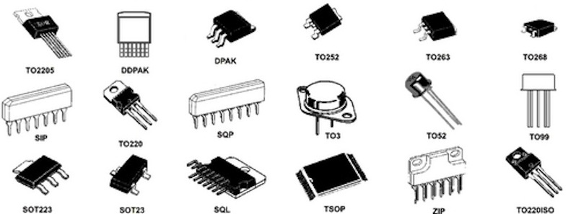
Discrete Components
George Hadley ©2014, Images Property of their Respective Owners.
Notes:
Cover photo image source: https://dlnmh9ip6v2uc.cloudfront.net/assets/c/7/a/1/9/51e0633cce395f867b000000.jpg

Slide 2
Outline
Discrete Component Overview
Passive Electrical Components (Resistors, Capacitors, Inductors)
Semiconductor Components (Diodes, Transistors)
Other Electrical Components (Oscillators, Transformers)
Mechanical Components (Connectors, Mounting)
Where to Get Components

Slide 3
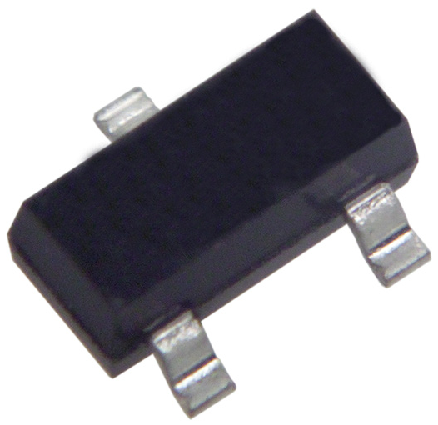
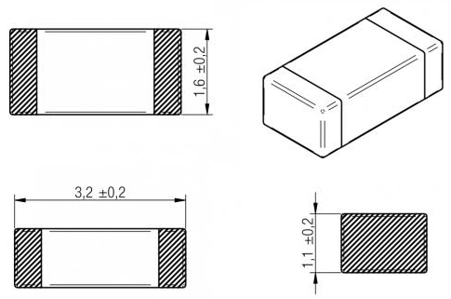
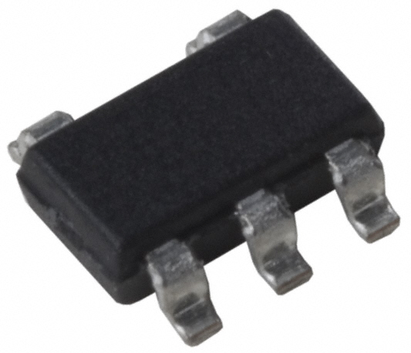
Discrete Components
Considerations
Common discrete electrical component packages:
Two terminal (1210, 1206, 0805, 0603, 0402)
Three terminal (SOT-23, SOT-223)
Five terminal (SOT-23-5, SOT-23-6)
Notes:
SMT Package Reference: http://en.wikipedia.org/wiki/Surface-mount_technology#Packages
Two-Terminal SMT Image Source: http://katalog.we-online.de/media/images/eisos/IndMI_1206_dimfixweb.jpg
Three-Terminal SMT Image Source: http://upload.wikimedia.org/wikipedia/commons/b/b0/SOT23.jpg
Five-Terminal SMT Image Source: http://media.digikey.com/photos/Micrel%20Photos/576-SOT-23-5.jpg

Slide 4
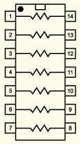
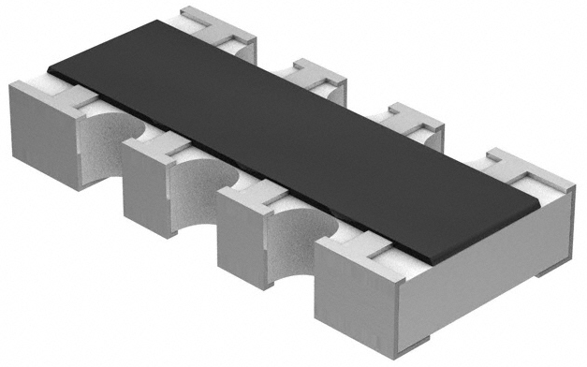
Discrete Components
Considerations 2
Depending on your needs, networks and arrays of components are available
Choice of component package impacts the amount of power that component can handle (example: 1206 resistors often rated for 0.125W whereas the same component in an 0603 package is only rated for 0.0625W)
Notes:
Resistor Network Image Source: http://www.ami.ac.uk/courses/topics/0135_cc/images/com_cc_imgb.gif
Resistor Network SMD Image Source: http://www.lucidtronix.com/system/pictures/28/original/Vishay_-_CRA06S-8.jpg?1357441237

Slide 5
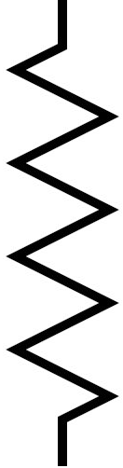
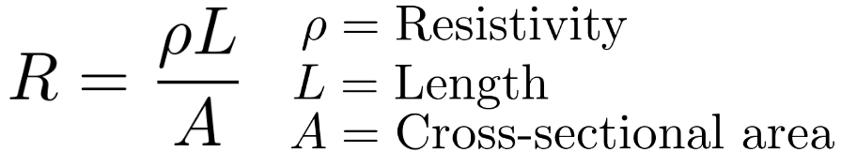
Resistors
Resistor Considerations
Resistance: Resistance value in (m/k/M)Ω
Tolerance: % error from expressed resistance value
Power/Voltage: Component rations, in W and V
Durability/Lifetime: How reliable the part is and how long it will last
Temp. Coefficient: How the resistance of the device changes as a function of temperature
Notes:
Resistance Equation Image Source: created by George Hadley
Resistor Symbol Image Source: http://lh4.ggpht.com/_9tKLtj1ReCQ/S9ZafLG5ExI/AAAAAAAAAZw/9MBWmZD7fGA/500px-Resistor_symbol_America.svg.png

Slide 6
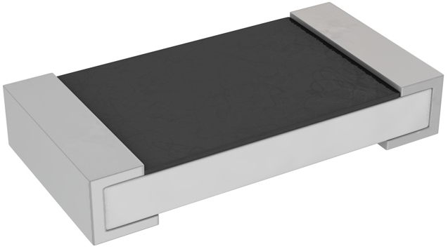
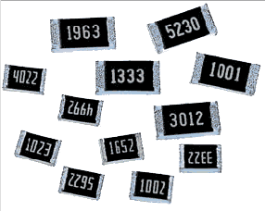
Resistors
Resistor Types – Carbon Film
Most common type for SMD and axial-lead resistors
Carbon film (resisting material) is applied to a substrate
Two varieties: “thick film” (looser tolerance, cheaper) and “thin film” (better performance, higher cost)
Thin film similar to thick film; laser trimmed for thinner films and improved properties
Useful in general resistance applications
Notes:
Carbon Film Resistor Image Source: http://media.digikey.com/Renders/Yageo%20Renders/CRSM%20PT1206.jpg
Chip Resistors Image Source: http://www.tutorialsweb.com/smt/smd-components/smt-pa1.gif

Slide 7
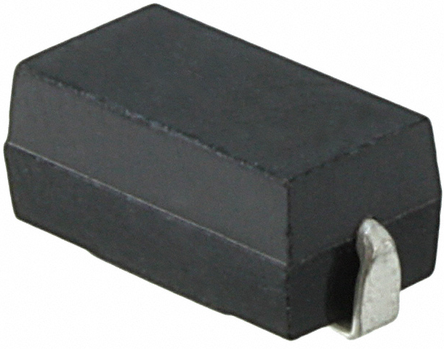
Resistors
Resistor Types – Metal/Metal Oxide Film
Similar to carbon film resistors, but uses a metallic alloy instead of carbon as the resistive element
Possess excellent linearity, temperature characteristics, power characteristics, and durability
Metallic alloy film can be replaced by a metal oxide for higher temperature operation, stability, and reliability
Notes:
Metal Film Resistor Image Source: http://www.digikey.com/product-detail/en/5-1879022-3/A103572CT-ND/2730345

Slide 8
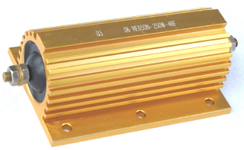
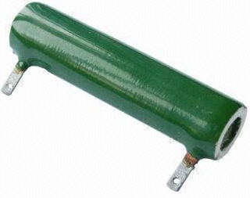
Resistors
Resistor Types – Wire Wound
Resistance achieved through use of a coil of resistive wire
Due to coil, wire wound resistors contain more parasitic inductance than other resistor types
Frequently used in high-power applications (resistors above 1W often referred to as “power resistors”)
Notes:
Aluminum Power Resistor Image Source: http://www.o-digital.com/uploads/2226/2230-1/Aluminum_Housed_Wirewound_Resistor_RX24_965.jpg
Ceramic Power Resistor Image Source: http://p.globalsources.com/IMAGES/PDT/B1051407057/Power-Resistor.jpg

Slide 9
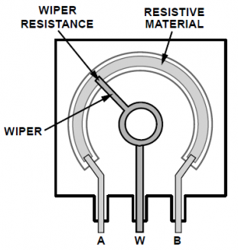
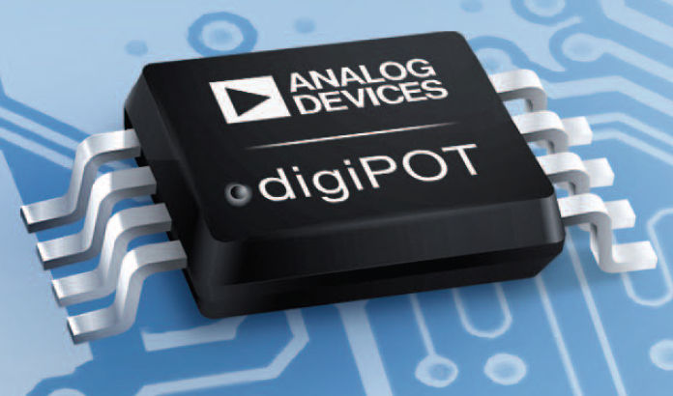
Resistors
Resistor Types – Potentiometer
Slider/wiper used to change effective resistance value
Digitally-controlled potentiometers also available (resistance controlled via PWM, I2C, SPI, etc.)
Used in variable resistance applications
Notes:
Potentiometer Image Source: http://s.eeweb.com/resized/images/remote/http_s.eeweb.com/quizzes/2011/4/27/potentiometer-construction-1317165052_500_344.png
Digital Potentiometer Image Source: http://img.directindustry.com/images_di/photo-g/digital-potentiometer-control-trimmer-22009-2912031.jpg

Slide 10
Resistors
Resistor Type Summary
Thick Film Carbon: Cheap, looser tolerances
Thin Film Carbon: Improved tolerances, higher cost
Metal Film: Good thermal stability, higher cost
Metal Oxide Film: Best thermal stability, higher cost
Wire Wound: High power ratings, good heat dissipation

Slide 11
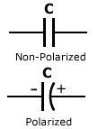
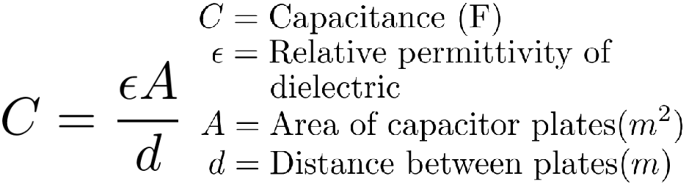
Capacitors
Capacitor Considerations
Capacitance: Capacitance value in (p/n/µ/m)F
Tolerance: %Error from stated capacitance value
Voltage: The voltage rating for the capacitor
Durability/Lifetime: How long the device will last
Equivalent Series Resistance (ESR): How much resistance is introduced by the device
Equivalent Series Inductance (ESL): How much inductance is introduced by the device
Notes:
Capacitor Equation Image Source: Created by George Hadley
Capacitor Symbol Image Source: http://www.electrotechservices.com/electronics/images/capacitor_symbols.jpg

Slide 12
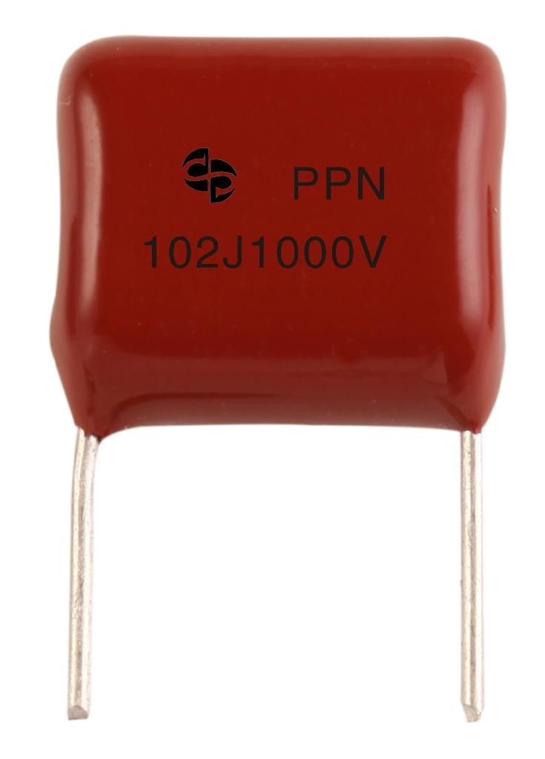
Capacitors
Capacitor Types: Film Capacitor
Foil-film and metal-film varieties
Utilize a low-K polymer dielectric (polyester, Teflon, polypropylene, polystyrene, polycarbonate, etc.)
Typical values < 10µF
Superior longevity to electrolytic
Through-hole (surface mount rare)
Foil-film: Alternating layers of dielectric and metal foil, used in applications requiring precision
Metal-film: Conductive film metallized directly onto dielectric, self-healing, reduced fire risk, used in high- voltage applications
Notes:
Film capacitor image source: http://img.diytrade.com/cdimg/1321223/17029860/0/1289310576/CBB13_polypropylene_film_metal_foil_capacitor_Non-inductive_PPN.jpg

Slide 13
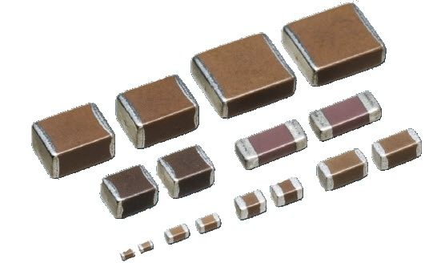
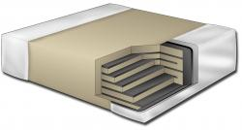
Capacitors
Capacitor Types: Ceramic Capacitor
Many surface mount chip capacitors are of this variety
Values range from ~1pF to ~1000µF
High dielectric constant (ideal in some cases, not in others)
Fast response times (~12ps)
Notes:
Chip Capacitor Image Source: http://img.directindustry.com/images_di/photo-g/chip-capacitor-ceramic-34778-2813475.jpg Chip Capacitor Cutaway Image Source: http://filecache.drivetheweb.com/mr5mr_kemet/177497/Multilayer+Ceramic+Chip+Capacitor+Cross+Section-medium.jpg

Slide 14
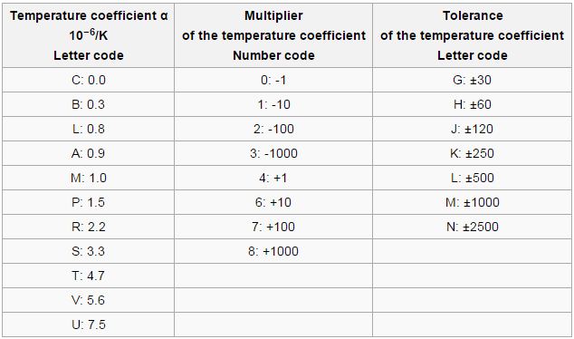
Capacitors
Ceramic Capacitors: Class 1
Class 1 ceramic capacitors are linear with temperature and have low electrical losses (high-Q devices)
Notes:
Class 1 Capacitor EIA Codes: http://en.wikipedia.org/wiki/Ceramic_capacitor#Class_1_ceramic_capacitors

Slide 15
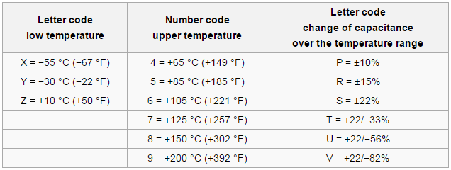
Capacitors
Ceramic Capacitors: Class 2
Class 2 ceramic capacitors are nonlinear with temperature and have higher losses but are more space-efficient
Notes:
Class 2 Capacitor EIA Codes: http://en.wikipedia.org/wiki/Ceramic_capacitor#Class_2_ceramic_capacitors

Slide 16
Capacitors
Ceramic Capacitors: Common Varieties
A few common varieties of ceramic capacitor:
C0G: High-Q, lower capacities. Useful in oscillator tuning circuits and other applications requiring precise capacitances
X5R/X7R: Nonlinear temperature constant (looser tolerances), cheaper than C0G ceramics
Z5U: Lower temperature stability than X5R/X7R, space efficient, cheap, often used in bypass and decoupling capacitor applications
Y5V: Lowest temperature stability, smallest, cheapest, may behave undesirably when DC-biased.
Notes:
Capacitor EIA Codes: http://en.wikipedia.org/wiki/Ceramic_capacitor

Slide 17
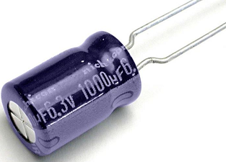
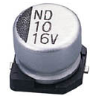
Capacitors
Capacitor Types: Electrolytic Capacitors
Dielectric is a very thin oxide layer grown chemically on the solid (typically aluminum) electrode
Electrolytic capacitors use an electrolyte solution as a “wet” electrode (typically use paper soaked with solution)
Electrolytic capacitors feature very high capacities and charge densities
Available in polarized and non-polarized varieties
Polarized caps can be destroyed if reverse-biased
Wet electrode of electrolytic caps can dry out over time, giving these devices limited life
Notes:
SMD Electrolytic Capacitor Image Source: http://www.su-scon.com.tw/Templates/pic/CN-01.jpg
Through-Hole Electrolytic Capacitor Image Source: https://content.solarbotics.com/products/photos/25f8597834fa83a403afdbd66e7929b1/lrg/cp1000uf.jpg

Slide 18
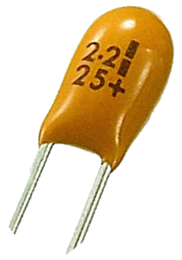
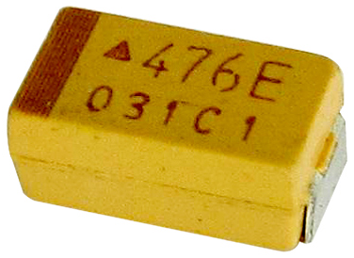
Capacitors
Capacitor Types: Tantalum Capacitors
Use a dry electrolyte (increases device lifetime)
Extremely thin dielectrics – results in higher capacitances and charge densities than aluminum electrolytics
Lower voltage operation (50V max typical)
Expensive (due to rarity of tantalum)
Modest transient response (~100ps)
High ESR typical
Notes:
SMD Tantalum Capacitor Image Source: http://image.made-in-china.com/2f0j00beqECUucOvrQ/SMD-Tantalum-Capacitor.jpg
Through-Hole Tantalum Capacitor Image Source: http://www.capacitorguide.com/wp-content/uploads/tantalum-capacitor.png

Slide 19
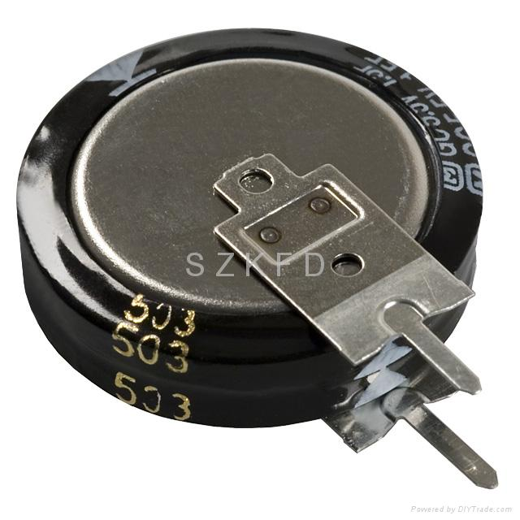
Capacitors
Capacitor Types: Supercapacitors (Ultracapacitors)
Hybrid capacitor device:
Electrostatic: Helmholtz double layer separates charge on the order of a few ångströms (0.3–0.8 nm)
Electrochemical: Some charge stored electrochemically, using methods similar to rechargeable batteries
Highest energy densities of any capacitor (up to 12kF@1.2V) but deliver/accept less than half as much power (power density)
Used for short-term storage of large amounts of energy and “burst-mode” power delivery
Notes:
Supercapacitor Image Source: http://img.diytrade.com/cdimg/636820/4740015/0/1210559781/Super_Capacitor_EECS5R5V105_EECS5R5V155.jpg

Slide 20
Capacitors
Capacitor Summary
Film Capacitors: High accuracy, high stability, poor space efficiency
Ceramic Capacitors: Higher space efficiency, lower accuracy, lower stability
Electrolytic Capacitors: High space efficiencies, reduced lifetimes, polarity considerations
Tantalum Capacitors: Higher capacities, high ESR, lower max voltages
Supercapacitors: Highest capacities, lowest max voltages, low frequency responses
Notes:
Supercapacitor Image Source: http://img.diytrade.com/cdimg/636820/4740015/0/1210559781/Super_Capacitor_EECS5R5V105_EECS5R5V155.jpg

Slide 21

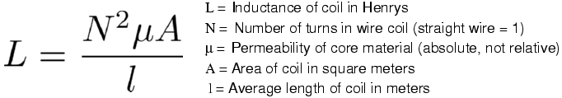
Inductors
Inductor Considerations
Inductance: Inductance value in (n/µ/m)H
Q-Factor: How ideal of an inductor is the device
Core Type: What type of core material the inductor uses (affects permeability, saturation, and other device characteristics)
Wire Gauge: What diameter of wire the coil uses
Equivalent Series Resistance (ESR)
Maximum Current Rating
Notes:
Inductance Equation Image Source: http://www3.eng.cam.ac.uk/DesignOffice/mdp/electric_web/AC/12100.png
Inductor Symbol Image Source: http://upload.wikimedia.org/wikipedia/commons/thumb/1/18/Inductor_symbol.svg/512px-Inductor_symbol.svg.png

Slide 22
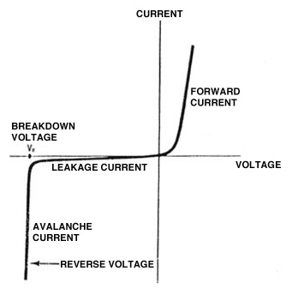
Diodes
Diode Considerations
Forward Current: Maximum current the device can pass
Forward Voltage: Voltage dropped across the device when conducting
Leakage Current: Current that can pass through device when reverse-biased
Breakdown Voltage: Maximum tolerable reverse voltage before avalanche breakdown occurs
Recovery Time: How quickly the diode responds (related to device frequency response)
Notes:
Diode IV Curve Image Source: Acquired from previous passive component lectures by David Meyer

Slide 23
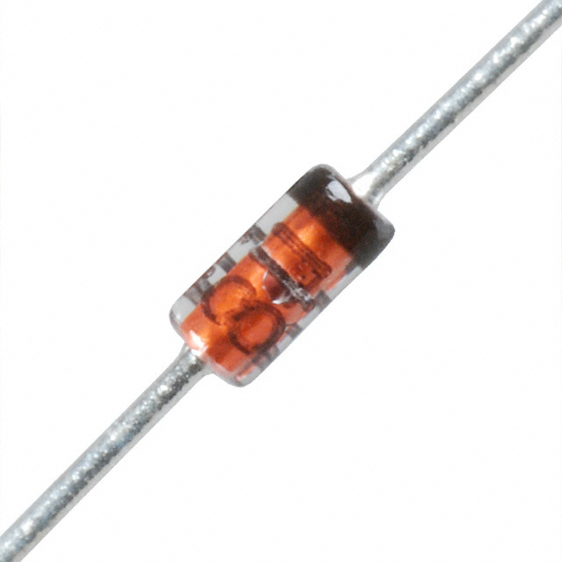
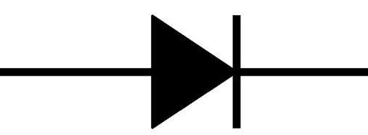
Diodes
Diode Types: PN Junction Diodes
Formed by using the junction between two “doped” semiconductor materials (typically silicon)
Junction capacitance reduces performance at high frequencies
Used in general purpose applications
Typical forward voltage: ~0.7V
Notes:
Diode Symbol Image Source: http://i1.wp.com/make-images.s3.amazonaws.com/TOoBcVnsw1NNcjYa.jpg?resize=620%2C465
1N4148 Diode Image Source: http://media.digikey.com/photos/Micro%20Commercial%20Photos/353-DO-35%20(1N914,1N4148%20Series).jpg

Slide 24
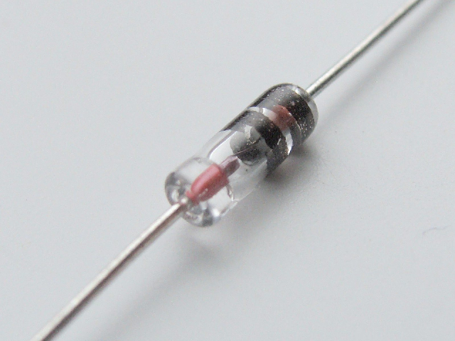
Diodes
Diode Types: Germanium Diodes
Similar to silicon diodes, but germanium is used instead
Germanium properties allow for improved response characteristics and high-frequency operation
Often used in RF and radio applications
Typical forward voltage: ~0.3V
Notes:
Diode Symbol Image Source: http://i1.wp.com/make-images.s3.amazonaws.com/TOoBcVnsw1NNcjYa.jpg?resize=620%2C465
1N60P Diode Image Source: http://upload.wikimedia.org/wikipedia/commons/0/06/Germanium_Diode_1N60P.jpg

Slide 25
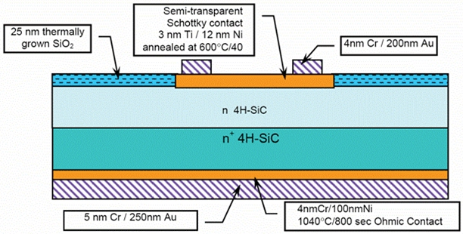
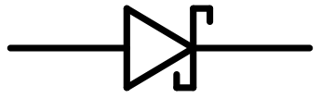
Diodes
Diode Types: Schottky Diode
Similar to silicon diode, but one of the silicon junction materials is replaced with a metal
Use of a metal reduces junction capacitance, improving frequency response at higher frequencies
Higher leakage currents than silicon junction diodes
Often used in high speed applications
Typical forward voltage: 0.4V – 0.5V
Notes:
Schottky Diode Symbol Image Source: http://upload.wikimedia.org/wikipedia/commons/thumb/c/c9/Schottky_diode_symbol.svg/500px-Schottky_diode_symbol.svg.png
Schottky Diode Construction Image Source: http://sci.esa.int/science-e-media/img/61/Schottky-diode1.jpg

Slide 26
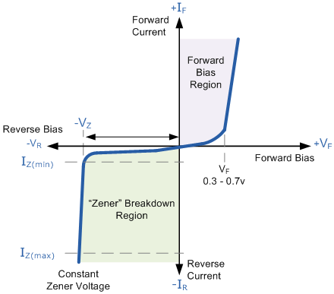
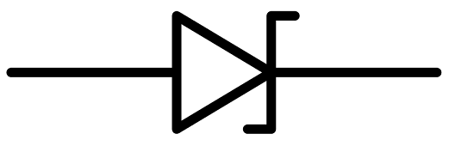
Diodes
Diode Types: Zener Diode
Diode specially designed to operate in the breakdown voltage range (other diodes can be damaged when operating in breakdown)
Provides a fixed voltage across a wide range of currents
Commonly used as a voltage reference
Available in many breakdown voltages (2.7V, 3.3V, 5.6V, etc.)
Notes:
Zener Diode I-V Curve Image Source: http://www.electronics-tutorials.ws/diode/diode11.gif
Zener Diode Symbol Image Source: http://upload.wikimedia.org/wikipedia/commons/thumb/7/7f/Zener_diode_symbol.svg/1280px-Zener_diode_symbol.svg.png

Slide 27
Diodes
Diode Summary
PN Junction Diode: General purpose operation, slower response times, ~0.7V forward voltage
Germanium Diode: High speed operation, often used in RF applications, ~0.3V forward voltage
Schottky Diode: Higher speed operation, higher leakage current, 0.4-0.5V forward voltage
Zener Diode: Designed for operation in breakdown region, often used to provide fixed voltage reference

Slide 28
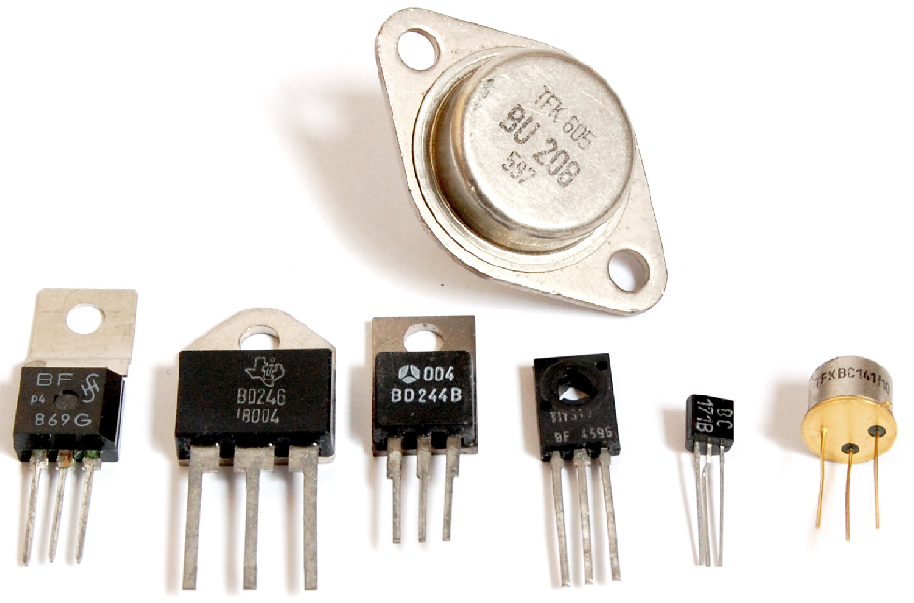
Transistors
Transistor Considerations
Voltage: Voltage at which the device operates (in W)
Power: Maximum rated power dissipation (in W)
Frequency: Max frequency at which the device can switch
Amplification: The gain from the base/gate
Current: Maximum allowable current through the device
Notes:
Transistor Image Source: http://upload.wikimedia.org/wikipedia/commons/0/0e/Transistors-white.jpg

Slide 29
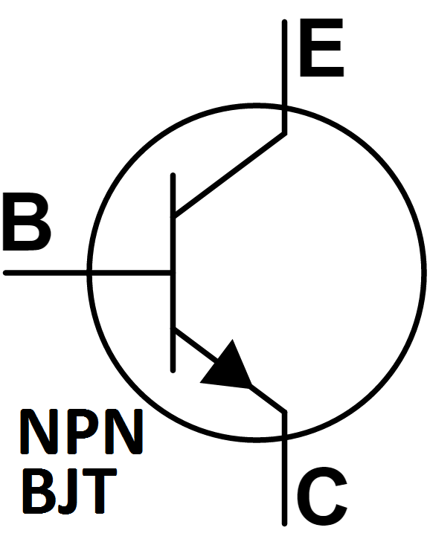
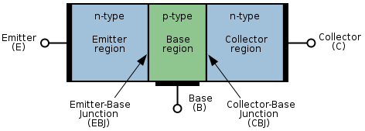
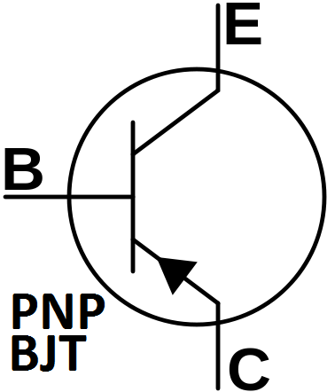
Transistors
Transistor Types - BJTs
Formed through a combination of two junction diodes
3 terminals – base, emitter, and collector
Require base current to be switched on or off
β - current gain from base to collector
Two types – npn and pnp
Cheap to produce but more susceptible to damage
Notes:
BJT Construction Image Source: http://upload.wikimedia.org/wikipedia/commons/thumb/f/fe/NPN_BJT.svg/475px-NPN_BJT.svg.png
NPN BJT Image Source: http://upload.wikimedia.org/wikipedia/commons/a/aa/BJT_symbol_NPN.svg
PNP BJT Image Source: https://upload.wikimedia.org/wikipedia/commons/thumb/0/0d/BJT_symbol_PNP.svg/408px-BJT_symbol_PNP.svg.png

Slide 30
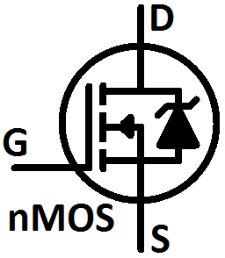
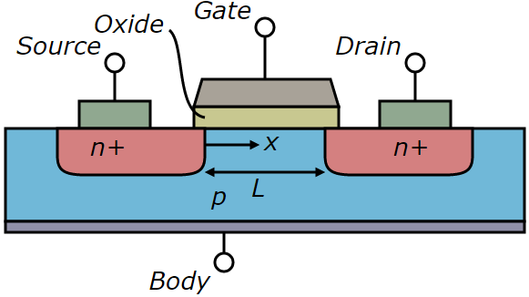
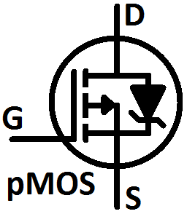
Transistors
Transistor Types - MOSFETs
Can operate as a voltage-controlled switch
3 terminals – gate, source, and drain
Require gate voltage to be switched on or off
h_{FE} – Transistor gain
nMOS and pMOS varieties available
Feature integrated diodes (body diodes)
Notes:
MOSFET Diagram Image Source: http://upload.wikimedia.org/wikipedia/commons/7/79/Lateral_mosfet.svg
MOSFET Symbol Image Source: Self created.

Slide 31
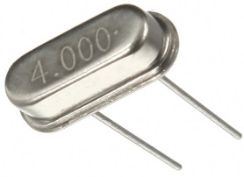
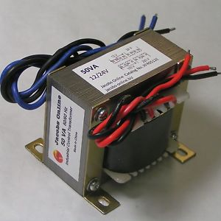
Other Electrical Components
Crystal Oscillators (XTAL):
Used to maintain a precise clock in digital circuits
External crystals often used when internal RC oscillators are not precise enough
Transformer:
Used to magnetically couple circuits together
Ratio of turns in coils controls voltage current ratio between circuits
Often used in power supplies and isolation applications
Notes:
Crystal Oscillator Image Source: http://img.banggood.com/thumb/view/upload/SKU033936/20120621120759656.JPG
Transformer Image Source: http://i.ebayimg.com/00/s/MTUxM1gxNTEz/z/kQ0AAOxyTjNSgrmX/$_35.JPG

Slide 32
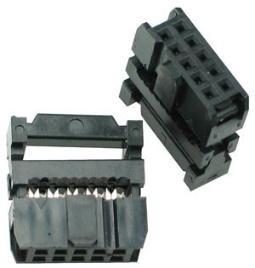
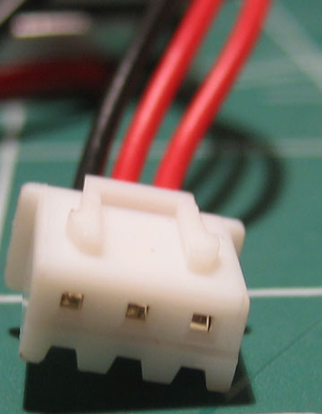
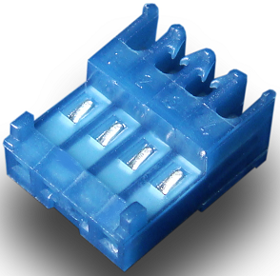
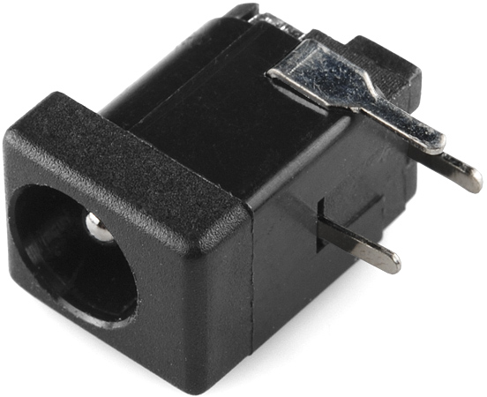
Mechanical Components
Connectors
Used to effectively and “cleanly” connect boards together (often used in conjunction with ribbon cables)
Considerations:
Physical Layout (width, height, pin array dimensions)
Voltage/Current/Power ratings
Ease of crimping and availability of tools
IDC
JST
MTA100
Barrel Jack
Notes:
Barrel Jack Image Source: http://www.karlssonrobotics.com/cart/prodimages/10811-01.jpg IDC Connector Image Source: https://www.futurlec.com/Pictures/IDCC10.jpg
JST Connector Image Source: http://www.phoenix-rc.com/images/products/CellPro-JST-XH-2s.jpg
MTA100 Connector Image Source: http://www.hrb-dg.com/upload/1381196873.jpg

Slide 33
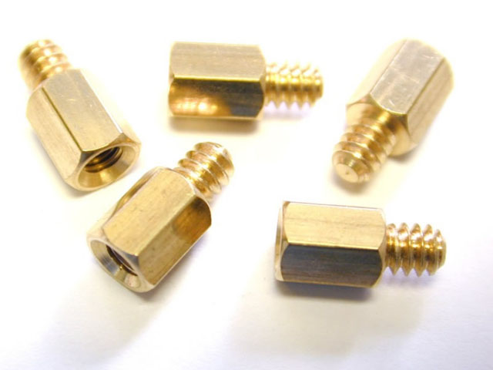

Mechanical Components
Standoffs
One method for physically mounting circuit boards to chasses
Require use of drilled mounting holes (need to be included in PCB layout)
Can enable stacked PCB designs (see below)
Notes:
Stacked PCB Image Source: http://alphazone1.com/x0xi0/install/mixer_pcb_files/image008.jpg
Standoffs Image Source: http://www.mountainmods.com/images/images_big/BSTANDOFF.jpg

Slide 34
Obtaining Parts
Vendors
Where do I get parts?
DigiKey, Mouser, Newark, Futurlec, McMaster Carr, etc.: Reputable online vendors, competitive prices
Sparkfun, Adafruit, etc.: Sell components at substantial markup. Recommend as last resort if a part is need online
EE Instrument Room, Lafayette Electronic Supply: Local component sources (Lafayette, IN specific)
Radioshack: When you need parts TODAY. $$$$$$$$$$$$$$
Other considerations for parts:
Source as many parts from a single vendor as possible (reduces shipping costs)
Purchase parts from reputable vendors if possible (beware of shady vendors and parts with poor documentation/support)
Notes:
Stacked PCB Image Source: http://alphazone1.com/x0xi0/install/mixer_pcb_files/image008.jpg
Standoffs Image Source: http://www.mountainmods.com/images/images_big/BSTANDOFF.jpg

Slide 35


Obtaining Parts
Part Search Engines
Octopart: https://octopart.com
Findchips: http://www.findchips.com
Allow users to search multiple vendors and compare prices, availability, cost breakpoints, etc. on components
Notes:
FindChips Logo Image Source: http://hackadaycom.files.wordpress.com/2013/09/randy_sargent-founder-of-findchips1.png?w=580
Octopart Logo Image Source: https://blog.octopart.com/wp-content/uploads/2014/08/Octopart_logo.png

Slide 36

Obtaining Parts
Sampling Parts
In addition to normal electronics channels, some vendors generously offer free samples of some parts for engineers to test to determine their validity in end product designs
Before ordering a part for prototyping purposes, it may be beneficial to see if samples can be procured
Sample parts programs behave somewhat on an honors system, and benefit the engineering community at large. Therefore, don’t abuse them.
Notes:
Free Samples Image Source: http://electronicsreviewsblog.info/wp-content/gallery/microchip-samples/microchip_samples-2.jpg

Slide 37
Obtaining Parts
Tips for Procuring Parts
To maximize your experience procuring parts:
Order parts that are currently available and in production. DO NOT rely on parts that are going to be in future production, parts that are EOL and not recommended for new designs, or any parts that cannot be found in stock
Order parts with good documentation and community support
Order parts that can be shipped in a reasonable timeframe (2 weeks or less recommended)
Order spare parts (at least 2 copies of most parts is highly recommended; 3-5 is even better)
Order parts from established vendors to minimize risks of counterfeit parts and shady practices.
Notes:
Free Samples Image Source: http://electronicsreviewsblog.info/wp-content/gallery/microchip-samples/microchip_samples-2.jpg

Slide 38
Obtaining Parts
What About Ebay?
Occasionally you may find parts selling for less than retail value on market sites such as eBay or Alibaba
Buyer Beware
eBay, Alibaba, etc. often suffer from significant problems, including:
Lack of reliable documentation: Vital for designs involving the products or components at hand
Increased likelihood of counterfeit parts: Which may not work as well as advertised, or at all
All of this leads to increased risk, so:
Always check the seller rating, documentation, and community support for parts AND
Proceed with caution

Slide 39

Obtaining Parts
Counterfeit Parts
The global economy, outsourced manufacturing and supply chains, and economic incentives have lead to significant increases in counterfeit chips and components in recent years
For an excellent case study in counterfeit electronics, see this post regarding the Chumby (open source hardware project) and issues faced from counterfeit ICs
Notes:
Counterfeit Electronics Parts: http://bunniestudios.com/blog/images/microsd_1.jpg

