Slide 1
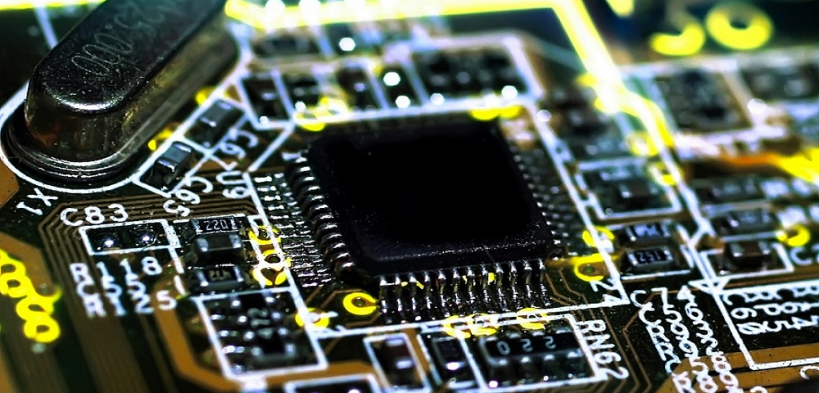
Embedded Hardware
Interfacing
George Hadley ©2014, Images Property of their Respective Owners.
Notes:
George Hadley ©2014
Cover image source: http://hd.wallpaperswide.com/thumbs/motherboard-t2.jpg

Slide 2
Outline
Microcontroller Selection
General Interfaces
User I/O Interfaces
Sensors
Actuators and How to Control Them
Memory
Wired Interfaces
Wireless Interfaces

Slide 3
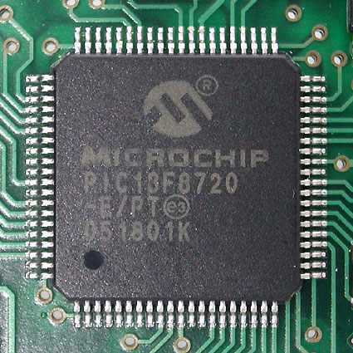
Microcontroller Selection
Importance and Guidance
Many different types and
manufacturers w/ variety of
metrics and capabilities
Many selection considerations
also apply to microprocessors,
CPLDs, FPGAs, etc.
2 “phases” of microcontroller
selection:
Initial Prototyping/Proof of Concept: Choose an appropriate device family (parts within should be pin compatible) for the final product, then pick the most powerful device in that family
Mature Prototype/Production: Based on your requirements from phase 1 (memory, etc.), refine your choice to a more cost-efficient part
Notes:
Microcontroller image source: http://upload.wikimedia.org/wikipedia/commons/1/18/PIC18F8720.jpg

Slide 4
Microcontroller Selection
Performance Considerations
Speed (a.k.a. frequency) – How fast can your device run? (Generally measured in MHz)
Power – How much power does your device consume? (Generally measured by current consumption in mA or µA)
Memory – How much onboard memory does your device have? (Measured in kB, typically)
Voltage – What voltage range can your device operate at? (Lower voltages use less power for a given frequency)

Slide 5
Microcontroller Selection
Capability Considerations
What onboard computational features does your device possess?
DSP operations (integrated multiply- accumulate, etc.)
Floating-point support?
Types of memory:
EEPROM – byte-addressable, nonvolatile
Flash – page-addressable, nonvolatile
RAM – byte addressable, volatile

Slide 6
Microcontroller Selection
Interface Considerations
What peripherals does your device possess?
General µC interfaces (recall from ECE362):
I²C, SPI, UART, GPIO, ADC, PWM, etc.
DAC (Digital-to-Analog) – Improved performance over PWM w/ lowpass filter
Computing interfaces:
USB, Ethernet, Bluetooth, etc.
Other specialty interfaces:
1-Wire, I²S, DMA, CAN, OBD-II, etc.
Interfaces can be implemented in software (referred to as “bit-banging”)

Slide 7
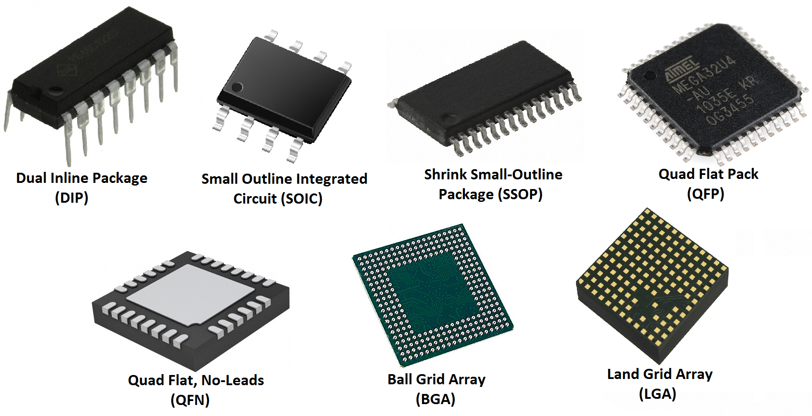
Microcontroller Selection
Packaging Considerations
Variety of device
packages available
Some packages are
impossible to solder
by hand (BGA, LGA,
most QFN)
Some packages contain
under-chip pads used for heat dissipation and/or mechanical stability
Recommendation: choose the most dense package variant for your desired part that you can solder by hand
(for initial prototyping phase, at least)
Notes:
DIP Image Source: http://media.digikey.com/photos/Microchip%20Tech%20Photos/RE46C122E16F.JPG
SOIC Image Source: http://estore.digxtech.com/image/cache/data/ProductImages/ICs_General/8Pin_SOIC_IC_1-600x600.jpg
SSOP Image Source: http://media.digikey.com/Photos/FTDI%20(Future%20Tech%20Devices)/28-SSOP.jpg
QFP Image Source: https://dlnmh9ip6v2uc.cloudfront.net/assets/8/3/6/3/b/51dc6e21ce395f0807000000.png
QFN Image Source: http://icanbuild.it/wp-content/uploads/2011/11/28-QFN-package.jpg
BGA Image Source: http://anysilicon.com/wp-content/uploads/2012/07/bga1-anysilicon.jpg
LGA Image Source: http://media.digikey.com/Photos/Linear%20Tech%20Photos/LTM4613.jpg

Slide 8
Microcontroller Selection
Other Considerations
Availability/cost of programming and debugging tools
Availability/cost/usability of software development tools
Age/status of the product. (Near end-of-life (EOL)? In production? Future product?)
Ease of acquiring device samples.
Ease of acquiring the microcontroller itself. Is it in stock? Can you get spares (2-3 spares)?
Silicon-level bugs in the manufactured devices (IC manufacturers generally publish known bugs in “Silicon Errata” documents which are available online)

Slide 9
Microcontroller Selection
Manufacturers and Availability
Various device manufacturers exist to research potential parts (use parametric selection tools to narrow offerings):
Microchip – http://www.microchip.com
Atmel – http://www.atmel.com
Texas Instruments – http://www.ti.com
Freescale Semiconductor – http://www.freescale.com
STMicroelectronics – http://www.st.com
Analog Devices – http://www/analog.com
NXP Semiconductors – http://www.nxp.com
Cypress Semiconductor - http://www.cypress.com/
Parts can be purchased or sampled (in some cases)

Slide 10
General Interfacing
Level Translation
Various logic families (5V, 3.3V, 2.5V, 1.8V, etc.)
Often necessary to convert from one voltage domain to another (e.g. a 3.3V microcontroller communicating with a 5V sensor)
Different level translation techniques available depending on:
Duplex (one-way communication or bidirectional?)
Number of lines (1 line? Several?)
Speed of communications
Dedicated ICs available, as well as analog methods (app notes available online)

Slide 11
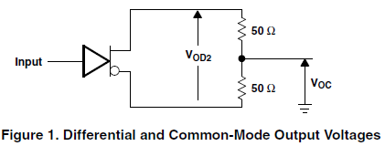
General Interfacing
Line Driving
Amplifier used to boost the strength of analog/digital signals
Typically used to drive signals over extended lengths of cable
Often used in telecommunications, audio, and certain digital computing applications (RS-232, USB, etc.)
ICs available from various
manufacturers to perform
line-driving functions
Notes:
Line Driver Schematic Image Source: http://www.ti.com/lit/ds/symlink/ua9638.pdf

Slide 12
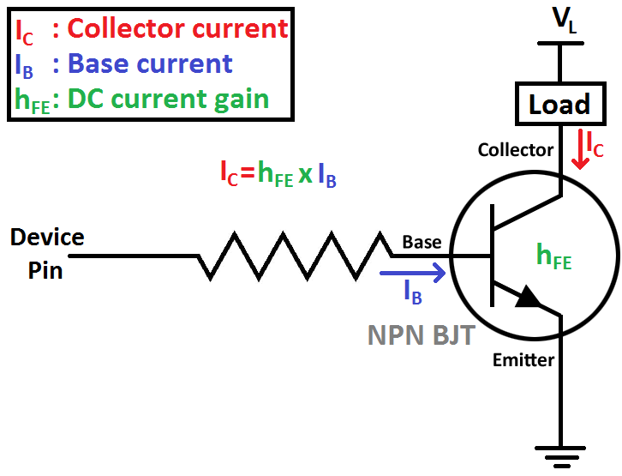
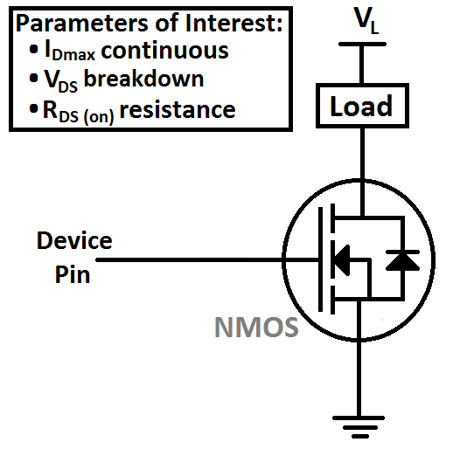
General Interfacing
Switching DC Loads – Transistors
µC/FPGA/etc. device pins are often incapable of sinking/sourcing sufficient current for a DC load
BJTs and MOSFETS can be used as switches in these situations, allowing a load to be switched on or off
Notes:
BJT, MOSFET Image Source: Self created.

Slide 13
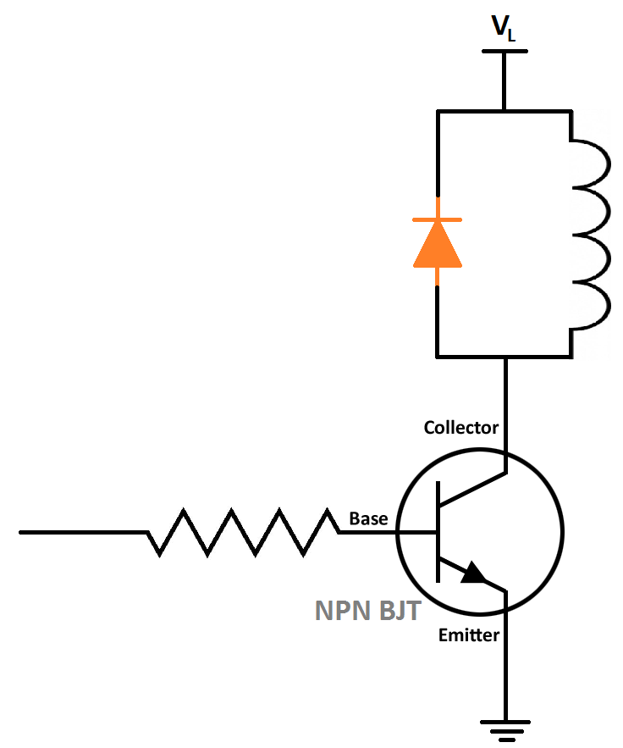
General Interfacing
Switching DC Loads – Transistors 2
Tradeoffs:
BJTs: May require substantial base current to achieve saturation (Darlington pairs often used to obtain high
h_{FE} at high I_{C})
MOSFETs: Require minimal gate current and less
susceptible to thermal runaway; more expensive
Inductive loads (relays, motors, etc.) may require
an arc suppression diode (Energy stored in an
inductive load must be dissipated;
otherwise the “inductive kickback”
can damage the switching device)
Notes:
Transistor Inductive Load Image Source: self created

Slide 14
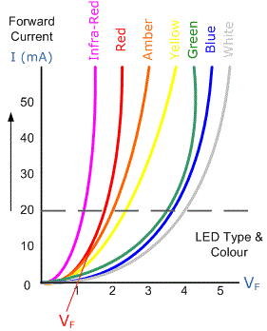
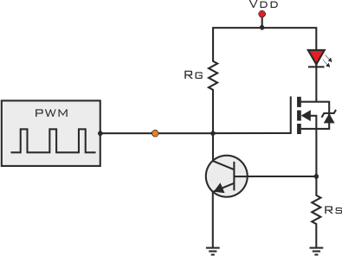
General Interfacing
Switching DC Loads – Constant Current Drivers
Some devices (LEDs, etc.) are sensitive to the current passed through them
Even small changes in the forward voltage of the LED can lead to significant changes in the current flowing through the device (potential to cause damage)
For these applications, constant current
drivers may be desirable
Drivers can be created using discrete
parts or purchased as ICs
Notes:
Constant Current Driver Image Source: http://www.pcbheaven.com/userpages/images/LED_driving_and_controlling_methods_14.png
LED I-V Curve Image Source: http://www.electronics-tutorials.ws/diode/diode12.gif

Slide 15
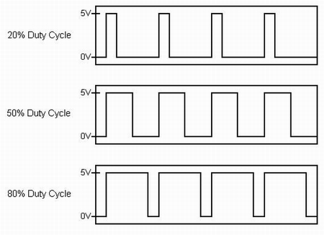
General Interfacing
Pulse Width Modulation (PWM)
Modulation technique in which the duty cycle of a pulsed signal is varied based on the transmitted data
Can be implemented in software
Major uses:
  Reducing power consumption by devices (LEDs)
  Motor speed control
  Simple audio
  Sensors
Notes:
PWM Image Source: http://www.ni.com/cms/images/devzone/tut/a/dadc74b4230.jpg

Slide 16
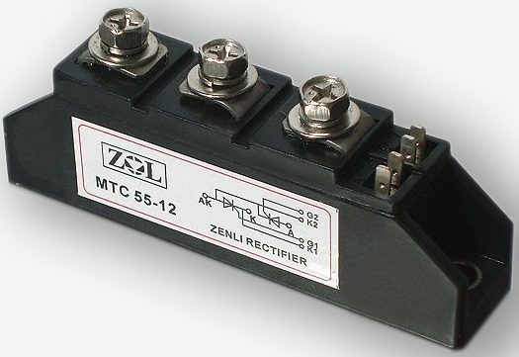
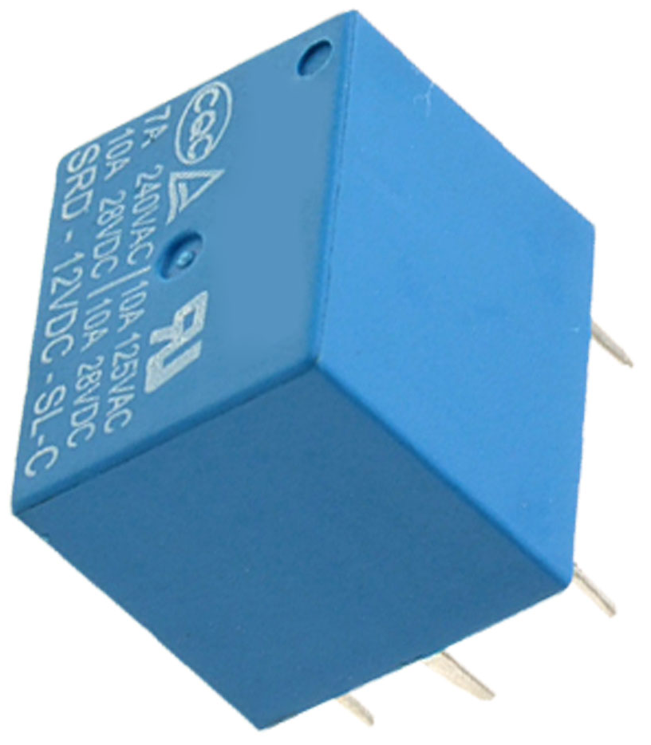
General Interfacing
Switching AC Loads
Sometimes needed for control of home appliances and devices (lamps, fans, etc.)
Generally use relays or semiconductors:
Relay: Mechanical device triggered using an electromagnet
Semiconductors: Cheaper, higher reliability, less noisy, special control requirements
Heat sinking and isolation usually required
Notes:
Relay Image Source: http://m4.sourcingmap.com/photo_new/20080229/g/ux_a08022900ux0021_ux_g03.jpg
SCR Image Source: http://img.alibaba.com/img/pb/183/259/239/1269679937279_hz_myalibaba_web13_4178.JPG

Slide 17
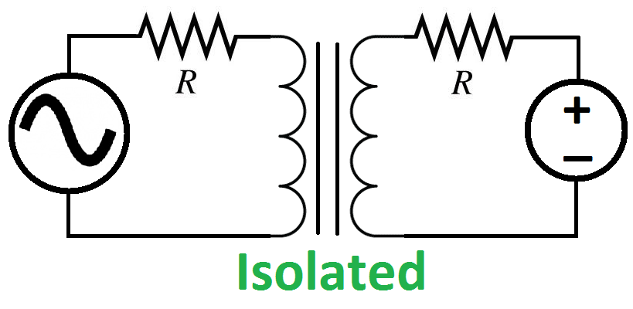
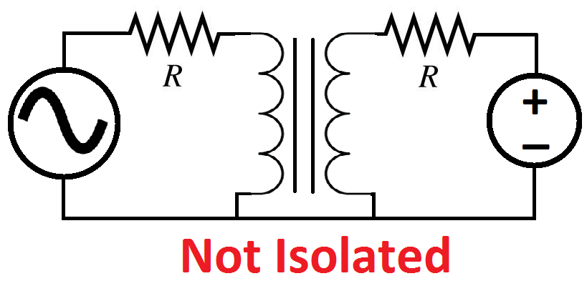
General Interfacing
Isolation
Isolation: The act of preventing current flow between 2 circuits by providing no direct conductive path between the elements of one circuit and those of another; often used in safety and reliability situations
Isolation is often ideal when an electrical failure in one circuit (such as a high-power DC load) could cascade to and destroy another circuit (such as a microcontroller)
IMPORTANT: Isolated circuits CANNOT have a shared ground connection; a shared ground connection defeats any efforts to isolate the circuits
Notes:
Isolated, Non-Isolated Image Source: Self created

Slide 18
General Interfacing
Isolation 2
Numerous methods exist to provide isolation between circuits:
Transformers: Provide isolation via magnetic flux between coils
Opto-isolators/Optocouplers: Provide isolation via light transmitted over an air gap
Capacitors: Provide isolation via electric fields over an air gap (pass AC signals but not DC signals)
Hall-Effect Sensors: Use an inductor to transmit information across an air gap magnetically
Relays/Solenoids: Allow flow of electricity when closed, air gap when open

Slide 19
General Interfacing
Isolation 3
Places where isolation is often used:
Safety situations: An electrical failure could cause injury or death to a living thing
Mission-critical situations: An electrical failure could cause catastrophic damage or destruction of an expensive piece of equipment
High-power loads: (E.g. high-power LEDs, motors, etc.) An electrical failure could cascade and cause damage or destruction of critical circuitry such as a microcontroller or FPGA
At point-of-entry for offboard cables: A long offboard cable can act like a large antenna, allowing to pick up large, unexpected, and potentially damaging induced voltages
and currents

Slide 20
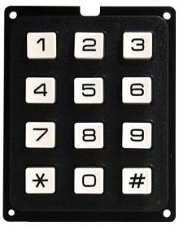
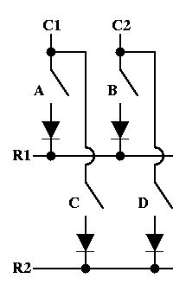
User I/O Interfacing
Keypads and Switch Matrices
Projects may call for a matrix of switches or switch-like elements (magnetic sensors, light sensors, etc.)
Standard approach is to assert individual rows of
the matrix and listen for signals on the columns
of the matrix. (Repeatedly scan through each row
of switch matrix). Can be performed by Keypad
Encoder IC (or similar)
Without proper care, “ghosting” or “masking” can
occur on a keypad matrix when attempting to
detect multiple key presses
An excellent writeup on switch matrices can be
found here:
http://www.dribin.org/dave/keyboard/one_html/
Notes:
Keypad Image Source: http://www.zen22142.zen.co.uk/Circuits/Switching/12keypad.jpg
Switch Matrix Image Source: http://www.dribin.org/dave/keyboard/one_html/switch_open.gif

Slide 21
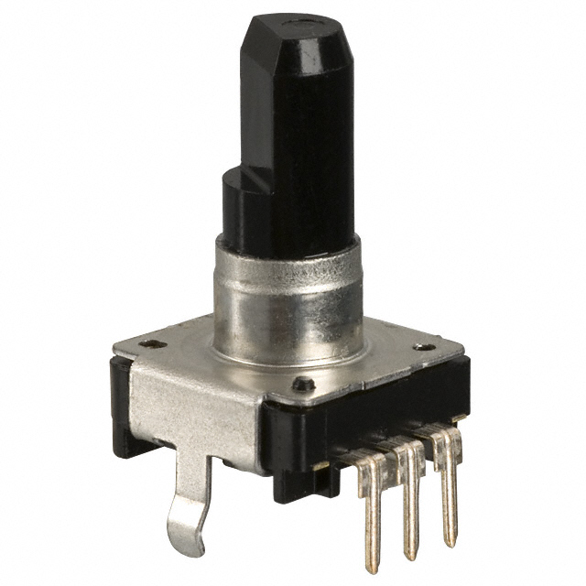
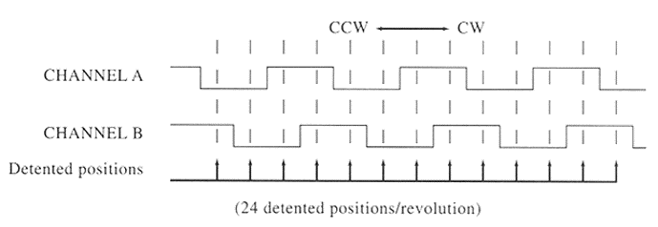
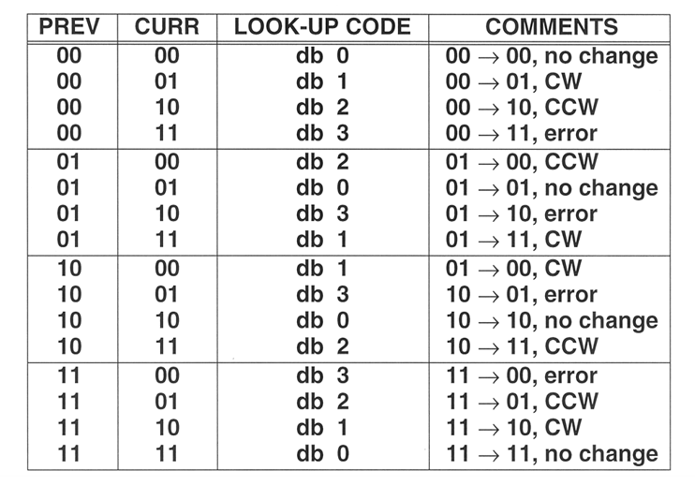
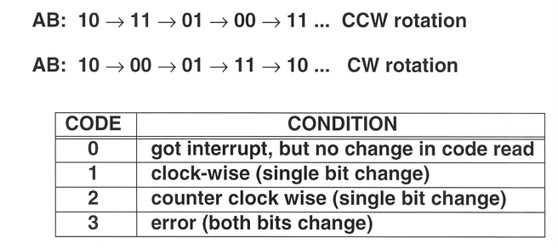
User I/O Interfacing
Rotary Encoders
Convert the angular position or motion of a shaft into an analog or digital code
Often used on user interfaces as knobs, particularly in instances when unlimited rotation is desirable
Notes:
Rotary Encoder Image Source: http://media.digikey.com/photos/Panasonic%20Photos/EVE-GA1F2012B,%20EVE-GA1F2024B.jpg
Timing Graphs and Logic Table: Borrowed from previous iteration of hardware interfacing lecture by Prof. David Meyer; original source unknown

Slide 22
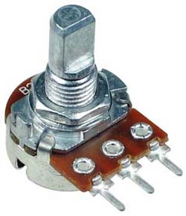
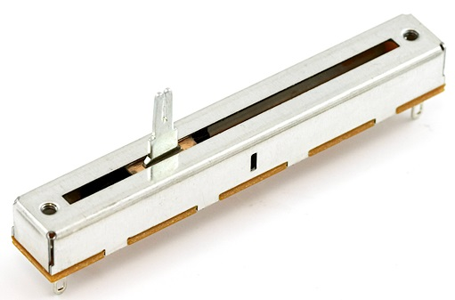
User I/O Interfacing
Knobs and Sliders
Sliders and knobs are generally available as potentiometers
Linear scales and logarithmic scales available (log scale potentiometers often used in audio and video applications)
Reading slider value is as simple as performing A/D conversion on the potentiometer value
Notes:
Rotary Potentiometer Image Source: http://amprepairparts.com/dshaft16.jpg
Slide Potentiometer Image Source: https://cdn.sparkfun.com//assets/parts/2/5/2/4/09119-03-L.jpg

Slide 23
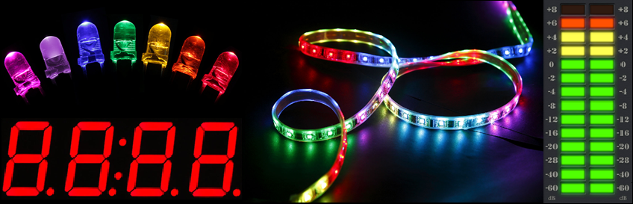
User I/O Interfacing
LEDS
Many types: Discrete, 7-segment display, LED strip, LED meter, etc.
Variety of colors: single color, bicolor, RGB, etc.
(color of LED influences forward voltage of LED)
Notes:
Discrete LED Image Source: http://th00.deviantart.net/fs70/PRE/f/2013/234/d/6/led_rainbow_by_steeph_k-d6jb8az.jpg
7-Segment Display Image Source: http://www.adafruit.com/images/1200x900/878-00.jpg
LED Strip Image Source: http://www.hitlights.com/blog/wp-content/uploads/2012/12/Illusion-LED-Strip-RRFT1000-40RGBD-1.jpg
LED Meter Image source: https://lh3.ggpht.com/amItC01K_Rlh7jlJCXB-2DVzu4czrZFz90776i46Z51rIvtFWLEPBw1cAawOopnUAQ=h900

Slide 24
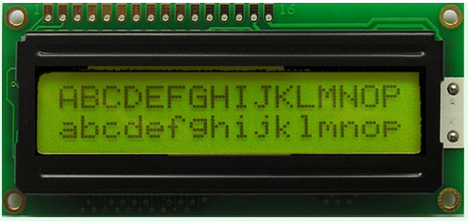
User I/O Interfacing
Character LCDs
Used to display
dot-matrix characters
Available in various
colors, backlight colors,
widths, heights, and
operating voltages
Various interfaces available; most character LCDs are ultimately based on the Hitachi HD44780 LCD controller
It is possible to store a limited number of custom characters onto LCD displays for custom graphics. One writeup on the subject is available here: http://www.pyroelectro.com/tutorials/16x2_lcd_custom_character/index.html
Notes:
Character LCD Image Source: http://www.blazedisplay.com/UploadFile/16X2_Character_LCD_Module_STN_Yellow_Green_L.jpg

Slide 25
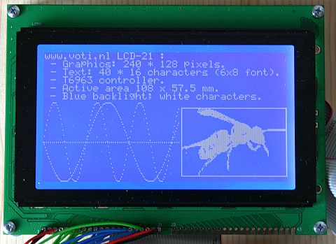
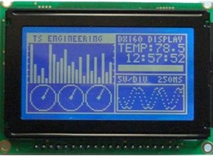
User I/O Interfacing
Graphical LCDs
Provide more flexible and
sophisticated options than
character LCDs
Variety of colors, screen sizes
(measured in pixels), interfaces,
voltages, etc.
Generally necessitate the use of
libraries such as graphics
libraries, fonts, drawing APIs,
etc. in order to use effectively
Notes:
Graphical LCD 1 Image Source: http://www.voti.nl/common/LCD_21_test2.jpg
Graphical LCD 2 Image Source: http://www.picbasic.co.uk/forum/attachment.php?attachmentid=1671&stc=1&d=1179960607

Slide 26
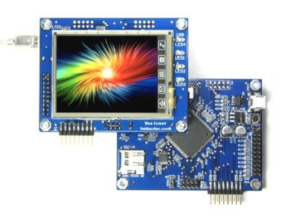
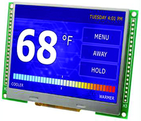
User I/O Interfacing
Touchscreen LCDs
Adds user interface layer to
existing graphical display
2 major touch technologies:
resistive and capacitive
Generally necessitate the use of
libraries such as graphics
libraries, fonts, drawing APIs,
etc. in order to use effectively
Generally necessitate the use of
dedicated display driver hardware
(µC offloads graphics commands to
display driver)
Notes:
Touchscreen LCD 1 Image Source: http://www.thaieasyelec.net/images/uploads/Product-Image/ARM/ETEE009-Bluescreen.jpg
Touchscreen LCD 2 Image Source: http://img-europe.electrocomponents.com/images/R7502581-01.jpg

Slide 27
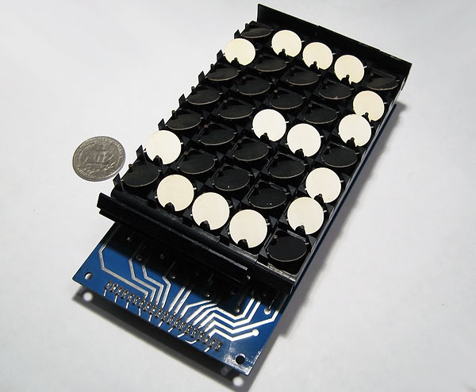
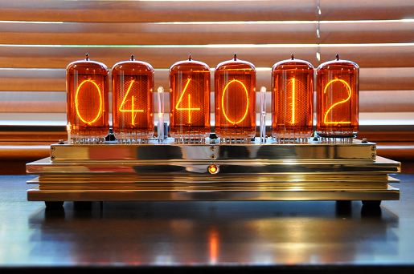
User I/O Interfacing
Esoteric Display Options
Nixie Tubes: Numbers displayed using gas tubes (similar in function to a neon sign)
Electromagnetic Dot Display: Uses magnets to flip dots into on or off position
Notes:
Nixie Tubes Image Source: http://badnixie.com/Web_Files/DSC_10014.JPG
Flip Dot Display Image Source: http://www.decadecounter.com/vta/pict13/flipdot1.jpg

Slide 28
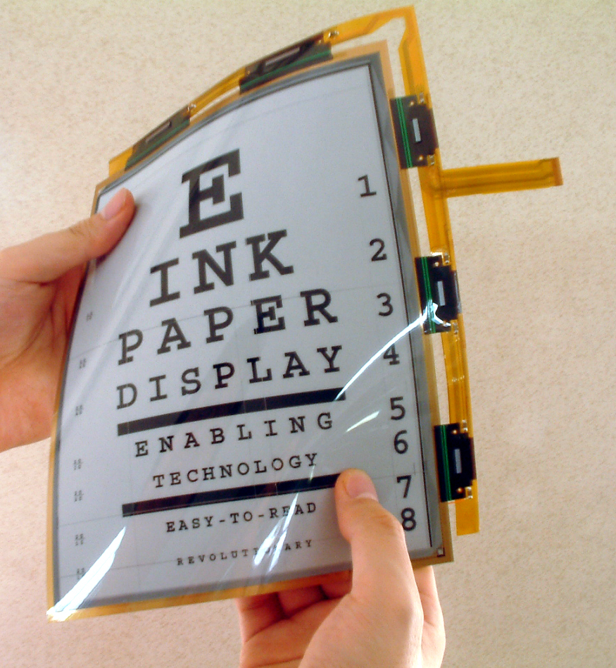
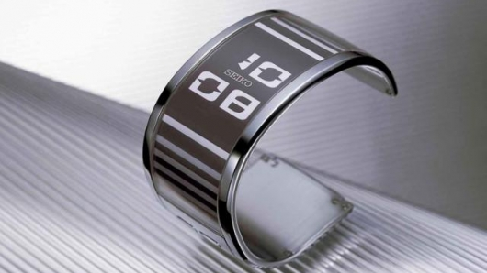
User I/O Interfacing
Emerging Display Options
Electronic Paper:
Reflects light, rather than emitting it (saving power)
Flexible
Capable of retaining static text and images indefinitely without application of power
Notes:
Electronic Paper Image Source 1: http://images.gizmag.com/hero/3949_170405115752.jpg
Electronic Paper Image Source 2: http://cdr.cz/sites/default/files/images/7029/03_e-ink_display_technologie.jpg

Slide 29
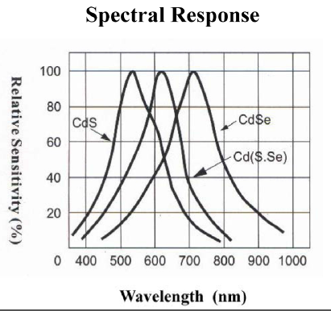
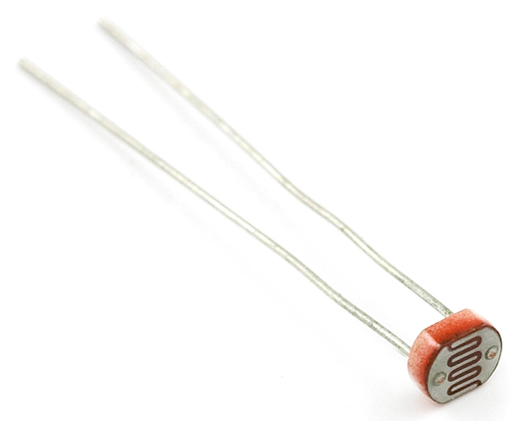
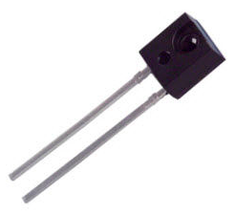
Sensors
Light, Color, and Imaging
Light-sensing techniques:
Photodiode/Phototransistor: Conductivity is determined by level of light exposure (tuned to various wavelengths of light)
Solar Cell: Supplies current proportional to incident light on the solar cell surface
Notes:
Sensitivity Graph Image Source: http://www.aliexpress.com/item/9mm-cds-ldr-photocell-sensor-GM9516/500733516.html
Photodiode Image Source: http://img.directindustry.com/images_di/photo-g/photodiode-silicon-33535-2583809.jpg
Photocell Image Source: https://cdn.sparkfun.com//assets/parts/2/4/6/2/09088-02-L.jpg

Slide 30
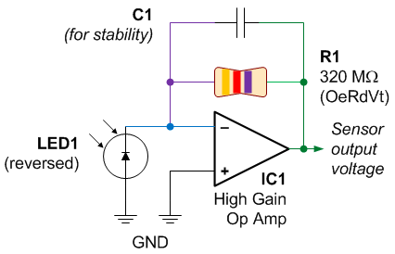
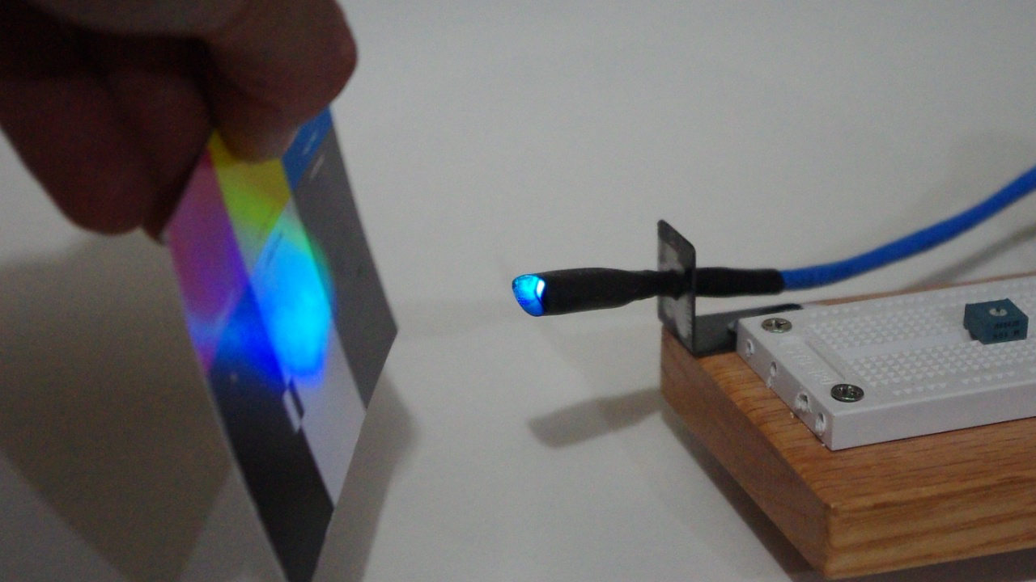
Sensors
Light, Color, and Imaging
Color sensing techniques:
Dedicated color sensors: Finely tuned photocells to detect RGB color wavelengths
LEDs: Can reverse-bias and use as a color-sensing device
Cameras: Can use cameras in conjunction with image processing software (OpenCV, etc.) to detect colored objects
Notes:
LED Color Sensor Schematic Image Source: http://www.robotroom.com/ReversedLED/PhotodiodeAmplifierSchematic.gif
LED Color Sensor Image Source: http://www.georgegardner.info/wp-content/uploads/2012/02/IMGP4235.jpg

Slide 31
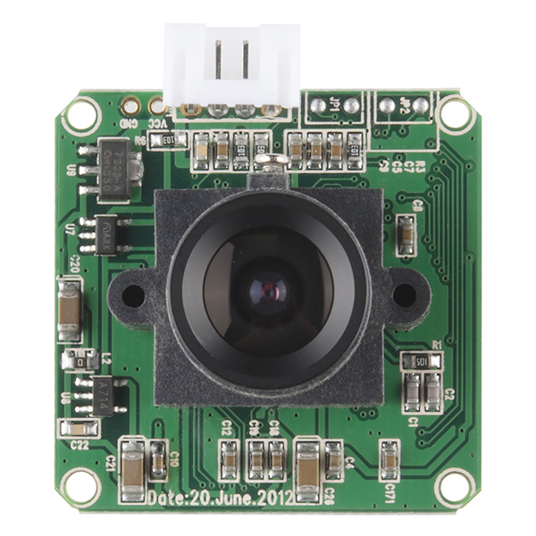
Sensors
Video/Photo Imaging
CMOS/Cellular Cameras readily available
Computational considerations: speed, resolution, frame rate, processing latency, memory/buffering considerations
Generally require additional
hardware considerations
(motherboards, embedded
drivers, dedicated hardware,
etc.)
Notes:
CMOS Camera Image Source: https://cdn.sparkfun.com//assets/parts/9/6/4/5/12804-04.jpg

Slide 32
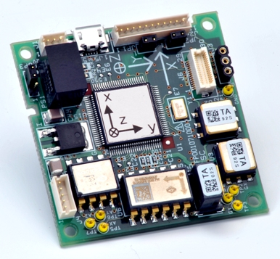
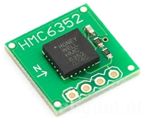
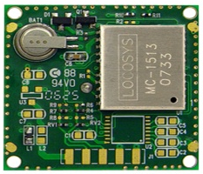
Sensors
Motion, Position, and Orientation
Gyroscopes: Measures orientation based on angular momentum principles
Compass: Senses orientation relative to magnetic fields
GPS: Senses position by measuring received signals in satellite constellation and calculating satellite delays
IMU: Inertial measurement unit; uses gyros, compasses, and accelerometers to accurately determine position and velocity of objects
Notes:
Digital Compass image Source: https://developer.mbed.org/media/uploads/aberk/hmc6352.jpg
GPS Module Image Source: http://www.laptopgpsworld.com/images/uploads/4784542567_1ac29afa37.jpg
IMU Image Source: http://www.cumatix.com/wp-content/uploads/2012/05/AU7428N200_s.jpg

Slide 33
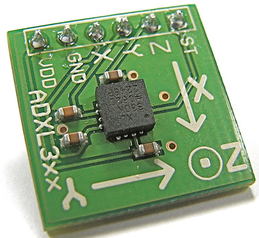
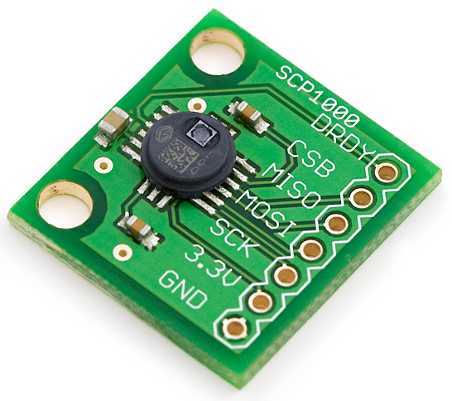
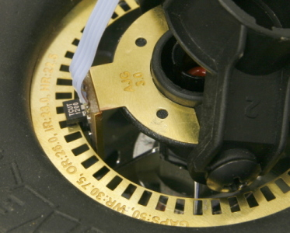
Sensors
Motion, Position, and Orientation
Accelerometers: Use MEMS and piezoelectric materials to measure force applied to a known mass (F = ma)
Altimeters/Barometers: Determine the height/altitude of an object by measuring atmospheric pressure
Shaft Encoders: Measure rotations of an axle, then use known properties of the wheel to determine distance traveled
Notes:
Accelerometer Image Source: http://farm2.static.flickr.com/1118/1193147290_d2069c9c08_m.jpg
Barometric Pressure Sensor Image Source: https://cdn.sparkfun.com//assets/parts/6/9/2/08161-03-L.jpg
Shaft Encoder Image Source: http://www.labbookpages.co.uk/circuits/files/wheelEncoder/sensor.jpg

Slide 34
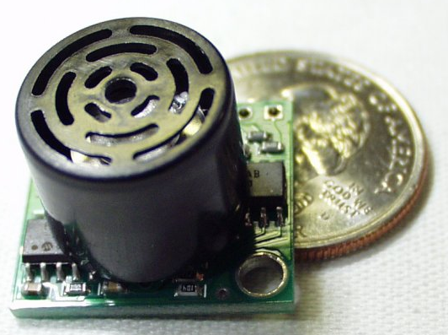
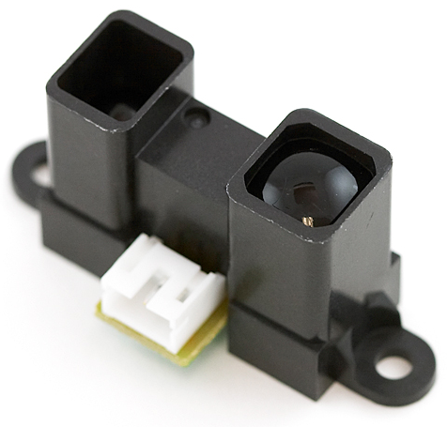
Sensors
Proximity and Rangefinding
Hall Effect Sensor: Measure presence of (nearby) magnetic fields
Rangefinder: Measure distance to an object through various methods
Sonar/Ultrasonic: Sound waves
Radar: Radio waves
Lidar: Light waves
Infrared: IR light
Notes:
IR Rangefinder Image Source: https://cdn.sparkfun.com//assets/parts/2/2/6/0/08958-03-L.jpg
Ultrasonic Rangefinder Image Source: https://cdn.sparkfun.com//assets/parts/1/0/5/2/EZ1_img.jpg

Slide 35
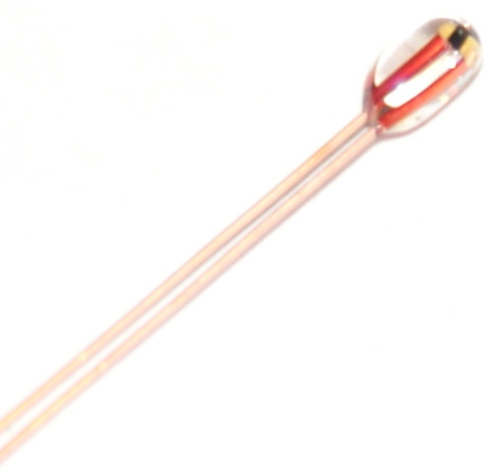
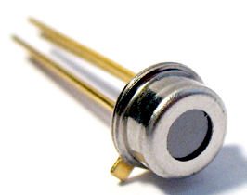
Sensors
Heat and Temperature
Thermocouple: Measures the voltage induced by the temperature gradient between dissimilar metals
Thermistor: Resistor whose resistance changes significantly as a function of temperature
Infrared: Measure heat by measuring the emitted infrared radiation
Notes:
IR Thermometer Image Source: http://www.medicaldevice-network.com/contractor_images/melexis/3-temperature-sensor.jpg
Thermistor Image Source: https://ultimachine.com/sites/default/files/imagecache/product_full/Thermistor_1_0.jpg

Slide 36
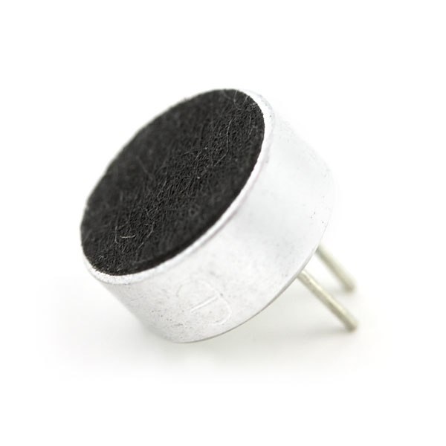
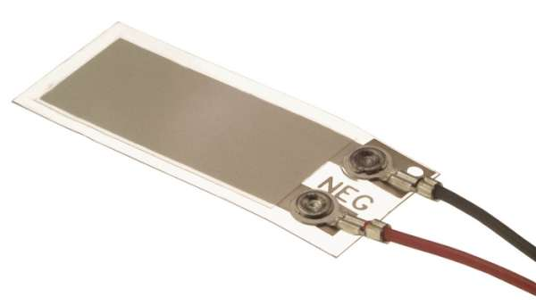
Sensors
Sound and Vibration
Microphone: (Electret type most common) – Uses dielectric material and diaphragm to detect sound
Piezoelectric: Materials which convert mechanical vibrations into electrical charge. Used in microphones and other sensors (such as flex sensors)
Notes:
Piezoelectric Sensor Image Source: http://www.meas-spec.com/uploadedImages/Sensor_Types/Piezo/Products/IMG_PiezoSensor_LDTI_028.jpg
Electret Microphone Image Source: https://cdn.sparkfun.com//assets/parts/1/7/6/9/08635-03-L.jpg

Slide 37



Sensors
Chemical and Biological
Fingerprint Scanners: User authentication and security applications
Gas Sensors: Used to detect the presence of methane, CO, CO₂, O₂, H₂, and other gases
Electrokardiogram (EKG): Used in heartbeat detection
Electroencephelogram (EEG): Used in brainwave detection
Notes:
Fingerprint Scanner Image Source: http://www.elabpeers.com/media/catalog/product/cache/1/image/800x800/9df78eab33525d08d6e5fb8d27136e95/i/m/img_9428.jpg
Gas Sensor Image Source: http://img-europe.electrocomponents.com/images/R538992-01.jpg
EKG Image Source: http://static.flavors.me/dynamic_images/background/e5bc2bf327504d14a2e9a37f0e0cf3e4

Slide 38



Actuators and Control
Light
Light Bulbs: Create light through use of a heated filament (or ionized channel, in case of fluorescent bulbs)
LEDs: Create light using semiconductor properties
Laser Diodes: Similar to LEDs, but generate lasers
Bright light sources and lasers require special safety considerations (eye protection)
Notes:
Fluorescent Light Bulb Image Source: http://www.elightbulbs.com/catpics/ge/97609lg.jpg
RGB Power LED Image Source: http://www.conrad.com/medias/global/ce/1000_1999/1800/1820/1827/182711_BB_00_FB.EPS_1000.jpg
Laser Diode Image Source: http://www.armlaser.com/images/armlaser.com%20450nm%20blue%20laser%20diode.jpg

Slide 39
Actuators and Control
Light Control
LEDs:
High-power LEDs: Require DC switching techniques, may require constant current drivers
Many LEDs: May require dedicated driver chip
Multiplexing: Switch groups of LEDs on and off quickly (reduces power consumption)
Charlieplexing: Technique for driving large numbers of LEDs from few device pins
Light bulbs: Require AC switching techniques (relays, triacs, etc.)
Laser diodes: Require DC switching techniques
Notes:
Multiplexing description: http://en.wikipedia.org/wiki/Multiplexed_display
Charlieplexing description: http://en.wikipedia.org/wiki/Charlieplexing

Slide 40


Actuators and Control
Audio
Buzzer: Converts electricity to frequency tones
Speaker: Converts electricity to sound
Dynamic Loudspeaker: Uses magnetic coil to vibrate diaphragm; good frequency response
Piezoelectric Speaker: Uses piezoelectric materials; poor frequency response but compact and durable
Notes:
Multiplexing description: http://en.wikipedia.org/wiki/Multiplexed_display
Charlieplexing description: http://en.wikipedia.org/wiki/Charlieplexing
Speaker Cutaway Image Source: http://upload.wikimedia.org/wikipedia/commons/7/79/Loudspeaker-bass.png
Piezoelectric Speaker Image Source: http://media.digikey.com/Photos/PUI%20Audio/APS2509S-T-R.JPG

Slide 41
Actuators and Control
Audio Control
Filtering needed to condition input and remove noise
Amplification generally needed (control sound volume):
“Class A” Amplifier: Simple, great performance, horrible efficiency (25-50% max depending on techniques)
“Class B” Amplifier: Improved efficiency (~78.5% max), distortion and performance issues
“Class AB” Amplifier: Compromise between A and B approaches; medium efficiency and performance
“Class C” Amplifier: Exists, but not recommended for audio applications
Amplifier techniques can be used for other applications (driving radio signals, motor control, etc.)

Slide 42

Actuators and Control
Audio Control 2
“Class D” Amplifier:
Uses transistors as switches rather than linear amplifiers
Output signal is modulated (PWM, delta-sigma, etc.), then fed to the amplifier
Pros: extremely power efficient with good performance
Cons: complexity
ICs available to perform this
functionality and reduce
complexity requirements
Notes:
Class-D Amplifier Image Source: http://dangerousprototypes.com/wp-content/media/2011/05/5731723841_7732b06cd2-W490.jpg

Slide 43


Actuators and Control
Thermal
Wire Heaters: Highly resistive wire which generates heat when current is passed through (similar to filaments in a toaster – Nichrome and Tungsten popular options)
Peltier Cooler: Uses electricity to generate a temperature differential (Used in some cooling applications)
Notes:
Peltier image source: http://www.reuk.co.uk/OtherImages/schematic-diagram-of-peltier-module.jpg
Nichrome wire image source: http://ak.picdn.net/shutterstock/videos/5437880/preview/stock-footage-tungsten-filament-burner-heats-up-and-turns-red.jpg

Slide 44

Actuators and Control
Motion: Motors
DC Motors: Use oscillating electromagnetic fields to produce continuous rotation
Brushed DC: Uses an internal commutator and conductive brushes to mechanically switch the magnetic field (low cost, simple control, lower life span)
Brushless DC (BDC): Utilizes
permanent magnet for switching of
magnetic field, external commutation
(higher cost, more complicated
control, higher reliability)
Notes:
Brushed DC motor image source: http://hades.mech.northwestern.edu/images/d/d0/Motor_cutaway.png

Slide 45


Actuators and Control
Motion: Motors 2
Stepper Motors: Similar to brushless DC, but produce motion in discretized steps rather than smooth motion. Sophisticated control schemes generally used; partial step motion is possible under certain control schemes
Servos: Designed to travel to a specific rotational angle based on a provided digital value. Motion limited to ~270º without modification.
Notes:
Stepper motor image source: http://upload.wikimedia.org/wikipedia/commons/8/83/Nema_17_Stepper_Motor.jpg
Servo motor image source: http://jeroendoggen.files.wordpress.com/2012/01/parallax-standard-servo.jpg

Slide 46


Actuators and Control
Motion: Other
Linear Actuators: Convert electricity into linear motion (solenoids, mechanical conversion of rotational to linear motion)
Muscle Wire/Shape memory alloy: Material changes shape when electric current applied; used to imitate biological muscles
Notes:
Linear actuator image source: http://images10.newegg.com/NeweggImage/productimage/A2C5_1302387647915556233GSmEgnSns.jpg
Muscle wire image source: http://a.tgcdn.net/images/products/zoom/ef2f_muscle_wire_moving_hand_kit_anim.gif

Slide 47


Actuators and Control
Motion: Other 2
Pumps: Used to transport fluids throughout a system
Important: some pumps must have fluids in them to work while others can be run dry.
Pneumatics: Air used to control motion of system parts
Hydraulics: Water, oil, or other liquid used for motion
Notes:
Pump image source: http://www.adafruit.com/blog/wp-content/uploads/2012/12/window-397.jpg
Pneumatics image source: http://www.chiefdelphi.com/pics/bin/1043974483pneumaticsboard.jpg

Slide 48


Actuators and Control
Motion: DC Motor Control
H-Bridge: Transistor circuit commonly used to control the direction of a DC motor (PWM input waveforms commonly used for speed control)
Transistors used as switches; arranged in “H” pattern
Notes:
H-Bridge image and table source: self-created

Slide 49


Actuators and Control
Motion: Stepper Motor Control
Stepper motor stator and rotor consist of wound coils
Stepping through rotation in a given direction is a matter of activating the coils in a specific sequence (partial stepping control options available)
Notes:
Stepper Motor Drawing Image Source: http://www.ustudy.in/sites/default/files/images/VR%20Motor.JPG
Stepper Motor Control Schematic Source: Based on previous hardware interfacing slides by Professor David Meyer; original source unknown

Slide 50


Memory
2 categories of memory:
Volatile: State lost when power is removed
Nonvolatile: State retained when power is removed
Types of memory:
EEPROM: Byte addressable, nonvolatile, smaller sizes (~8MB), fast access times
Flash: Page addressable (256-512B/page), nonvolatile, large sizes available (32GB+), slow access times
SRAM (Static RAM): Volatile, low power, dual-port options available
DRAM (Dynamic RAM): Dense, volatile,
requires periodic refreshing
Notes:
SD Card Image Source: http://blog.frankvh.com/wp-content/uploads/2009/07/sd-card.jpeg
DRAM Image Source: http://www.blogcdn.com/www.engadget.com/media/2009/01/samsung_dram-chips_1.29.09.jpg

Slide 51


Wired Interfacing
Computing Interfaces
Universal System Bus (USB)
Multiple data rate classes available:
  Low-Bandwidth: 1.5 Mbps (USB v1.1)
  Full-Bandwidth: 12 Mbps (USB v1.1)
  Hi-Speed: 480 Mbps (USB v2.0)
  SuperSpeed: 5.0 Gbps (USB v3.0)
  SuperSpeed+: 10 Gbps (USB v3.1)
Some common protocol implementations:
Host: Device acts as the master for other USB devices (requires implementation of 1+ host controllers)
Client: Device acts as a slave device (various profiles available)
USB On-The-Go (OTG): Devices take turns acting as host and slave
Notes:
USB Logo Image Source: http://upload.wikimedia.org/wikipedia/en/f/f4/USB.png
USB Cable Image Source: http://www.publicdomainpictures.net/pictures/10000/nahled/1-1211026487gA6W.jpg

Slide 52

Wired Interfacing
Computing Interfaces 2
USB cont.
USB connector options:
  Standard: larger connectors used on
  laptops, desktops, tablets, etc.
  Mini: Used in cameras, camcorders,
  and other small devices
  Micro: Supercedes mini on most
  smartphones, etc.
  USB Power Limits:
  USB v1.1: 150mA@5V from port, 2A@5V from external
  USB v2.0: 500mA@5V from port, 2A@5V from external
  USB v3.0: 900mA@5V from port, 2A@5V from external
  All USB devices start in low power mode; must request additional power
Notes:
USB Cable Chart Image Source: http://img528.imageshack.us/img528/8805/usbtypes.jpg

Slide 53


Wired Interfacing
Computing Interfaces 4
Ethernet (IEEE 802.3):
Specification involved in networking devices
(for more on networking devices, read up on
the OSI and TCP/IP networking models)
Consists of the physical layer and link layer
for connecting devices
Ethernet development generally requires
external support hardware:
  PHY Chip: Implements the physical layer
  functions of an Ethernet interface
  MAC Chip: Implements data link layer
  functions of an Ethernet interface
  A useful reference design for microcontroller
  Ethernet can be found here
Notes:
OSI Model Reference: http://en.wikipedia.org/wiki/OSI_model
TCP/IP Model Reference: http://en.wikipedia.org/wiki/Internet_protocol_suite
Microcontroller Ethernet Example: http://dangerousprototypes.com/docs/Web_Platform
Ethernet Cable Image Source: http://deltautomation.files.wordpress.com/2011/10/ethernet-cable-utp-mold-type-kb-aa06.jpg
Microcontroller Ethernet Board Source: http://dangerousprototypes.com/docs/images/4/41/Webplatformv11-overview.jpg

Slide 54

Wired Interfacing
Other Interfaces
Powerline Communication (PLC) / X-10:
  Modulate signals over existing AC power lines to send data
  Example applications: home automation, Christmas tree light controllers
Musical Instrument Digital Interface (MIDI):
Standard specifying a protocol and connectors
MIDI over USB is permitted
On-Board Diagnostic System (OBD-II):
Required on all US motor vehicles manufactured after 1995
Facilitates communication with onboard vehicle computers
Many manufacturers implement proprietary codes (use of licensed OBD-II protocol ICs can overcome this)
Notes:
MIDI Connector Image Source: http://www.adafruit.com/blog/wp-content/uploads/2012/12/1134_LRG.jpg

Slide 55

WireLESS Interfacing
General Computing Interfaces
WiFi (IEEE 802.11x):
At the embedded hobbyist level, WiFi is generally implemented using dedicated chips and/or modules
NOTE: PAL2.0/3.0 has challenges with
individual embedded WiFi (use of personal
routers recommended)
Revisions of the WiFi protocol:
IEEE 802.11a: 54Mbps@5GHz (OFDM)
IEEE 802.11b: 11Mbps@2.4GHz (OFDM)
IEEE 802.11g: 54Mbps@2.4GHz (OFDM)
IEEE 802.11n: 54-600Mbps@2.4GHz or
5GHz (OFDM), Support for multiple antennae (MIMO)
Future Revisions: More channels, millimeter wave band support (30+ GHz), etc.
Notes:
WiFi Module Image Source: http://media02.hongkiat.com/electronic-circuits-modules/spark-core.jpg

Slide 56


WireLESS Interfacing
General Computing Interfaces 2
Bluetooth:
Common wireless option for interfacing
to computers and mobile devices
(~100 yard/m max range)
2.4GHz operation (interference from
WiFi, microwaves, and
other 2.4GHz devices)
As of Bluetooth v4.0, a second
Bluetooth Low-energy spec
(Bluetooth LE) was introduced.
Bluetooth LE is not backwards
compatible with existing
Bluetooth hardware
Notes:
Bluetooth Logo Image Source: http://fontmeme.com/images/Bluetooth-Logo.jpg
Bluetooth Module Image Source: http://www.seeedstudio.com/depot/images/newblue_LRG.jpg

Slide 57


WireLESS Interfacing
Mobile/Cellular Interfaces
GSM/GPRS:
2nd Gen cell network protocols (900MHz, 1800MHz)
3G:
3rd Gen cell networks (various standards; CDMA, TDMA, FDMA common protocols)
4G:
4th Gen cellular networks (various standards; WiMax and LTE common protocols)
Notes:
GSM/GPRS Module Image Source: https://cdn.sparkfun.com//assets/parts/3/2/8/7/09533-01.jpg
4G Cell Module Image Source: http://linkwave.co.uk/sites/default/files/styles/zoom/public/mc7710_1.JPG?itok=Fb_IdeDB

Slide 58


WireLESS Interfacing
Embedded Interfaces
Zigbee:
2.4GHz operation (incompatible w/ Bluetooth and WiFi)
Support for mesh networking
(network nodes can be
added/dropped ad hoc)
RF:
Various RF modules exist at
different frequencies
Power, and supported modes
at various frequencies
governed by the FCC (in USA)
Notes:
Zigbee Module Image Source: http://www.newark.com/productimages/standard/en_US/4573287.jpg
RF Module Image Source: http://www.rf-module-china.com/admin/uploadfile/200905/2009052518390692.jpg

Slide 59


WireLESS Interfacing
Other Interfaces
Radio Frequency Identification (RFID):
Cheap, passive tags (used to ID objects)
Near Field Communication (NFC):
Communicates using electrical or
magnetic fields (but not radio waves)
Capable of communicating through
conductors
Secure, private (more difficult to
intercept than RF)
Wireless Power Transmission:
Used in some charging
applications
Notes:
RFID Module Image Source: http://www.robotshop.com/Images/big/en/rfid-reader-module-id-2.jpg
NFC Module Image Source: http://www.elecfreaks.com/store/images/NFC-Module.jpg

