Slide 1
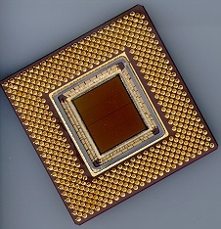
ECE 477 Digital Systems
Senior Design Project
© 2014 by D. G. Meyer
Module 2
Embedded System Hardware Interfacing

Slide 2
Outline
Level Translation
Line Drivers and Receivers
Switching D.C. Loads
Optically Isolation
Keypads (Switch Matrices)
Switch De-bouncer
Rotary Pulse Generators (RPG)
PWM Applications/Interfaces
Position Control and Stepper Motors
Servos
LCD Interface
Digitally Controlled Potentiometer
Temperature and Humidity
Compass
Accelerometer
Hall Effect Sensor
Pressure (Force) Sensor
Ultrasonic Range Sensor
IR Remote Control Decoding
RF Serial Link
AC Loads

Slide 3
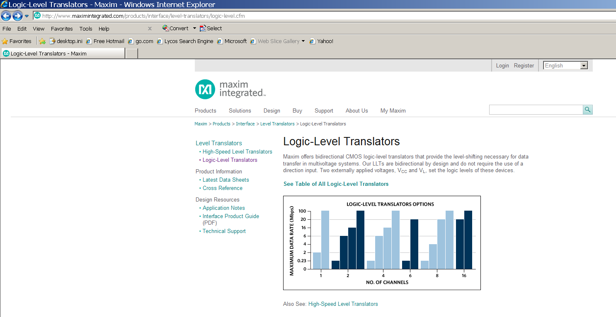
Level Translation
Needed for interfacing CMOS families operating at different supply voltages

Slide 4
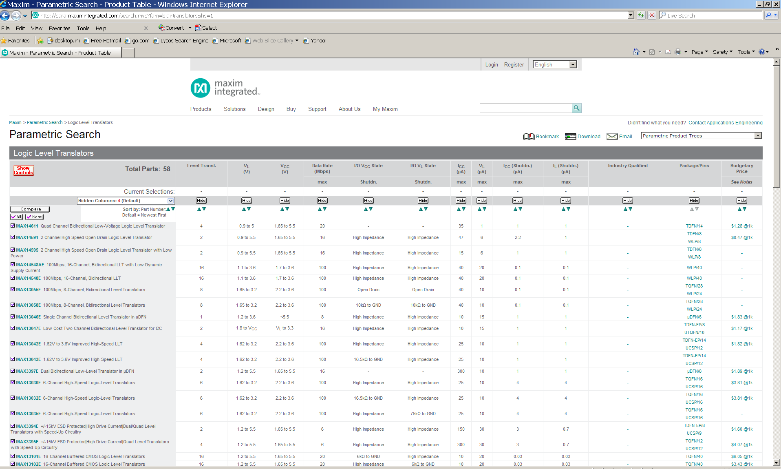
Level Translation

Slide 5
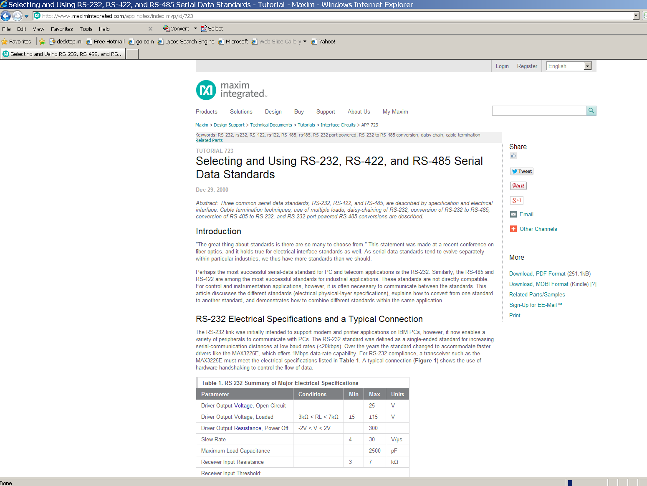
Line Drivers and Receivers
Needed for driving (long) cables based on various standards (e.g., RS 232, RS 422, RS 485, etc.)

Slide 6
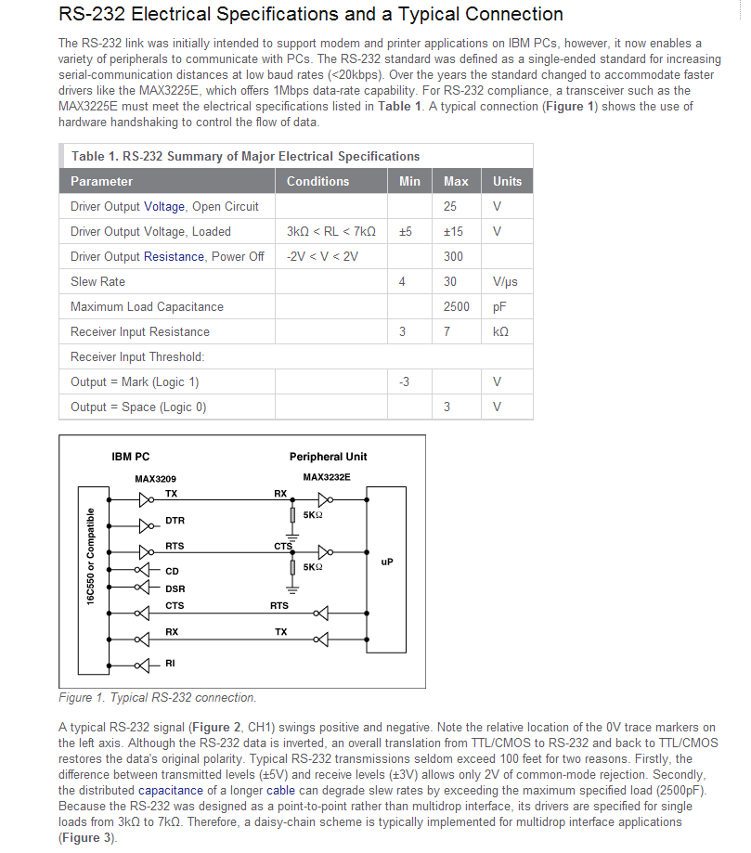
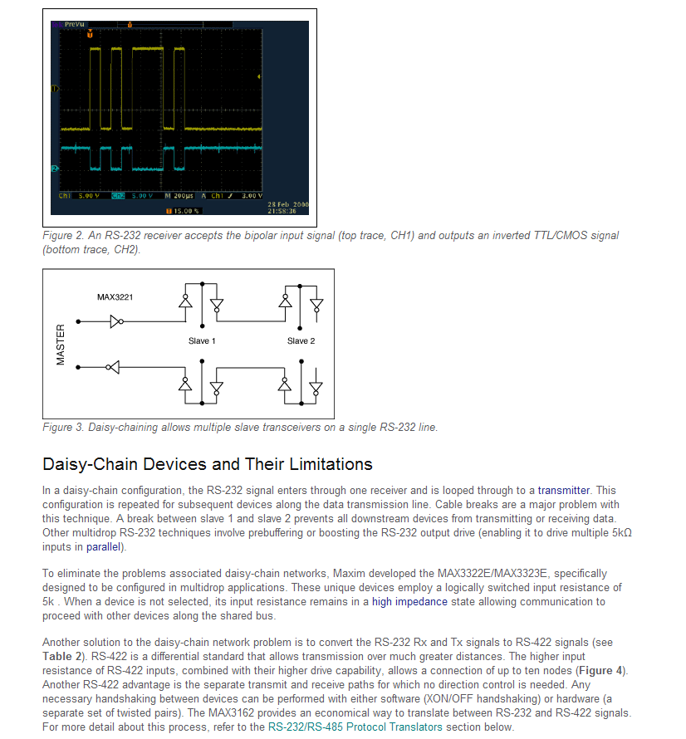
Line Drivers and Receivers
Example: RS 232

Slide 7
Switching D.C. Loads
Basic BJT-based switching circuit (“saturated mode”)
V_{L}
“current-controlled (low side) switch”
LOAD
C
Port Pin
B
NPN BJT
I_{C} = h_{FE} x I_{B}
E
Choose BJT based on following parameters
  I_{Cmax continuous}
  V_{CE breakdown}
  h_{FE} (D.C. current gain), also called β

Slide 8
Switching D.C. Loads
Basic MOSFET-based switching circuit
V_{L}
“voltage-controlled (low side) switch”
LOAD
D
Port Pin
G
N-channel power MOSFET
S
Choose MOSFET based on following parameters
  I_{Dmax} continuous
  V_{DS} breakdown
  r_{DS (on)} (drain-to-source “on” resistance)

Slide 9
Switching D.C. Loads
Tradeoffs
  BJTs: may require a significant amount of base current to drive into saturation (typically need Darlington for high h_{FE} at high I_{c})
  MOSFETs: require virtually no gate current to operate, less chance of thermal runaway than BJT
Inductive loads require arc suppression diode
Energy stored in an inductive load must be dissipated, otherwise the “inductive kickback” can damage the switching device

Slide 10
Switching D.C. Loads
Use optical isolation to protect microcontroller
V_{L}
Vcc
LOAD
NPN BJT
active low port pin
R1
Assume Vcc = 5 V, V_{LED} = 1.5 V, and V_{OL} @ 10 mA = 0.8V
⇒ R1 = 2.7/0.01 = 270Ω

Slide 11
Switching D.C. Loads
Use optical isolation to protect microcontroller
V_{L}
Vcc
V_{L}
LOAD
NPN BJT
R2
active low port pin
R1
Assume Vcc = 5 V, V_{LED} = 1.5 V, and V_{OL} @ 10 mA = 0.8V
⇒ R1 = 2.7/0.01 = 270Ω P_{R1}=0.027W

Slide 12
Switching D.C. Loads
Use optical isolation to protect microcontroller
V_{L}
Vcc
V_{L}
LOAD
NPN BJT
R2
active low port pin
R1
Assume switching 1 amp load, and that h_{FE} of transistor is 100 ⇒ need 10 mA of base current to saturate transistor (assume V_{BEsat} of transistor is 0.7 V, and that V_{CEsat} of photo transistor is 0.3 V)
⇒ R2 = (V_{L} – 1)/0.01 If V_{L}=18V, R2=1700ohms, P_{R2}=0.17W

Slide 13


Slide 14
Optically-Isolated Inputs
Off-board (external, remotely located) switch/data inputs should be optically isolated
  helps reduce noise
  helps prevent ESD-induced damage
  prevents “strange” voltages from entering board
  eliminates ground loops

Slide 15
“Ben Franklin Experiment”

Slide 16
Optically-Isolated Inputs
Off-board (external, remotely located) switch/data inputs should be optically isolated
  helps reduce noise
  helps prevent ESD-induced damage
  prevents “strange” voltages from entering board
  eliminates ground loops
Vcc
| +
L = closed
H = open
Isolated Power Supply (or Battery)
Remote Switch

Slide 17
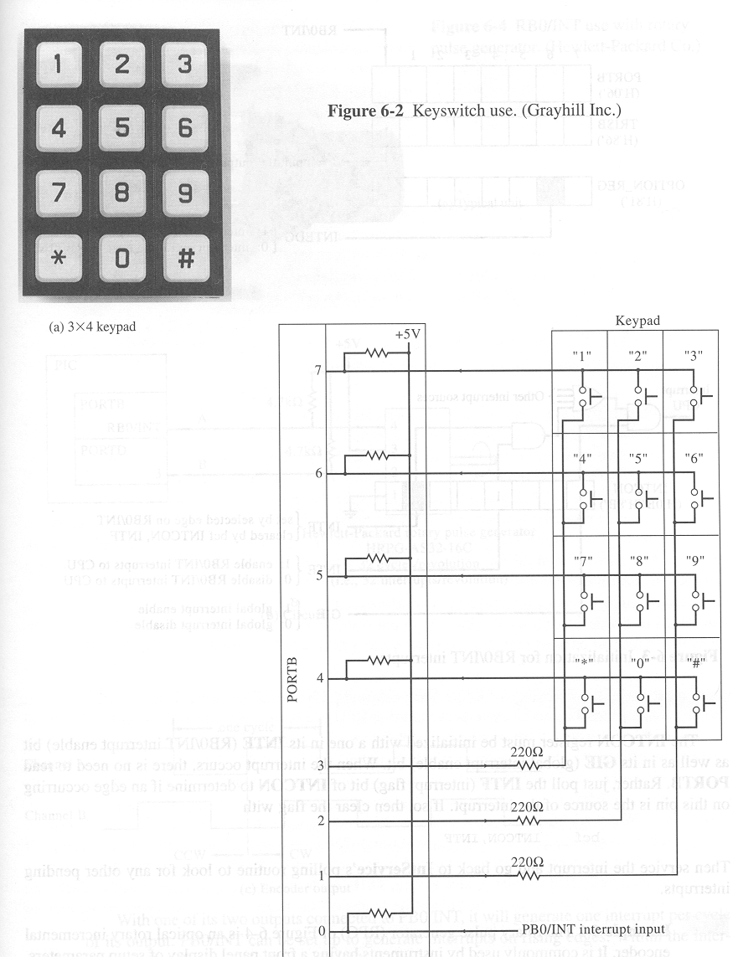
Scanned Keypad
row return lines
active low column scan lines

Slide 18
Scanned Keypad
H
H
H
H
row return lines
active low column scan lines
H
H
L

Slide 19
Scanned Keypad
H
H
H
H
row return lines
active low column scan lines
H
L
H

Slide 20
Scanned Keypad
H
H
H
H
row return lines
active low column scan lines
L
H
H

Slide 21
Scanned Keypad
H
H
H
H
row return lines
active low column scan lines
H
H
L

Slide 22
Scanned Keypad
H
H
H
H
row return lines
active low column scan lines
H
L
H

Slide 23
Scanned Keypad
H
L
H
H
row return lines
active low column scan lines
L
H
H

Slide 24

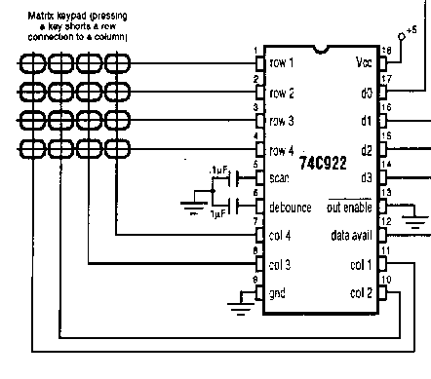
Keypad Encoder

Slide 25
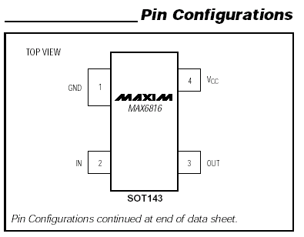

Switch Debouncer

Slide 26
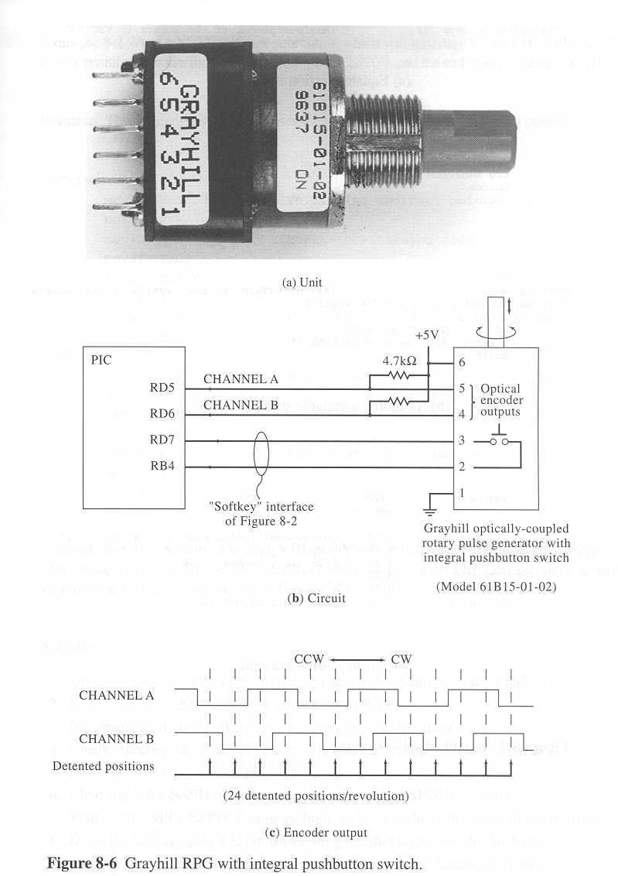
Rotary Pulse Generator (RPG)

Slide 27
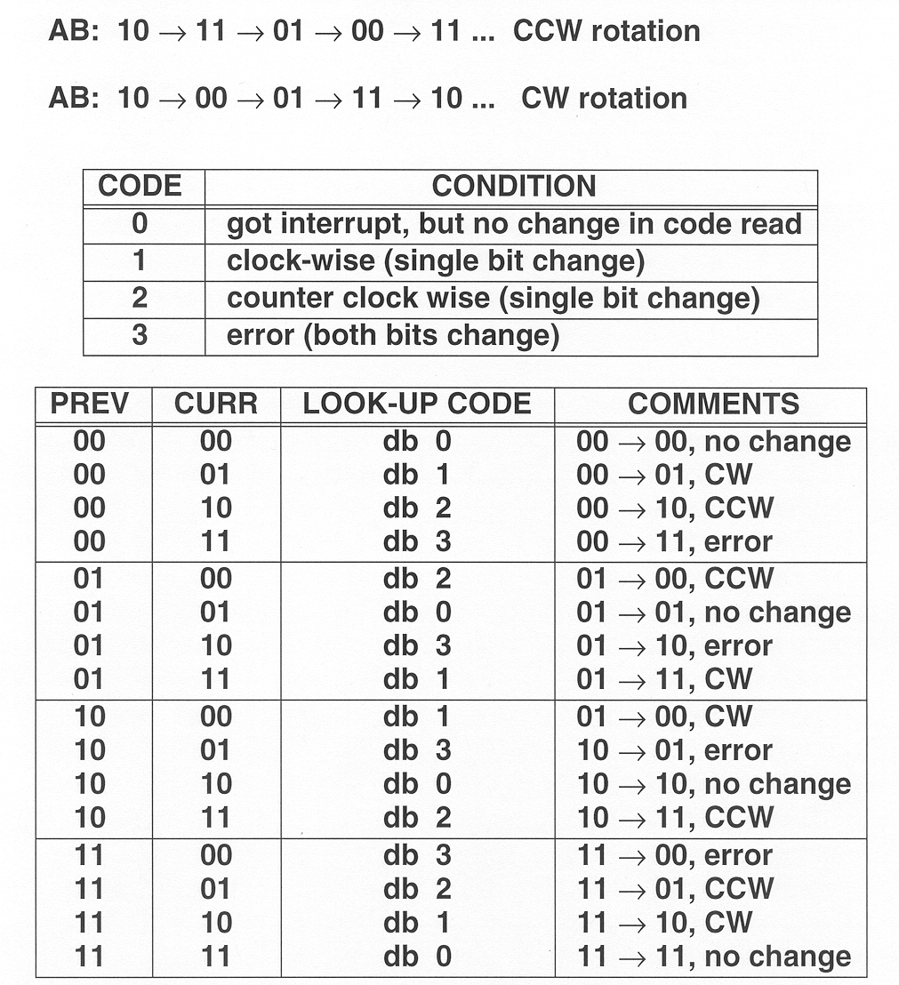
RPGs
Determine direction of rotation by concatenating “previous” and “current” codes, and using as look-up table index

Slide 28
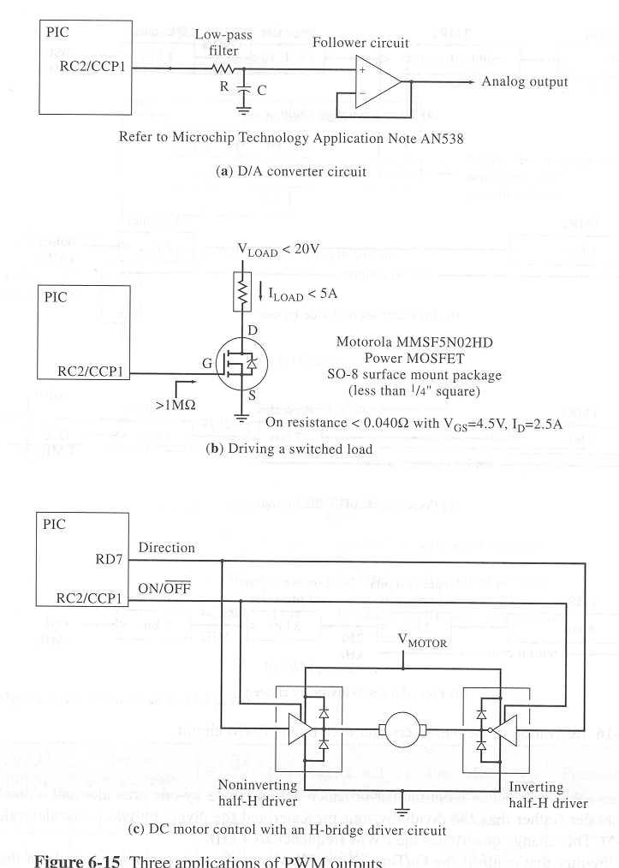
PWM Applications/Interfaces
Simple D/A converter
PWM

Slide 29
PWM Applications/Interfaces
Driving a switched load
Limitation: Capacitive load of MOSFET may limit switching frequency
PWM

Slide 30
PWM Applications/Interfaces
Motor speed and direction using H-bridge
PWM

Slide 31
“H Bridge”
V+
V+
motor
V-
V-
“coasting”

Slide 32
“H Bridge”
V+
V+
motor
+
-
V-
V-
“forward”

Slide 33
“H Bridge”
V+
V+
motor
-
+
V-
V-
“reverse”

Slide 34
“H Bridge”
V+
V+
motor
-
-
V-
V-
“braking” (breaking?)

Slide 35
PWM Applications/Interfaces
Motor speed and direction using H-bridge
PWM

Slide 36
Notes about H-bridges
H-bridge MUST be suitably sized for motor – measure inrush current of motor BEFORE buying H-bridge
Often need “dead time” between phases of driving the H-bridge input to prevent shoot-through (turn-off delay)
Use “snubber” diodes to protect H-bridge from inductive kickback from motor
Carefully check all specifications of H-bridge, specifically turn-off time, max frequency, R_{DS}, max supply voltage, V_{IH-min}, V_{IL-max}, etc.

Slide 37

Position Control
Position control
  required in many applications
  complications
    inertia/mechanical loading
    startup torque different than run torque (inrush)
    gear backlash
  stepping actuators are a good solution for many positioning problems
    Rotational and linear versions available
  why steppers are a good choice
    high resolution without gearing
    fast positioning (up to 1000 steps/sec)
    position error (usually) does not accumulate
    wide range of high and low torque (large/small) available
    simple/efficient drive circuitry

Slide 38
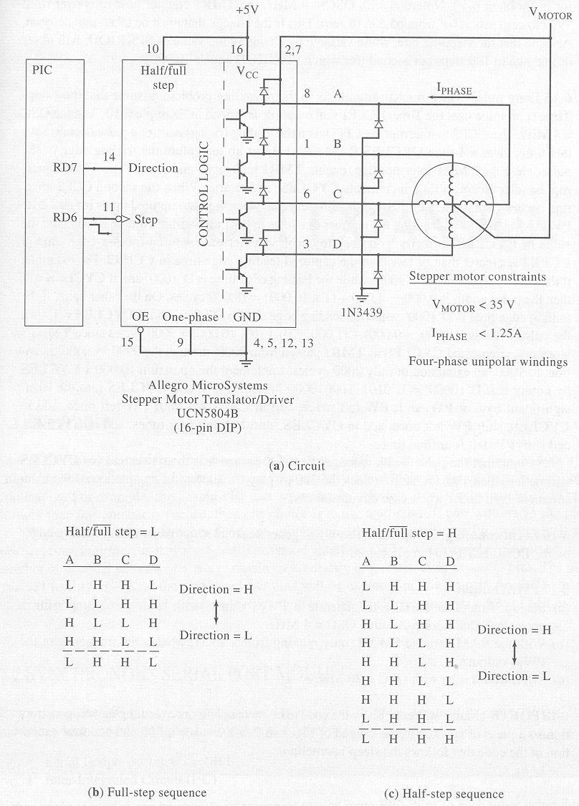
Stepper Motor Interface

Slide 39
A
B
C
V_{motor}
D

Slide 40
L
Y
L
0 1
1 1
H
X
0 0
1 0
V_{MOTOR}
H
FULL STEP MODE

Slide 41
H
Y
L
0 1
1 1
L
X
0 0
1 0
V_{MOTOR}
H
FULL STEP MODE

Slide 42
H
Y
H
0 1
1 1
L
X
0 0
1 0
V_{MOTOR}
L
FULL STEP MODE

Slide 43
L
Y
H
0 1
1 1
H
X
0 0
1 0
V_{MOTOR}
L
FULL STEP MODE

Slide 44
L
Y
L
0 1
1 1
H
X
0 0
1 0
V_{MOTOR}
H
FULL STEP MODE

Slide 45
L
Y
H
0 1
1 1
H
X
0 0
1 0
V_{MOTOR}
H
HALF STEP MODE

Slide 46
L
Y
L
0 1
1 1
H
X
0 0
1 0
V_{MOTOR}
H
HALF STEP MODE

Slide 47
H
Y
L
0 1
1 1
H
X
0 0
1 0
V_{MOTOR}
H
HALF STEP MODE

Slide 48
H
Y
L
0 1
1 1
L
X
0 0
1 0
V_{MOTOR}
H
HALF STEP MODE

Slide 49
H
Y
H
0 1
1 1
L
X
0 0
1 0
V_{MOTOR}
H
HALF STEP MODE

Slide 50
H
Y
H
0 1
1 1
L
X
0 0
1 0
V_{MOTOR}
L
HALF STEP MODE

Slide 51
H
Y
H
0 1
1 1
H
X
0 0
1 0
V_{MOTOR}
L
HALF STEP MODE

Slide 52
L
Y
H
0 1
1 1
H
X
0 0
1 0
V_{MOTOR}
L
HALF STEP MODE

Slide 53
L
Y
H
0 1
1 1
H
X
0 0
1 0
V_{MOTOR}
H
HALF STEP MODE

Slide 54
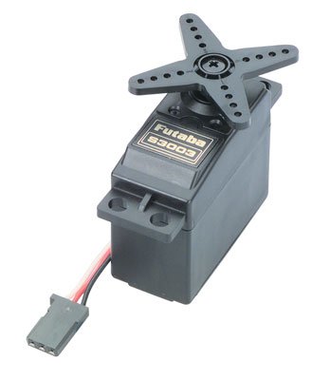
Hobbyist Servos
Position control
  Single-wire interface
  Can not rotate more than ~270°
  why servos are a good choice
    Low overhead for control – logic-level interface
    Simple interface (PWM)
Pulse width (0.9-2.9µs)
Refresh period (12-20ms)
  why servos may not be a good choice
    Limited range of motion
    Lower torque

Slide 55
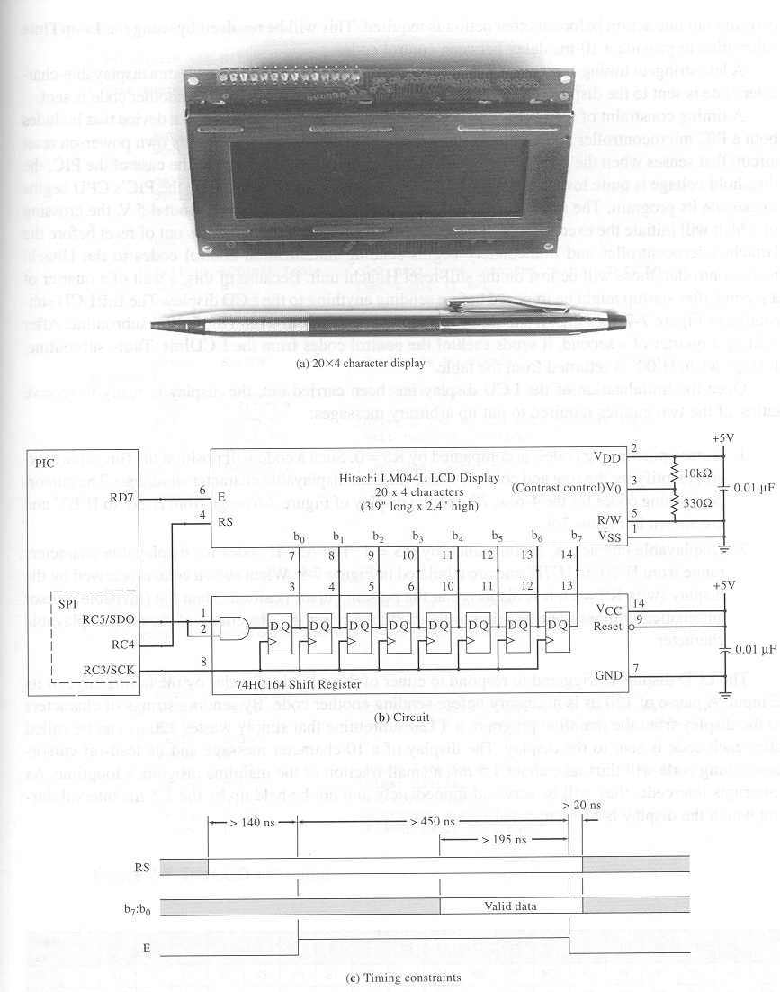
Basic LCD Interface

Slide 56
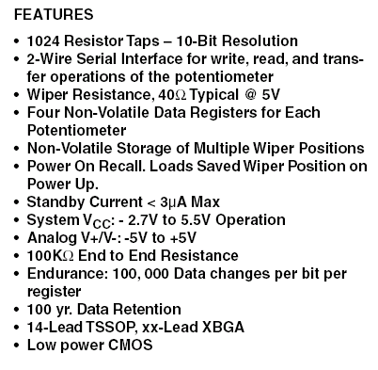
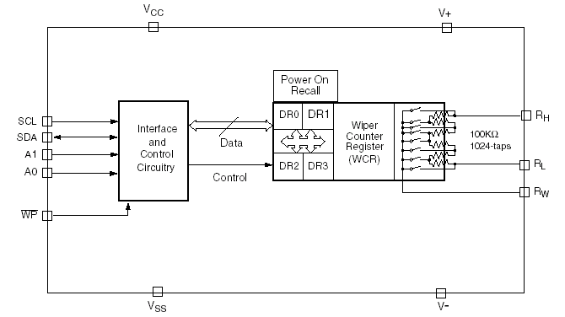
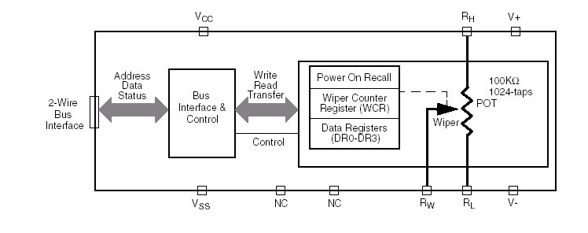

Digitally Controlled Potentiometer

Slide 57
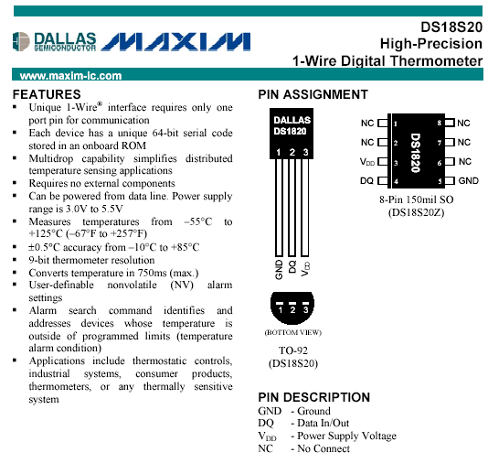
Digital Thermometer

Slide 58
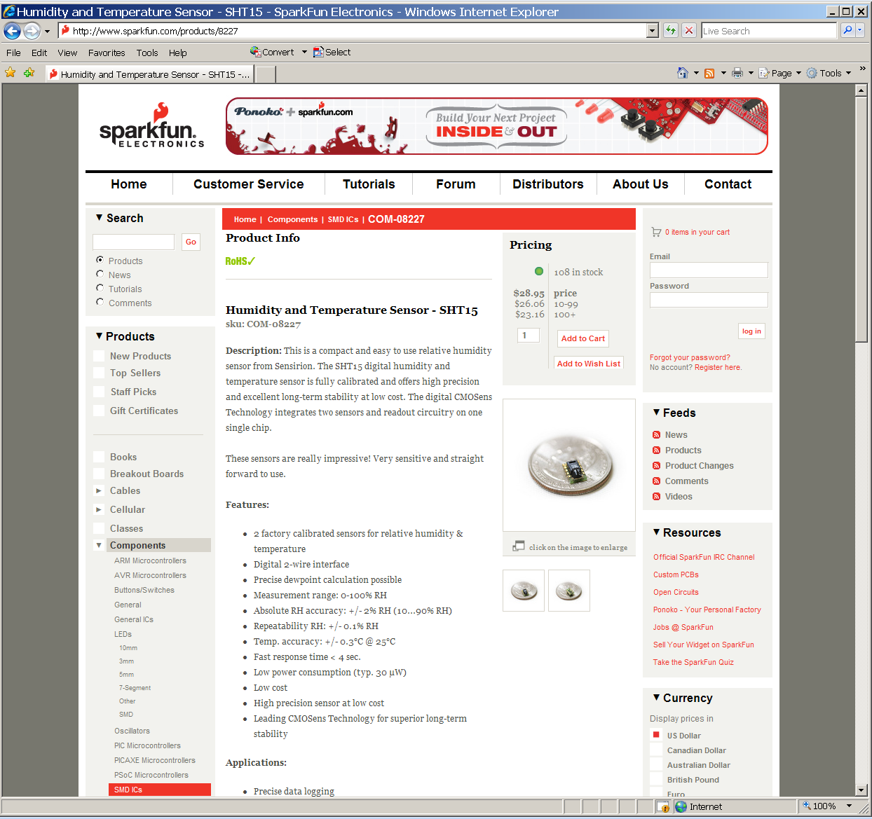
Humidity and Temperature Sensor

Slide 59
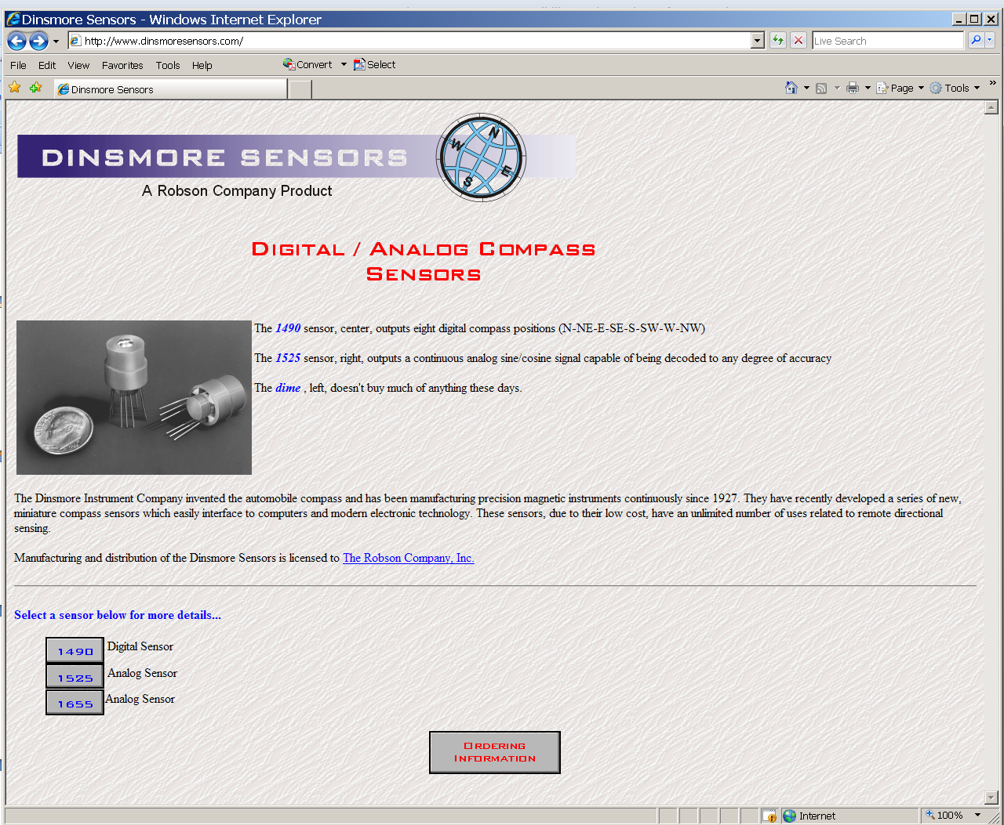
Digital/Analog Compass

Slide 60
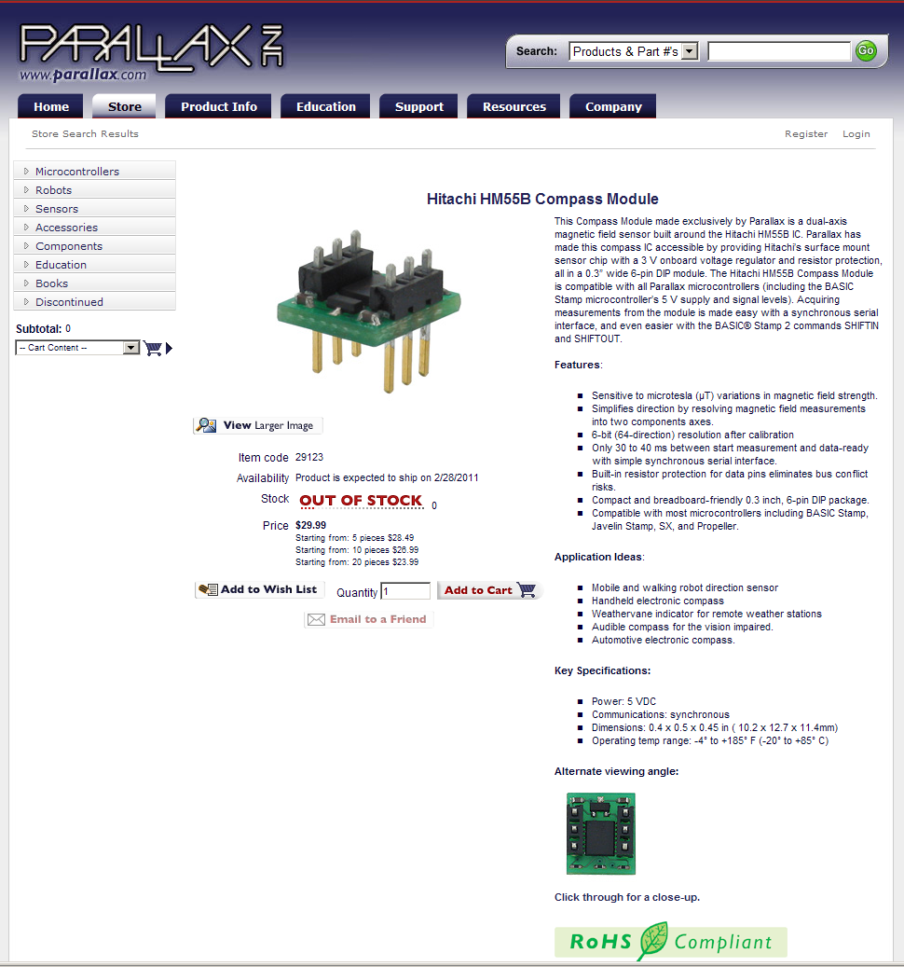
Digital Compass

Slide 61
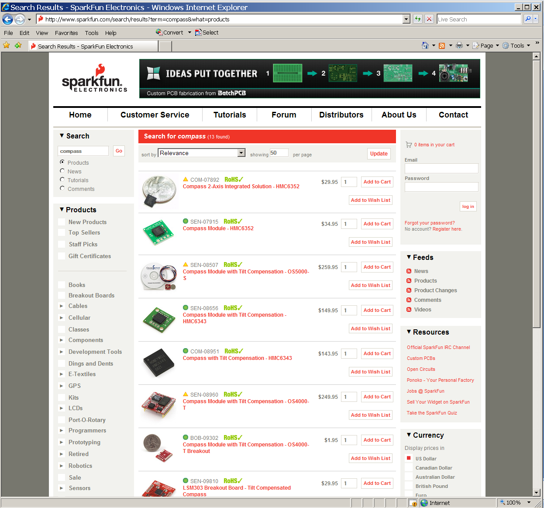
Digital Compass

Slide 62
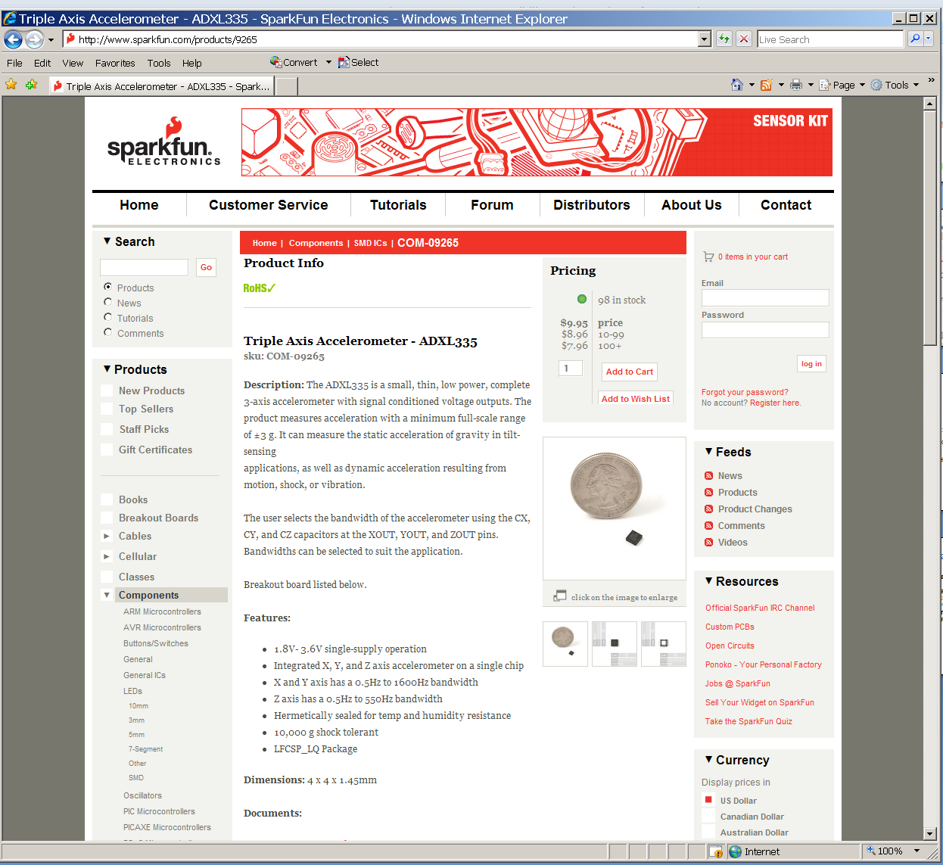
Accelerometer

Slide 63
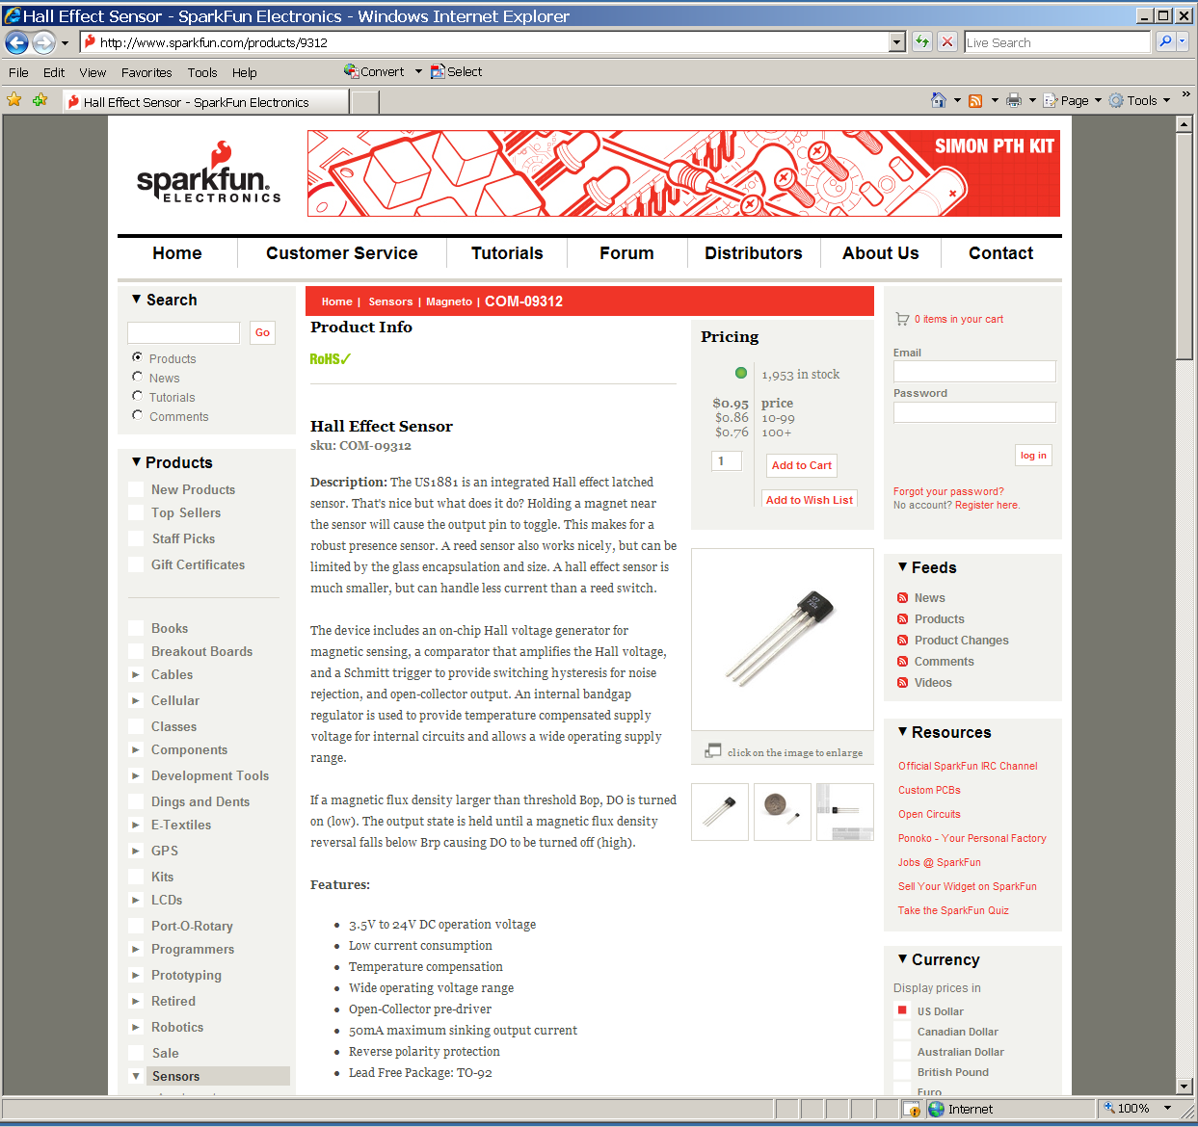
Hall Effect Sensor

Slide 64

Pressure (Force) Sensor

Slide 65
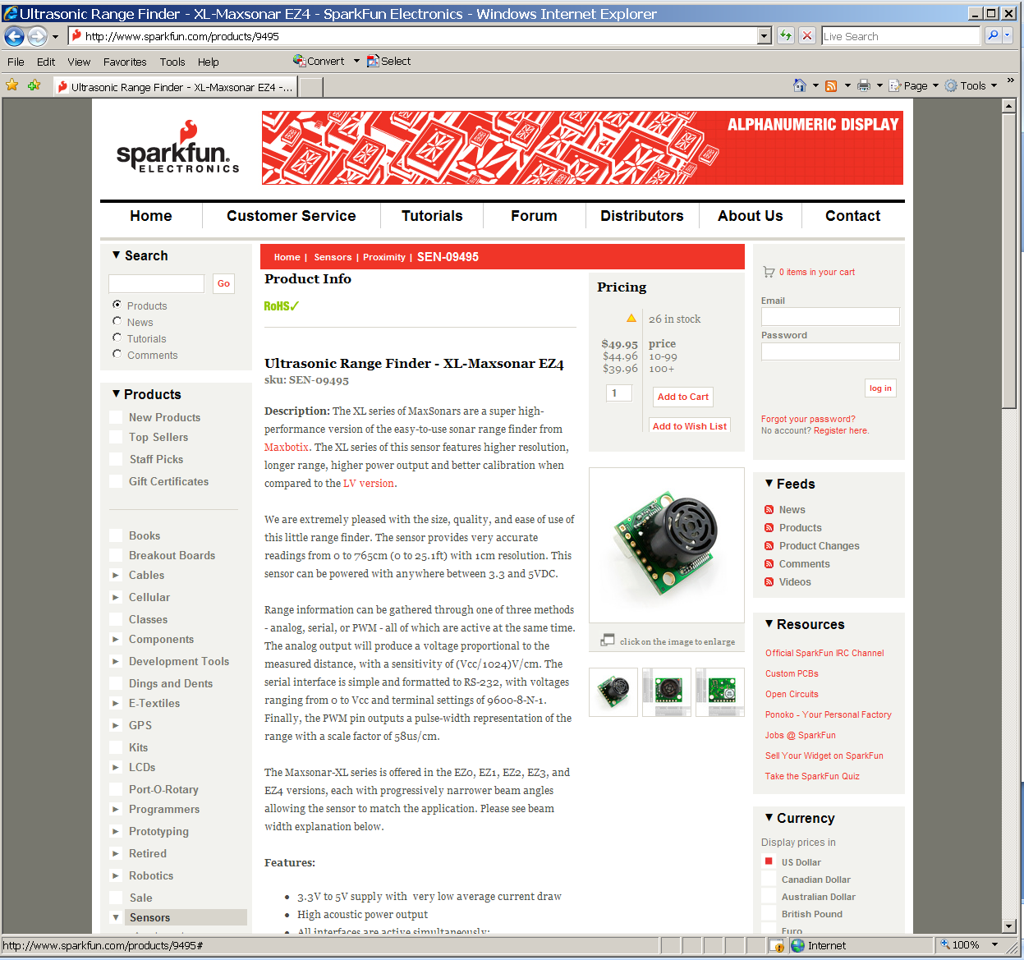
Ultrasonic Range Finder

Slide 66
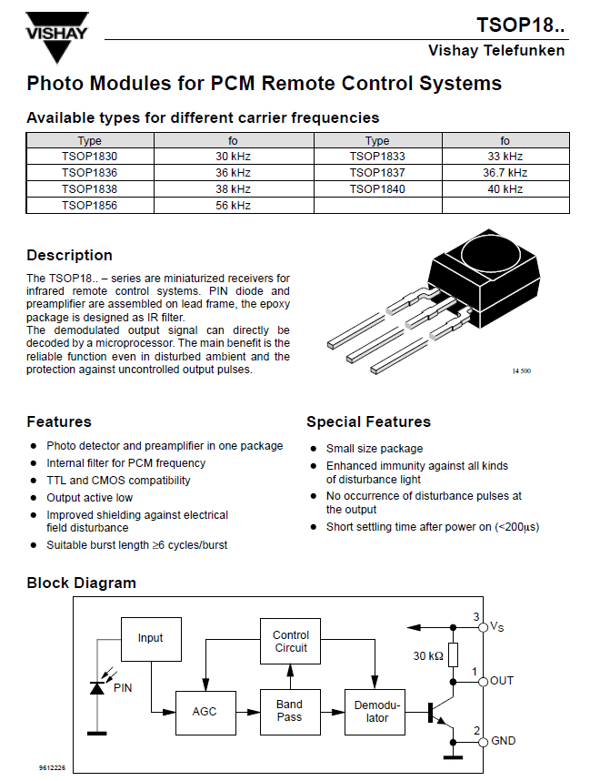
IR Remote

Slide 67
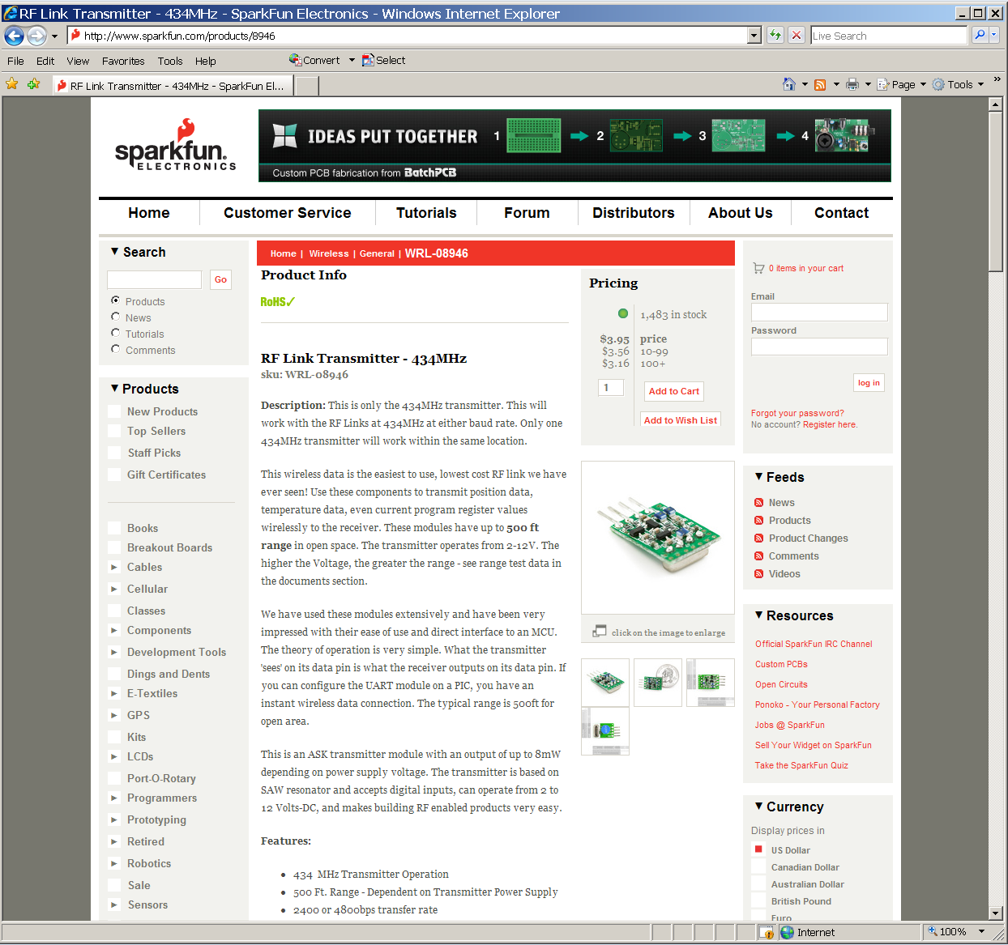
RF Link (Transmitter)

Slide 68
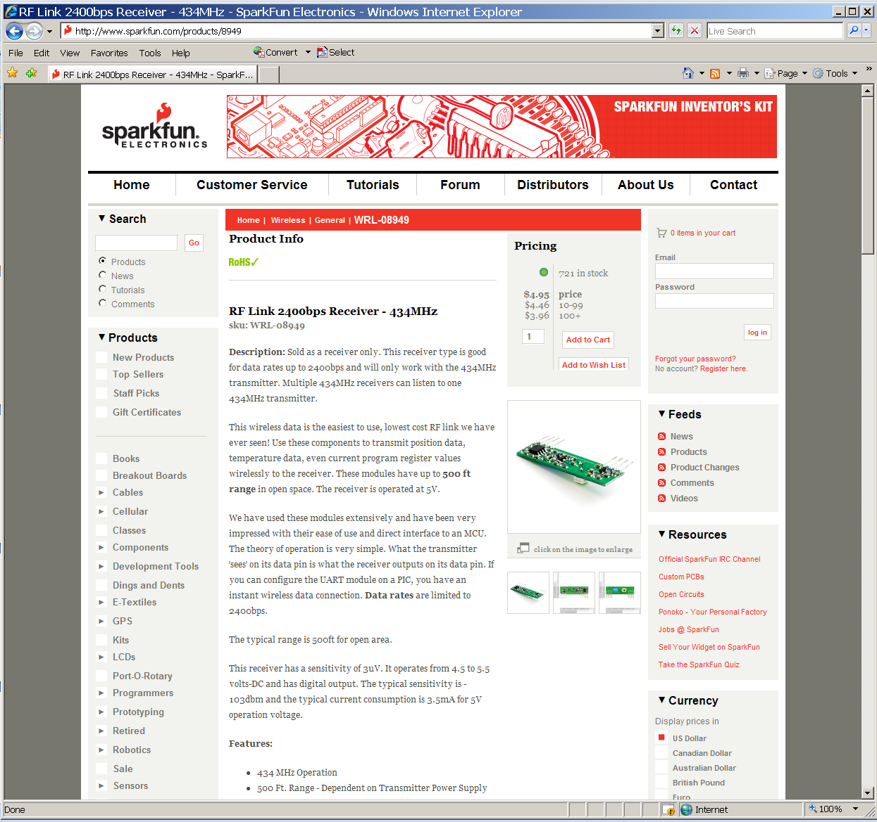
RF Link (Receiver)

Slide 69
Switching A.C. Loads
Use either relays or triacs
  Relays: expensive, noisy, and potentially unreliable
  Triacs: less expensive, more reliable, less noisy (if “zero current” switched)
Relay coil can be driven with a BJT or MOSFET circuit (remember: it is an inductive load)
Triacs must be optically isolated from logic circuitry (may also need heat sink)
Triacs are “regenerative” devices
  once triggered, stay on until “zero current” point
  must be re-triggered each A.C. half-cycle

Slide 70
Switching A.C. Loads
Basic mechanical relay circuit:
arc suppression diode

Slide 71
Switching A.C. Loads
Basic triac circuit – (very) small load:
Vcc
Port Pin
DIAC (MC 3031)

Slide 72
Switching A.C. Loads
Basic triac circuit – large load:
power triac (up to 25A)
Vcc
MT2
G
Port Pin
MT1
DIAC (MC 3031)

Slide 73
Switching A.C. Loads
Issues
  Triac circuits should be zero current switched to eliminate RFI
  For proportional control, a “snubber” circuit (LPF) must be used to reduce RFI
  Excessive RFI can cause “bad things to happen” in both digital circuits and analog circuits – it can also compromise FCC certification of product

Slide 74
Switching A.C. Loads
Generating A.C. zero-cross timing pulses
  Need to know when A.C. zero crossings occur to perform zero-current switching
  For proportional control, need A.C. zero crossing as reference for generating triac trigger pulse (in conjunction with on-chip timer subsystem)
  Other uses for A.C. zero-cross timing pulses include creating a highly accurate time-of-day clock

Slide 75
AC Line
Trigger Pulses
Power Delivered to Load

Slide 76
Switching A.C. Loads
Circuit (part of power supply) that can be used for A.C. zero cross timing pulse generation
Note: must be CMOS
Interrupt device flag

Slide 77

X-10 Protocol Devices
Communication via existing A.C. wiring
Computer interface available
Modules for appliance control and lamp dimming

