Slide 1

Next Steps: What’s Left to Do, and Where to go from here… David G Meyer ©2020, Images Property of their Respective Owners.
Notes:
Cover Image Source: http://theoutlook.com.ua/uploads/user/%D0%B8%D0%B0%D0%B3%D1%83%D1%81%D1%83/iguazu-falls-brazil-o.jpg

Slide 2
Outline
Summary of Remaining Work and Due Dates
Project Improvements
Project Ownership
Design and Business Competitions
Crowdfunding
Entrepreneurship
Research and Industry
Closing Thought

Slide 3
Summary of Remaining Work and Due Dates
Friday, April 24
Initial draft of HW #13 (ABET Senior Design Report)
Friday, May 1
HW #12 (User Manual)
PSSC Demos
Monday, May 4 (Finals Week)
Final Confidential Peer Review
Final draft of HW #13 (ABET Senior Design Report)
HW #14 (Final Project Archive)
Wednesday, May 6 (Finals Week)
Final Team Presentation

Slide 4
ABET Senior Design Report – Team Section

Slide 5
ABET Senior Design Report – Individual Section

Slide 6
User Manual

Slide 7
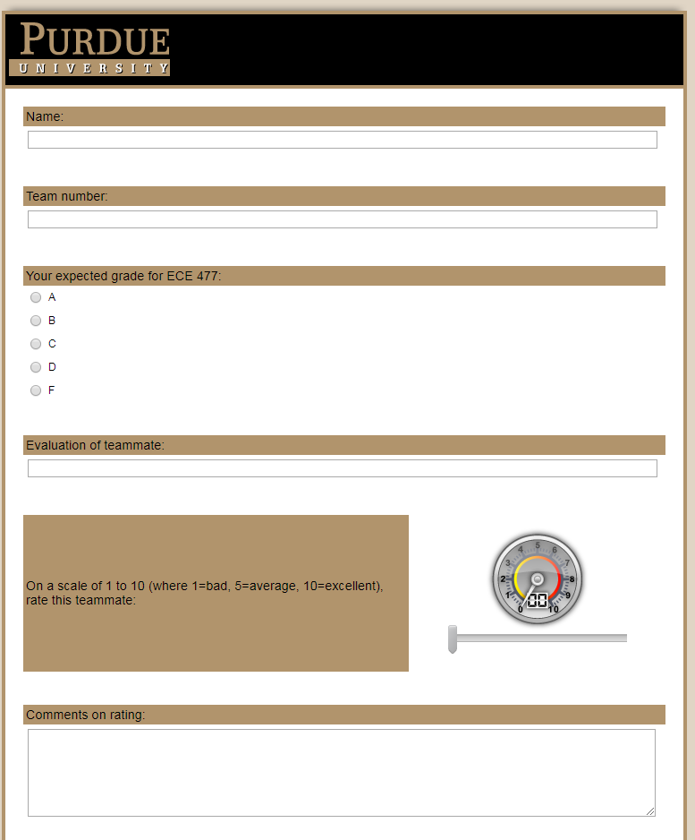
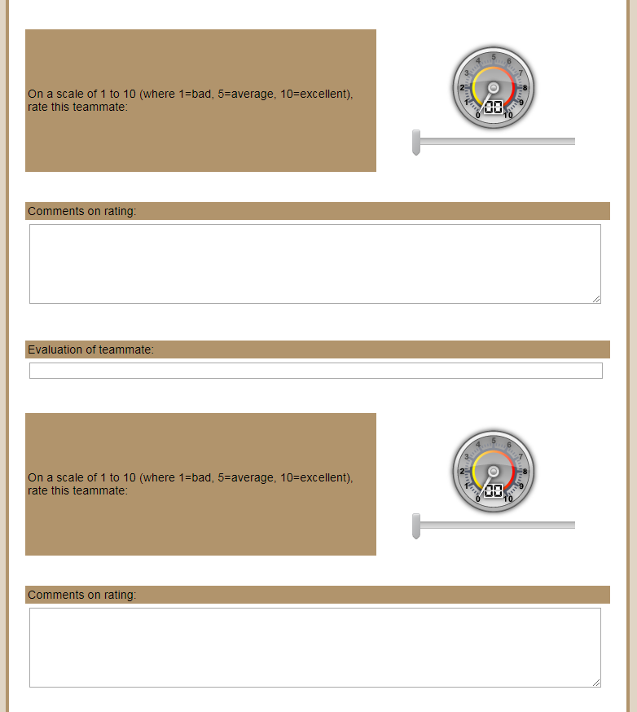
Final Confidential Peer Review

Slide 8
Final Project Archive
File Folder Organization (ZIP)
Documents
Homework Assignments 1, 2, 9, 10, 11, 12, 13
Midterm Design Review Slides
Final Presentation Slides
PSSC Demo Video
Electrical
Homework Assignments 4, 5, 6
Schematic and PCB Files
Mechanical
Homework Assignment 7
Packaging CAD Files
Software
Homework Assignments 3, 8
Code Source Files

Slide 9
Final Team Presentation
Length: 15 minutes total (including Q & A)
All team members should participate in the presentation as equally as possible
Links to your presentation slides and demo video should be posted on your team webpage
Use the presentation template provided and follow the outline:
Title slide/team introduction (a picture of team members should be on the title slide, annotated with names) – 1 minute
Project description and underlying motivation – 1 minute
Block diagram – 1 minute
Summary of design challenges faced, and how they were addressed – 2 minutes
Individual contributions (1 minute/team member = 4 minutes total)
Video* documenting successful demonstration of PSSC – 4 minutes
Questions/discussion – 2 minutes
__________________
* Course staff will watch demo video at this point in the presentation using the link provided on the team’s webpage

Slide 10
Final Team Presentation
Public Service Announcement Concerning Your Demo Video (PSA)

Slide 11

Project Improvements
Congratulations! You’ve finished version 1 of your project!
What about version 2?
Streamlined design? (remove unnecessary features to make it more cost efficient)
Additional features and capabilities?
Design for production?
Boot loader and other production hardware?
Built-in self test (BIST)?
Notes:
Production PCB Image Source: http://www.sciencephoto.com/image/346940/350wm/T3580166-Circuit_board_production-SPL.jpg

Slide 12
Project Ownership
You’ve finished your project, now… who owns your project?
Any development tools/systems provided by course staff (development boards, tools, most reusable components) are property of Purdue University and must be returned
Sponsored projects may be property of the sponsors, depending on specific conditions related to the agreement between the sponsor and the project team
Ownership of all other projects is decided upon by the student team members

Slide 13
Project Ownership
Who owns the intellectual property for your student project?
Intellectual property is handled at the University level. Policy on student-generated intellectual property is described here.
Student project work is classified at this time as Scholarly Copyrightable Works. The University retains a perpetual nonexclusive royalty-free license for pedagogical, research, and educational purposes.
Aside from this University license, students retain ownership of their intellectual property and are free to continue pursuing and/or commercializing their projects

Slide 14
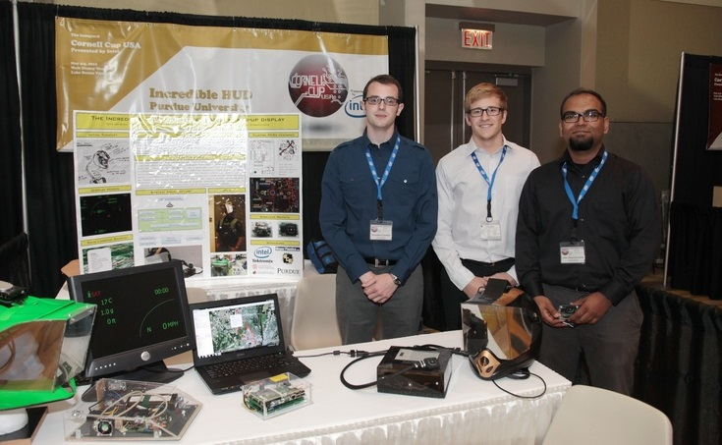
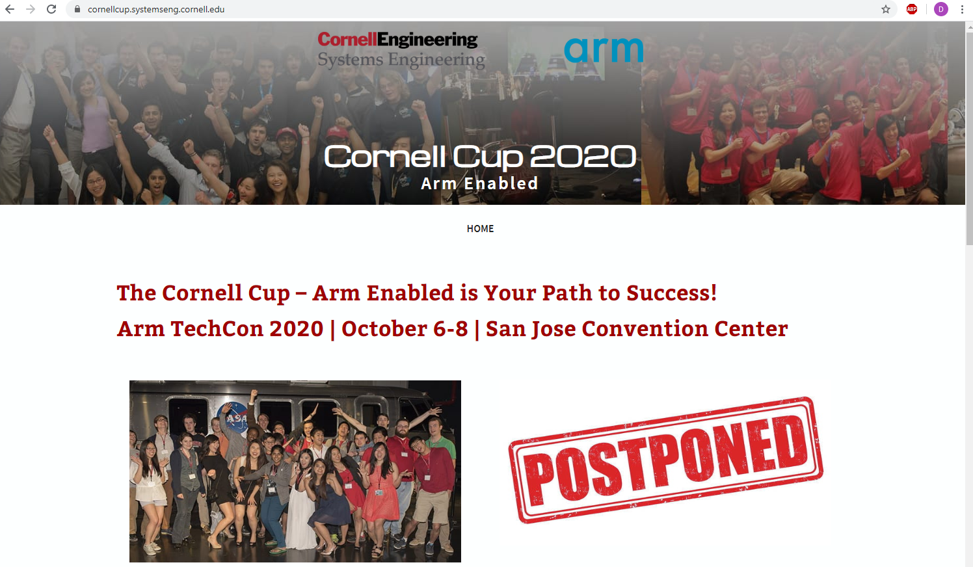
Design Competitions
Cornell Cup
Yearly design competition in which student teams demonstrate embedded projects developed using ARM hardware
Purdue has regularly participated since the original Cornell Cup in 2012
$10,000 prize for first place, chance for fame and recognition
https://cornellcup.systemseng.cornell.edu/
Notes:
Cornell Cup Image Source: https://engineering.purdue.edu/ece477/Incoming/img/CornellCupUSA.jpg

Slide 15
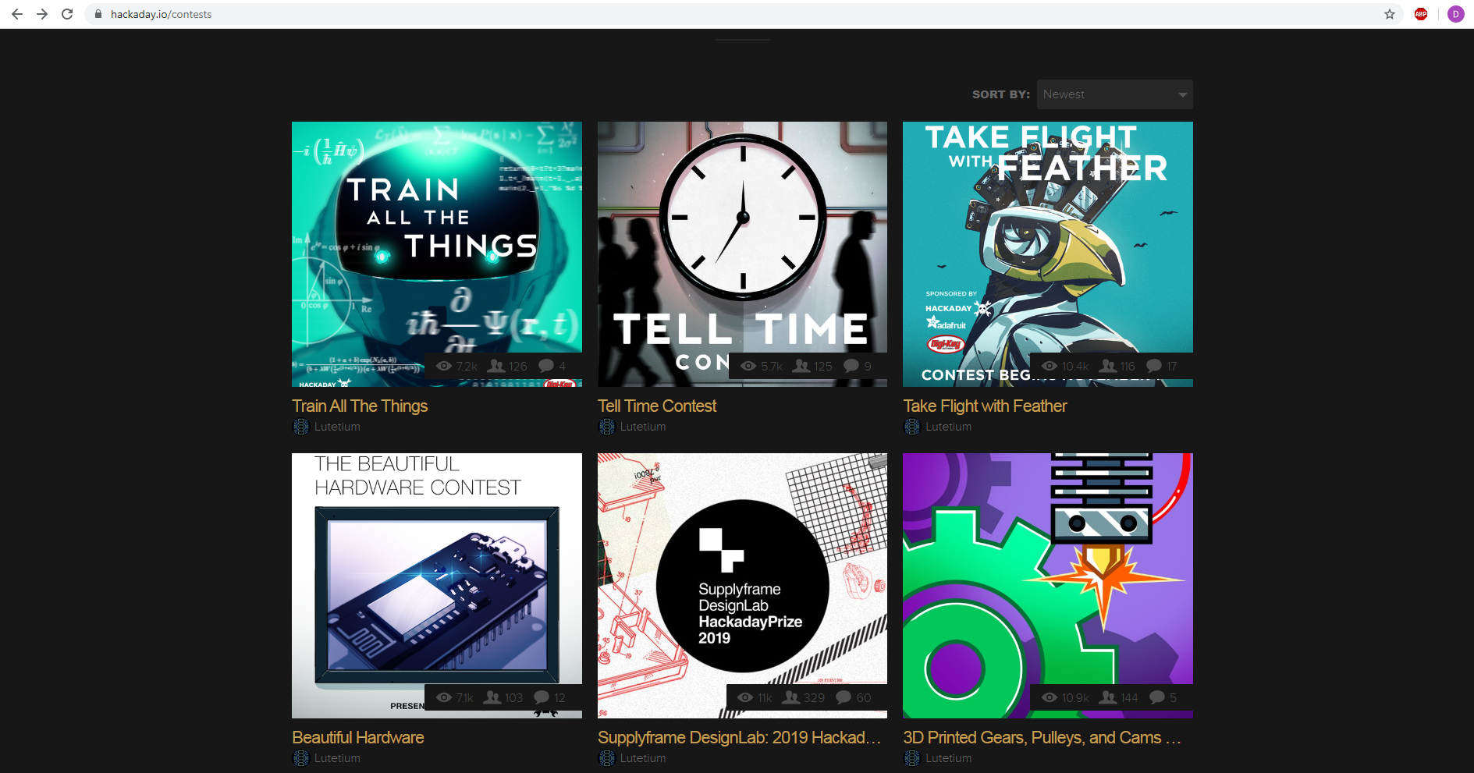
Design Competitions
Hackaday
Started in 2014, a global design competition open to all entrants
Develop embedded, open-source hardware/software for unique challenges
https://hackaday.io/contests
Notes:
SatNOGS Image Source: https://static.hackaday.io/images/7657121401903408421.jpg

Slide 16
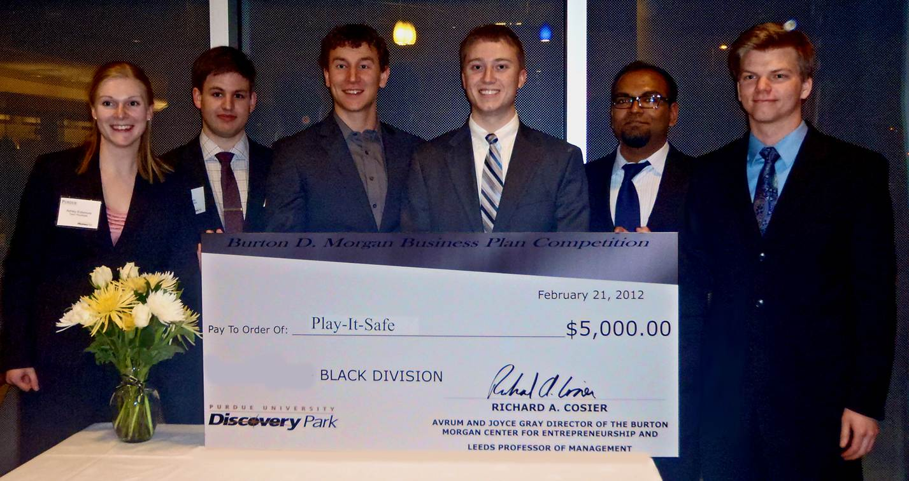
Business Competitions
Burton Morgan Business Plan Competition
The Burton D. Morgan Center for Entrepreneurship at Purdue University organizes an annual Business Model Competition that encourages students to develop their unique ideas for new products or services into a profitable business
The competition format provides participants with an opportunity to develop and improve transferable skills that will be valuable throughout their career
Over $100,000 in cash and in-kind prizes awarded (2019 winners in chart)
Place | Social Entrepreneurship | B2B
1st | $15,000 - GlobalSign | $20,000 - SnapWire
2nd | $10,000 - StemNode | $15,000 - OPSUS
3rd | $5,000 - Greeks For Good | $7,500 - FlykeArt
finalists | $2,500 - Engineering for Social Good | $2,500 - RightFit
https://www.purdue.edu/discoverypark/bdmce/competitions/business-model-competition/index.php
Notes:
Burton Morgan Competition Image Source: https://engineering.purdue.edu/ece477/Incoming/img/BurtonMorgan.jpg

Slide 17
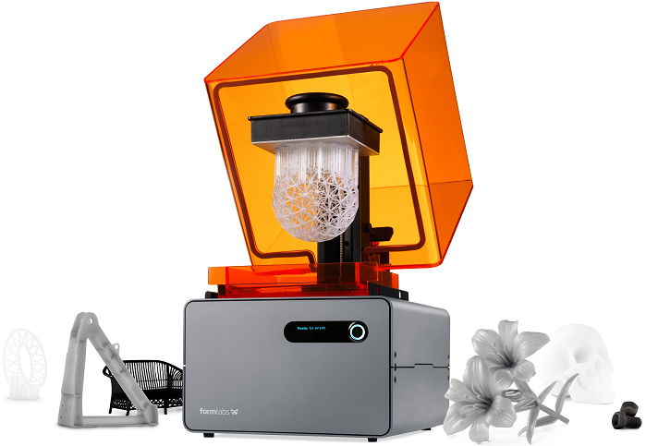
Crowdfunding
In 2012, the Jumpstart Our Business Startups (JOBS) Act was signed into law, easing securities regulations and granting legal allowance to crowdfunding practices
Numerous crowdfunding sites exist where inventors can pitch ideas to the general public, who can then pledge support to sponsor crowdfunding projects
Many inventions have been financially supported through sites such as Kickstarter and Indiegogo, with tens of millions of dollars pledged on a yearly basis
Notes:
Form 1+ Image Source: http://www.tenlinks.com/news/wp-content/uploads/sites/3/form_1_plus_models_open.jpg

Slide 18
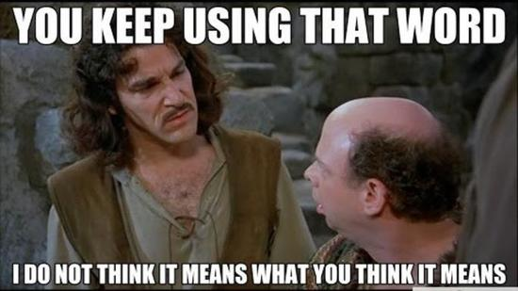
Crowdfunding
Despite the success and allure of crowdfunding, there are a few pitfalls that anyone considering this approach should be aware of:
You aren’t ready to start crowdfunding until you have viable hardware ready for a production run – never start a campaign on the promise of future hardware development
Occasionally, a campaign’s popularity can wildly exceed expectations and go from something manageable to an out of control time sink that devours the creator’s life – therefore, set limits on any campaigns and start small until you know what you’re getting into

Slide 19
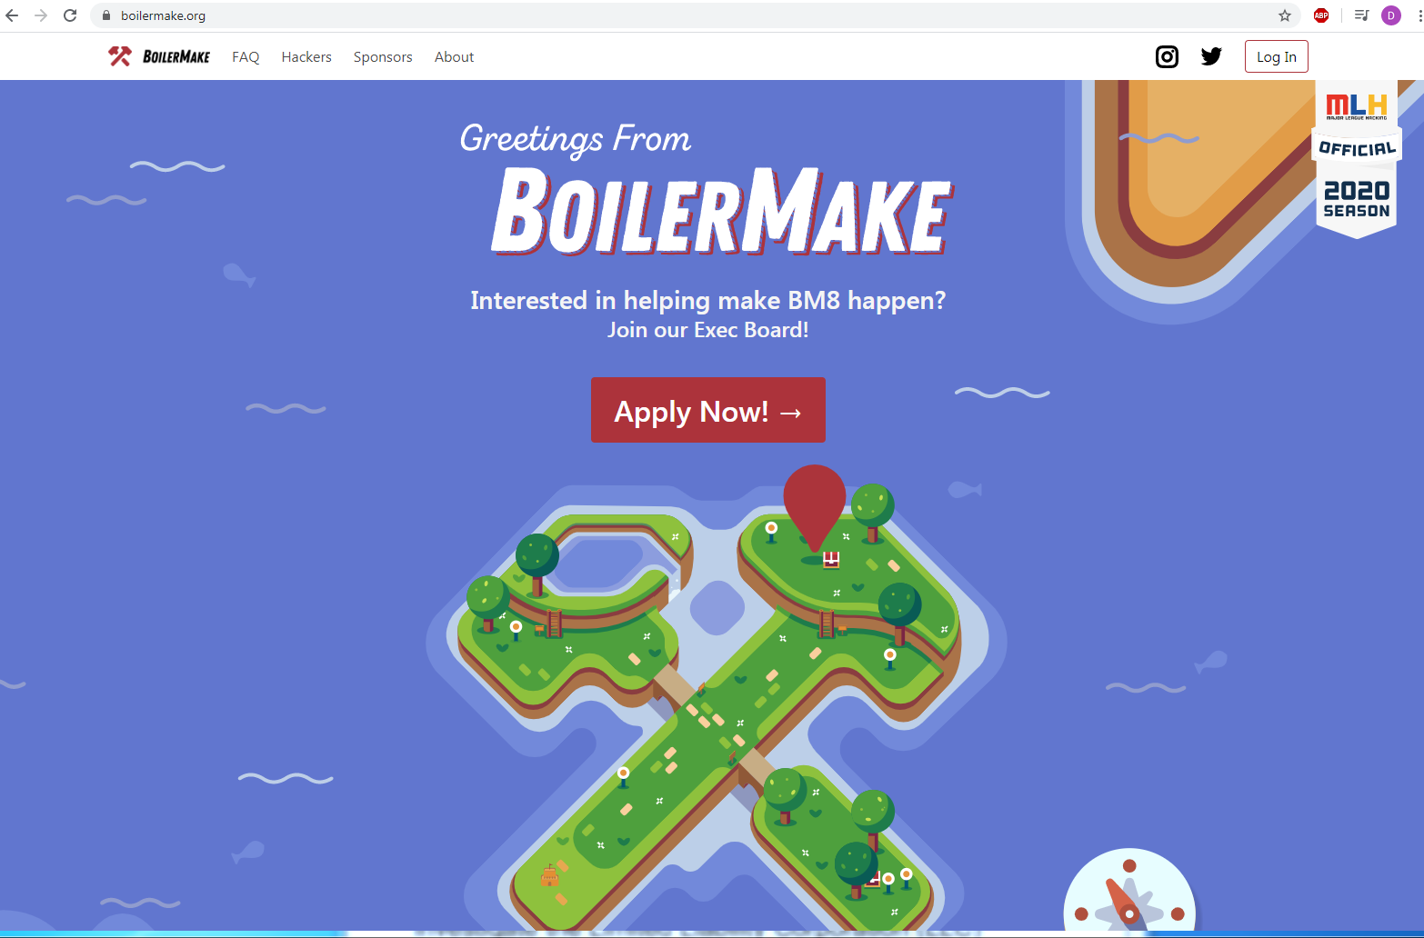
Hackerspaces and Accelerators
Hackathons: Weekend events sponsored by organizations to produce innovative hardware in a short period of time (e.g. BoilerMake at Purdue)
Accelerators: Investor groups, trade equity for resources and connections to help commercialize hardware
HAX Accelerator (Shenzhen, China)
Hackerspaces: Community groups and workshops for collaborative hacking opportunities
The Anvil (West Lafayette)
Club Cyberia (Indianapolis)

Slide 20

Entrepreneurship
Instead of or in addition to methods already discussed above, students might be interested in starting their own businesses
Students interested in starting a business are directed to investigate the Limited Liability Corporation (LLC) structure, as it reduces legal and financial liability for business owners compared to simpler structures (such as a sole proprietorship)
NOLO legal reference books can be purchased or acquired from the local library and provide a great starting point for small business ownership
Other legal services, such as web hosting and development, are readily available and inexpensive

Slide 21

Research and Industry
“We have too many people with hardware experience; we should reduce the number of people who understand how things work and how they are built” – No research or industry leader ever
Life advice #1: Every once in awhile, your supervisor is going to peak in and ask you what you’re working on that they don’t already know about – Always have an answer to that question
Life advice #2: The jobs you take will determine where you get to live, what you get to do, and how much time outside of work you’ll have to do the non work-related things you enjoy – so choose wisely
Notes:
“Best Professional Advice I Ever Got” by Eric Niebler - http://ericniebler.com/2013/07/04/best-professional-advice-i-ever-got/

Slide 22
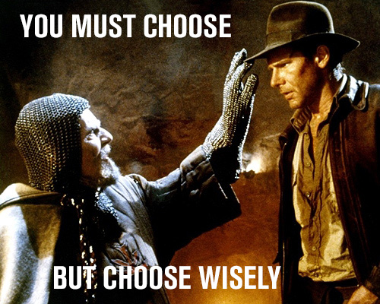
CLOSING THOUGHT
Notes:
He Chose Wisely Image Source - http://www.gordcollins.com/wp-content/uploads/2014/03/Choose-Wisely.jpg

