Slide 1

Environmental and sustainability concerns
George E Hadley and David G Meyer ©2016, Images Property of their Respective Owners.
Notes:
Cover Image Source: http://theoutlook.com.ua/uploads/user/%D0%B8%D0%B0%D0%B3%D1%83%D1%81%D1%83/iguazu-falls-brazil-o.jpg

Slide 2
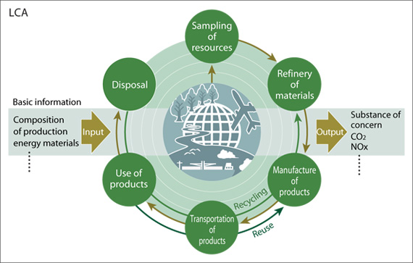
Outline
Why study environmental concerns?
Basic environmental questions
Where do our raw materials come from?
Production and manufacturing costs
The consumer lifecycle
E-waste and electronics recycling
What can be done
Case studies

Slide 3

Why Study Environmental?
Accreditation agencies (ABET) deem it an important part of all engineering curricula, including EE and CmpE
Idea of “best engineering practice” – environmental factors are an important element of this
Engineers have vast power to oversee the creation and development of designs and the environment, and thus have great responsibility to see to its care.
“It is expected that commonplace practice of sustainable development and business practice will evolve over time, either by choice or catastrophe.” F. Splitt, Northwestern University

Slide 4
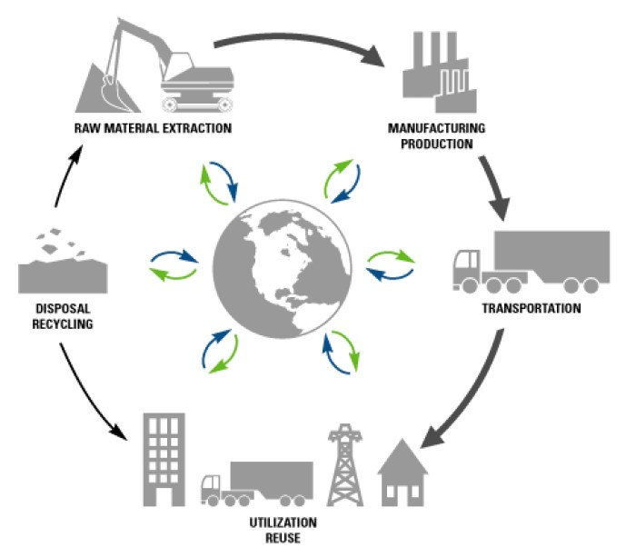
Basic Environmental questions
What are some of the environmental issues associated with the manufacture, use, and disposal of electronic devices?
What obligation is there to lengthen the useful lifetime of a product to the extent possible?
What obligation is there to reduce the energy consumption of a product to the extent possible?

Slide 5
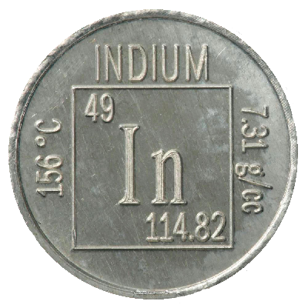
Raw Materials
Indium
What it’s used for: Transparent conductive coating for LCD panels, semiconductor applications, LEDs, anti-corrosion agent in batteries
Where it can be found: Extremely rare, occurs only in the form of indium mineral compounds, none of which are known to occur in significant deposits. Generally extracted from deposits of lead, tin,
copper, iron, and zinc
Worldwide Production: ~600 tons
EOL Recycling Rate: <1%
Remaining known supplies: ~14 years
Notes:
Indium Image Source: http://periodictable.com/Samples/049.10/s13.JPG

Slide 6
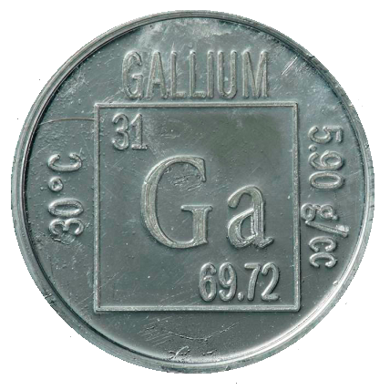
Raw Materials
Gallium
What it’s used for: High-speed semiconductor devices, high-powered lasers. Gallium arsenide (GaAs) and gallium nitride (GaN) are most common variants, accounting for 98% of commercial use
Where it can be found: Extremely rare, occurs only in the form of mineral compounds which are themselves too rare to mine. Extracted as a trace element from bauxite (aluminum ore) and sphalerite (zinc ore).
Worldwide Production: ~300 tons
EOL Recycling Rate: <50%
Remaining known supplies: Significant, but require substantial mining to access
Notes:
Gallium Image Source: http://periodictable.com/Samples/031.8/s12s.JPG

Slide 7
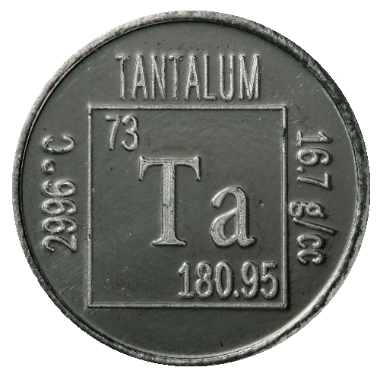
Raw Materials
Tantalum
What it’s used for: High reliability tantalum capacitors, found in phones, computers, tablets, and other consumer electronics.
Where it can be found: Extremely rare, occurs in an estimated 1-2 ppm in the earth’s crust. Primary sources include Australia, China, and central Africa. Tantalum mining is linked to warfare and thus Tantalum from these regions is considered a conflict mineral
Worldwide Production: ~1,600 tons
EOL Recycling Rate: ~25%
Remaining known supplies: < 50 years
Notes:
Tantalum Image Source: http://periodictable.com/Samples/073.21/s13.JPG
Tantalum Report: http://minerals.usgs.gov/minerals/pubs/commodity/niobium/myb1-2012-niobi.pdf

Slide 8

Raw Materials
Lithium
What it’s used for: Primarily used in batteries due to its low weight and high energy storage capabilities
Where it can be found: Rare, although can be extracted from seawater or mined from the crust in trace amounts (~20mg per kg of crust). Largest known source is the Salar de Uyuni (left) in Bolivia, containing 50-70% of known global lithium reserves
Worldwide Production: ~20,000 tons
EOL Recycling Rate: ~25%
Remaining known supplies:
< 100 years
Notes:
Salar de Uyuni Image Source: http://upload.wikimedia.org/wikipedia/commons/f/f4/Salar_de_Uyuni_2013.jpg

Slide 9
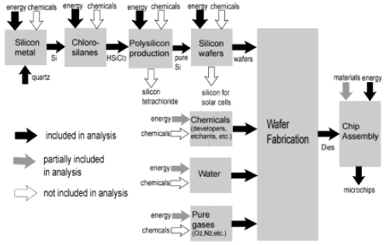
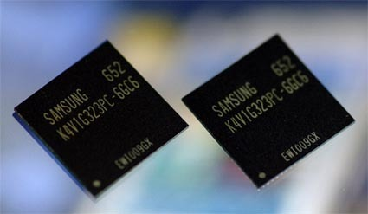
Production and Manufacturing
Modern electronics require highly purified base materials which are rare, scarce, and challenging to extract. Due to the complex designs involved in integrated circuits the cost and material usage of electronics is much higher than many other products
A single 2-gram DRAM chip uses an estimated 1.6 kg of fossil fuels and
72 g of chemicals. Large amounts of water (32 kg) are required as well
(Source: American Chemical Society)
Notes:
Silicon Environmental Process Lecture: http://pubs.acs.org/doi/pdf/10.1021/es025643o
“The 1.7 Kilogram Microchip: Energy and Material Use in the Production of Semiconductor Devices”: http://pubs.acs.org/doi/pdf/10.1021/es025643o
Dartmouth Environmental Lecture: https://engineering.dartmouth.edu/~d30345d/courses/engs171/ElectronicsIndustry.pdf

Slide 10
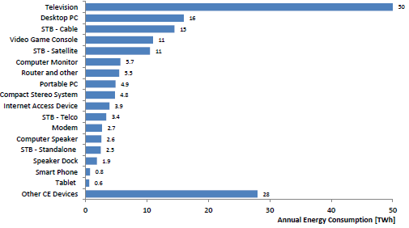
Consumer Lifecycle
Once products are manufactured and shipped, they are used by end users in their designed application. The primary environmental impact at this stage involves energy expenditure
In 2013, consumer electronics devices used an estimated 170.4 TWh of energy
Notes:
“Energy Consumption of Consumer Electronics in US Homes in 2013”: http://www.ce.org/CorporateSite/media/environment/Energy-Consumption-of-Consumer-Electronics.pdf

Slide 11
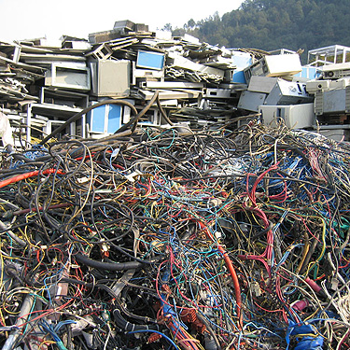
E-waste and Recycling
Increased consumption and demand for electronics in modern society has led to enormous amounts of electronic waste (E-waste)
In 2012, the United States alone generated an estimated 20 billion pounds of E-waste, much of it sent to landfills
Some E-waste is exported, largely from developed countries, to developing and poor countries, for recycling
Recycling of E-waste involves large amounts of labor with numerous environmental and human hazards
E-waste is often burned, producing byproducts such as lead fumes and metallic toxins, which are extremely dangerous to human health

Slide 12

What can be done
As engineers, resource depletion and electronic waste can be mitigated in the following steps:
Eliminate: New devices and designs which eliminate the need for previously existing classes of products (example: smartphones eliminating need for a dedicated MP3 player)
Reduce: New devices and designs which use fewer resources and energy than their predecessors
Reuse: New devices and designs which are easily repairable, upgradeable, and multifunctional
Recycle: Send remaining salvage to recyclers to responsibly recycle old electronic materials
Notes:
Recycle Logo Image Source: http://earthuntouched.com/wp-content/uploads/2014/10/managing-e-waste-4.jpg

Slide 13
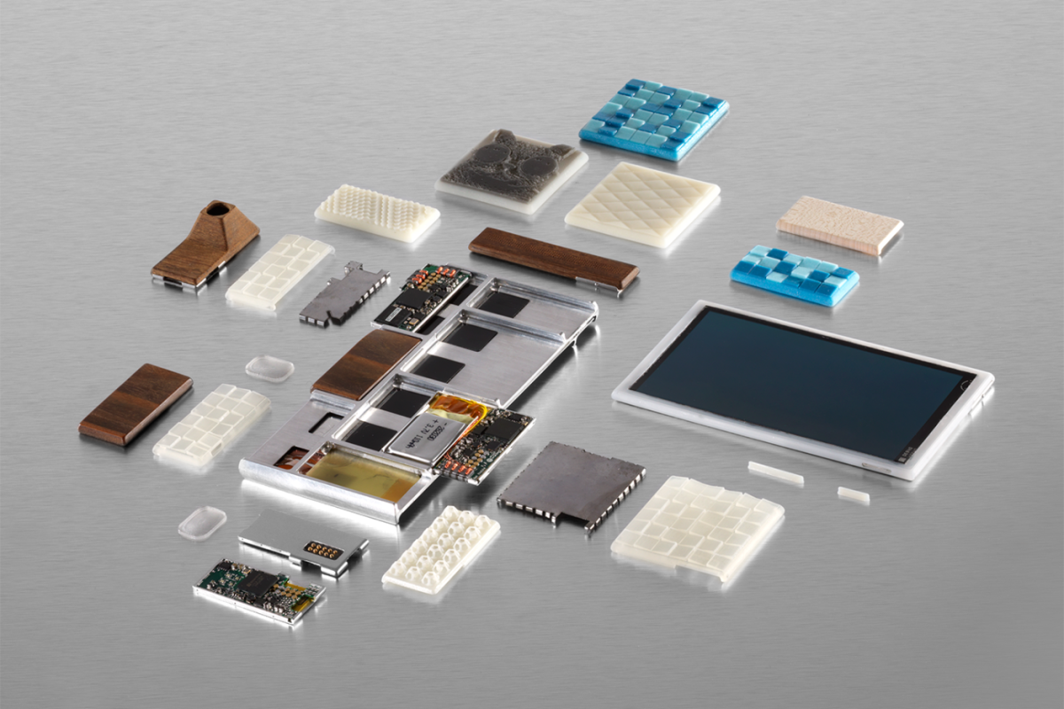
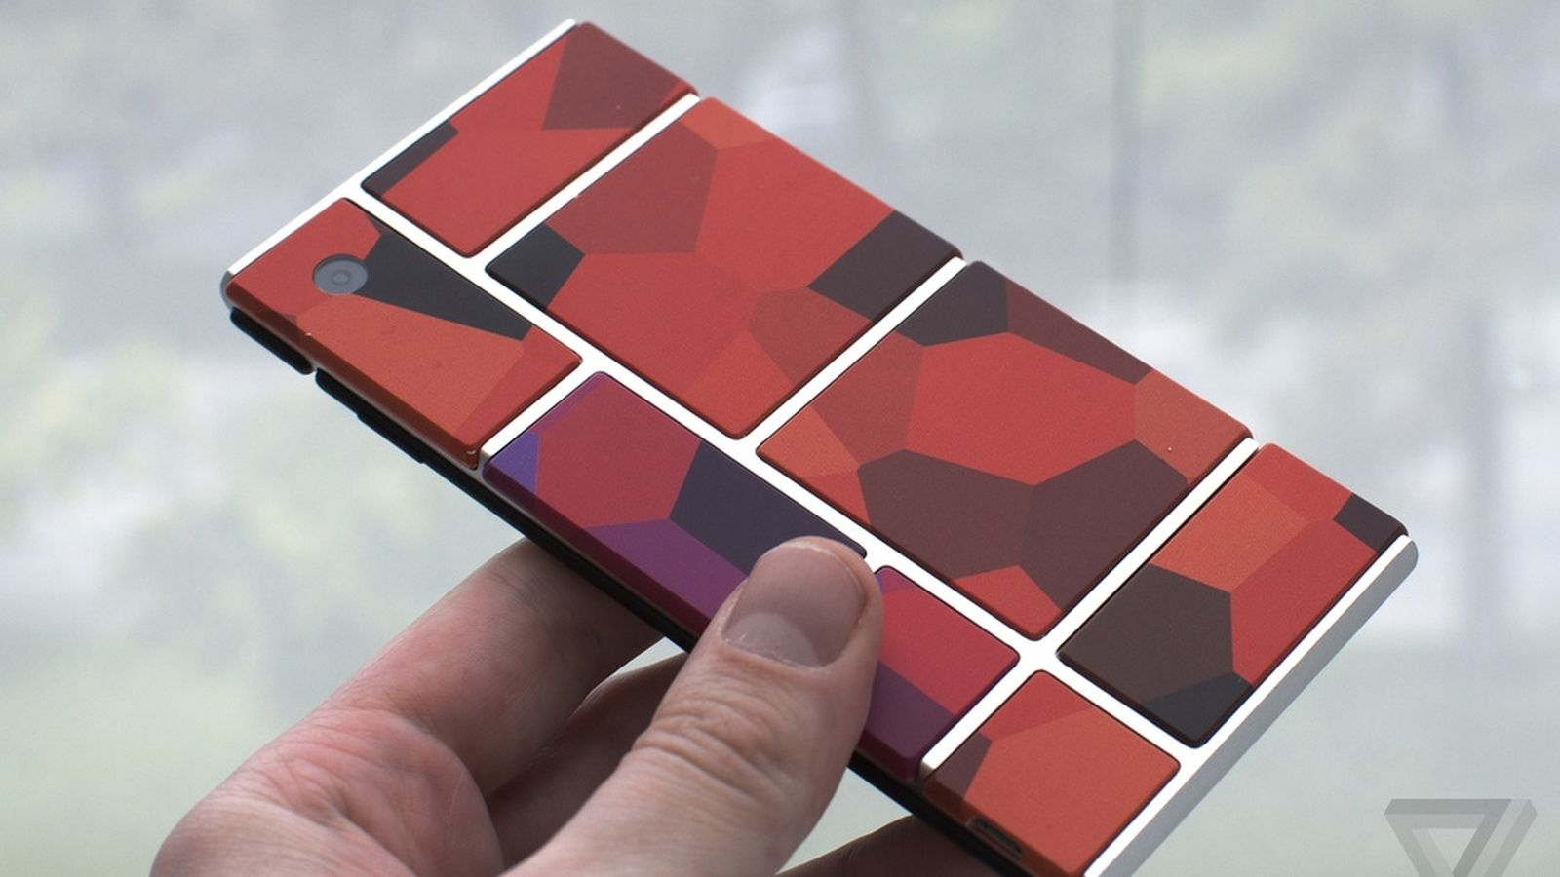
Environmenal Case Studies
Project Ara
Google/Motorola initiative - modular smartphone design
End users can decide which components and functionality their phones need, and purchase modules on this basis
When an upgrade is desired or a repair needs to be made, the module can be replaced without needing to discard the entire device
Project Ara concept video: https://www.youtube.com/watch?v=TQjGBEEiejU
Notes:
Project Ara Image Source: http://upload.wikimedia.org/wikipedia/en/7/7d/Project_Ara_scattered_parts.png

Slide 14
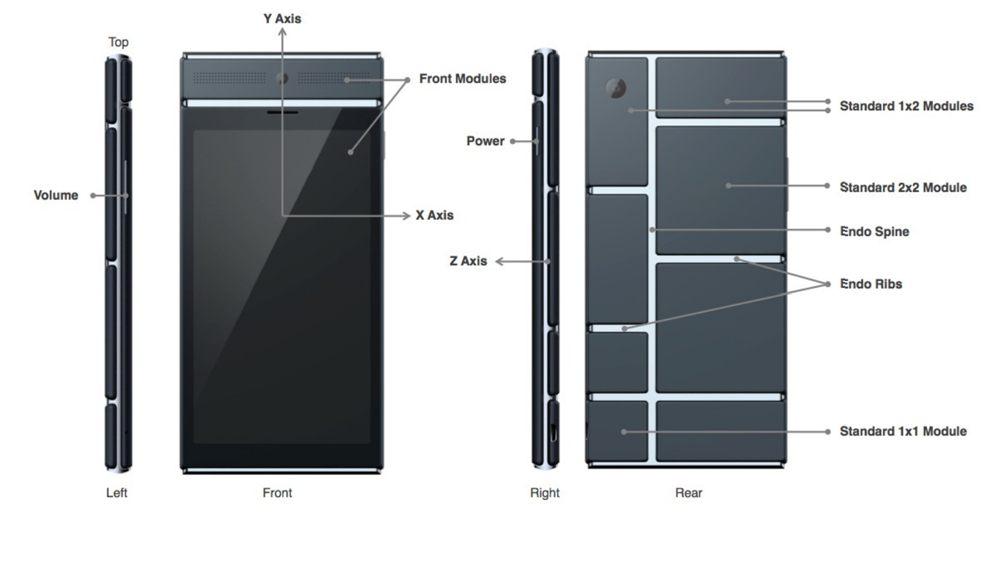
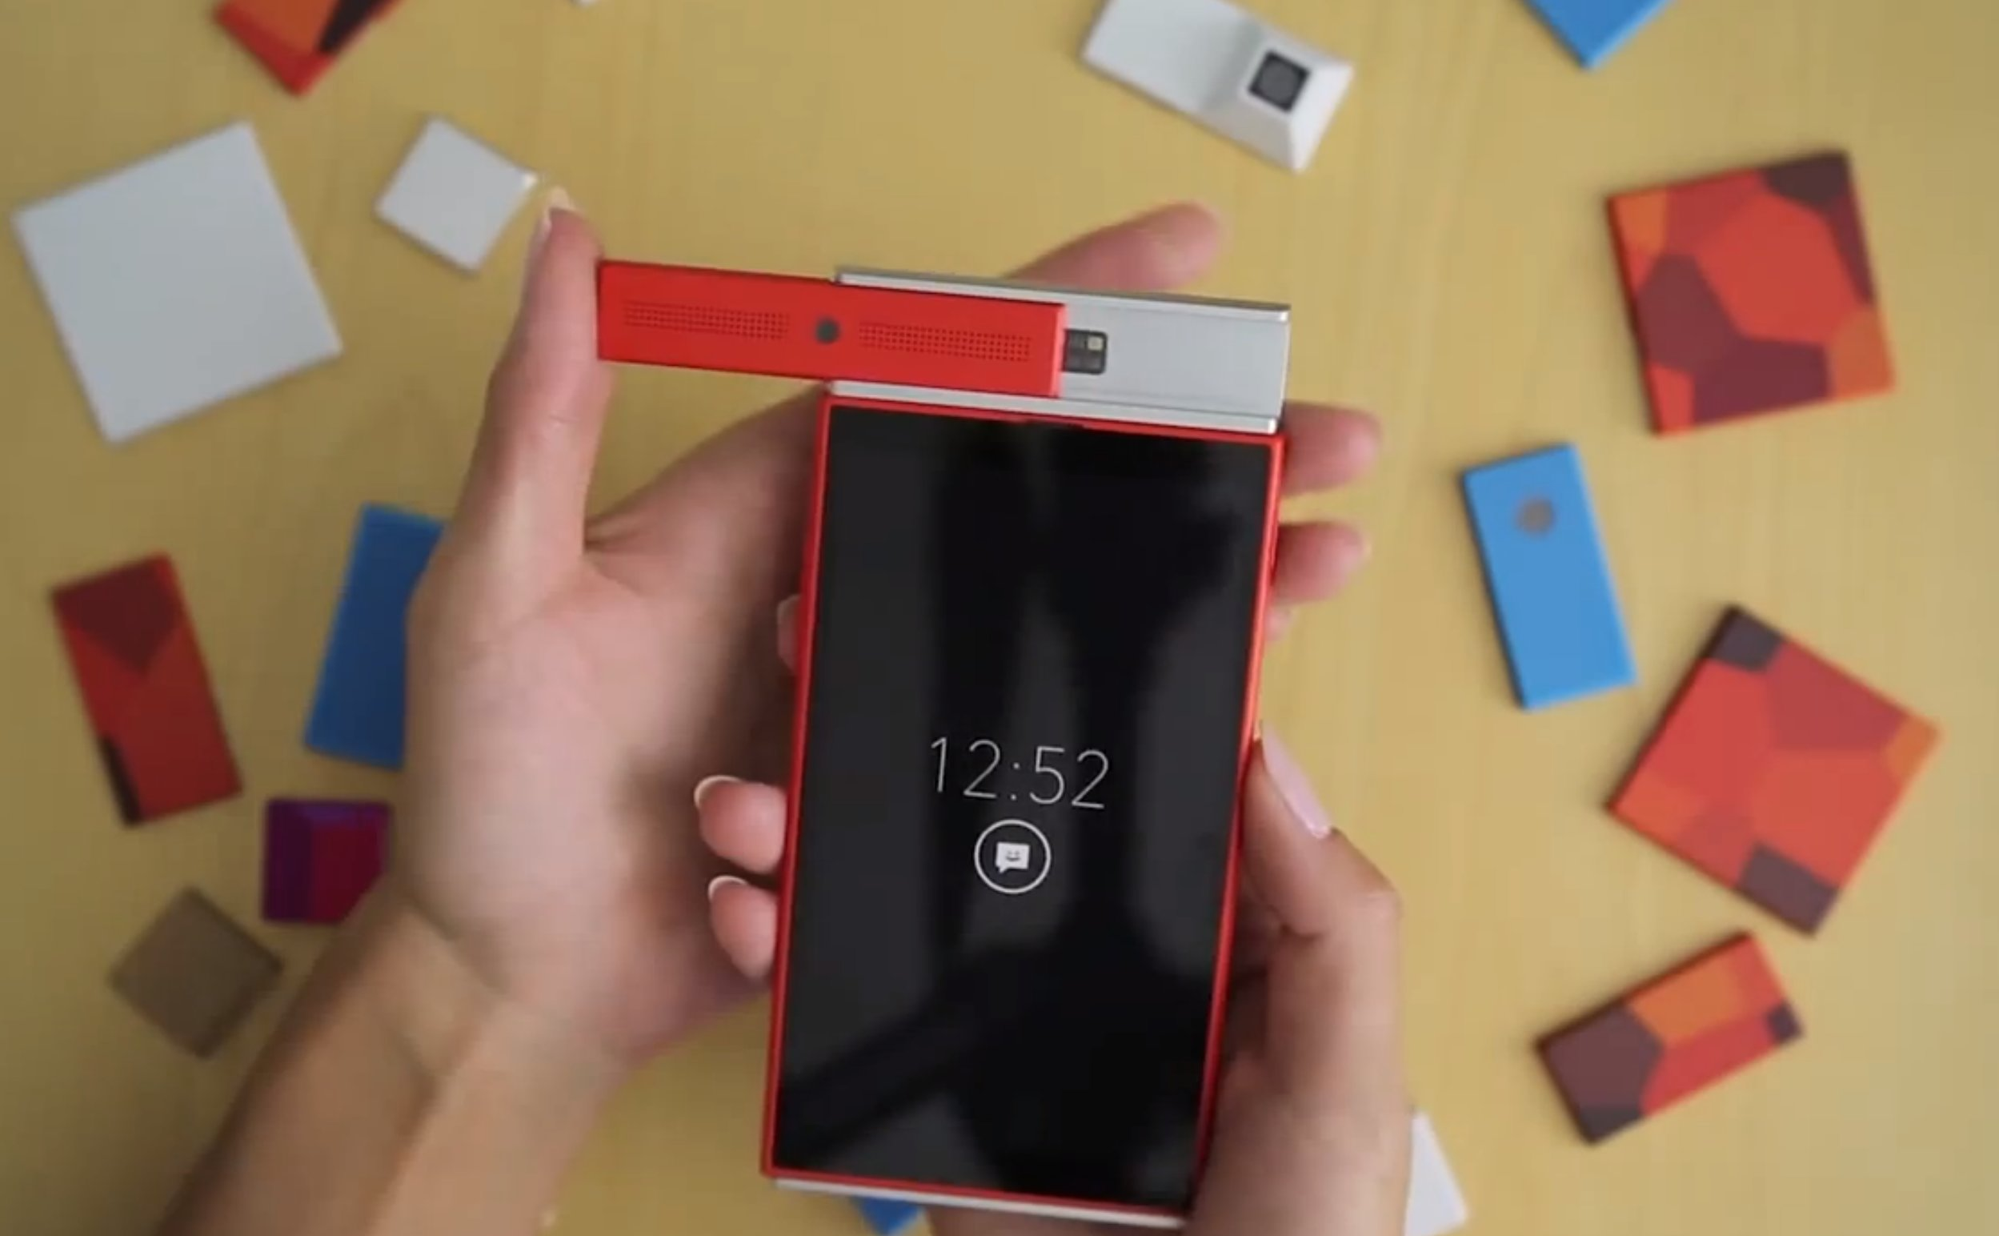
Environmenal Case Studies
Project Ara
Relevant questions:
What are the positive environmental impacts of this project? Negative impacts?
Would you buy a device like this? What premium would you be willing to pay compared to a normal disposable device?

Slide 15
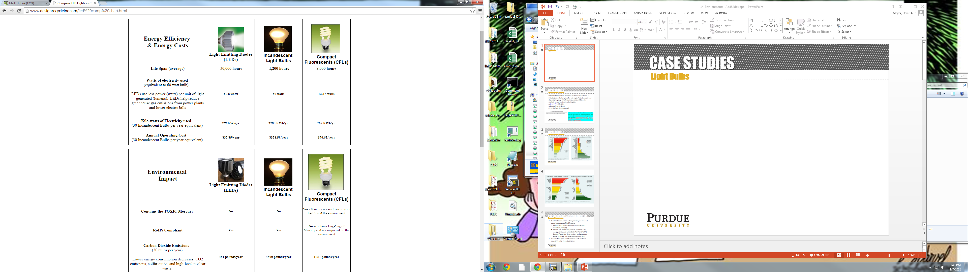
Environmenal CASE STUDIES
Light Bulbs

Slide 16
Environmenal CASE STUDIES
Light Bulbs

Slide 17
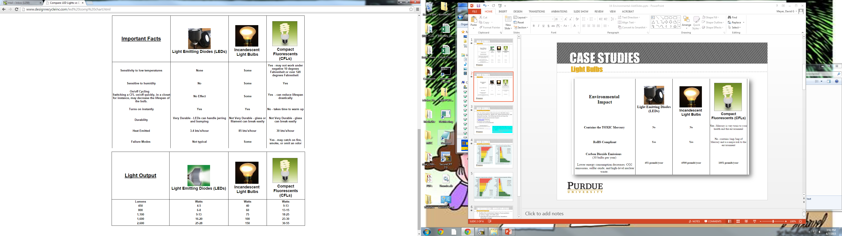
Environmenal CASE STUDIES
Light Bulbs

Slide 18
Environmenal CASE STUDIES
Light Bulbs
Source: http://www.designrecycleinc.com/led%20comp%20chart.html

Slide 19
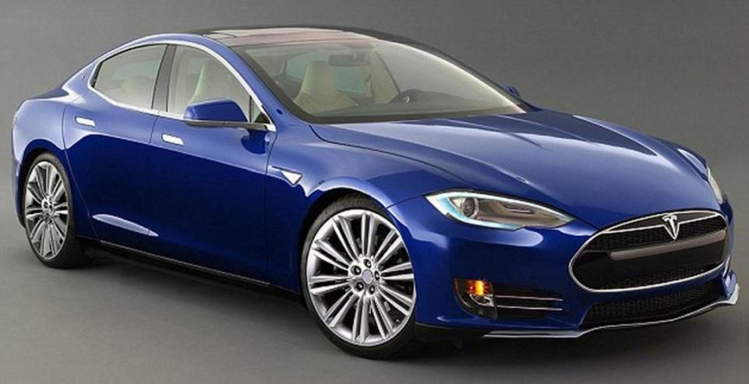
Environmenal CASE STUDIES
Tesla Model 3
Notes:
Tesla Model 3 Image Source: http://s.newsweek.com/sites/www.newsweek.com/files/styles/embed-lg/public/2016/02/11/tesla-model-3-speed-price-rumors-elon-musk.jpg

Slide 20
Environmental Case Studies
Tesla Model 3
Perspectives on electric cars:
As environmentally unfriendly as conventional cars, if powered by fossil fuels. (Climate change skeptic)
A gateway to reducing fossil fuel dependence by making the burning of oil/coal/natural gas an optional way to get power. (Science advocates)
More efficient than conventional cars even with fossil fuels, as large generators are much more efficient than hood-sized internal combustion engines. (Electric vehicle industry advocates)

Slide 21
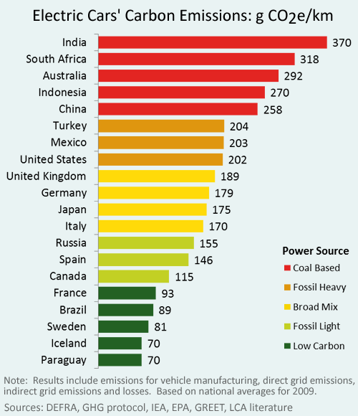
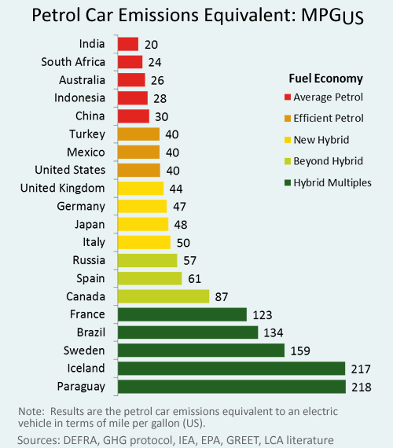
Environmenal CASE STUDIES
Hybrid/Electric Vehicles

Slide 22
Environmental Case Studies
Tesla Model 3
Relevant questions:
What are the positive or negative environmental impacts of electric vehicles?
What value do you, as a consumer, place on reduced carbon emissions when driving?
What challenges, if any, still need to be overcome in electric cars before they are ready for mass-market adoption?

Slide 23
Environmental Impact ANALYSIS
Homework Assignment
Outline the environment impact of your product at various stages of its life-cycle
  manufacture (natural resources, hazardous chemicals, energy)
  normal use (expected product lifetime, EMI, energy consumed when both “on” and “off”)
  disposal/recycling (instructions for hazardous waste handling and disassembly/recycling)
Discuss how you would address each of these environmental impact concerns

