Slide 1

Ethical And Moral
Considerations
George Hadley ©2014, Images Property of their Respective Owners.
Notes:
Cover Image Source: http://www.ethicaluniform.com/wp-content/uploads/2011/12/Ethics-Cropped.jpg

Slide 2
Outline
Why study ethics?
Code of ethics
Basic ethics questions
Ethical conflict
Consequences of unethical practices
Ethical case studies

Slide 3
Why Study Ethics?
Accreditation agencies (ABET) deem it a critical part of all engineering curricula, including EE and CmpE
Virtually all professional societies have a code of ethics:
IEEE Code of Ethics: http://www.ieee.org/about/corporate/governance/p7-8.html
ACM Code of Ethics: http://www.acm.org/about/code-of-ethics

Slide 4
Code of Ethics
Highlights from the IEEE Code of Ethics:
“To accept responsibility in making decisions consistent with the safety, health, and welfare of the public, and to disclose promptly factors that might endanger the public or the environment”
“To avoid real or perceived conflicts of interest whenever possible, and to disclose them to affected parties when they do exist”
“To be honest and realistic in stating claims or estimates based on available data”
“To avoid injuring others, their property, reputation, or employment by false or malicious action”

Slide 5
Some Basic Ethics Questions
What forms the basis of our views and our understanding of ethics?
Why is ethical behavior important to society? What could happen if the issue of ethics was completely disregarded?
How can ethical practices best be learned, promoted, and ensured?

Slide 6
Ethical Conflict
Duty/Responsibility vs. Malice/Indifference
Example: FTDI counterfeit IC driver issue
Duty vs. Self-Interest (“Conflict of Interest”)
Examples: Bribery, misuse of position, etc.
Duty vs. Duty
Maximize profit for employer vs. obligation to society
Confidentiality vs. whistle-blowing (Edward Snowden)

Slide 7
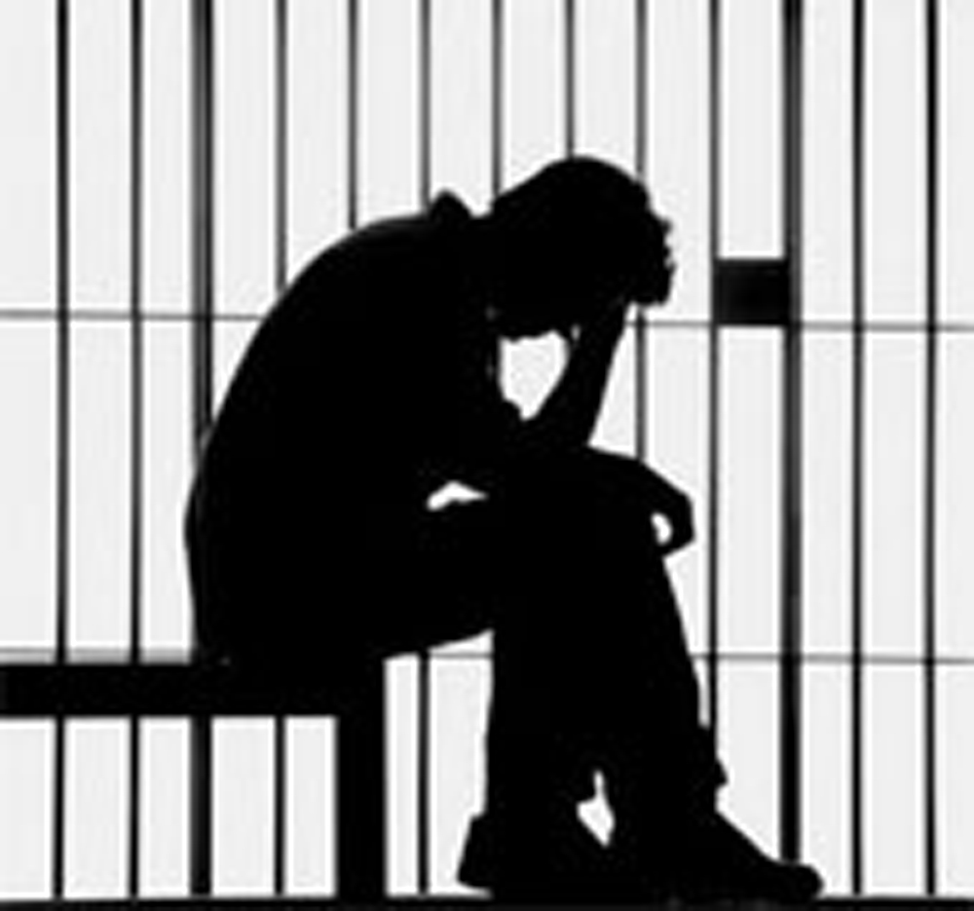
Consequences
Some consequences of unethical practices:
Injury or loss of human life
Loss of business contracts or customers
Damage to a business’s image or reputation
Fines and penalties
Jail time
What other consequences
can you think of?
Notes:
Prison Image Source: https://speakbluntly.files.wordpress.com/2015/01/prison-bars-1.jpg

Slide 8
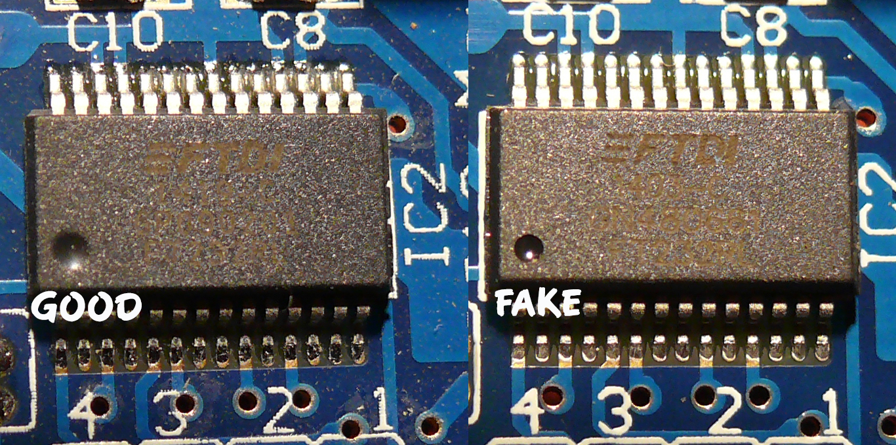
Ethics Case Studies
FTDI Counterfeit ICs Driver Scandal
The Setup: Future Technology Devices Incorporated (FTDI) is a leading manufacturer of USB to serial converter ICs popular among hobbyists. This popularity has lead to cloning and knockoffs, particularly in emerging markets. Both original and counterfeit ICs rely upon a driver produced by FTDI in order to function properly.
Notes:
FTDI Scandal Background Information: http://arstechnica.com/information-technology/2014/10/ftdis-anti-counterfeiting-efforts-sit-between-a-rock-and-a-hard-place/

Slide 9
Ethics Case Studies
FTDI Counterfeit ICs Driver Scandal
What Happened: FTDI released an updated driver for their USB-to-Serial devices on their website (9/29/2014). The updated driver would identify software-compatible FTDI clones and brick them by rewriting the USB Product ID to “0000”. The new driver was automatically added to Windows Update, whereupon it was automatically mass-installed to many, many devices.
Aftermath: The driver was quickly pulled from Windows Update and an emergency patch was committed the following week to work with bricked devices. The CEO was forced to issue a public apology. Substantial damage was done to the reputation of FTDI

Slide 10
Ethics Case Studies
FTDI Counterfeit ICs Driver Scandal
Ethical Questions to Ponder:
Did FTDI’s actions constitute unethical behavior? If so, at what point, and why?
As a customer who has purchased a gadget containing an FTDI chip, how did you know if the chip was legitimate or not?
What sorts of devices could use a USB interface featuring an FTDI chip? What sorts of damage could be done if the devices became inoperable?

Slide 11
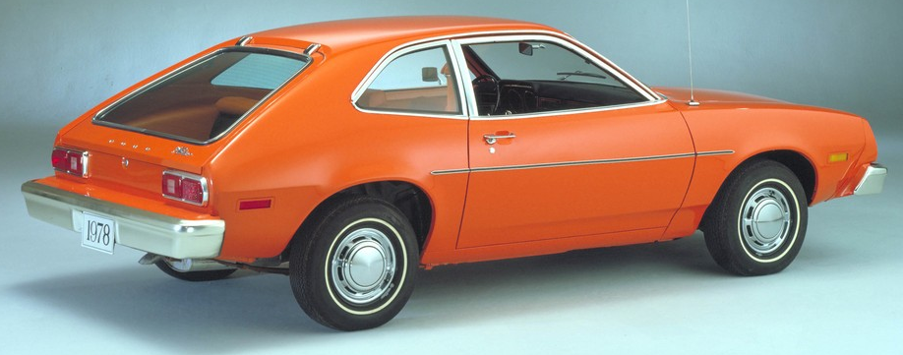
Ethics Case Studies
The Ford Pinto
The Setup:
Early 1970s, gas prices are rising in the United States
American customers are interested in smaller, more efficient cars (specialty of Japanese car manufacturers)
Ford created a small car, the Pinto, to compete
Due to the rushed design process, errors were made and the fuel tank was designed poorly. Ford was aware of this issue from internal studies and had a patent on a safer fuel tank design.
US regulations only
required frontend crash
testing at speeds less
than 20MPH at the time
Notes:
Ford Pinto Image Source: http://assets.blog.hemmings.com/wp-content/uploads//2011/03/Pinto_1000.jpg

Slide 12
Ethics Case Studies
The Ford Pinto
The Setup, continued:
The cost of modifying a Pinto in 1970 was determined to be $11 (~$150 today)
In order to determine whether or not the redesign was necessary, Ford performed an economic analysis. The following economic assumptions were used:
Cost of a human life: $200,000 (~$1.2 million today)
Cost of a severe burn injury: $67,000 (~$415,000 today)
Cost to replace destroyed vehicle: $700 ($4,327 today)
Estimated deaths: 180
Estimated burn injuries: 180
Estimated vehicles destroyed: 2100
Estimated vehicles sold: 11 million
Estimated light trucks sold: 1.5 million

Slide 13
Ethics Case Studies
The Ford Pinto
What Happened:
The results of the economic analysis can be seen below:
Category | Cost/incident | # Incidents | Cost
Burn Deaths | $200,000 | 180 | $36M
Burn Injuries | $67,000 | 180 | $12M
Burned Vehicles | $700 | 2100 | $1.5M
Total: |  |  | $48.5M
Category | Cost/unit | # Units | Cost
Cars | $11 | 11M | $121M
Light Trucks | $11 | 1.5M | $16.5M
Total |  |  | $137.5M

Slide 14
Ethics Case Studies
The Ford Pinto
What Happened:
Ford Pinto was delivered to market
Some cars were burned, some burn injuries occurred, and some deaths resulted from the previously mentioned problems
Ford became engaged in a high-profile court case
Incriminating Evidence:
“We’ll never go to a jury again. Not in a fire case. Juries are too sentimental. They see those charred remains and forget the evidence. No sir, we’ll settle.” Ford Employee
Ford was forced to recall the Pinto for a significant cost

Slide 15
Ethics Case Studies
Ethical Questions
Did Ford’s actions constitute unethical behavior? If so, at what point, and why?
What is the monetary value of a human life?
If you had the option to pay $150 to make your car 1% safer, would you do so? Why or why not?

