Slide 1
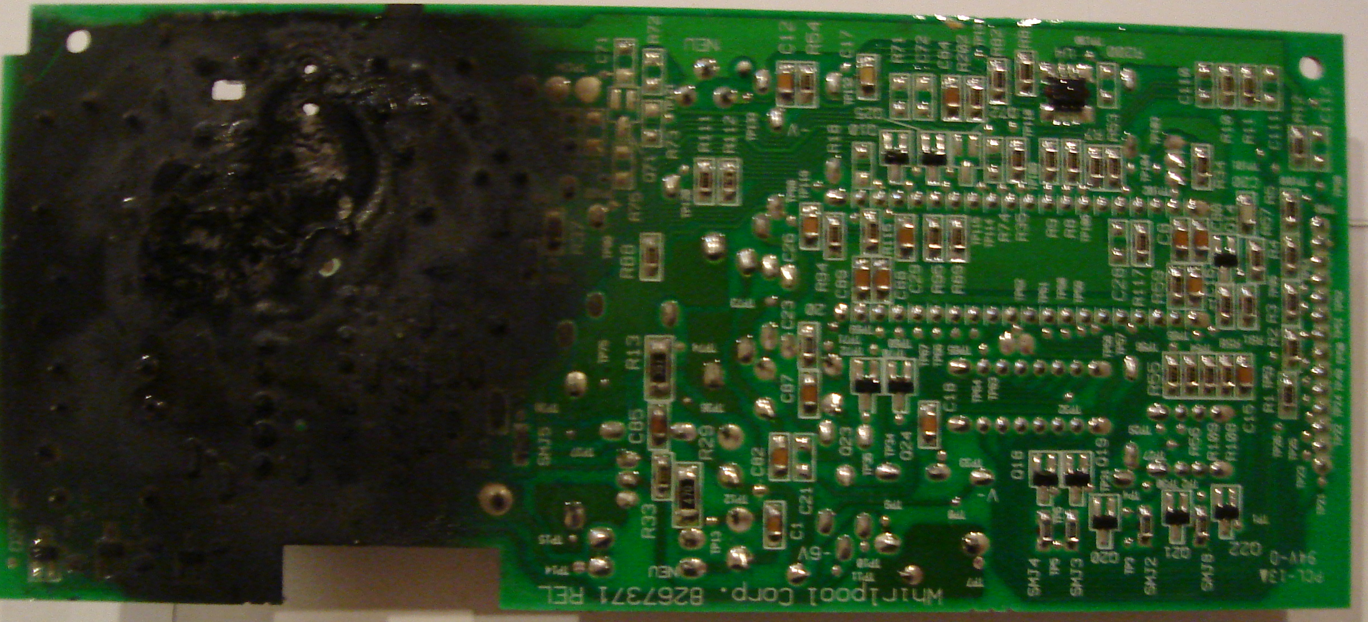
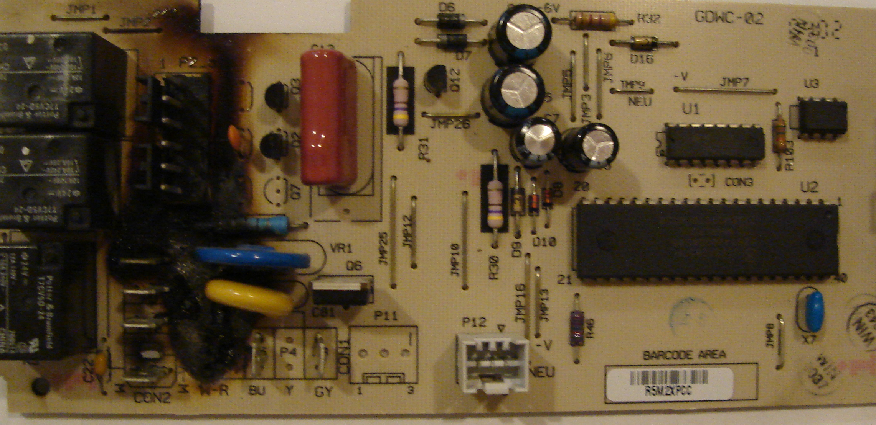

Reliability and Safety
George E Hadley & David G Meyer ©2016, Images Property of their Respective Owners
Notes:
PCB Cover Image Source:

Slide 2
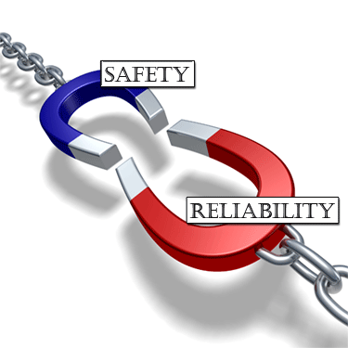
Outline
Introduction
Component Failures and Wear
Definition of Failure Rate
Reliability Models for Components
Mean Time To/Before Failure (MTTF/MTBF)
Failure Mode & Effects Analysis (FMEA)
Criticality Analysis (FMECA)
Revisiting the Nest Case Study
Software Reliability
Maintainability
Standards and Compliance
Reference: “Designing for Reliability, Maintainability, and Safety – Parts 1, 2, and 3”, Circuit Cellar, December 2000, January 2001, April 2001.

Slide 3
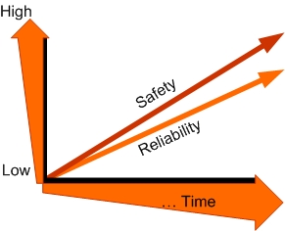
Introduction
Reliability, maintainability, and safety integral to product development
Tradeoffs between requirements and cost
Reducing probability of failure is expensive
Given little potential for personal injury, the primary consideration is manufacturing cost vs. potential customer unhappiness
There are UL, CE, IEC, FCC standards (possibly others) to be met

Slide 4
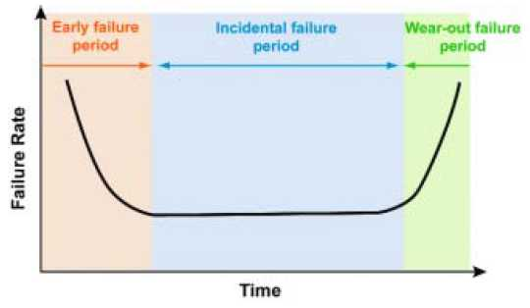
Component Failures And Wear
Electronic components can most often be modeled by constant failure rate (λ)*
Leads to exponential failure distribution
Same probability of failure in the next hour regardless of whether it is new or used – result is a “bathtub curve”
*but…see also May 2011 IEEE Spectrum feature article on “Transistor Aging”

Slide 5
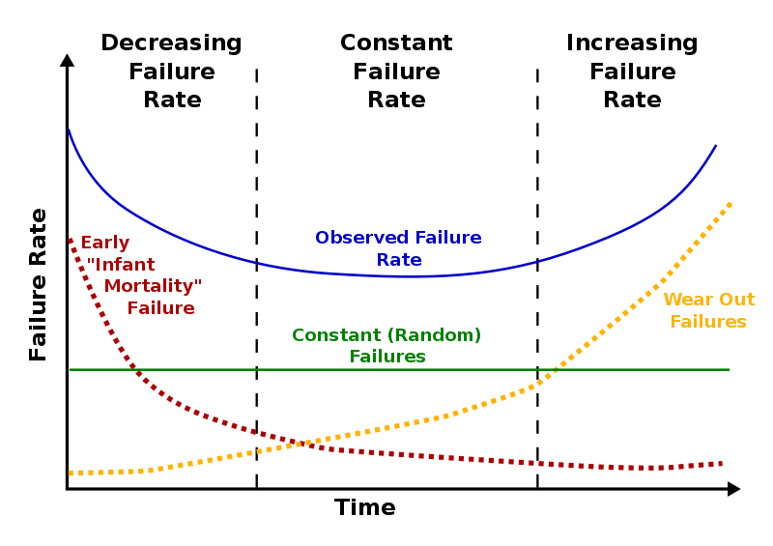
Component Failures And Wear
Components do not “age” or “degrade” with use – constant failure rate unrelated to hours of use (under certain conditions)
Equivalent information is gained testing 10 units for 10,000 hours vs. testing 1000 units for 100 hours
“Impossible” 10⁻⁹ failure as likely to happen in the first five minutes of operation as 114,000 years from now
Infant mortality reduced by robust designs, manufacturing process control, and “shake and bake”

Slide 6
Definition of Failure Rate
Units: usually given in terms of failures per hour, normalized for a single unit
Not really a probability, but rather an “expected value”
More intuitive way to describe: “unit failures per million hours per unit”, i.e. [fails/(10⁶ hour × unit)]
Equivalent to:
  number of failures per unit per million hours
  number of failures/hour given one million units in field (assuming failed units are replaced)

Slide 7
Definition of Failure Rate
Given λ_{p} × 10⁻⁶ [fails/(hr × unit)], N [units] in the field and T [hours]
  expected number of failures in T hours
    F (no. of failures) = λ_{p} × 10⁻⁶ fails/(hr × unit) × N units × T hours
    F = λ_{p} × 10⁻⁶ × N × T failures (all other units cancel out)
  example: given 1000 units in the field (at all times), and λ_{p} = 2 × 10⁻⁶, how many failures would you expect in one year?
    F = 2 × 10⁻⁶ fails/(hr × unit) × 1000 units × (365 × 24) hours = 17.52

Slide 8
Definition of Failure Rate
Given λ_{p} × 10⁻⁶ [fails/(hr × unit)], N [units] in the field and T [hours]
  expected number of failures in T hours
    F (no. of failures) = λ_{p} × 10⁻⁶ fails/(hr × unit) × N units × T hours
    F = λ_{p} × 10⁻⁶ × N × T failures (all other units cancel out)
  suppose you are aiming for no more than one unit failure per week with 10,000 units in the field – what is an acceptable failure rate?
    F = λ_{p} × 10⁻⁶ × N × T failures
    λ_{p} × 10⁻⁶ = F/(N × T) = 1 failure / (10,000 × 7 × 24 hrs) = 0.595×10⁻⁶ failures per unit per hour

Slide 9
Perspective
How long is 10⁶ hours?
  41,667 days
  1370 months
  114 years
  all of the above
  none of the above
Given a failure rate of 1 x 10⁻⁶ units/hour, should you be “happy*” if a typical single unit only fails once in 114 years on average?
  yes
  no
* What regulations or standards should determine your degree of “happiness”?
Notes:
1-D, 2-“probably”

Slide 10
Perspective
How long between unit failures will it be if you have one million units in use?
  0.1 hour (6 minutes)
  1 hour
  10 hours
  1,000 hours
  1,000,000 hours
Is this rate acceptable* if said failure causes serious injury or property damage?
  yes
  no
* If not, what would be an acceptable “high criticality” failure rate?
Notes:
3-B, 4-B

Slide 11
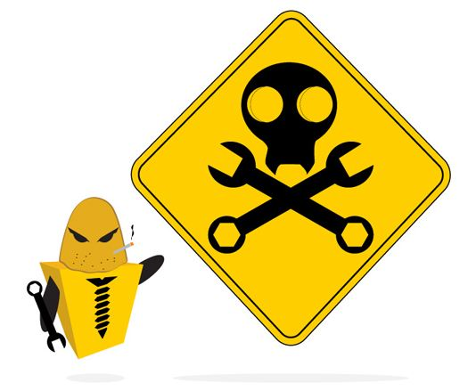
Component Wear
If, based on observation, failure rate does depend on time used, it may be due to wear caused by improper derating
Well-derated electronic systems seldom reach the point of wear-out failure
Well-derated = working at < 30-40% of specified ratings
Heat is the main reliability killer – even a small reduction will have a significant effect
Components like electrolytic capacitors can “dry out” and deteriorate over time (and/or become “leaky”)
See also “An Odometer for CPUs,” IEEE Spectrum, May 2011

Slide 12
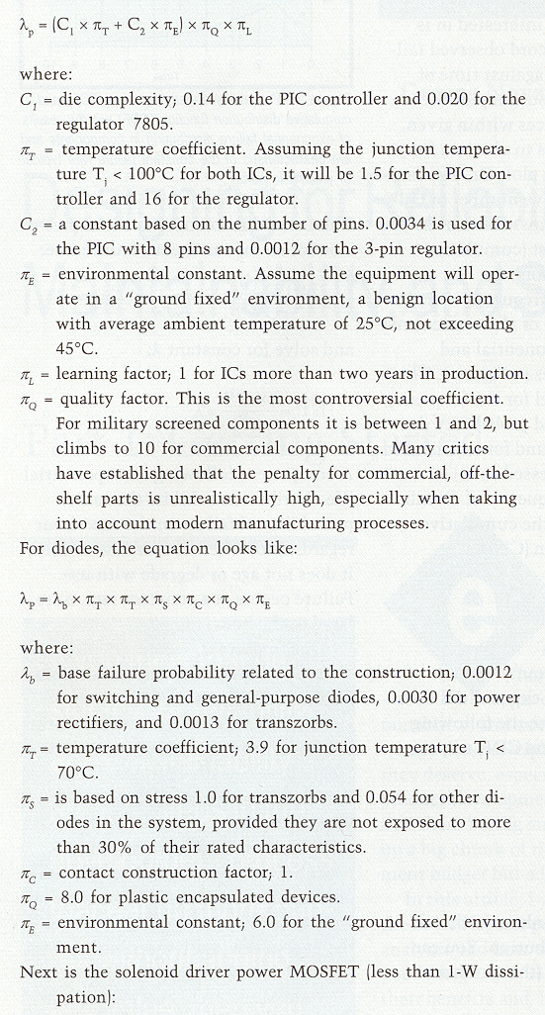
Reliability Models for Components
Calculated value is λ_{p}, the predicted number of failures per 10⁶ hours of operation
Examples (MIL-HDBK-217F):
Somewhat dated, but publically available
Microelectronic Circuits
(based on # of gates or transistors or on “size” of micro, e.g., 8-bit, 16-bit, etc.)
Diodes
“ground fixed” environment means a benign location with average ambient temperature of 25° C (not exceeding 45° C)

Slide 13
Reliability Models for Components
PN Junction Diode (Power Rectifier Application)
Parameter | Description | Value | Comments
λ_{D} | Diode type/application | 0.0030 | Power rectifier
π_{T} | Temperature factor | 1.0 | T_{J} = 25° C
π_{S} | Electrical stress factor | 0.29 | 0.4 < V_{S} ≤ 0.5
π_{C} | Contact construction | 1.0 | Metallurgically bonded
π_{Q} | Quality factor | 8.0 | Plastic case
π_{E} | Environmental factor | 1.0 | G_{B}
λ_{P} = λ_{D} x π_{T} x π_{S} x π_{C} x π_{Q} x π_{E} = 6.96 x 10⁻⁸
Reference: MIL-HDBK-217F, pp. 6-2 – 6-3.
Notes:
C1 - based on # of gates or # of transistors

Slide 14
Reliability Models for Components
Silicon MOSFET (Power Switching Application)
Parameter | Description | Value | Comments
λ_{b} | Base failure rate | 0.012 | MOSFET
π_{T} | Temperature factor | 1.0 | T_{J} = 25° C
π_{A} | Application factor | 2.0 | Power FET
π_{Q} | Quality factor | 8.0 | Plastic case
π_{E} | Environmental factor | 1.0 | G_{B}
λ_{P} = λ_{b} x π_{T} x π_{A} x π_{Q} x π_{E} = 1.92 x 10⁻⁷
Reference: MIL-HDBK-217F, p. 6-8.
Notes:
C1 - based on # of gates or # of transistors

Slide 15
Reliability Models for Components
CMOS Switch-Mode Regulator IC (8 pin)
Parameter | Description | Value | Comments
C₁ | Number of transistors | 0.040 | 300 < x < 1000
π_{T} | Temperature factor | 0.1 | CMOS, T_{J} = 25° C
C₂ | Package failure rate | .0013 | 8-pin flatpack
π_{E} | Environmental factor | 0.5 | G_{B}
π_{Q} | Quality factor | 2.0 | Class B-1
π_{L} | Learning factor | 1.0 | ≥ 2 years
λ_{P} = (C₁ x π_{T} + C₂ x π_{E}) x π_{Q} x π_{L} = 9.3 x 10⁻⁸
Reference: MIL-HDBK-217F, p. 5-1.
Notes:
C1 - based on # of gates or # of transistors

Slide 16
Reliability Models for Components
CMOS 16-bit Microcontroller (TI MSP430, 80-pin QFP)
Parameter | Description | Value | Comments
C₁ | Die complexity | 0.28 | 16-bit CMOS
π_{T} | Temperature factor | 0.1 | CMOS, T_{J} = 25° C
C₂ | Package failure rate | .08724* | 80-pin flatpack
π_{E} | Environmental factor | 0.5 | G_{B}
π_{Q} | Quality factor | 2.0 | Class B-1
π_{L} | Learning factor | 1.0 | ≥ 2 years
*C₂ = 3 x 10⁻⁵ x (no. pins)^{1.82}
λ_{P} = (C₁ x π_{T} + C₂ x π_{E}) x π_{Q} x π_{L} = 1.4324 x 10⁻⁷
Reference: MIL-HDBK-217F, p. 5-1.
Notes:
C1 - based on # of gates or # of transistors

Slide 17
MTTF/MTBF
For irreparable parts, use mean time to failure (MTTF) = 1/λ for components with an exponential life distribution
For assemblies with repairable parts, mean time between failure (MTBF) is appropriate
Field returns are always a more powerful statement of performance than statistical predictions
Reliability models are conservative - equipment generally outperforms the statistics (well designed equipment)

Slide 18
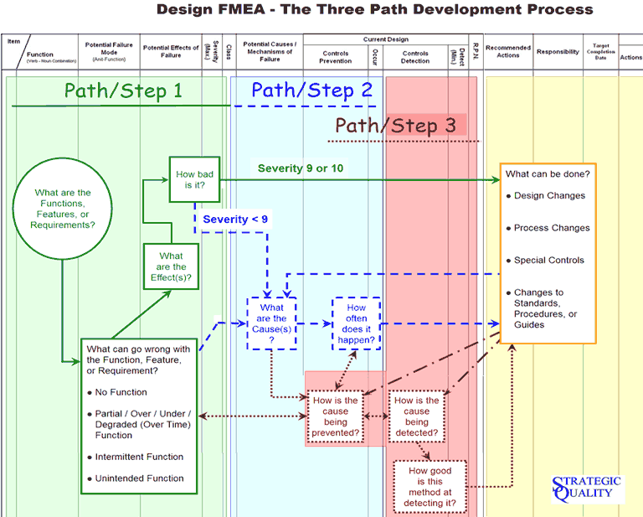
FMEA
Failure Mode Effects Analysis
Bottom-up review of a system
Examine components for failure modes
Note how failures propagate through system
Study effects on system behavior
Leads to design review and possibly changes to eliminate weaknesses

Slide 19
FMECA
Addition of criticality analysis
Not necessary to examine every component
  multiple components may have same failure effect
Rearrange design into functional blocks
  consider component failures within those blocks that may be critical
Create chart listing possible failures
  block, failure mode, possible cause, failure effects, method of detection, criticality, and probability*
* probability calculation not required for homework

Slide 20
Failure Cause/Mode/Effect/Criticality
(use Circuit Cellar article for examples, but these are the course definitions)
Cause – failure of a device
  open circuit, short circuit, or change in device behavior
  for complex devices, could be failure of a particular feature (e.g., caused by “stuck at” fault of microcontroller port pin)
  list all components that could produce this failure mode
Mode – related to method of diagnosis
  observable or measurable behavior of component or sub-circuit resulting from a device failure
  something you might observe when probing internals of the system with a multi-meter, scope, or logic analyzer
Effect – external behavior of entire system
  for thermostat, it either over-heats/cools or under-heats/cools the residence
  for most systems – possibility of fire or damage to other components, external or internal
Criticality – how serious are the consequences
  HIGH: potential for human injury, requires rate ≤ 10⁻⁹ (e.g., heating/cooling stuck on)
  MEDIUM (optional): renders system inoperable (e.g., battery failure – no charge storage)
  LOW: inconvenience to user, required rate typically > 10⁻⁶ (e.g., humidity sensor failure)

Slide 21
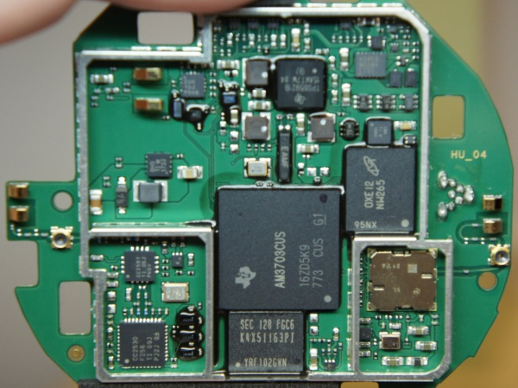
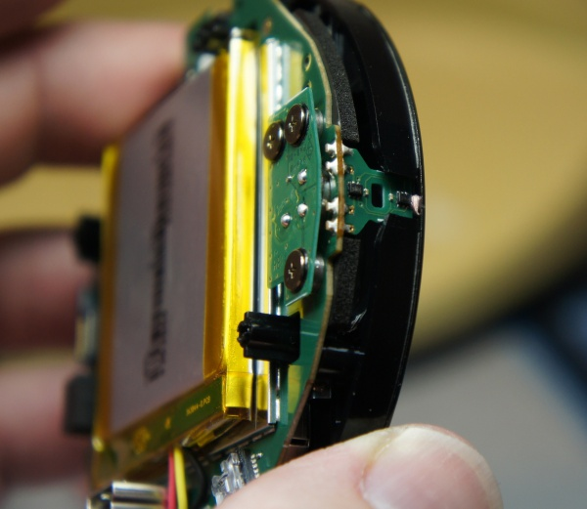
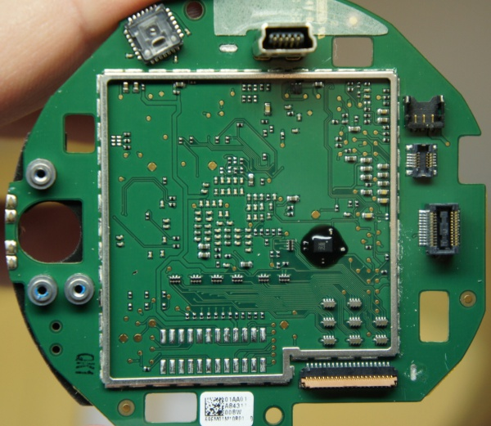
Revisiting the nest case study
What’s Inside

Slide 22
Revisiting the nest case study
Conceptual Block Diagram

Slide 23
Revisiting the nest case study
Block Diagram

Slide 24
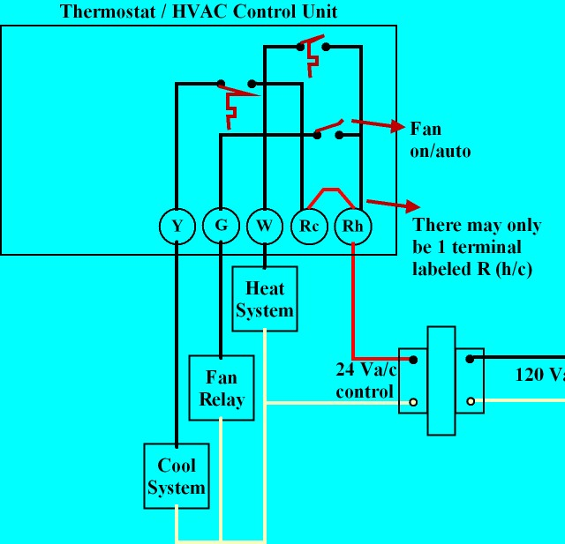
Revisiting The nest case study
Basic 4-Wire Circuit Thermostat Circuit
What can go wrong:
LCD/backlight fails
  thermostat continues to function, but nothing is displayed on LCD screen
  LOW criticality
Failure to close control contact
  no heating/cooling
  MEDIUM criticality
Control contact stuck closed
  continuous heating or cooling (will not shut off)
  HIGH criticality (damage to HVAC system and/or personal property, potential health risk)

Slide 25
FMECA Analysis
Identify Potential Failure Modes and Associated Criticality Level

Slide 26
FMECA Analysis
Identify Potential Failure Modes and Associated Criticality Levels

Slide 27
FMECA Analysis
High Voltage Buck Converter
LTC3631
Potential failure modes and effects:
PN diode fails open → no power, device inoperative
PN diode fails shorted
  No power, device inoperative
  AC potentially across capacitors → short circuit/damage
  HVAC control contact stuck closed → continuous heat/cool

Slide 28
FMECA Analysis
High Voltage Buck Converter
LTC3631
Potential failure modes and effects:
Zener diode fails open → (limited effect, may be undetected)
Zener diode fails shorted
  No power, device inoperative
  HVAC control contact stuck closed (circuit draws excessive current) → continuous heat/cool

Slide 29
FMECA Analysis
High Voltage Buck Converter
LTC3631
Potential failure modes and effects:
Capacitor fails open → (limited effect, may be undetected)
Capacitor fails shorted
  No power, device inoperative
  HVAC control contact stuck closed (circuit draws excessive current) → continuous heat/cool

Slide 30
FMECA Analysis
High Voltage Buck Converter
LTC3631
Potential failure modes and effects:
Buck regulator fails with Vout = 0 → thermostat inoperative
Buck regulator fails with Vout = Vin
  Overvoltage to backplate, fry most active components
  Unpredictable effect on thermostat control contacts

Slide 31
FMECA Analysis
High Voltage Buck Converter
No. | Failure Mode | Possible Causes | Failure Effects | Detection Method | Criticality
1 | Vout = 0 | open PN diode failed regulator | unable to operate HVAC or charge battery | no current drawn from control contact | MEDIUM
2 | Vout=0 | shorted PN diode shorted capacitor shorted zener diode | HVAC stuck on, unable to charge battery | excessive current drawn from control contact | HIGH
3 | Vout > 4.5 | failed regulator | Unpredictable effect, potential for component damage | backplate supply voltage > 4.5 V | HIGH

Slide 32
FMECA Analysis
Output Drive for Connection Between RC and W (or Y / G)
Most electronic thermostats accomplish this function (switching AC signals) using a relay or an (optically isolated) thyristor (triac or SCR) – why is such a complicated circuit used by the Nest Thermostat to perform essentially the same task?
Why is a transformer required?
Why is PWM used?
Why are two MOSFETs required?

Slide 33
FMECA Analysis
Focus on Power MOSFETs
Potential failure modes/effects:
Either or both MOSFETs fail open?
  unable to turn on heating or cooling
  unpredictable effect if only one MOSFET fails open
Either or both MOSFETs fail shorted?
  heating/cooling stuck on (no way to turn off)
  unable to harvest energy → battery will discharge

Slide 34
FMECA Analysis
MOSFET Output Drive (Contact Closure)
No. | Failure Mode | Possible Causes | Failure Effects | Detection Method | Criticality
1 | open | open MOSFET gate drive failed off | unable to operate HVAC | open (Hi-Z) control contact | MEDIUM
2 | closed | shorted MOSFET gate drive failed on | HVAC stuck on, unable to charge battery | closed (shorted) control contact | HIGH
3 | partial open | one MOSFET failed open | Unpredictable effect, may not be able to operate HVAC | “half-wave” control contact when ”on” | MEDIUM
4 | partial closed | one MOSFET failed closed | Unpredictable effect, HVAC may be stuck on, battery charge current reduced | “half-wave” control contact when ”off” | HIGH

Slide 35
FAILURE REPORTS
Customer Complaints
I can't even begin to say how upset I am to have to title the Nest Learning Thermostat as "The Worst Thermostat EVER." For the "cool" factor and appearance it was in "A" in my book. I installed it in November 2014 and it worked like a charm... for 4 weeks. Then we came home to a house that was 80+ degrees in winter (in Buffalo no less) and found "the base unit was malfunctioning" preventing the nest from shutting off. The "overnight" Fed-Ex replacement arrived in 2 days which meant I had to manually turn on and off the furnace from the circuit breaker. The new nest worked great... for 3 weeks before it did the same thing. Another call to nest with their crazy long wait customer service stated this was a known issue and another unit would be sent... "overnight." Four (4) days later FedEx showed with my third unit in the same number of months and it worked again...well. Yesterday, after only 2 1/2 weeks from install, the Nest again malfunctioned and my phone call to their customer support agent and "senior" agent finally concluded my energy effecient Heil forced air gas furnace was "incompatable" to the nest. What?!?!? I have finally had it and went straight to Home Depot and purchased a Honeywell Smart Thermostat as a replacement. My last Honeywell thermostat lasted over 20 years and I'm just hopeful this one will last longer then the Nest's.

Slide 36
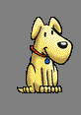
Software Reliability
Watchdog Timer
Role of watchdog timer is to reset processor if “strobe timeout” occurs
Problem: watchdogs integral to microcontroller are no more reliable than microcontroller itself
External watchdogs “better”, but have to make sure that it is prevented from being strobed in the event of failures/bugs
Possible solution: make watchdog respond to a “key” (that would be difficult for failed software/bug to generate)

Slide 37
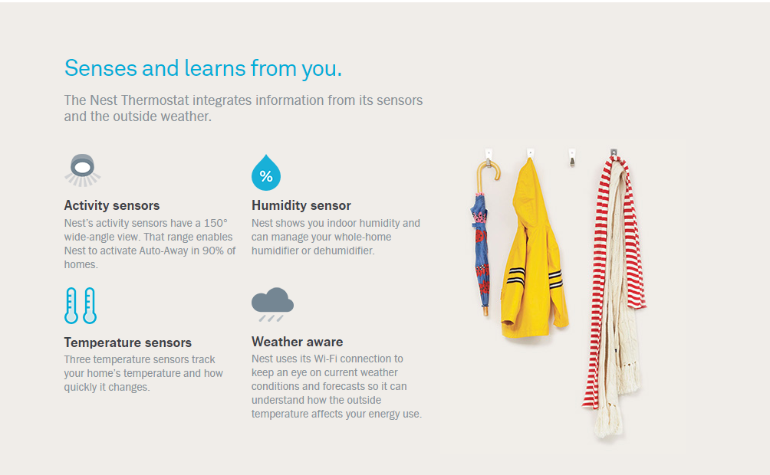
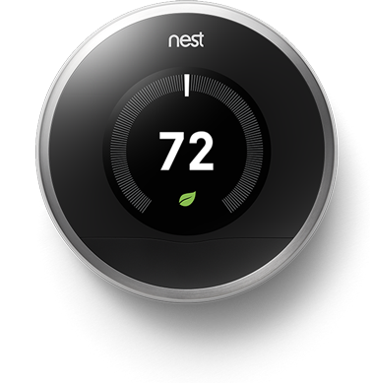
Software Reliability
Revisiting How Nest Learns

Slide 38
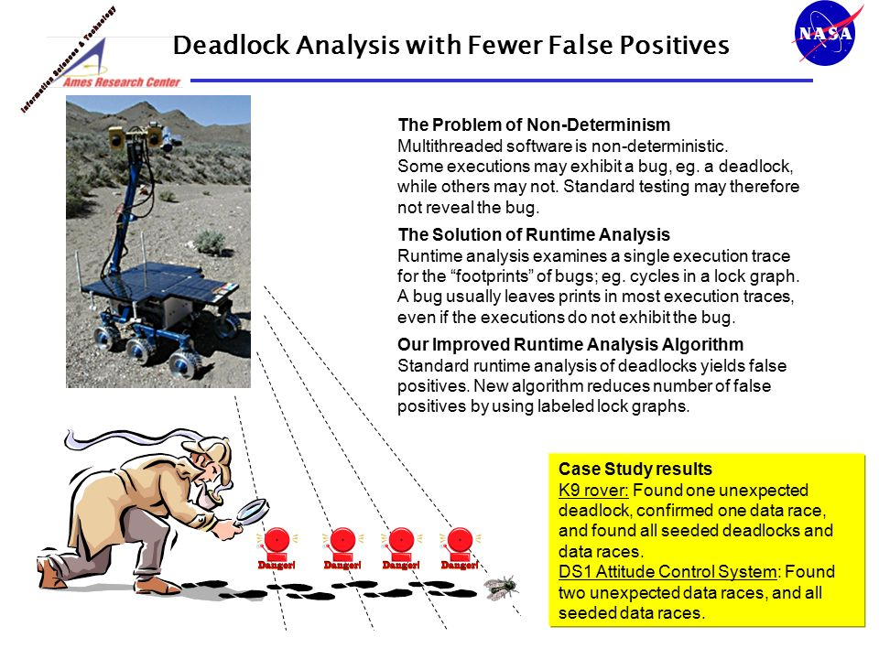
Software Reliability
Discussion
Potential non-determinism associated with multithreaded software
  Large set of input variables (sensors) and states
  Effect of sensor malfunction on learning ability and impact on program behavior hard to predict
    potential to learn “bad habits”?
    ability to recognize and “clear” incorrectly learned behavior?
  Standard testing may not reveal latent software bugs

Slide 39
FAILURE REPORTS
Customer Complaints
“The NEST product was an interesting and fun gadget for a year and a half ... until control of it was taken away by someone during one of the coldest days of the year. As the house got colder and colder I worked through the NEST website looking for tech support to no avail. Finally Googling "NEST help" got me a contact number. During three hours of troubleshooting I found out that this thermostat was part of an energy savings program. NEST thought the thermostat was controlled by my local utility. I contract my local utility and they had no idea what I was talking about. I then went back to NEST and they still had no idea who was controlling the thermostat or how low the "Controller" whoever that was would let the temp fall. I worked with them a little longer in an attempt to opt out of this energy saving program and after three hours I told them thank you very much, but your time is up. I then replaced this thermostat with a conventional programmable thermostat. The NEST product is not ready for prime time.”
WOWWW The coldest day of the year, this is the second time NEST shut down heating system and said it wanted us to call nest service to come fix heating system. I had to reconnect old thermostat which corrected the issue. what a scam .;.; im wondering who had control of my house ???

Slide 40
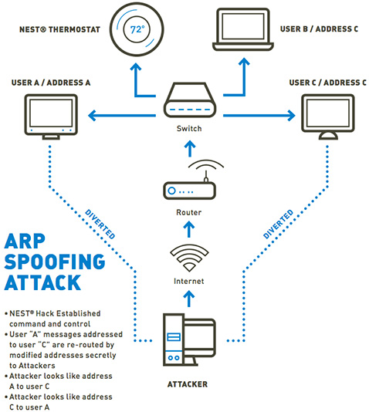
SOFTWARE RELIABILITY
Hacking Vulnerability
TrapX confirmed the design flaws discovered in the Nest Learning Thermostat. They validated the attack vector presented at the Black Hat 2014 Conference by compromising the device and an entire home network.
"While the Nest Learning Thermostat has relatively robust security compared to most IoT devices, the attack vectors presented at Black Hat enabled our lab to completely compromise the device within our Advanced Test Bed Facility (ATBF)…"

Slide 41
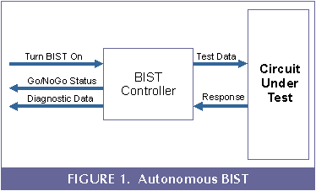
The Rest of the Story…
Designing a functional product represents about 30% of the design effort
Making sure a product always fails in a safe, predictable manner takes the remaining 70%
Law of diminishing returns: exercise good judgment in adding safety features
Keep in balance: safety features and possibility of “nuisance alarms” (failures resulting from added complexity)
Utilize built-in self-test (BIST)

Slide 42

Maintainability
Reliability predication indicates how many problems per day will need to be serviced after, say, 10,000 units have been shipped
Keep customers happy with quick repair turn-around time (TAT)
Repair will most likely be by replacement (“line replaceable units” – LRU)
Maintainability analysis generates data showing the time needed to identify the faulty LRU, the time to replace it, and the time to re-test the system
Mean-time-to-repair (MTTR)

Slide 43
Standards and Compliance
Example Category Relevant to ECE 477 Projects
  IEC 62368-1 Audio/Video, Information and Communication Technology Equipment – Safety Requirements. Published Jan. 2010, UL & CSA versions, Feb. 2011
Arcade, Amusement and Gaming Machines − Bowling and Billiard Equipment − Cable and Satellite Communication Equipment − Circuit Components for Use in Audio/Video Equipment − Commercial Audio and Radio Equipment, Systems and Accessories − Low Voltage Portable Electronics; Household Audio and Video Equipment − Musical Instruments − Professional, Commercial and Household Use Equipment

Slide 44
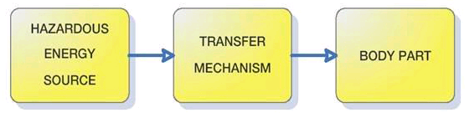
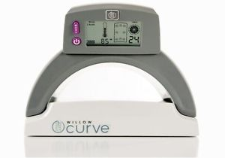
Standards and Compliance
From ElectronicsDesign.com
The ABCs of IEC 62368-1, An Emerging Safety Standard (Posted: October 22, 2010)
Hazard Based Safety Engineering
Energy sources: electrical, thermal, kinetic, and radiated
To prevent pain or injury, either the energy source can be designed to levels incapable of causing pain or injury, or safeguards such as insulation can be designed into the product to prevent energy transfer to the body part.

