Slide 1



Legal & Regulatory Hurdles with bringing your product to market
George E Hadley & David G Meyer ©2016, Images Property of their Respective Owners

Slide 2

Regulatory
Underwriters Laboratory (UL)
Global safety science company - largest and oldest independent testing laboratory in the United States
Tests the latest products and technologies for safety before they are marketed around the world (19,000 annually)
Five strategic areas - product safety, environment, life & health, university and verification services
UL Listing means that UL has tested representative samples of the product and determined that it meets UL’s requirements

Slide 3


Regulatory
“Conformité Européenne” (literally “European Conformity”) or CE
Verifies product complies with all relevant EU legislation that mandates compliance with specific standards and requirements
  product safety
  environmental impact
  consumer protection
  Products covered
  medical devices
  products that have an impact on energy consumption
  products which are capable of generating EMI
  radio and telecommunications equipment
  electrical devices that operate in low voltage range (50-1000 VAC or 75-1500 VDC)
  measuring instruments
ce marks
CAUTION – Be wary of authentic CE mark vs. China Export

Slide 4

Regulatory
Restriction of Hazardous Substances (RoHS)
RoHS, also known as Directive 2002/95/EC, originated in the European Union and restricts the use of six hazardous materials found in electrical and electronic products
  Lead (Pb): < 1000 ppm
  Mercury (Hg): < 100 ppm
  Cadmium (Cd): < 100 ppm
  Hexavalent Chromium: (Cr VI) < 1000 ppm
  Polybrominated Biphenyls (PBB): < 1000 ppm
  Polybrominated Diphenyl Ethers (PBDE): < 1000 ppm
All applicable products in the EU market after July 1, 2006 must pass RoHS compliance
Any business that sells applicable electrical or electronic products, sub-assemblies or components directly to RoHS countries, or sells to resellers, distributors or integrators that in turn sell products to these countries, is impacted if they utilize any of the restricted materials

Slide 5
Regulatory
Federal Communications Commission (FCC)
Any device that communicates via RF or (unintentionally) generates electromagnetic interference (EMI)
  Class A digital device (commercial/industrial)
    product not marketed for residential use
    intended application generally precludes operation in residential areas
    price high enough that there is little likelihood of use in a residential environment
  Class B digital device (marketed for use in a residential environment)
Any electronic circuit with a clock can be a source of EMI; anything that emits EMI complicates spectrum management

Slide 6
Regulatory
Federal Communications Commission (FCC)
Part-15 rules: unlicensed RF devices
  Interference – effect of unwanted energy
  Harmful interference – endangers functioning of radio navigation service
  Spurious emission – harmonic, parasitic, intermodulation products
  Intentional radiator – “radio transmitter”
  Unintentional radiator – e.g. computer with a high-frequency clocking circuit
  Incidental radiator – arcs in DC motors (brushes) and light switches
  Digital device – generally unintentional radiators
  Carrier-current system – transmits RF energy by conduction over power lines

Slide 7
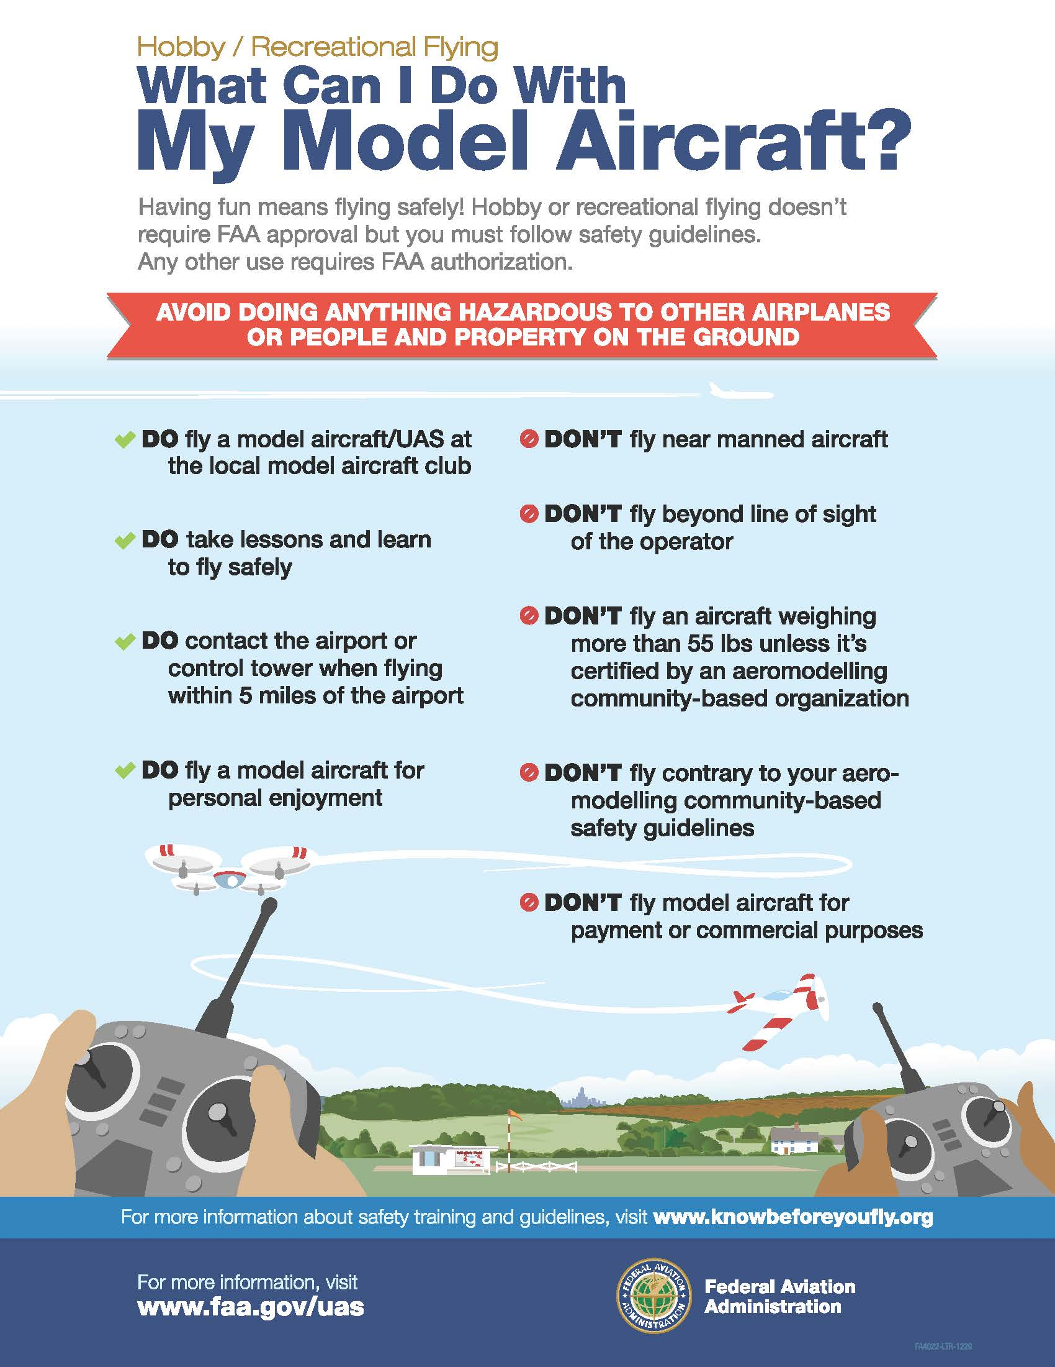
Regulatory
Federal Aviation Administration (FAA)
Restrictions on use of drones for commercial purposes
  unmanned aircraft must weigh less than 55 lbs. (25 kg)
  visual line-of-sight (VLOS) only
  at all times the small unmanned aircraft must remain close enough to the operator for the operator to be capable of seeing the aircraft with vision unaided by any device other than corrective lenses
  small unmanned aircraft may not operate over any persons not directly involved in the operation
  daylight-only operations (official sunrise to official sunset, local time)

Slide 8
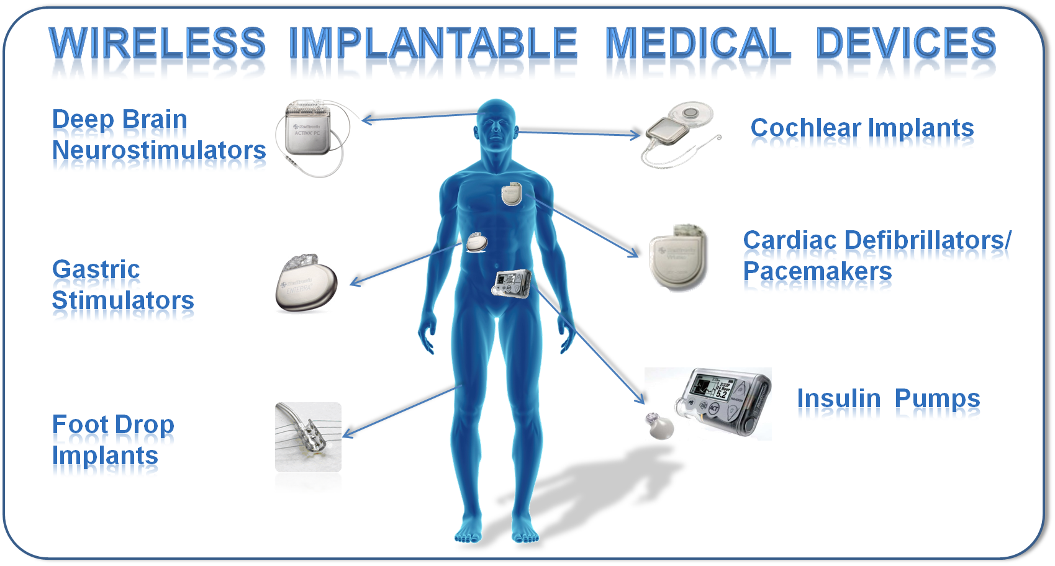
Regulatory
Food and Drug Administration (FDA)
Medical devices, implantable devices
  Class 1 – low risk
  Class 2 – medium (pre-notification, but not pre-approval)
  Class 3 – preapproval (high barrier to show low risk of harm)
Also, FDA will regulate mobile aps that turn smartphones into medical devices (e.g., ultrasound)

Slide 9
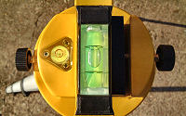


Regulatory
Center for Devices and Radiological Health (CDRH)
Division of FDA, responsible for administering most U.S. regulations which apply to laser light emitting products
Laser products are classified into categories depending on the level of hazard they present (hazard level based mainly on laser power output
Example: A laser product such as a "line leveler" would fall under the category of “surveying, leveling or alignment”. Lasers in this category are limited to Class IIIa and lower power levels. The maximum power level for Class IIIa is 4.95 milliwatts, for a small diameter, collimated beam. This is the same power level allowed in an over-the-counter laser pointer.

Slide 10

Regulatory
International Electrotechnical Commission (IEC)
World’s leading organization for the preparation and publication of International Standards for all electrical, electronic and related technologies (“electrotechnology”)
Provides a platform to companies, industries and governments for meeting, discussing and developing the International Standards they require
Over 10,000 experts from industry, commerce, government, test and research labs, academia and consumer groups participate in IEC Standardization work.

Slide 11
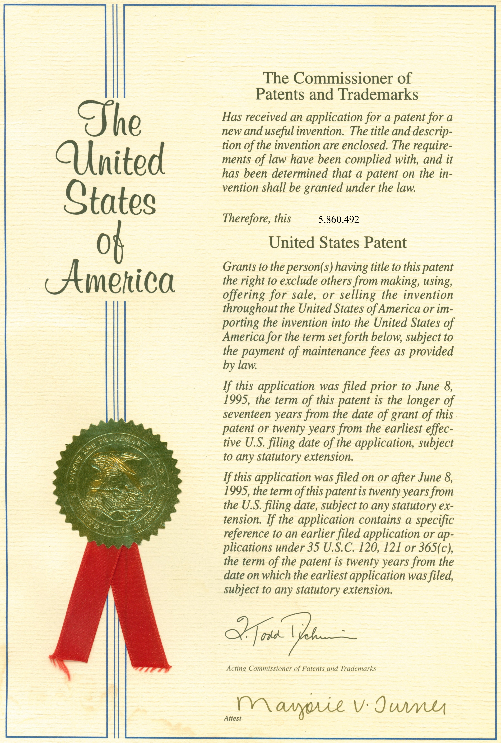
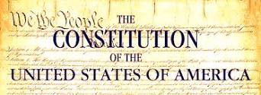
PATENT LIABILITY
Protection of Intellectual Property
Congress shall have the power . . . to promote the progress of science and useful arts, by securing for limited times to authors and inventors the exclusive right to their respective writings and discoveries.
U.S. Constitution - Article 1, Section 8

Slide 12
PATENT LIABILITY
Patent = Right to Exclude
Prevent others from making, using or selling your invention
Right to exclude ≠ Right to make
  may not own all required components
  need for licensing
Patent is not needed to manufacture a product
Duration = 20 years from filing date

Slide 13
PATENT LIABILITY
Patent Requirements
Useful
Novel
Non-obvious (to someone “skilled in the art”)
“Trade secrets” can not be patented – patents must be fully disclosed and include a preferred embodiment

Slide 14
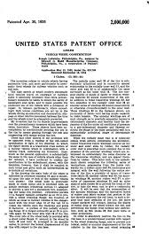
PATENT LIABILITY
Patent Contents
Written description
Drawings/schematics
Claims
  independent
  dependent

Slide 15
PATENT LIABILITY
Types of Patents – Regular and Design

Slide 16
PATENT LIABILITY
Patent Applications (Pending Patents)

Slide 17

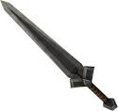
PATENT LIABILITY
How Patents Are Used
Shield – protect/shield IP, stop others from using it
Sword – stop other businesses, extract revenue (license fees) from other businesses

Slide 18
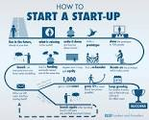
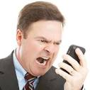

PATENT LIABILITY
Patent Perspectives
CEO of large corporation
Start-up
Employee of large corporation
Litigator/investor

Slide 19
PATENT LIABILITY
CEO Perspective
Maximize revenues (“sword”)
  Shut down competitors
  Extract license fees
Minimize liabilities (“shield”)
  Minimize license fees
  Prevent infringement penalties
  Prevent catastrophic shutdown
Strategy: assemble a large patent portfolio
  Not necessarily limited to core business
  “Offense is the best defense”

Slide 20
PATENT LIABILITY
CEO Perspective
Tactics
  Toward employees
    incentivize patent applications/awards
    support processes that maximize yield
    provide training to avoid willful infringement
  Toward competitors
    keep a large enough sword (to act as a shield – “mutually assured destruction” – MAD)
    negotiate truce where possible
Truce example: Intel and AMD – each acquits other of liability for ongoing infringement that might exist, and each grants non-exclusive, non-transferable license to the other

Slide 21
PATENT LIABILITY
Startup Perspective
  Informal view – what appears to be “old tech” falls within 20-year lifespan of many existing patents
  Incumbents hold large patent portfolios (“swords”)
  Startups (typically) hold no significant portfolios that can hurt incumbents (no “shields”)
  Strategies
    Stay poor (cheaper for incumbents to ignore you than hire a lawyer to shut you down)
    Contest patents of adversary (“sword is invalid”) – very difficult to achieve in practice
    Get a strong ally and/or buy help (license a large/relevant portfolio of patents, obtain cash by selling startup stake to investors)

Slide 22
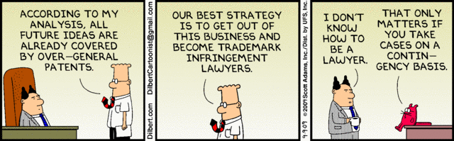
PATENT LIABILITY
Employee Perspective
  Incentives to protect IP of company (“patent everything”)
  Training to avoid willful infringement
    Disclose what you know about closely related work
    Do not actively look for patents while you are designing a product (hire lawyers to examine potential for infringement)

Slide 23
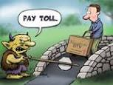
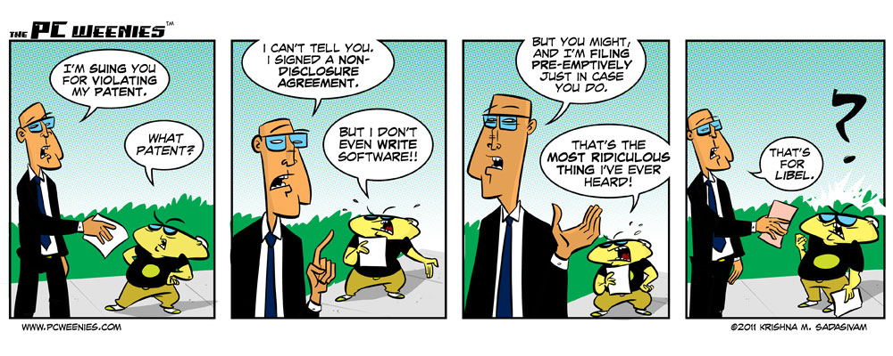
PATENT LIABILITY
Investor/Litigator Perspective
  Goal: IP is property (invest and aggressively monetize property to maximize ROI)
  No interest in making anything (no MAD)
  Strategy
    Buy broad patents from distressed companies
    Sue everyone
  Spin
    Patent trolls, hurting real businesses (“swords”)
    Defending their property (“shields”)

Slide 24
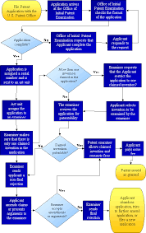
PATENT LIABILITY
Patent Application Process
Applying for a patent requires
  extensive search of prior art
  protracted negotiation with assigned patent officer
  patent lawyer
Many patent search engines are available
  freepatentsonline.com
  google.com/patents
Official web site of the U.S. Patent Office is www.uspto.gov

Slide 25
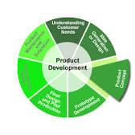
PATENT LIABILITY
Patent Infringement Analysis
Best time to search for possible patent infringement is at product conception stage
If the possibility of infringement exists, either:
  eliminate infringing function from your design
  modify your design so that the infringing function is performed in a “substantially different way”
Types of infringement
  literal
  doctrine of equivalents

Slide 26
PATENT LIABILITY
Literal Infringement
Exactly same function performed exactly the same way
Should be “obvious”
Either eliminate this function from your design -or- obtain license/pay royalty fee to use this function
Note that “simply adding additional features” does not eliminate infringement
Patent infringement is the commission of a prohibited act with respect to a patented invention without permission from the patent holder. Permission may typically be granted in the form of a license.

Slide 27
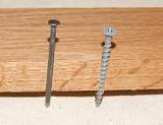
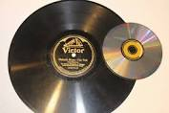
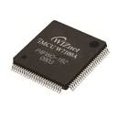
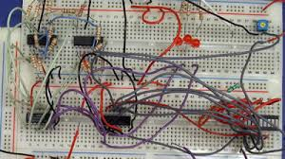
PATENT LIABILITY
Infringement Under Doctrine of Equivalents
Substantially same function performed substantially the same way
Hypothetical examples
  for fastening pieces of wood together, does a screw perform “substantially the same function” in “substantially the same way” as a nail?
  for reproducing recorded music, does a vinyl LP perform “substantially the same function” in “substantially the same way” as a CD?
  does software running on a microcontroller perform “substantially the same function” in “substantially the same way” as a state machine realized with discrete flip-flops and gates?
The doctrine of equivalents is a legal rule in most of the world's patent systems that allows a court to hold a party liable for patent infringement even though the infringing device or process does not fall within the literal scope of a patent claim, but nevertheless is equivalent to the claimed invention.

Slide 28
PATENT LIABILITY
Doctrine of Equivalents
Need a clear understanding of mechanism (“way”) – the mechanism is the function of interest in analyzing infringement liability under the doctrine of equivalents
  hypothetical #1: “fastening” is not what is patented; rather, the fastening mechanism (ribbing on nail vs. threads on screw)
  hypothetical #2: “music reproduction” is not what is patented; rather, the music reproduction mechanism (needle vibration following molded groove vs. optically reading digital data from pits molded into plastic disc)
  hypothetical #3: “doing something on a computer” is not what is patented; rather, the software method (algorithm)
What (some action) vs. how (method/mechanism/function)

Slide 29
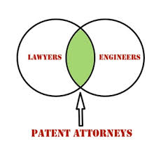

PATENT LIABILITY
Doctrine of Equivalents
Stated another way, is the “software” implementation of any function the equivalent of a (digital) hardware implementation of that function under the doctrine of equivalents?
Answer: “hard to say” – this is why there are patent lawyers!
No case to date where software ruled the equivalent of hardware per se – but have been cases where functions (“algorithms”) of hardware and software devices ruled as performed in “substantially the same way”

Slide 30
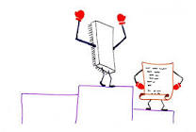
PATENT LIABILITY
Doctrine of Equivalents
Discussion: What are some of the differences between a microcontroller-based “software” realization of a given function and a “discrete hardware” realization?
  development tools
  design process
  clocking source / clock rate
  execution (sequential vs. parallel)
  ease of modification

Slide 31
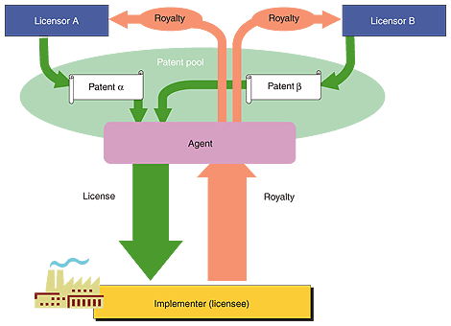

PATENT LIABILITY
Avoiding Infringement
Designing around
Licensing
  straight license
  cross-license
Acquiring subject patent
Declaratory judgment action
Ceasing manufacturing

Slide 32
PATENT LIABILITY
Why There Are Lawyers
Construe meaning of words “substantially”, “novel”, “useful”, “non-obvious”, etc.
Construe claim construction and interpret claim language (pretrial Markman hearing)
Perform prior art search
Problem 1: some individuals/companies obtain patents for the sole purpose of suing others (usually for functions many “skilled in the art” would consider “obvious” based on prior art)
Problem 2: a substantial number of “bad patents” have been issued (for devices that don’t even work)
Problem 3: “bad people” have been known to take advantage of “bad patents”
Important note: The “abstract” of a patent typically does not describe what is officially patented – this must be determined by a careful analysis of the claim language (a process called “claim construction”)

Slide 33
PATENT LIABILITY
Why There Are Lawyers
Major concern: limited technical expertise of lawyers, judges, and jury pools
Lawsuits are typically very expensive and often take years to resolve
Questions
  How can judges and juries with limited expertise decide cases involving hardware/software?
  What could be done to make it harder for “bad people” to profit from “bad patents”?

Slide 34
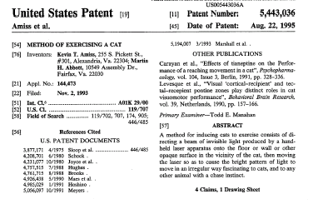
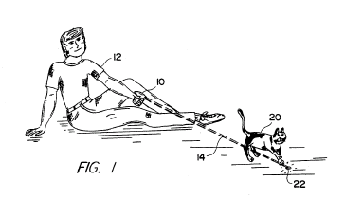
PATENT LIABILITY
A “Bad” (“Stupid”) Patent

Slide 35
Nest CASE STUDY
Patent Liability Lawsuit
February 2012 - Honeywell filed a lawsuit claiming that some of its patents had been infringed by Nest (e.g., US 7,476,988 “Power Stealing Control Devices” – one of seven patents in question)
Start-up vs Incumbent

Slide 36
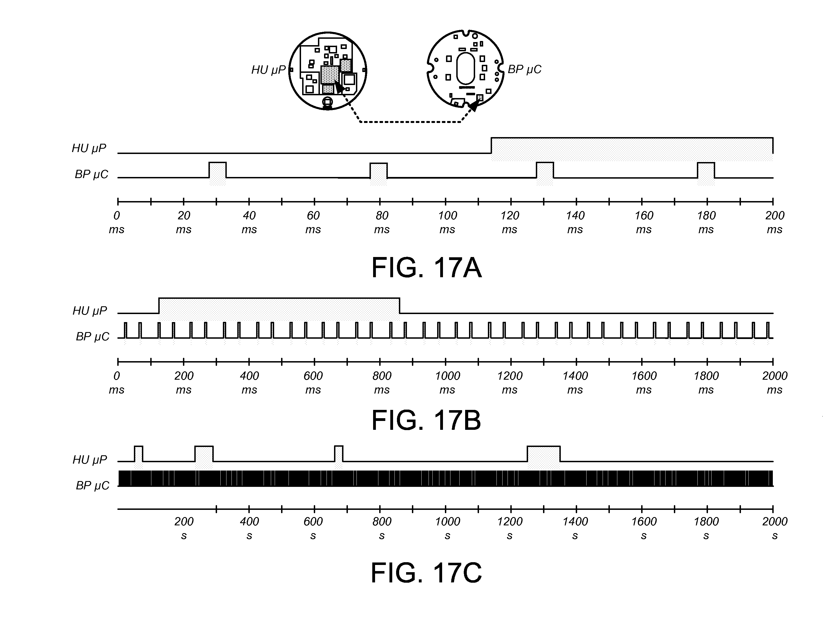
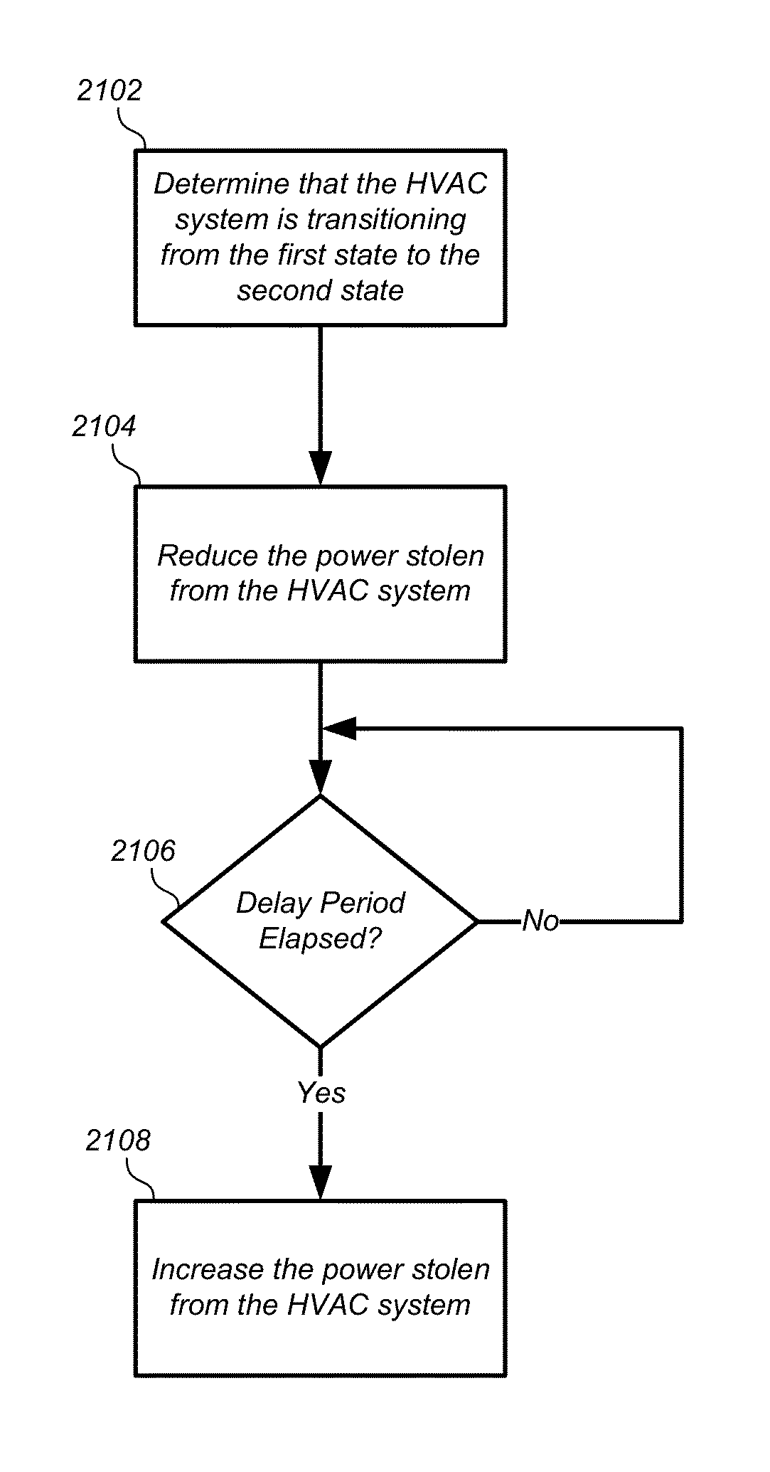
Nest Case Study
Advanced Energy Harvesting (“Power Stealing”) Strategy
US Patent 8,511,577 (filed Aug. 2012, issued Aug. 2013)
Thermostat with power stealing delay interval at transitions between power stealing states
ABSTRACT A thermostat includes a plurality of HVAC (heating, ventilation, and air conditioning) wire connectors including a connection to at least one call relay wire. The thermostat may also include a powering circuit, including a rechargeable battery, which is configured to provide electrical power to the thermostat by power stealing from a selected call relay wire. The power stealing may include an active power stealing mode, in which power is taken from the same selected call relay wire that is used to call for an HVAC function, and an inactive power stealing mode in which, in which no active call is being made. The powering circuit may be configured to substantially suspend (or at least reduce the level of) power stealing for at least a first time period following each transition of the thermostat from between operating states.

Slide 37
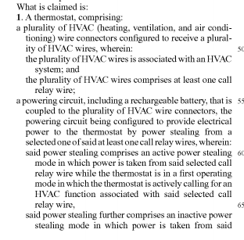
Nest CASE STUDY
US Patent 8,511,577 Claim Language
Claim 1 is the major independent claim
  Two mode operation of power stealing (active & inactive modes) with delay

Slide 38
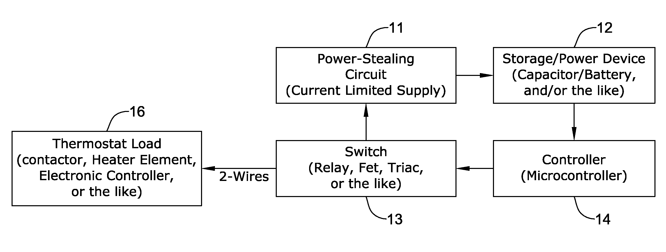
Nest CASE STUDY
Honeywell US 7,476,988 B2 Claim Language
Claim 1 is the major independent claim
  Energy harvesting technique for a “switched load” circuit (such as used in a thermostat)
  Includes possibility of a storage device (e.g., battery or super capacitor)

Slide 39
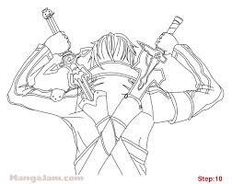
Nest CASE STUDY
Beefing Up the Shield (Before More Swords Are Drawn…)
September 2013 – Nest announced patent license agreement with Intellectual Ventures, and acquired several patents (unclear how many)
February 2014 Google buys Nest for $3.2 Billion

Slide 40
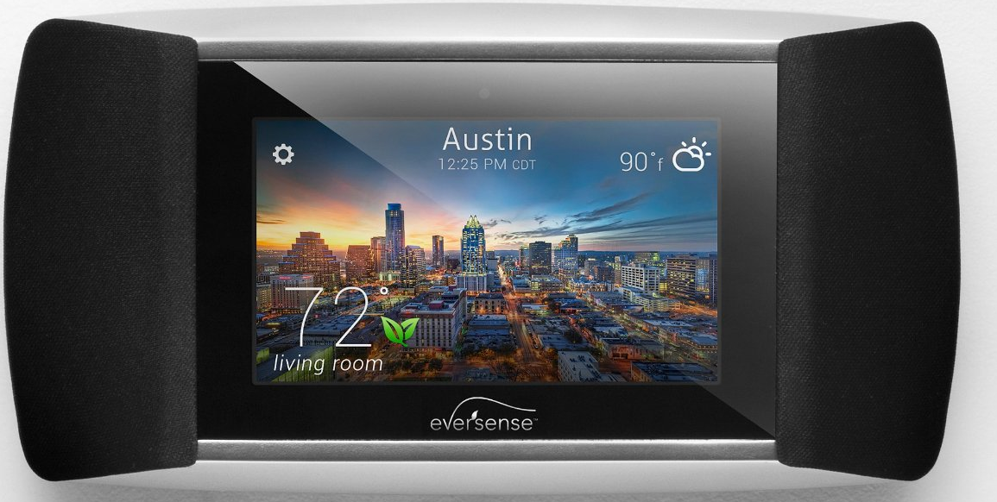
Nest Case Study
Other Patent Infringement Lawsuits
February 2012 - Honeywell filed a lawsuit claiming that some of its patents had been infringed by Nest (e.g., US 7,476,988 “Power Stealing Control Devices”)
May 2013 – Allure Energy filed lawsuit against Nest for newly issued patent US 8,442,695 “Auto-Adaptable Energy Management Apparatus” (filed November 2011)
Kevin Imes, president and CEO of Allure Energy, first began developing a smart thermostat in 2009, filing its patent application in 2010, to manage home temperature and energy usage. Allure Energy also developed and patented “Proximity Control Technology” that instantly adapts to a user’s daily schedule to provide automatic comfort and energy savings at home based on the distance a user may be from a residence.
“With our own capital, we created a smart and original thermostat control that also syncs music, reports local weather and offers energy tips, and filed all the required patent documentation well before Nest Labs launched its products.”

Slide 41
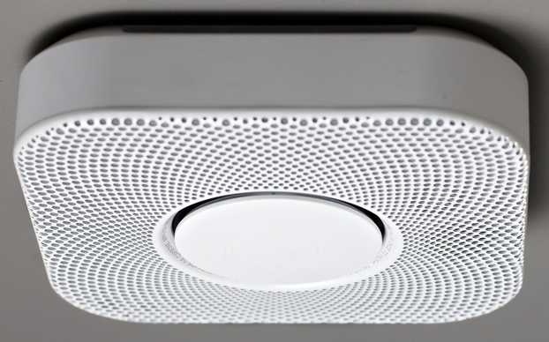
Nest Case Study
Other Patent Infringement Lawsuits
September 2013 – Nest announced patent license agreement with Intellectual Ventures, and acquired several patents (unclear how many)
November 2013 – BRK (First Alert) filed a lawsuit against Nest alleging infringement on six of its patents (e.g., location warning voice alerts)
The location warning system, BRK says, was laid out in a series of patents that cover using pre-recorded voice alerts to "describe the type of environmental condition detected or the location" of the detector that senses it. That "exclusive" technology was first used in a 2003 smoke detector, and the company says it's sold 1.8 million units with voice and location alarm systems since then.

Slide 42
PATENT LIABILITY
Patent Reform Act of 2011
Leahy-Smith America Invents Act (AIA), signed into law on September 16, 2011
Represents the most significant change to patent law since 1952
Switches U.S. patent system from a “first to invent” to a “first to file” system, eliminates interference proceedings, and develops post-grant opposition
Part of a continuous process
  Previous reforms targeted “submarine patents”
  Patent protection from date of issue vs. patent protection from date of filing
An interference proceeding is an administrative proceeding conducted by a panel of administrative patent judges of the USPTO to determine which applicant is not entitled to the patent if both claimed the same invention in: two or more pending patent applications, or at least one pending patent application and at least one patent issued within a year of the pending application's filing date.

Slide 43
PATENT LIABILITY
Patent Reform Act of 2011
First-Inverter-to-File
  move US further toward first-to-file system
  discourages patent awards based on “secret knowledge”
  each patent application given an “effective filing date”
  patentability judged on whether any prior art was available prior to the filing date (retain one-year grace period, but only for inventor’s own disclosures)
  obviousness also judged as of the effective filing date
Damages
  specific procedures and checks added on how a judge manages the damages portion of a case (identify methodologies and factors that are relevant to the determination of damages)
  court required to consider either party’s contentions regarding evidentiary base

Slide 44
PATENT LIABILITY
Patent Reform Act of 2011
Enhanced damages
  historically based on “willful” (or “reckless”) infringement, allowing the court to increase damages up to 3 times the amount found or assessed
  codified: infringement is not deemed “willful” unless claimant proves by clear and convincing evidence that accused infringer’s conduct with respect to the patent was objectively reckless (i.e. that the infringer was acting despite an objectively high likelihood that his actions constituted infringement of a valid patent)
  accusations of willful infringement must be pled with particularity (proof of knowledge of patent is insufficient to establish willful infringement)
  in a “close case” there will be no willful infringement

Slide 45
PATENT LIABILITY
Patent Reform Act of 2011
Third-Party Challenges to Patent Rights
  pre-issuance third-party submissions (allows a third party to submit any printed publication along with a description of the relevance to the USPTO during examination of pending patent application)
  third-party requested post grant review (would allow a third party to present essentially any legal challenge to the validity of at least one claim…but must be filed within 9 months of issuance)
  inter partes review proceedings (once 9-month window expired, a third party can request reconsideration of novelty and obviousness issues based on prior art patents and printed publications)

Slide 46
PATENT LIABILITY
Patent Reform Act of 2011
Best mode
  intended to prevent “less-than-full” patent disclosures by documenting only an inferior implementation of the patent
  excludes failure to disclose a best mode from being used as a basis for invalidating an issued patent
  PTO will still have a duty to only issue patents where the best mode requirement has been satisfied

Slide 47
PATENT LIABILITY
Patent Reform Act of 2011
Concerns
  further entrenchment of market incumbents
  falling rate of startup formation
  falling levels of venture capital
  diminished incentives for investment and development
  greater options for accused infringers and weakened rights of patentees
  “better solution” would be to issue higher quality patents in the first place to help avoid the overhead (and possible inequities) associated with the reexamination process…(?)

