Slide 1
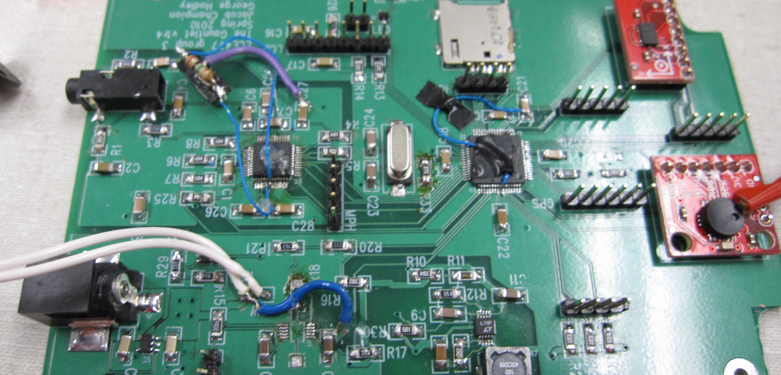
Verification and Debugging George Hadley ©2017, Images Property of their Respective Owners.
Notes:
Cover Image Source: https://engineering.purdue.edu/ece477/Archive/2010/Spring/S10-Grp03/images/AudioAssembled.JPG

Slide 2
Outline
Purpose and Motivation
Do’s and Don’ts of Debugging
The Debugging Mindset (“What could go wrong?”)
Hardware Verification Process
Software Verification Process
Debugging Case Study

Slide 3
Purpose And Motivation
Once hardware has been designed and software has been written, it comes time to verify whether or not the proposed design works
The process of verifying hardware and software can be tedious
Employing a methodical approach to debugging can deliver superior results and shorten overall verification times

Slide 4
Do’s and Don’ts of Debugging
DON’T solder parts, attach wires, connect probes, etc. while a circuit board is energized – Temporary shorts can destroy your circuit board and its components. The tip of the iron is GROUNDED, and tying random points of the board to ground can be very bad!
DON’T attempt to probe between the leads of your microcontroller – A short can be disastrous and possibly destroy your microcontroller. Include test points and pin headers instead.

Slide 5
Do’s and Don’ts of Debugging
DON’T attempt to power different parts of your circuit with different (external) power supplies – Even small differences in voltage between two isolated supplies can result in large amounts of unwanted current flowing across a set of traces. (ground loops)
DON’T connect port pins directly to power supply rails to obtain a logic “1” or “0” when debugging – This is an easy way to destroy pin drivers and buffers, killing individual pins, ports, or the entire device

Slide 6
Do’s and Don’ts of Debugging
DO systematically check for the root causes of an error wherever possible, changing only a single variable at a time – This will help eliminate potential causes and reduce your problem space.
DO keep updated notes about errors that occur in your hardware, including your hardware setup, conditions under which the error occurs, and steps necessary to reproduce the problem – This will facilitate easier sharing of debugging information with others.
DO keep rovers, quadcopters, etc. tethered and immobile until full system testing is necessary – this will reduce the risk of breaking equipment and injuring people

Slide 7
The Debugging Mindset
Root Causes and Problem Spaces
Problem: “<x, y, z> doesn’t work.”
Problem Space: The set of all possible issues in the hardware and software which could lead to the issue at hand
Root Causes: The underlying issues which ultimately cause the erroneous behavior
Efficient debugging employs a series of tests to reduce the problem space as much as possible, identify root causes, and remediate the issues to produce functional hardware

Slide 8
The Debugging Mindset
Class Exercise: Reducing the Problem Space
Class Exercise:
The instructor is thinking of an integer between 1 and 100
A student must guess a number, and the instructor will then tell the student whether their guess is correct, too low, or too high
Objective: Using as few guesses as possible, the student must correctly guess the instructor’s number. What strategy will reliably return the answer in the fewest number of guesses?

Slide 9
The Debugging Mindset
Reducing the Problem Space
In debugging hardware, there are many ways to reduce the problem space. For a given issue, consider:
Is the issue hardware or software (or both)?
Which device is the source of the problem?
(In the case of debugging communication links) Is the issue a transmit issue? Receive issue?

Slide 10
The Debugging Mindset
Identifying Root Causes
In debugging, errors are often propagated throughout a system. Therefore, it is useful to attempt to isolate and identify the root cause of an issue.
When the problem space has been reduced as much as possible, determine the conditions under which an error occurs and the steps needed to reproduce a problem.

Slide 11
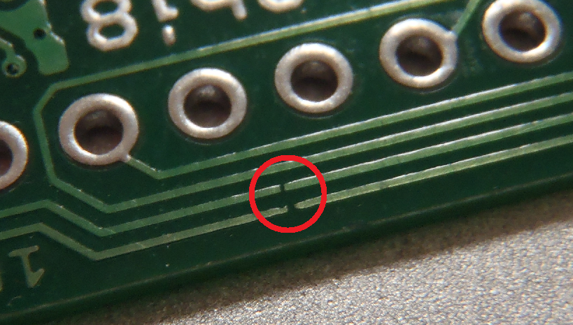
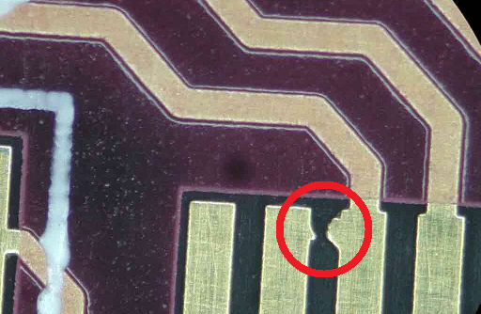
Hardware Verification Process
When Circuit Boards are First Received
Visually inspect your received circuit boards for any manufacturer defects, such as signal plane flooding. Use a multi-meter to check the resistance between power and ground and ensure there are no shorts.
Notes:
PCB Manufacturer Defect Image Source: http://www.electronictechsupport.com/images/SolderPhotos/Pad.JPG
PCB Manufacturer Defect 2 Image Source: http://dangerousprototypes.com/forum/download/file.php?id=6424&mode=view

Slide 12
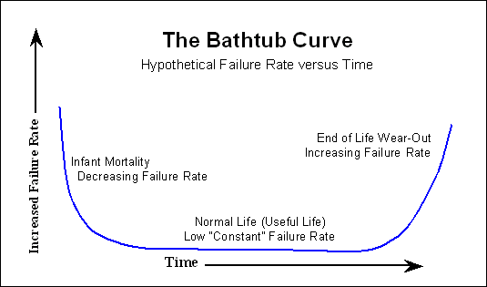
Hardware Verification Process
Power Supply Testing
Once boards have been determined to be sound, the power supply should be assembled and tested on board.
Power supplies should generally undergo an “endurance” test, being left on for a full day (helps mitigate the possibility of infant mortality rate failures)
Power supplies should be tested to ensure they can deliver necessary current and voltage under load. To simulate a load for the power supply, use of a “load resistor” is recommended
Notes:
Bathtub Curve Image Source: http://www.weibull.com/hotwire/issue21/ht21_1.gif

Slide 13
Hardware Verification Process
Microcontroller Testing
Once the power supply works correctly, add the microcontroller (or other relevant device) and all needed support components (decoupling caps, etc.) to the circuit board.
Troubleshoot any issues related to programming your microcontroller, then run a simple heartbeat program to verify that the microcontroller executes code
Bring interfaces to other devices online, one by one, troubleshooting any issues that occur interface by interface

Slide 14
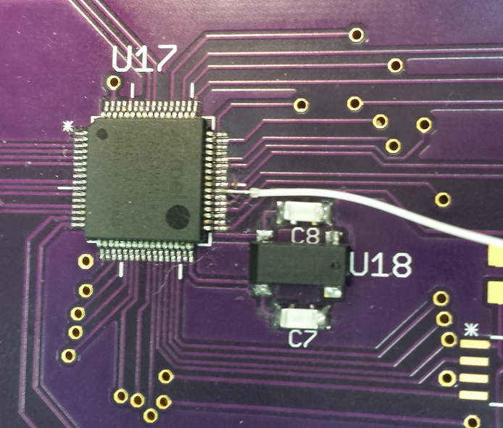
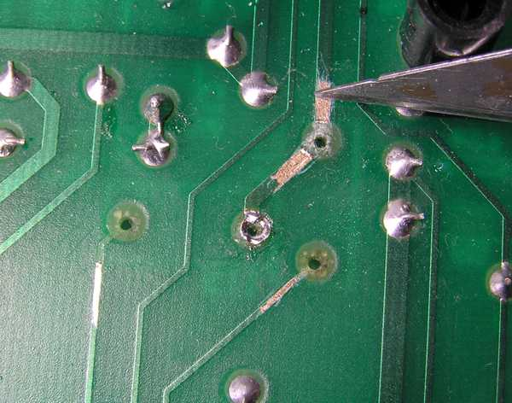
Hardware Verification Process
Flywiring, Trace Cutting and Scraping
Flywiring: Adding an electrical connection with fine-gauge wire (and a steady hand)
Trace cutting: Removing an electrical connection (generally done using an exacto blade or sharpened screwdriver)
Scraping: Carefully scraping away soldermask (but not the copper) to create new pads and electrical connection points
Notes:
Flywire Image Source: Self-created
Trace Cutting Image Source: http://home.comcast.net/~machrone/bjr/scrape_resist.jpg

Slide 15
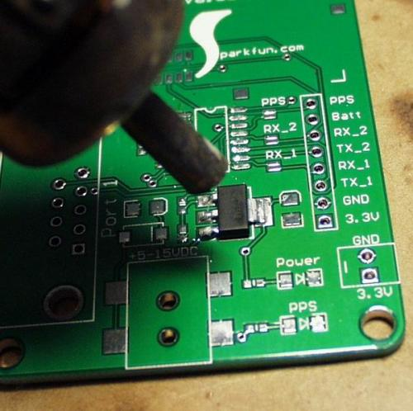
Hardware Verification Process
IC Removal
2 Techniques for IC Removal:
Hot-Air Rework: Reflow all solder joints to an IC simultaneously, then carefully remove IC using tweezers or pick (while hot air is still being applied)
Iron and “chisel”: Using a chisel, cut each IC lead individually, remove die, and then remove leads one by one with soldering iron
Notes:
Hot Air Rework Image Source: https://www.sparkfun.com/images/tutorials/SMD_HowTo/Hot-Air-Rework-3.jpg

Slide 16
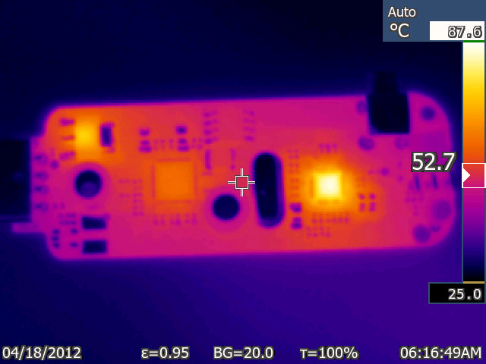
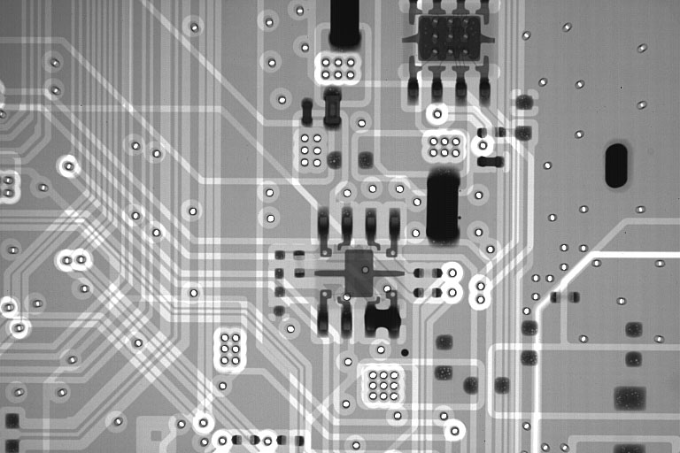
Hardware Verification Process
X-Rays and Thermal Cameras
Lab staff have access to high end debugging equipment:
Thermal Camera: Quickly identify hot-spots when design features a short
X-Ray: Verify proper soldering of leadless parts; verify boards with inner layers
Notes:
X-Ray Image Source: http://creativeelectron.com/images/pcb-solution1.jpg
Thermal Camera Image Source: http://rtlsdrblog.rtlsdrblog.netdna-cdn.com/wp-content/uploads/2015/10/rtlsdr_thermal_cam.jpg

Slide 17
Software Verification Process
Modular Coding
Modularize software into a hierarchy of software “blocks”
Verify the functionality of all low level blocks before testing higher level functional blocks
Repeat process until software functions as desired
Depending on code, programmers may have to test a variety of corner cases to ensure software reasonably functions under all conditions
Microcontroller background debuggers available on most major platforms to assist with embedded-level debugging efforts

Slide 18
Software Verification Process
RTFM
“My Code Isn’t Working.”
Follow these steps:
Acquire the necessary datasheets (device datasheet, library documentation, device family reference manuals)
Read said documentation to get a thorough understanding of how the system operates
Verify system operation through the microcontroller debugger, step-by-step
Google searches and Stack Overflow answers are useful for specific topics, but are not good for developing the base level of understanding needed to program a device

Slide 19
Debugging Case Study
PIC24 Programming Issue
Year: 2014 Semester: Fall
Description of problem: A team had a microcontroller (PIC32MX360F512L) on their board which they were unable to program. Multiple replacement microcontrollers were tried, and it was determined that 3 of the microcontrollers placed on the board were “bad”. An entire week had been dedicated to this problem and had not yet returned results.
Exercise: Suggest tests that could be done to narrow the problem space and identify the root cause of the problem.

Slide 20
Debugging Case Study
PIC24 Programming Issue
Cause of Issue: The team had configured the ENVREG input of their microcontroller incorrectly. By grounding the ENVREG pin of their microcontroller, they disabled the voltage regulator for the core voltage of their microcontroller device. This then fed the voltage present on their VCORE pin (3.3V) into the microcontroller core, destroying the core logic of the microcontroller. By tying this pin to Vdd and using an appropriate capacitor, they were able to program their microcontroller and stopped burning up new micros.

Slide 21
Clicker Quiz

Slide 22
Question 1
If a logic “0” is constantly output on a pin that is programmed as an output port regardless of the value written to the port register, this most likely is…
due to a programming error
due to a power supply issue
due to a “stuck at” fault (bad pad driver)
what should be expected (i.e., normal)
none of the above
Notes:
C – image source http://web.stanford.edu/class/ee386/public/stuck_at_fault_6per_page.pdf

Slide 23
Question 2
If a logic “1” is constantly output on a pin that is programmed as an output port regardless of the value written to the port register, this most likely is…
due to a programming error
due to a power supply issue
due to a “stuck at” fault (bad pad driver)
what should be expected (i.e., normal)
none of the above
Notes:
C – image source http://web.stanford.edu/class/ee386/public/stuck_at_fault_6per_page.pdf

Slide 24
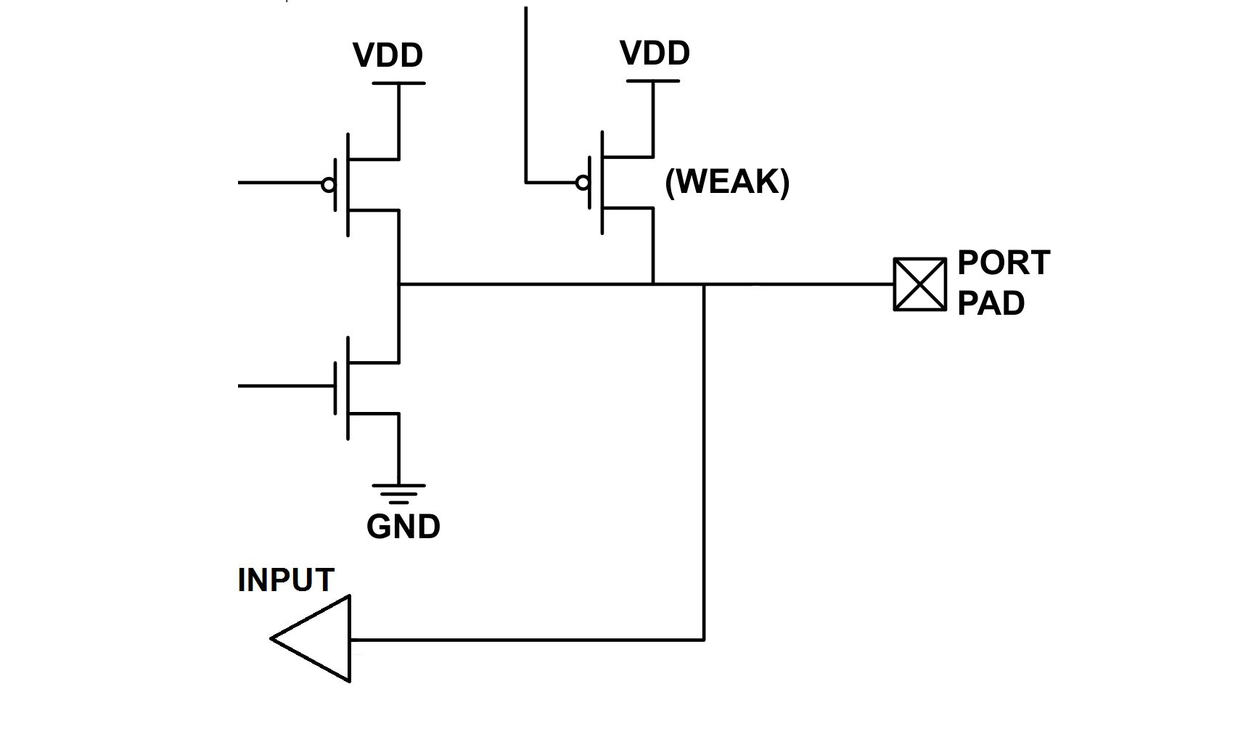
Question 3
If a logic “0” is constantly output on a port pin that is programmed as an input port, this most likely is…
due to a programming error
due to a power supply issue
due to a “stuck at” fault (bad pad driver)
what should be expected (i.e., normal)
none of the above
Notes:
D – what is expected

Slide 25
Question 4
If a logic “1” is constantly output on a port pin that is programmed as an input port, this most likely is…
due to a programming error
due to a power supply issue
due to a “stuck at” fault (bad pad driver)
what should be expected (i.e., normal)
none of the above
Notes:
C

Slide 26
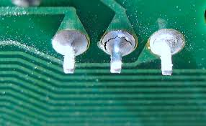
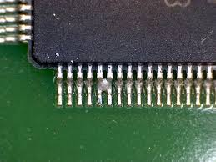
Question 5
If the same value is read from adjacent input port pins, this most likely is due to a…
solder bridge
cold solder joint
floating adjacent pin
all of the above
none of the above
Notes:
D – all are possibilities

Slide 27
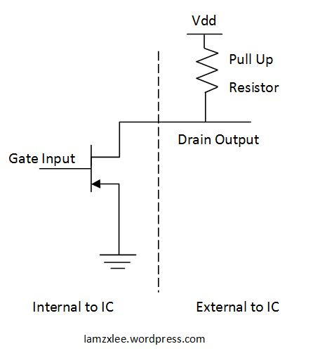
Question 6
If a port pin is configured as open drain, the voltage read from probing the pin without a pull-up resistor connected will:
always be Vss (ground)
always be Vdd (power)
be Vss if “0” is written to the port pin and Vdd if a “1” is written
be Vss if “1” is written to the port pin and Vdd if a “0” is written
none of the above
Notes:
A – no pull-up device

Slide 28
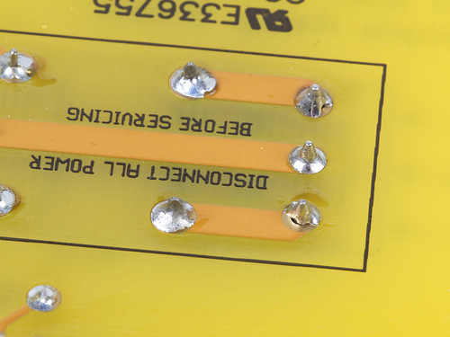

Question 7
The primary reason you should not attempt to solder a “live” circuit is:
the tip of the soldering iron is grounded and, as such, could short out the power supply and destroy components, vaporize PCB traces, and otherwise make you very unhappy
the solder could heat up too fast due to extra current flowing
the spark resulting from an inevitable short circuit might scare you
if you are scared by the spark, you might drop the iron and burn yourself
none of the above
Notes:
A – image source http://www.evilmadscientist.com/2015/how-not-to-solder/

