Slide 1
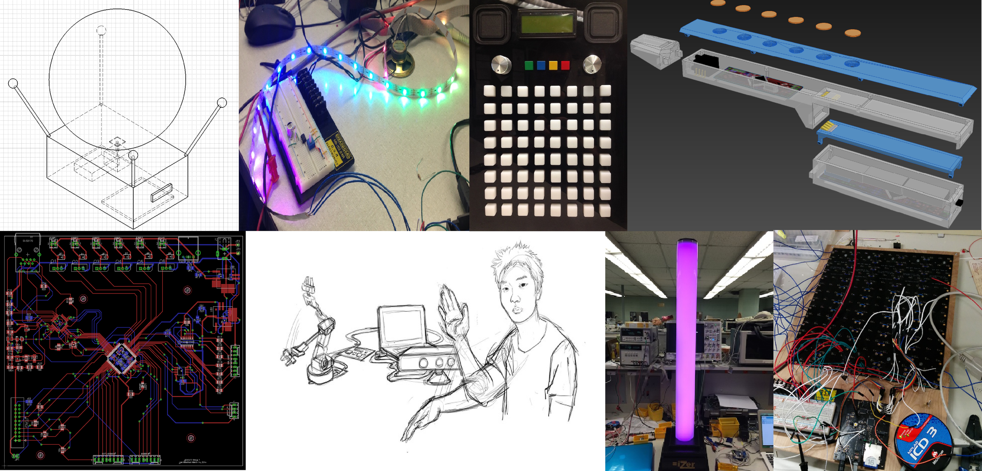
Introduction to ECE477 George Hadley ©2014, Images Property of their Respective Owners.

Slide 2
Outline
Course Overview
Communications
Staff and TAs
Schedule and Calendar
Policies
Grade Determination
Sample ECE477 Projects
Project Specific Success Criteria
Action Items to Get Started
Mandatory Lab Hours

Slide 3
Course Overview
Purpose and Objectives:
To provide students with a practical, hands-on design project to apply their electrical engineering knowledge
To simulate conditions students are expected to experience in industry and/or research settings
Teams:
Teams of 4 (team members chosen prior to semester)
Projects:
Chosen by student teams (must be of interest to 2+ members)
Embedded design projects (utilize MCU, FPGA, or CPLD)
Project success evaluated through use of project-specific success criteria (PSSCs)

Slide 4
Course Overview
Laboratory Space:
EE061/EE063/EE064
24/7 access available via electronic door lock
TA office hours held here
Laboratory Equipment:
Permanent equipment (To remain in ECE477 lab areas)
Student laboratory equipment (hand tools, development boards, etc) available for check-out and use
Mandatory Laboratory Times:
Replaces previously conducted TCSP sessions
Students are required to show up in lab at the start of their TCSP session
Used to assess progress, provide feedback, and improve student/staff communication
Attendance will be taken and is MANDATORY (students may miss up to 2 sessions unexcused and still pass the course)

Slide 5
Course Overview
Lectures:
Provided by Professor Meyer and George Hadley (occasional guest lecturers)
Held Tuesdays and Thursdays 1:30-2:20pm in MSEE B012
Consult course calendar for lecture dates and topics
Midterm and Final Presentations:
Formal presentations given before classmates and staff
Opportunity to showcase design and/or prototype, detail progress
Weekly Progress Updates:
Used to detail individual design activities and progress
An important part of student grades and a REQUIRED COURSE OUTCOME (60%+ average required on progress updates to pass course).
Evaluated many times throughout the semester.

Slide 6
Course Communications
Individual Emails:
Used to communicate with particular staff members or TAs
Available in the About/Staff section of the course site
ECE477 Course Email (ece477@ecn.purdue.edu)
Primary method of communicating issues, grades, course information, etc.
Monitored by multiple ECE477 staff members
ECE477 Course Website
https://engineering.purdue.edu/ece477
Tested with Firefox, Chrome, IE, and Safari
Mobile device support not presently implemented
Please address any website issues to George Hadley (ghadley@purdue.edu)

Slide 7
Course Communications
Project Websites:
Website template available for teams by default
Created and maintained by ECE477 student teams
Primary method of sharing and communicating design and project progress with the world
Should be hosted in the webspace provided by course staff

Slide 8
Course Staff
Professor David Meyer (meyer@ecn.purdue.edu) Professor-In-Charge
Doctor Mark Johnson (mcjohnso@purdue.edu) Senior Design Corporate Relations
Joseph Bougher (bougher@purdue.edu) Digital Systems Laboratory Engineer
George Hadley (ghadley@purdue.edu) Course Development, Course Coordinator
Additional staff details can be found on the About/Staff section of the course website

Slide 9
Course TAs
George Toh (ytoh@purdue.edu) Head ECE477 Teaching Assistant
Richard Marcus (rmarcus@purdue.edu) Senior ECE477 Teaching Assistant
Matthew Schoenwald (mschoenw@purdue.edu) ECE477 Teaching Assistant
Vipul Bhat (vbhat@purdue.edu) ECE477 Teaching Assistant
Additional staff details can be found on the About/Staff section of the course website

Slide 10
Course Website
About – General course overview, staff information, history
Course – Assignments, lectures, documents, policies, processes
Teams – Information about current teams and links to websites
Archive – Information about past teams and links to websites
Sponsors – Information for corporate sponsors
Incoming – Information for students looking to register for ECE477
Contact – Course account email link for communications

Slide 11
Course Schedule/Calendar
Weeks 1-4: Concept Development:
Functional Project Proposal: “Our idea seems sound… what do we need to get started?”
Functional Analysis: “How will our project be used? What are our project’s requirements?”
Electrical and Software Overviews: “At a high level, how will our project function?”
Component Analysis and Bill of Materials: “What parts does our project need to use?”
Ordering/Acquisition of parts, tools, and prototyping hardware

Slide 12
Course Schedule/Calendar
Weeks 5-9: Design:
Mechanical Overview: “What will our project look like? What form factor does it need to fit within?”
Software Formalization: “What software components will our design use? How will we verify and test the software?”
Printed Circuit Board Layout
Midterm Design Review
PCB Submission and Verification

Slide 13
Course Schedule/Calendar
Weeks 10-15: Testing and Integration:
Legal Analysis: “What steps must be taken to ensure our project can be legally sold to our customers?”
Reliability and Safety Analysis: “What risks are associated with use of our product? What parts are most likely to fail?”
Ethical and Environmental Analysis: “What resources does our project use? How can we responsibly manage our project’s life cycle? What ethical issues does our project present?”
User Manual: Guide to your project for the end user
Week 16: Demos, Final Presentations, and Final Documentation

Slide 14
Course Policies
The Golden Rule: ECE477 course staff are the final arbiters of all course policies
The Golden Guideline: In the event of an ECE477 issue (team issue, absence, course issue, etc.), always Always ALWAYS contact course staff
Email is preferred (easier to recall a well-documented paper trail)
All ECE477 course policies are subject to the above rule and guideline, even where not explicitly stated
Course policies are available for viewing and download from the ECE477 course website

Slide 15
Course Policies
Lab Equipment and Usage Policy:
Common sense (don’t intentionally break things, no food/drink/drugs/alcohol, etc.)
Safety (wear proper safety gear, 2 people in the lab at all times when soldering or using power tools, etc.)
Certain lab equipment can be checked out of the lab (consult the Digital Systems Laboratory Engineer for details)
Lab equipment must be checked back in at the end of the semester to avoid academic penalties
Do not sabotage, steal from, or otherwise interfere with other ECE477 teams (members, workspaces, projects, etc.)

Slide 16
Course Policies
Project Hardware:
Prototyping Hardware: any hardware you use to prototype aspects of your design
Final Hardware: hardware used to satisfy PSSCs, grades, and course outcomes
Q: Can we use <x> to prototype our design? A: Sure, go right ahead.
Q: Can we use <Arduino or similar, trivial breakout board, etc.> in our final design? A: Probably not.
Q: We’re unsure if <piece of hardware> is allowed, what should we do? A: Contact course staff

Slide 17
Course Policies
Online Collaboration Policy:
use of github, Sourceforge, Google Code, etc. is allowed BUT:
All students must maintain an online progress report using provided formatting
All students must maintain a project website hosted on the provided server space
Open source and third-party libraries may be used, provided they are properly attributed
Accepting patches and modifications from third parties to team member source code is explicitly forbidden
Cheating and other academic dishonesty will result in automatic course failure (so don’t do it)

Slide 18
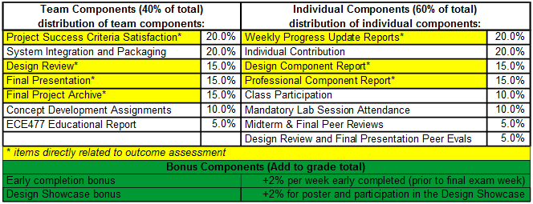
Grade Determination
Covered in further detail in the Grade Determination Policy, located in the Course -> Policies section of the website
Notes:
Grade Determination Policy Table: Self created.

Slide 19
Grade Determination
Late Policy
Deliverables in this class are like project deliverables to a customer
A late penalty of -10% per day will be assessed for any items turned in after the deadline
If an assignment is more than 3 days late, course staff will have final determination on whether to grade the assignment or not

Slide 20
Grade Determination
Learning Outcomes: (must be satisfied in order to pass the course)
An ability to apply knowledge obtained in earlier coursework and obtain new knowledge necessary to design and test a microcontroller-based digital system
An understanding of the engineering design process
An ability to function on a multidisciplinary team
An awareness of professional and ethical responsibility
An ability to communicate effectively, in both oral and written form

Slide 21
Grade Determination
Failures, Conditional Failures, and Incompletes
Students are responsible for their actions in ECE477; some actions may lead to failing grades
Be aware of your academic situation in ECE477 and other courses before considering post-graduation plans or accepting job offers
In some situations, students may be assigned an incomplete (I) or conditional failure (E) in lieu of a failing grade (F)
Report all University-eligible absences (death, illness, family emergency, etc.) to course staff

Slide 22
Grade Determination
Cheating and Academic Dishonesty
Not tolerated at Purdue
Automatic failure from ECE477, possible disciplinary action
All cases of academic dishonesty will be reported to the Office of the Dean of Students
In Summary…
Don’t.
A professional does not take credit for the work of somebody else

Slide 23
Sample ECE477 Projects

Slide 24
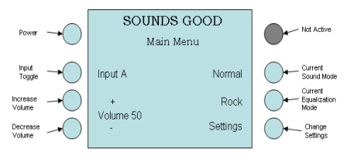
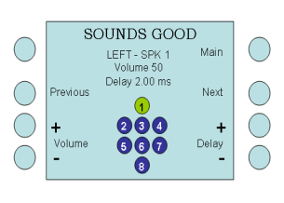
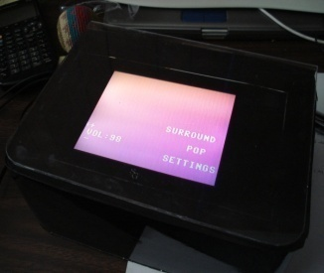
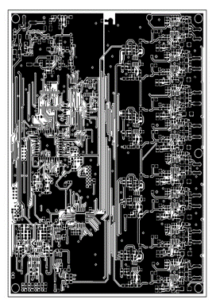
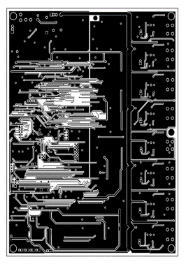
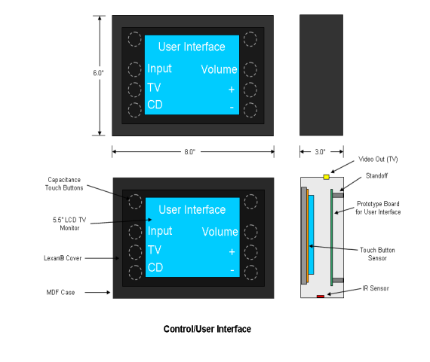
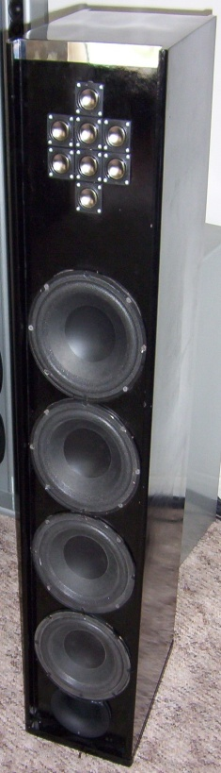
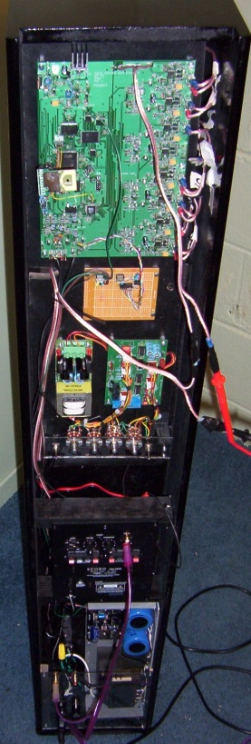
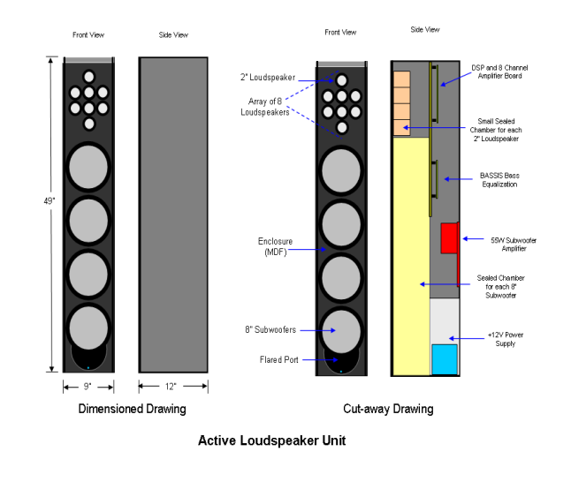
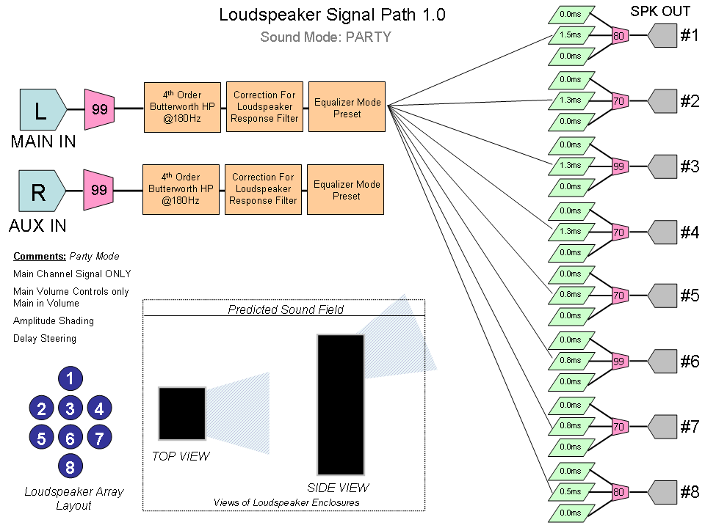

ECE 477 Digital Systems Senior Design Project − Spring 2007
SOUNDS GOOD / DS³ Digital Steerable Sound System
Joe Land, Ben Fogle, James O’Carroll, Elizabeth Strehlow
PROJECT DESCRIPTION:
USER INTERFACE UNIT:
USER MENUS CONCEPT:
Digitally Steerable Sound System, allows for non-ideal placement of speakers
Six Preset Equalization Modes
Wireless Control Interface
PCB LAYOUT:
ILLUSTRATION OF CONCEPT:
LOUDSPEAKER UNIT:
Top Copper
Bottom Copper
SIGNAL PATH:
FRONT
BACK
Digijock(ette)-Strength Digital System DesignTM

Slide 25

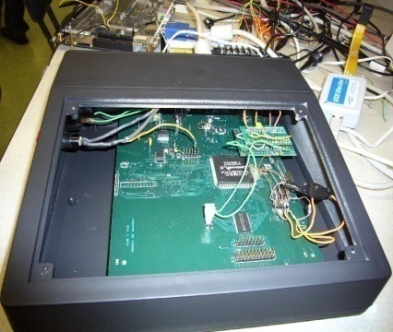
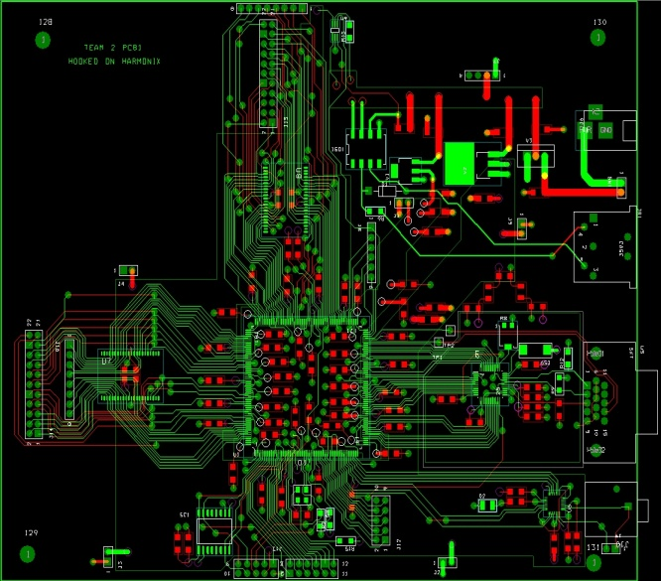
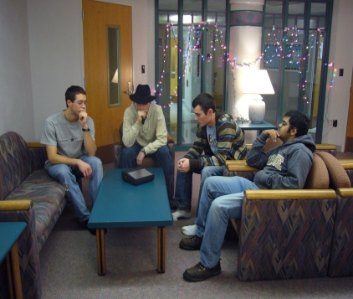
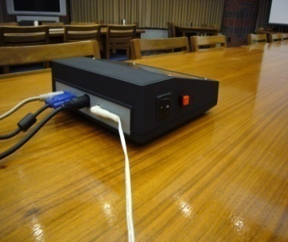
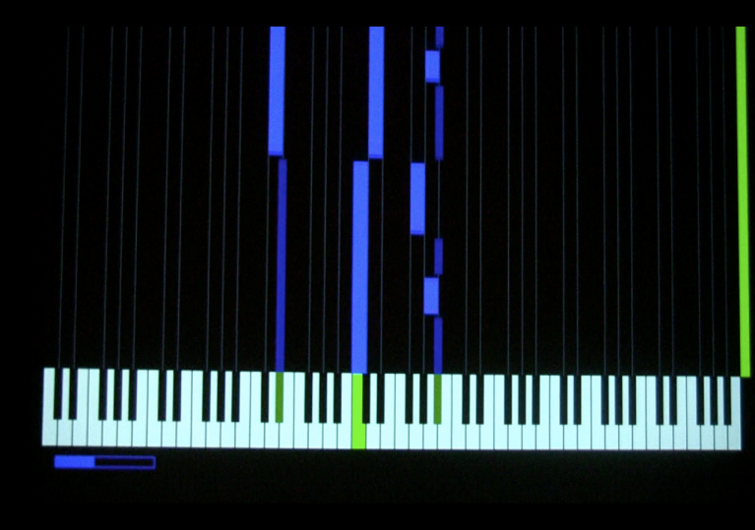
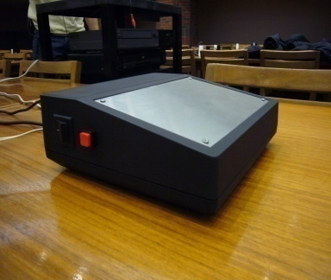
ECE 477 Digital Systems Senior Design Project − Fall 2007
Team 2: Hooked on Harmonix
Final Printed Circuit Board (PCB)
Hooked on Harmonix is a learning tool that teaches the user valuable piano skills while providing an entertaining experience at the same time.
4-layer Printed Circuit Board (PCB)
Synopsis: The user selects one of several MIDI tracks stored in Flash memory, and the corresponding file is parsed outputting bars of appropriate length to a standard computer monitor. Performance from a standard MIDI keyboard is judged and graded when the song is finished.
I/O Ports (from left): Audio Output, VGA output, MIDI input, power input
User input from standard MIDI keyboard is compared to stored MIDI song file
Digijock(ette)-Strength Digital System DesignTM

Slide 26

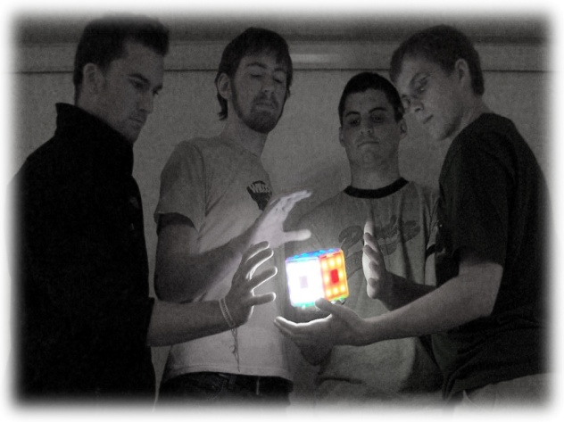
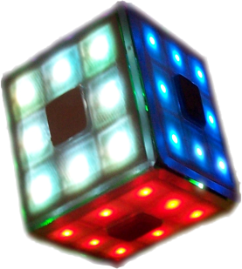
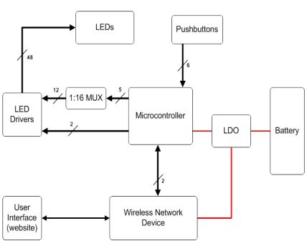
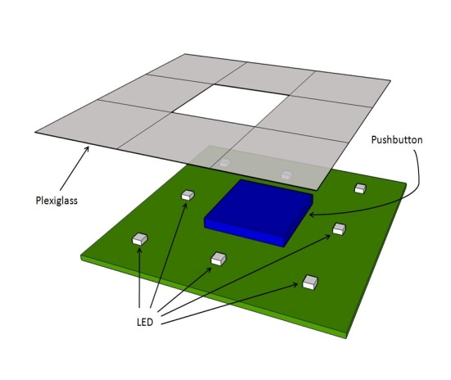
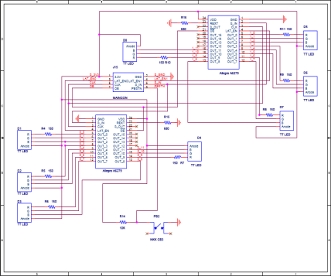
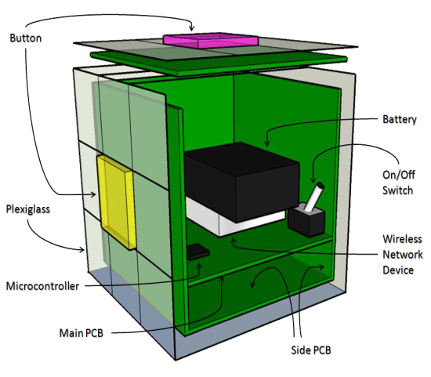
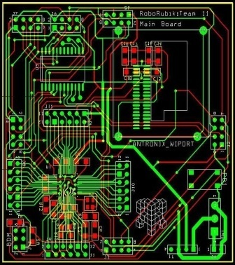
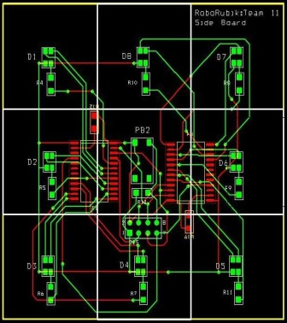
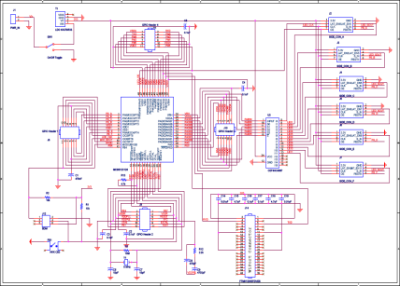


ECE 477 Digital Systems Senior Design Project − Spring 2008
Design
Device
RoboRubik
Block Diagram
Tyler Heck
Dave Bukiet
Erik Carron
Casey Kloiber
RoboRubik is a self-contained automated Rubik's Cube solver.
You can scramble and solve it just like a normal Rubik’s Cube. If you get stuck, you can get hints as to what your next move should be. RoboRubik comes with an embedded user interface accessed through any device with wireless networking ability. It’s a fun and simple way to learn about and play with one of the most beloved puzzles in the world.
Side PCB Schematic
Side PCB Sketch
Development
Main PCB Schematic
Main PCB
Side PCB
Cut-away Sketch
Digijock(ette)-Strength Digital System DesignTM
© 2008 RoboRubik

Slide 27
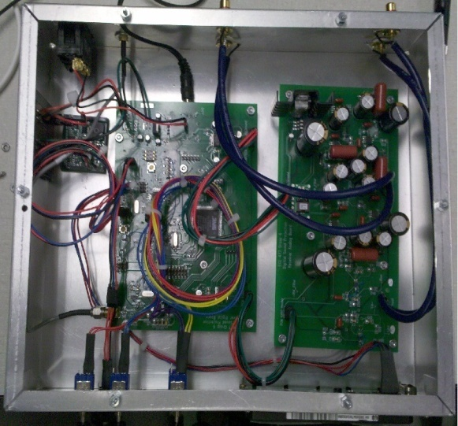
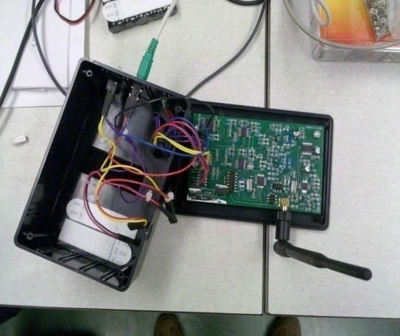
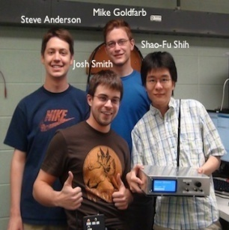
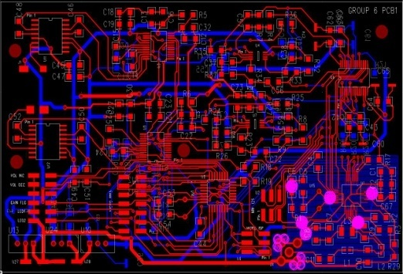
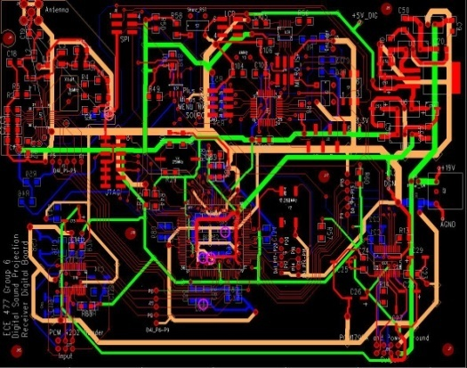
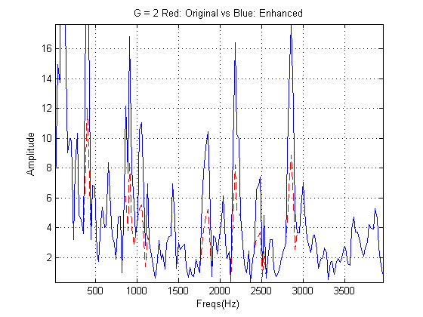
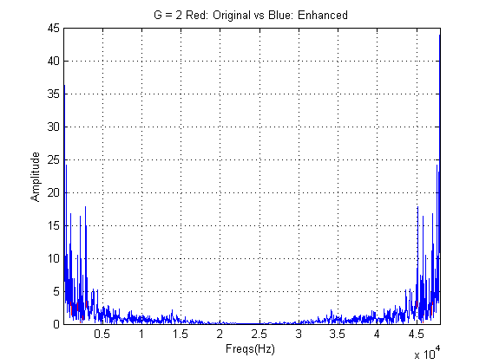
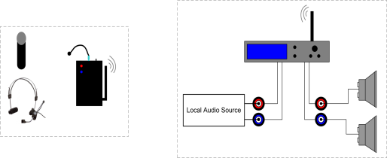
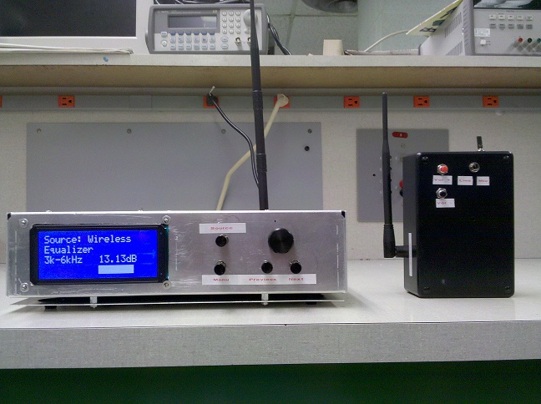
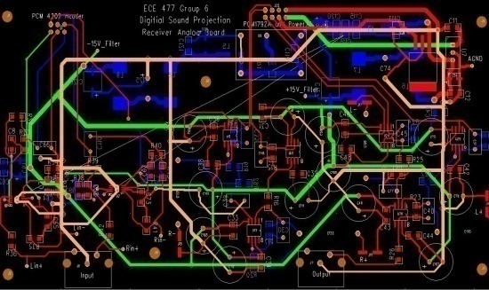
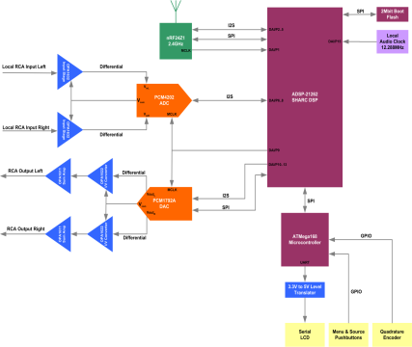
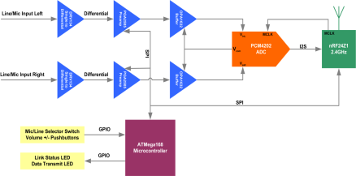
ECE 477 Digital Systems Senior Design Project − Spring 2010
Team 6 – Digital Sound Projection
Digital Sound Projection is a high fidelity audio transceiver with EQ and voice enhancement signal processing functions for lecture halls or theatre venues.
Transmitter Internals
Receiver Internals
Transmitter PCB Layout
Receiver “Digital” PCB Layout
Receiver “Analog” PCB Layout
Completed Project
Digijock(ette)-Strength Digital System DesignTM

Slide 28
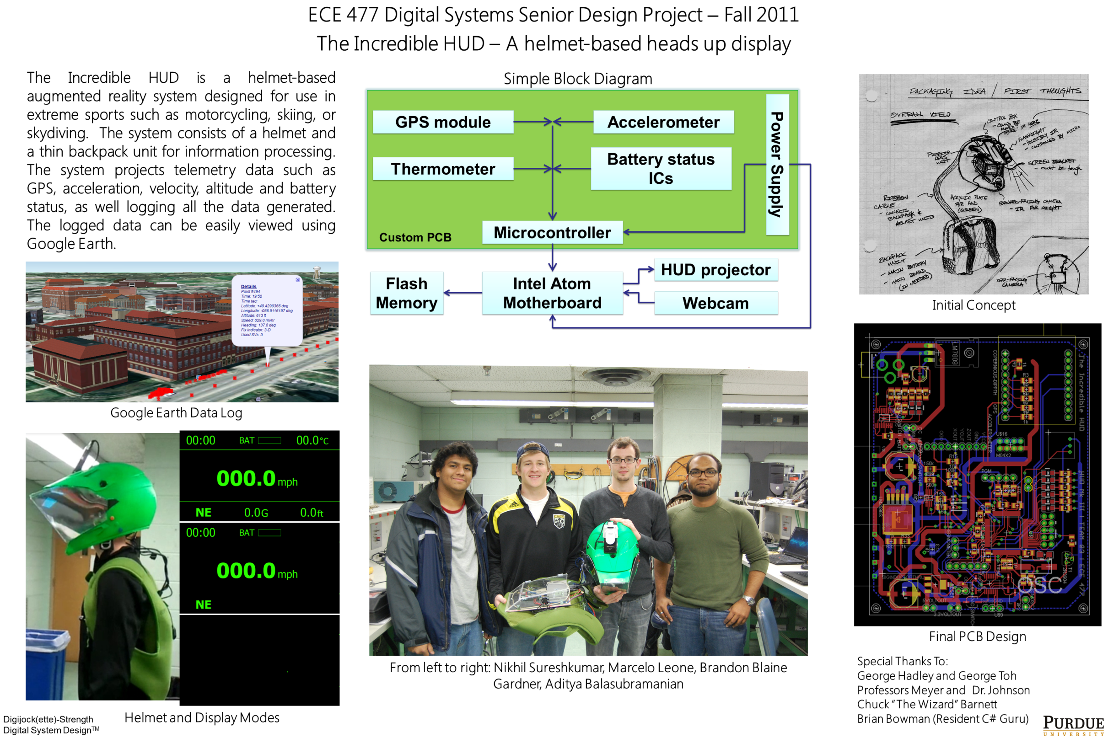

Slide 29
Project Specific Success Criteria (PSSCS)
What are PSSCs?
Used to measure the degree to which teams have successfully implemented their projects
5 objectives that should be accomplished by the final design (Approved by course staff); begin each PSSC with the phrase “An ability to…”
Each PSSC should describe some aspect of the functionality of the final design
In order to pass the course, 3 PSSCs must be successfully demonstrated
2 of the PSSCs must focus on hardware built by team
1 of the PSSCs can focus on an external item (such as an app)

Slide 30
Project Specific Success Criteria (PSSCS)
Default Functionality of a Component Rule
PSSCs cannot be based on functionality that an aspect of the design is able to do trivially or out of the box
Examples:
“An ability to transmit data over a wireless connection”
“An ability to take pictures with a camera”
“An ability to emit light from a light emitting diode”
Preliminary and Final PSSCs
Preliminary PSSCs: Aspects of the project can be demonstrated without full integration; used to pass outcomes
Final PSSCs: Must be demonstrated with a fully-integrated project; used to receive points and for early completion bonus credit

Slide 31
Project Specific Success Criteria (PSSCS)
Examples of Unacceptable PSSCs:
“Interface with the flight controller to achieve stable flight” (Start all PSSCs with the phrase “an ability to”)
“An ability to design a motor controller for our project” (PSSCs must be based on the capabilities of your end project)
“An ability to receive GPS coordinates and send them to the microcontroller” (Default functionality of a component rule)
“An ability to filter out high frequency noise from a received RF signal” (Unacceptable if being done by a filter IC; acceptable if performed by a user design)

Slide 32
Project Specific Success Criteria (PSSCS)
Common subjects for PSSCs:
Communication interfaces (acceptable IF you specify the types of data being transmitted over the interface)
User interfaces (define types of data being displayed to the user interface as well as the nature of the UI)
Motor control and robotics techniques (GPS waypoint navigation, obstacle avoidance, PID control, etc.)
Power techniques (battery monitoring/charging/ notifications, backup power supplies, low power modes)
Audio techniques (sound effects, audio synthesis, voice recognition, video/audio/signal processing, FFTs – may be acceptable depending on circumstances of use)

Slide 33
Action Items To Get Started
This week:
Meet with your team (if you haven’t already)
Determine roles, schedules, meeting times, methods of contacting one another, etc.
Set up progress reports and course website
Use of HTML/CSS/Javascript templates is acceptable
Course accounts come with a web template that may be used
Access information is available in the download folder for your team

Slide 34
Action Items To Get Started
This week (cont.):
Homework 1 – Final Project Proposal
Due Friday at 11:59pm (use website submission tool)
Determine and state team member roles and responsibilities (including homework assignment responsibilities)
Determine project-specific success criteria (see PSSC Policy for specific course mandates on selecting PSSCs)

Slide 35
Mandatory Lab Hours
This week (and subsequent weeks):
Report to EE063 during your assigned TCSP section
Meet the ECE477 laboratory staff
Become familiar with the ECE477 lab space, team workbench space, and lockers
Have team photos taken
Receive TA assignments and discuss office hour availability with assigned TA

