Slide 1
Team 21 Pop ‘em Drop ‘Em Robots
TCSP #7 Patent Liability Analysis
Mark Tubergen

Slide 2
Abstract
Electronic version of "Rock'em Sock'em Robots"
One or two players control movements of robots using a Microsoft Kinect
Player punches and dodges translate into robot movements
Hits are recorded and deplete a health bar
Selectable battle music

Slide 3
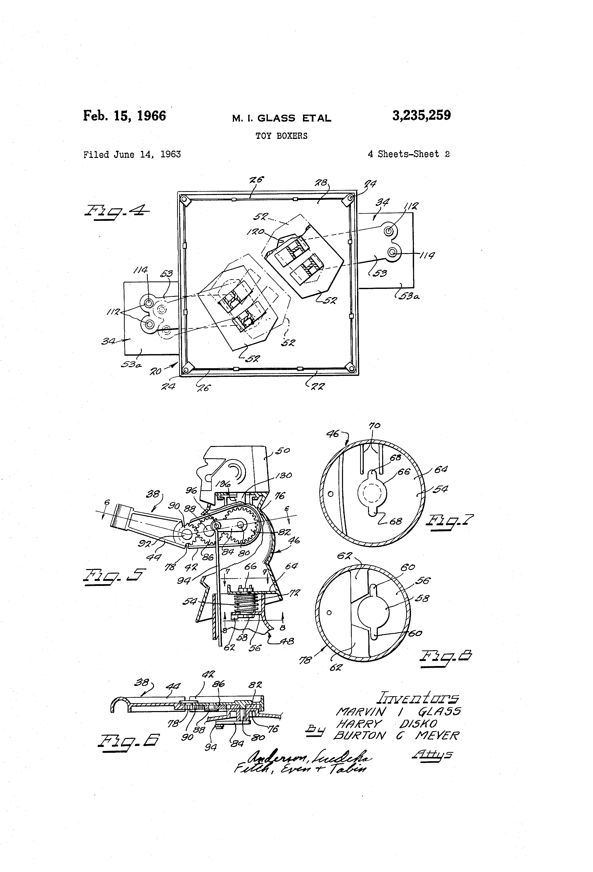
Case of Literal Infringement
Use of original Rock ‘em Sock ‘em Robots game
Assigned to Marvin Glass & Associates
Filed June 14, 1963
Issued Feb. 15, 1966

Slide 4
A Similar Case
“Figure Fighting Game”
Filed Nov. 2, 2006
Issued January 13, 2009
To: Mattel, Inc.

Slide 5
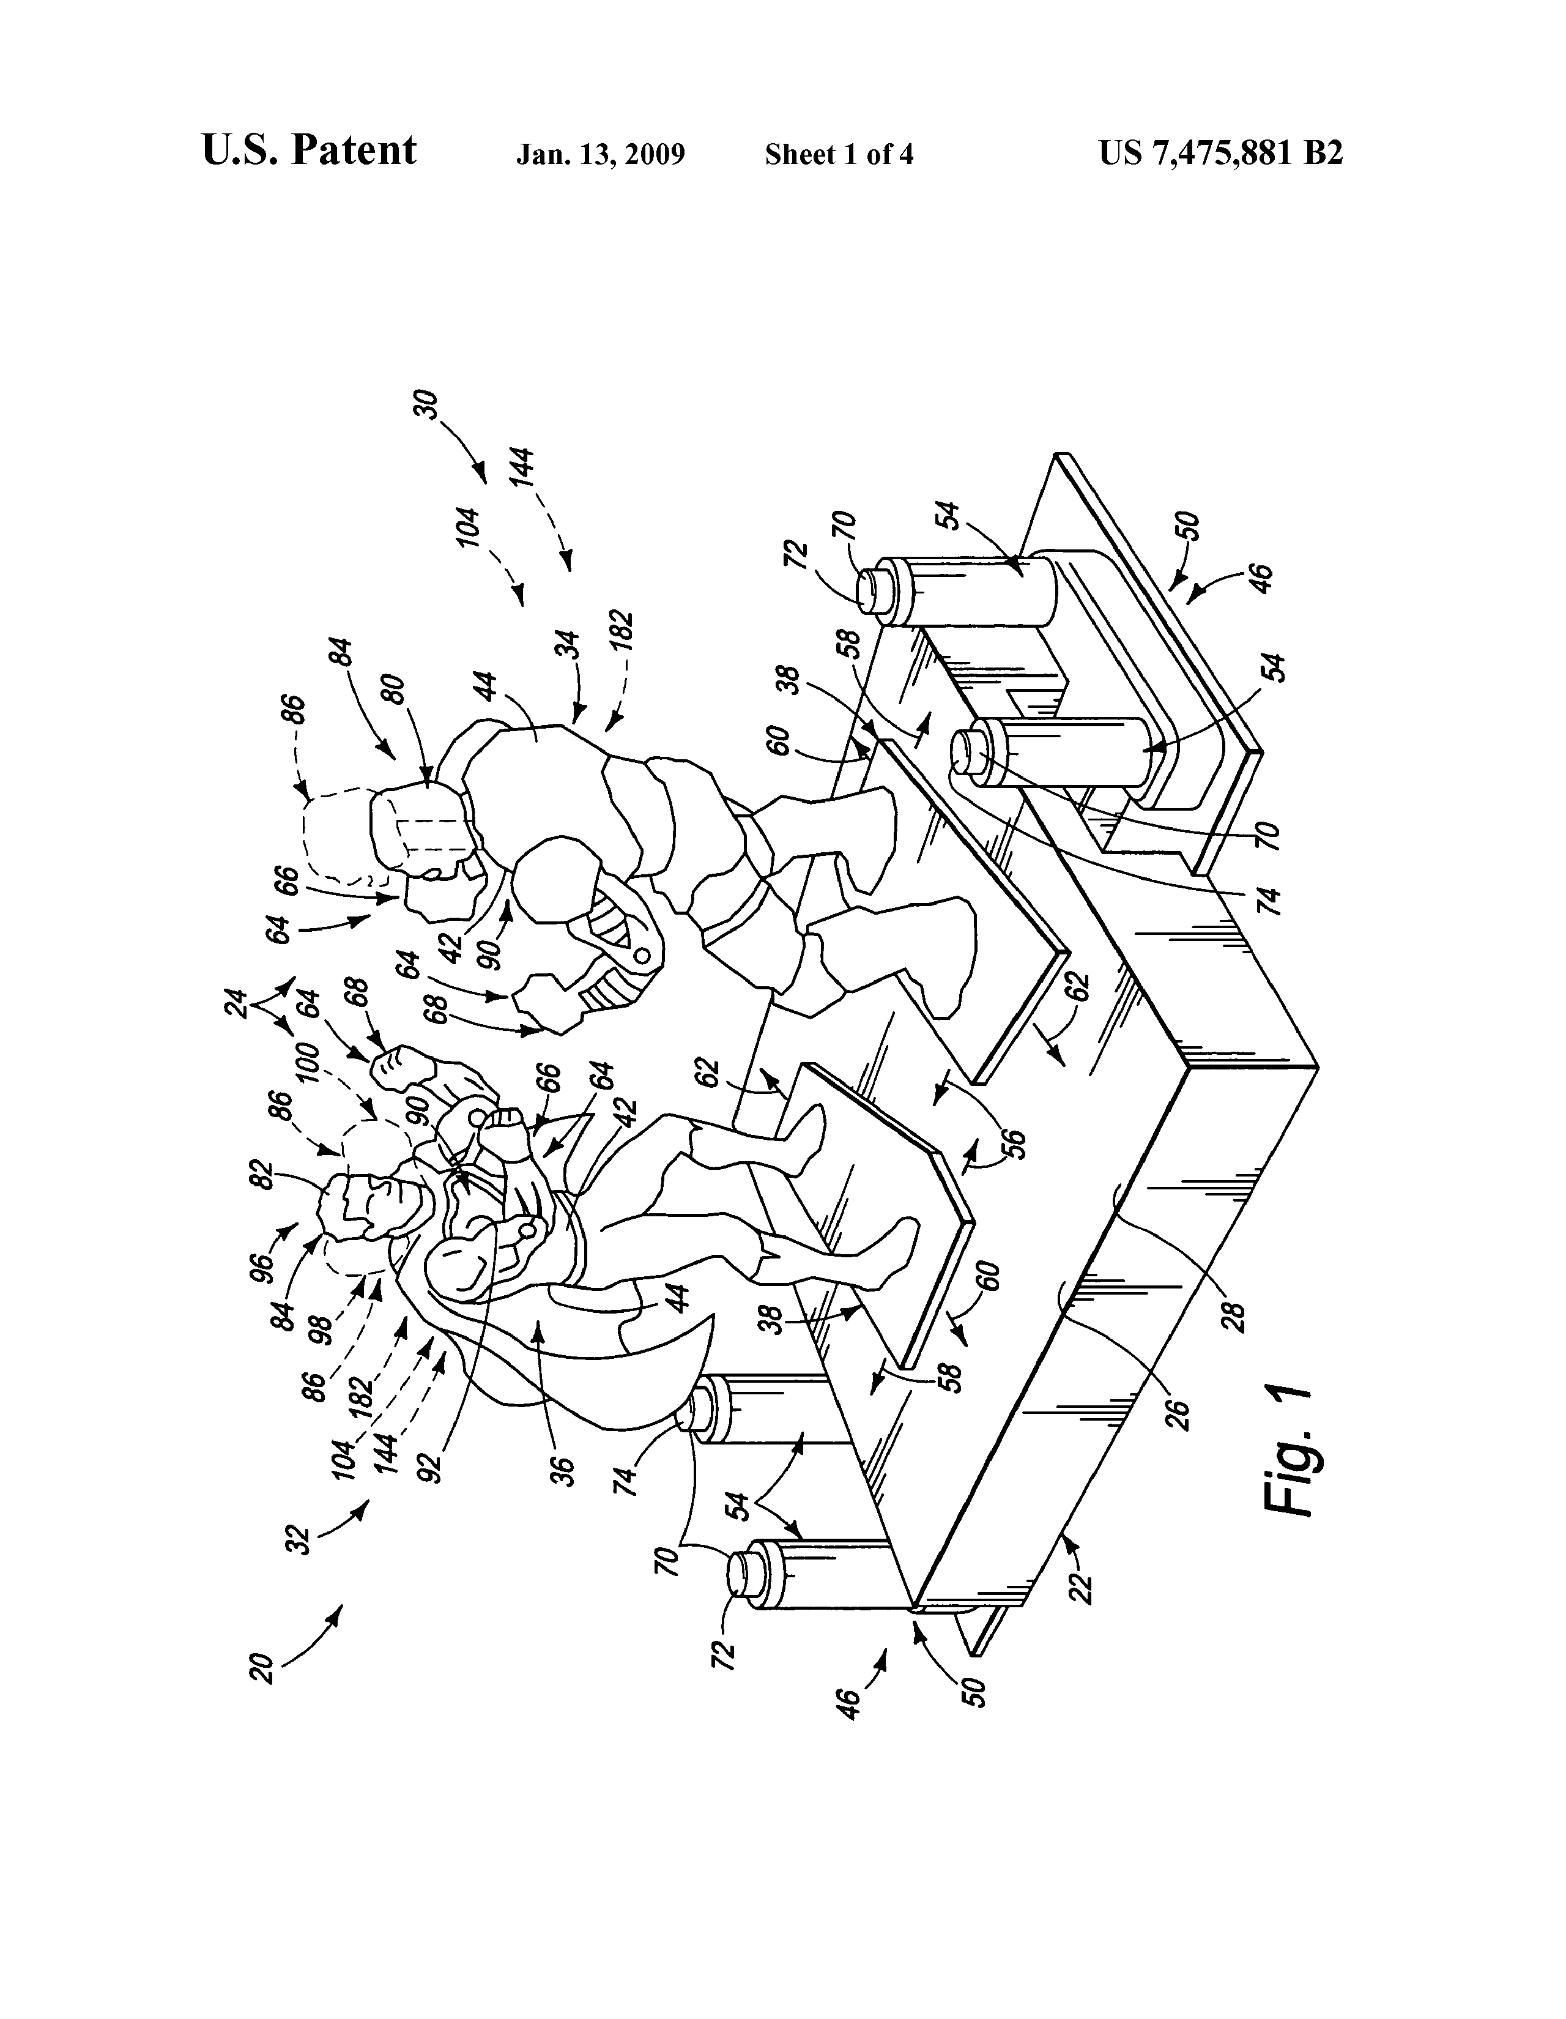
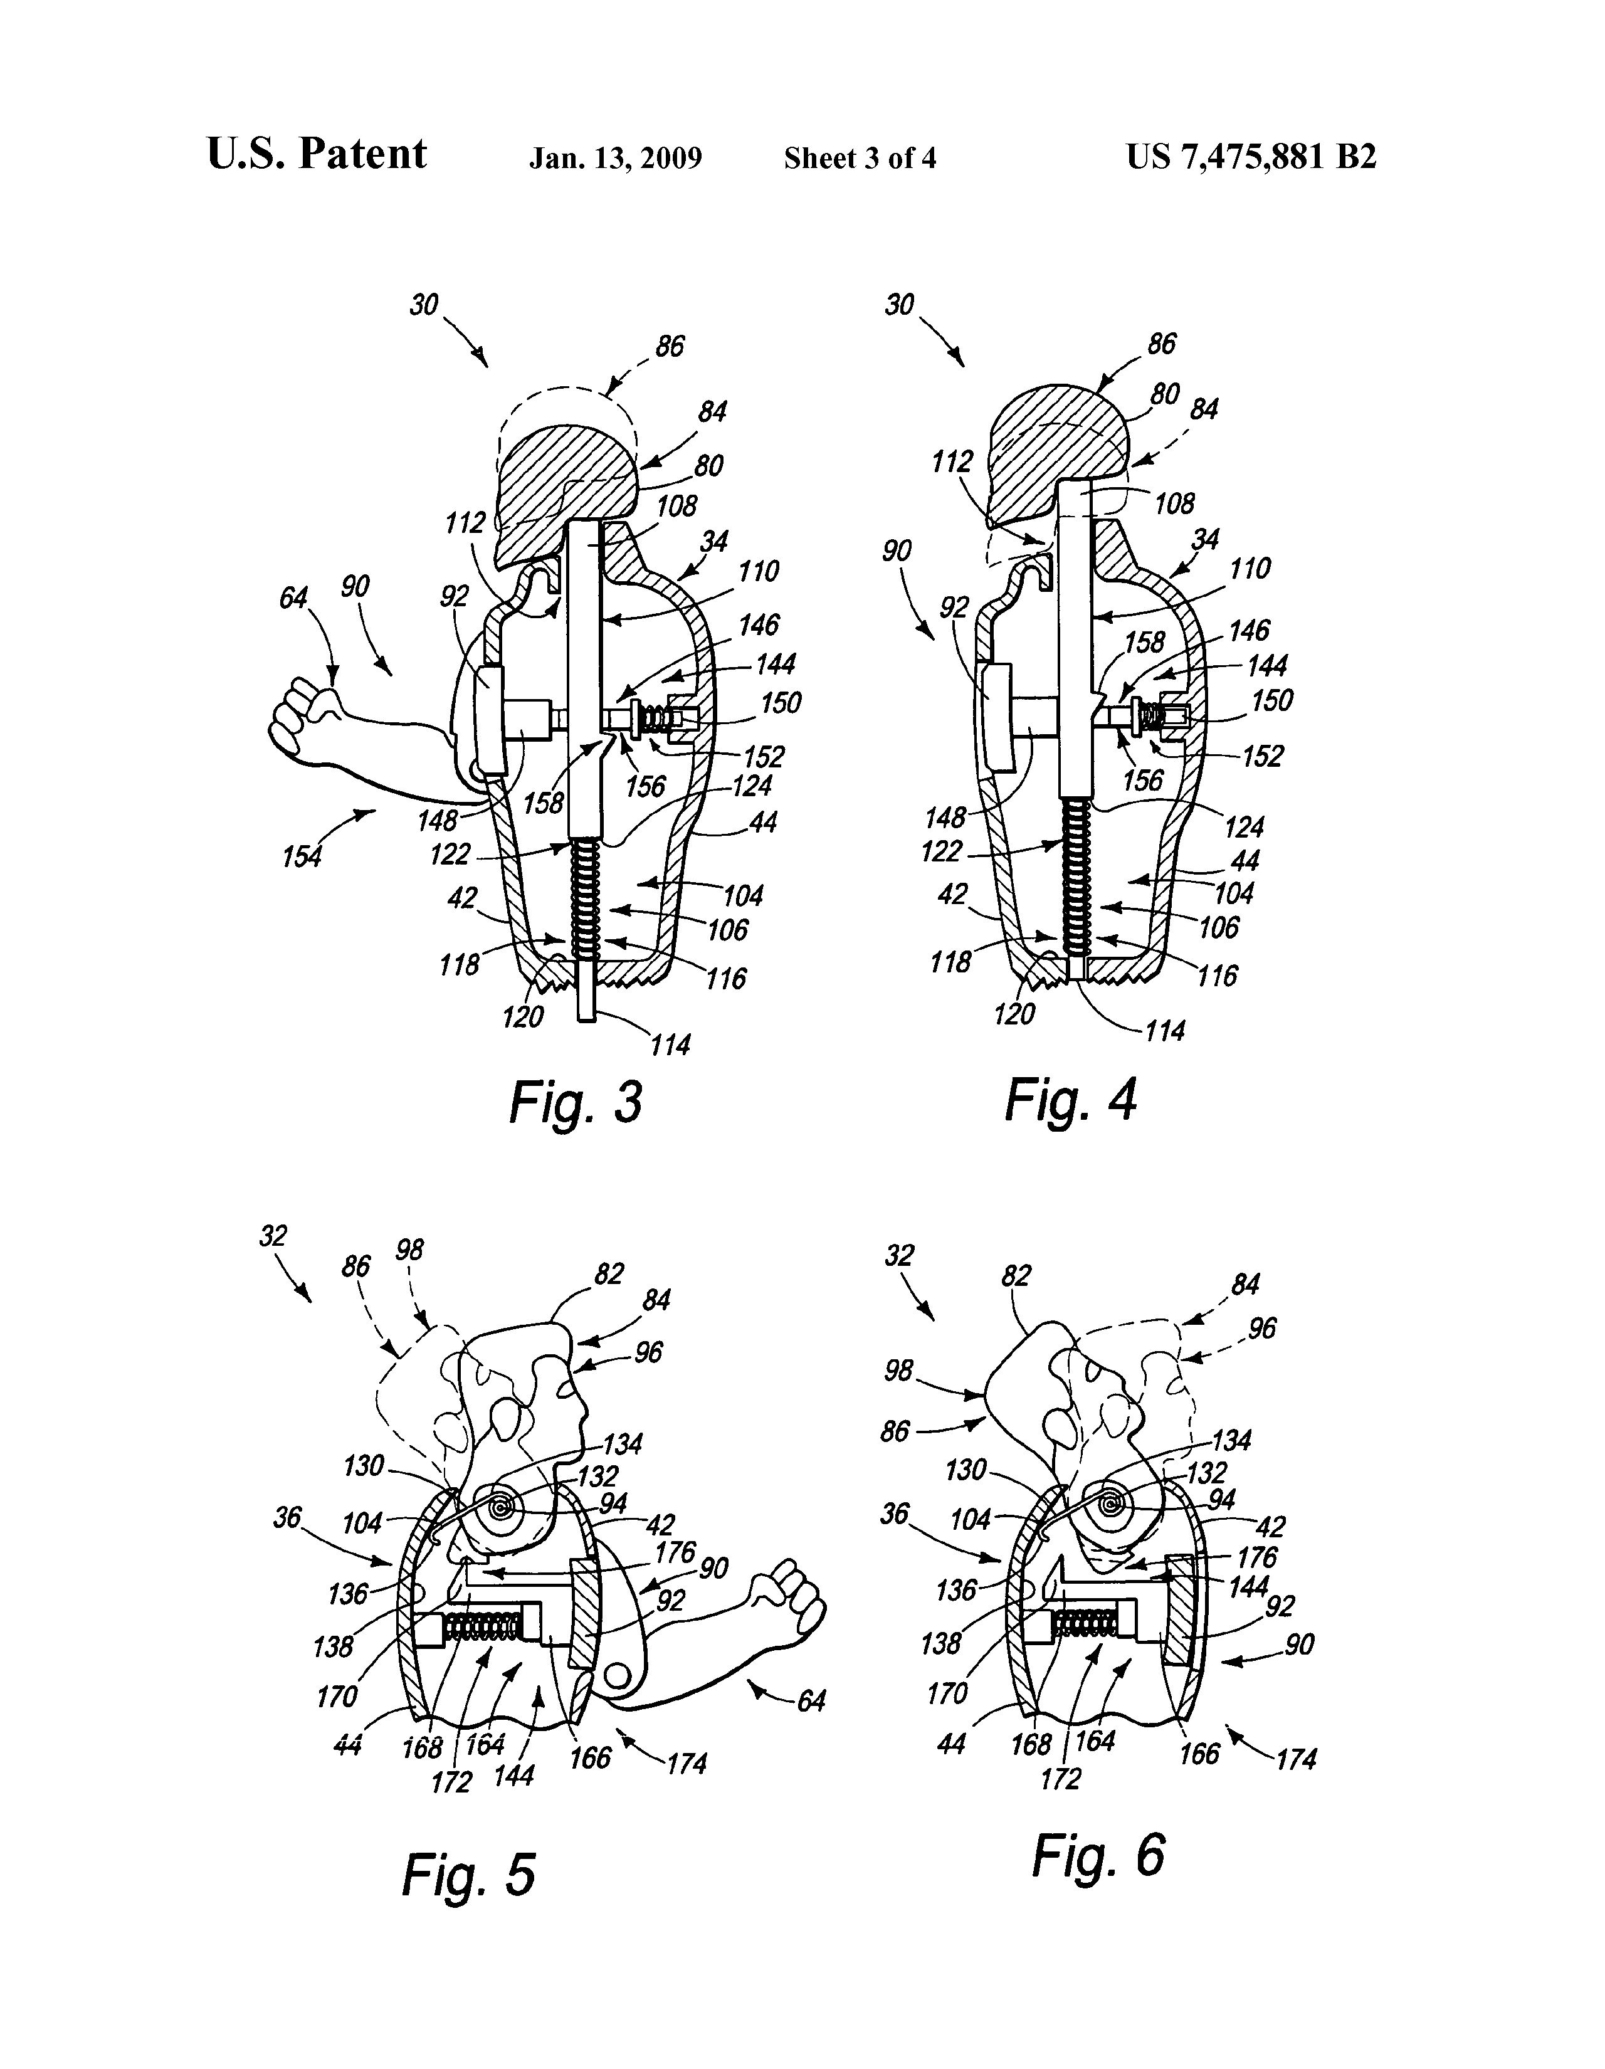
Look Familiar?

Slide 6
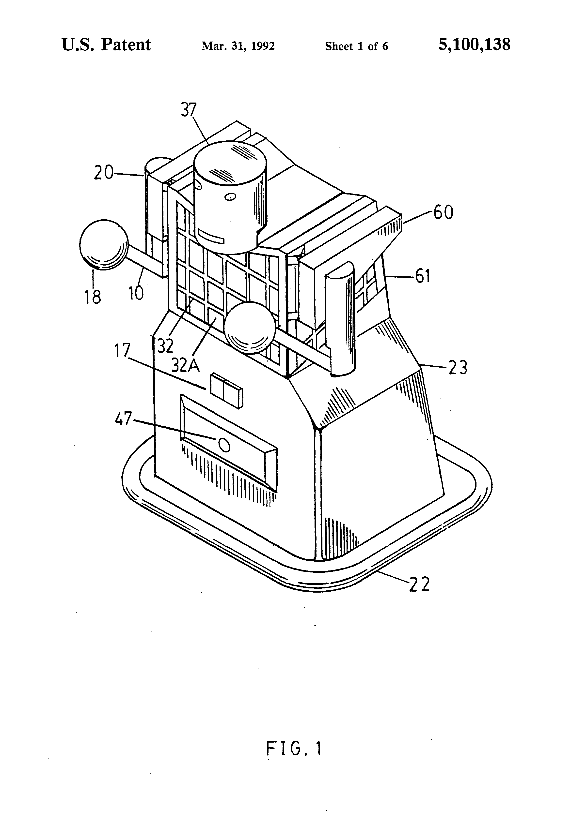
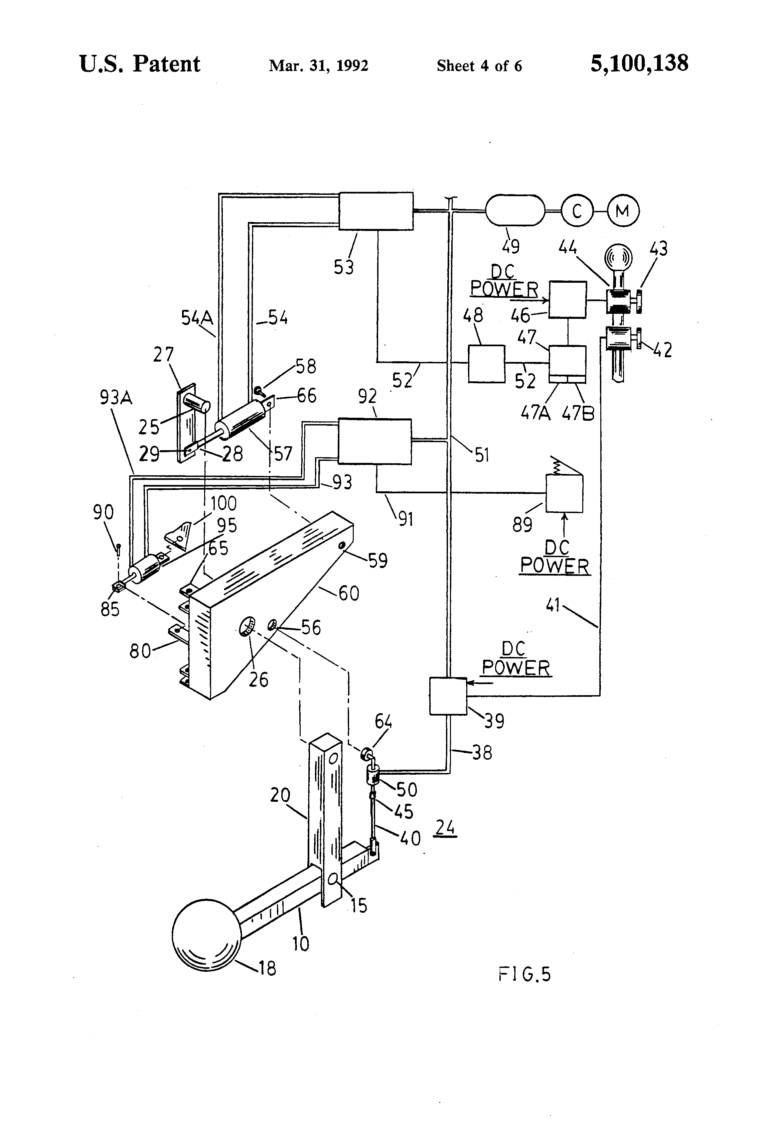
Doctrine of Equivalents
“Motorized Mobile Boxing Robot”
Filed August 18, 1990
Issued March 31, 1992
“Actuator delivers rotational force through the crank arm to the upper arm”

Slide 7
QUESTIONS?

