Slide 1
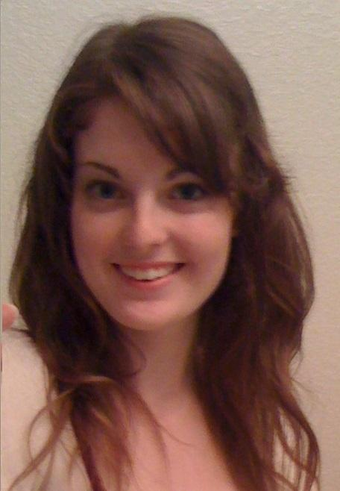
Team 21
Pop'em Drop'em Robots
TCSP #6 - Software Design Narrative
Jacqueline Greer

Slide 2
Abstract
Electronic version of "Rock'em Sock'em Robots"
One or two players control movements of robots using a Microsoft Kinect
Player punches and dodges translate into robot movements
Hits are recorded and deplete a health bar
Selectable battle music

Slide 3
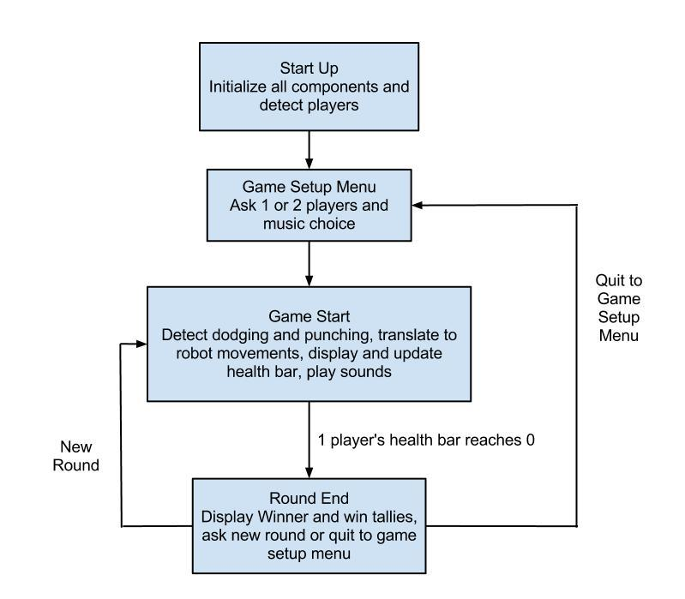
Software Flowchart

Slide 4
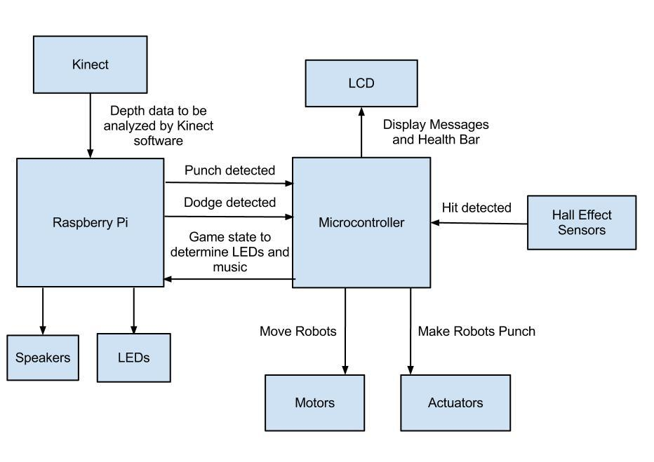
Software Design Considerations

Slide 5
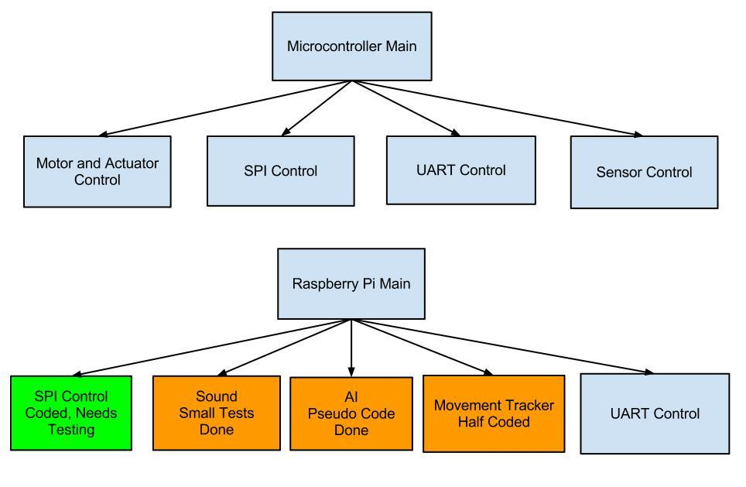
Software Development Status

Slide 6
Software Development Status - Micro
Main - Controls other modules
Motor and Actuator Control - Translate Pi's movement and punch signals into robot movement and punches
SPI Control - Control LCDs
UART Control - Communicate with Pi, using polling policy
Sensor Control - poll hall effect sensors to detect a hit, update health counts

Slide 7
Software Development Status

Slide 8
Software Development Status - Pi
Main - Controls other modules
SPI Control - Controls tri-color LEDs
Sound - Plays music
AI - Used for 1 Player Practice Mode to generate movements for the other robot
Movement Tracker - Uses modified OpenNI and PrimeSense NITE software for the Kinect to identify users, recognize dodges, punches, and gestures
UART Control - Communication with micro

Slide 9
Questions?

