Slide 1
Pop’em Drop’em Robots
Duncan Swartz
TCSP #5 - Preliminary PCB Layout

Slide 2
Abstract
Electronic version of “Rock’em Sock’em Robots”
Two players control movements of one of two punching robots via a Microsoft Kinect
Player punches and dodges translated into robot movements
Hits recorded through depletion of a health bar
Selectable battle music with light effects, potential single-player mode vs. computer

Slide 3
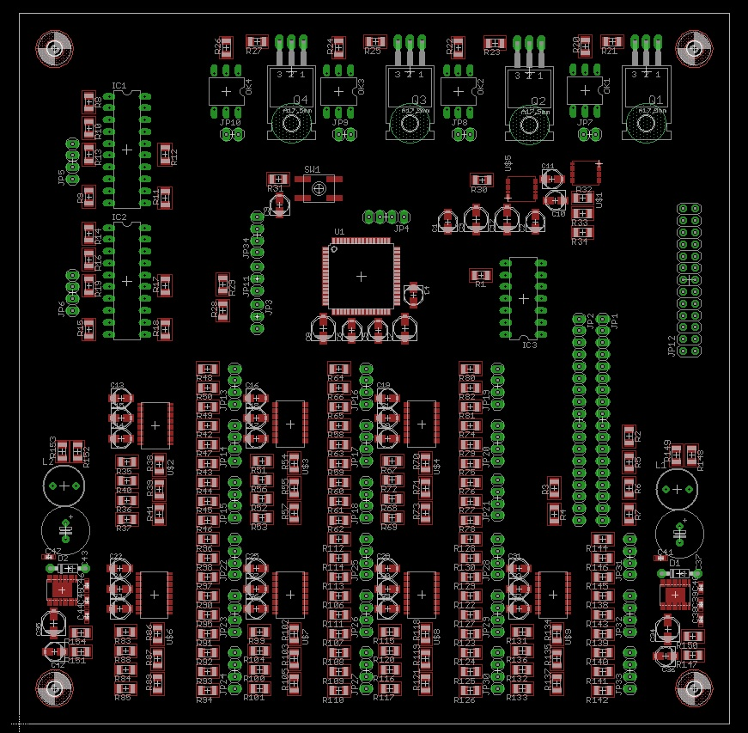
Prelim. PCB Overview
6” x 6”
board
Analog
Digital
DC-DC
(3.3V)
DC-DC
(5V)

Slide 4
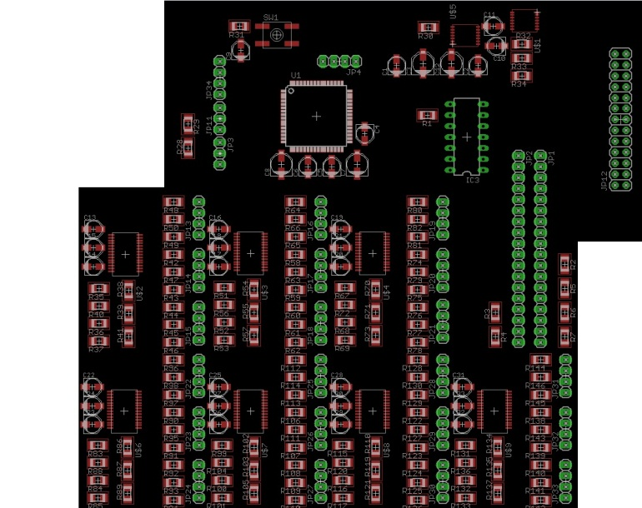
PCB subset: Digital
Atmel AT32UC3C2128C – 5V
LED drivers – 5V
Header to Raspberry PI – externally powered
Shift register and
headers to 2 LCD’s – 5V
Level translators – 5V

Slide 5
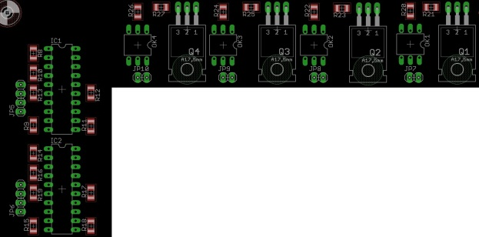
PCB subset: Analog
Stepper motor controllers and headers to motors – 5V
NPN power transistors, optical isolators, and headers to solenoids – 12V (from power supply)

Slide 6
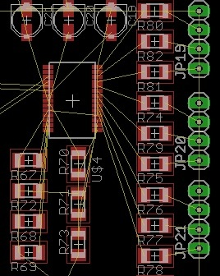
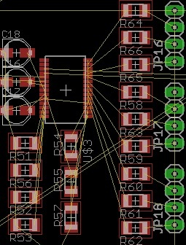
Thoughts while designing
Keeping decoupling capacitors as close to IC pins as possible:
Before:
After:

Slide 7
Thoughts while designing
Leave space around border of PCB to run power lines, route inwards as needed, helps with EMI

Slide 8
Thoughts while designing
When making copper fills, keep separate grounds for analog, digital, and dc-dc conversion components
Join up these separate grounds at a single “star-shape point”.

Slide 9
Questions?

