Slide 1
Pop'em Drop'em Robots
TCSP #4 - Hardware Design Narrative
Team 21

Slide 2
Abstract
Electronic version of “Rock’em Sock’em Robots"
Two players control movements of one of two punching robots via a Microsoft Kinect
Player punches and dodges translated into robot movements
Hits recorded until either player’s health bar value reaches zero.
Selectable battle music
Single-player mode (player vs. computer)

Slide 3
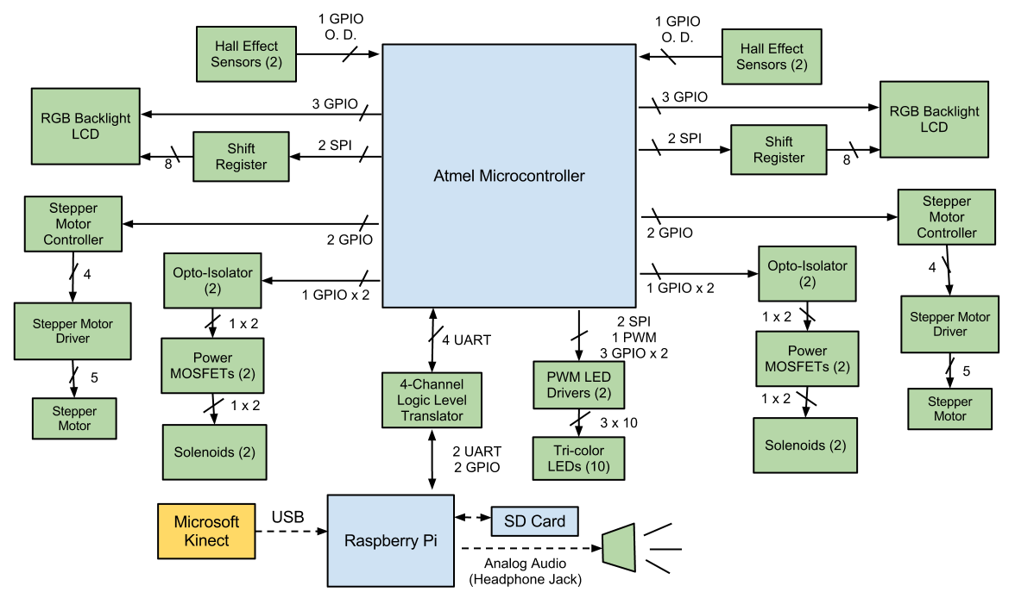
Block Diagram

Slide 4
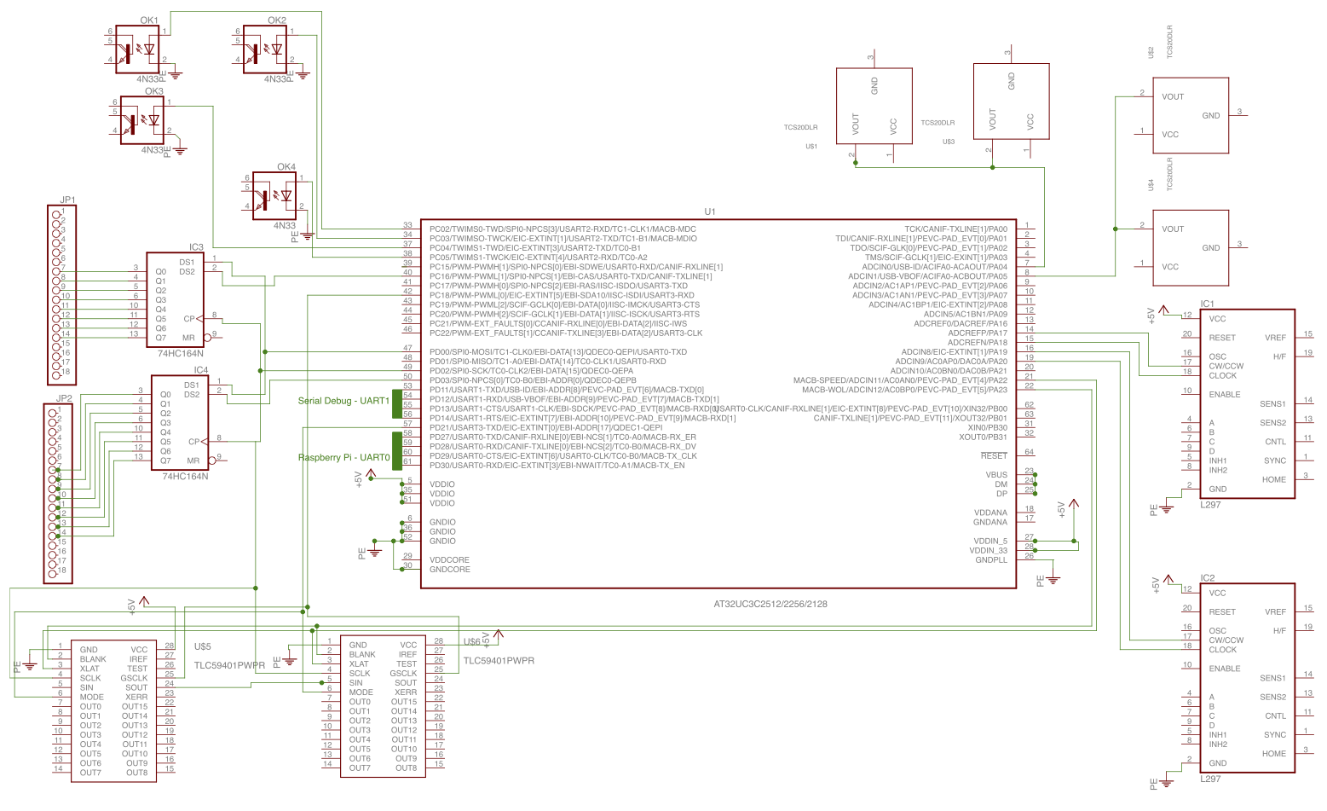
Preliminary Schematic

Slide 5
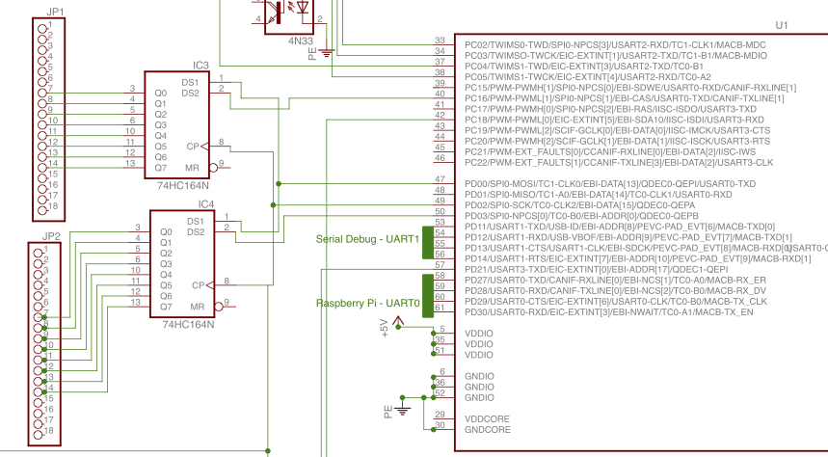
LCD Control & Interfacing

Slide 6
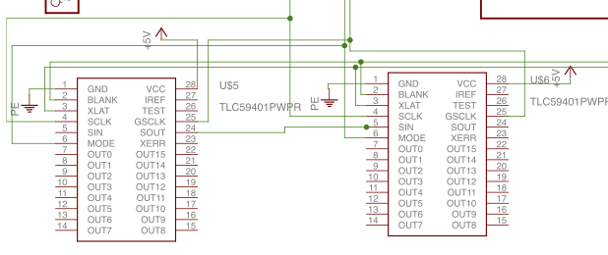
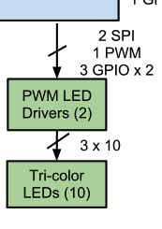
LED PWM Control Subsystem

Slide 7
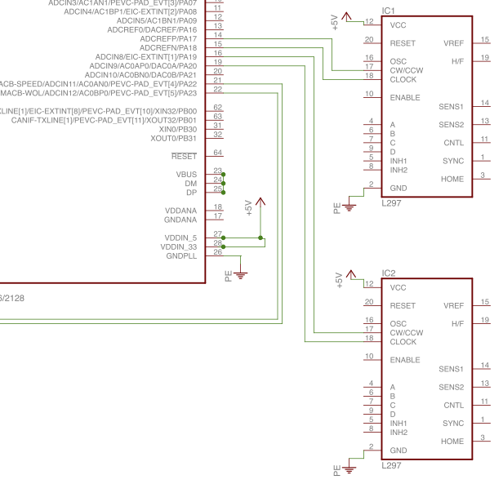
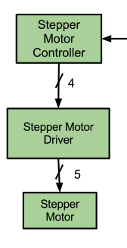
Stepper Motor Control Subsystem

Slide 8
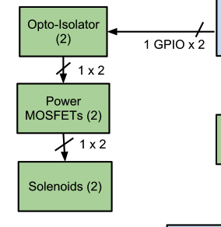
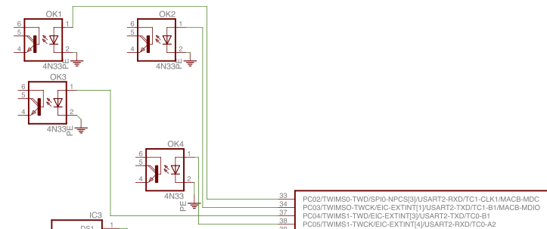
Solenoid Control Subsystem

Slide 9
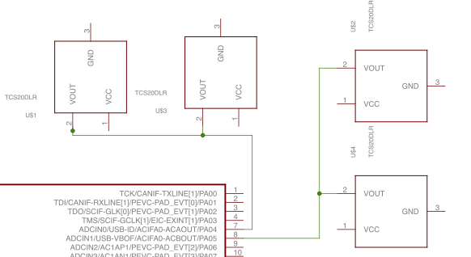
Hall-Effect Sensor Network

Slide 10
Questions

