Slide 1
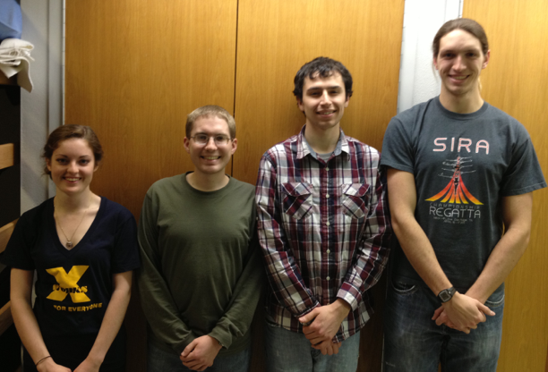
ECE 477 Design Review
Team 21 - Spring 2013
Jacqueline
Greer
Thomas
Pansino
Duncan
Swartz
Mark
Tubergen

Slide 2
Outline
Project Overview
Project Specific Success Criteria
Block Diagram
Component Selection Rationale
Packaging Design
Schematic and Theory of Operation
PCB Layout
Software Design/Development Status
Project Completion Timeline
Questions/Discussion

Slide 3
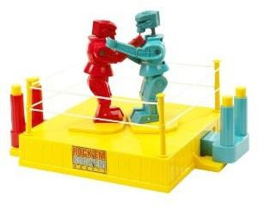
Project Overview
Electronic version of "Rock'em Sock'em Robots"
One or two players control movements of robots using a Microsoft Kinect
Player punches and dodges translate into robot movements
Hits are recorded and deplete a health bar
Selectable battle music

Slide 4
Project-Specific Success Criteria
An ability to power and control electric motors.
An ability to detect a "hit" on an opponent.
An ability to track player movements with a Microsoft Kinect.
An ability to provide player feedback using sounds, LEDs, and game information via LCDs.
An ability to play in either single or dual-player mode.

Slide 5
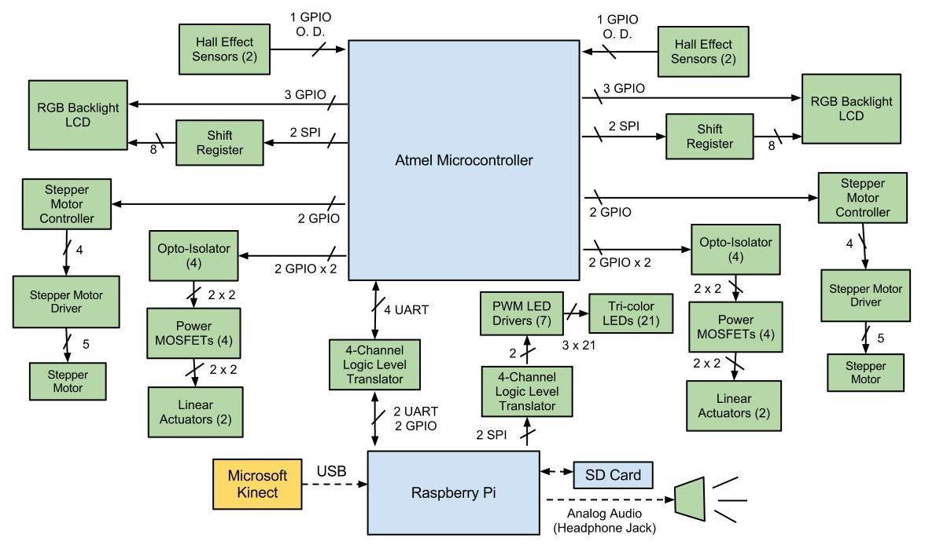
Block Diagram

Slide 6
Component Selection Rationale
Atmel-AT32UC3C2128C (Microcontroller)
45 GPIO
4 UART
1 SPI
128KB Flash memory
66MHz max clock speed
Omron-W2RF004RM (LED Driver)
Programmable Fade
Serialized Input

Slide 7
Component Selection Rationale
New Haven-NHD‐0216K1Z‐NS (LCD Display)
(R-Pi) RASPBRRY-MODB-512M (Motherboard)
Has had documented success interfacing with Kinect
STM-L297D013TR (Stepper Motor Controller)
Arduino-28YBJ-48 (Stepper Motor/Drive Board)

Slide 8
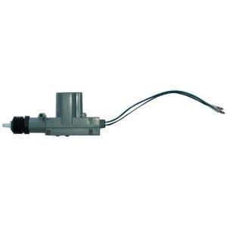
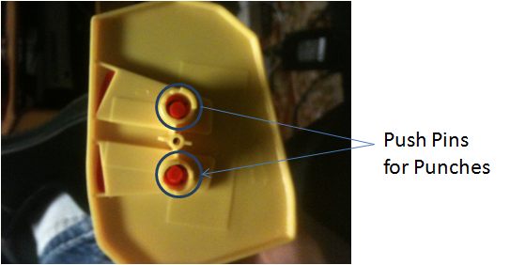
Actuation Mechanism
Tested two different solenoids that failed to actuate properly
GALAXY AC-1 Door Lock Actuator
12V
5.6oz

Slide 9
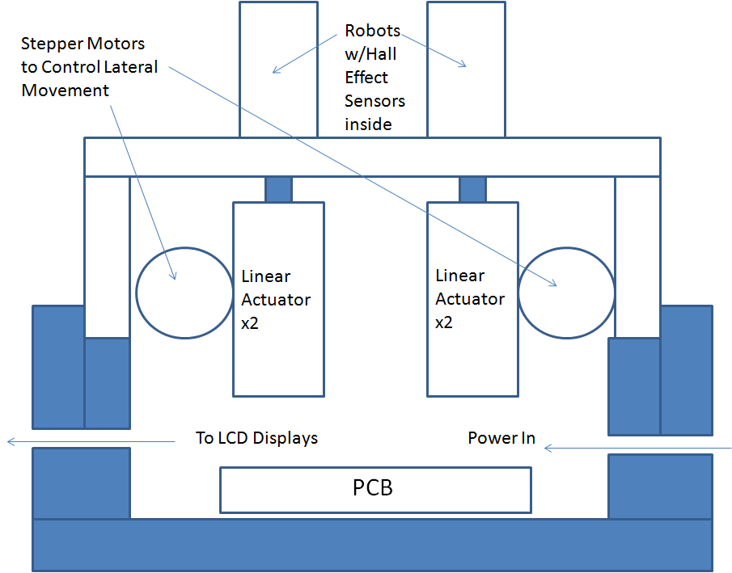
Packaging Design

Slide 10
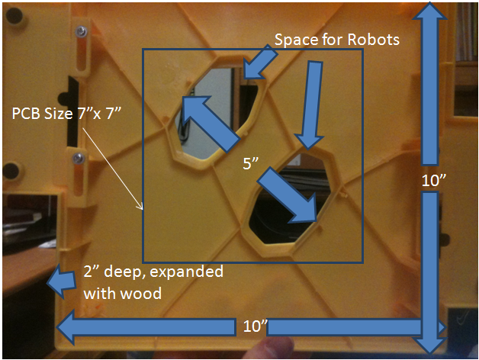
Packaging Design

Slide 11
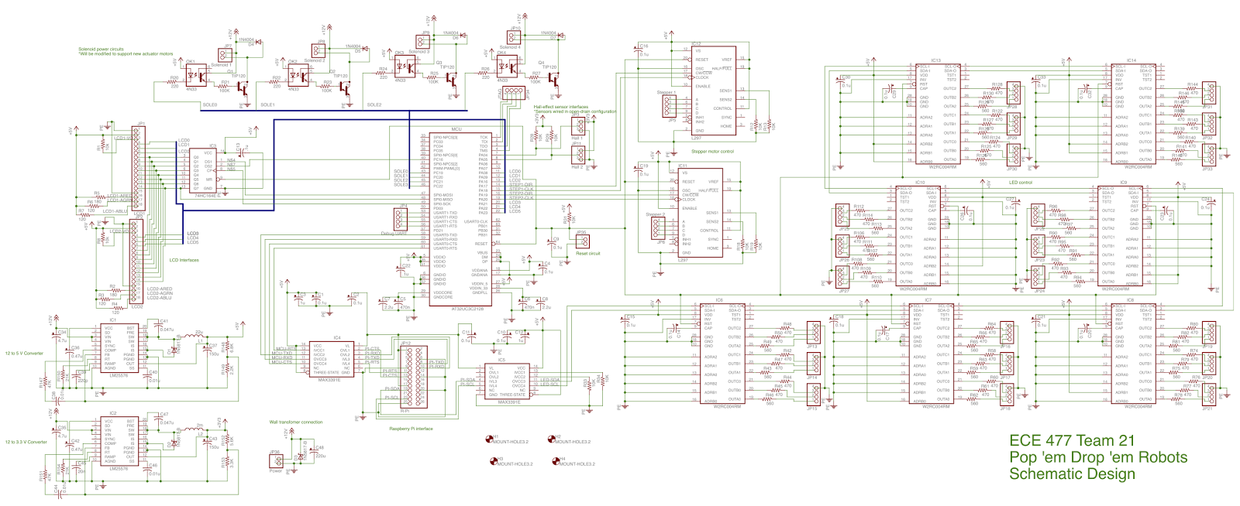
Schematic/Theory of Operation

Slide 12
Schematic/Theory of Operation
Microcontroller
Motherboard
Power Supply
Linear Actuators
Stepper Motors
Hall-Effect Sensors
LCDs
LEDs

Slide 13
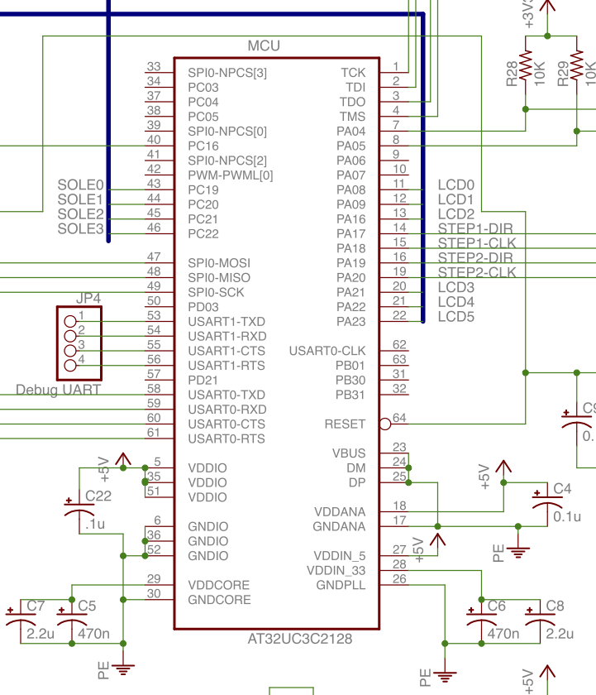
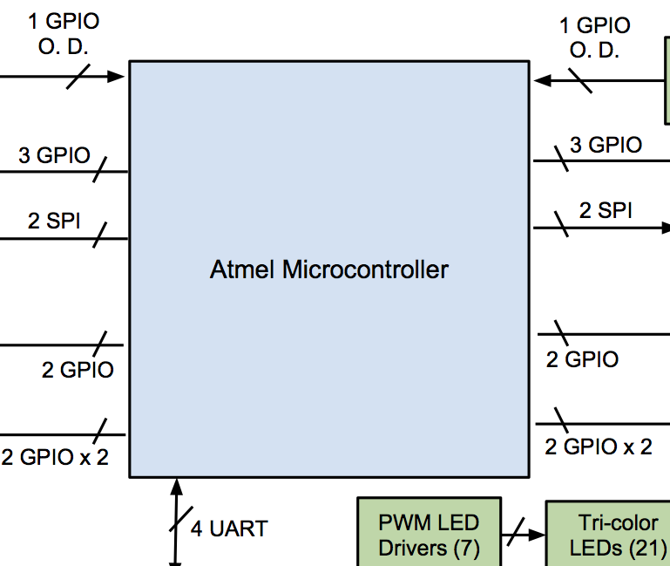
Schematic (Microcontroller)

Slide 14
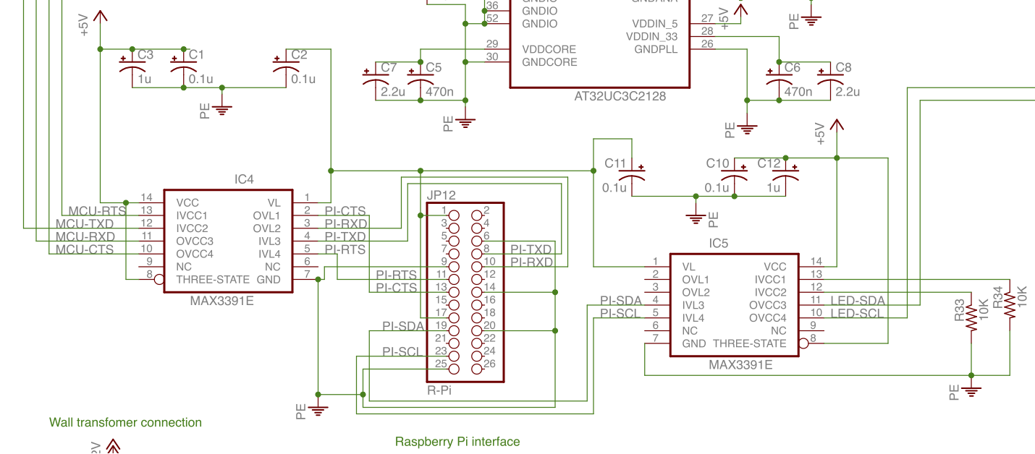
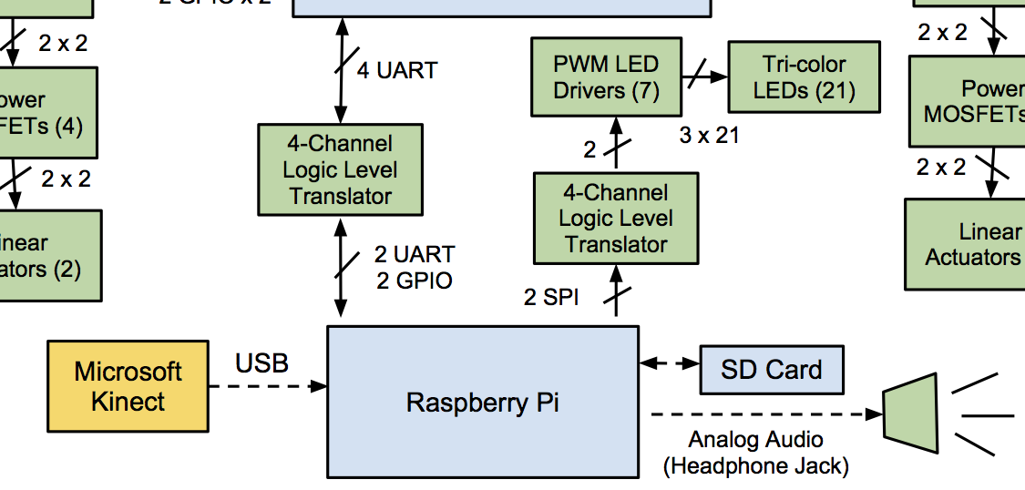
Schematic (Motherboard)

Slide 15
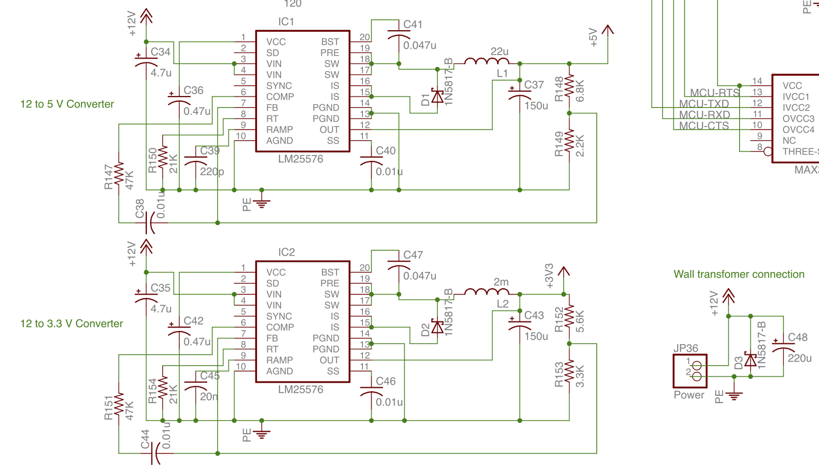
Schematic (Power Supply)

Slide 16
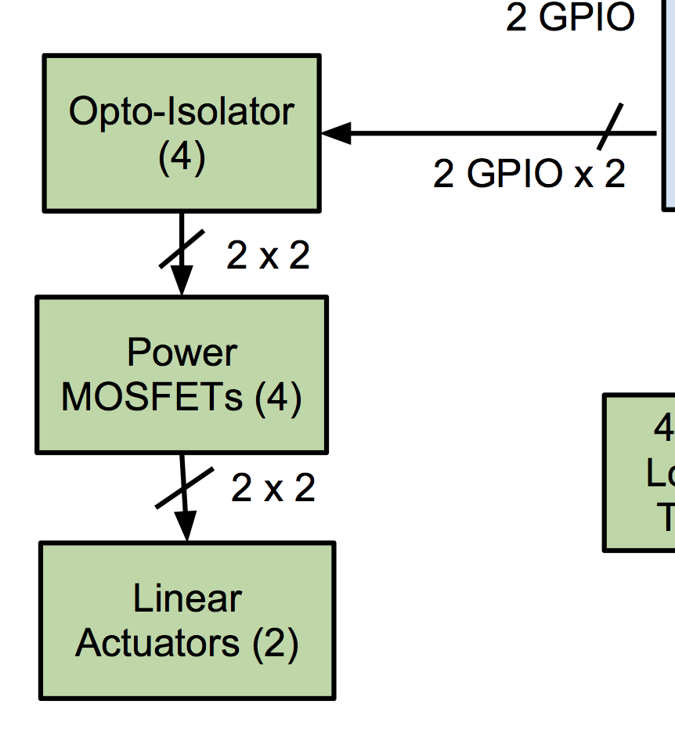
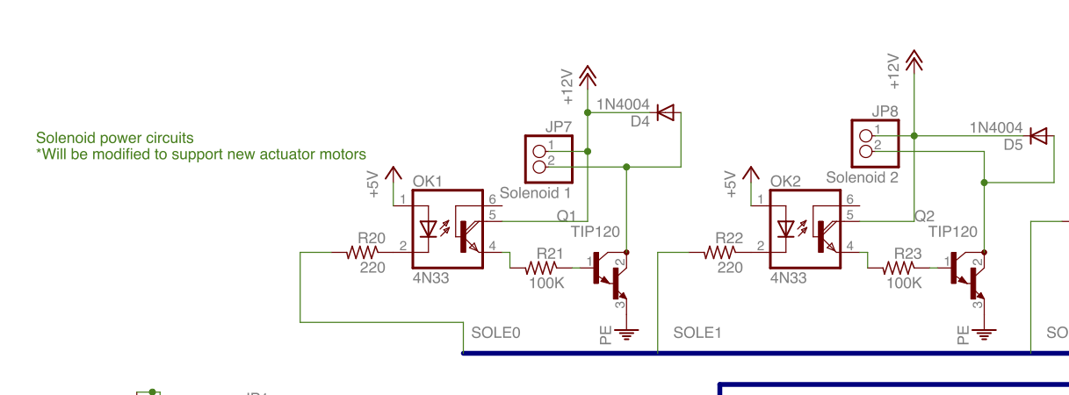
Schematic (Linear Actuators)

Slide 17
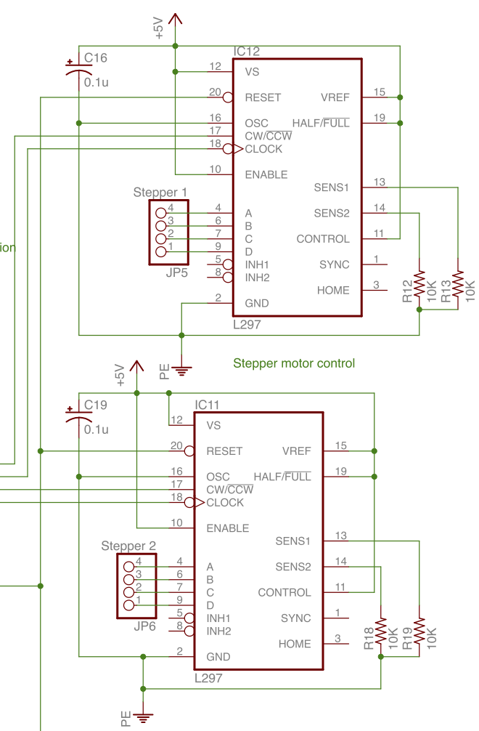
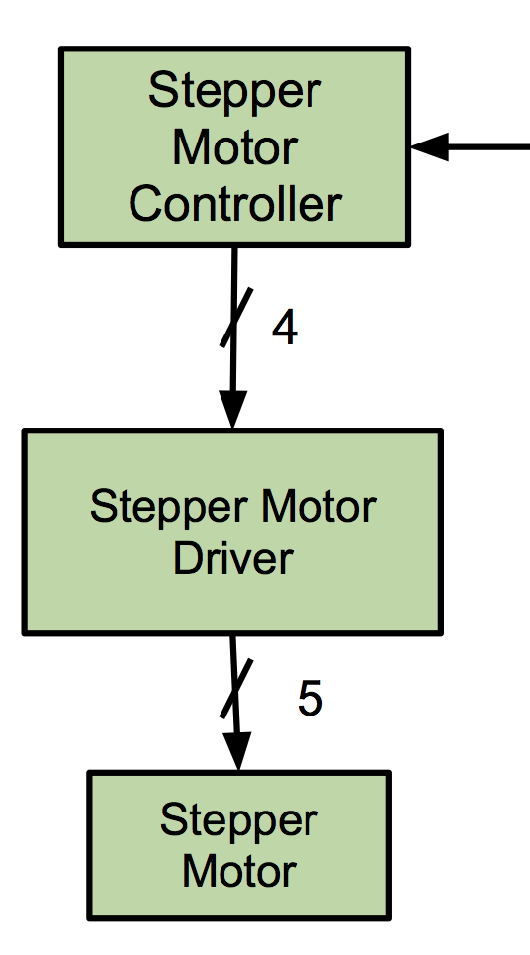
Schematic(Stepper Motors)

Slide 18
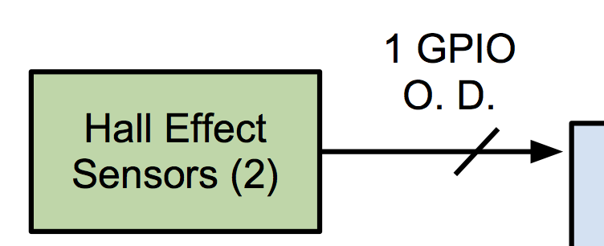
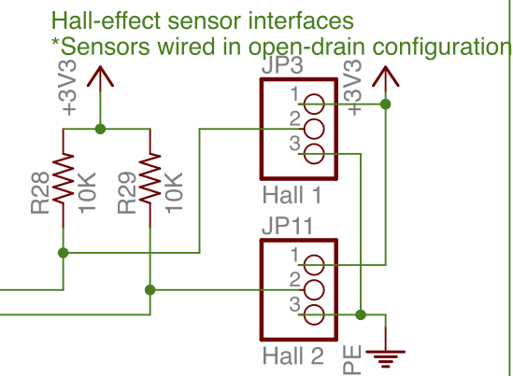
Schematic (Hall-Effect Sensors)

Slide 19
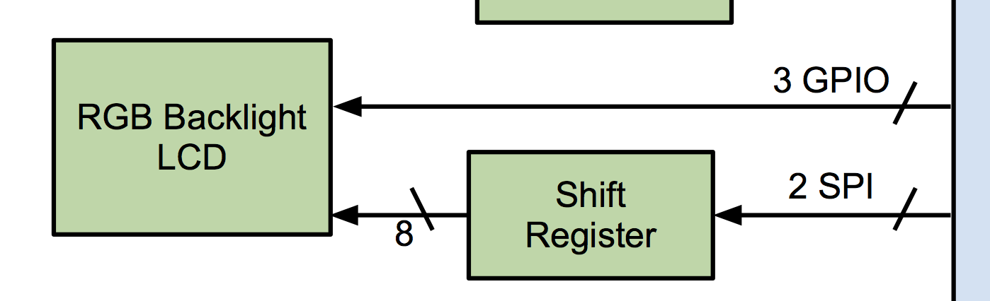
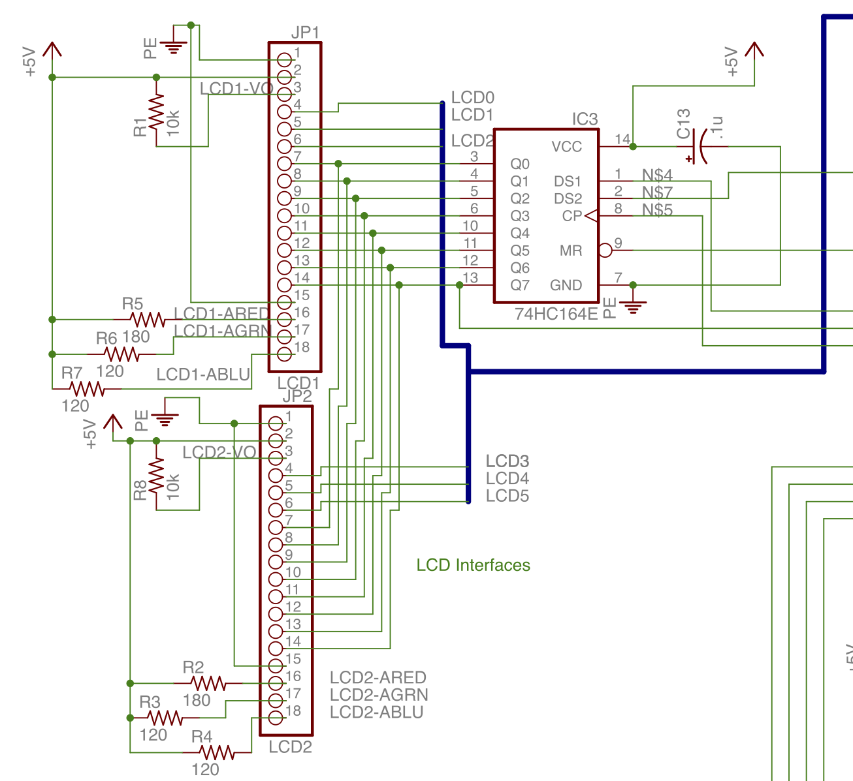
Schematic (LCDs)

Slide 20
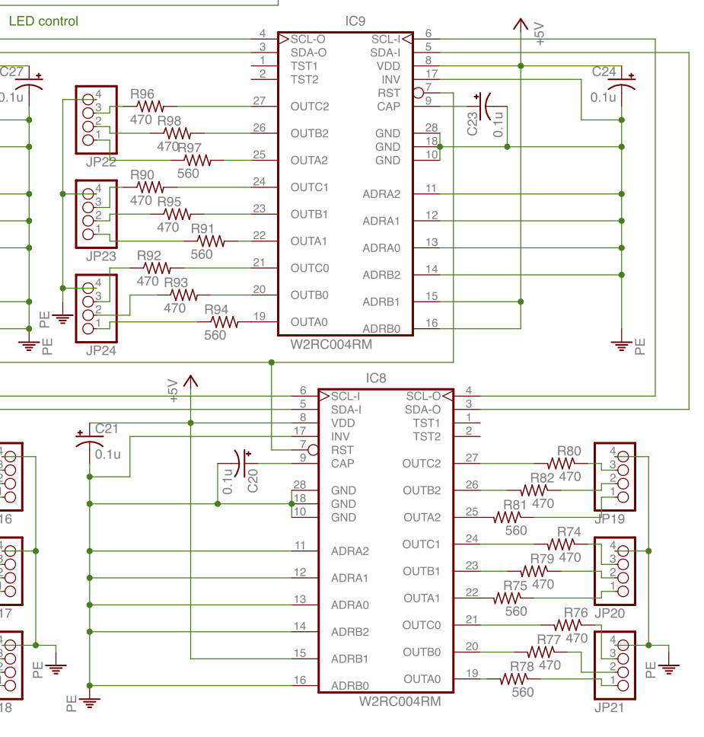
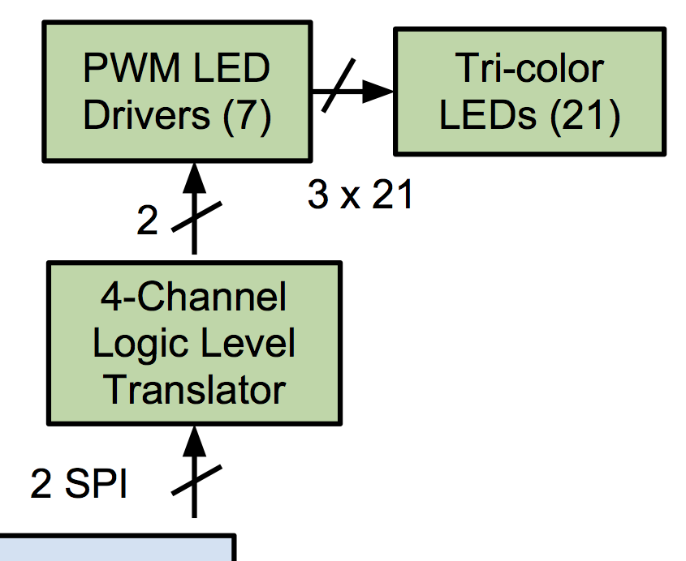
Schematic(LEDs)

Slide 21
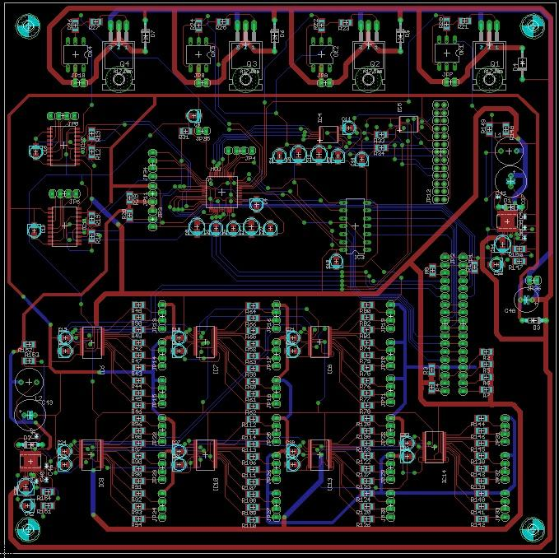
PCB Layout

Slide 22
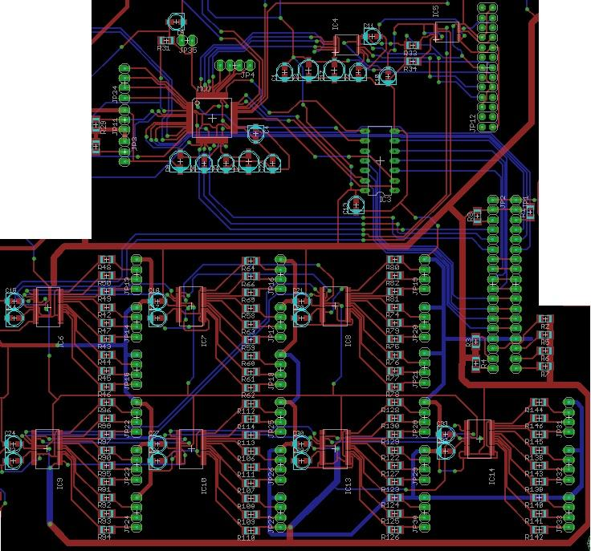
PCB: Digital
Headers to Hall Effect sensors
Atmel micro
Header to R-Pi
Headers to LCD screens and shift register
LED drivers and headers to tri-color LED's
`

Slide 23
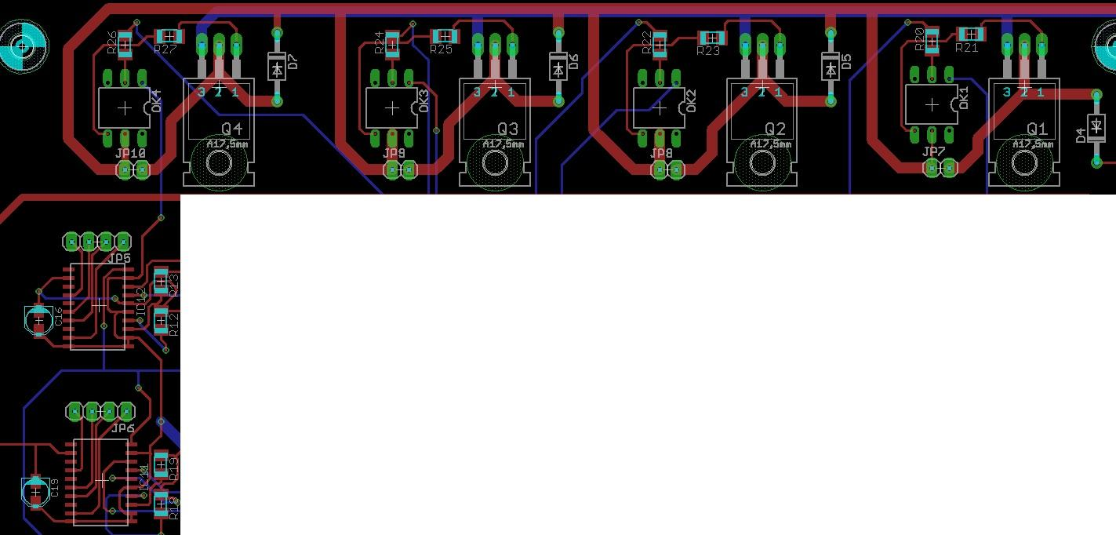
PCB: Analog
Optical isolator
NPN power transistor
Header to solenoid
L297 stepper motor controller
Header to stepper motor
`

Slide 24
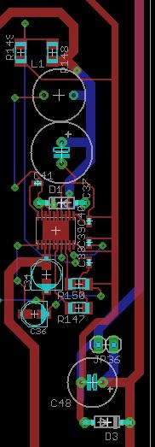
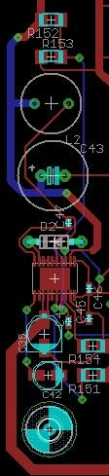
PCB: Power supply
12V and GND from external power supply
Bulk capacitor
LM25576 buck converter
12V trace
3.3V trace
5V trace
`

Slide 25
Software Design/Development Status
Created software flowchart to help with modularizing code
Began experimenting with basic functionality on Pi - LEDs, SPI, UART, sound
Began Kinect software - recognizes two users and does basic tracking
Just received development board for micro

Slide 26
Project Completion Timeline
Week 9
  Finalize schematic and PCB
  Test basic functionality of parts
  Test interface between Kinect and Pi
Week 10 - Spring Break
Week 11
  Complete basic software tests on Pi
  Begin testing PCB and populating with components
Week 12
  Complete basic software tests on micro
  Begin gameplay software on Pi and micro

Slide 27
Project Completion Timeline
Week 13
  Complete Kinect software and put it on Pi
Week 14
  Complete Pi software
  Complete Micro software
  Finish PCB
  Design and build packaging
Week 15
  Create user manual
  Finish assembling project
Week 16
  Create final presentation, PSSC video, poster

Slide 28
Questions?

