Slide 1
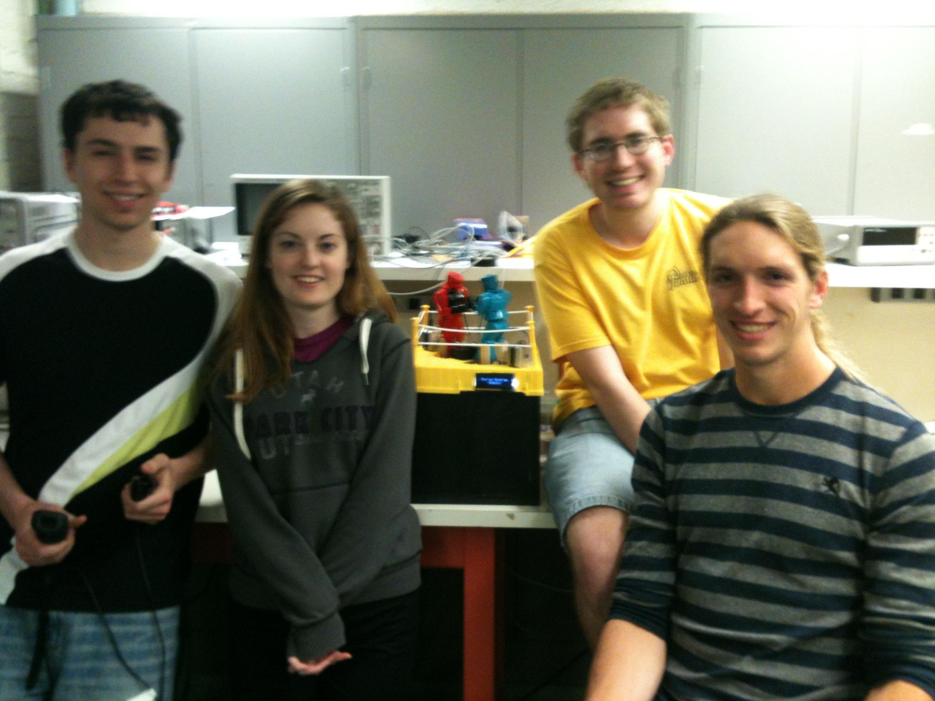
ECE 477 Final Presentation
Team 21 - Spring 2013
Team Members: Duncan Swartz, Jacqueline Greer, Tom Pansino, Mark Tubergen

Slide 2
Outline
Project Overview
Block Diagram
Design Challenges
Individual Contributions
Project Demonstration
Questions / Discussion

Slide 3
Project Overview
Electronic version of Rock 'Em Sock 'Em Robots
One or two players control movements of robots using Nintendo WiiMote and Nunchuk
Player punches and dodges translate into robot movements
Hits are recorded and deplete a health bar
Selectable battle music

Slide 4
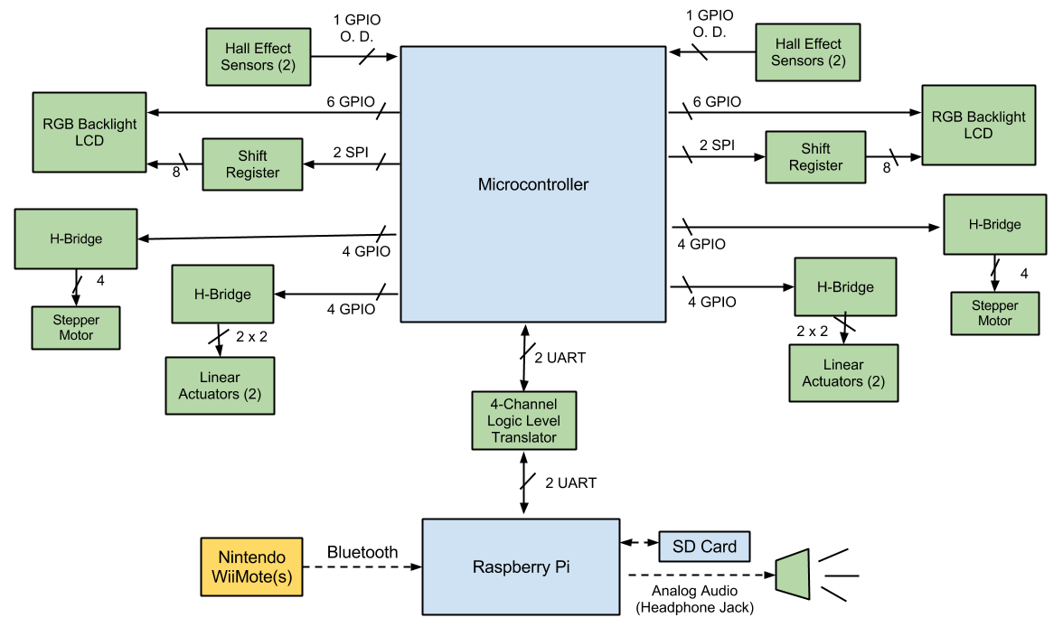
Block Diagram

Slide 5
Design Challenges
Tracking player movements
Began with Kinect
Incompatible with Raspberry Pi
Software very complicated
Moved to WiiMotes
Easy to program and use
Not very accurate, could not track dodges
Designing proper motor subsystem
Difficulty selecting solenoid/actuator
Required redesigning PCB several times
Handle large transient currents needed for punching

Slide 6
Individual Contributions
Team Leader - Thomas Pansino
Team Member 2 - Jacqueline Greer
Team Member 3 - Mark Tubergen
Team Member 4 - Duncan Swartz

Slide 7
Team Leader - Thomas Pansino
Design Constraints - HW 3
Schematic - HW 5
Raspberry Pi software
LED control library
Code framework
Microcontroller software
Hardware testing, integration, debugging
Microcontroller
Shift-register & LCDs
H-bridges

Slide 8
Member 2 - Jacqueline Greer
PSSC #3 - An ability to track player movements with WiiMotes
WiiMote software on Raspberry Pi
PSSC #5 - An ability to play in either single or dual player mode
AI software on Raspberry Pi

Slide 9
Member 3 - Mark Tubergen
PSSC #1- An ability to power and control electric motors
Packaging Design and Construction
Modified original packaging to fit our needs
Mounted all components
Soldered a majority of PCB parts
Patent Liability and Safety Analysis

Slide 10
Member 4 - Duncan Swartz
PCB design and HW5
Reliability and Safety Analysis and HW11
PSSC #2 - An ability to detect a "hit" on an opponent (hardware side)
Power supply design and analog component prototyping
Wiring of all external components to the PCB via headers and other misc. hardware production
Website maintenance
PSSC video production

Slide 11
Project Demonstration
An ability to power and control electric motors.
An ability to detect a "hit" on an opponent.
An ability to track player movements with WiiMotes.
An ability to provide player feedback using audio speakers and LCDs.
An ability to play in either single or dual-player mode.

Slide 12
Questions?

