Slide 1
ECE 477 Group 11
RevGeo
Multipurpose Puzzle Box
Josh Marchi, Jeff King, Paul Rosenberger, Dan Chambers

Slide 2
Overview
“Reverse Geocache” Box
Locked box that will only open after one or more pre-determined GPS locations have been visited
Directs user to next location by GPS coordinates or text displayed on LCD, or by an LED compass
Route stored on microSD card located inside the box, able to be reprogrammed by PC
RFID “master key” to allow access to box without finishing puzzle

Slide 3
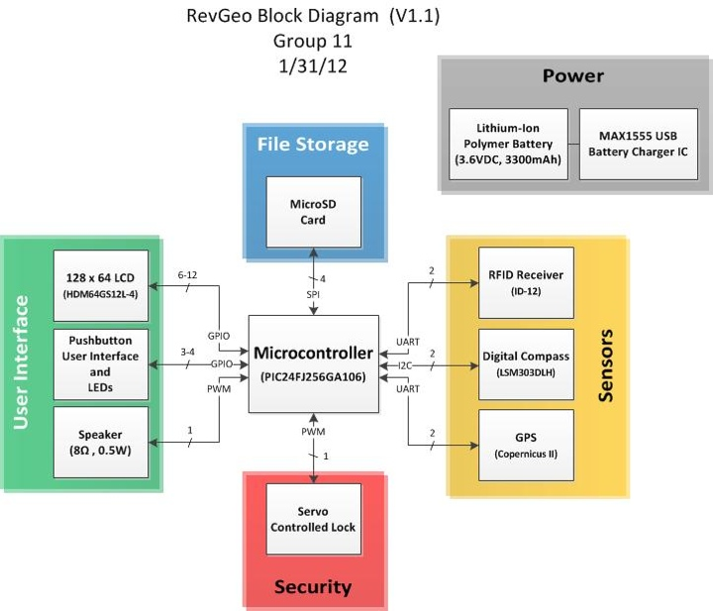

Slide 4
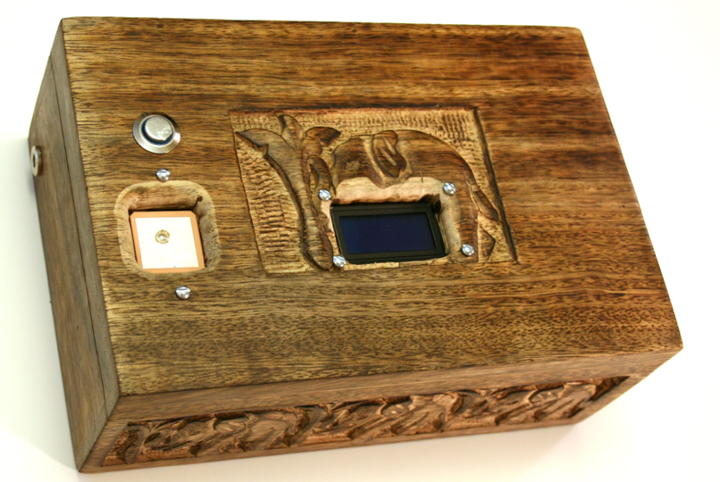
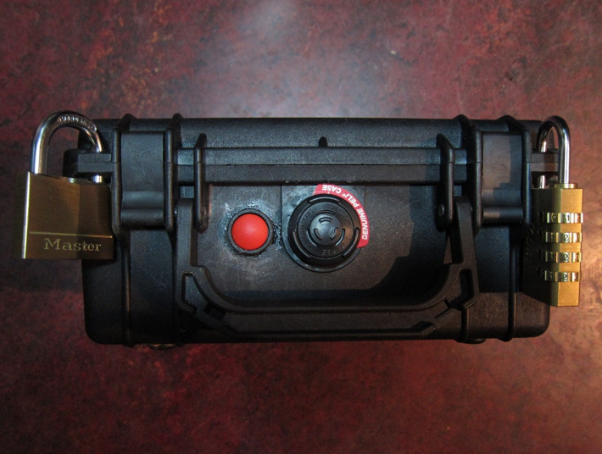
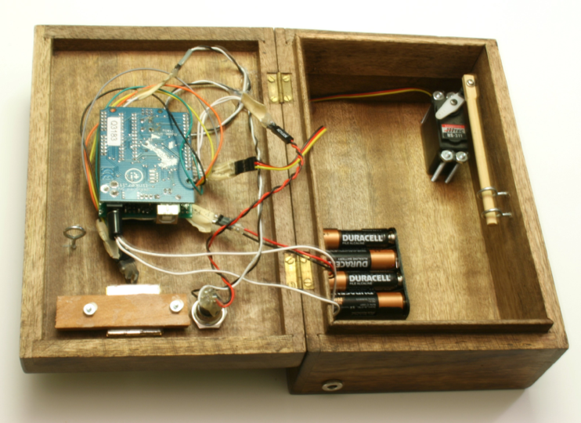
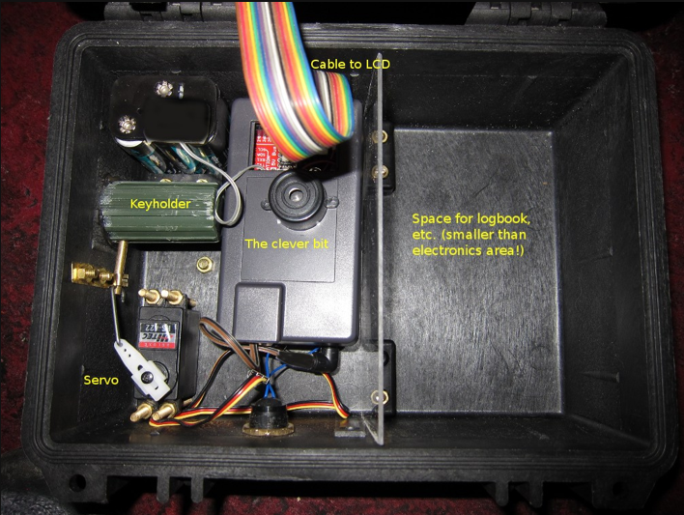
Commercial Product Packaging

Slide 5
Commercial Product Packaging
Pros | Cons
Simplicity of Pelican Case | Small LCD screen
Personalized Box | Messy Wiring
Custom Housing for PCB | Empty Space : Total Volume ratio
Ribbon Cable | Lock and Key

Slide 6
Packaging Requirements
The RevGeo shall use electronic components in order to maximize volume for contents.
The case shall be durable.
All components not mounted on the PCB shall be organized in a way to easily connect to PCB.
The PCB shall be sized to fit the dimensions of the top lid of the case.
The locking mechanism shall be mounted to the case.

Slide 7
RevGeo Packaging
A pelican case will be used as the case.
The PCB, Battery, Servo, and LCD will fit into the upper lid of the pelican case.
Will use water jet to have clean cuts in case.
The total weight will be less than 5 pounds.
The total cost will be approximately $50.

Slide 9
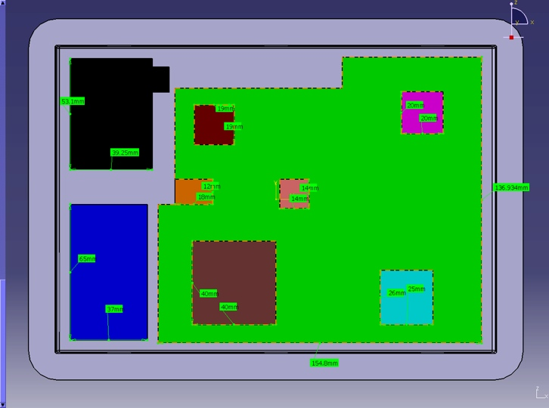
CAD Drawing and PCB Layout

Slide 10
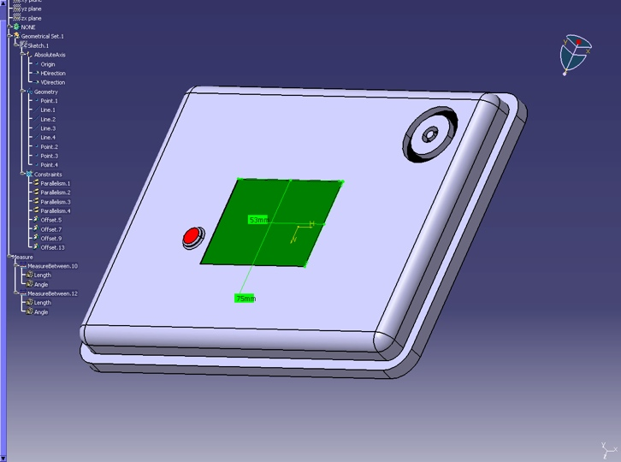
CAD Drawing and PCB Layout

Slide 11
Summary
The backbone of the package will be the Pelican Case
The PCB along with all other components will be small enough to fit inside the top lid.
The RevGeo packaging will be sturdy and lightweight.

