Slide 1
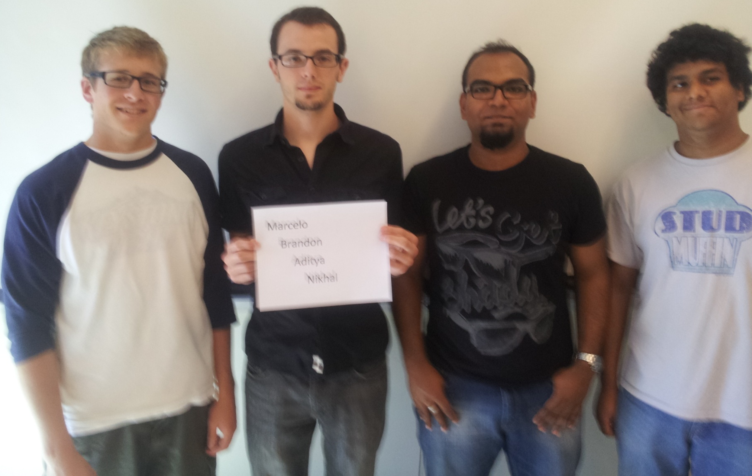
THE INCREDIBLE HUD
MARCELO L. BRANDON G. ADITYA B. NIKHIL S.

Slide 2
Project Overview
Helmet-based heads-up display
Displays telemetry data such as speed, direction, temperature, and G-force
Displays image from web camera to implement a “rear view mirror”
The user can select different display modes
An accelerometer, GPS module, and thermometer will generate telemetry data
Data will be recorded onto SD card to allow for future review
The battery pack, motherboard and primary PCB will be located in a secondary backpack enclosure

Slide 3
Project-Specific Success Criteria
An ability to display critical system information via a heads-up-display (HUD).
An ability to measure telemetry information (speed, acceleration, temperature, and GPS) and store it to flash memory.
An ability to maintain portability through the use of a rechargeable battery system.
An ability to enable/disable important features within the display (full information, minimal, on/off).
An ability to plot recorded GPS data on a map while overlaying telemetry information on a computer.

Slide 4
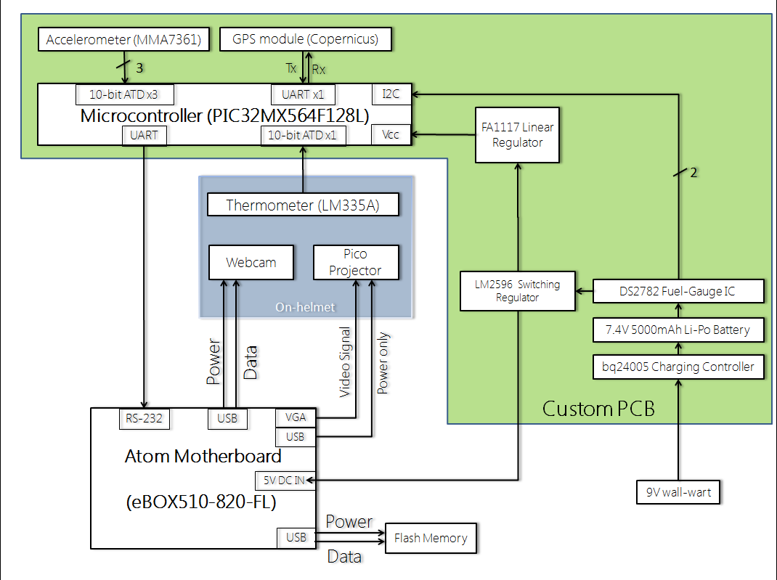
Block Diagram
12V

Slide 5
Environmental Impact
Manufacturing
- Carbon fiber, Plexiglas, aluminum
- PCB, LCD display, Atom board, etc.
- Battery

Slide 6
Environmental Impact
Disposal
- Carbon fiber, Plexiglas, aluminum are not considered hazardous waste
- PCB, LCD display, Atom board, etc.
- Li-po batteries can be thrown away

Slide 7
Ethical Challenges
Safety of the complete product
Misinformation
Rear-view camera
Warning labels for battery
Operating conditions
LCD display mount
User manual

Slide 8
Questions ?

