Slide 1
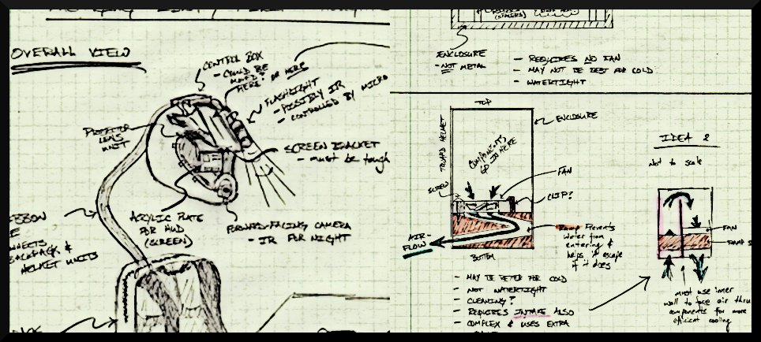
THE INCREDIBLE HUD
ADITYA B. BRANDON G. MARCELO L. NIKHIL S.

Slide 2
Possible Patent Liabilities
Display technology: projection + combiner glass + diffuser + lens/mirror
Data collection: GPS, accelerometer, thermometer, webcam + μController + Atom
The way the data is collected and displayed all together is KEY
A portable, battery powered, controllable, helmet based device

Slide 3
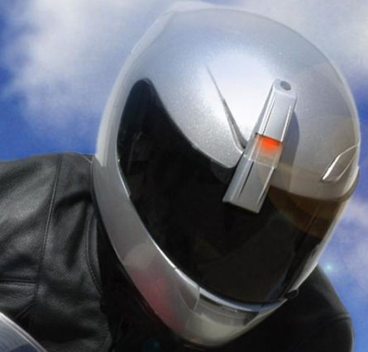
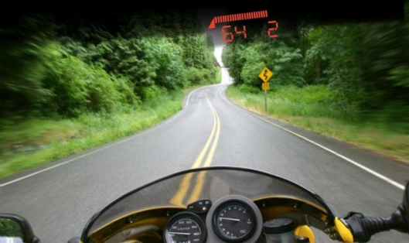
Product Search
SportVue MC2:
Helmet attachment
Speed, RPM, Gear, Radar
Data recording
Beam display
Battery Powered

Slide 4
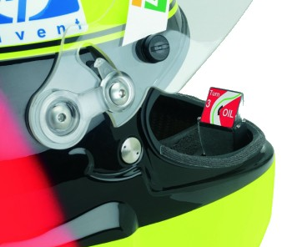
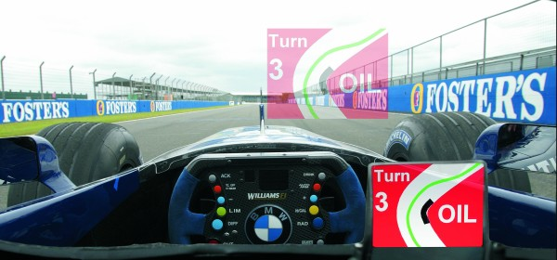
Product Search
BMW Formula One HUD:
Micro LCD Display
Map, Info from the pit
Transparent image
Car powered

Slide 5
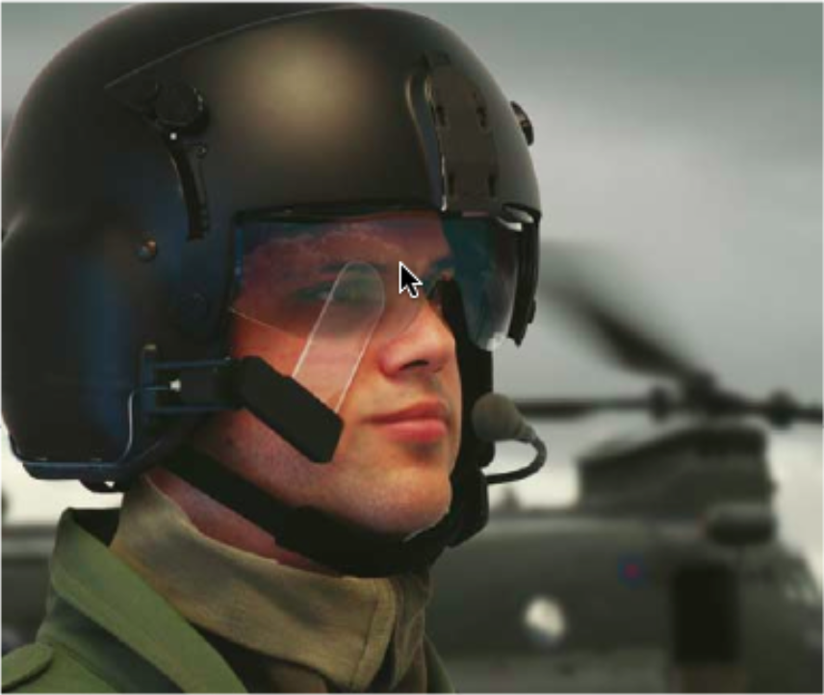
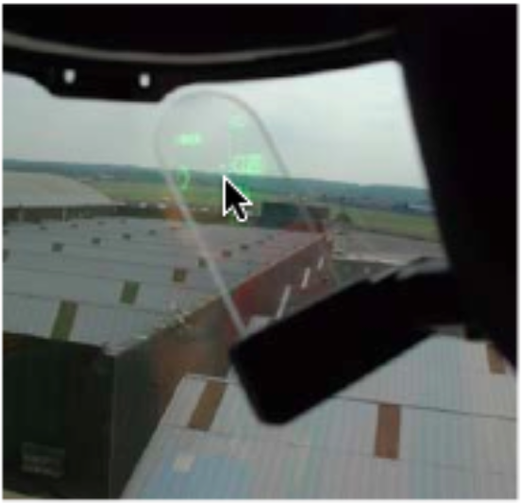
Product Search
BAE Systems Q-Sight:
LCD to combining lens
Holographic waveguide
Clip on device
Plug and Play

Slide 6
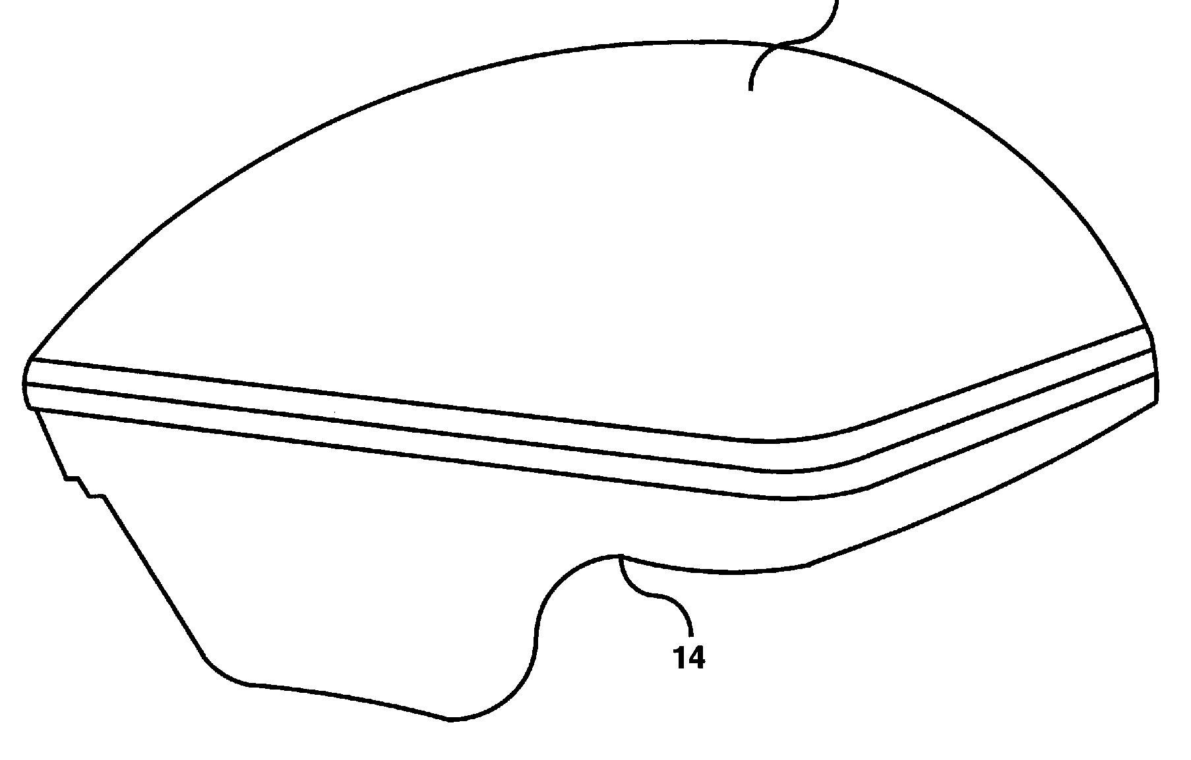
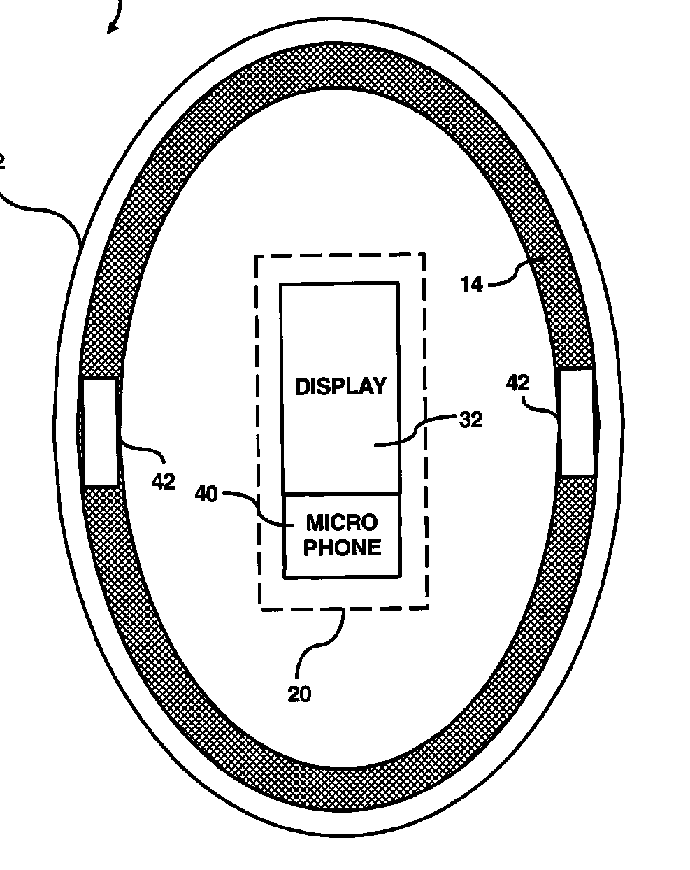
Product Search
Smart Helmet:
Integrated electronics
GPS, sensors, comm. network, dot-matrix display, etc.
Built into helmet
Battery powered

Slide 7
Patent Analysis
Similar items but not completely alike
One or two individual conflicts
But lack functions as a whole
For example:
Non-projection display
Not based with the helmet
Minimal data displayed/recorded
Found many patents that were only “an ability” to display a HUD via helmet
Many ‘same function/different way’ or ‘different function/ same way’ – not both!

Slide 8
Questions?

