Slide 1
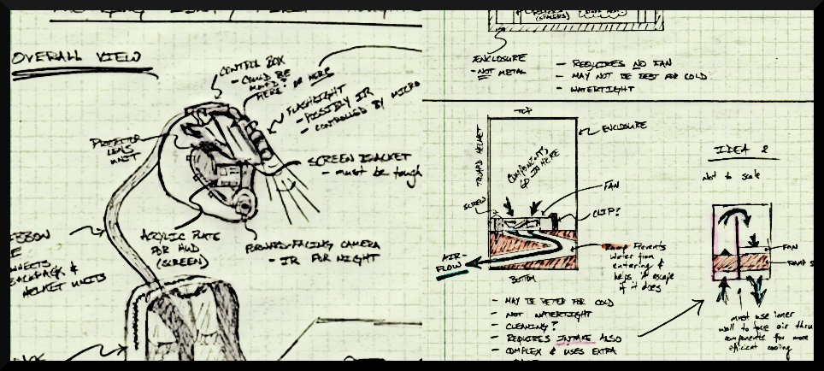
THE INCREDIBLE HUD
ADITYA B. BRANDON G. MARCELO L. NIKHIL S.

Slide 2
Project-Specific Success Criteria
An ability to display critical system information via a heads-up-display (HUD).
An ability to measure telemetry information (speed, acceleration, temperature, and GPS) and store it to flash memory.
An ability to maintain portability through the use of a rechargeable battery system.
An ability to enable/disable important features within the display (full information, minimal, on/off).
An ability to plot recorded GPS data on a map while overlaying telemetry information on a computer.

Slide 3
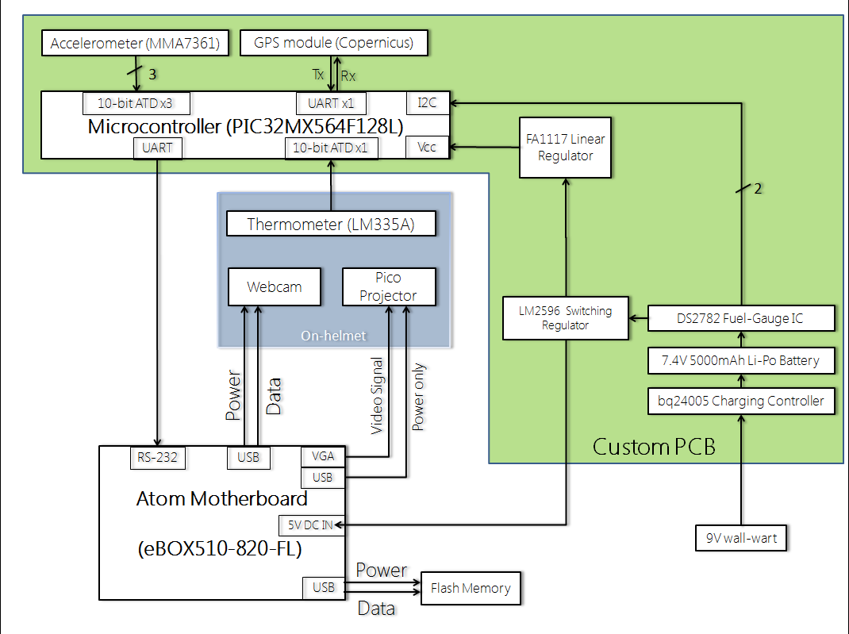
Block Diagram

Slide 4
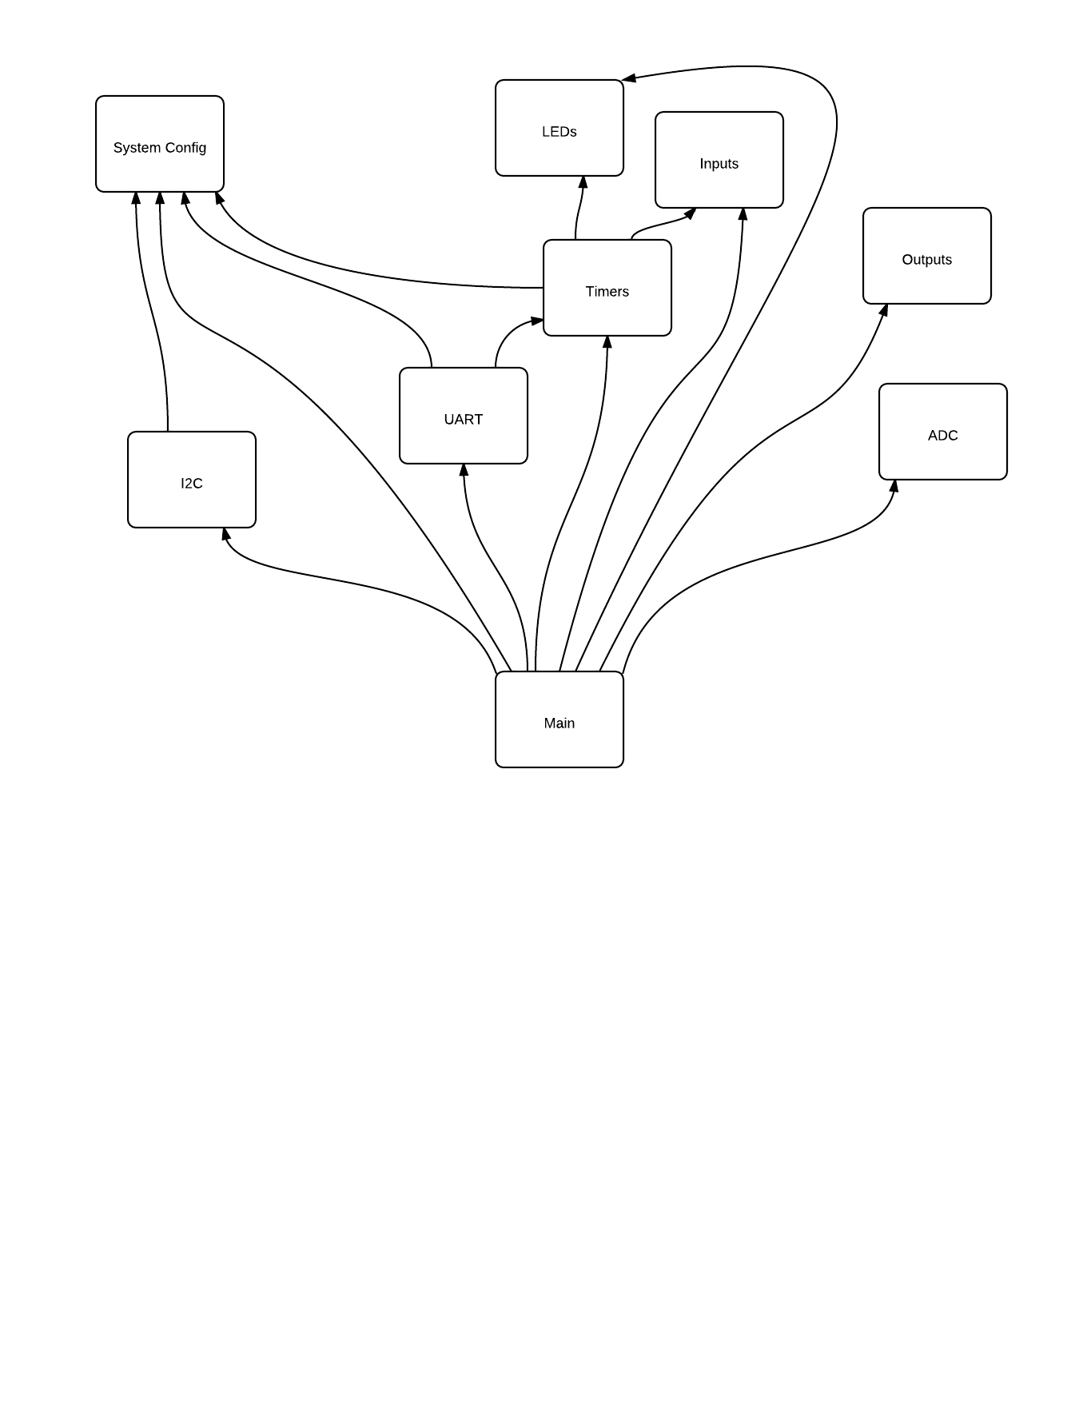
Code Hierarchy

Slide 5
Code Flowchart

Slide 6
Code Flowchart

Slide 7
Code Flowchart

Slide 8
Code Flowchart

Slide 9
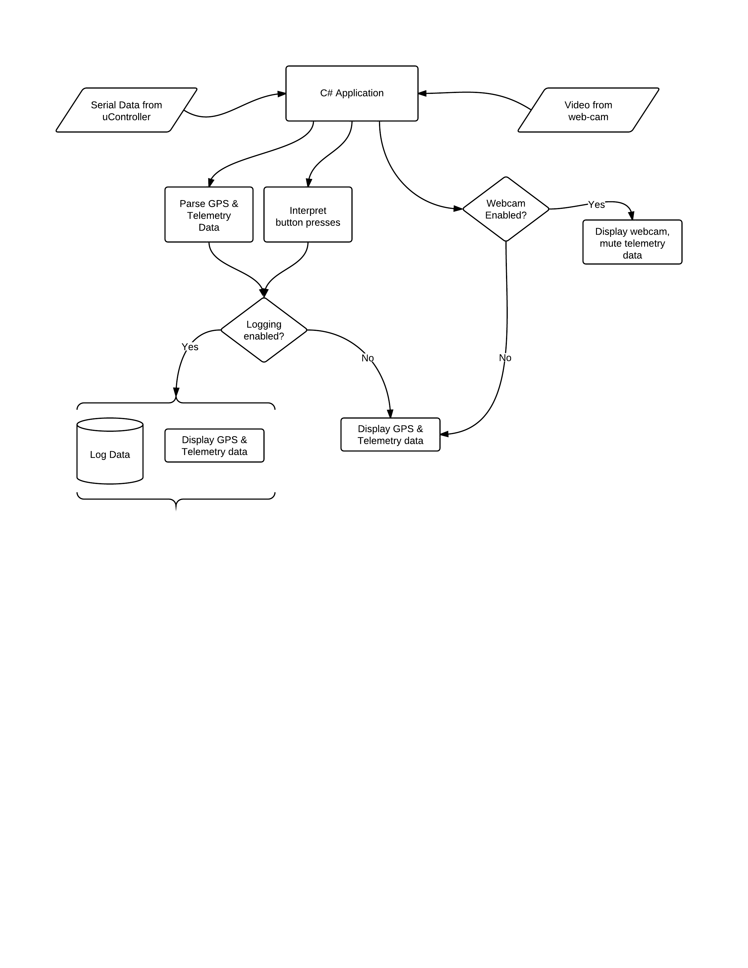
Atom GUI software flowchart

Slide 10
Software Design / Development Status
Peripheral Name | Comm. Status | Algorithm | Algorithm Status
PC RS232 Comm. | 1xUART Tested OK | Functions to send data packets and receive interrupt | Implemented Tested OK
GPS | 1xUART Tested OK | Interpretation of packets received + config if necessary | Unimplemented
Accelerometer | 3xADC Tested OK | Conversion of data into g-force measurements | Implemented Tested OK
Thermometer | 1xADC Untested | Conversion of data into temperature measurement | Unimplemented
Charge Counter | 1xI²C Tested OK | Configuration setup and interpretation of sent packets | Partially impl.
Buttons | 7xGPIO 1 Tested | Sampling of buttons + assignment to actions | 1 Implemented Tested OK
GUI elements on Atom | 1xRS232 Untested | Display GUI, receive/interpret packets from PIC32 | Unimplemented

Slide 11
Questions?
ADITYA B. BRANDON G. MARCELO L. NIKHIL S.

